Slide 1

Regularization and Sparse Models for High Dimensions
Steve Elston
Copyright 2018, 2019, 2020, 2021, 2022, 2023 2024, 2025 Stephen F Elston. All rights reserved.

Slide 2
Review
There are a number of assumptions in linear models that you overlook at your peril!
The independent or predictor variables should be independent of one another
This is rarely true in practice
Multi-collinearity between features makes the model under-determined
Numeric independent variables or predictors have zero mean and about the same scale
Want regression coefficient estimates with independent variables with 0 mean
Want to have predictors with same numeric range
Residuals should be iid and stationary
If residuals change with predicted values they are heteroscedastic
If residuals have serial correlation the iid assumption is violated - use time series models

Slide 3
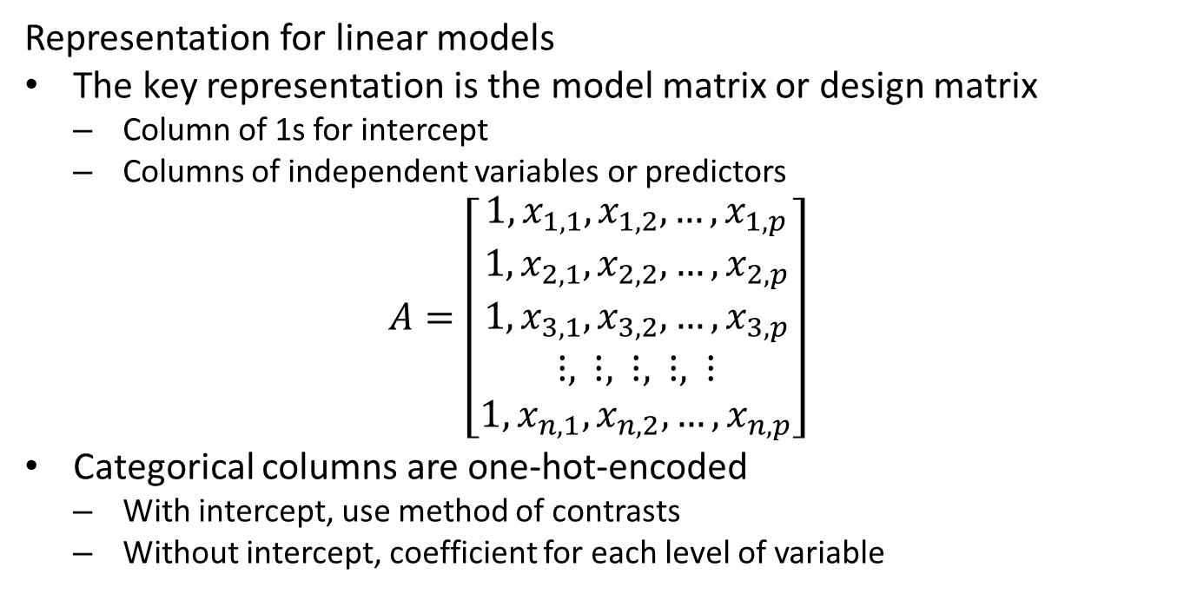
Review
Representation for linear models
The key representation is the model matrix or design matrix
Column of 1s for intercept
Columns of independent variables or predictors
$$A=\left[\begin{matrix}1,x_{1,1},x_{1,2},…,x_{1,p} \\ 1,x_{2,1},x_{2,2},…,x_{2,p} \\ 1,x_{3,1},x_{3,2},…,x_{3,p} \\ ⋮, ⋮, ⋮, ⋮, ⋮ \\ 1,x_{n,1},x_{n,2},…,x_{n,p}\end{matrix}\right]$$
Categorical columns are one-hot-encoded
With intercept, use method of contrasts
Without intercept, coefficient for each level of variable

Slide 4
Review
Models with nonlinear response have non-Normal distributions
The generalized linear model accommodates nonlinear response distributions
Link function transforms to linear model
Inverse link function transforms from Normal distribution to response distribution
Evaluating Binomial response models
Confusion matrix organizes outcomes
Compute metrics from confusion matrix
Use multiple evaluation criteria
Compare model performance with deviance

Slide 5
Review
How do we perform model building as data scientists?
Perform an initial exploration of the data to find interesting and important relationships
Scale data
Select independent variables, including interaction and nonlinear terms
Fit model
Evaluate model fit and significance, parameter significance and residuals
If required, update choice of independent variables, e.g. add or remove variables, interaction terms, nonlinear terms and jump to step 4
Perform inference with the model to develop understanding of data relationships

Slide 6
Introduction

Slide 7
Introduction to Regularization and Sparse Model
We need methods to create sparse models from high dimensional variable spaces
Models in high-dimensions, independent variables are nearly always exhibit collinearity
Model is overfit
Inverse of covariance is ill-posed
Need regularization to find sparse model
L2 regularization or ridge regression
L1 regularization or Lasso regression
Elasticnet regularization integrates L2 and L1 regularization

Slide 8
Introduction to Regularization and Sparse Model
We want our models to be sparse
A sparse model is parsimonious with minimum complexity required to explain the data
The sparse model is a manifestation of Occam’s Razor
A scientific principle that the simplest of competing theories is the preferred one
Sparse models use the minimum number of independent variables (features)
Generalize well
Use regularization methods to identify minimum and constrained coefficient set

Slide 9
Dealing With Overfit Models

Slide 10
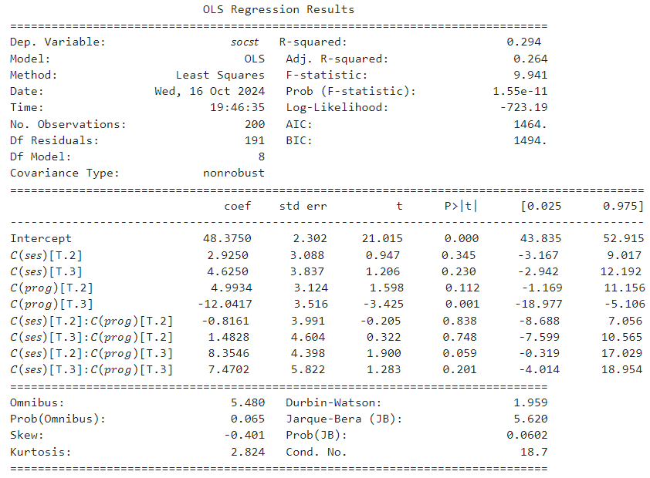
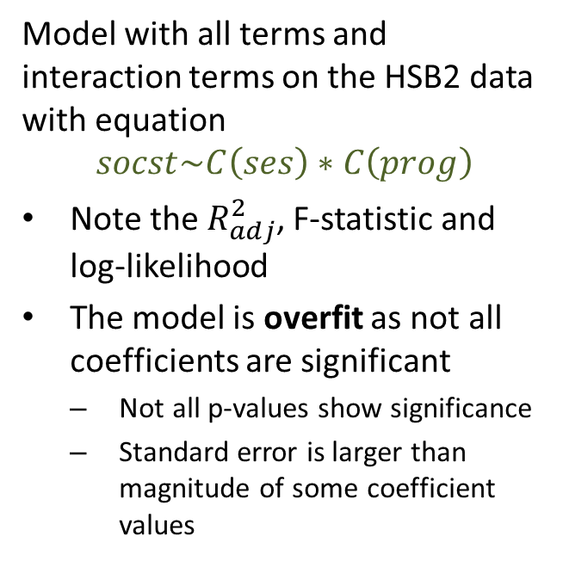
Dealing with Overfit Models
Model with all terms and interaction terms on the HSB2 data with equation
$$socst\sim C\left(ses\right)∗C\left(prog\right)$$
Note the $R_{adj}^{2}$, F-statistic and log-likelihood
The model is overfit as not all coefficients are significant
Not all p-values show significance
Standard error is larger than magnitude of some coefficient values

Slide 11
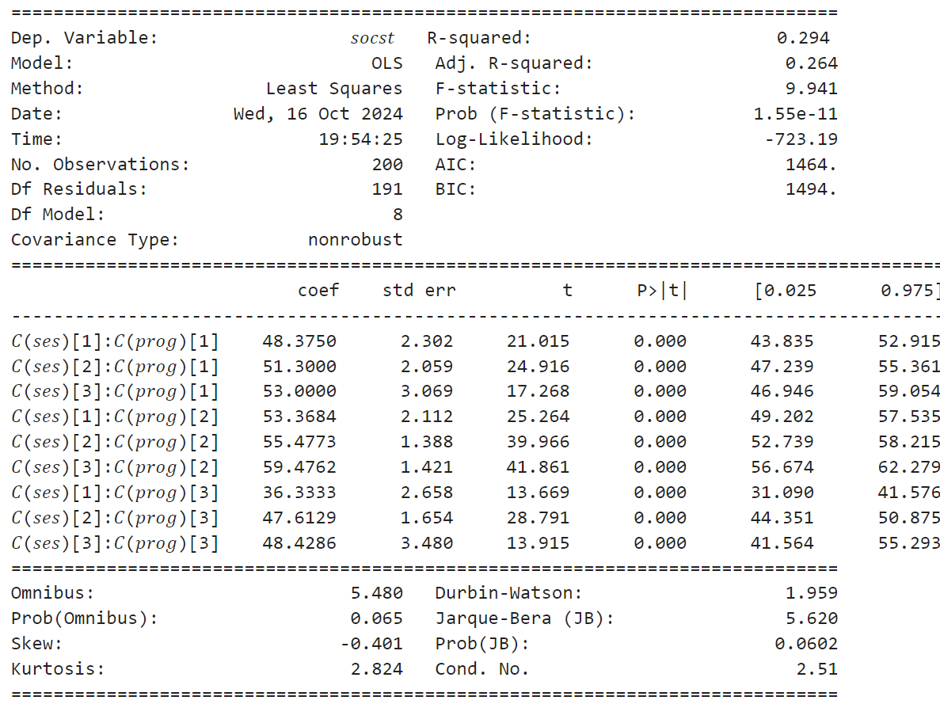
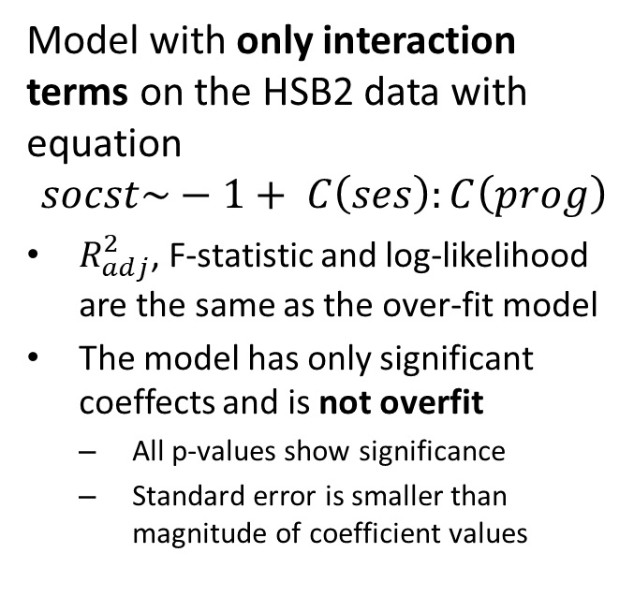
Dealing with Overfit Models
Model with only interaction terms on the HSB2 data with equation
$$socst\sim −1+ C\left(ses\right):C\left(prog\right)$$
$R_{adj}^{2}$, F-statistic and log-likelihood are the same as the over-fit model
The model has only significant coeffects and is not overfit
All p-values show significance
Standard error is smaller than magnitude of coefficient values

Slide 12
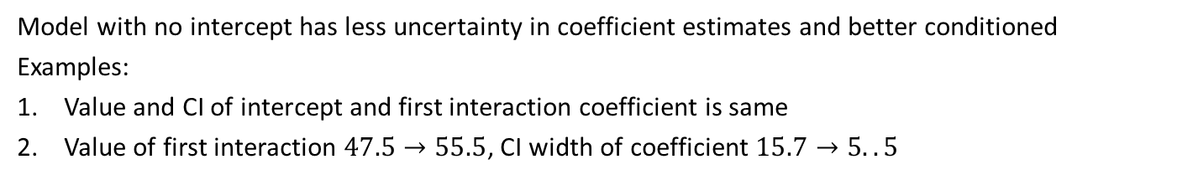
Dealing with Overfit Models
Model with no intercept has less uncertainty in coefficient estimates and better conditioned
Examples:
Value and CI of intercept and first interaction coefficient is same
Value of first interaction $47.5→55.5$, CI width of coefficient $15.7→5..5$
1
2
3. Reduced condition
number

Slide 13
Dealing with Overfit Models
Let’s compare the results of the unpruned and pruned models
The metrics indicate the fit is exactly the same
Why prefer the sparse (pruned) model?
What are the consequences of the over-fit model?
Some independent variables (features) are not needed
Including non-significant predictors can only increase noise and reduce generalization
Colinear features confound model fitting - coefficient values not independent
For model with linear response, consider the effect of an unexpected value of a non-significant predictor
Manually pruning a model with a great many features is a doomed task!
What if we included all the interactions with type of school, race and sex?
Example: start with up to 5th order interaction - 45 model coefficients with none significant!!

Slide 14
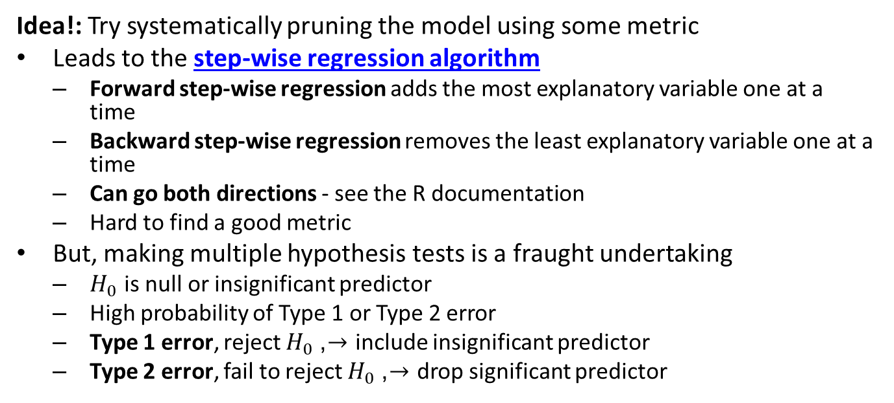
Dealing with Overfit Models
Idea!: Try systematically pruning the model using some metric
Leads to the step-wise regression algorithm
Forward step-wise regression adds the most explanatory variable one at a time
Backward step-wise regression removes the least explanatory variable one at a time
Can go both directions - see the R documentation
Hard to find a good metric
But, making multiple hypothesis tests is a fraught undertaking
$H_{0}$ is null or insignificant predictor
High probability of Type 1 or Type 2 error
Type 1 error, reject $H_{0}$, $→$ include insignificant predictor
Type 2 error, fail to reject $H_{0}$, $→$ drop significant predictor

Slide 15
Regularization and the Bias-Variance Trade-Off

Slide 16
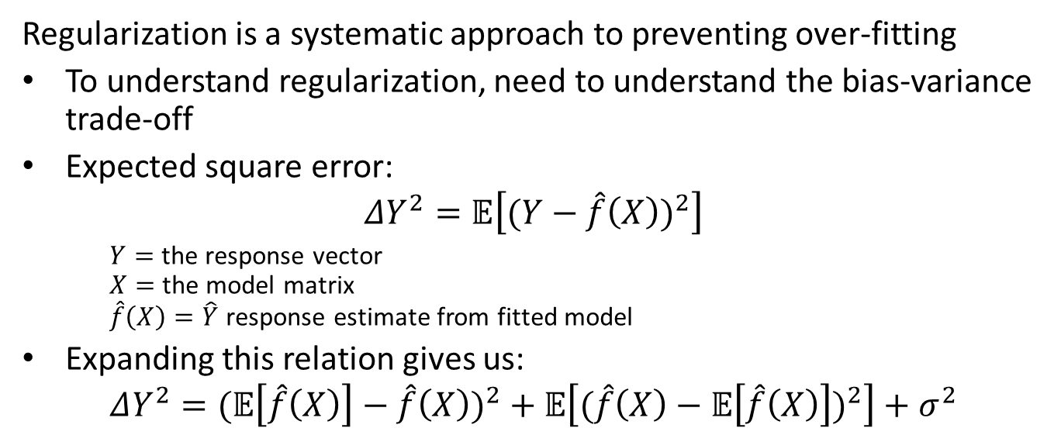
Regularization - The Bias-Variance Trade-Off
Regularization is a systematic approach to preventing over-fitting
To understand regularization, need to understand the bias-variance trade-off
Expected square error:
$$ΔY^{2}=𝔼\left[(Y−\hat{f}\left(X\right))^{2}\right]$$
$Y=$ the response vector $X=$ the model matrix $\hat{f}\left(X\right)=\hat{Y}$ response estimate from fitted model
Expanding this relation gives us:
$$ΔY^{2}=(𝔼\left[\hat{f}\left(X\right)\right]−\hat{f}\left(X\right))^{2}+𝔼\left[(\hat{f}\left(X\right)−𝔼\left[\hat{f}\left(X\right)\right])^{2}\right]+σ^{2}$$

Slide 17
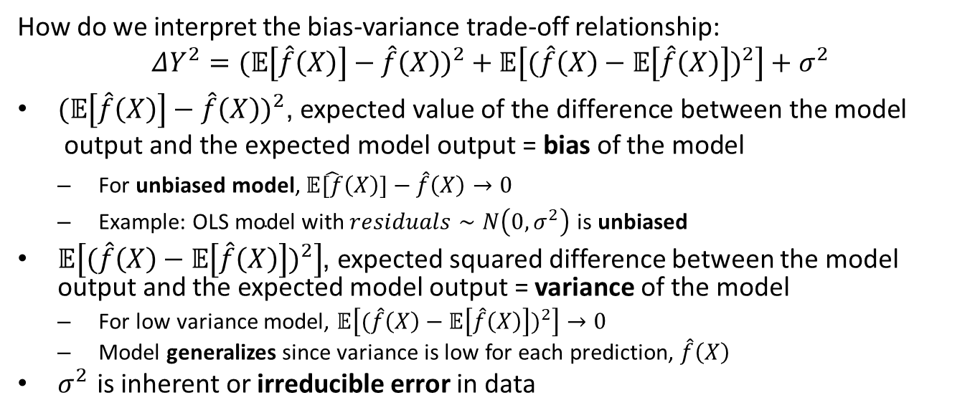
Regularization - The Bias-Variance Trade-Off
How do we interpret the bias-variance trade-off relationship:
$$ΔY^{2}=(𝔼\left[\hat{f}\left(X\right)\right]−\hat{f}\left(X\right))^{2}+𝔼\left[(\hat{f}\left(X\right)−𝔼\left[\hat{f}\left(X\right)\right])^{2}\right]+σ^{2}$$
$(𝔼\left[\hat{f}\left(X\right)\right]−\hat{f}\left(X\right))^{2}\text{,} \text{expected} \text{value} \text{of} \text{the} \text{difference} \text{between} \text{the} \text{model} \text{output} \text{and} \text{the} \text{expected} \text{model} \text{output} \text{= }\text{bias} \text{of} \text{the} \text{model}$
$\text{For} \text{unbiased} \text{model}\text{, }𝔼\hat{[f}\left(X\right)]−\hat{f}\left(X\right)→0$
$\text{Example}\text{: }\text{OLS} \text{model} \text{with} residuals∼N\left(0,σ^{2}\right) \text{is} \text{unbiased}$
$𝔼\left[(\hat{f}\left(X\right)−𝔼\left[\hat{f}\left(X\right)\right])^{2}\right]$, expected squared difference between the model output and the expected model output = variance of the model
For low variance model, $𝔼\left[(\hat{f}\left(X\right)−𝔼\left[\hat{f}\left(X\right)\right])^{2}\right]→0$
Model generalizes since variance is low for each prediction, $\hat{f}\left(X\right)$
$σ^{2}$ is inherent or irreducible error in data

Slide 18
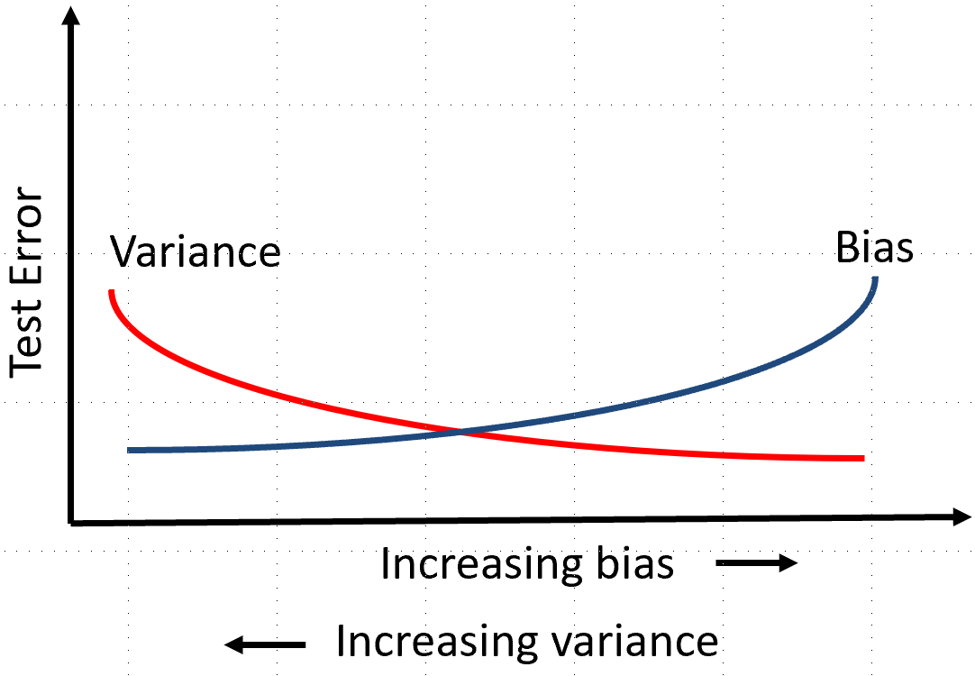
Regularization - The Bias-Variance Trade-Off
There is a trade-off between bias and variance
Low bias models fits training data, high variance and poor generalization
Low variance model generalizes well to new cases, high bias so poor model fit
Need to find the optimal trade-off point
The trade-off between bias and variance

Slide 19
Regularization and Eigendecomposition

Slide 20
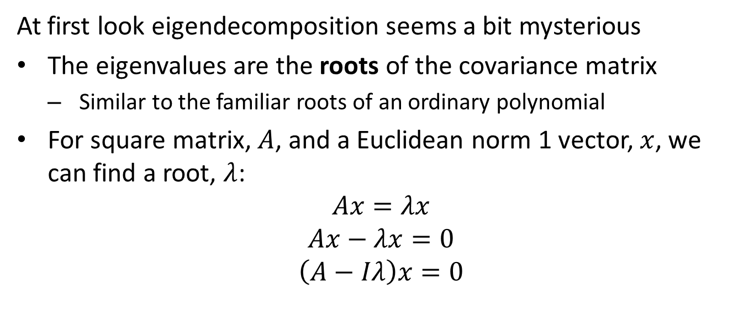
Eigendecomposition - Review
At first look eigendecomposition seems a bit mysterious
The eigenvalues are the roots of the covariance matrix
Similar to the familiar roots of an ordinary polynomial
For square matrix, $A$, and a Euclidean norm 1 vector, $x$, we can find a root, $λ$:
$$Ax=λx$$
$$Ax−λx=0$$
$$\left(A−Iλ\right)x=0$$

Slide 21
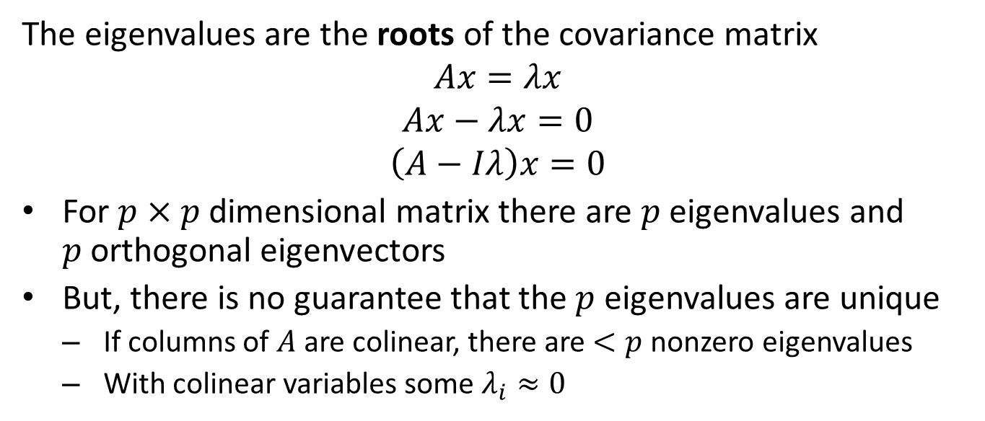
Eigendecomposition - Review
The eigenvalues are the roots of the covariance matrix
$$Ax=λx$$
$$Ax−λx=0$$
$$\left(A−Iλ\right)x=0$$
For $p×p$ dimensional matrix there are $p$ eigenvalues and $p$orthogonal eigenvectors
But, there is no guarantee that the $p$ eigenvalues are unique
If columns of $A$ are colinear, there are $<p$ nonzero eigenvalues
With colinear variables some $λ_{i}≈0$

Slide 22
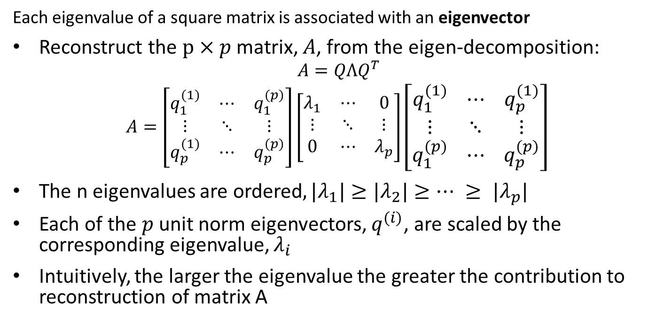
Review of Eigenvalues and Eigenvectors
Each eigenvalue of a square matrix is associated with an eigenvector
Reconstruct the $p×p$ matrix, $A$, from the eigen-decomposition:
$$A=QΛQ^{T}$$
$$A=\left[\begin{matrix}q_{1}^{(1)} & ⋯ & q_{1}^{(p)} \\ ⋮ & ⋱ & ⋮ \\ q_{p}^{(1)} & ⋯ & q_{p}^{(p)}\end{matrix}\right]\left[\begin{matrix}λ_{1} & ⋯ & 0 \\ ⋮ & ⋱ & ⋮ \\ 0 & ⋯ & λ_{p}\end{matrix}\right]{\left[\begin{matrix}q_{1}^{(1)} & ⋯ & q_{p}^{(1)} \\ ⋮ & ⋱ & ⋮ \\ q_{1}^{(p)} & ⋯ & q_{p}^{(p)}\end{matrix}\right]}^{ }$$
The n eigenvalues are ordered$, {|λ}_{1}|≥{|λ}_{2}|≥… ≥ {|λ}_{p}|$
Each of the $p$ unit norm eigenvectors, $q_{ }^{(i)}$, are scaled by the corresponding eigenvalue, $λ_{i}$
Intuitively, the larger the eigenvalue the greater the contribution to reconstruction of matrix A

Slide 23
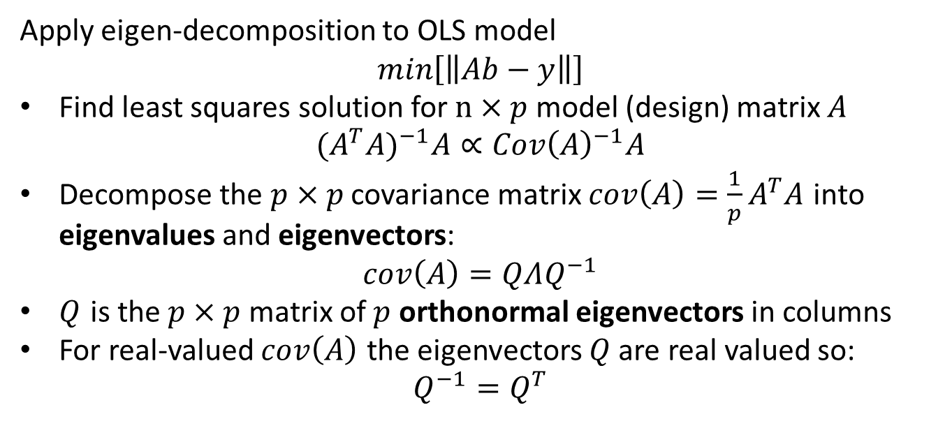
Eigen-decomposition of Lease Squares Problems
Apply eigen-decomposition to OLS model
$$min\left[\left\|Ab−y\right\|\right]$$
Find least squares solution for $n×p$ model (design) matrix $A$
$$(A^{T}A)^{−1}A∝Cov{\left(A\right)}^{−1}A$$
Decompose the $p×p$ covariance matrix $cov\left(A\right)=\frac{1}{p}A^{T}A$ into eigenvalues and eigenvectors:
$$cov\left(A\right)=QΛQ^{−1}$$
$Q$ is the $p×p$ matrix of $p$ orthonormal eigenvectors in columns
For real-valued $cov\left(A\right)$ the eigenvectors $Q$ are real valued so:
$$Q^{−1}=Q^{T}$$

Slide 24
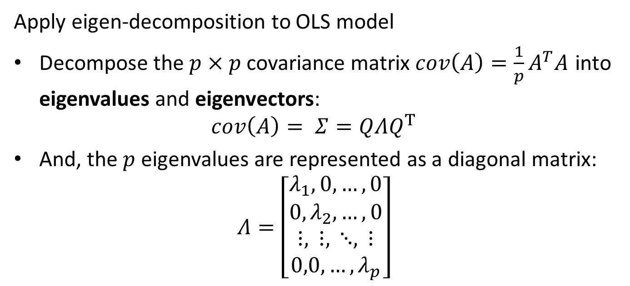
Eigen-decomposition of Lease Squares Problems
Apply eigen-decomposition to OLS model
Decompose the $p×p$ covariance matrix $cov\left(A\right)=\frac{1}{p}A^{T}A$ into eigenvalues and eigenvectors:
$$cov\left(A\right)= Σ=QΛQ^{T}$$
And, the $p$ eigenvalues are represented as a diagonal matrix:
$$Λ=\left[\begin{matrix}λ_{1},0,…,0 \\ 0,λ_{2},…,0 \\ ⋮, ⋮, ⋱, ⋮ \\ 0,0,…,λ_{p}\end{matrix}\right]$$

Slide 25
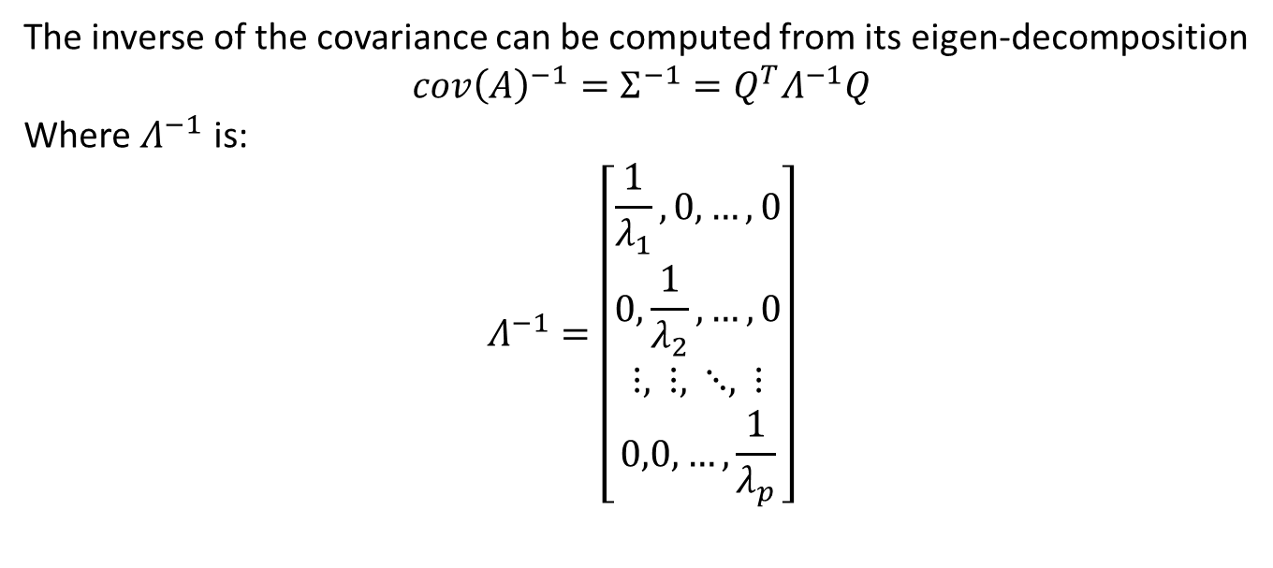
Eigen-decomposition of Lease Squares Problems
The inverse of the covariance can be computed from its eigen-decomposition
$$cov{\left(A\right)}^{−1}=Σ^{−1}=Q^{T}Λ^{−1}Q$$
Where $Λ^{−1}$ is:
$$Λ^{−1}=\left[\begin{matrix}\frac{1}{λ_{1}},0,…,0 \\ 0,\frac{1}{λ_{2}},…,0 \\ ⋮, ⋮, ⋱, ⋮ \\ 0,0,…,\frac{1}{λ_{p}}\end{matrix}\right]$$

Slide 26
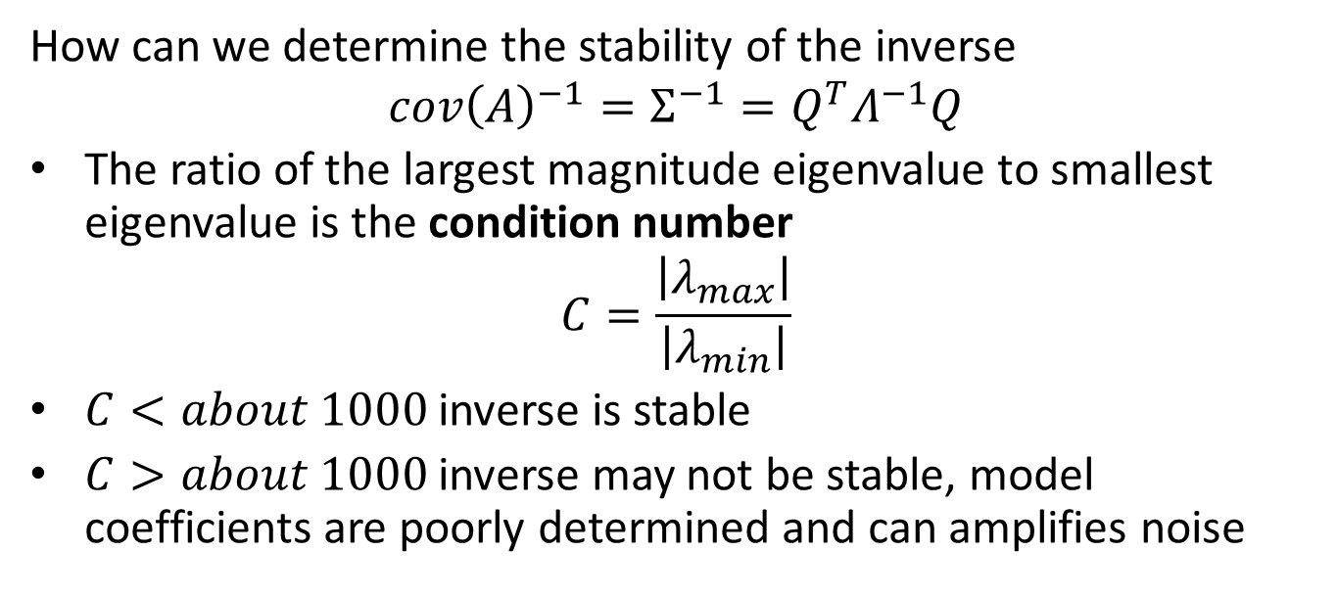
Eigen-decomposition of Lease Squares Problems
How can we determine the stability of the inverse
$$cov{\left(A\right)}^{−1}=Σ^{−1}=Q^{T}Λ^{−1}Q$$
The ratio of the largest magnitude eigenvalue to smallest eigenvalue is the condition number
$$C=\frac{\left|λ_{max}\right|}{\left|λ_{min}\right|}$$
$C<about 1000$ inverse is stable
$C>about 1000$ inverse may not be stable, model coefficients are poorly determined and can amplifies noise

Slide 27
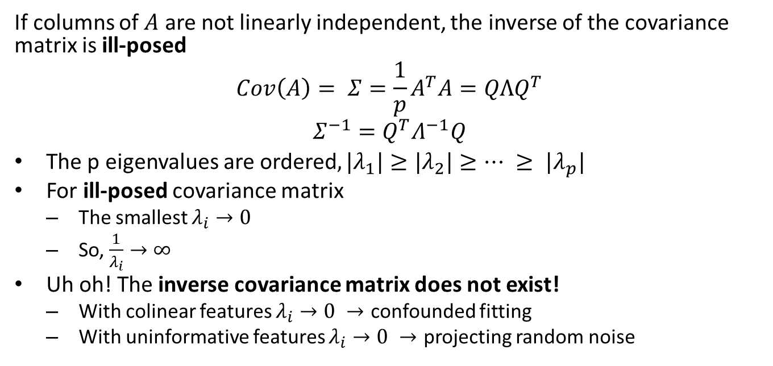
Regularization - Ill-Posed Problems
If columns of $A$ are not linearly independent, the inverse of the covariance matrix is ill-posed
$$Cov\left(A\right)= Σ=\frac{1}{p}A^{T}A=QΛQ^{T}$$
$$Σ^{−1}=Q^{T}Λ^{−1}Q$$
The p eigenvalues are ordered$, {|λ}_{1}|≥{|λ}_{2}|≥… ≥ {|λ}_{p}|$
For ill-posed covariance matrix
The smallest $λ_{i}→0$
So, $\frac{1}{λ_{i}}→∞$
Uh oh! The inverse covariance matrix does not exist!
With colinear features $λ_{i}→0 →$ confounded fitting
With uninformative features $λ_{i}→0 →$ projecting random noise

Slide 28
Ill-Posed Problems – Example
Can compute the model matrix
> formula = 'city_mpg ~ C(fuel_type) + C(aspiration) + C(drive_wheels) + horsepower + compression_ratio + curb_weight + engine_size’
> Y, X = dmatrices(formula, data=auto_data_train)
> X
DesignMatrix with shape (100, 9)
Columns:
['Intercept',
'C(fuel_type)[T.gas]',
'C(aspiration)[T.turbo]',
'C(drive_wheels)[T.fwd]',
'C(drive_wheels)[T.rwd]',
'horsepower',
'compression_ratio',
'curb_weight',
'engine_size']

Slide 29
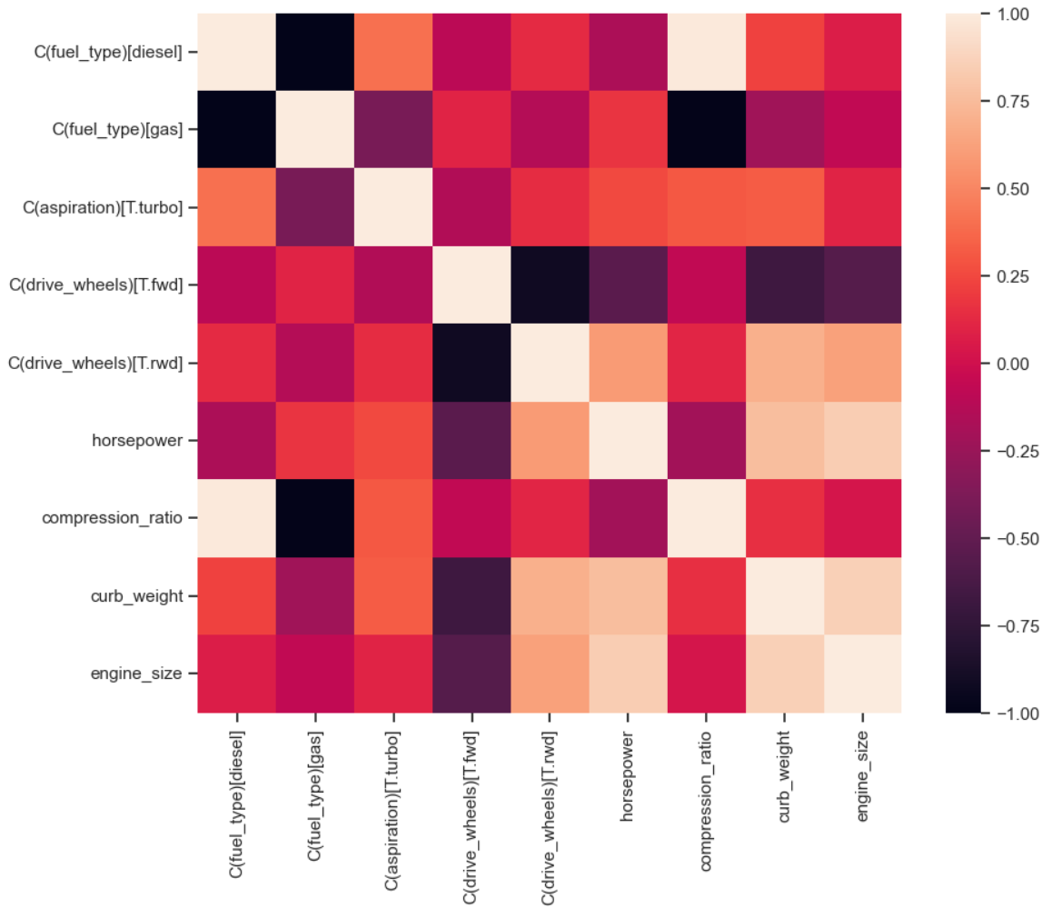
Ill-Posed Problems – Example
Can compute the model matrix
> formula = 'city_mpg ~ C(fuel_type) + C(aspiration) + C(drive_wheels) + horsepower + compression_ratio + curb_weight + engine_size’
> Y, X = dmatrices(formula, data=auto_data_train)
> Cor(X)

Slide 30
Ill-Posed Problems – Example
Evaluate the square covariance matrix and eigenvalues
> cov_X
array([[11.14, 9.89, 2.11, 6. , 4.44, 1.39, 0.24, 0.56, 1.14],
[ 9.89, 9.92, 1.44, 5.44, 3.78, 2.13, -3.3 , -0.09, 1. ],
[ 2.11, 1.44, 2.14, 0.89, 1. , 1.03, 0.98, 1.22, 0.4 ],
[ 6. , 5.44, 0.89, 6.03, 0. , -2.56, -0.04, -3.4 , -2.81],
[ 4.44, 3.78, 1. , 0. , 4.48, 4.14, 0.58, 4.05, 4.24],
[ 1.39, 2.13, 1.03, -2.56, 4.14, 14.01, -3.23, 9.4 , 11.68],
[ 0.24, -3.3 , 0.98, -0.04, 0.58, -3.23, 11.8 , 1.27, -0.17],
[ 0.56, -0.09, 1.22, -3.4 , 4.05, 9.4 , 1.27, 11.47, 10.45],
[ 1.14, 1. , 0.4 , -2.81, 4.24, 11.68, -0.17, 10.45, 13.19]])
> eigenvalues
[3.709e+01 2.557e+01 1.340e+01 2.870e+00 2.160e+00 1.910e+00 6.800e-01, 2.300e-01 1.000e-02]
The condition number = 4120.9

Slide 31
L2 Regularization

Slide 32
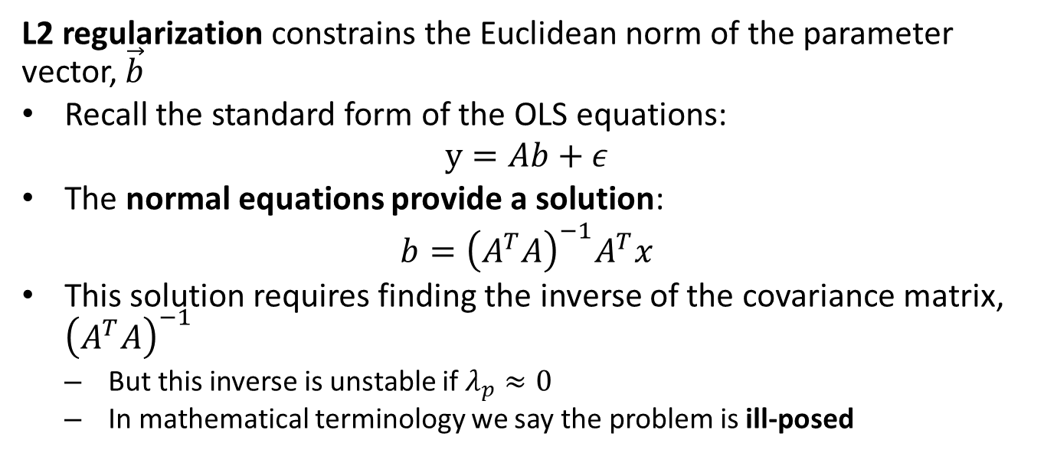
L2 Regularization
L2 regularization constrains the Euclidean norm of the parameter vector, $\vec{b}$
Recall the standard form of the OLS equations:
$$y=Ab+ε$$
The normal equations provide a solution:
$$b={\left(A^{T}A\right)}^{−1}A^{T}x$$
This solution requires finding the inverse of the covariance matrix, ${\left(A^{T}A\right)}^{−1}$
But this inverse is unstable if $λ_{p}≈0$
In mathematical terminology we say the problem is ill-posed

Slide 33
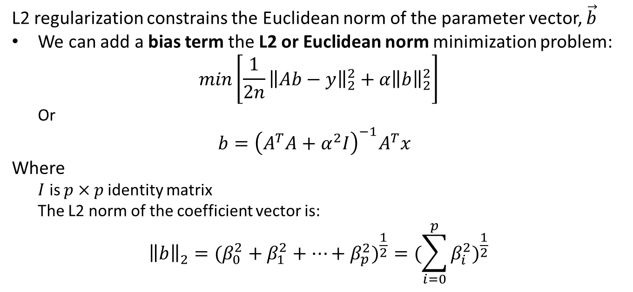
L2 Regularization
L2 regularization constrains the Euclidean norm of the parameter vector, $\vec{b}$
We can add a bias term the L2 or Euclidean norm minimization problem:
$$min\left[{\frac{1}{2n}\left\|Ab−y\right\|}_{2}^{2}+α{\left\|b\right\|}_{2}^{2}\right]$$
Or
$$b={\left(A^{T}A+α^{2}I\right)}^{−1}A^{T}x$$
Where
$I$ is $p×p$identity matrix
The L2 norm of the coefficient vector is:
$${\left\|b\right\|}_{2}^{ }=(β_{0}^{2}+β_{1}^{2}+…+β_{p}^{2})^{\frac{1}{2}}=(\sum_{i=0}^{p}{β_{i}^{2}})^{\frac{1}{2}}$$

Slide 34
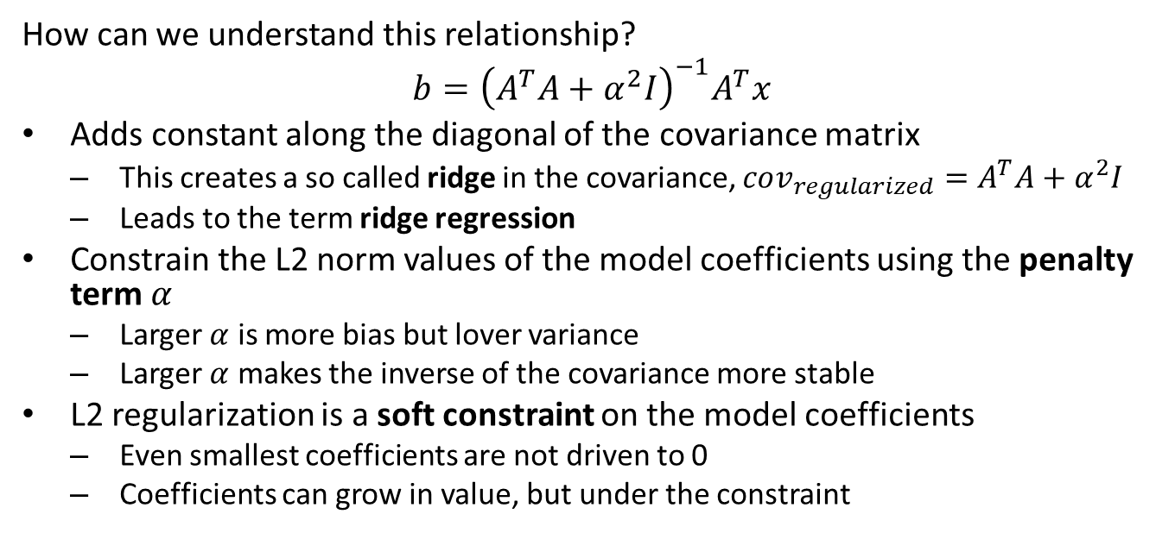
L2 Regularization
How can we understand this relationship?
$$b={\left(A^{T}A+α^{2}I\right)}^{−1}A^{T}x$$
Adds constant along the diagonal of the covariance matrix
This creates a so called ridge in the covariance, $cov_{regularized}=A^{T}A+α^{2}I$
Leads to the term ridge regression
Constrain the L2 norm values of the model coefficients using the penalty term $α$
Larger $α$ is more bias but lover variance
Larger $α$ makes the inverse of the covariance more stable
L2 regularization is a soft constraint on the model coefficients
Even smallest coefficients are not driven to 0
Coefficients can grow in value, but under the constraint

Slide 35
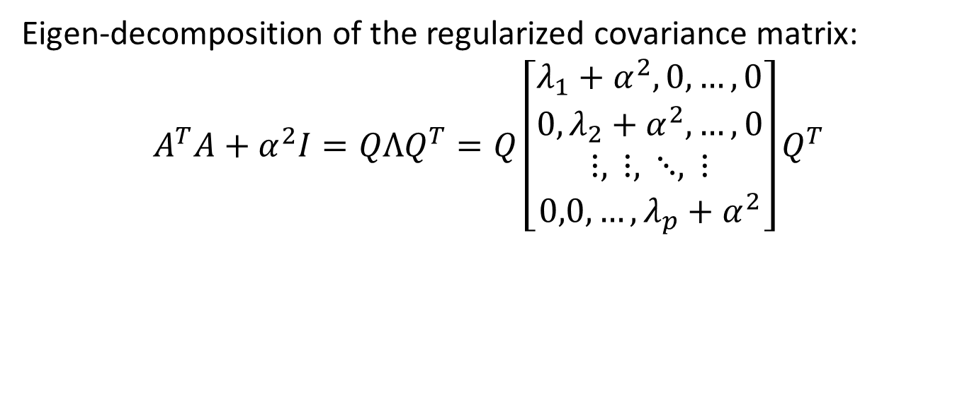
L2 Regularization
Eigen-decomposition of the regularized covariance matrix:
$$A^{T}A+α^{2}I=QΛQ^{T}=Q\left[\begin{matrix}λ_{1}+α^{2},0,…,0 \\ 0,λ_{2}+α^{2},…,0 \\ ⋮, ⋮, ⋱, ⋮ \\ 0,0,…,λ_{p}+α^{2}\end{matrix}\right]Q^{T}$$

Slide 36
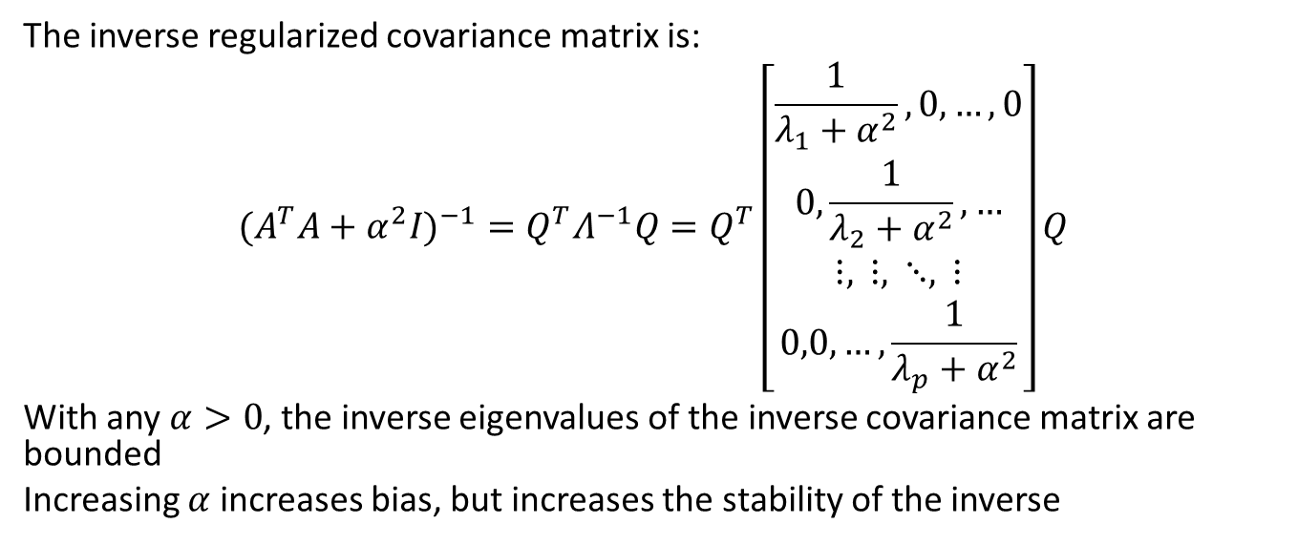
L2 Regularization
The inverse regularized covariance matrix is:
$$(A^{T}A+α^{2}I)^{−1}=Q^{T}Λ^{−1}Q=Q^{T}\left[\begin{matrix}\frac{1}{λ_{1}+α^{2}},0,…,0 \\ 0,\frac{1}{λ_{2}+α^{2}},… \\ ⋮, ⋮, ⋱, ⋮ \\ 0,0,…,\frac{1}{λ_{p}+α^{2}}\end{matrix}\right]Q$$
With any $α>0$, the inverse eigenvalues of the inverse covariance matrix are bounded
Increasing $α$ increases bias, but increases the stability of the inverse

Slide 37
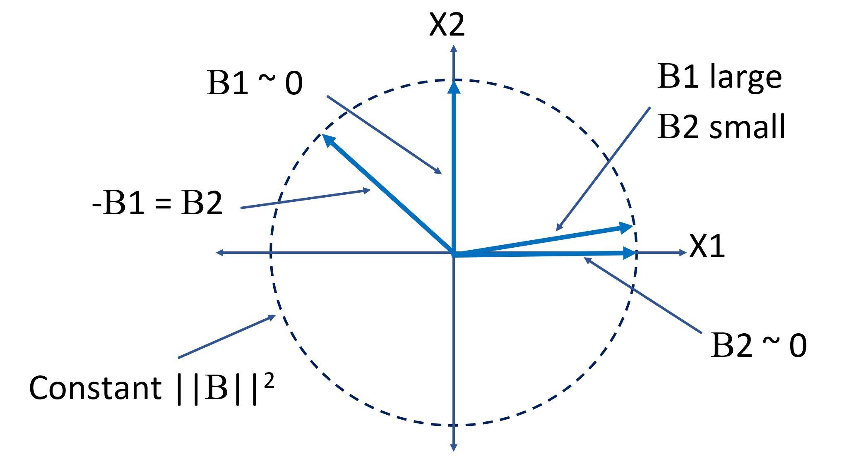
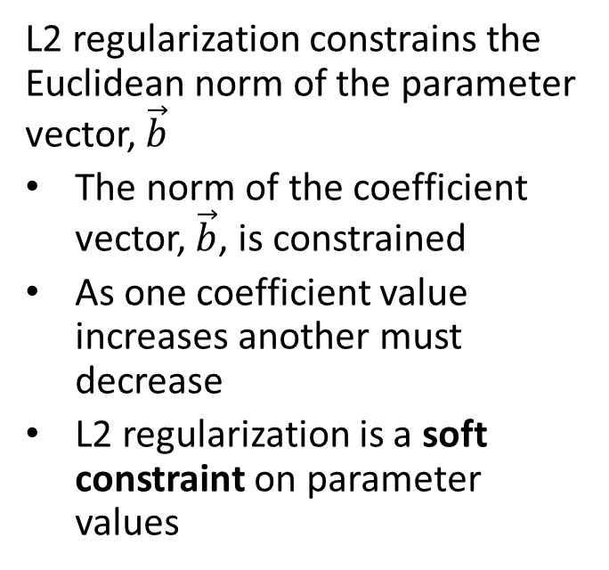
L2 Regularization
L2 regularization constrains the Euclidean norm of the parameter vector, $\vec{b}$
The norm of the coefficient vector, $\vec{b}$, is constrained
As one coefficient value increases another must decrease
L2 regularization is a soft constraint on parameter values
L2 norm constraint of model coefficients

Slide 38
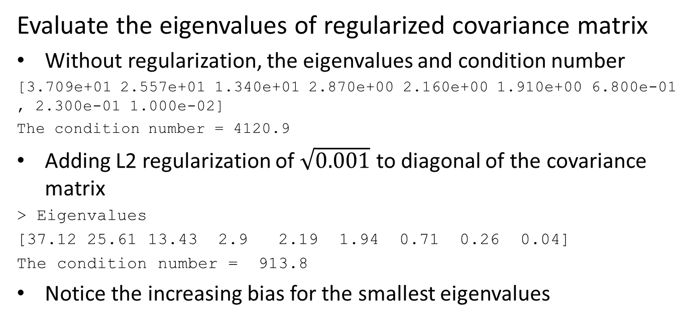
Ill-Posed Problems – Example
Evaluate the eigenvalues of regularized covariance matrix
Without regularization, the eigenvalues and condition number
[3.709e+01 2.557e+01 1.340e+01 2.870e+00 2.160e+00 1.910e+00 6.800e-01, 2.300e-01 1.000e-02]
The condition number = 4120.9
Adding L2 regularization of $\sqrt{0.001}$ to diagonal of the covariance matrix
> Eigenvalues
[37.12 25.61 13.43 2.9 2.19 1.94 0.71 0.26 0.04]
The condition number = 913.8
Notice the increasing bias for the smallest eigenvalues

Slide 39
L2 Regularization
Example: Increasing constraint on model coefficients with larger L2 regularization hyperparameter
def regularized_coefs(df_train, df_test, alphas, L1_wt=0.0, n_coefs=8, formula = 'socst_zero_mean ~ C(ses)*C(prog)', label='socst_zero_mean'): '''Function that computes a linear model for each value of the regularization parameter alpha and returns an array of the coefficient values. The L1_wt determines the trade-off between L1 and L2 regularization''' coefs = np.zeros((len(alphas),n_coefs + 1)) MSE_train = [] MSE_test = [] for i,alpha in enumerate(alphas): ## First compute the training MSE temp_mod = smf.ols(formula, data=df_train).fit_regularized(alpha=alpha,L1_wt=L1_wt) coefs[i,:] = temp_mod.params MSE_train.append(np.mean(np.square(df_train[label] - temp_mod.predict(df_train)))) ## Then compute the test MSE MSE_test.append(np.mean(np.square(df_test[label] - temp_mod.predict(df_test)))) return coefs, MSE_train, MSE_test alphas = np.arange(0.0, 0.3, step = 0.003) Betas, MSE_test, MSE_train = regularized_coefs(test_scores_train, test_scores_test, alphas)

Slide 40
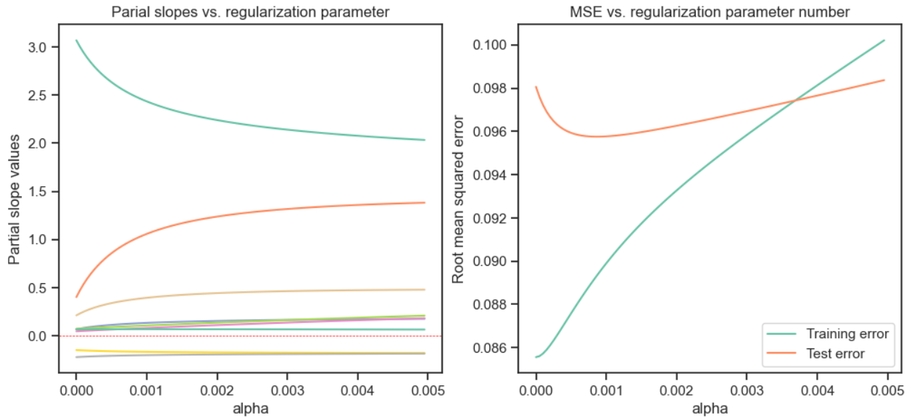
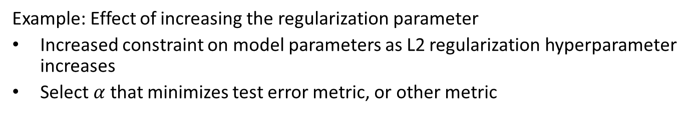
L2 Regularization
Example: Effect of increasing the regularization parameter
Increased constraint on model parameters as L2 regularization hyperparameter increases
Select $α$ that minimizes test error metric, or other metric

Slide 41
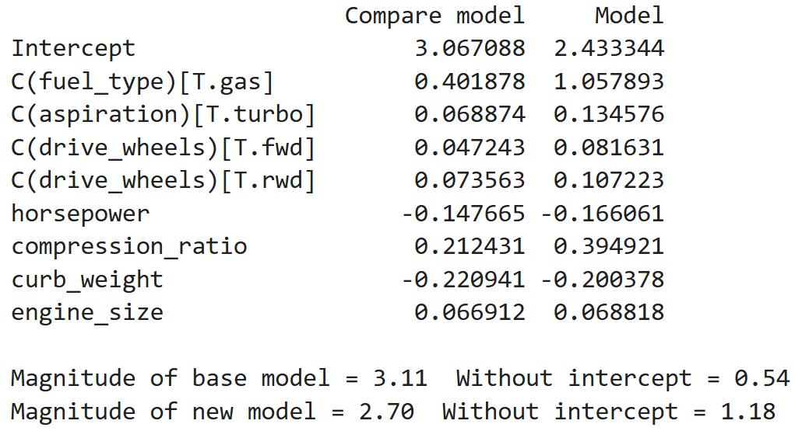
Example: L2 Regularization
L2 regression is no longer overfit
Intercept parameter has decreased
Some parameters increased
One parameter is constrained
Norm of coefficient vector is limited
No model coefficients are driven to 0

Slide 42
L1 Regularization

Slide 43
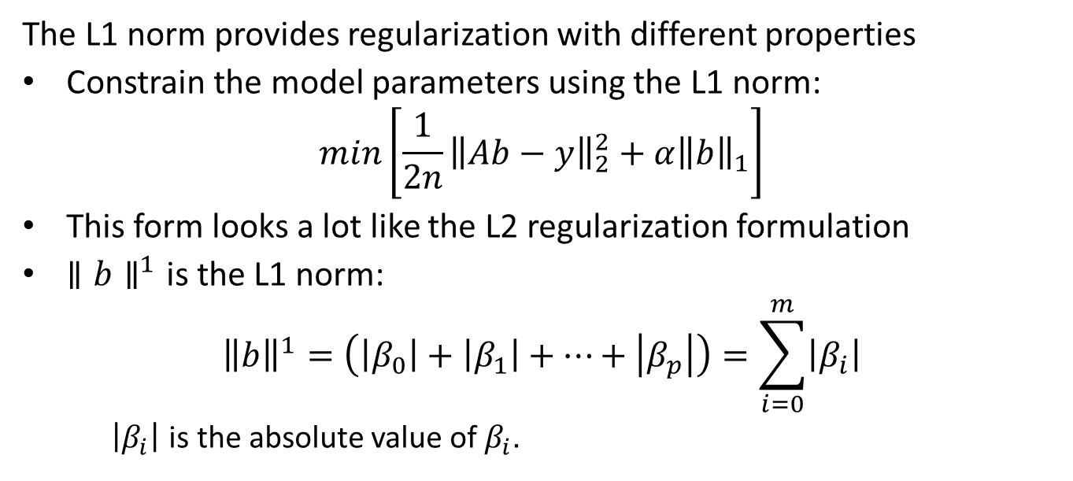
L1 Regularization
The L1 norm provides regularization with different properties
Constrain the model parameters using the L1 norm:
$$min\left[{\frac{1}{2n}\left\|Ab−y\right\|}_{2}^{2}+α{\left\|b\right\|}_{1}\right]$$
This form looks a lot like the L2 regularization formulation
$∥b∥^{1}$ is the L1 norm:
$${\left\|b\right\|}^{1}=\left(\left|β_{0}\right|+\left|β_{1}\right|+…+\left|β_{p}\right|\right)=\sum_{i=0}^{m}{\left|β_{i}\right|}$$
$\left|β_{i}\right|$ is the absolute value of $β_{i}$.

Slide 44
L1 Regularization
What are the properties of the L1 regularization?
L1 regularization is a hard constraint
L1 regularization drives coefficients to zero
The hard constraint property leads to the term lasso regularization – least absolute shrinkage and selection operator
Lasso regression is a method of feature selection for high dimensions

Slide 45
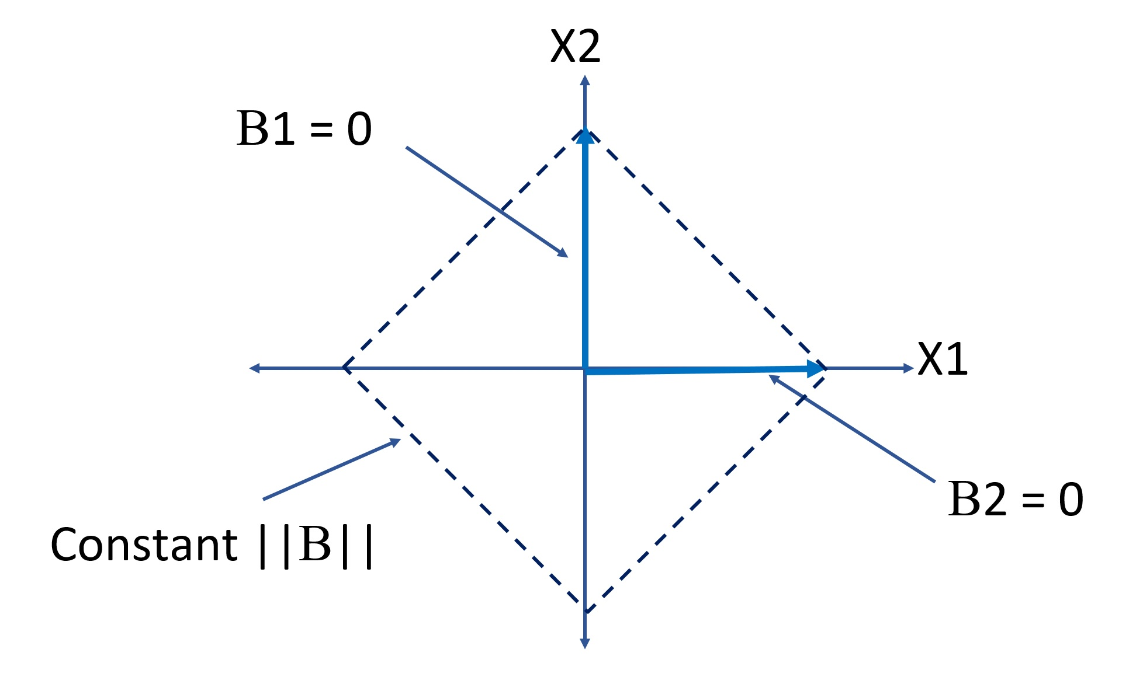
L1 Regularization
The Lasso regularization is a strong constraint on coefficient values
As one coefficient value increases another must decrease
Some coefficients are forced to zero
The constraint curve is like a lasso – a rope pulled tight
L1 norm constraint of model coefficients

Slide 46
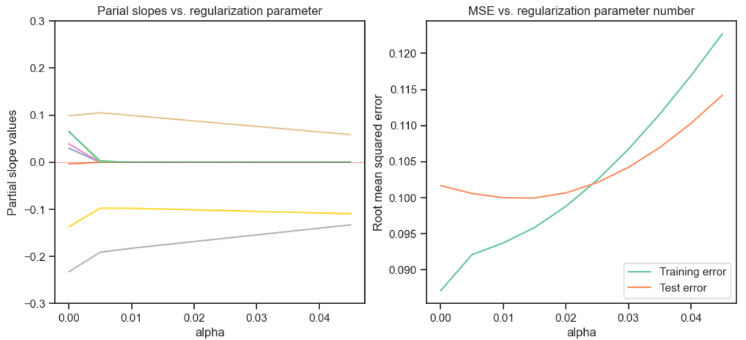
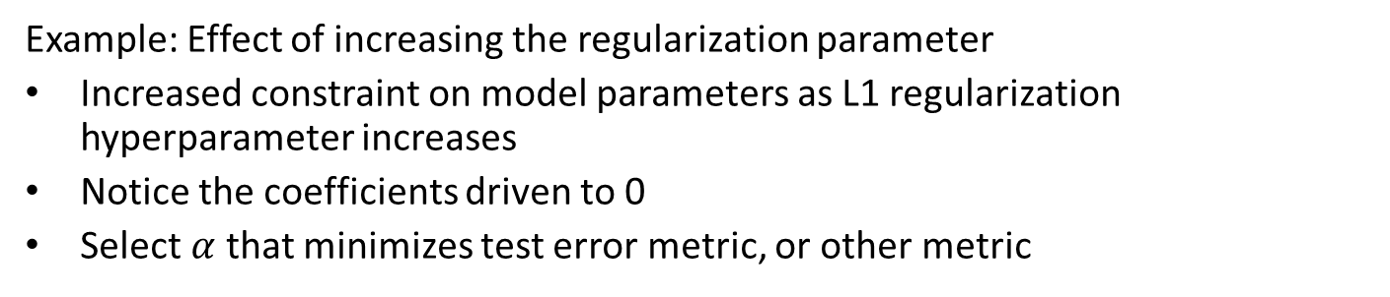
L1 Regularization
Example: Effect of increasing the regularization parameter
Increased constraint on model parameters as L1 regularization hyperparameter increases
Notice the coefficients driven to 0
Select $α$ that minimizes test error metric, or other metric

Slide 47
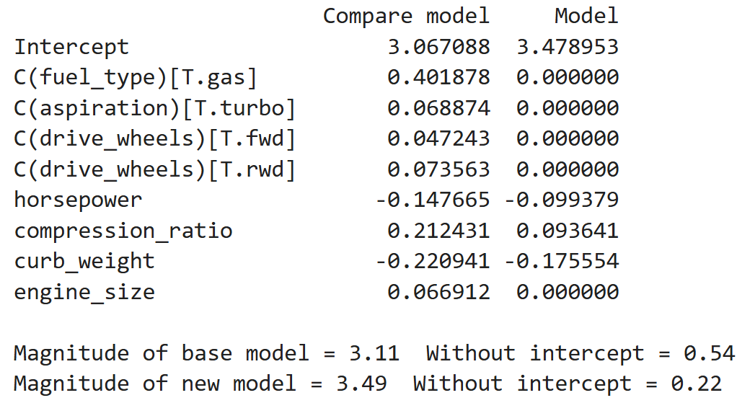
Example: L1 Regularization
L1 regression is no longer overfit
Intercept parameter has increased
Most model coefficients are driven to 0
Other parameters are constrained
Norm of coefficient vector is limited, except intercept

Slide 48
ElasticNet Regularization

Slide 49
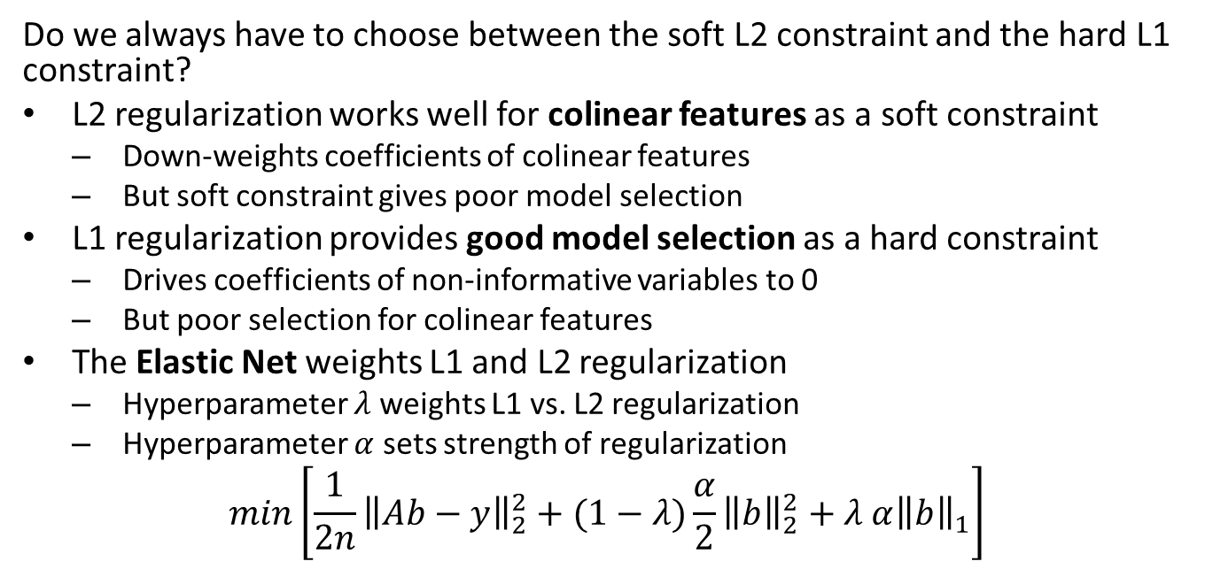
ElasticNet Regularization
Do we always have to choose between the soft L2 constraint and the hard L1 constraint?
L2 regularization works well for colinear features as a soft constraint
Down-weights coefficients of colinear features
But soft constraint gives poor model selection
L1 regularization provides good model selection as a hard constraint
Drives coefficients of non-informative variables to 0
But poor selection for colinear features
The Elastic Net weights L1 and L2 regularization
Hyperparameter $λ$ weights L1 vs. L2 regularization
Hyperparameter $α$ sets strength of regularization
$$min\left[{\frac{1}{2n}\left\|Ab−y\right\|}_{2}^{2}+(1−λ)\frac{α}{2}{\left\|b\right\|}_{2}^{2}+λ α{\left\|b\right\|}_{1}\right]$$

Slide 50
ElasticNet Regularization
Example: Increasing constraint on model coefficients with larger L1 regularization hyperparameter
alphas = np.arange(0.0, 0.5, step = 0.02) Betas, MSE_train, MSE_test = regularized_coefs(test_scores_train, test_scores_test, alphas, L1_wt=0.5)

Slide 51
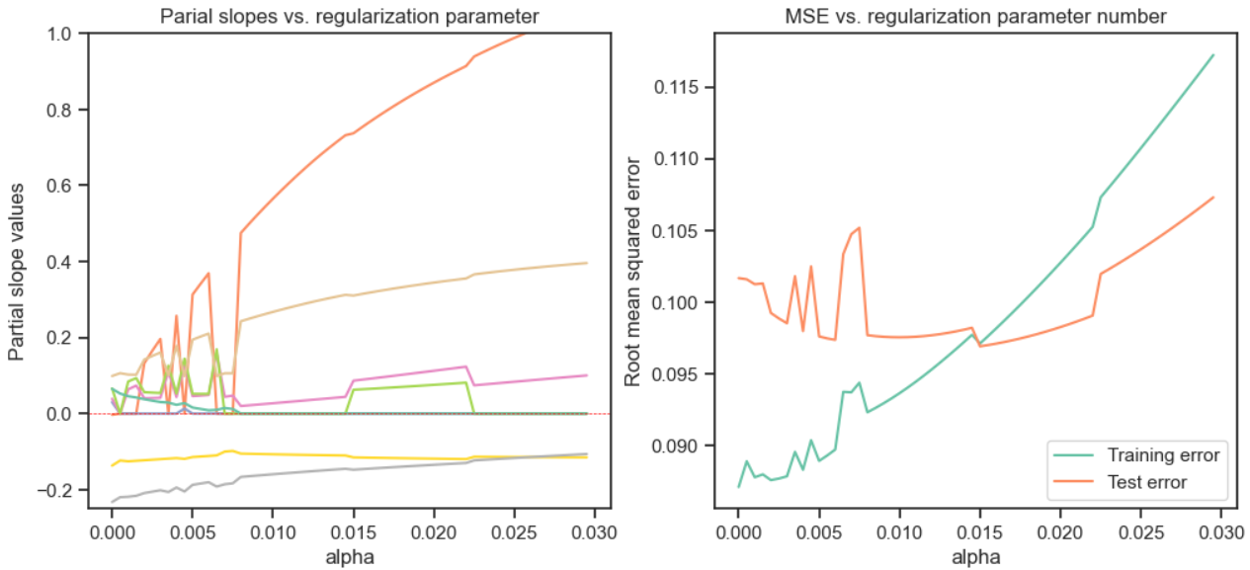
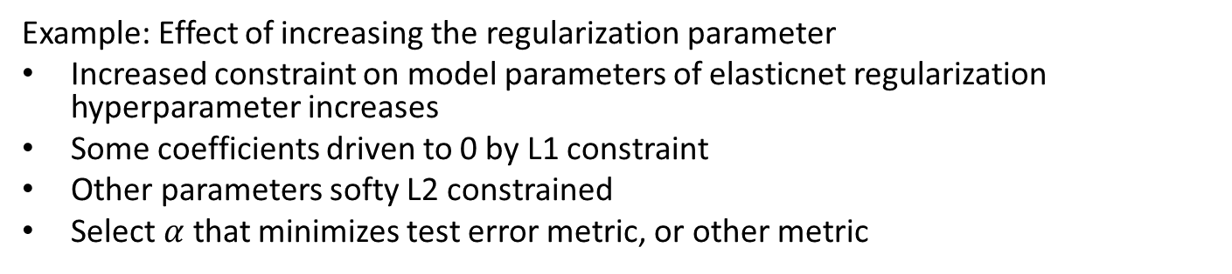
ElasticNet Regularization
Example: Effect of increasing the regularization parameter
Increased constraint on model parameters of elasticnet regularization hyperparameter increases
Some coefficients driven to 0 by L1 constraint
Other parameters softy L2 constrained
Select $α$ that minimizes test error metric, or other metric

Slide 52
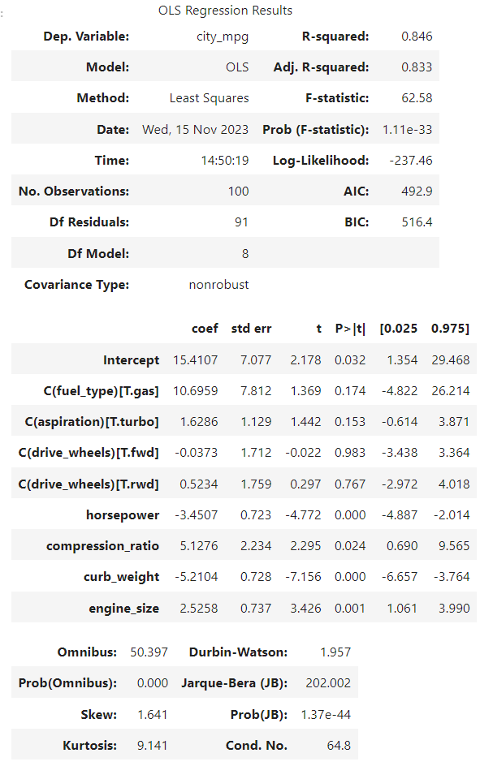
Example: Elastic Net Regularization
The OLS model is significantly overfit
Several of the model coefficients have CIs including 0 and large p-values

Slide 53
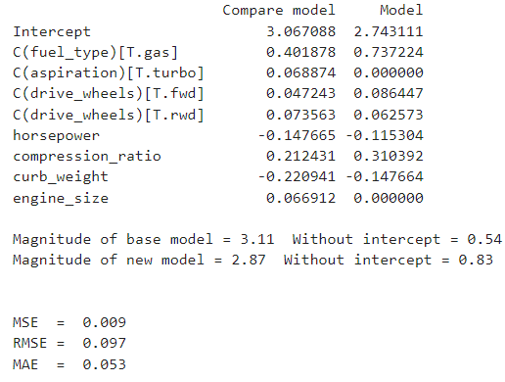
Example: Elastic Net Regularization
Elasticnet regression is no longer overfit
Some model coefficients are driven to 0
Other parameters are constrained
Norm of coefficient vector is limited by Elastic net

Slide 54
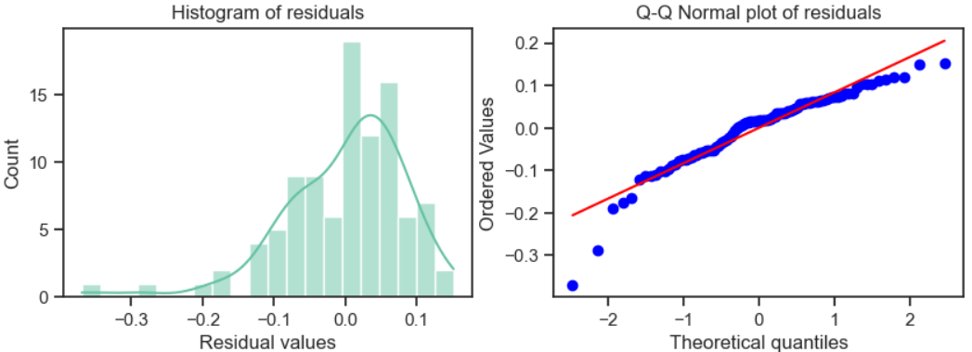
Example: Elastic Net Regularization
Residuals of OLS model show significant outliers

Slide 55
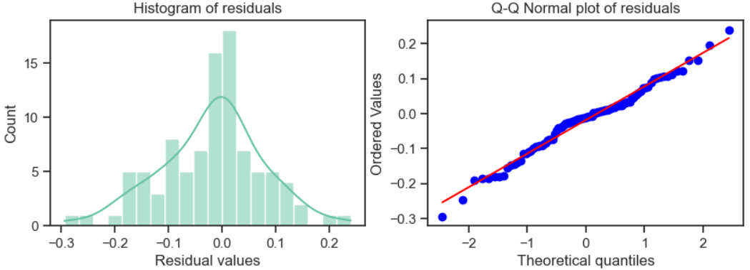
Example: Elastic Net Regularization
Residuals of elasticnet regularized model are approximately normal

Slide 56
Summary
Over-fit models and regularization
Bias variance trade-off between fit to training data (bias) and generalization error (vaiance)
Prefer minimal or sparse models
L2 regularization is a soft constraint
L1 regularization is a hard constraint
ElasticNet combines L1 and L2 regularization

