Slide 1

Basic Time Series Models
Steve Elston
Copyright 2018, 2019, 2020, 2021, 2022, 2023 2024, 2025, 2026 Stephen F Elston. All rights reserved.

Slide 2
Why Are Time Series Useful?
Data are often time-ordered
Estimates show that 30% of data science problems include time series data
Must use specific time series models

Slide 3
Why Are Time Series Useful?
“It’s tough to make predictions, especially about the future!”
Karl Kristian Steincke, Danish politician, ca 1937
Demand forecasting: Electricity production, Internet bandwidth, Traffic management, Inventory management, sales forecasting
Medicine: Time dependent treatment effects, EKG, EEG
Engineering and Science: Signal analysis, Analysis of physical processes
Capital markets and economics: Seasonal unemployment, Price/return series, Risk analysis

Slide 4
Why Are Time Series Data Different?
Models must account for time series behavior
Most statistical and machine learning assume data samples are independent identically distributed (iid)
But, this is not the case for time series data
Time series data exhibit Serial correlation
  Serial correlation of values
  Serial correlation of model errors
  Violate iid assumptions of many statistical and ML Models
  `

Slide 5
Properties of Time Series
Fundamental elements of time series
Fundamental components which cannot be predicted
  White noise
  Random walks
Nonstationary predictable components
  Trend
  Seasonal components
Autocorrelation and partial autocorrelation
  Fundamental properties of stationary time series
Differencing to transform to stationarity
  Seasonal differencing
  Non-seasonal differencing
Stationarity tests
  augmented Dicky-Fuller test
  KPSS test

Slide 6
Introduction to Forecasting

Slide 7
Time Series Forecasting Models
Forecasting is the goal of much of time series analysis
Forecasting models attempt to predict future values conditional on past observations
Here, we focus on linear ARIMA and SARIMAX models
  Models support inference
  Work for many nonstationary time series
Many alternatives
  Expert judgement or subjective forecasting is widely applied, e.g. an experienced purchasing manager
  Exponential smoothing Holt-Winters models create robust forcasts; see Chapter 7 of Hyndman and Athanaosopoulos, 3rd edition
  To date, LSTM models and LLM models, have not been shown to provide significantly better forecasts than conventional models in general cases

Slide 8
Time Series Forecasting Models
Large and growing volume of time series modeling and forecasting software and literature
For comprehensive introduction see Forecasting: Principles and Practice, Hyndman and Athanaosopoulos, 3rd edition, 2018, available as book or free online
Rob Hyndman’s blog is a source of many interesting ideas and example in time series analysis
Another applied source, The Analysis of Time Series, Chatfield and Xing, 2019
The long-time go-to text for theory by Box, Jenkins, Reinsel and Ljung, now in the 5th edition

Slide 9
Time Series Models
The ARIMA model for time series comprises three components:
Autoregressive component (AR) accounts for partial autocorrelation
  Serial correlation of observations
Integrative component (I) accounts random walks and trend
  Differencing provides stationary series for AR and MA components
Moving Average (MA) accounts for autocorrelation
  Serial correlation of model error
ARIMA models are often called Box-Jenkins models

Slide 10
Time Series Models
Many types of time series models
SARIMA: seasonal autoregressive integrative moving average, adds seasonal components
  seasonal AR accounts for serial correlation of seasonal values
  Seasonal differencing accounts for random walk and trend of seasonal components
  seasonal MA accounts for seasonal serial correlation of errors
SARIMAX: seasonal autoregressive integrative moving average with exogenous variables
  Add effect of external factors
  Example; effect of specific holiday
  Example; effect arising from independent factors not incorporated in endogenous variable

Slide 11
Autoregressive Model

Slide 12
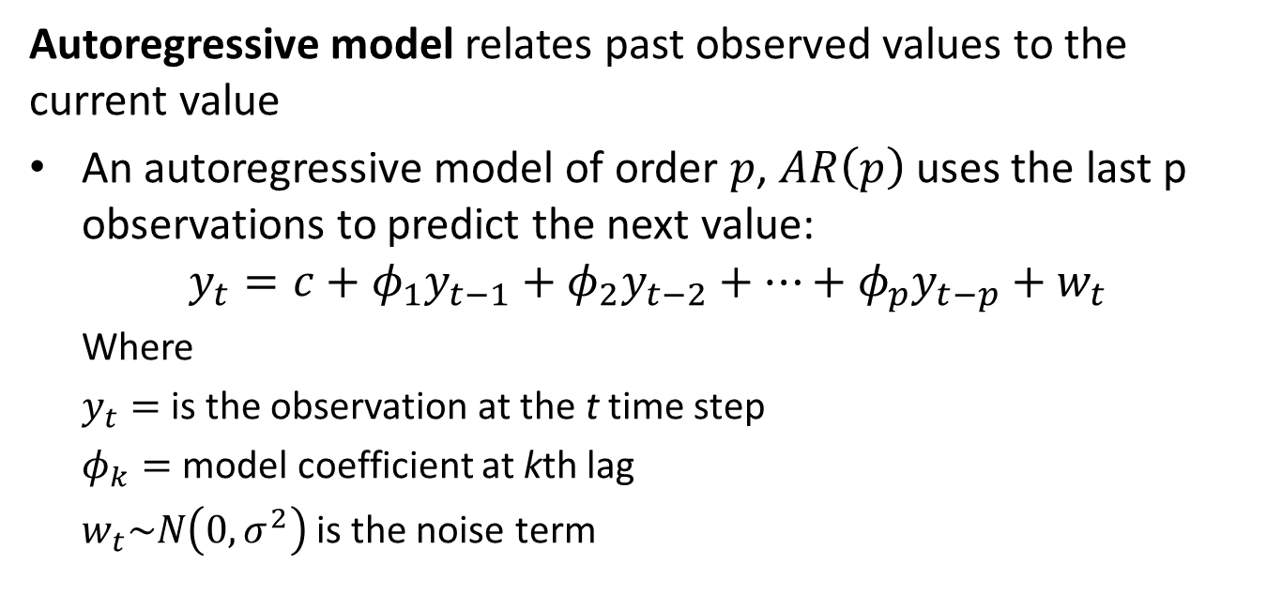
The Autoregressive Model
Autoregressive model relates past observed values to the current value
An autoregressive model of order $p$, $AR\left(p\right)$ uses the last p observations to predict the next value:
$$y_{t}={c+φ}_{1}y_{t−1}+φ_{2}y_{t−2}+…+φ_{p}y_{t−p}+w_{t}$$
  Where
  $y_{t}=$ is the observation at the t time step
  $φ_{k}=$ model coefficient at kth lag
  $w_{t}\sim N\left(0,σ^{2}\right)$ is the noise term

Slide 13
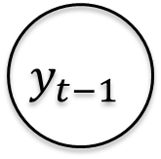

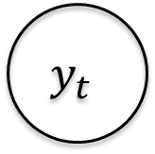


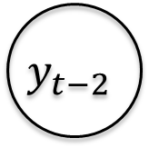
The Autoregressive Model
$$φ_{2}y_{t−2}$$
$$φ_{1}y_{t−1}$$
$$y_{t−2}$$
$$y_{t−1}$$
$$y_{t}$$
$$y_{t}={c+φ}_{1}y_{t−1}+φ_{2}y_{t−2}+w_{t}$$
Illustration of the AR(2) model

Slide 14
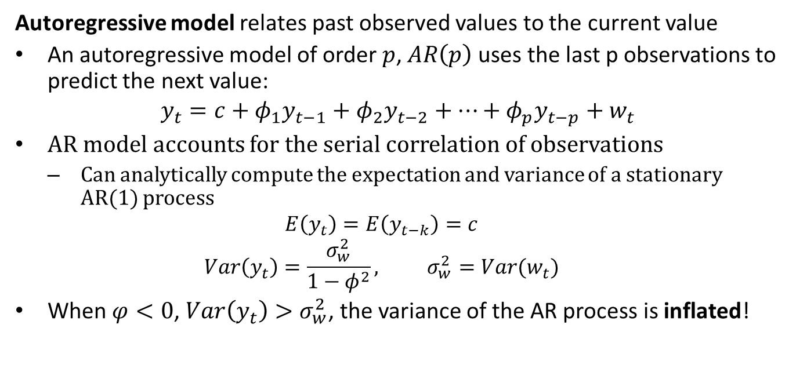
The Autoregressive Model
Autoregressive model relates past observed values to the current value
An autoregressive model of order $p$, $AR\left(p\right)$ uses the last p observations to predict the next value:
$$y_{t}={c+φ}_{1}y_{t−1}+φ_{2}y_{t−2}+…+φ_{p}y_{t−p}+w_{t}$$
AR model accounts for the serial correlation of observations
  Can analytically compute the expectation and variance of a stationary AR(1) process
  $$E\left(y_{t}\right)=E\left(y_{t−k}\right)=c$$
  $$Var\left(y_{t}\right)=\frac{σ_{w}^{2}}{1−φ^{2}}, σ_{w}^{2}=Var(w_{t})$$
When $φ<0$, $Var\left(y_{t}\right)>σ_{w}^{2}$, the variance of the AR process is inflated!

Slide 15
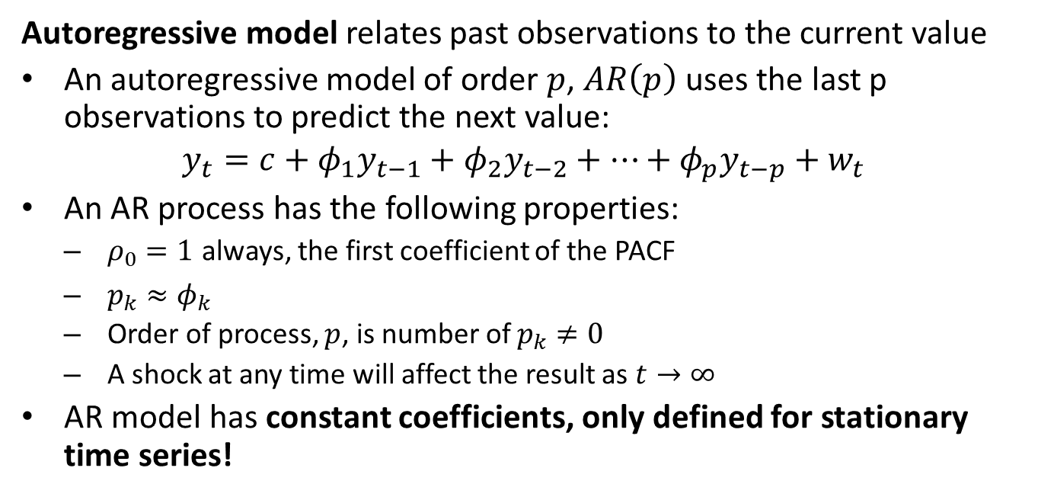
The Autoregressive Model
Autoregressive model relates past observations to the current value
An autoregressive model of order $p$, $AR\left(p\right)$ uses the last p observations to predict the next value:
$$y_{t}={c+φ}_{1}y_{t−1}+φ_{2}y_{t−2}+…+φ_{p}y_{t−p}+w_{t}$$
An AR process has the following properties:
  $ρ_{0}=1$ always, the first coefficient of the PACF
  $p_{k}≈φ_{k}$
  Order of process, $p$, is number of $p_{k}≠0$
  A shock at any time will affect the result as $t→∞$
AR model has constant coefficients, only defined for stationary time series!

Slide 16
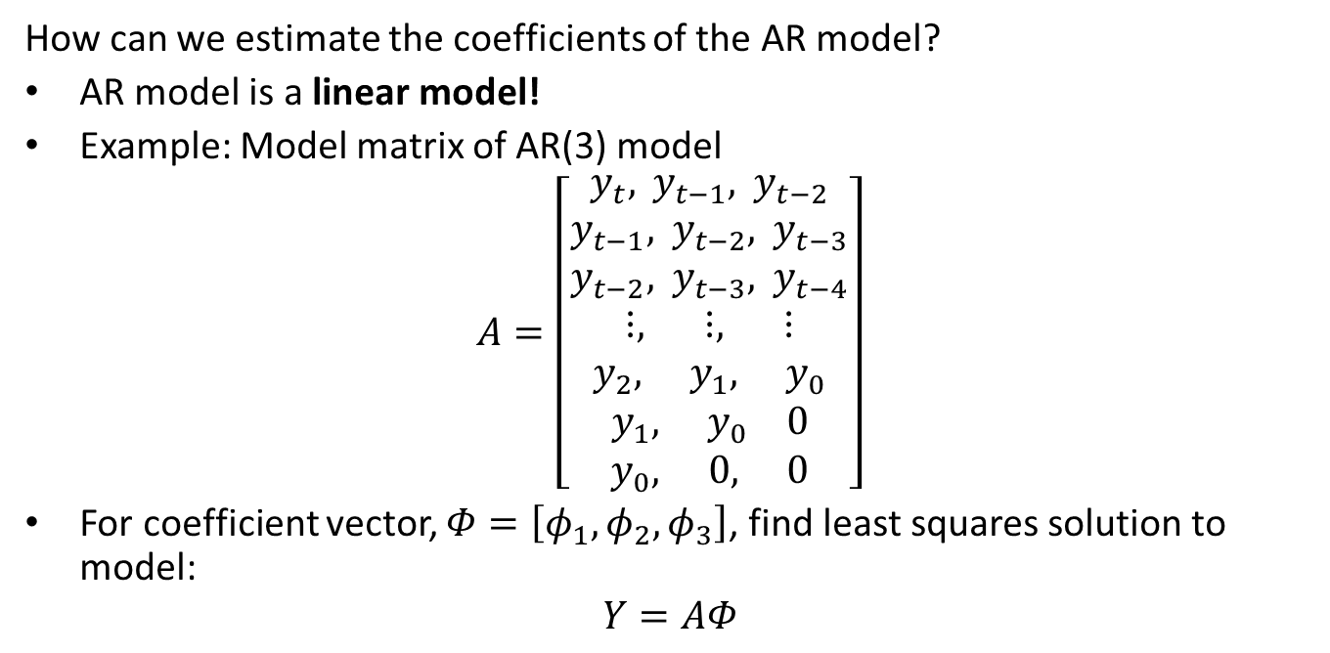
The Autoregressive Model
How can we estimate the coefficients of the AR model?
AR model is a linear model!
Example: Model matrix of AR(3) model
$$A=\left[\begin{matrix}y_{t}, y_{t−1}, y_{t−2} \\ y_{t−1}, y_{t−2}, y_{t−3} \\ y_{t−2}, y_{t−3}, y_{t−4} \\ ⋮, ⋮, ⋮ \\ y_{2}, y_{1}, y_{0} \\ y_{1}, y_{0} 0 \\ y_{0}, 0, 0\end{matrix}\right]$$
For coefficient vector, $Φ=\left[φ_{1},φ_{2},φ_{3}\right]$, find least squares solution to model:
$$Y=AΦ$$

Slide 17
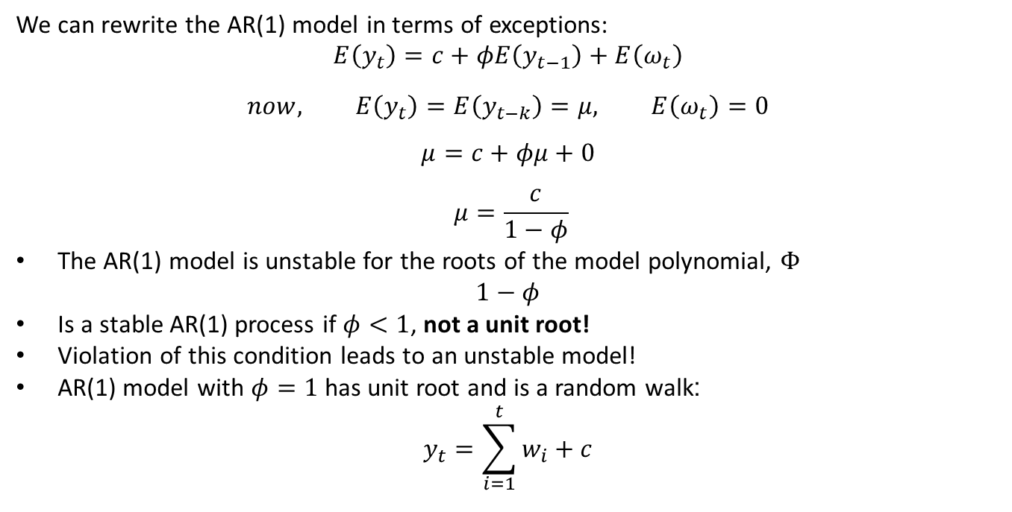
The Autoregressive Model
We can rewrite the AR(1) model in terms of exceptions:
$$E\left(y_{t}\right)=c+φE\left(y_{t−1}\right)+E\left(ω_{t}\right)$$
$$now, E\left(y_{t}\right)=E\left(y_{t−k}\right)=μ, E\left(ω_{t}\right)=0$$
$$μ=c+φμ+0$$
$$μ=\frac{c}{1−φ}$$
The AR(1) model is unstable for the roots of the model polynomial, $Φ$
$$1−φ$$
Is a stable AR(1) process if $φ<1$, not a unit root!
Violation of this condition leads to an unstable model!
AR(1) model with $φ=1$ has unit root and is a random walk:
$$y_{t}=\sum_{i=1}^{t}{w_{i}+c}$$

Slide 18
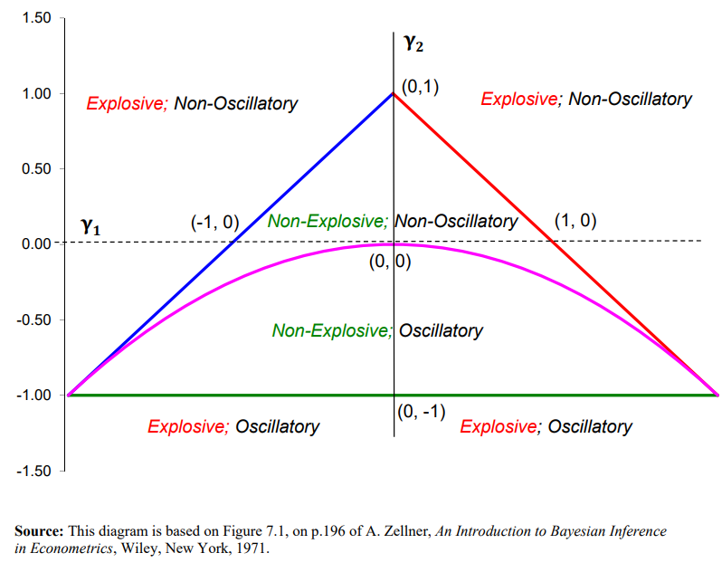


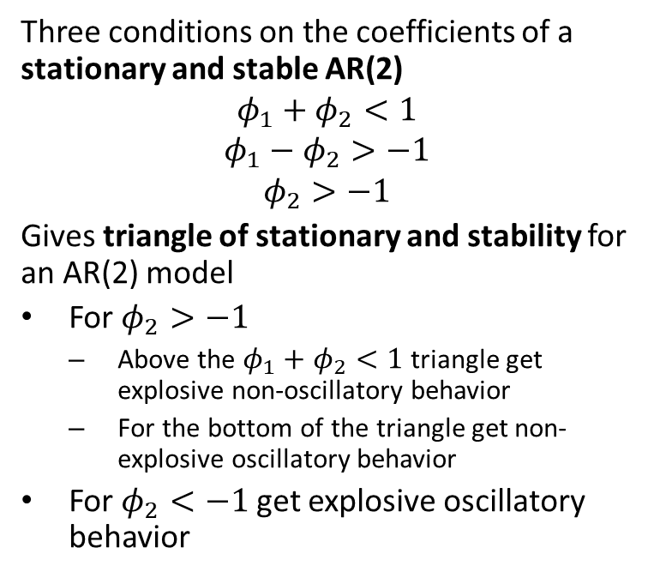
The Autoregressive Model
Three conditions on the coefficients of a stationary and stable AR(2)
$$φ_{1}+φ_{2}<1$$
$$φ_{1}−φ_{2}>−1$$
$$φ_{2}>−1$$
Gives triangle of stationary and stability for an AR(2) model
For $φ_{2}>−1$
  Above the $φ_{1}+φ_{2}<1$ triangle get explosive non-oscillatory behavior
  For the bottom of the triangle get non-explosive oscillatory behavior
For $φ_{2}<−1$ get explosive oscillatory behavior
$$φ_{2}$$
$$φ_{1}$$
Stationarity of AR(2) model
From lecture notes by David E. Giles, Simon Fraser University

Slide 19
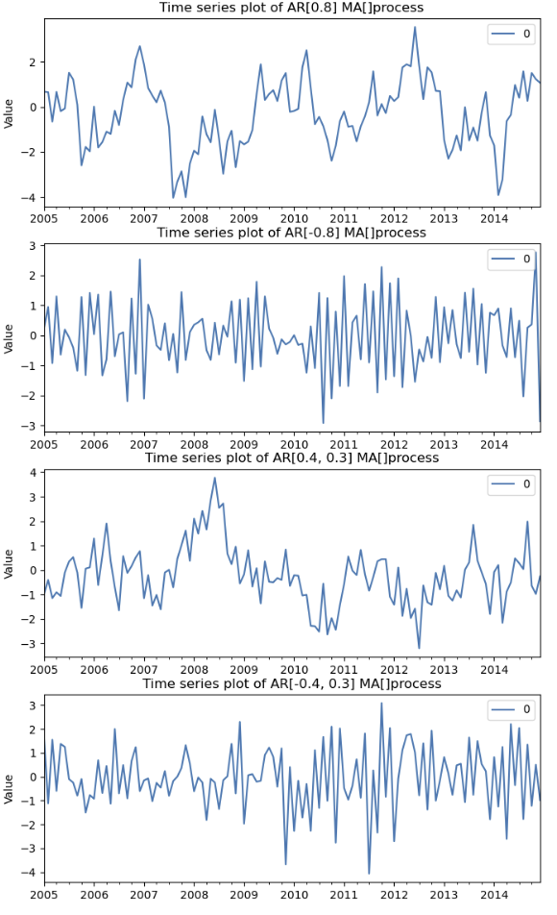
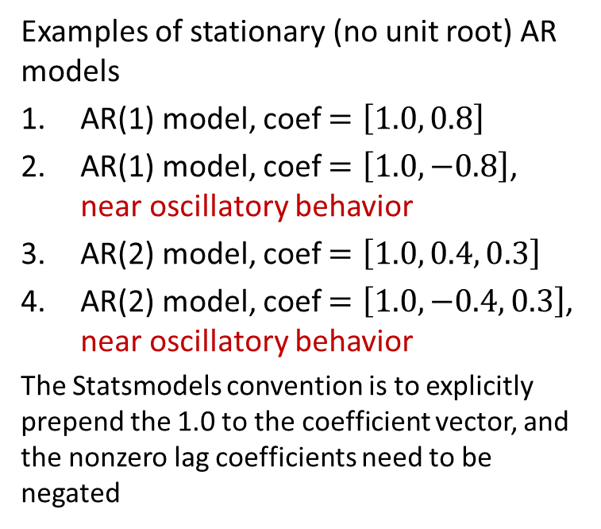
Example: Autoregressive Model
Examples of stationary (no unit root) AR models
AR(1) model, coef $=\left[1.0, 0.8\right]$
AR(1) model, coef $=\left[1.0, −0.8\right]$, near oscillatory behavior
AR(2) model, coef $=\left[1.0, 0.4, 0.3\right]$
AR(2) model, coef $=\left[1.0, −0.4, 0.3\right]$, near oscillatory behavior
The Statsmodels convention is to explicitly prepend the 1.0 to the coefficient vector, and the nonzero lag coefficients need to be negated

Slide 20
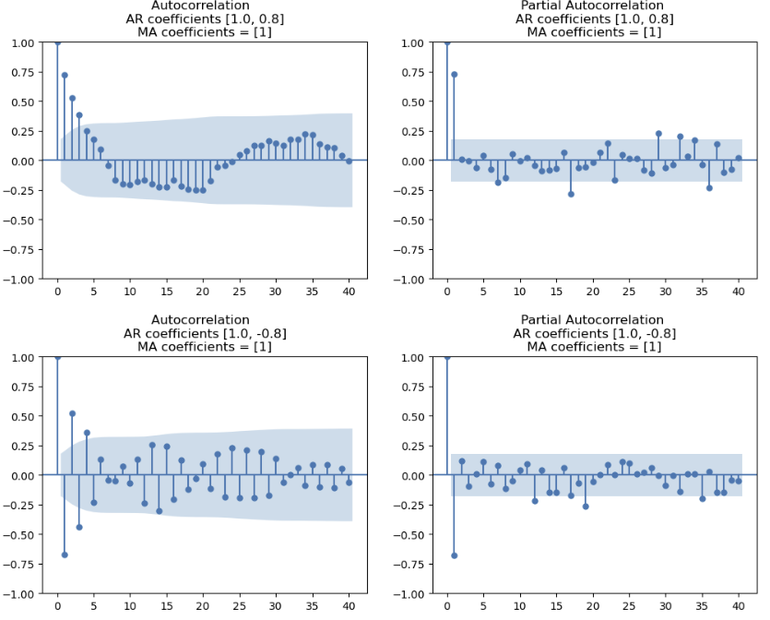
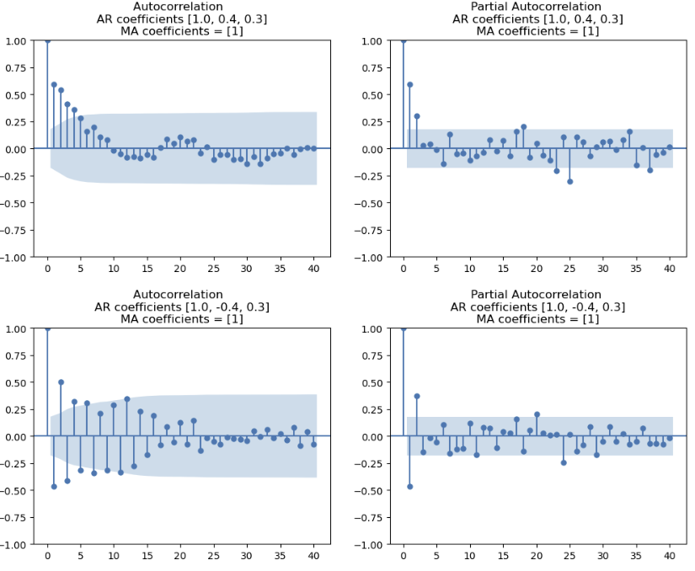
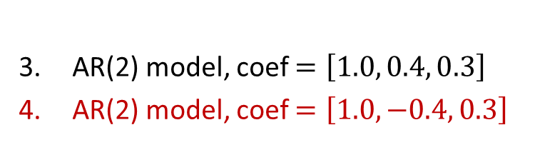
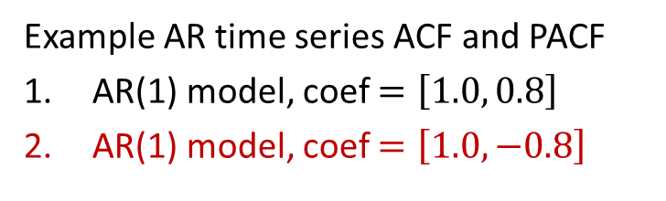
Example: Autoregressive Model
Example AR time series ACF and PACF
AR(1) model, coef $=\left[1.0, 0.8\right]$
AR(1) model, coef $=\left[1.0, −0.8\right]$
AR(2) model, coef $=\left[1.0, 0.4, 0.3\right]$
AR(2) model, coef $=\left[1.0, −0.4, 0.3\right]$

Slide 21
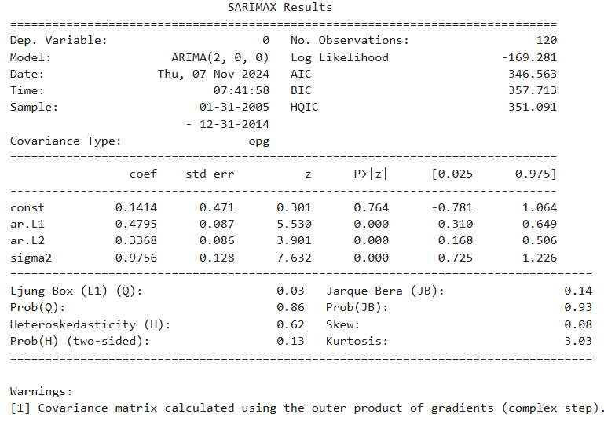
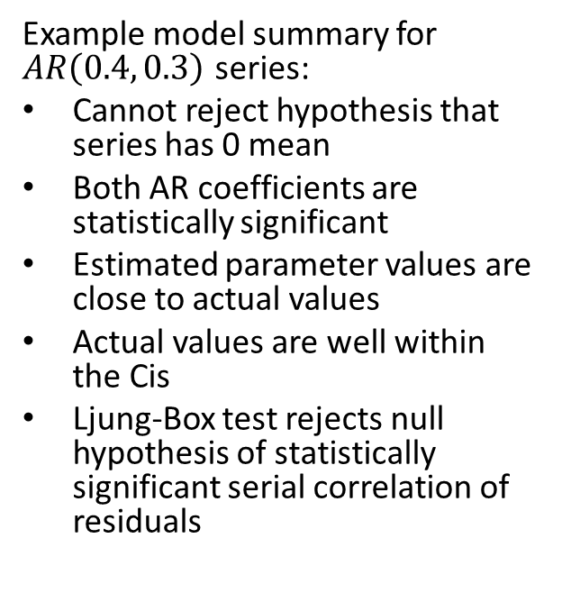
The Autoregressive Model
Example model summary for $AR\left(0.4, 0.3\right)$ series:
Cannot reject hypothesis that series has 0 mean
Both AR coefficients are statistically significant
Estimated parameter values are close to actual values
Actual values are well within the Cis
Ljung-Box test rejects null hypothesis of statistically significant serial correlation of residuals

Slide 22
Moving Average Model

Slide 23
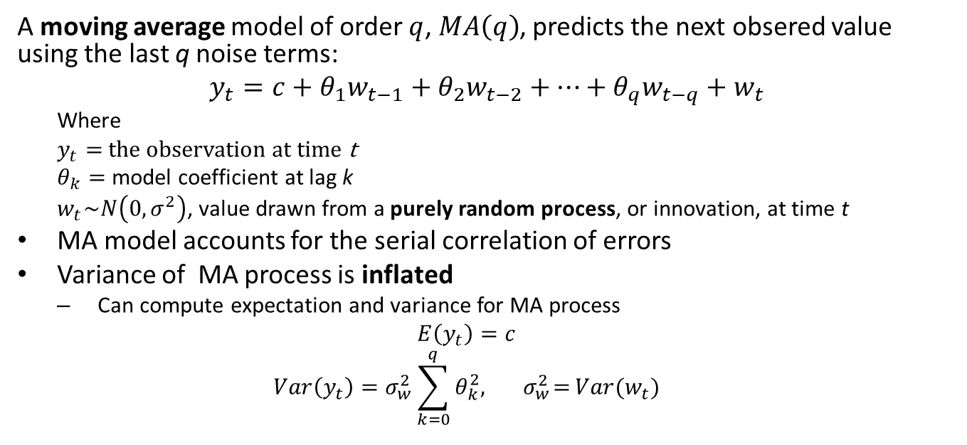
The Moving Average Model
A moving average model of order $q$, $MA\left(q\right)$, predicts the next obsered value using the last q noise terms:
$$y_{t}={c+θ}_{1}w_{t−1}+θ_{2}w_{t−2}+…+θ_{q}w_{t−q}+w_{t}$$
  Where
  $y_{t}=$ the observation at time t
  $θ_{k}=$ model coefficient at lag k
  $w_{t}\sim N\left(0,σ^{2}\right)$, value drawn from a purely random process, or innovation, at time t
MA model accounts for the serial correlation of errors
Variance of MA process is inflated
  Can compute expectation and variance for MA process
  $$E\left(y_{t}\right)=c$$
  $$Var\left(y_{t}\right)=σ_{w}^{2}\sum_{k=0}^{q}{θ_{k}^{2},{ σ}_{w}^{2}=}Var(w_{t})$$

Slide 24
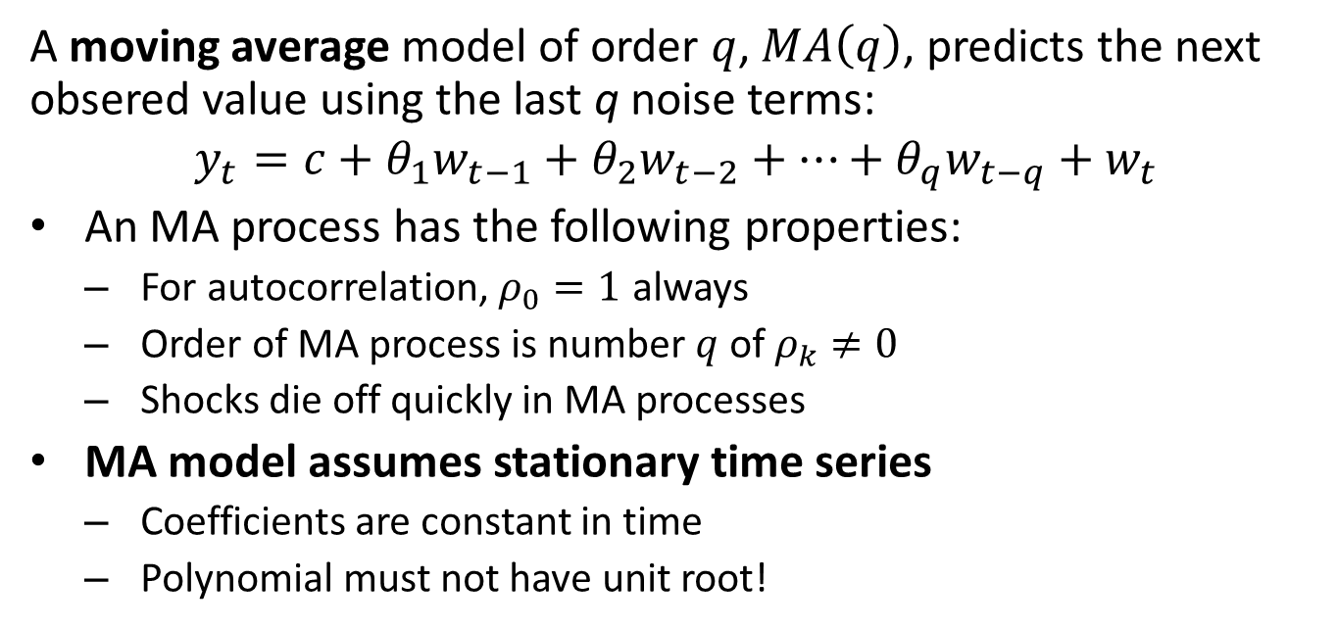
The Moving Average Model
A moving average model of order $q$, $MA\left(q\right)$, predicts the next obsered value using the last q noise terms:
$$y_{t}={c+θ}_{1}w_{t−1}+θ_{2}w_{t−2}+…+θ_{q}w_{t−q}+w_{t}$$
An MA process has the following properties:
  For autocorrelation, $ρ_{0}=1$ always
  Order of MA process is number $q$ of $ρ_{k}≠0$
  Shocks die off quickly in MA processes
MA model assumes stationary time series
  Coefficients are constant in time
  Polynomial must not have unit root!

Slide 25
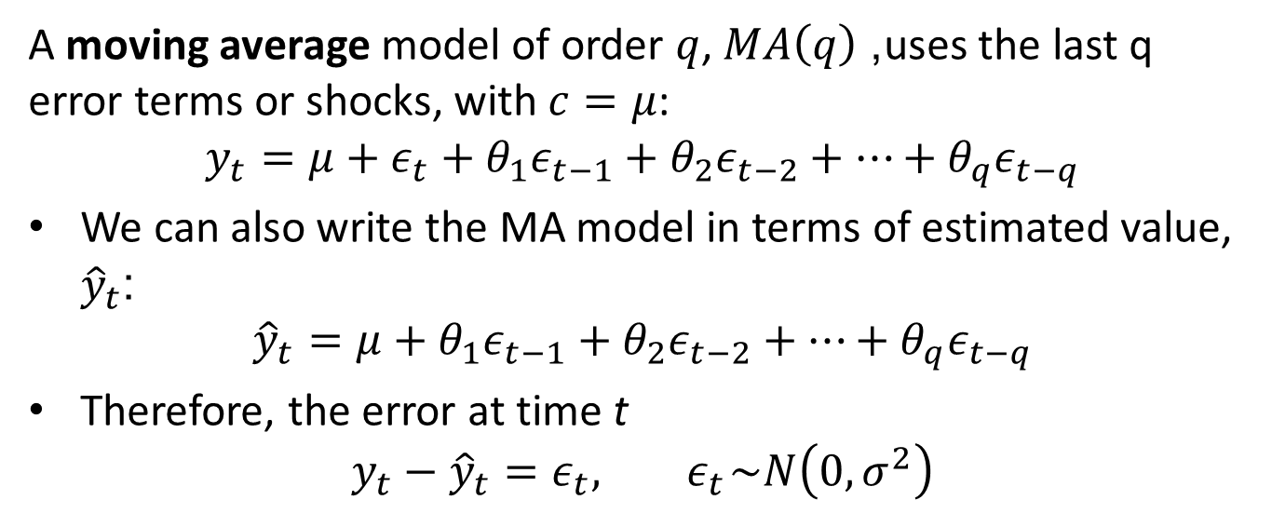
The Moving Average Model
A moving average model of order $q$, $MA\left(q\right)$, uses the last q error terms or shocks, with $c=μ$:
$$y_{t}=μ+ε_{t}+θ_{1}ε_{t−1}+θ_{2}ε_{t−2}+⋯+θ_{q}ε_{t−q}$$
We can also write the MA model in terms of estimated value, ${\hat{y}}_{t}$:
$${\hat{y}}_{t}=μ+θ_{1}ε_{t−1}+θ_{2}ε_{t−2}+⋯+θ_{q}ε_{t−q}$$
Therefore, the error at time t
$$y_{t}−{\hat{y}}_{t}=ε_{t},{ ε}_{t}\sim N\left(0,σ^{2}\right)$$

Slide 26
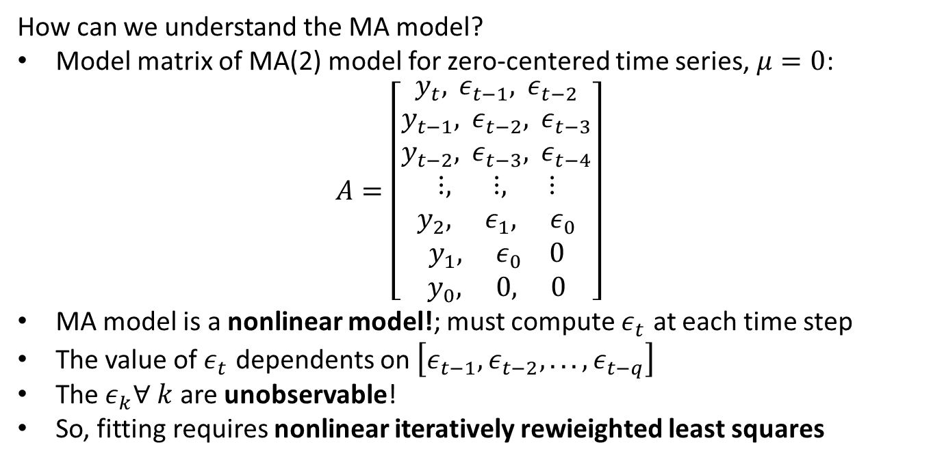
The Moving Average Model
How can we understand the MA model?
Model matrix of MA(2) model for zero-centered time series, $μ=0$:
$$A=\left[\begin{matrix}y_{t}, ε_{t−1}, ε_{t−2} \\ y_{t−1}, ε_{t−2}, ε_{t−3} \\ y_{t−2}, ε_{t−3}, ε_{t−4} \\ ⋮, ⋮, ⋮ \\ y_{2}, ε_{1}, ε_{0} \\ y_{1}, ε_{0} 0 \\ y_{0}, 0, 0\end{matrix}\right]$$
MA model is a nonlinear model!; must compute $ε_{t}$ at each time step
The value of $ε_{t}$ dependents on $\left[ε_{t−1},ε_{t−2},...,ε_{t−q}\right]$
The $ε_{k}∀ k$ are unobservable!
So, fitting requires nonlinear iteratively rewieighted least squares

Slide 27
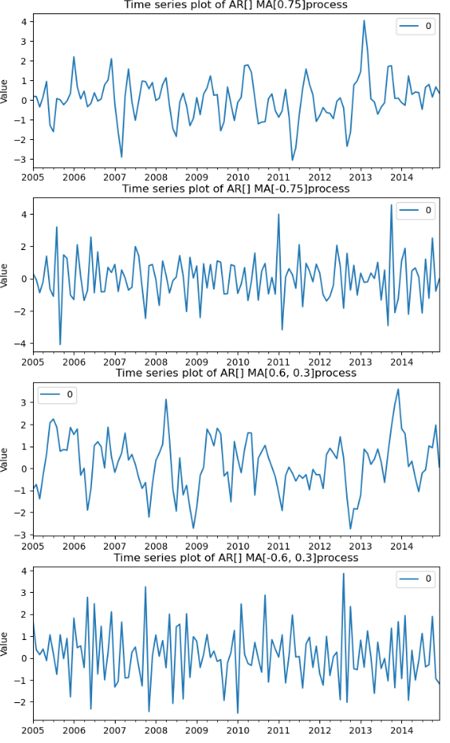
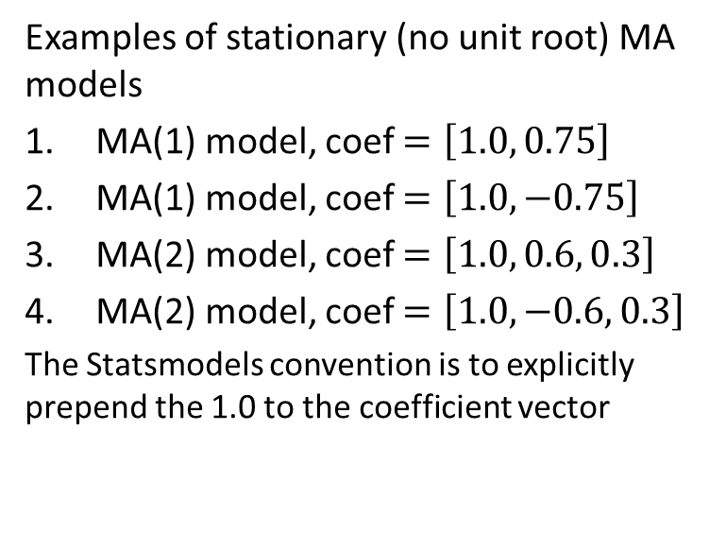
Example: Moving Average Model
Examples of stationary (no unit root) MA models
MA(1) model, coef $=\left[1.0, 0.75\right]$
MA(1) model, coef $=\left[1.0, −0.75\right]$
MA(2) model, coef $=\left[1.0, 0.6, 0.3\right]$
MA(2) model, coef $=\left[1.0, −0.6, 0.3\right]$
The Statsmodels convention is to explicitly prepend the 1.0 to the coefficient vector

Slide 28
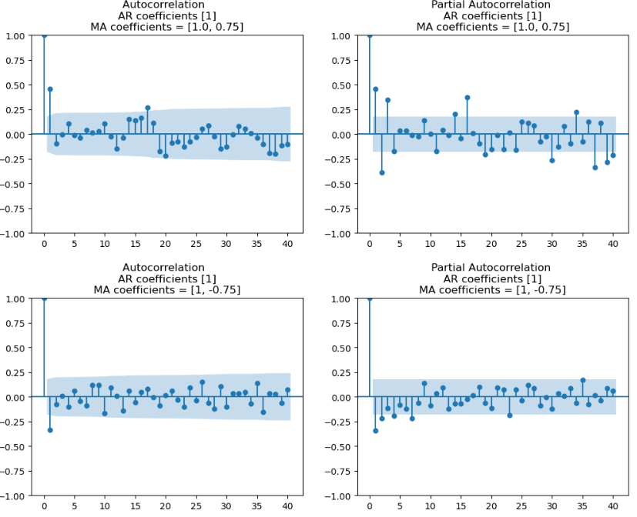
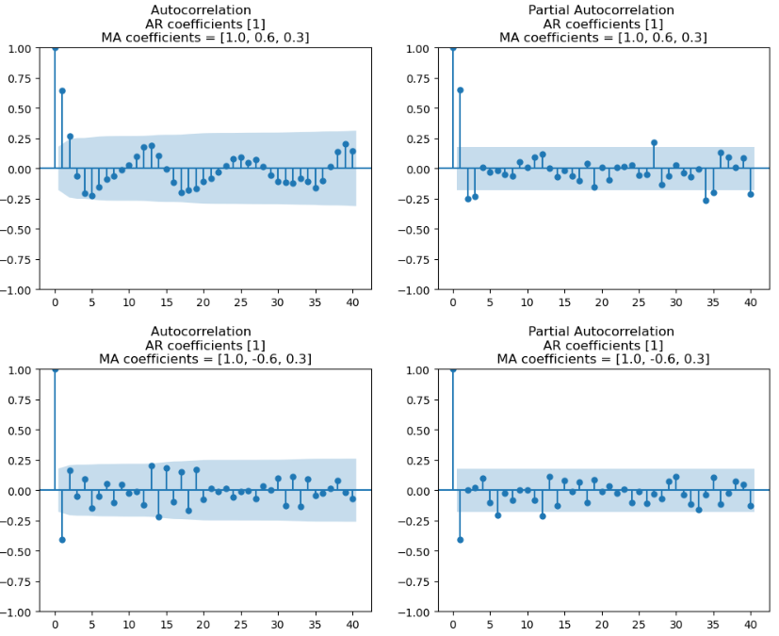
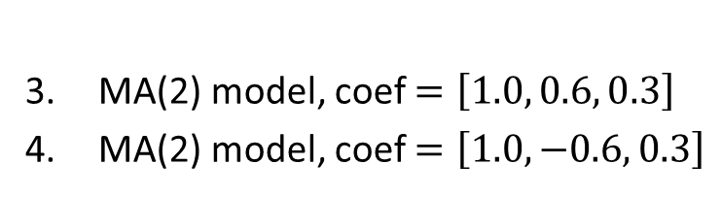
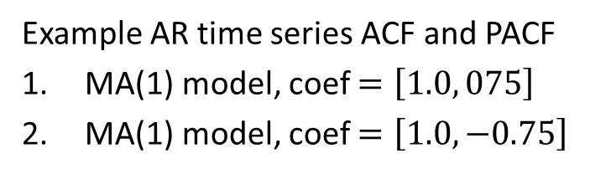
Example: Moving Average Model
Example AR time series ACF and PACF
MA(1) model, coef $=\left[1.0, 075\right]$
MA(1) model, coef $=\left[1.0, −0.75\right]$
MA(2) model, coef $=\left[1.0, 0.6, 0.3\right]$
MA(2) model, coef $=\left[1.0, −0.6, 0.3\right]$

Slide 29
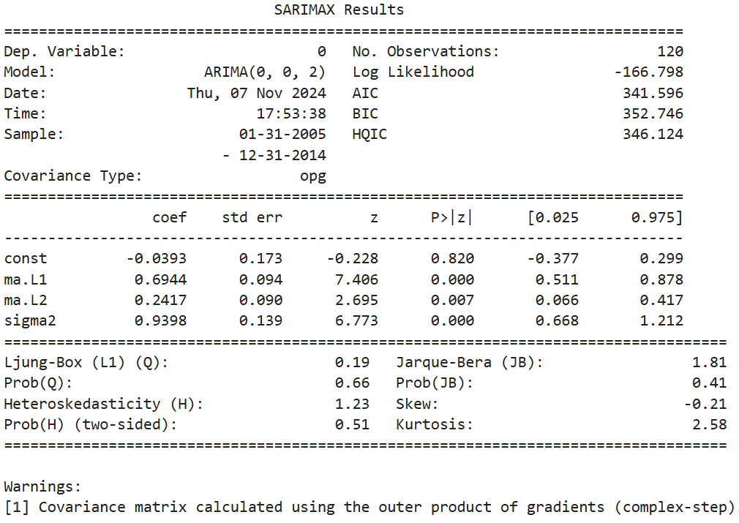
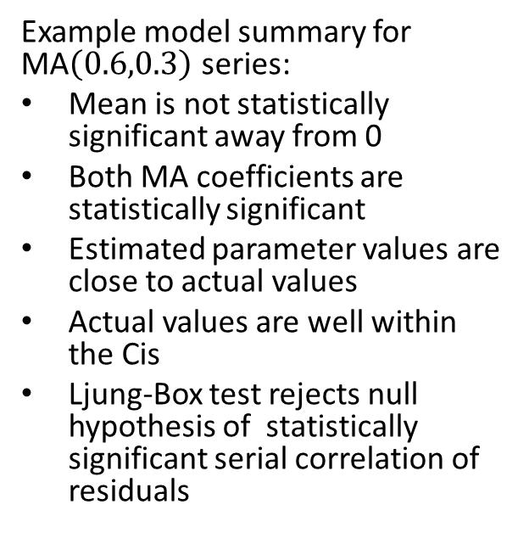
Example: Moving Average Model
Example model summary for MA$\left(0.6,0.3\right)$ series:
Mean is not statistically significant away from 0
Both MA coefficients are statistically significant
Estimated parameter values are close to actual values
Actual values are well within the Cis
Ljung-Box test rejects null hypothesis of statistically significant serial correlation of residuals

Slide 30
Autoregressive Moving Average and ARIMA Models

Slide 31
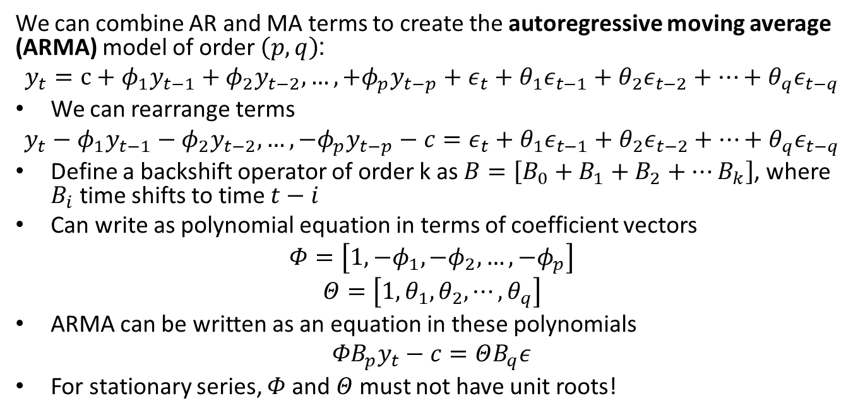
Autoregressive Moving Average Model
We can combine AR and MA terms to create the autoregressive moving average (ARMA) model of order $\left(p,q\right)$:
$$y_{t}=c+φ_{1}y_{t−1}+φ_{2}y_{t−2},…,+φ_{p}y_{t−p}+ε_{t}+θ_{1}ε_{t−1}+θ_{2}ε_{t−2}+⋯+θ_{q}ε_{t−q}$$
We can rearrange terms
$$y_{t}−φ_{1}y_{t−1}−φ_{2}y_{t−2},…,−φ_{p}y_{t−p}−c=ε_{t}+θ_{1}ε_{t−1}+θ_{2}ε_{t−2}+⋯+θ_{q}ε_{t−q}$$
Define a backshift operator of order k as $B=\left[{B_{0}+B}_{1}+B_{2}+…B_{k}\right]$, where $B_{i}$ time shifts to time $t−i$
Can write as polynomial equation in terms of coefficient vectors
$$Φ=\left[1,{−φ}_{1},−φ_{2},…,{−φ}_{p}\right]$$
$$Θ=\left[1,θ_{1},θ_{2},⋯,θ_{q}\right]$$
ARMA can be written as an equation in these polynomials
$${{ΦB}_{p}y}_{t}−c=ΘB_{q}ε$$
For stationary series, $Φ$ and $Θ$ must not have unit roots!

Slide 32
The ARIMA Model
An integrative term addresses some non-stationary components of a time series
Random walks
Trends
Based on difference operator
  Typically, first order seasonal and non-seasonal differences
  Is deterministic, no model coefficient to estimate

Slide 33
The ARIMA Model
The autoregressive integrative moving average (ARIMA) model includes AR, integrative and MA terms
The order of an ARIMA is specified as (p,d,q)
  p is the AR order
  d is the order of differencing
  q is the MA order
The integrative term transforms time series with trend and random walks to stationarity
First order differencing does not account for seasonal effect

Slide 34
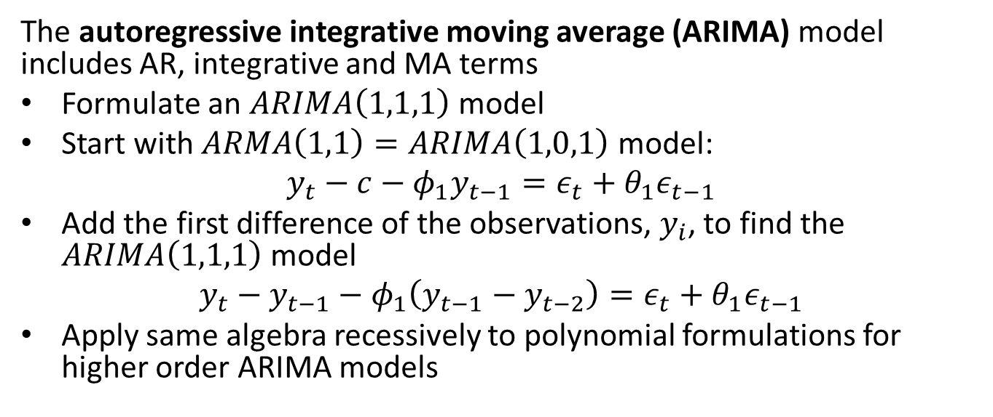
The ARIMA Model
The autoregressive integrative moving average (ARIMA) model includes AR, integrative and MA terms
Formulate an $ARIMA\left(1,1,1\right)$ model
Start with $ARMA\left(1,1\right)=ARIMA\left(1,0,1\right)$ model:
$$y_{t}−c−φ_{1}y_{t−1}=ε_{t}+θ_{1}ε_{t−1}$$
Add the first difference of the observations, $y_{i}$, to find the $ARIMA\left(1,1,1\right)$ model
$$y_{t}−y_{t−1}−φ_{1}\left(y_{t−1}−y_{t−2}\right)=ε_{t}+θ_{1}ε_{t−1}$$
Apply same algebra recessively to polynomial formulations for higher order ARIMA models

Slide 35
Seasonal Models

Slide 36
Seasonal Models
Several possible seasonal models
Seasonal effects can be periodic or single event (e.g. holiday, game day, etc.)
Linear regression model to find effect for each time step in period
STL decomposition
Fourier decomposition
  Accommodates multiple periods of seasonality
  Used by PROFIT model, Statsmodels and others
SARIMAX, the S term, requires:
  Known period of the cycle or time of seasonal event
  Additive or logarithmic transformation (multiplicative)

Slide 37
SARIMA Model
The SARIMA model adds seasonal and exogenous terms
Order of multiplicative SARIMA model is specified as (p,d,q)(P,D,Q,S)
ARIMA terms are same, (p,d,q)
Seasonal terms:
  Seasonal ARIMA model, order (P,D,Q,S)
  Must specify period, S, seasonal difference order, D
  P is seasonal AR order
  Q is seasonal MA order
See Statsmodels State Space User Guide for more details and examples

Slide 38
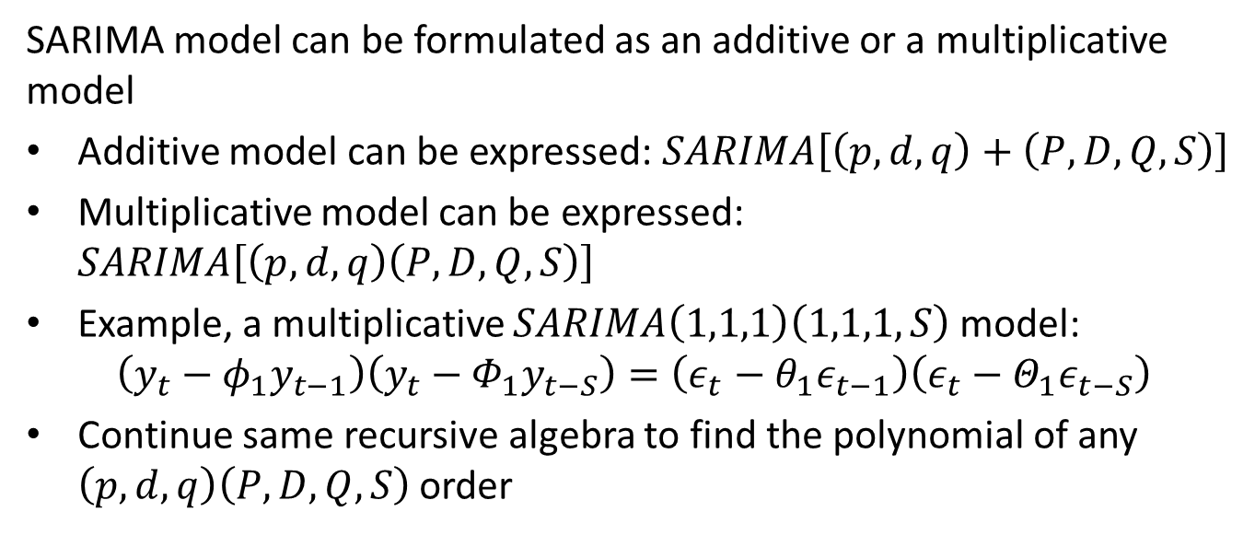
SARIMA Model
SARIMA model can be formulated as an additive or a multiplicative model
Additive model can be expressed: $SARIMA\left[\left(p,d,q\right)+\left(P,D,Q,S\right)\right]$
Multiplicative model can be expressed: $SARIMA\left[\left(p,d,q\right)\left(P,D,Q,S\right)\right]$
Example, a multiplicative $SARIMA\left(1,1,1\right)\left(1,1,1,S\right)$ model:
$$\left(y_{t}−φ_{1}y_{t−1}\right)\left(y_{t}−Φ_{1}y_{t−S}\right)=\left(ε_{t}−θ_{1}ε_{t−1}\right)\left(ε_{t}−Θ_{1}ε_{t−S}\right)$$
Continue same recursive algebra to find the polynomial of any $\left(p,d,q\right)\left(P,D,Q,S\right)$ order

Slide 39
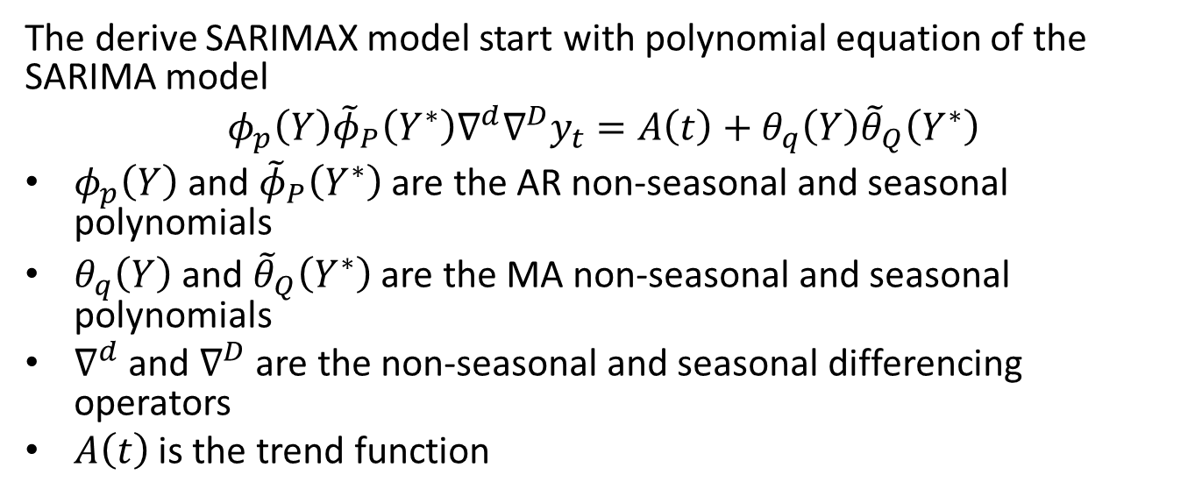
SARIMAX Model
The derive SARIMAX model start with polynomial equation of the SARIMA model
$$φ_{p}\left(Y\right){\tilde{φ}}_{P}\left(Y^{∗}\right)∇^{d}∇^{D}y_{t}=A\left(t\right)+θ_{q}\left(Y\right){\tilde{θ}}_{Q}\left(Y^{∗}\right)$$
$φ_{p}\left(Y\right)$ and ${\tilde{φ}}_{P}\left(Y^{∗}\right)$ are the AR non-seasonal and seasonal polynomials
$θ_{q}\left(Y\right)$ and ${\tilde{θ}}_{Q}\left(Y^{∗}\right)$ are the MA non-seasonal and seasonal polynomials
$∇^{d}$ and $∇^{D}$ are the non-seasonal and seasonal differencing operators
$A\left(t\right)$ is the trend function

Slide 40
Seasonal Model with Exogenous Variables

Slide 41
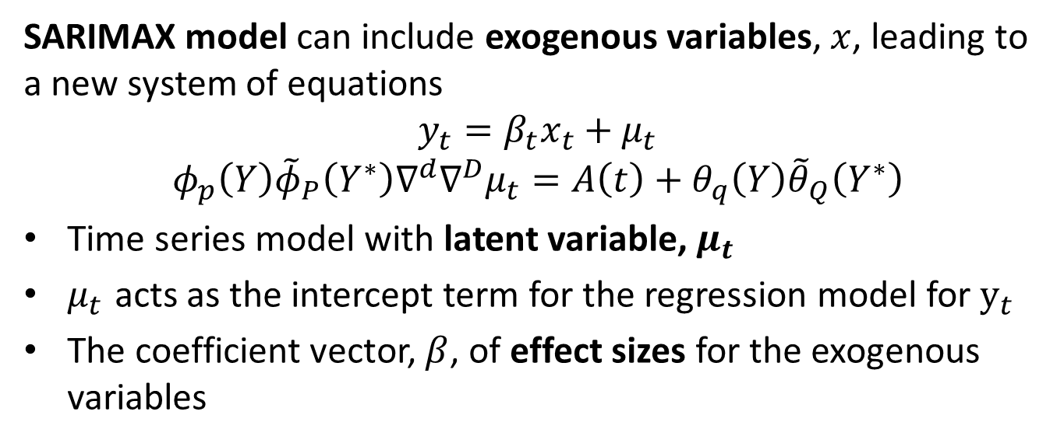
SARIMAX Model
SARIMAX model can include exogenous variables, $x$, leading to a new system of equations
$$y_{t}=β_{t}x_{t}+μ_{t}$$
$$φ_{p}\left(Y\right){\tilde{φ}}_{P}\left(Y^{∗}\right)∇^{d}∇^{D}μ_{t}=A\left(t\right)+θ_{q}\left(Y\right){\tilde{θ}}_{Q}\left(Y^{∗}\right)$$
Time series model with latent variable, $μ_{t}$
$μ_{t}$ acts as the intercept term for the regression model for $y_{t}$
The coefficient vector, $β$, of effect sizes for the exogenous variables

Slide 42
Forecasting with ARIMA

Slide 43
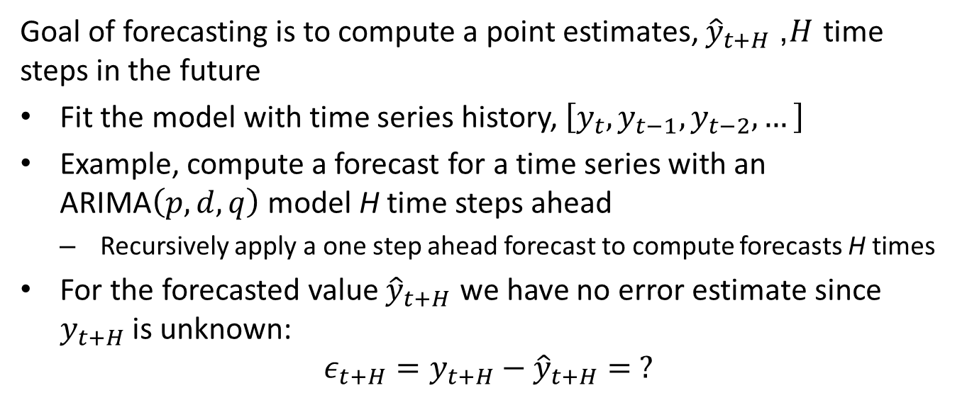
Forecasting with the ARIMA model
Goal of forecasting is to compute a point estimates, ${\hat{y}}_{t+H}$, $H$ time steps in the future
Fit the model with time series history, $\left[y_{t},y_{t−1},y_{t−2},…\right]$
Example, compute a forecast for a time series with an ARIMA$\left(p,d,q\right)$ model H time steps ahead
  Recursively apply a one step ahead forecast to compute forecasts H times
For the forecasted value ${\hat{y}}_{t+H}$ we have no error estimate since $y_{t+H}$is unknown:
$$ε_{t+H}=y_{t+H}−{\hat{y}}_{t+H}= ?$$

Slide 44
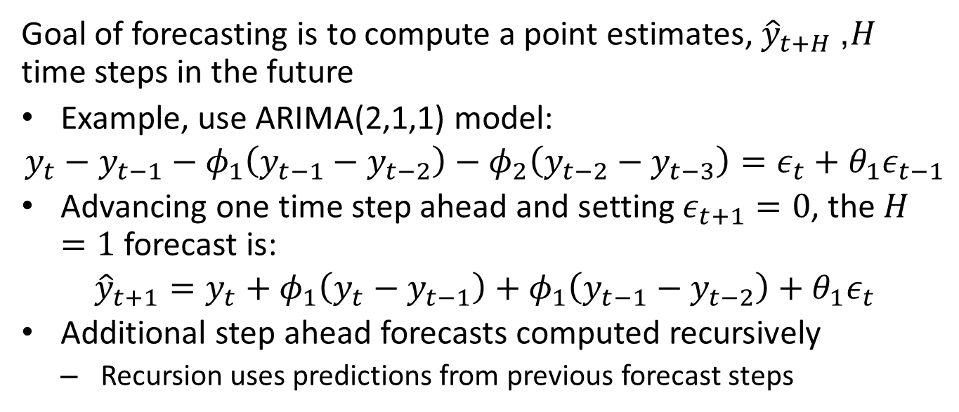
Forecasting with the ARIMA model
Goal of forecasting is to compute a point estimates, ${\hat{y}}_{t+H}$, $H$ time steps in the future
Example, use ARIMA(2,1,1) model:
$$y_{t}−y_{t−1}−φ_{1}\left(y_{t−1}−y_{t−2}\right)−φ_{2}\left(y_{t−2}−y_{t−3}\right)=ε_{t}+θ_{1}ε_{t−1}$$
Advancing one time step ahead and setting $ε_{t+1}=0$, the $H=1$ forecast is:
$${\hat{y}}_{t+1}=y_{t}+φ_{1}\left(y_{t}−y_{t−1}\right)+φ_{1}\left(y_{t−1}−y_{t−2}\right)+θ_{1}ε_{t}$$
Additional step ahead forecasts computed recursively
  Recursion uses predictions from previous forecast steps

Slide 45
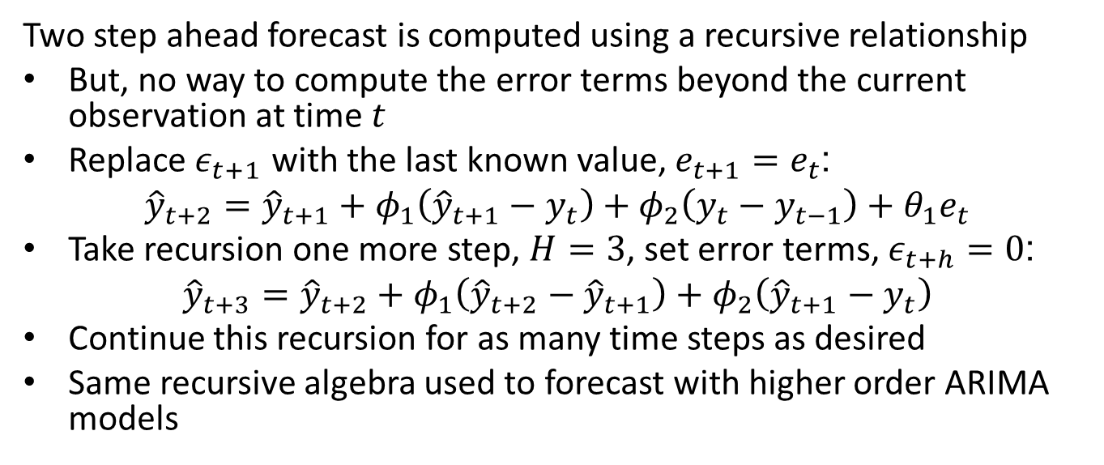
Forecasting with the ARIMA model
Two step ahead forecast is computed using a recursive relationship
But, no way to compute the error terms beyond the current observation at time $t$
Replace $ε_{t+1}$ with the last known value, $e_{t+1}=e_{t}$:
$${\hat{y}}_{t+2}={\hat{y}}_{t+1}+φ_{1}\left({\hat{y}}_{t+1}−y_{t}\right)+φ_{2}\left(y_{t}−y_{t−1}\right)+θ_{1}e_{t}$$
Take recursion one more step, $H=3$, set error terms, $ε_{t+h}=0$:
$${\hat{y}}_{t+3}={\hat{y}}_{t+2}+φ_{1}\left({\hat{y}}_{t+2}−{\hat{y}}_{t+1}\right)+φ_{2}\left({\hat{y}}_{t+1}−y_{t}\right)$$
Continue this recursion for as many time steps as desired
Same recursive algebra used to forecast with higher order ARIMA models

Slide 46
Evaluating and Comparing Time Series Models

Slide 47
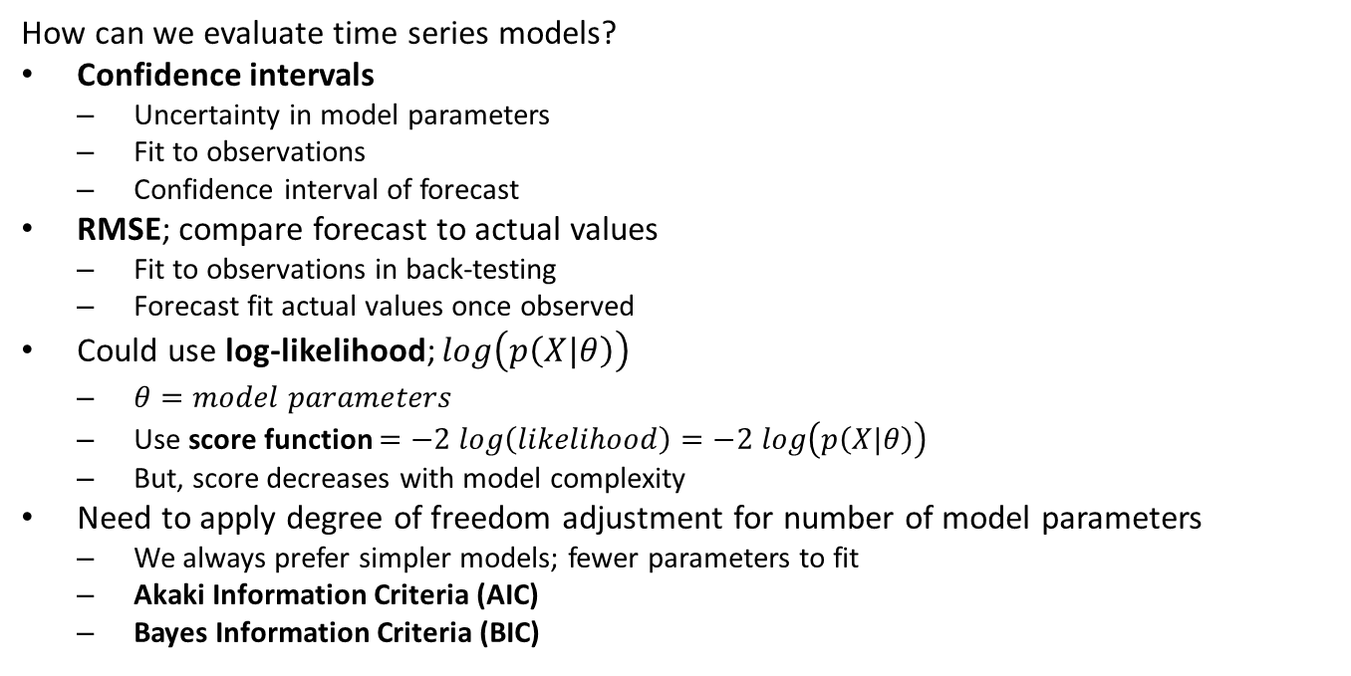
Evaluating and Comparing Time Series Models
How can we evaluate time series models?
Confidence intervals
  Uncertainty in model parameters
  Fit to observations
  Confidence interval of forecast
RMSE; compare forecast to actual values
  Fit to observations in back-testing
  Forecast fit actual values once observed
Could use log-likelihood; $log\left(p\left(X|θ\right)\right)$
  $θ=model parameters$
  Use score function $=−2 log\left(likelihood\right)=−2 log\left(p\left(X|θ\right)\right)$
  But, score decreases with model complexity
Need to apply degree of freedom adjustment for number of model parameters
  We always prefer simpler models; fewer parameters to fit
  Akaki Information Criteria (AIC)
  Bayes Information Criteria (BIC)

Slide 48
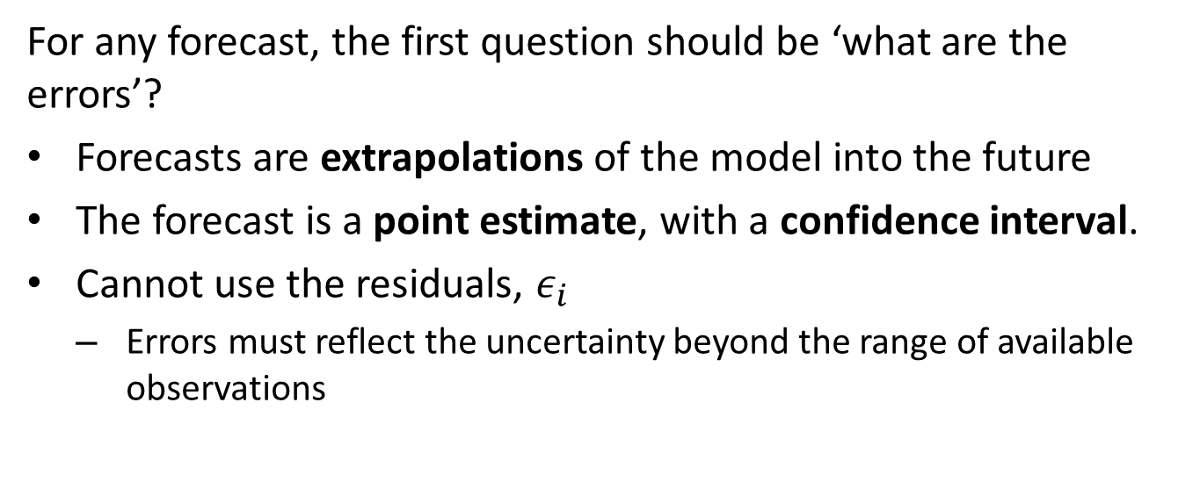
Forecast Confidence Intervals
For any forecast, the first question should be ‘what are the errors’?
Forecasts are extrapolations of the model into the future
The forecast is a point estimate, with a confidence interval.
Cannot use the residuals, $ε_{i}$
  Errors must reflect the uncertainty beyond the range of available observations

Slide 49
Forecast Confidence Intervals
Several methods commonly used to compute confidence intervals:
Theoretical sampling distribution:
  Compute confidence intervals from a theoretical sampling distribution
  Deriving a suitable distribution can be difficult, assume Normal distribution
  Actual sampling distribution is invariably different
Bootstrap resampling:
  Use bootstrap resampling to compute a non-parametric sampling distribution
  Bootstrap resampling of time series requires block resampling methods
  Confidence intervals are computed from emperical sampling distribution
Back-testing:
  Time series model is trained on a portion of the data
  Forecasts are made several time steps ahead, and errors calculated based on held-back observations
  The training and forecast windows are moved n steps forward
  Sampling distribution and the confidence intervals are computed
  Compute RMSE, MAE, etc. from the back test

Slide 50
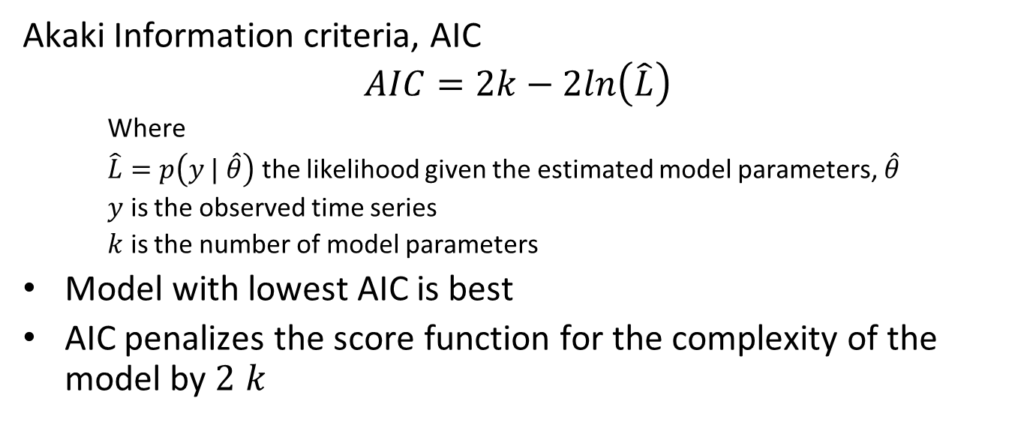
Evaluating and Comparing Time Series Models
Akaki Information criteria, AIC
$$AIC=2k−2ln\left(\hat{L}\right)$$
    Where
    $\hat{L}=p\left(y | \hat{θ}\right)$ the likelihood given the estimated model parameters, $\hat{θ}$
    $y$ is the observed time series
    $k$ is the number of model parameters
Model with lowest AIC is best
AIC penalizes the score function for the complexity of the model by $2 k$

Slide 51
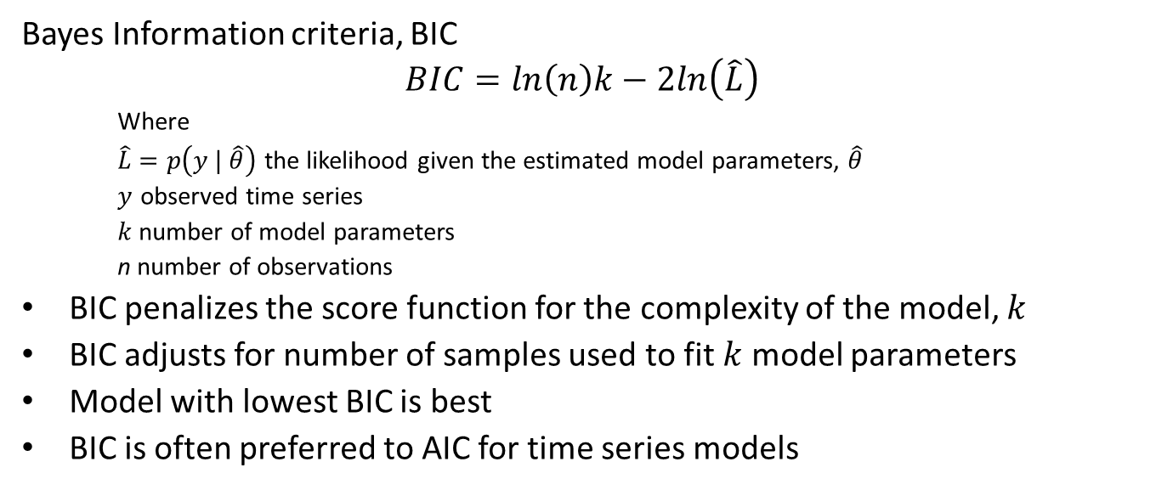
Evaluating and Comparing Time Series Models
Bayes Information criteria, BIC
$$BIC=ln\left(n\right)k−2ln\left(\hat{L}\right)$$
    Where
    $\hat{L}=p\left(y | \hat{θ}\right)$ the likelihood given the estimated model parameters, $\hat{θ}$
    $y$ observed time series
    $k$ number of model parameters
    n number of observations
BIC penalizes the score function for the complexity of the model, $k$
BIC adjusts for number of samples used to fit $k$ model parameters
Model with lowest BIC is best
BIC is often preferred to AIC for time series models

Slide 52
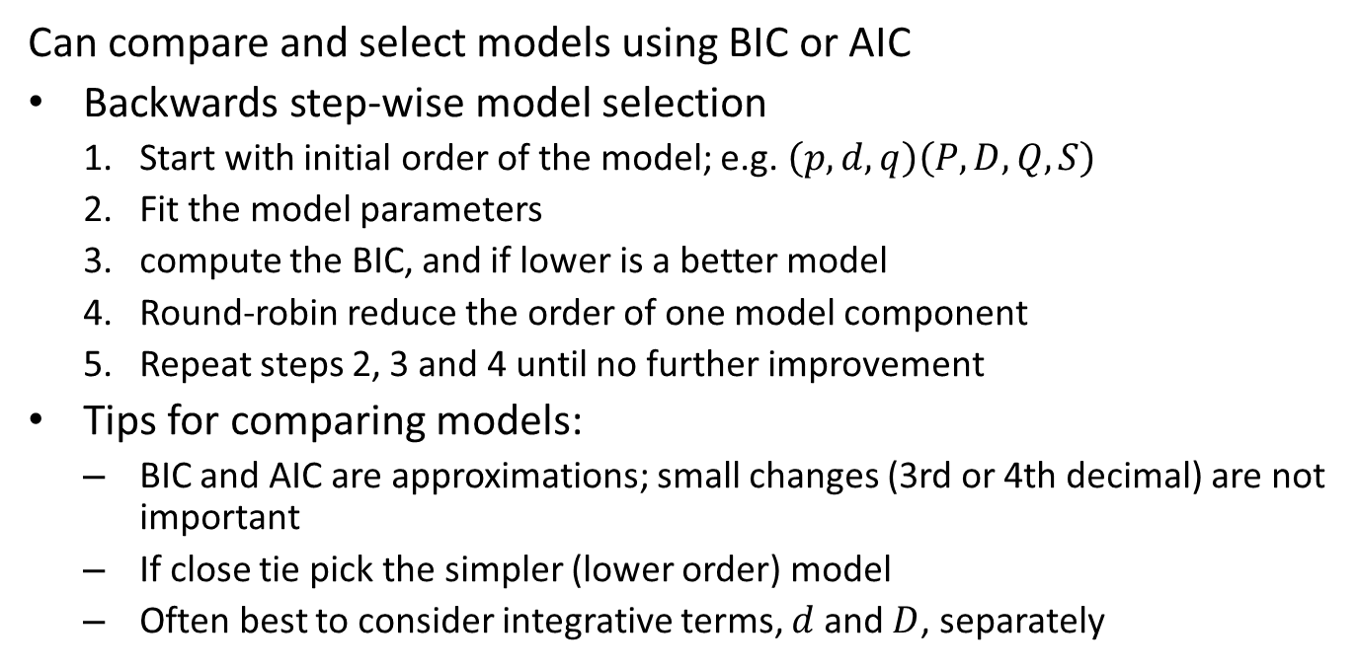
Evaluating and Comparing Time Series Models
Can compare and select models using BIC or AIC
Backwards step-wise model selection
  Start with initial order of the model; e.g. $\left(p,d,q\right)\left(P,D,Q,S\right)$
  Fit the model parameters
  compute the BIC, and if lower is a better model
  Round-robin reduce the order of one model component
  Repeat steps 2, 3 and 4 until no further improvement
Tips for comparing models:
  BIC and AIC are approximations; small changes (3rd or 4th decimal) are not important
  If close tie pick the simpler (lower order) model
  Often best to consider integrative terms, $d$ and $D$, separately

Slide 53
SARIMA Example

Slide 54
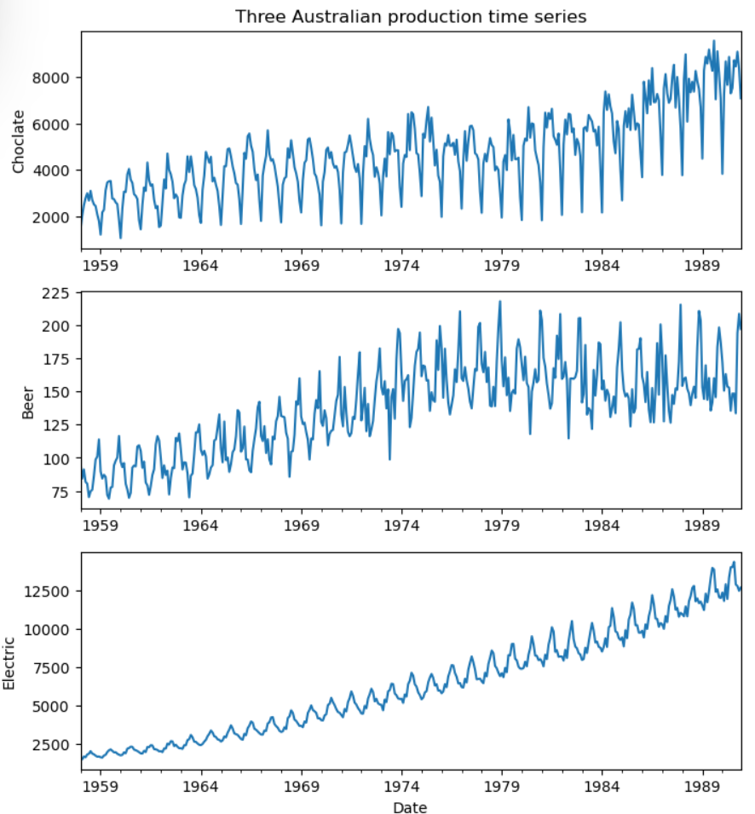
SARIMA Example
Forecasting example dataset
Three time series from Australia
  Chocolate production
  Beer production
  Electricity production
Series have nonlinear trend component
Notice increase in seasonal variation with trend of series

Slide 55
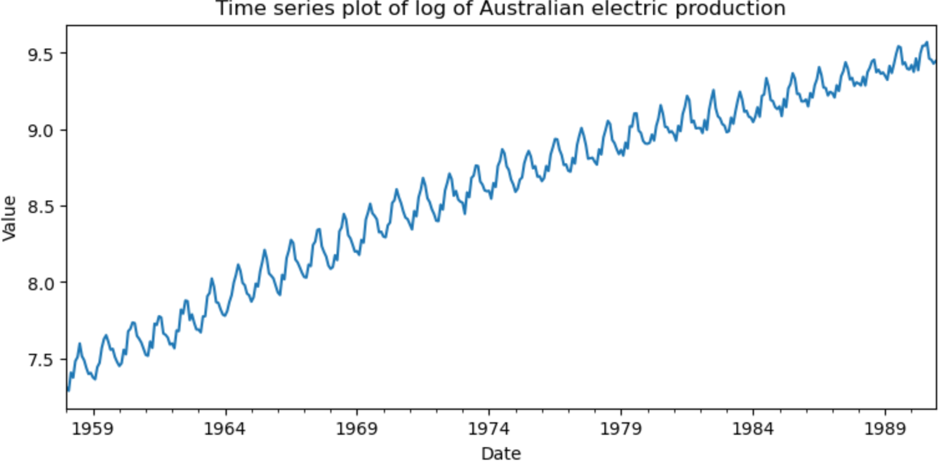
SARIMA Example
Log transform to multiplicative model
Account for seasonal dependency on trend
After log transformation seasonal variation is near constant

Slide 56
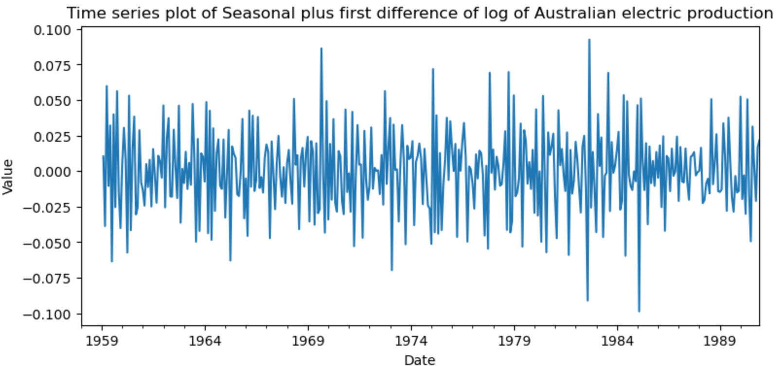
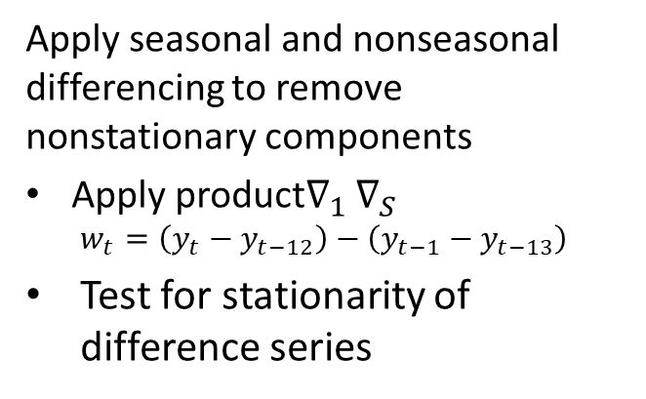
SARIMA Example
Apply seasonal and nonseasonal differencing to remove nonstationary components
Apply product$∇_{1}$ $∇_{S}$
  $$w_{t}=\left(y_{t}−y_{t−12}\right)−\left(y_{t−1}−y_{t−13}\right)$$
Test for stationarity of difference series

Slide 57
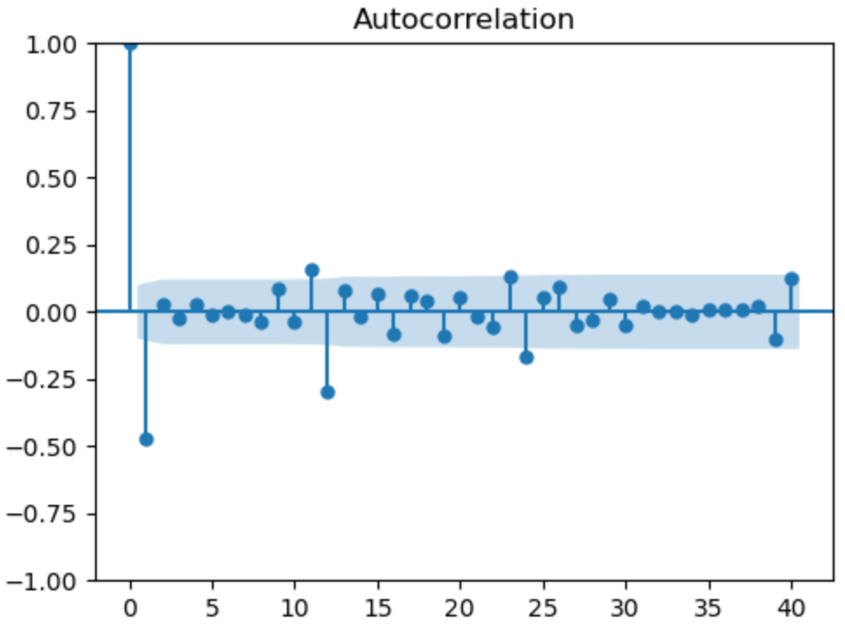
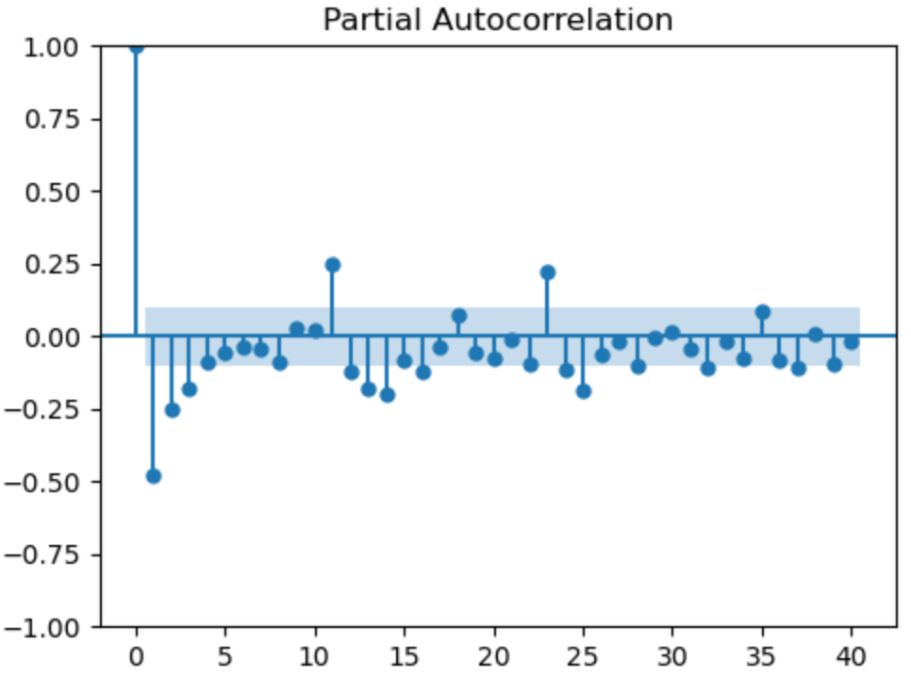
SARIMA Example
Verify the statistical properties of the difference series
ACF and PACF show serial correlation
Nonseasonal dependency
Seasonal dependency

Slide 58
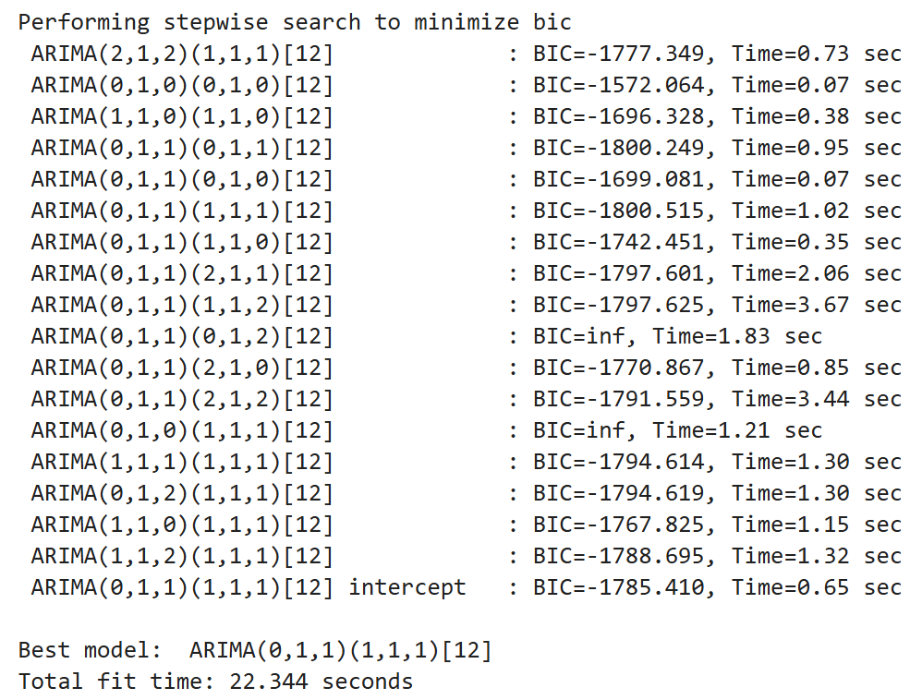

SARIMA Example
Stepwise hyperparameter search for SARIMA parameters by minimum BIC
Based on EDA, fix $d=1, D=1$
Lowest BIC model
$$\left(p,d,q\right)\left(P,D,Q\right)=\left(0,1,1\right)\left(1,1,1\right)$$
BIC is nearly identical for simpler model
$$\left(p,d,q\right)\left(P,D,Q\right)=\left(0,1,1\right)\left(0,1,1\right)$$
We choose the more parsimonious (simpler) model

Slide 59


SARIMA Example
Fit the parsimonious model
$$\left(p,d,q\right)\left(P,D,Q\right)=\left(0,1,1\right)\left(1,1,0\right)$$
Coefficients are all significant
Small standard error and CIs
Ljung-Box test regects null hypothesis of significant serial correlation
Overall, a good model fit!

Slide 60

SARIMA Example
Examine the fit of the prediction
Last 12 months of observations have been held back from training
Compare 12-month forecasts to the held-back observations
Fit looks good
Notice confidence interval increases with forecast time steps

Slide 61

SARIMA Example
Examine the residuals of the forecasts
Residuals are approximately Normally distributed
Residuals have no statistically significant ACF for lag > 0
Residuals have no statistically significant PACF for lag > 0
Short test period, with small number of samples, 12

Slide 62
Future Directions and Summary

Slide 63
Future Directions For Forecasting Models
There is an ongoing explosion of research in forecasting models
As of now, there is little evidence that deep NN models outperform properly applied conventional models
  Are Transformers Effective for Time Series Forecasting?, Zeng, et. al., 2022
  Are LLMs Actually Useful for Forecasting?, Tan, et. al., 2024
  A comparative assessment of SARIMA, LSTM RNN and Fb Prophet models forecast total and peak monthly energy demand for India, Chaturvedi, et.al., 2022
There are a number of promising research directions including,
  N-HiTS: Neural Hierarchical Interpolation for Time Series Forecasting, Challu, et.al. 2020
  N-BEATS: Neural basis expansion analysis for interpretable time series forecasting, Oreshkin, et. al., 2020

Slide 64
Summary
Time series models must account for serial correlation
e.g. ARIMA and SARIMAX
AR components for serial correlation of values
MA components for serial correlation of errors
Integrative components for random walk and trend, I
Seasonal, (P,D,Q,S)
Exogenous variables, X

Slide 65
Summary
Evaluation and model comparison
RMSE
AIC and BIC, penalize score function for model complexity
Use BIC (or AIC) to perform backwards step-wise model selection

