Slide 1

Models for Messy Data
Steve Elston
Copyright 2018, 2019, 2020, 2021, 2022, 2023 2024, 2025, Stephen F Elston. All rights reserved.

Slide 2
Welcome to the Second Half of CSCI E-83!
Plan going forward:
Week 8, Oct 23: Statistical Properties of Time Series
Week 9, Oct 30: Introduction to Time Series Models
Week 10, Nov 6: Introduction to Bayes Models
Week 11, Nov 13: MCMC for Bayes
Week 12, Nov 20: Hierarchical Bayesian models
Nov 24: Project proposals due
Nov 27: No class, Thanksgiving holiday
Week 13, Dec 4: Modern Time Series Models or TBD
Dec 19: Submit Graduate Independent Projects – No extension possible!
Let me know if you have suggestions to update this schedule

Slide 3
Introduction
Several commonly encountered data problems affect models used for inference
Zero inflated response variables have an unusual number of zero values
  Use a mixture model to switch between a binomial and another distribution
Over-dispersed response variables have a long tails
  Can be asymmetric with long tails
  Use heavy tailed distribution models
  Apply models with mixtures of distributions to account for large low probability responses
Outliers in independent variables have an undue influence on OLS and GLM models
  Robust regression models limit the influence of outliers on parameter estimates
Missing data are common in many types of data
  Imputation methods must preserve distributions to be valid for influence
We can extend the OLS and GLM frameworks to deal with these situations

Slide 4
Models for Zero-Inflated Response

Slide 5
Zero-Inflated Responses
Zero-inflated response variables arise in many situations
Most people who view an ecommerce site buy 0 products
Most auto drivers have no crashes per year
Most dental patients examined require 0 root canals
In much of the world the average rainfall measured on a specific day is 0
The number of sever weather events in a specific area per month is typically 0
In epidemiology the probability distribution of the of people contracting a disease per day in a geographic area is often 0
Etc.

Slide 6
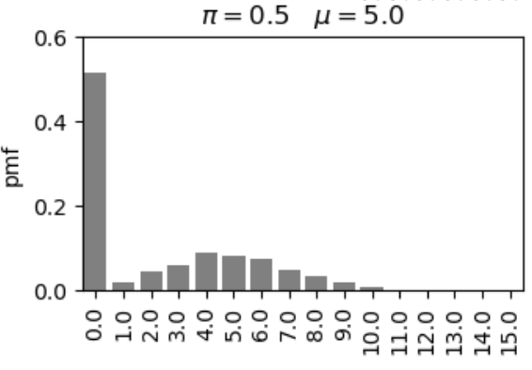
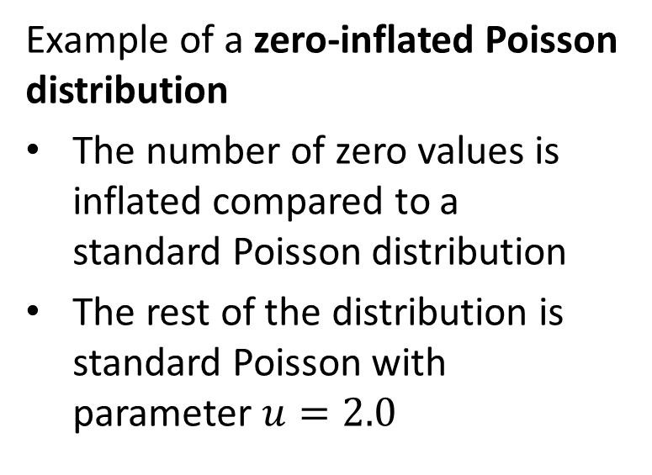
Zero-Inflated Responses
Example of a zero-inflated Poisson distribution
The number of zero values is inflated compared to a standard Poisson distribution
The rest of the distribution is standard Poisson with parameter $u=2.0$

Slide 7
Modeling Zero-Inflated Distributions
How can we model zero inflated distributions?
Standard ‘named’ distributions do not account for zero-inflation
Can use a mixture of two distributions
  A binomial distribution, or switching distribution
  A standard distribution
The binomial distribution serves as a ‘switch’ between 0 response and the other distribution

Slide 8
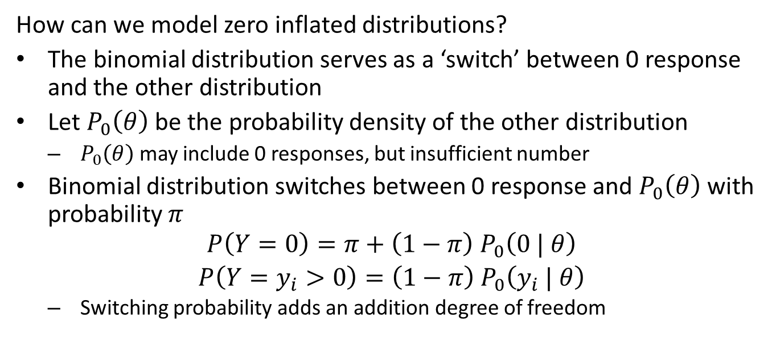
Modeling Zero-Inflated Distributions
How can we model zero inflated distributions?
The binomial distribution serves as a ‘switch’ between 0 response and the other distribution
Let $P_{0}\left(θ\right)$ be the probability density of the other distribution
  $P_{0}\left(θ\right)$ may include 0 responses, but insufficient number
Binomial distribution switches between 0 response and $P_{0}\left(θ\right)$ with probability $π$
$$\begin{matrix}P\left(Y=0\right)=π+\left(1−π\right){ P}_{0}\left(0 | θ\right) \\ P\left(Y=y_{i}>0\right)=\left(1−π\right){ P}_{0}\left(y_{i} | θ\right)\end{matrix}$$
  Switching probability adds an addition degree of freedom

Slide 9
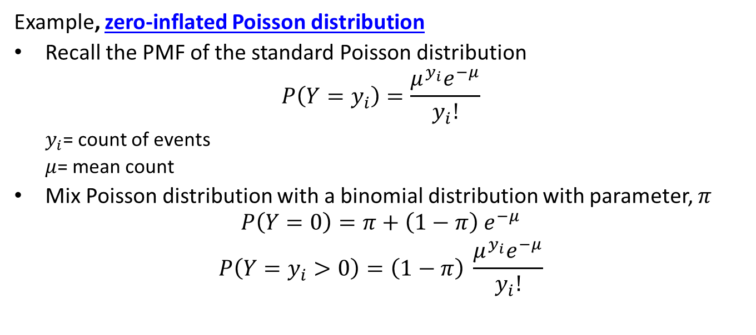
Zero-Inflated Poisson Distribution
Example, zero-inflated Poisson distribution
Recall the PMF of the standard Poisson distribution
$$P\left(Y=y_{i}\right)=\frac{μ^{y_{i}}e^{−μ}}{y_{i}!}$$
  $y_{i}$= count of events
  $μ$= mean count
Mix Poisson distribution with a binomial distribution with parameter, $π$
$$\begin{matrix}P\left(Y=0\right)=π+\left(1−π\right){ e}^{−μ} \\ P\left(Y=y_{i}>0\right)=\left(1−π\right) \frac{μ^{y_{i}}e^{−μ}}{y_{i}!}\end{matrix}$$

Slide 10
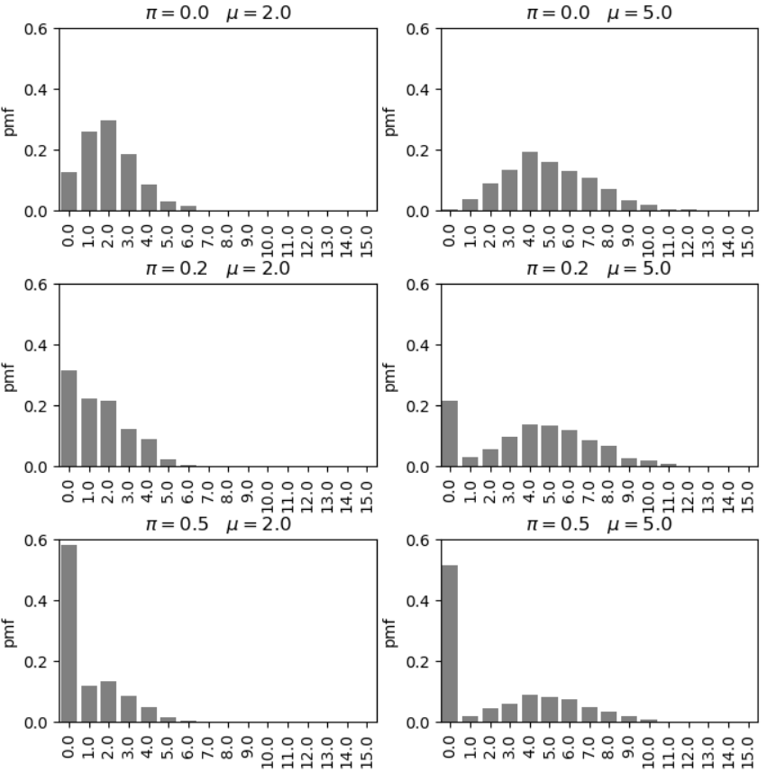
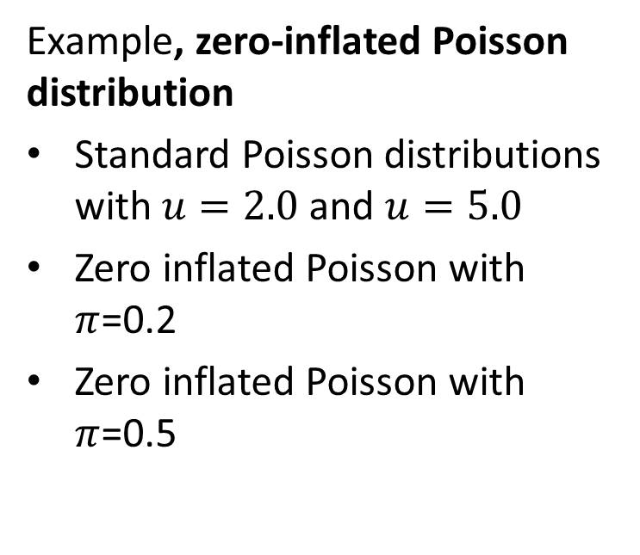
Zero-Inflated Poisson Distribution
Example, zero-inflated Poisson distribution
Standard Poisson distributions with $u=2.0$ and $u=5.0$
Zero inflated Poisson with $π$=0.2
Zero inflated Poisson with $π$=0.5

Slide 11
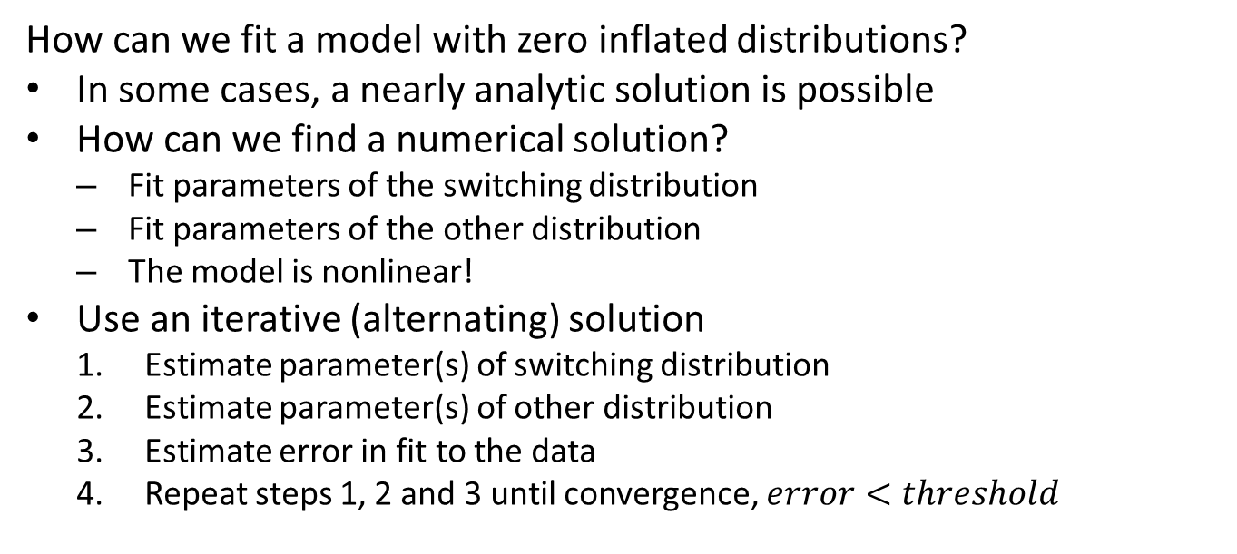
Zero-Inflated Response Regression
How can we fit a model with zero inflated distributions?
In some cases, a nearly analytic solution is possible
How can we find a numerical solution?
  Fit parameters of the switching distribution
  Fit parameters of the other distribution
  The model is nonlinear!
Use an iterative (alternating) solution
  Estimate parameter(s) of switching distribution
  Estimate parameter(s) of other distribution
  Estimate error in fit to the data
  Repeat steps 1, 2 and 3 until convergence, $error<threshold$

Slide 12
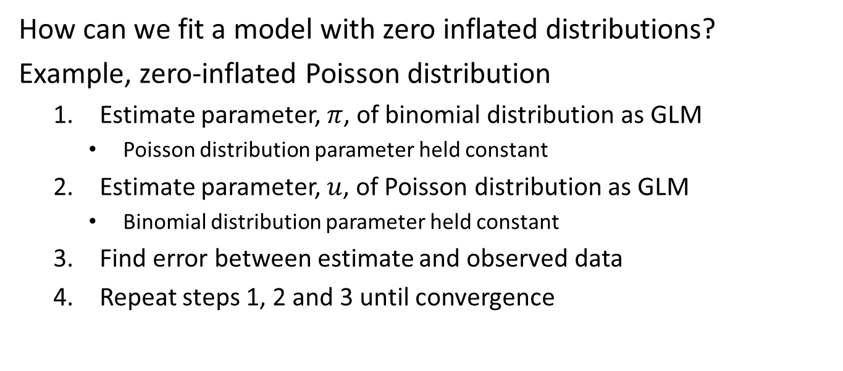
Zero-Inflated Response Regression
How can we fit a model with zero inflated distributions?
Example, zero-inflated Poisson distribution
  Estimate parameter, $π$, of binomial distribution as GLM
    Poisson distribution parameter held constant
  Estimate parameter, $u$, of Poisson distribution as GLM
    Binomial distribution parameter held constant
  Find error between estimate and observed data
  Repeat steps 1, 2 and 3 until convergence

Slide 13
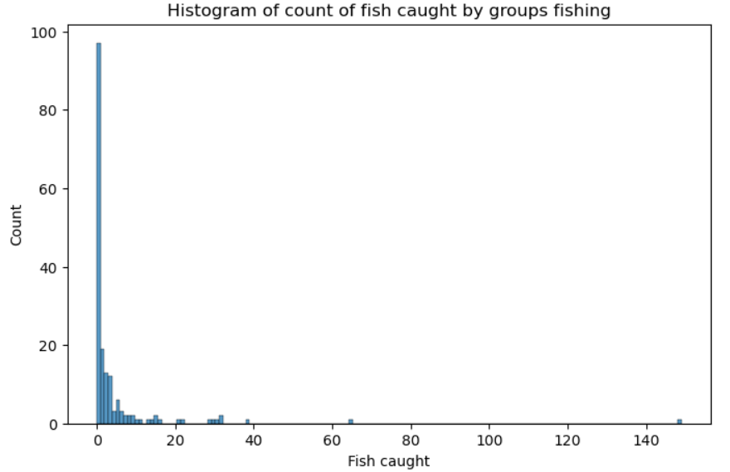
Example: Zero-Inflated Poisson Regression
Example: model for fish caught by parties visiting a park
The distribution is zero inflated, many parties do not catch any fish

Slide 14
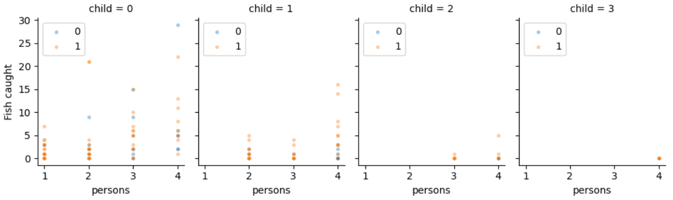
Example: Zero-Inflated Poisson Regression
Example: model for fish caught by parties visiting a park
Exogenous variables, persons in party, children in party, did the party camp
Facet plot of the response variable vs. the exogenous variables

Slide 15
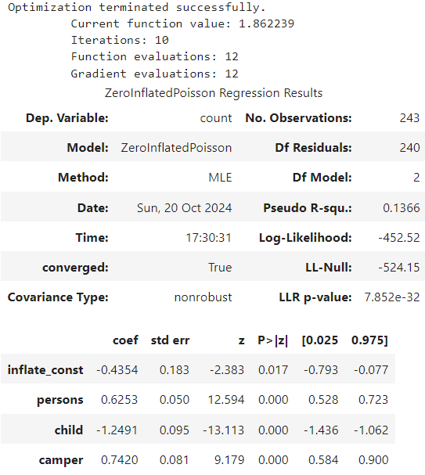
Example: Zero-Inflated Poisson Regression
Example: model for fish caught by parties visiting a park
Model is significant in explaining the data compared to the null model
The coefficients are all significant
  Coefficient for switching
  Adding people to party or camping increases expected number of fish caught
  Children in party reduce expected number of fish caught

Slide 16
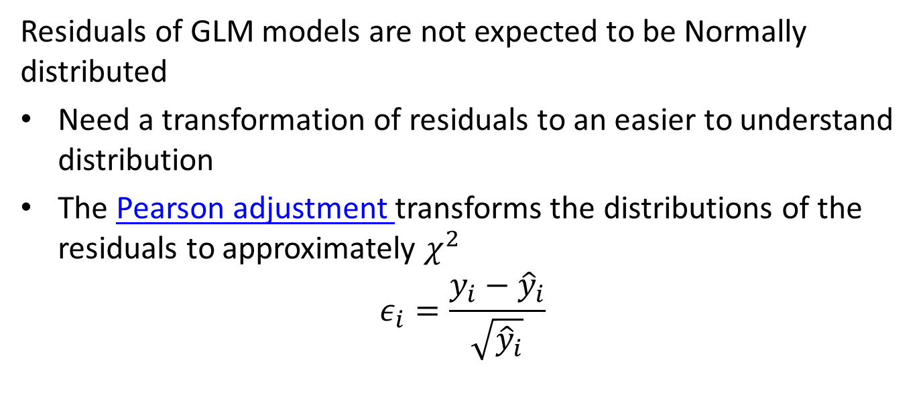
Example: Zero-Inflated Poisson Regression
Residuals of GLM models are not expected to be Normally distributed
Need a transformation of residuals to an easier to understand distribution
The Pearson adjustment transforms the distributions of the residuals to approximately $χ^{2}$
$$ε_{i}=\frac{y_{i}−{\hat{y}}_{i}}{\sqrt{{\hat{y}}_{i}}}$$

Slide 17
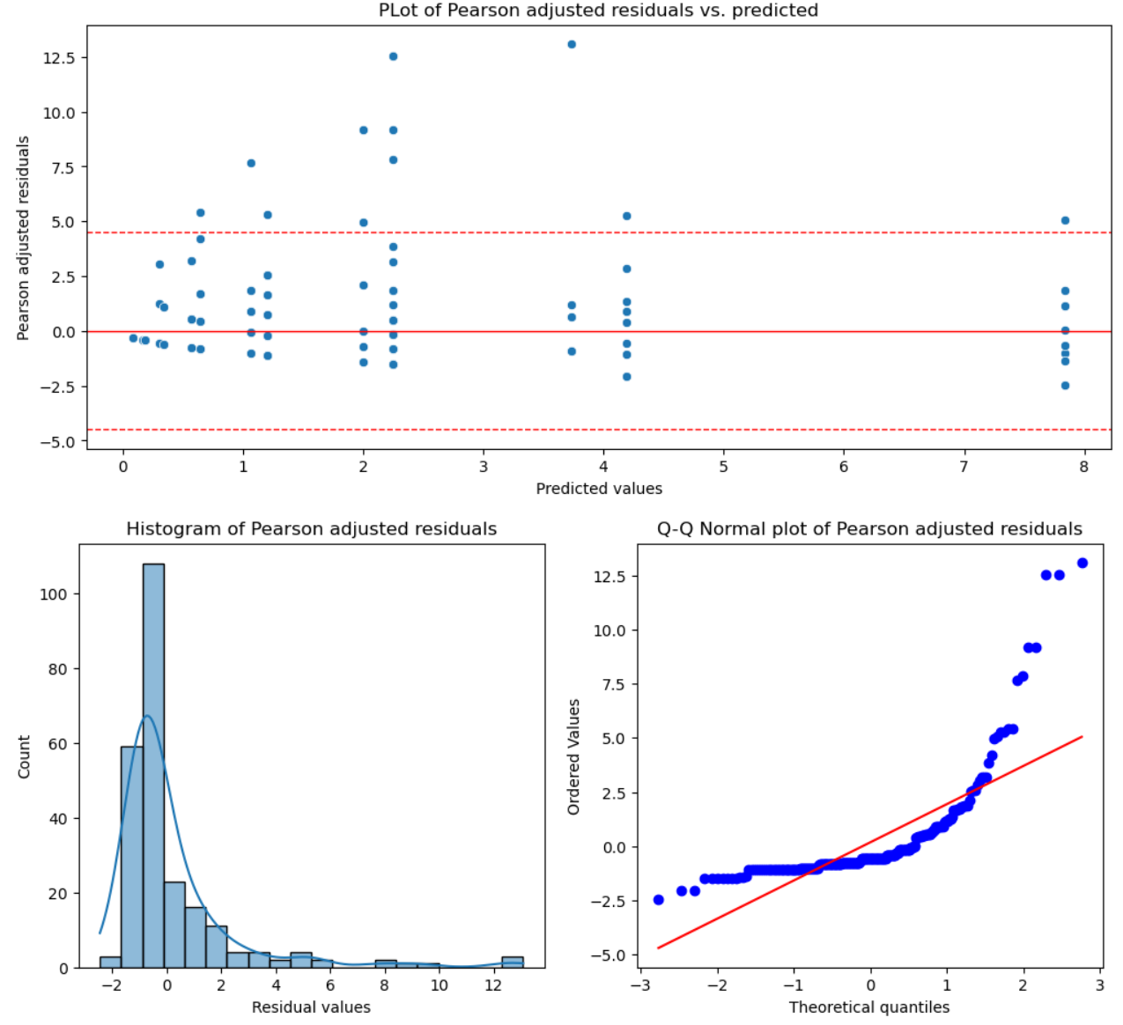
Example: Zero-Inflated Poisson Regression
Example: model for fish caught by parties visiting a park
Pearson adjusted residuals show some heteroscedastic behavior
  Do not over interpret this plot!
  A sample of only 250 cases is small and there can be considerable variation from sampling alone
Histogram and Q-Q plot show considerable right skew and larger outliers in the Pearson adjusted residuals

Slide 18
Models for Over-Dispersed Response

Slide 19
Over-Dispersed Response Distributions
Over-dispersed response variables are commonly encountered
Sales volume of a product can show have sudden surges
Demand on an electric grid can have extreme spikes beyond the mean load
Number of emergency patients seen at a hospital can surge well beyond the norm
Sightings of heard and flock animals seen at a location can have large numbers at some times
Frequency of tornados is subject to outbreaks
Number of publications by academic researchers, where a few people have very high numbers
The daily trading volume of a stock can spike occasionally
In epidemiology, the number of people contracting a disease is generally low, but can spike to large numbers
Etc.

Slide 20
Modeling Over-Dispersed Distributions
How can we model over-dispersed distributions?
Two widely used options
Inherently heavy tailed distributions
Mixtures of distributions
Or both

Slide 21
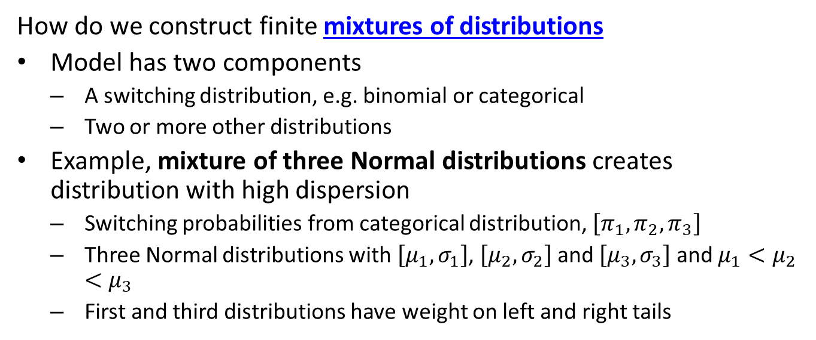
Modeling Over-Dispersed Distributions
How do we construct finite mixtures of distributions
Model has two components
  A switching distribution, e.g. binomial or categorical
  Two or more other distributions
Example, mixture of three Normal distributions creates distribution with high dispersion
  Switching probabilities from categorical distribution, $\left[π_{1},π_{2},π_{3}\right]$
  Three Normal distributions with $\left[μ_{1},σ_{1}\right]$, $\left[μ_{2},σ_{2}\right]$ and $\left[μ_{3},σ_{3}\right]$ and $μ_{1}<μ_{2}<μ_{3}$
  First and third distributions have weight on left and right tails

Slide 22
Modeling Over-Dispersed Distributions
Many choices of heavy tailed distributions to model over-dispersed variables
Student-t with low degrees of freedom – cannot use GLM!
Negative binomial
Log-gamma
Pareto
Log-logistic
Log-normal
Etc.

Slide 23
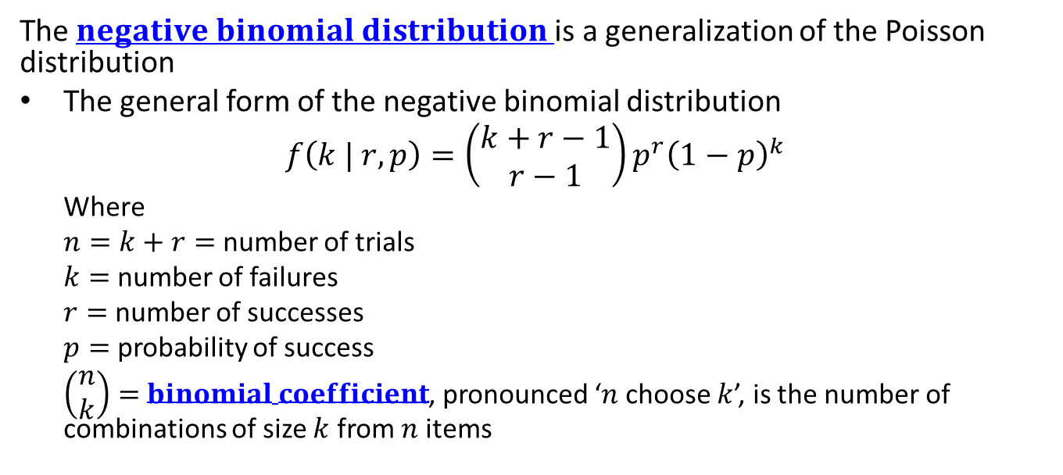
Negative Binomial Distribution
The $negative binomial distribution$is a generalization of the Poisson distribution
The general form of the negative binomial distribution
$$f\left(k | r, p\right)=\left(\begin{matrix}k+r−1 \\ r−1\end{matrix}\right)p^{r}{\left(1−p\right)}^{k}$$
  Where
  $n=k+r=$ number of trials
  $k=$ number of failures
  $r=$ number of successes
  $p=$ probability of success
  $\left(\begin{matrix}n \\ k\end{matrix}\right)=$ $binomial coefficient$, pronounced ‘$n$ choose $k$’, is the number of combinations of size $k$ from $n$ items

Slide 24
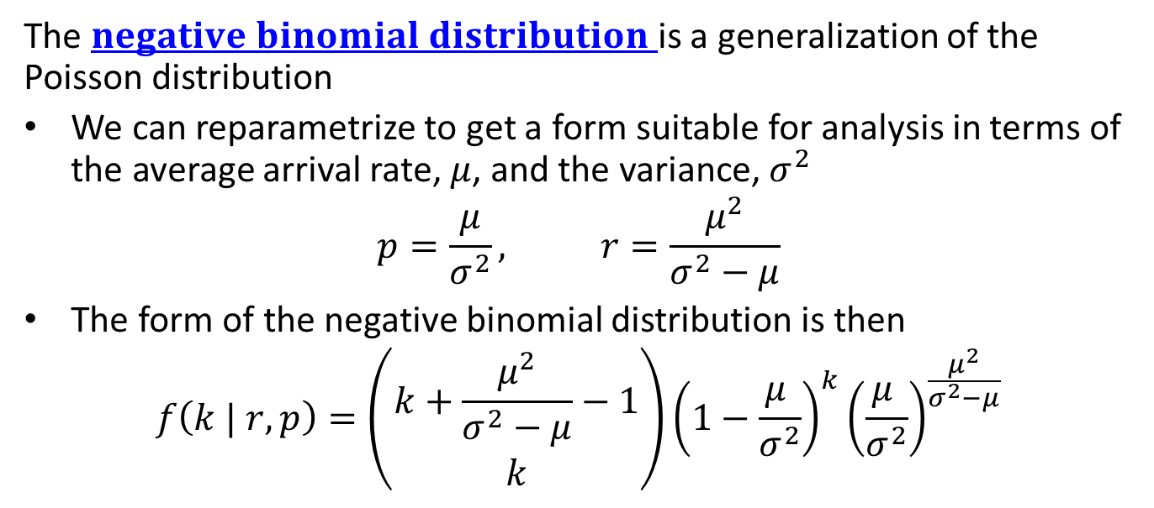
Negative Binomial Distribution
The $negative binomial distribution$is a generalization of the Poisson distribution
We can reparametrize to get a form suitable for analysis in terms of the average arrival rate, $μ$, and the variance, $σ^{2}$
$$p=\frac{μ}{σ^{2}}, r=\frac{μ^{2}}{σ^{2}−μ}$$
The form of the negative binomial distribution is then
$$f\left(k | r, p\right)=\left(\begin{matrix}k+\frac{μ^{2}}{σ^{2}−μ}−1 \\ k\end{matrix}\right){\left(1−\frac{μ^{ }}{σ^{2}}\right)}^{k}{\left(\frac{μ^{ }}{σ^{2}}\right)}^{\frac{μ^{2}}{σ^{2}−μ}}$$

Slide 25
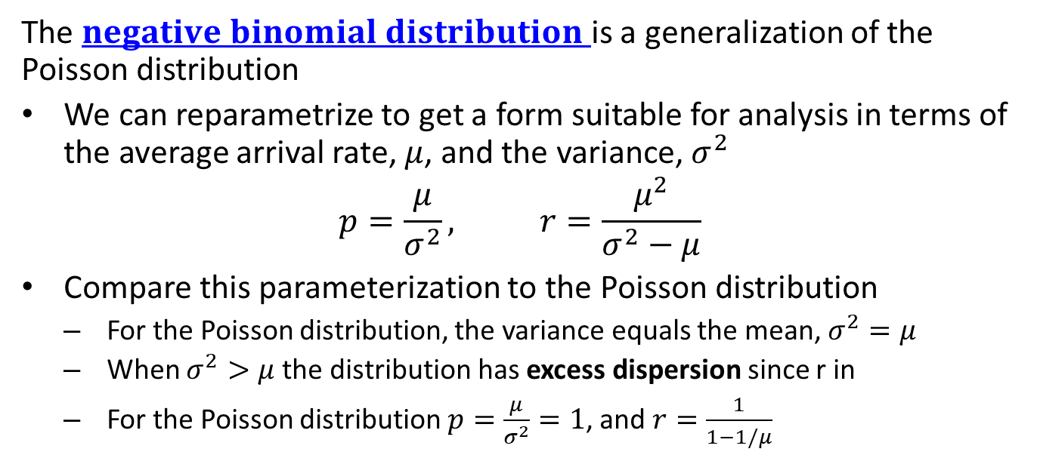
Negative Binomial Distribution
The $negative binomial distribution$is a generalization of the Poisson distribution
We can reparametrize to get a form suitable for analysis in terms of the average arrival rate, $μ$, and the variance, $σ^{2}$
$$p=\frac{μ}{σ^{2}}, r=\frac{μ^{2}}{σ^{2}−μ}$$
Compare this parameterization to the Poisson distribution
  For the Poisson distribution, the variance equals the mean, $σ^{2}=μ$
  When $σ^{2}>μ$ the distribution has excess dispersion since r in
  For the Poisson distribution $p=\frac{μ}{σ^{2}}=1$, and $r=\frac{1}{1−1/μ}$

Slide 26
Zero-Inflated Over-Dispersed Distributions
How can we work with distributions that exhibit both zero-inflation and over-dispersion?
Create a mixture of two distributions
  A binomial switching distribution for the zero-inflation
  An over-dispersed distribution
Examples of zero-inflated and over-dispersed count data:
  There are zero tornados on most days in most area, but can have large outbreaks with low probability
  A wildlife biologist may spot none of a specific species on a given day, but could encounter large numbers occasionally
  Most days there are no auto accidents on a segment of road, but there are a few days with high numbers of accidents
  Demand for a rarely purchased product is zero on most days, but can have spikes in demand

Slide 27
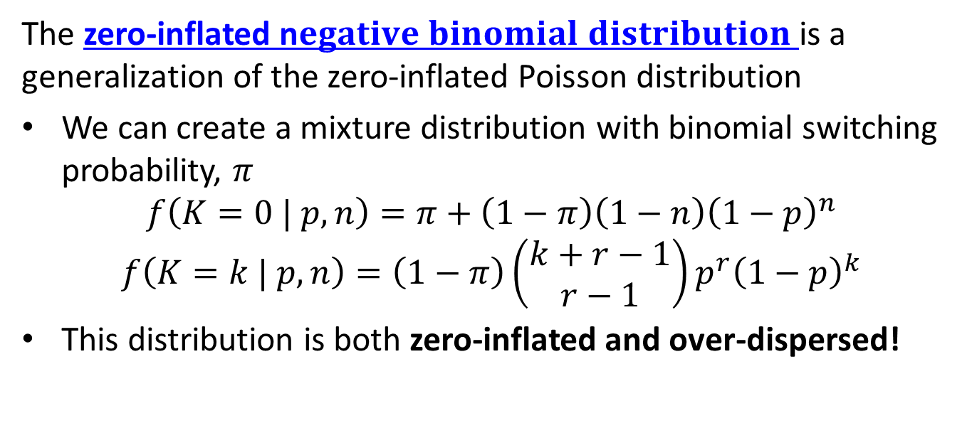
Zero-Inflated Negative Binomial Distribution
The zero-inflated n$egative binomial distribution$is a generalization of the zero-inflated Poisson distribution
We can create a mixture distribution with binomial switching probability, $π$
$$f\left(K=0 | p,n\right)=π+\left(1−π\right)\left(1−n\right){\left(1−p\right)}^{n}$$
$$f\left(K=k | p,n\right)=\left(1−π\right)\left(\begin{matrix}k+r−1 \\ r−1\end{matrix}\right)p^{r}{\left(1−p\right)}^{k}$$
This distribution is both zero-inflated and over-dispersed!

Slide 28
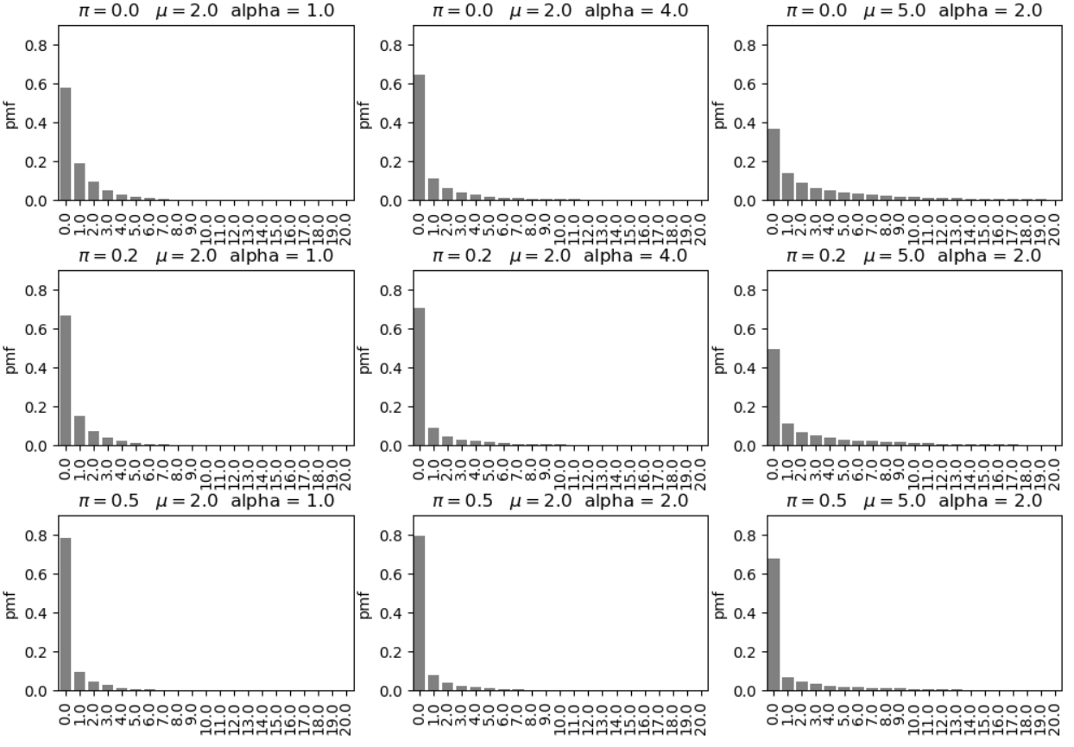
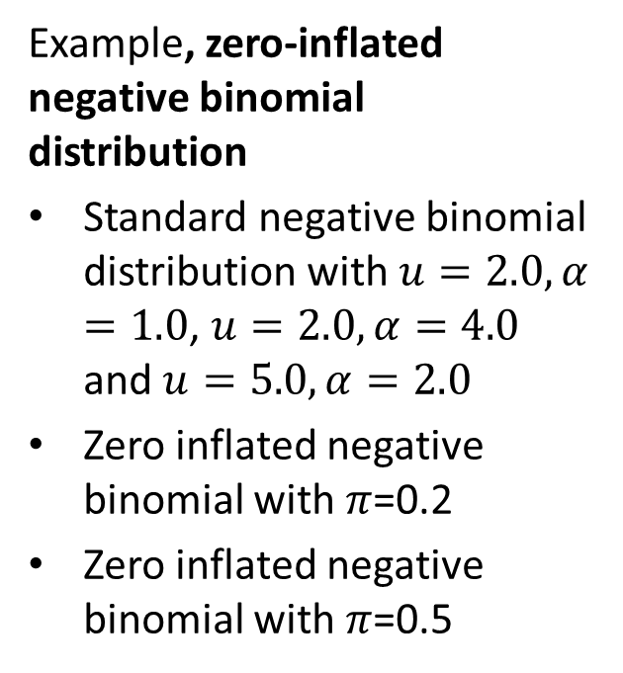
Zero-Inflated Negative Binomial Distribution
Example, zero-inflated negative binomial distribution
Standard negative binomial distribution with $u=2.0, α=1.0$, $u=2.0, α=4.0$ and $u=5.0,α=2.0$
Zero inflated negative binomial with $π$=0.2
Zero inflated negative binomial with $π$=0.5

Slide 29
Example: Zero-Inflated Poisson Regression
Example: model for fish caught by parties visiting a park
The distribution is zero inflated, many parties do not catch any fish
There is a strong right skew, some parties catch large numbers of fish – over-dispersion!

Slide 30
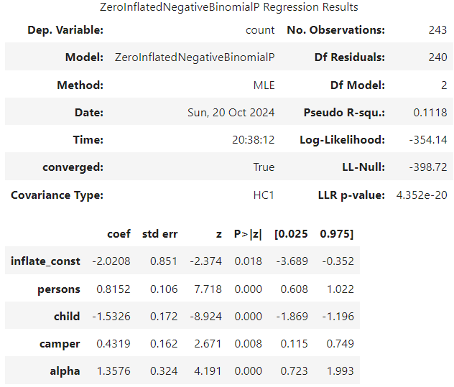
Example: Zero-Inflated NB Distribution Regression
Example: The zero-inflated Poisson regression model for fish caught showed significant over-dispersion
Try zero-inflated negative binomial distribution regression
Log-likelihood increased from -542 for zero-inflated Poisson regression
All coefficients are significant
The inflation coefficient has a large standard error and wide CI!
Significant over-dispersion coefficient
  Adds 1 extra parameter to model compared to zero-inflated Poisson

Slide 31
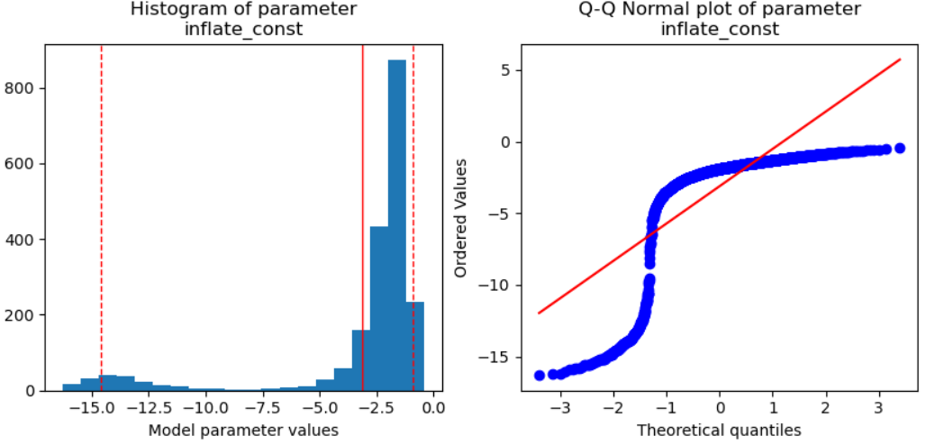
Example: Zero-Inflated NB Distribution Regression
Example: Compare zero-inflated negative binomial distribution regression to zero-inflated Poisson regression
The distribution of the over-dispersion coefficient is far from Normal
Distribution is bimodal with asymmetric CI
Perhaps a Bayesian model would have been a better choice?

Slide 32
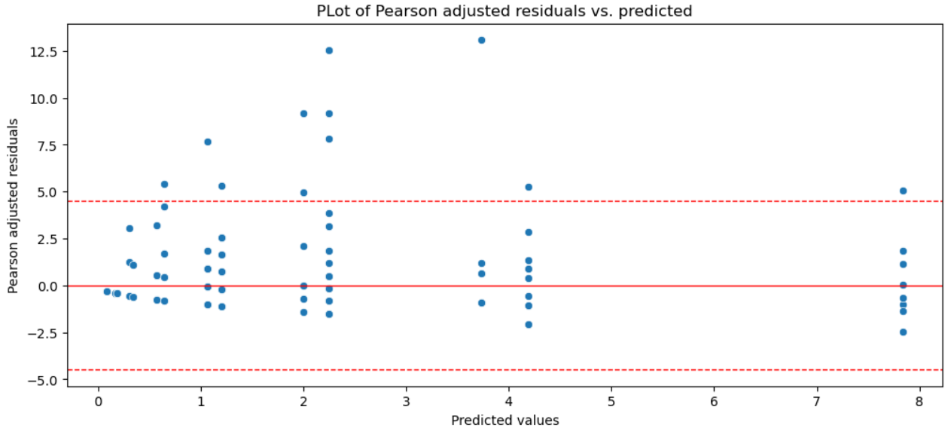
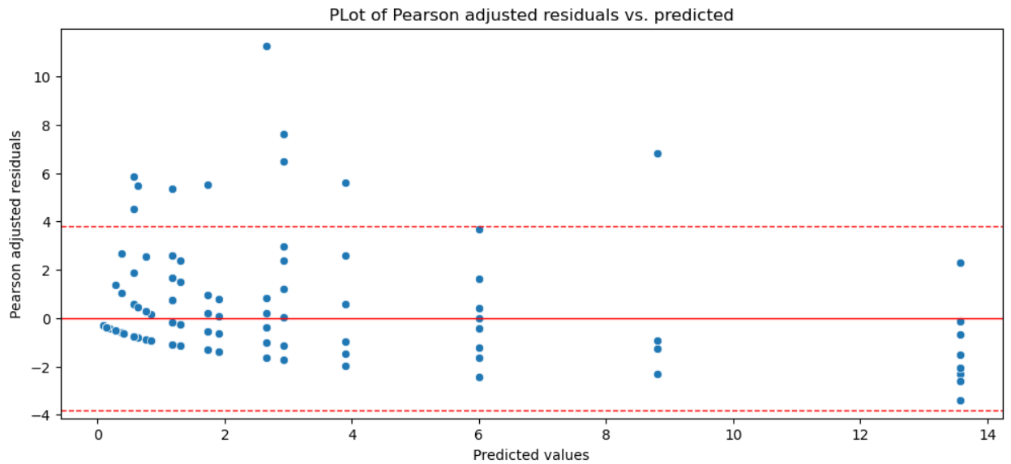
Example: Zero-Inflated NB Distribution Regression
Example: Compare zero-inflated negative binomial distribution regression to zero-inflated Poisson regression
Residual plots are similar, with noticeable outliers
Both models exhibit a bit of heteroskedasticity
Heteroskedasticity near zero could be result of poor fit of binomial parameter
Zero-inflated Poisson regression
Zero-inflated NB distribution regression

Slide 33
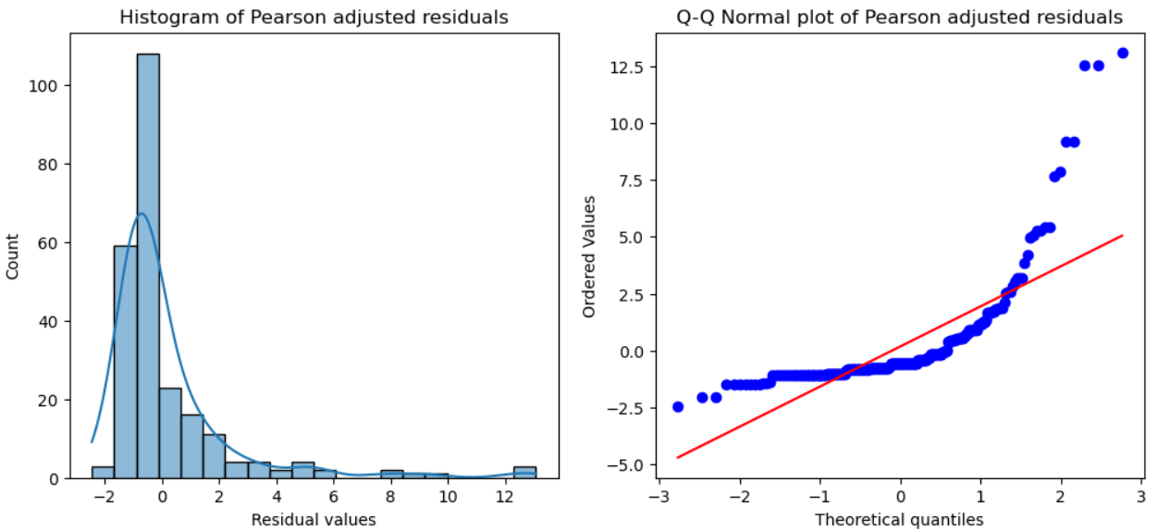
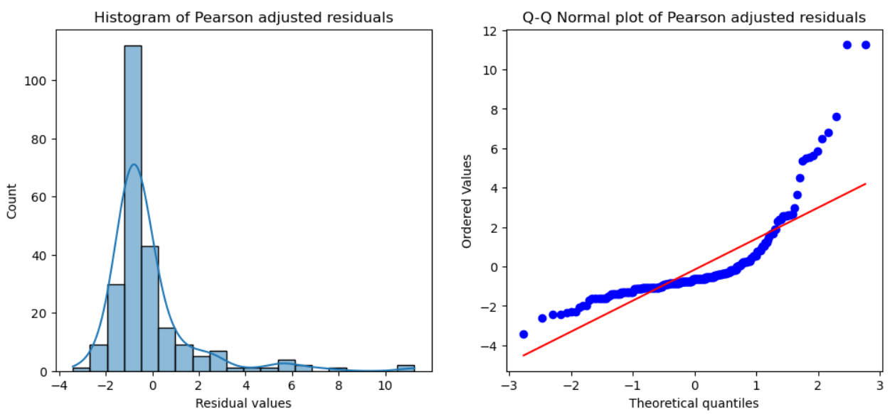
Example: Zero-Inflated NB Distribution Regression
Example: Zero-inflated negative binomial distribution regression for fish caught
Dispersion of residuals is a slightly less for NB distribution regression
Bulk of residual distribution more symmetric for NB regression
Notice the greater fraction in straight line (e.g. Normal) for NB distribution
Zero-inflated Poisson regression
Zero-inflated NB distribution regression

Slide 34
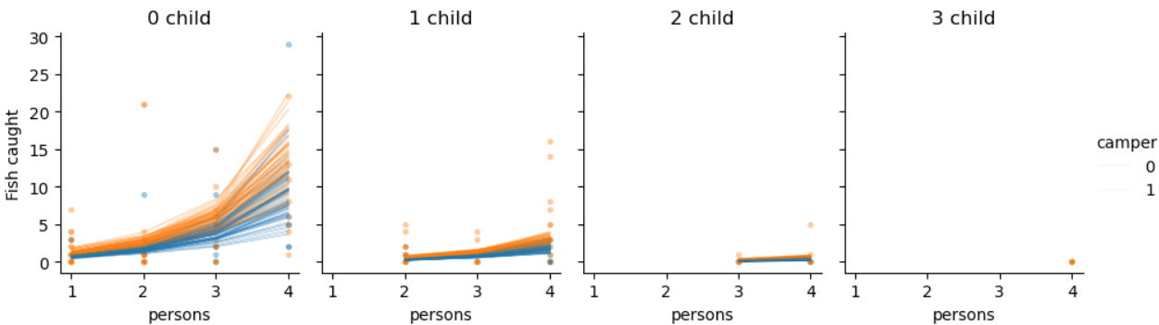
Example: Zero-Inflated NB Distribution Regression
Example: Zero-inflated negative binomial distribution regression for fish caught
Bootstrap resamples of the NB distribution regression
General behavior is reasonable, but wide dispersion of outcomes
Notice outliers that affect the model fit

Slide 35
Dealing with Outliers

Slide 36
Dealing With Outliers
Outliers are a persistent problem with statistical and machine learning models
What are outliers?
  Errors or noisy measurement values
  Extreme events not accounted for in model
But, outliers may be of greatest interest!
  May need to explicitly model
  Example: Fraud detection
  Example: Scientific discovery
Outliers can be hard to detect
  Difficult in high-dimensions
  Often find by influence on model

Slide 37
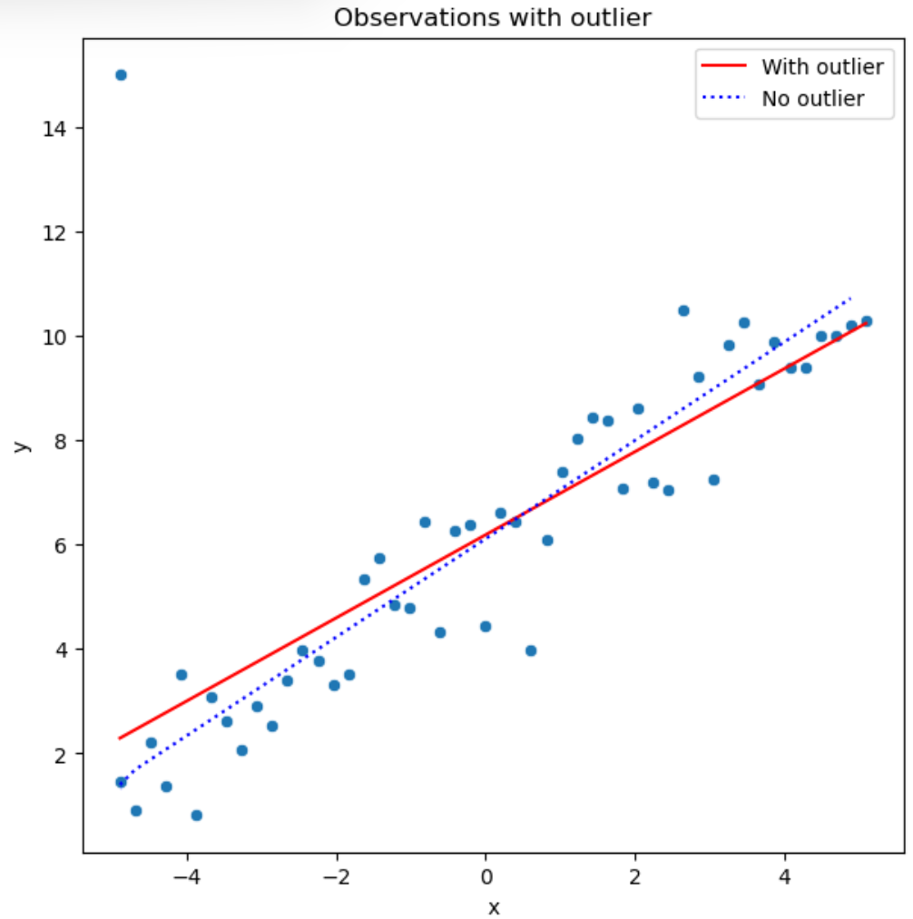
Effects of Outliers
Example: OLS regression with and without a single outlier
Add a single outlier with high leverage to the regression data set
Regression without the outlier represents the bulk of the data well
The regression line with the outlier is skewed with respect to the bulk of the data

Slide 38
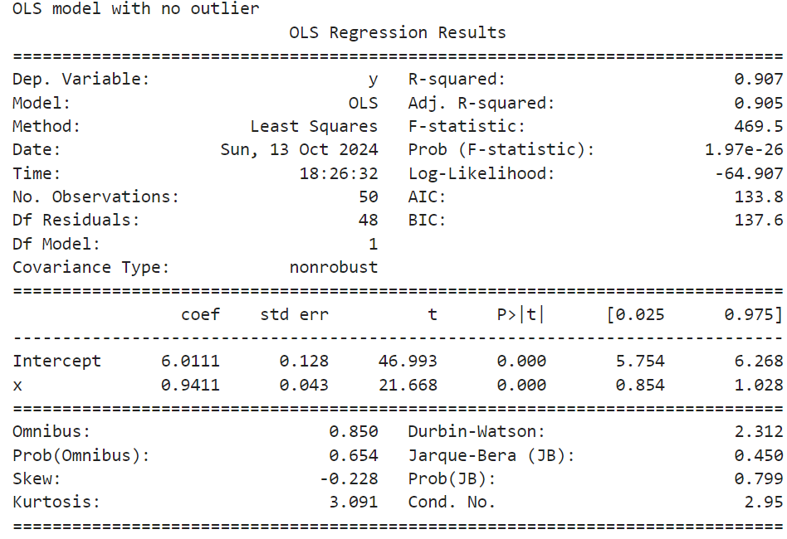
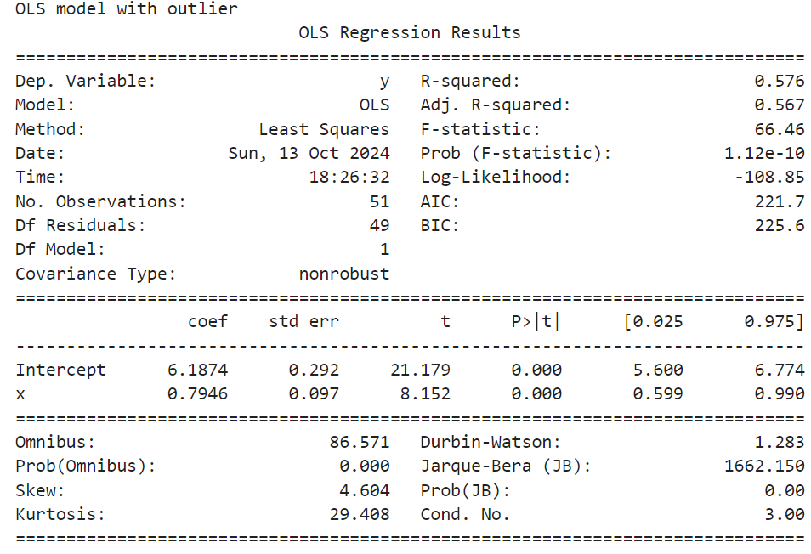
Effect of Outliers
Example: OLS regression with and without a single outlier
Intercept has only small change
Slope is noticeably changed
Changes are not statistically significant

Slide 39
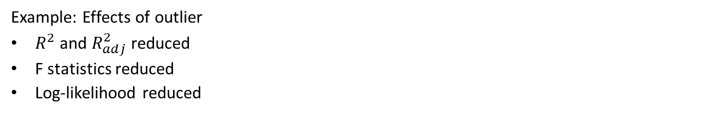
Effect of Outliers
Example: Effects of outlier
$R^{2}$ and $R_{adj}^{2}$ reduced
F statistics reduced
Log-likelihood reduced

Slide 40
Measuring Influence of Outliers
There are several measures we can use to understand outliers
Residual distance, the difference between observed and model response
Leverage, a measure of distance of an observation from the mean of the independent variables
Influence and Cooke’s distance, the change in the response from leaving out an observation when fitting the model

Slide 41
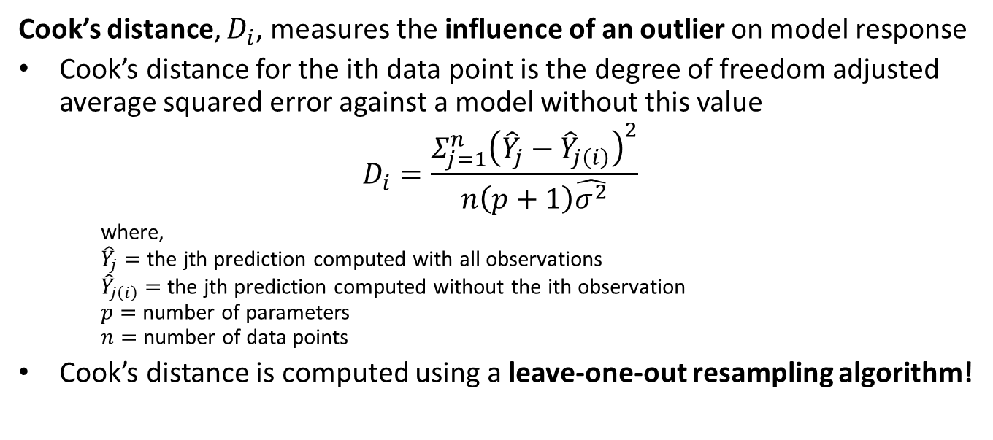
Measuring Influence of Outliers
Cook’s distance, $D_{i}$, measures the influence of an outlier on model response
Cook’s distance for the ith data point is the degree of freedom adjusted average squared error against a model without this value
$$D_{i}=\frac{Σ_{j=1}^{n}{\left({\hat{Y}}_{j}−{\hat{Y}}_{j\left(i\right)}\right)}^{2}}{n\left(p+1\right)\hat{σ^{2}}}$$
    where,
    ${\hat{Y}}_{j}=$ the jth prediction computed with all observations
    ${\hat{Y}}_{j\left(i\right)}=$ the jth prediction computed without the ith observation
    $p=$ number of parameters
    $n=$ number of data points
Cook’s distance is computed using a leave-one-out resampling algorithm!

Slide 42
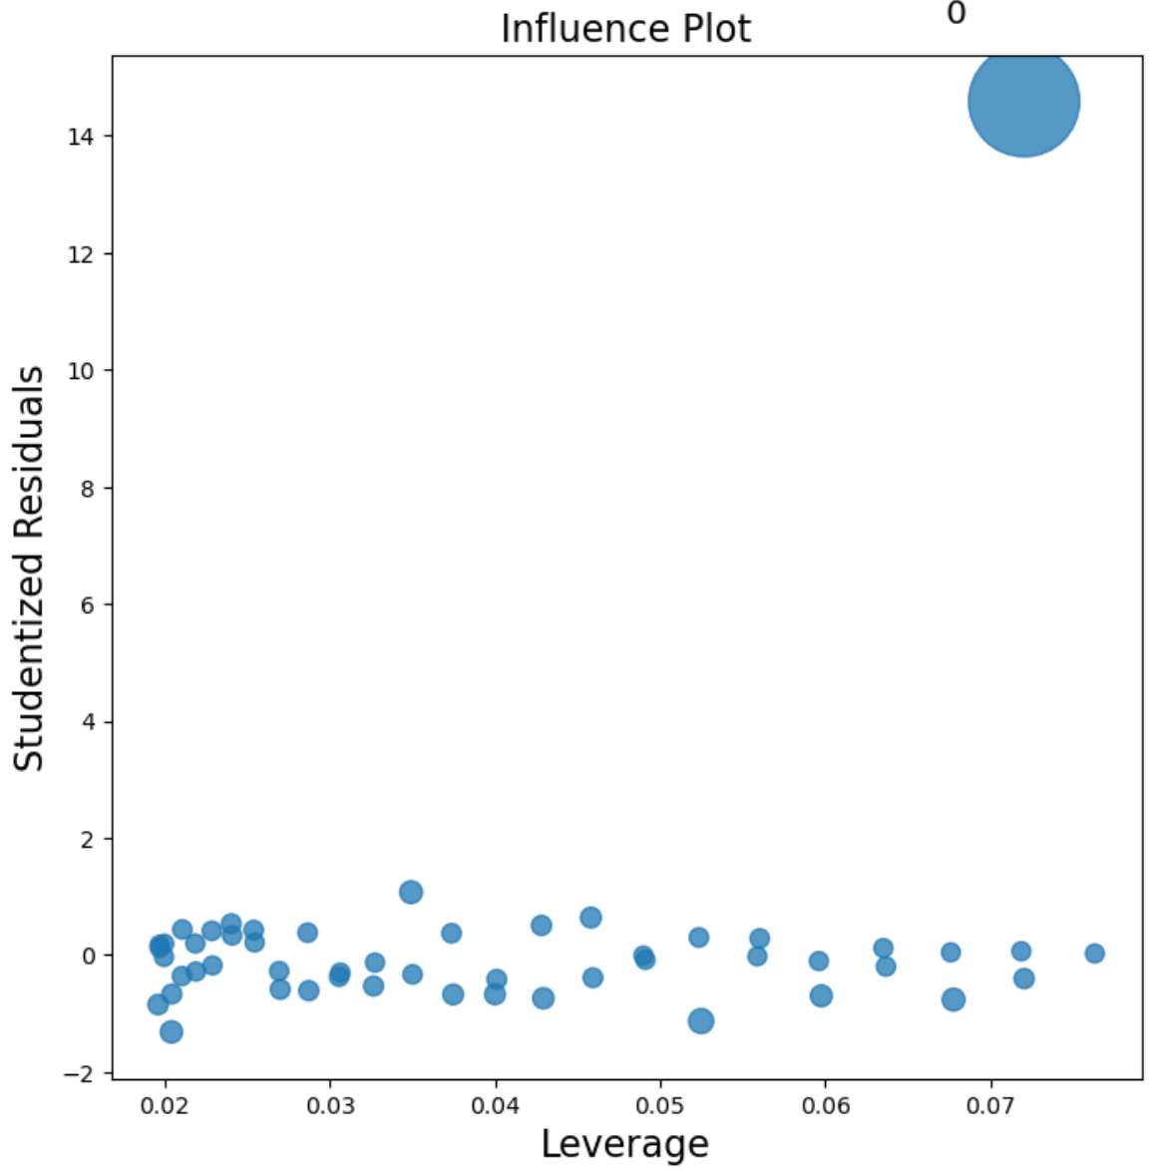
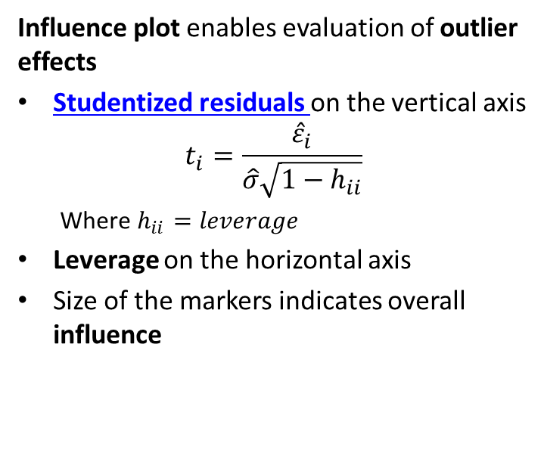
Measuring Influence of Outliers
Influence plot enables evaluation of outlier effects
Studentized residuals on the vertical axis
$$t_{i}=\frac{{\hat{ε}}_{i}}{\hat{σ}\sqrt{1−h_{ii}}}$$
  Where $h_{ii}=leverage$
Leverage on the horizontal axis
Size of the markers indicates overall influence

Slide 43
Robust Models and Influence Function
We can measure the sensitivity of a model by its influence function
Example: Ordinary linear regression uses squared error loss function
  Optimal if the errors are iid Normal
  Is an unbiased estimator
  But the influence function is unbounded!
Robust models have bounded influence function

Slide 44
Robust Models and Influence Function
Example: compare robust and non-robust model
Ordinary linear regression uses squared error loss function
  Optimal if the errors are iid Normal
  Has unbounded influence function
In 1-dimension, median is robust to outliers
  A high bias estimator
  Difficult to implement beyond 1-dimension
  Bounded influence function
We can compare the response of estimators to outliers by comparing their influence functions

Slide 45
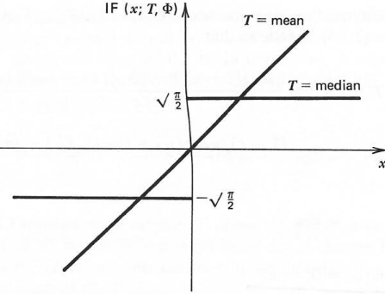
Robust Models and Influence Function
Compare the influence functions of the mean and median estimators
Mean estimator has linear influence function
  Influence of outliers is unbounded
  Derivative of the influence function is constant
Influence function of median estimator is discontinuous
  Influence of any observation is bounded and constant
  Derivative of influence function is not defined at 0
Influence functions for mean and median
Figure from Hampel, el.al., Robust Statistics, 1986

Slide 46
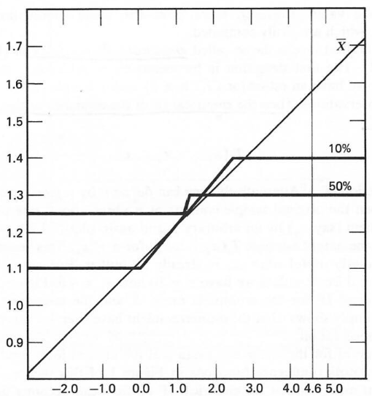
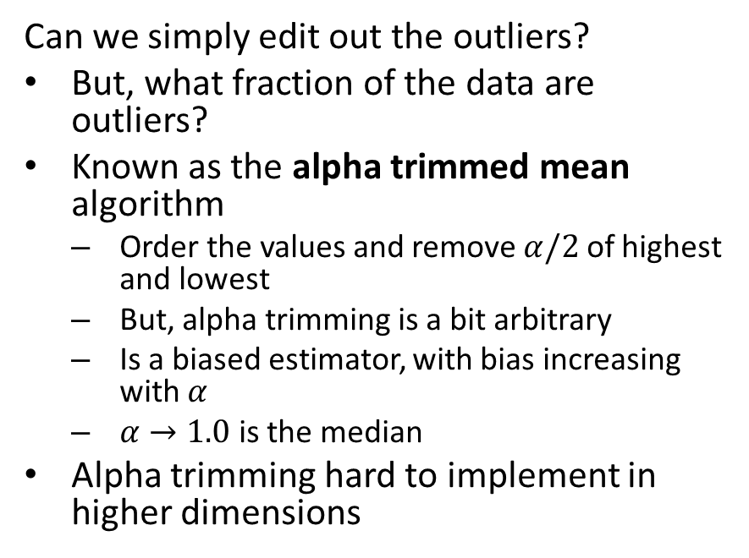
Dealing With Outliers
Can we simply edit out the outliers?
But, what fraction of the data are outliers?
Known as the alpha trimmed mean algorithm
  Order the values and remove $α/2$ of highest and lowest
  But, alpha trimming is a bit arbitrary
  Is a biased estimator, with bias increasing with $α$
  $α→1.0$ is the median
Alpha trimming hard to implement in higher dimensions
Influence functions for alpha trimmed mean
Figure from Hampel, el.al., Robust Statistics, 1986
Figure from Hampel, el.al., Robust Statistics, 1986

Slide 47
Dealing With Outliers
Are there better robust estimators?
Yes, but must accept some bias
Idea; estimator can be unbiased near the expected value
  Limit influence of outliers
  Trade-off between high robustness and low bias
Many ideas have been tried
  A major research focus in the 1970s and 1980s
  Huber estimator
  Family of M-estimators

Slide 48
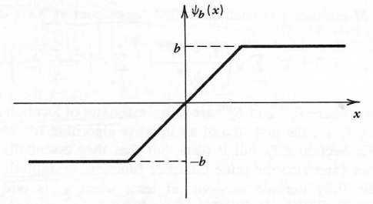
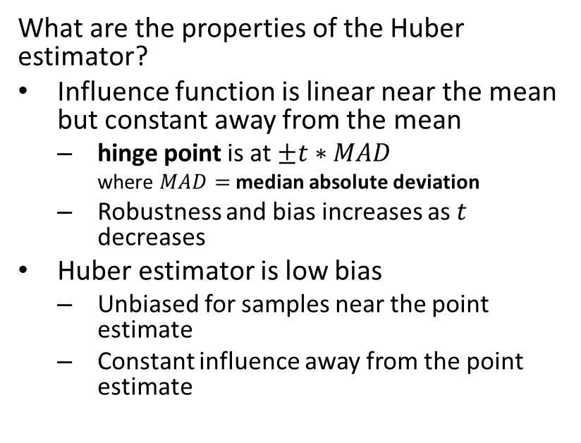
Dealing With Outliers
What are the properties of the Huber estimator?
Influence function is linear near the mean but constant away from the mean
  hinge point is at $±t∗MAD$
    where $MAD=$ median absolute deviation
  Robustness and bias increases as $t$ decreases
Huber estimator is low bias
  Unbiased for samples near the point estimate
  Constant influence away from the point estimate
Influence function of the Huber estimator
Figure from Hampel, el.al., Robust Statistics, 1986

Slide 49
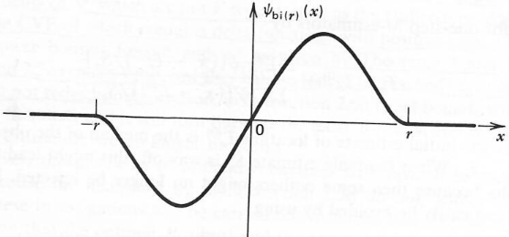
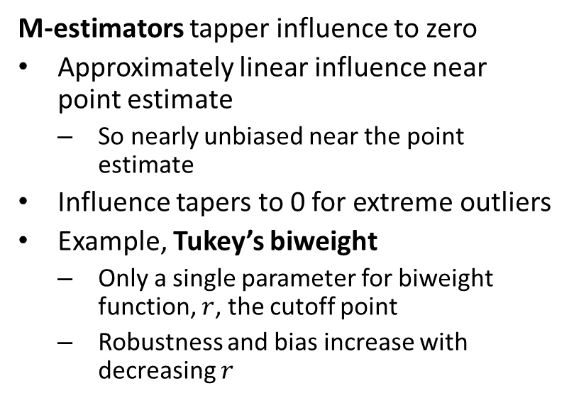
Dealing With Outliers
M-estimators tapper influence to zero
Approximately linear influence near point estimate
  So nearly unbiased near the point estimate
Influence tapers to 0 for extreme outliers
Example, Tukey’s biweight
  Only a single parameter for biweight function, $r$, the cutoff point
  Robustness and bias increase with decreasing $r$
Influence function of the Tukey’s Biweight M-estimator
Figure from Hampel, el.al., Robust Statistics, 1986

Slide 50
Example: Dealing With Outliers
Example: regression with Huber loss function
## Define the robust regression model and fit it to the data
ols_model_huber = smf.rlm(formula ='y~x', data = sim_data_ol).fit()
# Add predicted to pandas data frame
sim_data_ol['predicted_huber'] = ols_model_huber.predict(sim_data_ol.x)
## Display sumamry
ols_model_huber.summary()

Slide 51
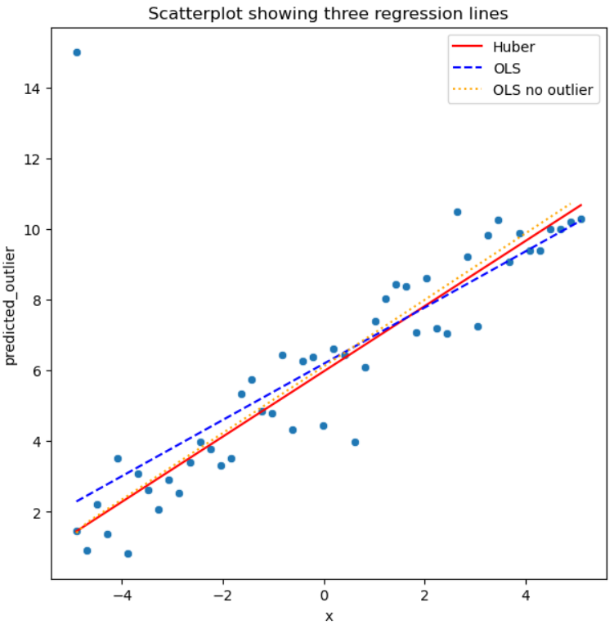
Example: Dealing With Outliers
Example: Comparing regression Results
Regression line with no outlier is benchmark
OLS fit shows influence of single outlier
Huber loss regression is nearly the same as OLS with no outlier

Slide 52
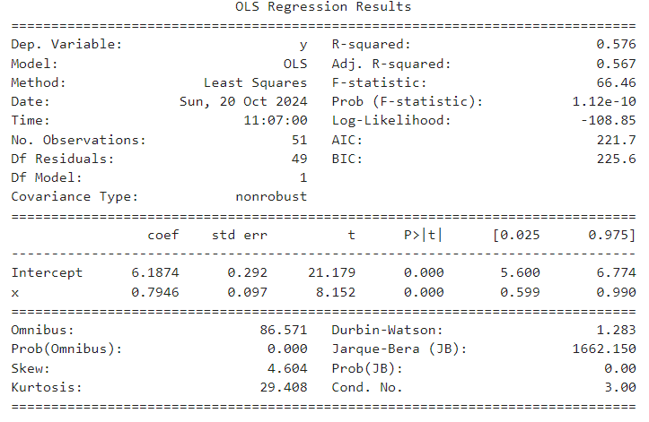
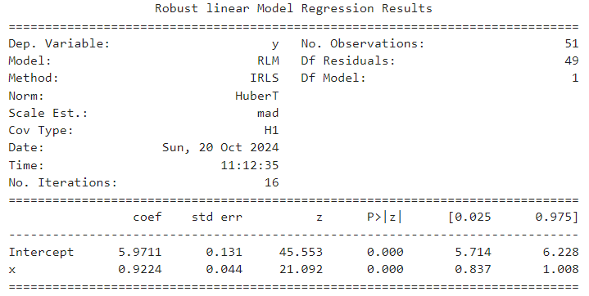
Example: Dealing With Outliers
Example: Comparing regression Results
The slope coefficients are noticeably different
CIs of intercept and slope coefficient are reduced in robust model
From the confidence intervals the differences are not statistically significant
Summary of OLS regression
Summary of Huber regression

Slide 53
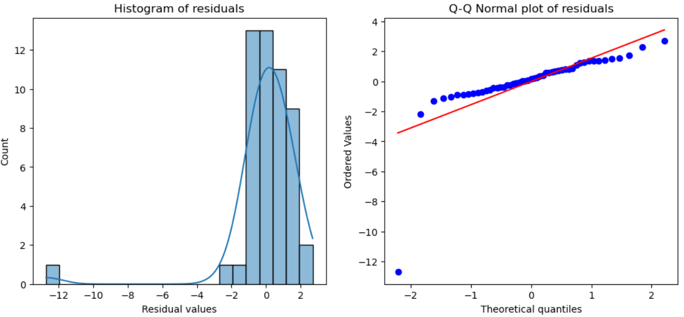
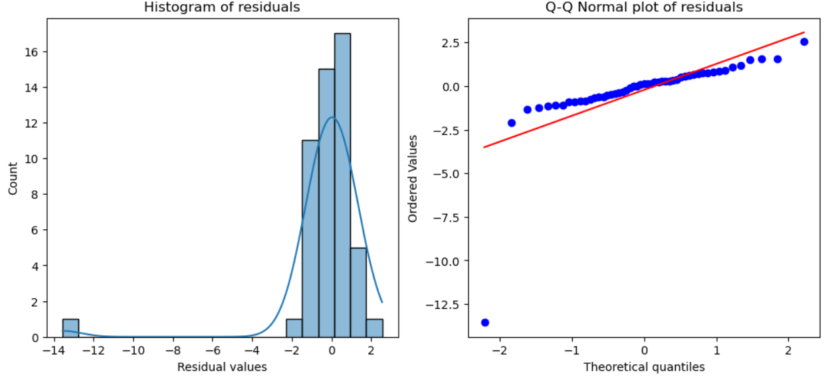
Example: Dealing With Outliers
Example: Comparing regression Results
The residuals are nearly identical for the two models
The residuals are near normal except of an obvious outlier
  Note the near straight line of the quantiles in the Q-Q plots
Residuals of OLS regression
Residuals of Huber regression

Slide 54
Limitations of Robust Estimators
Robust estimators have some important limitations
The nonlinear treatment precludes parametric estimation of confidence intervals
  Bootstrap instead!
Robust estimators do not work when the number of outliers is past the breakdown point
  For example, at 50% outliers the univariate median estimator breaks down
Robust estimators struggle with the detection and treatment of high-dimensional outliers
Variance of point estimates is inherently worse than for linear estimators

Slide 55
Example: Dealing With Outliers
For further reading on robust statistical models
For an up to date broad and deep treatment of theory and practical use of robust models see Robust Statistics, Theory and Methods (with R), Second Edition, Maronna, Martin, Yohai, Salibian-Barrera, Wiley, 2019
The classic treatment of this subject is Robust Statistics, The Approach Based on Influence Functions, Hample, Rousseeuw, Ronchetti, Stahel, Weily, 1986

Slide 56
Working with Missing Values

Slide 57
Understanding Missing Values
Missing values are nearly ubiquitous when working with real-world data
Incomplete data entry
Dataset results from merging tables with incomplete coverage of variables
Scientific, engineering, or medical measurement are sometimes not recorded
  Measurement procedure was skipped
  Instrument failure
People responding to surveys often skip questions
Etc….

Slide 58
Understanding Missing Values
We can classify missing data patterns into three categories
Observations that are missing completely at random (MCAR) have missing observations that are a random subset of all observations of a random variable
  The missing and observed values will have similar distributions in this case
Observations that are missing at random (MAR) have possible systematic differences between the missing and observed values of a random variable.
  MAR values can be entirely explained by other observed variables

Slide 59
Understanding Missing Values
We can classify missing data into three categories
Missing not at random (MNAR) observations have a systematic pattern for missing values of a random variable.
  Example; values are missing for cases when the value of the variable or another variable is greater or less than some threshold.
  For Cases of missing not at random are best address by a filling algorithms and methods

Slide 60
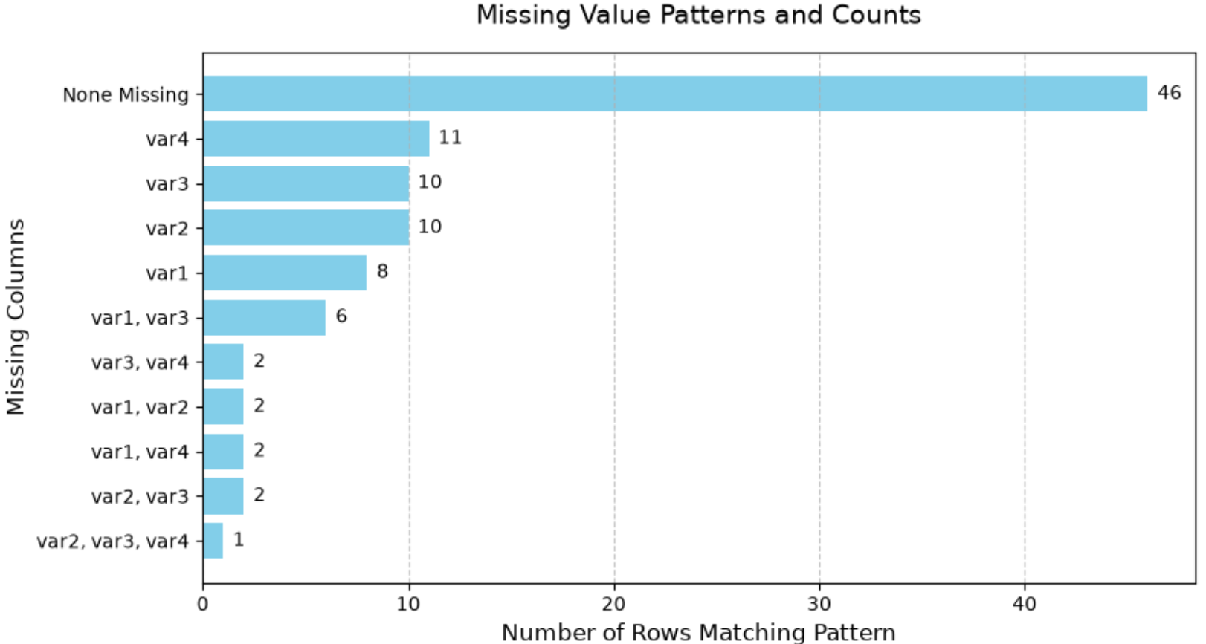
Understanding Missing Values
Exploring missing data patterns
Plot reveals missing value pattern in variables by row
Some rows have only one missing value
Other rows have multiple missing values

Slide 61
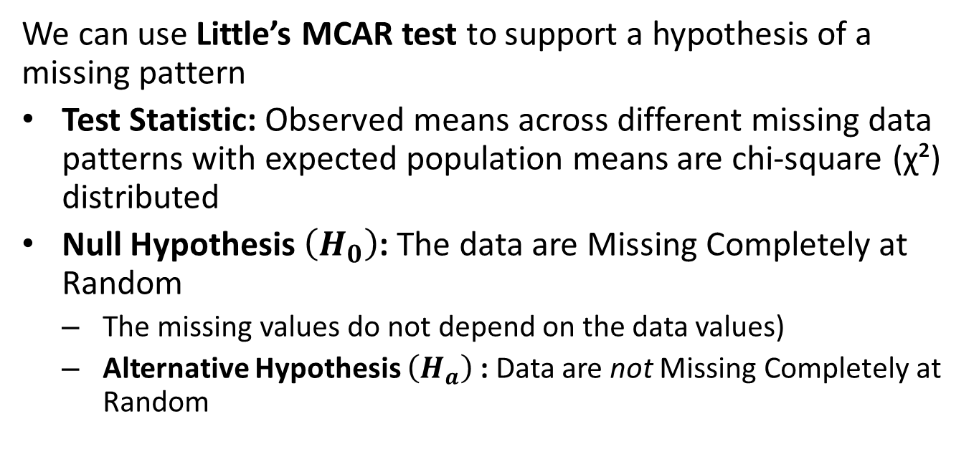
Understanding Missing Values
We can use Little’s MCAR test to support a hypothesis of a missing pattern
Test Statistic: Observed means across different missing data patterns with expected population means are chi-square (χ²) distributed
Null Hypothesis $\left(H_{0}\right)$: The data are Missing Completely at Random
  The missing values do not depend on the data values)
  Alternative Hypothesis $\left(H_{a}\right)$: Data are not Missing Completely at Random

Slide 62
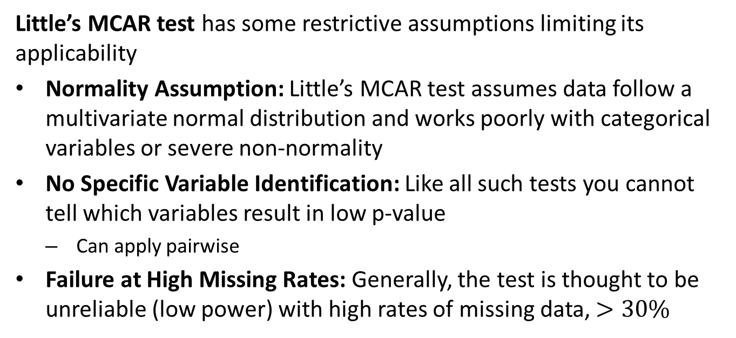
Understanding Missing Values
Little’s MCAR test has some restrictive assumptions limiting its applicability
Normality Assumption: Little’s MCAR test assumes data follow a multivariate normal distribution and works poorly with categorical variables or severe non-normality
No Specific Variable Identification: Like all such tests you cannot tell which variables result in low p-value
  Can apply pairwise
Failure at High Missing Rates: Generally, the test is thought to be unreliable (low power) with high rates of missing data, $>30\%$

Slide 63
Imputation of Missing Values
Imputation methods must match the missing data pattern and intended use
Machine learning algorithms only need a good point estimate for the imputed value
  For ML, we do not much care what the confidence intervals are
Inference requires drawing imputed values from the distribution of the variable
  We want unbiased estimates of the confidence intervals

Slide 64
Imputation of Missing Values
Algorithms used for MCAR and MAR data for machine learning do not need to preserve distributions
Commonly used algorithms for machine learling include
  Filling, mean, median, …
  Interpolation, linear, spline, etc.
  Forward and back filling
  K-nearest neighbors
  etc…
These algorithms only provide point estimates and are not useful for inference

Slide 65
Imputation of Missing Values
There are several approaches to imputation for MNAR variables
Join with another table – don’t overlook the obvious!
Systematic filling
  Example: are all the missing values 0s
  Example are the missing values dependent on other specific values of another variable(s)
Use autoencoder to learn missing value pattern

Slide 66
Imputation of Missing Values
The Multivariate Imputation by Chained Equations (MICE) algorithm preserves distributions for MCAR and MAR variables by these 6 steps:
A simple place-holder imputation, such as filling with mean values, is performed for all missing values in the dataset
Place-holder imputations of one variable are set back to missing

Slide 67
Imputation of Missing Values
The Multivariate Imputation by Chained Equations (MICE) algorithm preserves distributions for MCAR and MAR variables by these 6 steps:
The missing values from Step 2 are regressed on the other variables in the dataset.
  The multivariate aspect of the algorithm
  Not all of the other variables need be used
  Regression models can include linear, logistic, or Poison regression models
  Random forest models and other nonlinear regression models can be used

Slide 68
Imputation of Missing Values
The Multivariate Imputation by Chained Equations (MICE) algorithm preserves distributions for MCAR and MAR variables by these 6 steps:
The missing values from step 2 are replaced with predictions or imputations computed with the multivariate regression model.
  The imputed value can now be used as an observation for regression on other missing values.

Slide 69
Imputation of Missing Values
The Multivariate Imputation by Chained Equations (MICE) algorithm preserves distributions for MCAR and MAR variables by these 6 steps:
Steps 2–4 are then repeated for each variable with missing values.
  Cycling through each of the variables with missing values constitutes one iteration of the algorithm.
  This process continues until a stopping condition is reached where the imputed values are not changing significantly.
  The foregoing steps are the chained equations

Slide 70
Imputation of Missing Values
The Multivariate Imputation by Chained Equations (MICE) algorithm preserves distributions for MCAR and MAR variables by these 6 steps:
The process in steps 1-5 is repeated to compute random draws of the imputed values from a posterior distribution.
  Multiple draws give an estimate of the posterior distribution characterizing the uncertainty of imputed value estimates
  Rubin's rules are then used to compute the point estimate and error statistics for the imputed values.

Slide 71
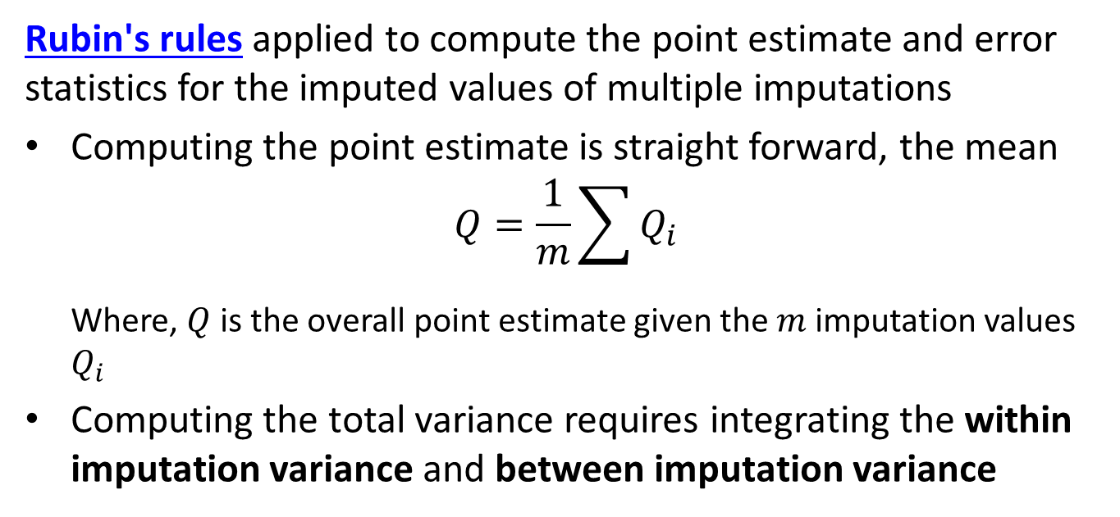
Imputation of Missing Values
Rubin's rules applied to compute the point estimate and error statistics for the imputed values of multiple imputations
Computing the point estimate is straight forward, the mean
$$Q=\frac{1}{m}\sum{Q_{i}}$$
  Where, $Q$ is the overall point estimate given the $m$ imputation values $Q_{i}$
Computing the total variance requires integrating the within imputation variance and between imputation variance

Slide 72

Imputation of Missing Values
Rubin's rules applied to compute the point estimate and error statistics for the imputed values of multiple imputations
Computing the total variance, $T$, requires integrating the within imputation variance and between imputation variance
$$T=\hat{U}+B+\frac{1}{m}B=\hat{U}+\left(1+\frac{1}{m}\right)B$$
  Within imputation variance, given the sampling variances, $U_{i}$: $\hat{U}=\frac{1}{m}\sum{U_{i}}$
  Between imputation variance$:$ $B=\frac{1}{m−1}\sum{{\left(Q−Q_{i}\right)}^{2}}$

Slide 73

Imputing Missing Values
We can visualize the quality of the imputed results
The distributions of imputed and observed values should match even for complex distributions
Deviations in density show less than ideal behavior

Slide 74

Imputing Missing Values
We can visualize the quality of the imputed results
Biplots show the relationship of observed and imputed values between two variables
4 possible combinations of observed and missing
The imputed values of the variables should not deviate noticeably from the observed cases
Limited number of missing cases makes interpretation uncertain

Slide 75
Imputation of Missing Values
The MICE algorithm has several advantages
MICE is effective for MCAR and particularly MAR where there is a relationship between missing values and other variables.
MICE preserves the uncertainty of the posterior distribution by using multiple imputations
Since MICE uses a different regression model for each variable, supporting multiple variable types

Slide 76
Imputation of Missing Values
Like all imputatiom algorithms, MICE algorithm has several disadvantages
MICE requires multiple imputation which is computationally intensive for large datasets or data with many variables
MICE is not suitable for time series data
MICE is not ideal for MNAR variables
MICE is susceptible to misspecification of the regressions for the missing values
There are no convergence guarantees and the uncertainty estimate can be overly optimistic

Slide 77
Imputation of Missing Values
For further reading:
For a detailed discussion of imputation with the MICE algorithm see Flexible Imputation of Missing Data, Second Edition, Stef van Buuren, Chapman and Hall, 2018
For a broad and deep exploration of working with missing data see Statistical Analysis with Missing Data, Little and Rudin, Wiley, 2020

Slide 78
Summary

Slide 79
Summary
Several commonly encountered data problems create problems for OLS and GLM models
Zero inflated response variables have an unusual number of zero values
  Use a mixture model to switch between a binomial and another distribution
Over-dispersed response variables have a long (typically right) tail
  Apply models with distributions and mixtures that account for large low probability responses
Outliers in independent variables have an undue influence on OLS and GLM models
  Robust regression models limit the influence of outliers on the response
Imputation of missing values must preserve distributions to be useful for inference
  The MICE algorithm is a flexible imputation model that preserves distributions

