Slide 1

CSCI E-83 Perception for Scientific Visualization
Steve Elston
Copyright 2018, 2019, 2020, 2021, 2022, 2023 2024, 2025, Stephen F Elston. All rights reserved.

Slide 2
Why This Course?
21st Century datasets are large and complex
Complexity is harder to address than size
Complexity makes understanding of relationships in data difficult
Complexity addressed with computer-intensive methods
Our focus is on the big ideas of computer-intensive statistics and data analysis arising in the late 20th and early 21st Centuries

Slide 3
Why This Course?
Data science is the science of understanding data
Complexity makes understanding the difficult part of data science!
Statistics is the science of making principled inferences from data
Inference leads to understanding
Inference is becoming harder as dataset complexity increases
Can’t we just use an LLM?
No!
LLMs are generative models not inferential models
LLMs and other AI models cannot generate understanding!

Slide 4
Why This Course?
What is the difference between statistical inference and predictive analytics?
Inference and prediction closely related
Prediction is the domain of machine learning; easier part
Goal is accurate predictions
Prediction is a form of inference
Predictive inference quantifies uncertainty
Statistical inference seeks to make discoveries by applying statistical models
Goal is to understand changes in response to changes in independent variables
Statistical inference quantifies uncertainty in parameter estimates
We focus on inference for this course, not machine learning and prediction

Slide 5
What We’ll Cover
Our focus is on the big ideas of computer-intensive statistics and data analysis arising in the late 20th and early 21st Centuries
Exploratory data analysis (EDA) to understand relationships in big complex data sets
Large scale and sparse models for complex and high-dimensional data sets
Non-Normal response models
Models for messy data, zero-inflation, over-dispersion, missing data, outliers
Time series properties and forecasting models for data with serial correlation
Computer intensive resampling methods for building models and inference, Bootstrapping and MCMC Bayes
Bayesian hierarchical models for complex relationships

Slide 6
Course Objectives
This fast-moving survey course helps build your toolbox for modeling complex data
Add understanding through inference to your data science toolbox
Broad introduction to the theoretical and methodological basis of data science
Exploratory data analysis (EDA) methods
Using inference to gain understanding
Computationally intensive methods
Models for data exhibiting serial correlation
Understand models for complex and messy datasets
Understanding data relationships and inference
What confidence should have in our inferences?

Slide 7
About your Instructor: Steve Elston
Instructor for Harvard since 2017
Data science consultant with several decades of experience
Clients include Microsoft, SAP, Lloyds Banking Group
Lead team that commercialized Bell Labs S, now open-source R
Company co-founder and held executive positions in several industries
Creator of multiple edX courses, author of books and articles
Inventor/coinventor on 5 issued patents
BS, physics and math (minor), University of New Mexico
MS and PhD, geophysics, Princeton University – John von Neuman Supercomputing Fellow
I love anything to do with natural history and the outdoors

Slide 8
About your TA: Eric Trucksess
Patent attorney focused on the chemical arts, particularly pharmaceuticals, solid state devices and polymeric coatings
Founder/architect of HasHave, formerly an online bartering site which facilitated the exchange of goods and services amongst member
Counsel to RocketFuel, an early-generation targeted marketing firm that applied ML principles in online marketing campaigns
Currently, consultant to a Dubai-based horse racing betting platform assisting in the collection, analysis and digestion of racing data

Slide 9
About your TA: Jacqueline Hardy
Bachelor’s Degree from Harvard Extension School (2015-2018)
Field of Study: International Relations
Minors: Quantitative Analysis & Government
Master’s Degree from Harvard Extension School (2022-2024)
Field of Study: Data Science
LG Electronics:
Product Specialist
Go-to-Market Manager
Data Analytics Specialist
SharkNinja
Strategic Planning and Operations Data Scientist
Building my own Data Science Consulting Firm

Slide 10
Grading: Undergraduate
Activity | Grade weight
Participation (graded discussions) | 10%
Assignments | 90%

Slide 11
Grading: Graduate
Activity | Grade weight
Participation (graded discussions) | 10%
Assignments | 60%
Independent project proposal | 5%
Independent project report | 25%

Slide 12
Assignments
Hands-on assignments tie theory to practice applied to data examples
Most of us only recall methods we actually use
Lectures provide introduction only
Expect to work out some details
Do not hesitate to ask for help on concepts or coding!!
It is okay to display code and exception messages in your public Ed Discussion posts!

Slide 13
Grading: Graduate
Independent Graduate Project:
An end-to-end project you will execute independently
Pay careful attention to grading rubric in Canvas
Can be great addition to your data science project portfolio
Pick a problem of particular interest to you!
Plan to spend about 80 hours on your analysis and report
Sufficient data must be available
Must use analytical methods within the scope of this course - e.g. focus in EDA and inference, no advanced ML or deep learning
Start thinking about your project soon - don’t put it off
Resources to help you get started are under the Project Module in Canvas
List of possible data sources: Far from comprehensive
Example project proposals and reports

Slide 14
Late Assignment Policy
Timely feedback is an important part of the learning process
To allow the timely release of solutions for assignments this course applied a late assignment policy:
Up to one day late - no penalty
Up to 5 days late - less 20%
More than 5 days late - no credit
Advice: start assignments and your project as soon as you can so you have time to address problems and ask questions!
Note: No extension is possible for Graduate Independent Projects!

Slide 15
Class Schedule
Class meeting Thursdays, 6:00 pm US Eastern Time:
Focus on theory to understand concepts
Limited time for code discussions
Section meetings Tuesdays, 6:00 pm US Eastern Time:
Focus on answer student questions - your questions!
Course concepts
Discus code and coding problems
Background and supplementary material as needed
All class meetings are recorded for on-demand viewing

Slide 16
Communications
Communicating with your instructors and other students is a significant aspect of participation in this course!
Ask questions about the course material, homework, etc.
Ask questions in the public forum so others can answer and gain from the discussion: if you have a question others do as well!
Answer other students’ questions
Comment on weekly graded discussion topics
Ed is the primary communications method
Generally, use public posts - okay to include code
Option to ask instructors private questions
Ask for the help you need!
Any communications by Canvas will likely be delayed!!

Slide 17
Communications
For private matters, you can directly communicate with the instructional team:
Grades
Late assignments
Etc.
Steve Elston: stephen_elston at g dot harvard dot edu
TAs, Eric Trucksess: ert713 at g dot Harvard dot edu, Jacqueline Hardy: jacquelinehardy at g dot harvard dot edu
Office hours: If you need individual assistance, please ask to schedule office hours. Don’t be shy!
Communications by Canvas may be significantly delayed!

Slide 18
Using AI for this course
As AI (LLMs) is becoming a standard tool for professional data scientists, limited use is allowed for this course
Writing & Analysis: Your written reports, question responses and discussion post must be your own original work!
Code Generation: You may use AI to generate small, discrete portions of code.
You may do so for up to 4 instances of up to 20 lines each in an assignment or a report
Required: Include the exact prompt(s) used to generate the code in your submission.
Validation of Results: You are responsible for validating the correctness, efficiency, and security of any AI-generated code.
Attribution & Integrity: Cite AI use per the Harvard Academic Integrity Policy (e.g., "Code generated using [Tool Name] with prompt: ‘...’")
An exception message is a valid prompt
See course syllabus in Canvas for additional details

Slide 19
Where can you find the course materials?
Read and understand the Syllabus!
Material specific to this course are in the Github repository
Slides
Notebooks for assignments
Data
Supplementary materials for review
Assignment due dates, submissions, and grading in Canvas
Class assignments
Graduate independent projects
Solutions and examples under Modules
Assignments are being revised!
Do not start assignments before they are posted in Canvas
Do a pull on the GitHub repository to get updated notebooks

Slide 20
Poll
Then, back to the lecture

Slide 21
Why Exploration and Visualization?
Exploratory data analysis (EDA) tools are essential to good data science
Isn’t the goal of data science to build predictive machine learning models?
Not always!
Often, we need to understand relationships found in data
Explain scientific or behavioral relationships
Determine if a relationship is important
Provide interpretable and actionable results
Our goal is to gain deep understanding for complex problems
EDA methods
Statistical inference

Slide 22
Why Exploration and Visualization?
Exploratory data analysis (EDA) tools are essential to good data science
Why not just start building models?
Understanding relationships in data saves missteps and unexplained poor model performance
Which variables are actually important?
How do these variables behave?
Are there errors and outliers in the data?

Slide 23
Why Exploration and Visualization?
Exploratory data analysis (EDA) tools are essential to good data science
Why not just start building models?
Communications is an important component of data science
Analytic results are only useful if they are understood and trusted
Graphical results are easy interpret
Graphical presentation greatly assists understanding by less technical colleagues
How good is a model fit?
Use EDA methods to explore model results
Compare model performance

Slide 24
Why is Perception Important?
Goal: Communicate information visually
Visualization technique maximize the information a viewer perceives
Gain insights when exploring relationships in data
Communicate insights to others
Limits of human perception are a significant factor in understanding complex relationships
Can apply results of the considerable research on human perceptions for data visualization

Slide 25
Use Aesthetics to Improve Perception
Use aesthetics to improve perception
We take a very broad view of the term ‘aesthetic’ here
A plot aesthetics is any property of a visualization which highlight aspects of the data relationships
Aesthetics are used to project additional dimensions of complex data
Plots generally restricted to 2-dimensional surface
Must project multiple dimensions of complex data on 2-d surface

Slide 26
Use Aesthetics to Improve Perception
Important note!!
I expect you to use good perceptual methodology for creating plots for your project!!

Slide 27
Organization of Plot Aesthetics
We can organize aesthetics by their effectiveness:
Easy to perceive plot aesthetics: help most people gain understanding of data relationships
Aesthetics with moderate perceptive power: useful properties to project data relationships when used sparingly
Aesthetics with limited perceptive power: useful within strict limits

Slide 28
Properties of Common Aesthetics
Property or Aesthetic | Perception | Data Types
Aspect ratio | Good | Any
Regression lines | Good | Numeric
Marker position | Good | Numeric, counts
Bar length | Good | Counts, numeric
Sequential color palette | Moderate | Numeric, counts, ordered categorical
Marker size | Moderate | Numeric, counts, ordered categorical
Line types | Limited | Categorical
Qualitative color palette | Limited | Categorical
Marker shape | Limited | Categorical
Area | Limited | Numeric, counts, ordered categorical
Angle | Limited | Numeric

Slide 29
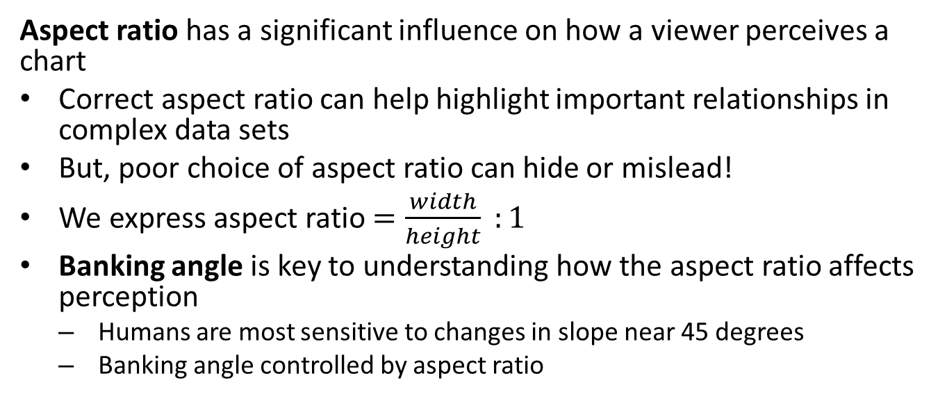
Aspect Ratio
Aspect ratio has a significant influence on how a viewer perceives a chart
Correct aspect ratio can help highlight important relationships in complex data sets
But, poor choice of aspect ratio can hide or mislead!
We express aspect ratio $=\frac{width}{height} :1$
Banking angle is key to understanding how the aspect ratio affects perception
Humans are most sensitive to changes in slope near 45 degrees
Banking angle controlled by aspect ratio

Slide 30
Example of Changing Aspect Ratio
Longest directly measured scientific time series in existence is the sunspot count:
## YEAR SUNACTIVITY ## 0 1700.0 5.0 ## 1 1701.0 11.0 ## 2 1702.0 16.0 ## 3 1703.0 23.0 ## 4 1704.0 36.0
* Longest directly observed temperature series starts in 1772

Slide 31
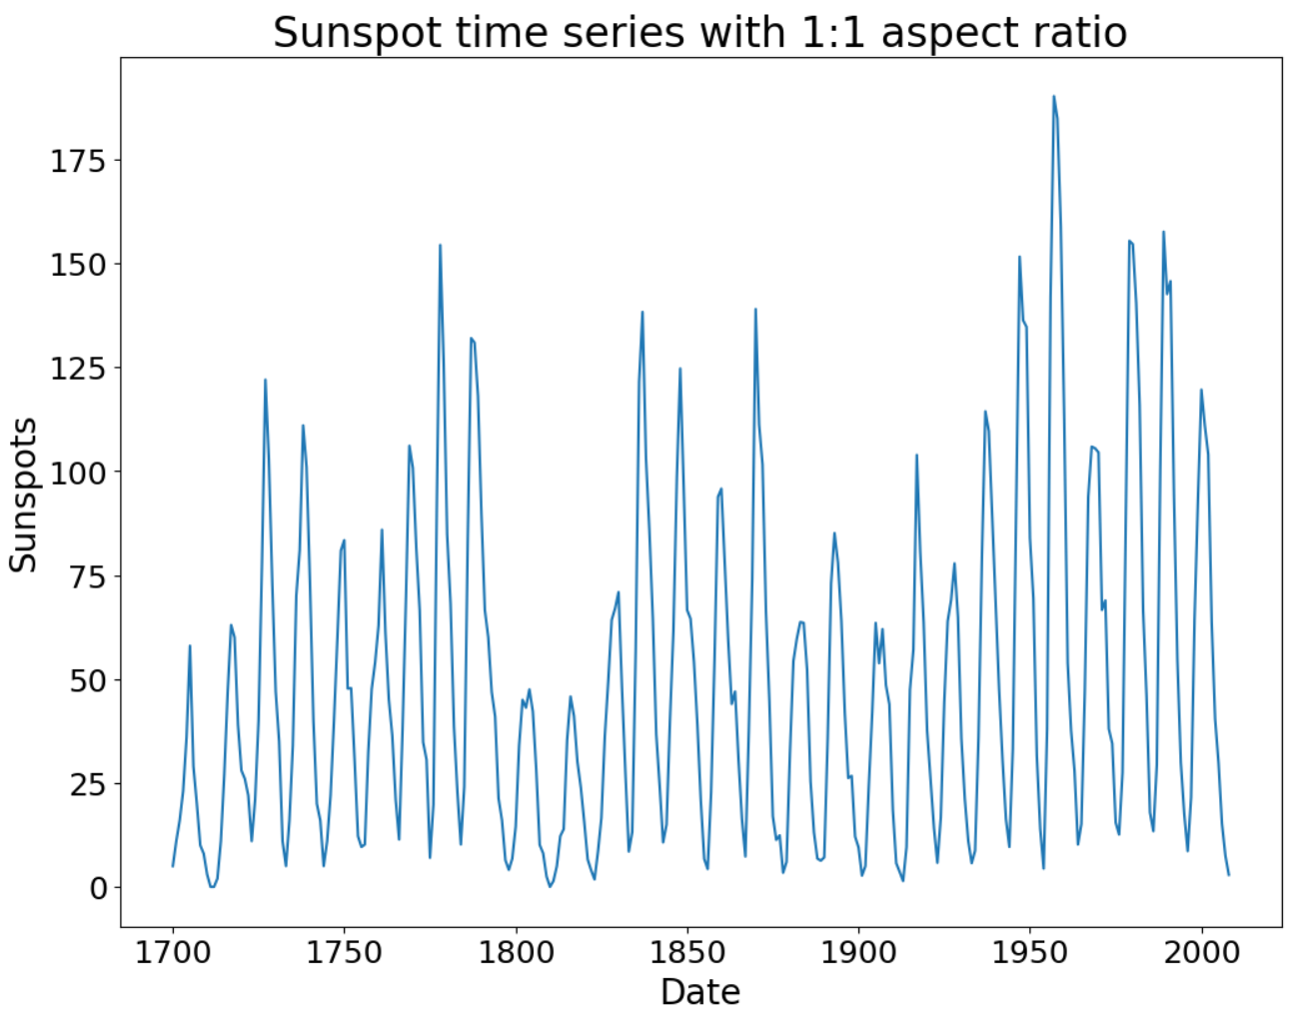
Example of Changing Aspect Ratio
Example uses data from 1700 to 1980
Aspect ratio is 1:1
Banking angle is near vertical
Can you perceive the asymmetry in these sunspot cycles?

Slide 32
Example of Changing Aspect Ratio
Notice how changing aspect ratio change perception of the asymmetry?
Aspect ratio is now 20:1
Banking angle is about 45 degrees for most of the cycles
Can you see the asymmetry in these cycles now?

Slide 33
Sequential and Divergent Color Palettes
Use of color as an aesthetic in visualization is a complicated subject.
Color is often used, also often abused!
A qualitative palette is a palette of individual colors for categorical values
Sequential palettes and divergent palettes are a sequence of colors
Numeric variables
Ordinal or ordered categorical variables
For examples of the foregoing palette types see the Seaborn Choosing Color Palettes Tutorial
To examine the wide range of available color pallets see Choosing Color Maps in Matplotlib

Slide 34
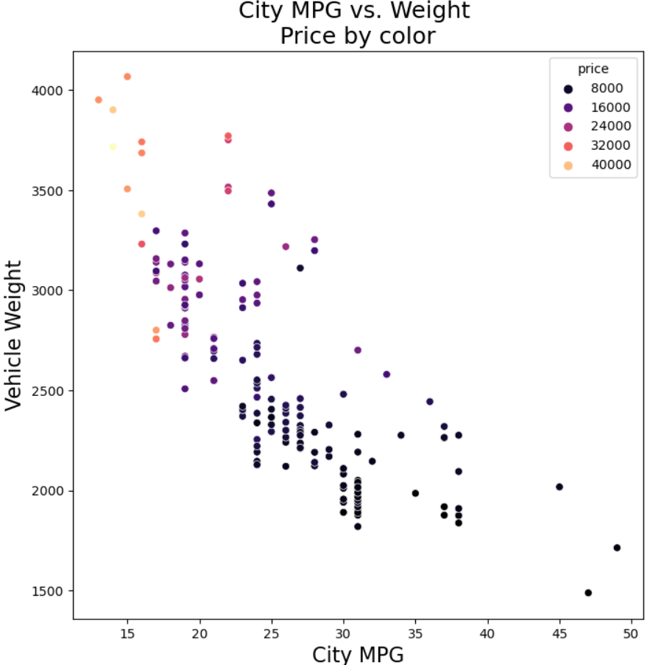
Auto Weight by Sequential Color Palette
Sequential pallet shows relative auto price
Darker colors lower higher price
Lighter colors indicate higher price
Can you see the pattern that emerges?

Slide 35
Limits of Color
Regardless of the approach there are some significant limitations
A significant number of people are color blind
Red-green color blindness is most common, primarily affecting men
Even the best sequential or divergent palettes show only relative value of numeric variables
Perception of exact numeric values is difficult, except in special cases
People cannot perceive large number of colors for categories
Warning! Avoid using meaningless color in graphics
Using color for no reason is a distraction!
Example: meaningless color for bar plots
Example: meaningless color in box plots

Slide 36
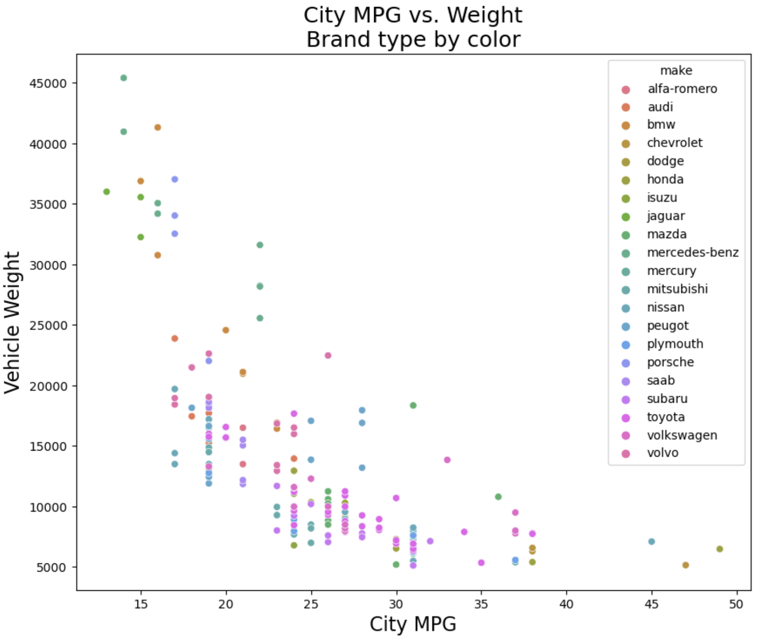
Limits of Color
Large qualitative color pallet reduces perception
This plot includes too many similar colors for large number of categories
Virtually impossible to determine where autos from each make fall on the plot

Slide 37
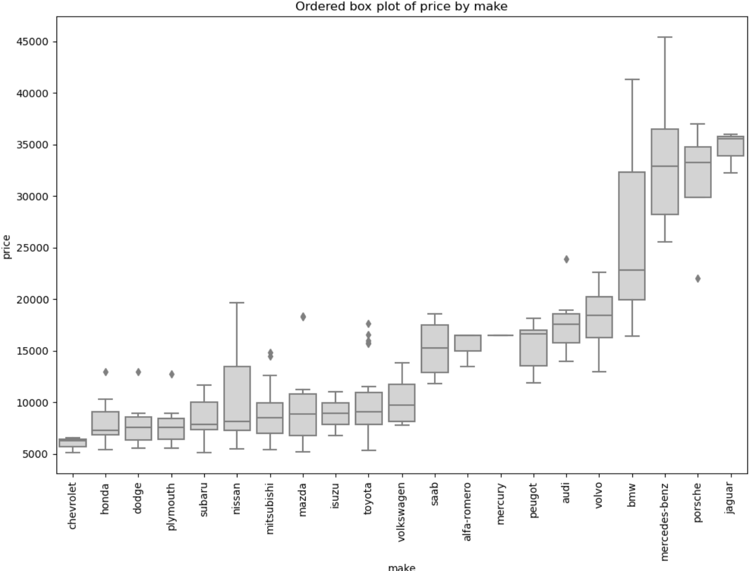
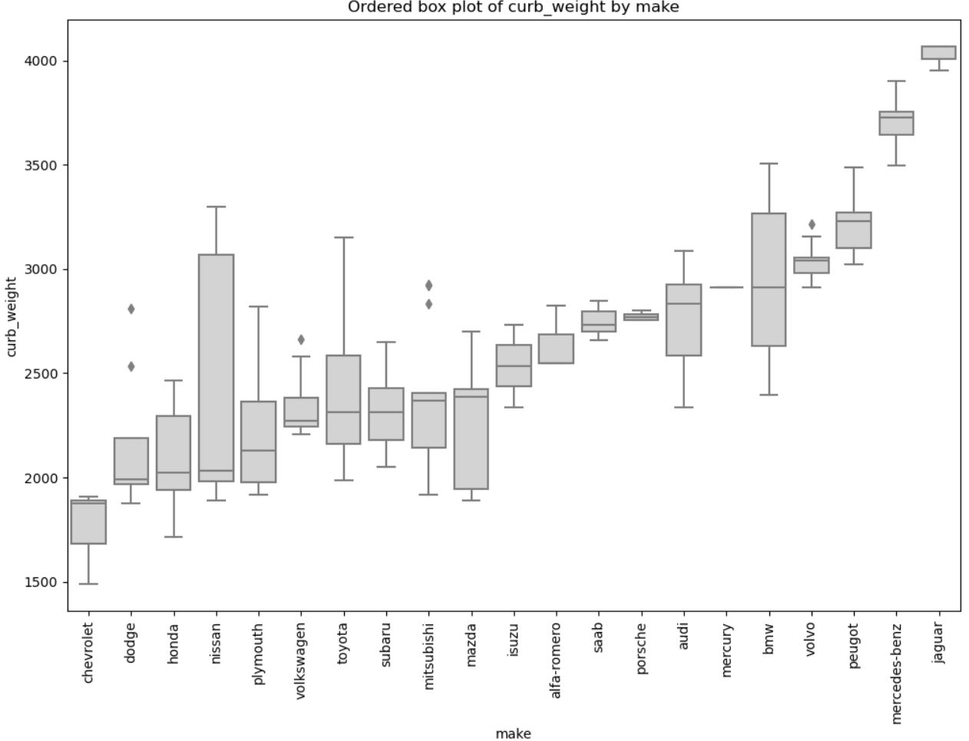
Limits of Color
Ordered box plot is an alternative to qualitative color and shape for variables with too many categories
Ordering improves perception, i.e. like ordered bar chart

Slide 38
Marker Size
Marker size is moderately effective aesthetic
Used properly, marker size can highlight important relationships in complex data sets
Numeric values
Ordinal variables
Viewers can generally perceive relative differences, but not actual values
Small size differences are not perceptible
Only relative relationship in numeric variables
Limited steps of ordinal variables

Slide 39
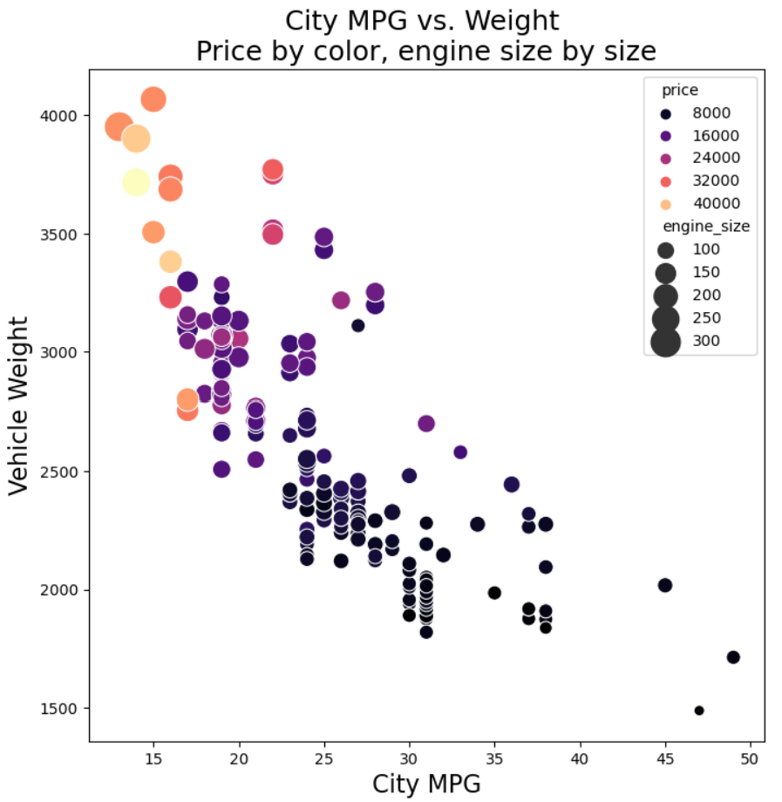
Engine Size by Marker Size and Price by Sequential Color Palette
Sequential color pallet for price, marker size for engine size
Color pallet same as previous example
Engine size by relative marker size
Can you see the patterns in this 4-dimensional projection?

Slide 40
Line Plots and Line Type
Line plots connect discrete, ordered, data points by a line
Can use different colors and line pattern types to differentiate categories
Only useful for a limited number of lines on one graph
Too many similar colors and line patterns on one plot leads to viewer confusion and poor perception
You can see examples of line styles supported in Matplotlib in this article

Slide 41
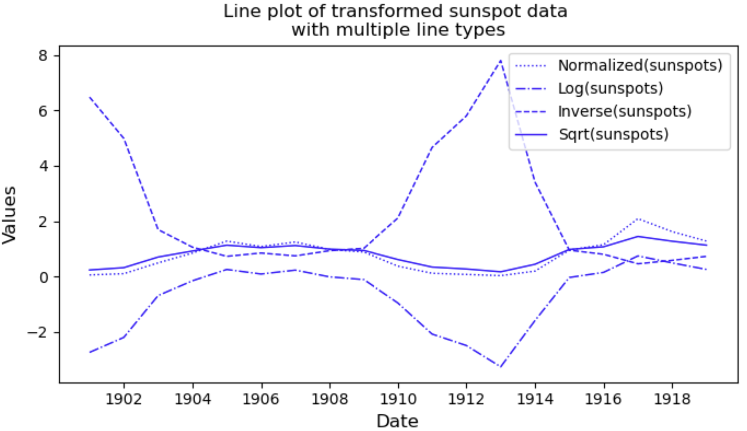
Limits of Line Type
Line type indicates type of transformation
It is easy to perceive the 4 line types
Only a limited number of line types can be perceived!

Slide 42
Marker Shape
Marker shape is useful for displaying categorical relationships
Aesthetic is only useful when two conditions are met:
The number of categories is small
Distinctive shape are chosen for the markers
Human perception limits the number of shapes humans can perceive well
You can find a list of Matplotlib marker shapes here

Slide 43
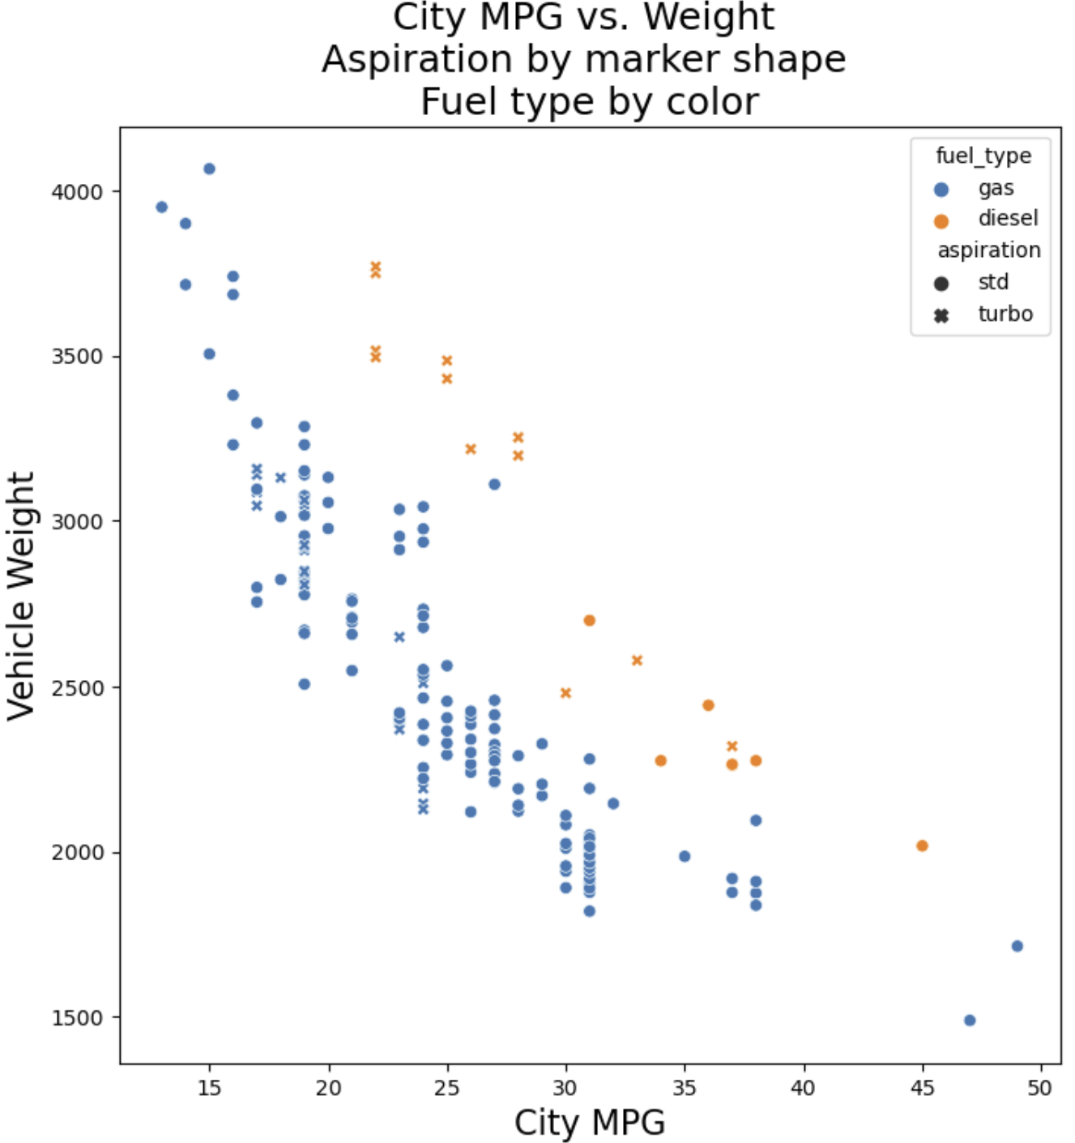
Aspiration by Marker Shape
Limited use of qualitative color and marker shape projects 4 dimensions
Limited color pallet for good perception
Limited number of marker shapes for good perception
Can you see the pattern that emerges?

Slide 44
Regression Lines
Regression lines draw viewers attention
Typically use a nonlinear regression line
Polynomial
Splines - piece wise model
Lowess - local nonlinear regression
Bootstrap confidence intervals show range of probable trends
More about bootstrap resampling later
Ideally want straight line relationship
Nonlinear relationships often arise from non-Normal distributions
Linear relationship is more intuitive

Slide 45
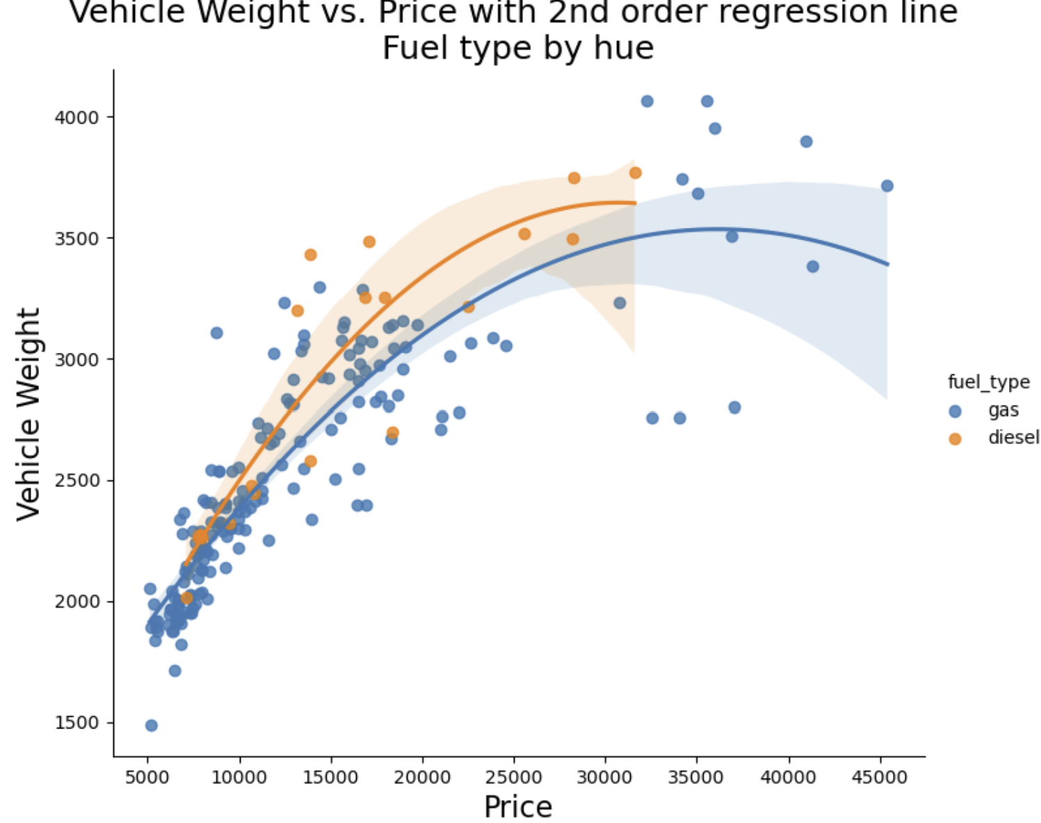
Regression Line and Transformation Example
Regression lines highlight the trends for gas and diesel engines
Second order polynomial fit produces curved lines

Slide 46
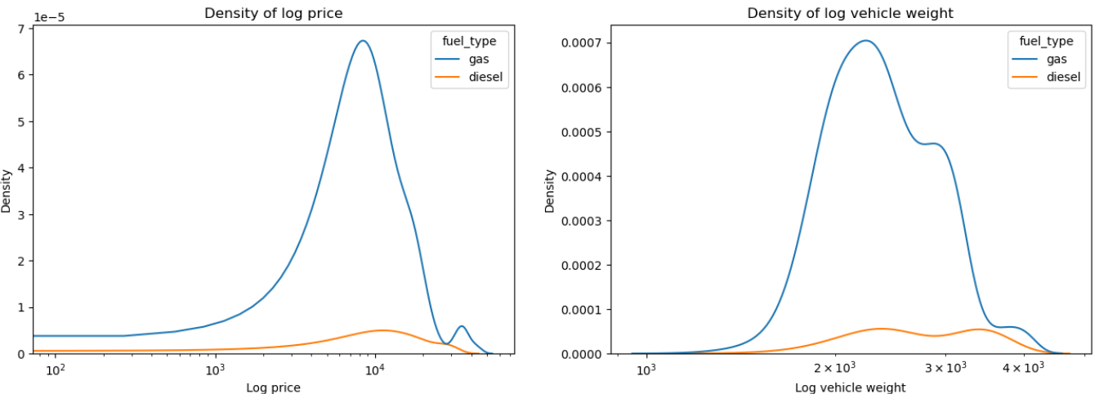
Regression Line and Transformation Example
What are the distributions of these variables?
Notice the right skew of these distributions

Slide 47
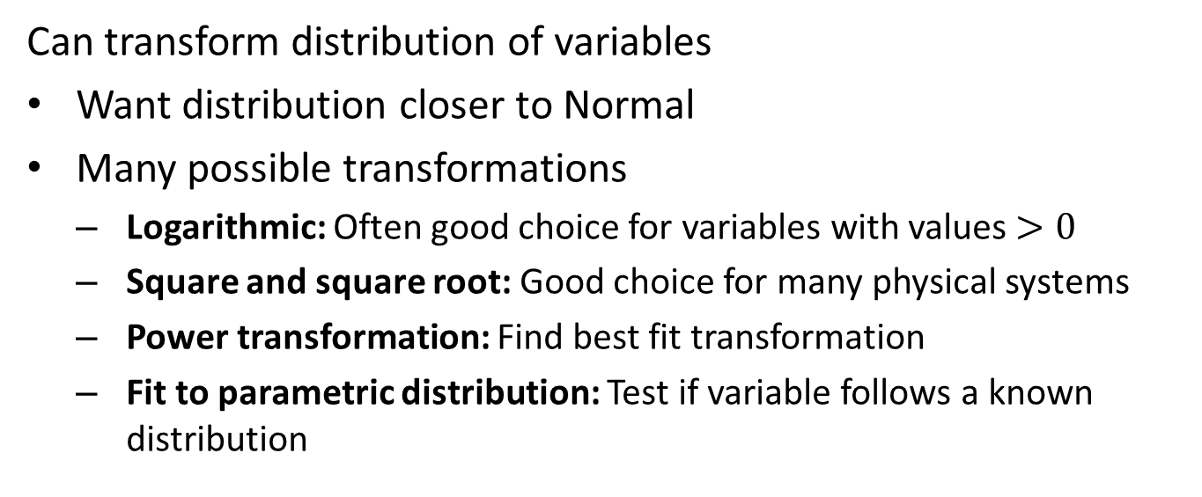
Regression Line and Tramsformation Example
Can transform distribution of variables
Want distribution closer to Normal
Many possible transformations
Logarithmic: Often good choice for variables with values $>0$
Square and square root: Good choice for many physical systems
Power transformation: Find best fit transformation
Fit to parametric distribution: Test if variable follows a known distribution

Slide 48
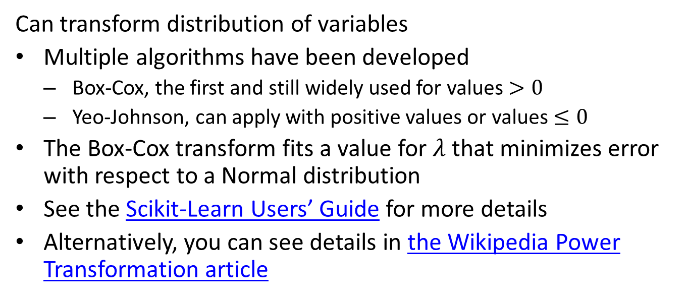
Regression Line and Tramsformation Example
Can transform distribution of variables
Multiple algorithms have been developed
Box-Cox, the first and still widely used for values $>0$
Yeo-Johnson, can apply with positive values or values $≤0$
The Box-Cox transform fits a value for $λ$ that minimizes error with respect to a Normal distribution
See the Scikit-Learn Users’ Guide for more details
Alternatively, you can see details in the Wikipedia Power Transformation article

Slide 49

Regression Line and Tramsformation Example
Transformed distributions
Distribution of logarithm of the curb weight is nearly symmetric

Slide 50
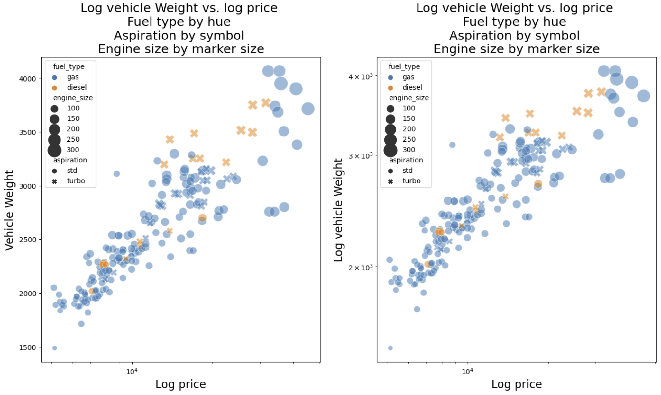
Regression Line and Tramsformation Example
Transform the distributions
Distribution of logarithm of the curb weight
The plots are fairly similar, log-log with less dispersion

Slide 51
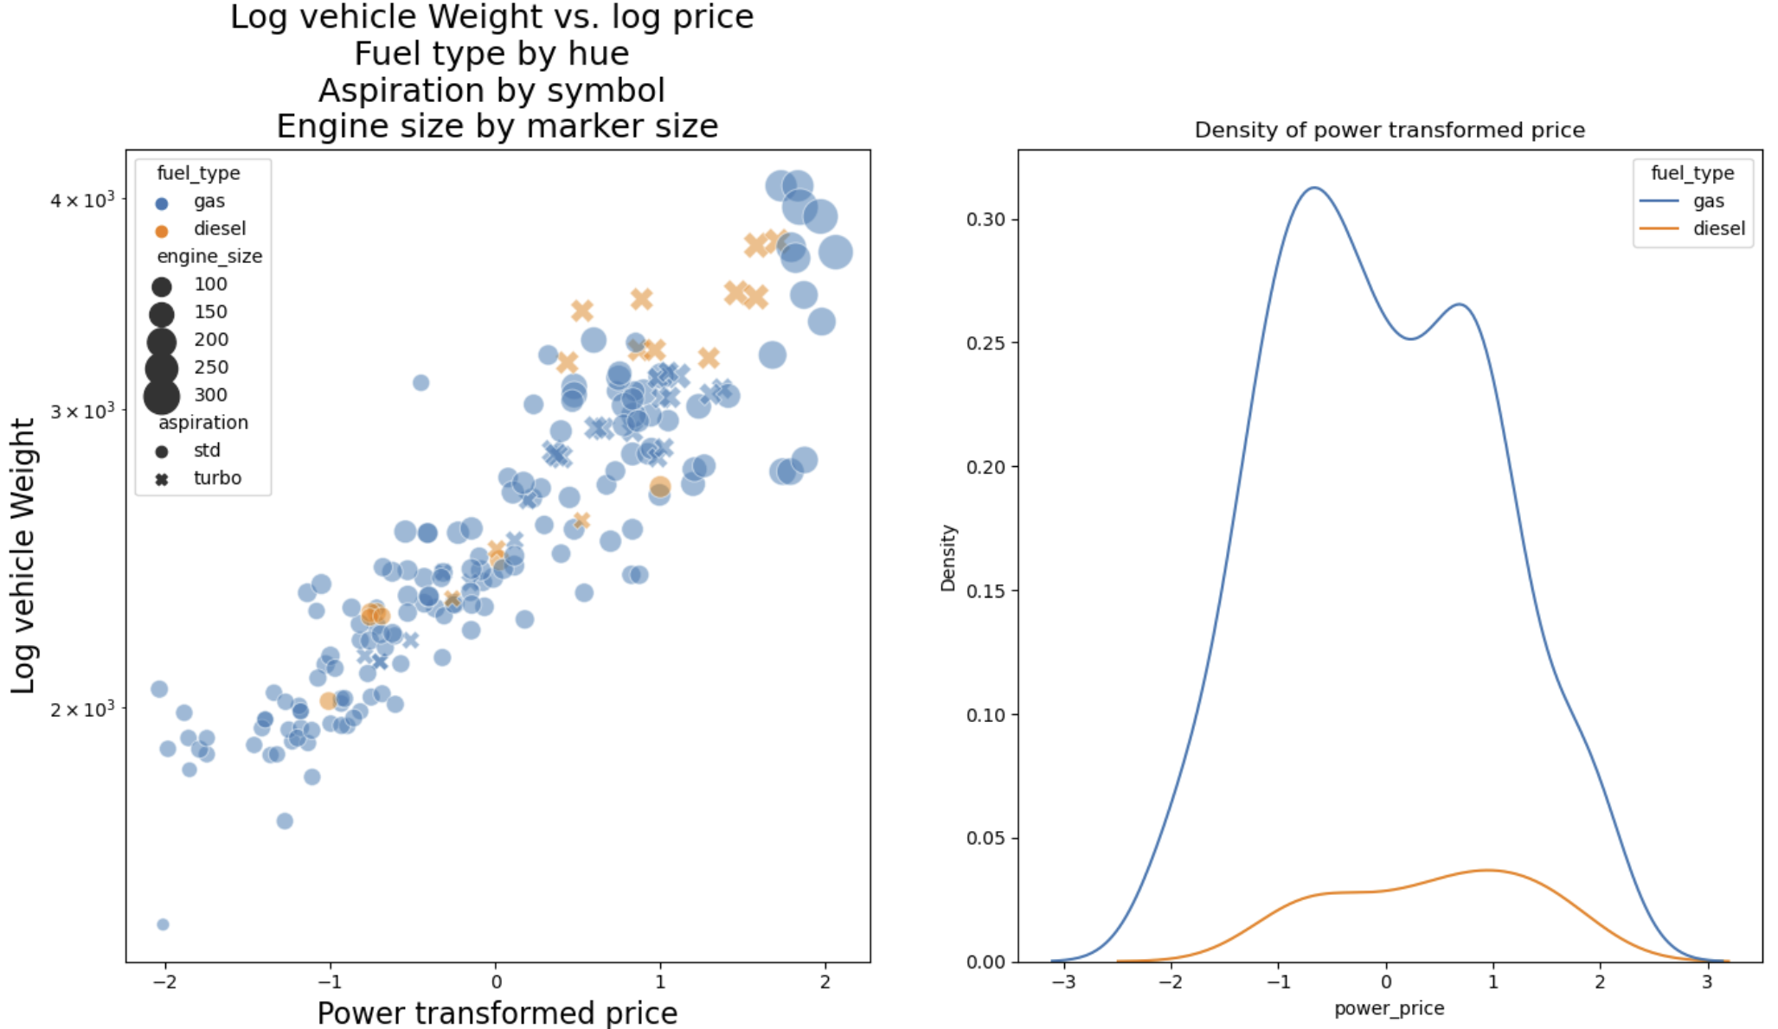
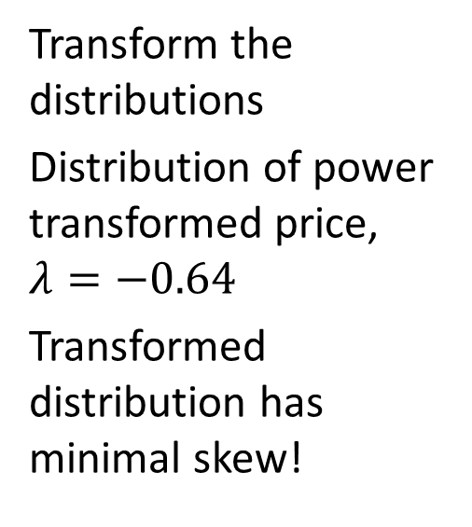
Regression Line and Transformation Example
Transform the distributions
Distribution of power transformed price, $λ=−0.64$
Transformed distribution has minimal skew!

Slide 52
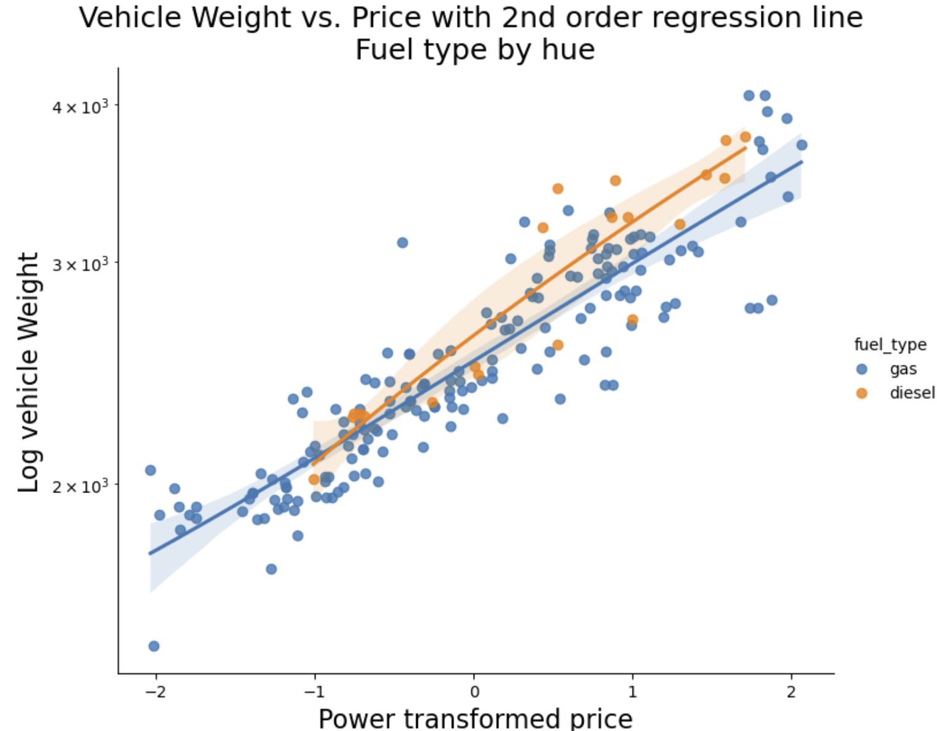
Regression Line and Tramsformation Example
Second order polynomial fit to transformed variables
Regression lines are nearly strait!

Slide 53
Summary
We have explored these key points
Visualization is a powerful EDA method
Understand relationships in data
Communicate data science insights
Proper use of plot aesthetics enable projection of multiple dimensions of complex data onto the 2-dimensional plot surface.
All plot aesthetics have limitations which must be understood to use them effectively
The effectiveness of a plot aesthetic varies with the type and the application
Regression lines help to focus viewer on trends
Transformations to linear relationships can be informative

Slide 54
Properties of Common Aesthetics
Property or Aesthetic | Perception | Data Types
Aspect ratio | Good | Any
Regression lines | Good | Numeric
Marker position | Good | Numeric, counts
Bar length | Good | Counts, numeric
Sequential color palette | Moderate | Numeric, counts, ordered categorical
Marker size | Moderate | Numeric, counts, ordered categorical
Line types | Limited | Categorical
Qualitative color palette | Limited | Categorical
Marker shape | Limited | Categorical
Area | Limited | Numeric, counts, ordered categorical
Angle | Limited | Numeric

