Slide 1

Spectral Properties of Time Series
Steve Elston
Copyright 2025 Stephen F Elston. All rights reserved.

Slide 2
Spectral Properties of Time Series
The power spectrum of an image reveals fundamental properties
Power spectrum reveals frequency components of a time series
Low frequency components represent regions with slowly changing properties
High frequency components arise from local features with rapid changes
Filtering changes the power spectrum of a time series

Slide 3
Spectral Properties of Images
We can decompose an image into frequency components using a Fourier transform
The Fourier transform decomposes a signal into frequency components
Is a linear transform from time domain to frequency domain
The 1-dimensional Fourier transform of a function, $f\left(x\right)$, can be expressed:
$$\hat{f}\left(ω\right)=\int_{−∞}^{∞}{f\left(x\right) e^{−2πixω}dx}$$
$\hat{f}\left(ω\right)$ is the complex spectrum of $f\left(x\right)$
Imaginary component is phase at frequency $ω$
Magnitude of the complex number is amplitude at frequency $ω$

Slide 4
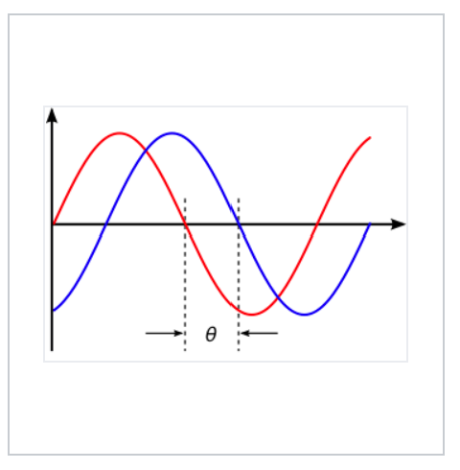
Spectral Properties of Images
We can decompose an image into frequency components using a Fourier transform
The Fourier transform decomposes a signal into frequency components
$$\hat{f}\left(ω\right)=\int_{−∞}^{∞}{f\left(x\right) e^{−2πixω}dx}$$
$\hat{f}\left(ω\right)$ is the complex spectrum of $f\left(x\right)$
Imaginary component is phase at frequency $ω$
Magnitude of the complex number is the signal amplitude at frequency $ω$
Amplitude
Two sinusoidal signals with identical frequency and amplitude, phase shifted by θ
Credit, Wikipedia commons

Slide 5
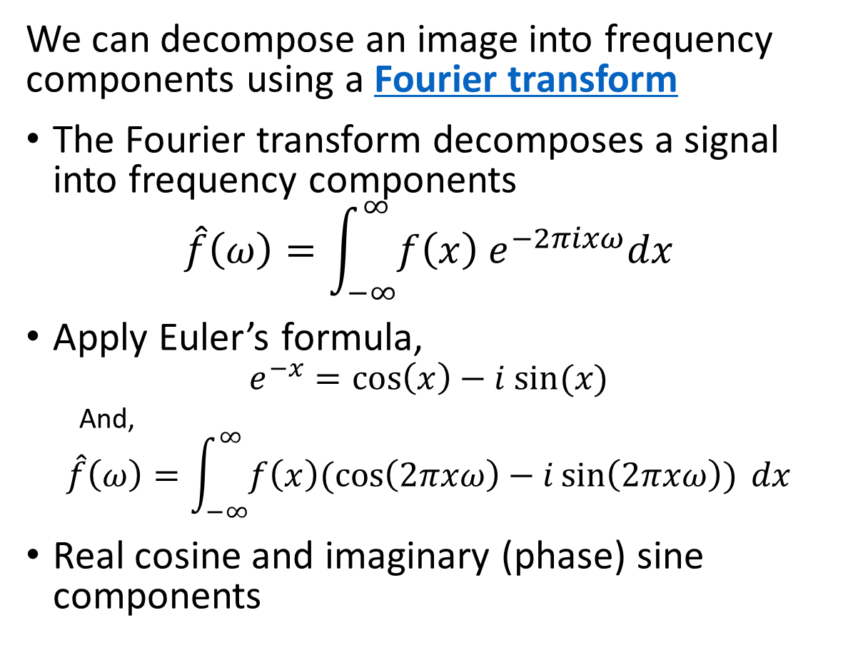
Spectral Properties of Images
We can decompose an image into frequency components using a Fourier transform
The Fourier transform decomposes a signal into frequency components
$$\hat{f}\left(ω\right)=\int_{−∞}^{∞}{f\left(x\right) e^{−2πixω}dx}$$
Apply Euler’s formula,
$$e^{−x}=\cos\left(x\right)−i sin⁡(x)$$
And,
$$\hat{f}\left(ω\right)=\int_{−∞}^{∞}{f\left(x\right)(\cos\left(2πxω\right)−i\sin\left(2πxω\right)) dx}$$
Real cosine and imaginary (phase) sine components
Amplitude
Two sinusoidal signals with identical frequency and amplitude, phase shifted by θ
Credit, Wikipedia commons

Slide 6
Spectral Properties of Images
We can decompose an image into frequency components using a Fourier transform
The Fourier transform decomposes a signal into frequency components
$$\hat{f}\left(ω\right)=\int_{−∞}^{∞}{f\left(x\right) e^{−2πixω}dx}$$
For our purposes, we mostly care about the power spectrum
$$\overline{S_{ω}}\left(ω\right)≜{\left|\hat{f}\left(ω\right)\right|}^{2}$$
Amplitude
Two sinusoidal signals with identical frequency and amplitude, phase shifted by θ
Credit, Wikipedia commons

Slide 7
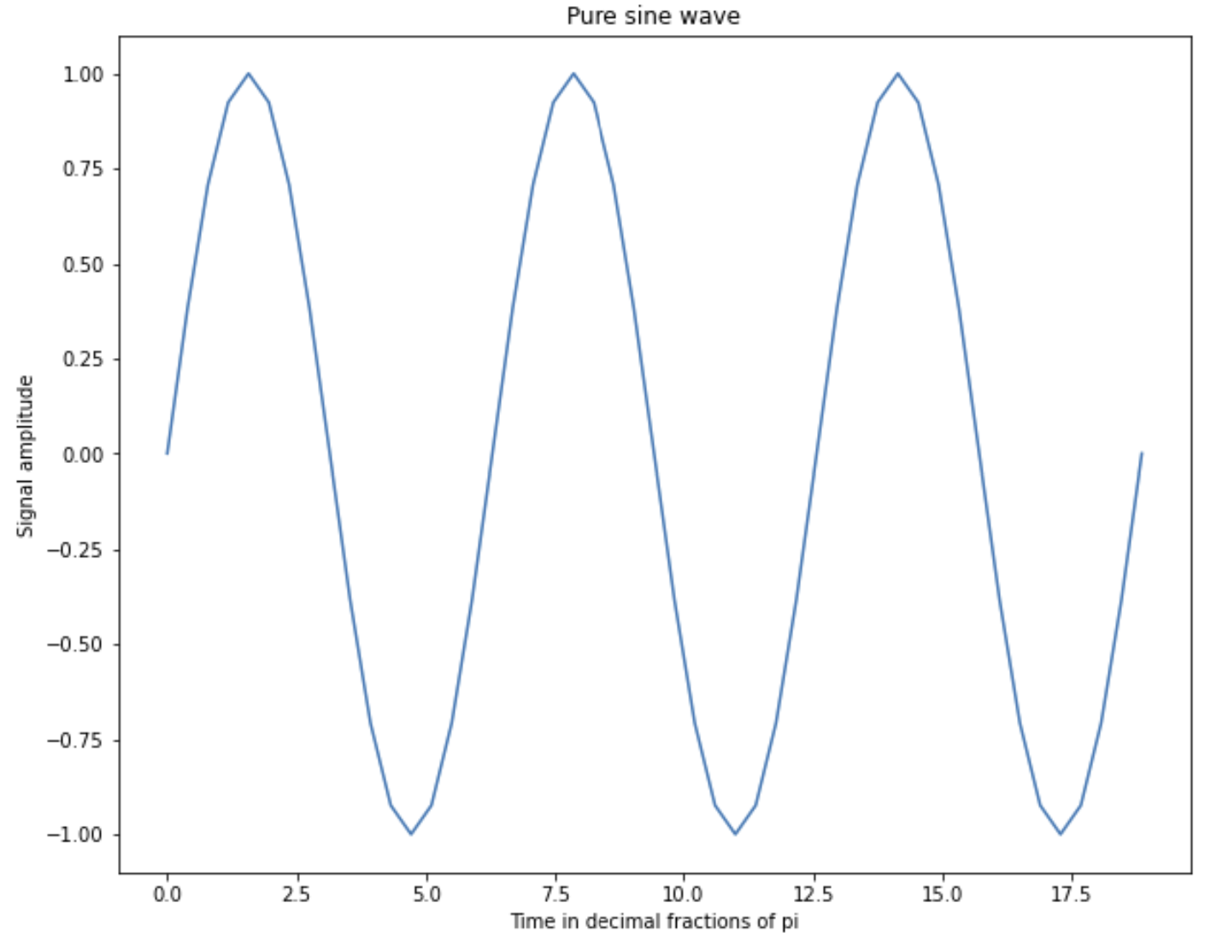
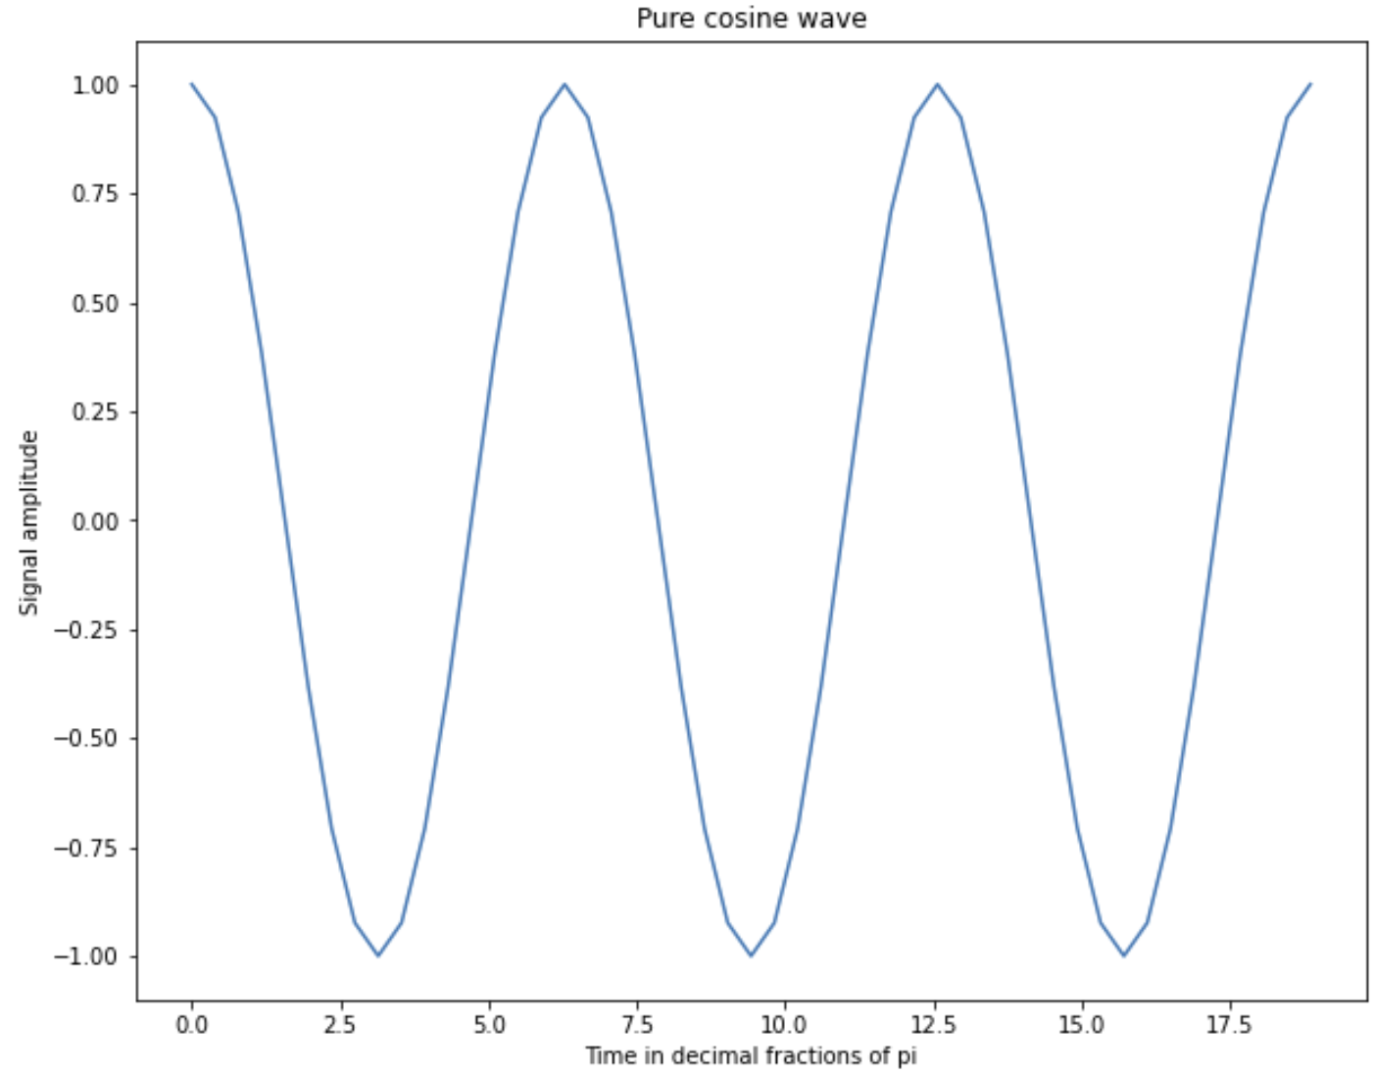
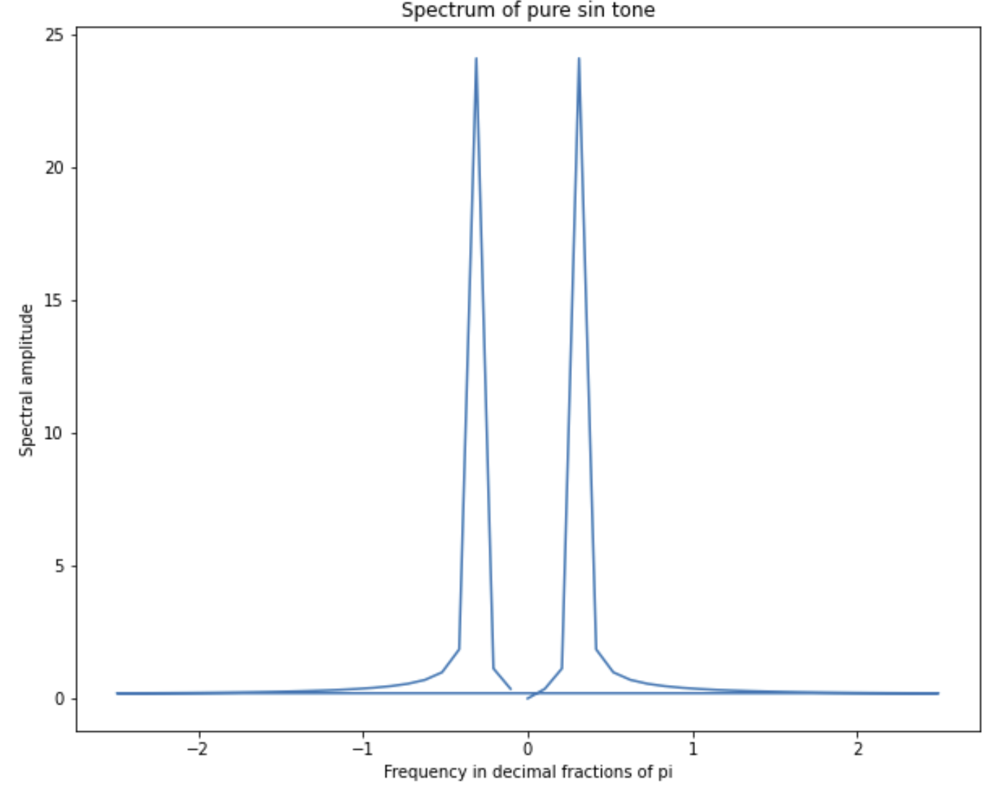
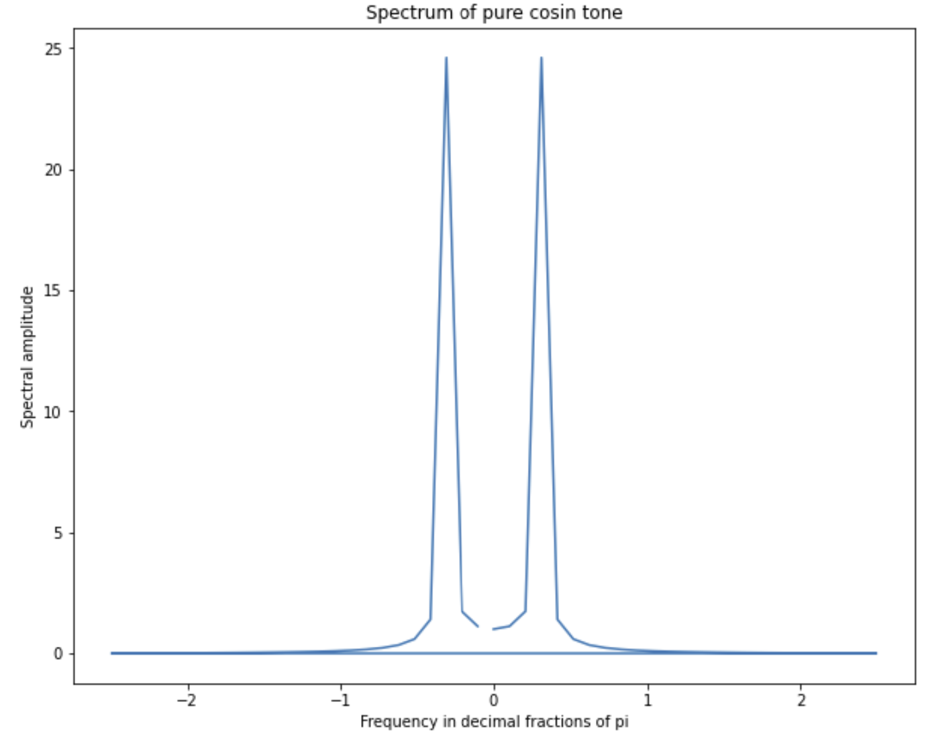
Spectral Properties of Images
Example of single frequency time series and their power spectrum

Slide 8
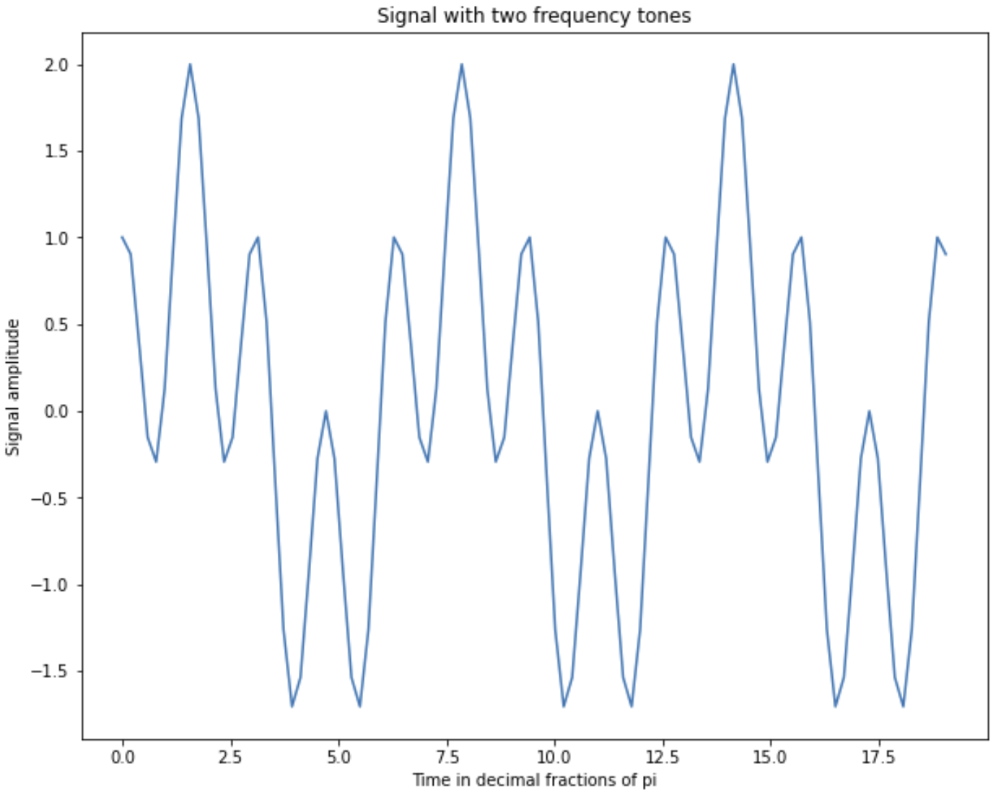
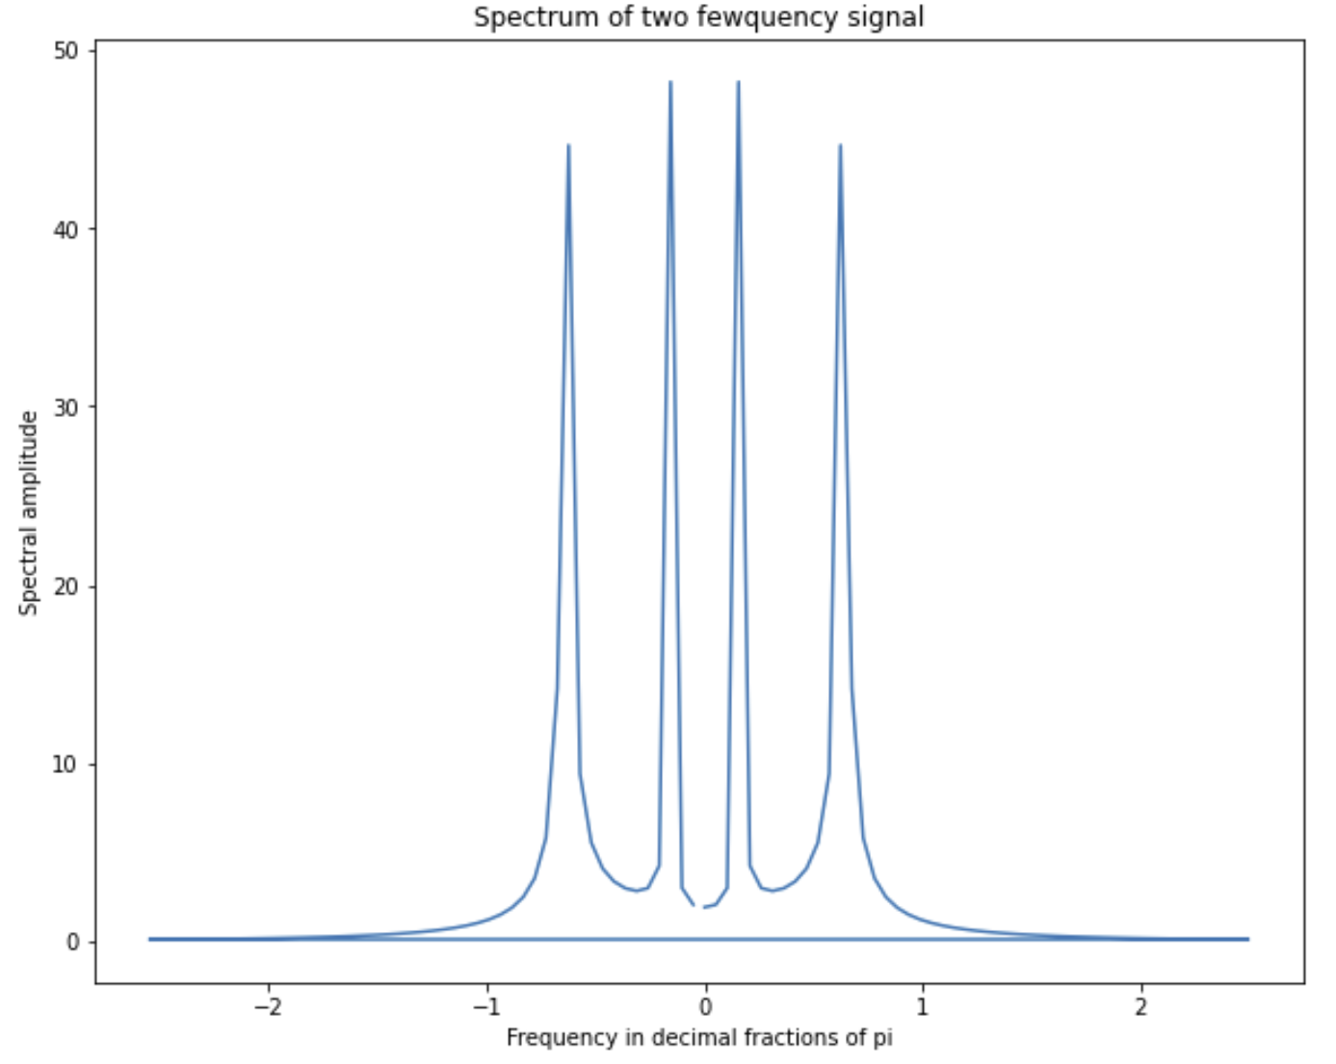
Spectral Properties of Images
Example of time series with two frequencies and the power spectrum

Slide 9
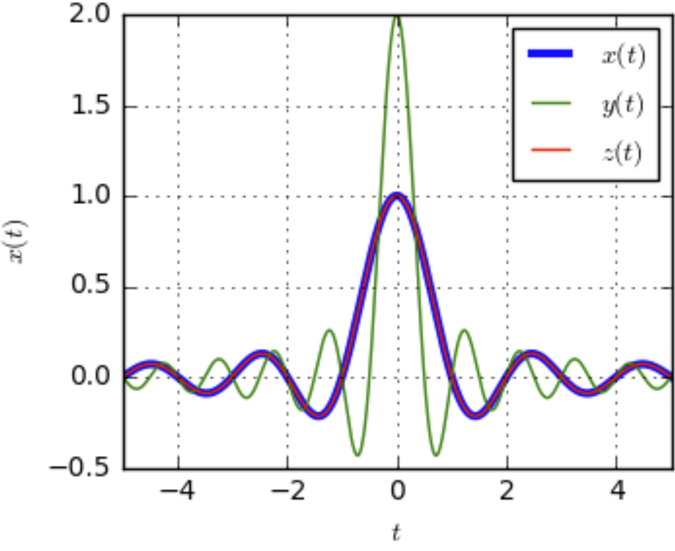
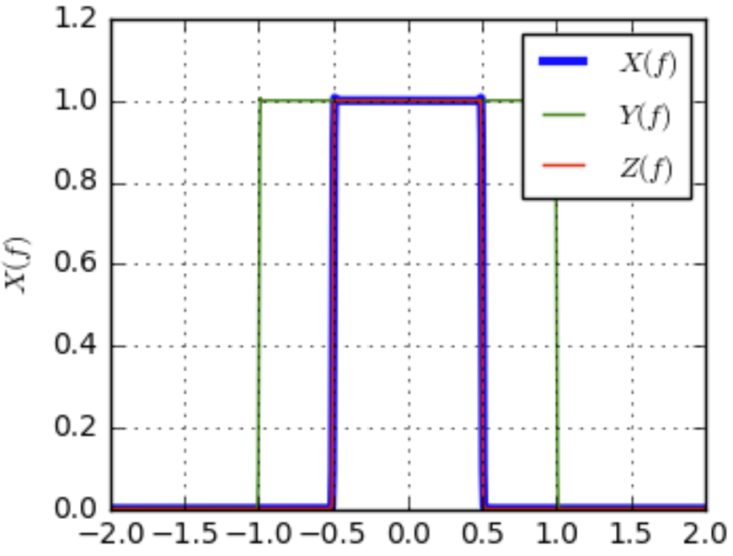
Spectral Properties of Images
Impulse response of convolutional a filter is the Fourier transform in the frequency domain
Fourier Transform
Filter in time domain
Filter in frequency domain
Credit, DSP Illustrations
Relationship is invertable (inverse Fourier transform) and commutable – exchange time and frequency domain

