Slide 1

Introduction to Inference and Confidence Intervals
Steve Elston
Copyright 2018, 2019, 2020, 2021, 2022, 2023 2024, 2025, Stephen F Elston. All rights reserved.

Slide 2
Introduction to Statistical Inference
All statistical inference has uncertainty
Characterization of uncertainty is a goal of statistical inference
Any model using real-world data has inherent uncertainty
Quantification of uncertainty is vital to trustworthy inference
Statistical inference seeks to avoid being fooled by randomness; A catchy title of a book

Slide 3
Introduction to Statistical Inference
All statistical inference has uncertainty
A very few examples of false inference from randomness
Hypothesis | Fooled by Randomness
How certain are you that eating fast food improves your health? | Some of my friends are doing great on this diet
How much confidence should we have that a marketing campaign increased sales? | Sales are up in the last month since the campaign started
How effective is a certain stock trading strategy for actually improving returns? | Traders using this strategy have made money recently
How good are the model parameter estimates? | The model has made accurate predictions so far

Slide 4
Applications of Statistical Inference
Confusingly, the term statistical inference is applied in many contexts
Inference on differences in distributions: Are samples drawn from the same distribution or not?
The null hypothesis; the distributions are the same
Inference for model parameters and model selection: Statistical models, including machine learning models, use estimates of unknown parameters
Compute uncertainty in model parameter estimates
Test hypothesis that the parameter values are not significant
Test if differences in model performance are significant
Inference for prediction: In recent decades the distinction between prediction and classical inference has blurred
Example, classification decision rules determine the most likely class for each case of input values
Inference also used to determine the confidence in predictions

Slide 5
Types of Hypothesis Tests
A great many tests have been developed
Different tests for one sample, two samples or more
Parametric test uses assumptions about the sample distribution
Non-parametric tests make no distribution assumptions
Select test for discrete, continuous or numeric, categorical, ordinal, interval, count, ratios, …

Slide 6
Types of Hypothesis Tests
A great many tests have been developed
Common tests are available to compare many statistics
effect size (e.g. means)
Variance
goodness of fit
Correlation
Heteroskedasticity
distribution assumptions
Independence
Etc.

Slide 7
Inference for Hypotheses
Hypothesis testing seeks to answer the question, are the differences in a statistic statistically significant?
Statistical significance must not be confused importance to the problem being addressed!
In 1922, Ronald A. Fisher warned:
“I believe that no one who is familiar, either with mathematical advances in other fields, or with the range of special biological conditions to be considered, would ever conceive that everything could be summed up in a single mathematical formula, however complex.”

Slide 8
Inference for Hypotheses
Many statisticians say that a statistically significant result indicates a relationship worthy of further investigation by methods including:
Gather more data, either observational or experimental
Find other variables which might illuminate the relationship under investigation
Consider the theoretical basis of the relationship. e.g., can known science or domain knowledge add understanding?
Etc.

Slide 9
Confidence Intervals; the Key to Inference
In frequentist statistics uncertainty of an inference is expressed in terms of a confidence interval
A confidence interval is defined as the expected variation of a statistical point estimate from random sampling alone
A point estimate is the best estimate of a statistic from the sampled observations
Example, a maximum likelihood estimate of a model parameter given the observations
Two types of of confidence intervals:
Two-sided confidence intervals: express confidence that a sample estimate is within some range around the point estimate
One-sided confidence intervals: express confidence that the sample estimate is greater or less than some range of values

Slide 10
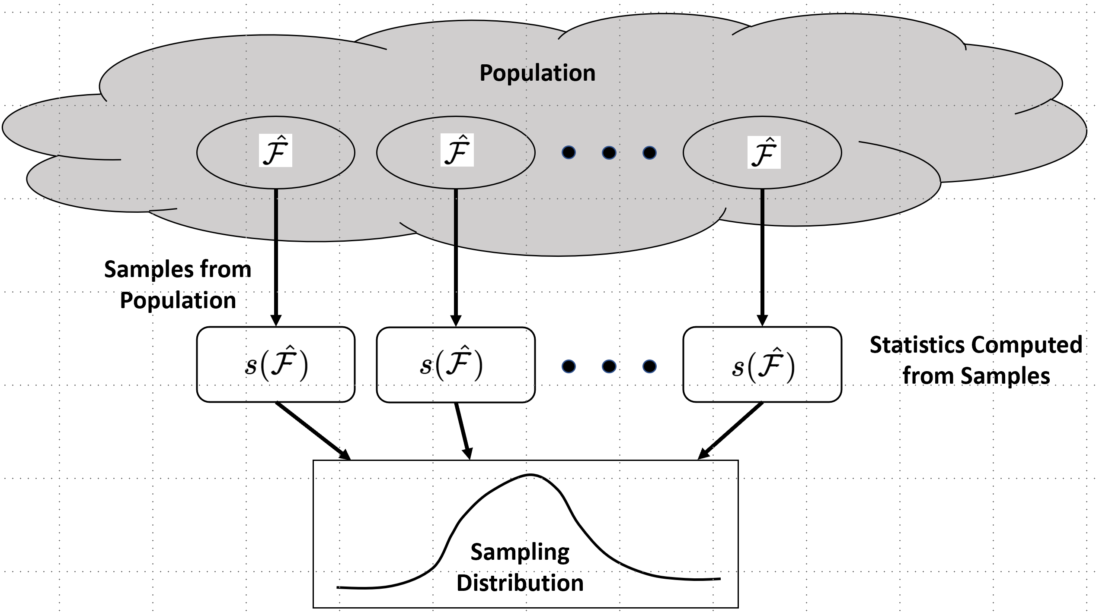
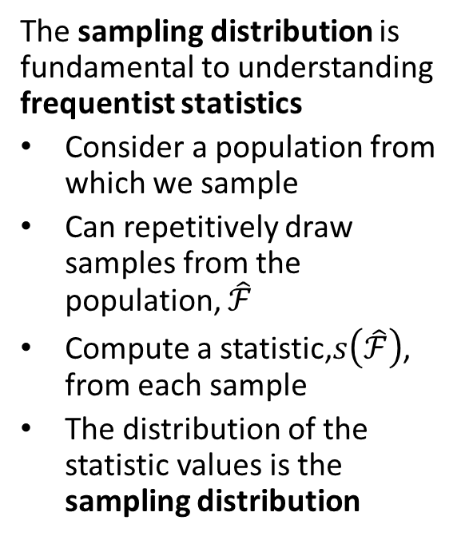
What is the Sampling Distribution?
The sampling distribution is fundamental to understanding frequentist statistics
Consider a population from which we sample
Can repetitively draw samples from the population, $\hat{ℱ}$
Compute a statistic,$s\left(\hat{ℱ}\right)$, from each sample
The distribution of the statistic values is the sampling distribution
Sampling distribution of unknown population parameter

Slide 11
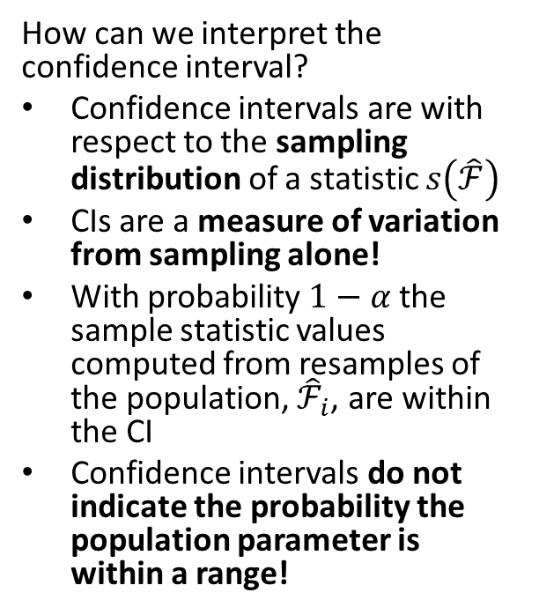
Interpretation of Confidence Intervals
How can we interpret the confidence interval?
Confidence intervals are with respect to the sampling distribution of a statistic $s\left(\hat{ℱ}\right)$
CIs are a measure of variation from sampling alone!
With probability $1−α$ the sample statistic values computed from resamples of the population, ${\hat{ℱ}}_{i}$, are within the CI
Confidence intervals do not indicate the probability the population parameter is within a range!
CI
Sampling distribution of unknown population parameter

Slide 12
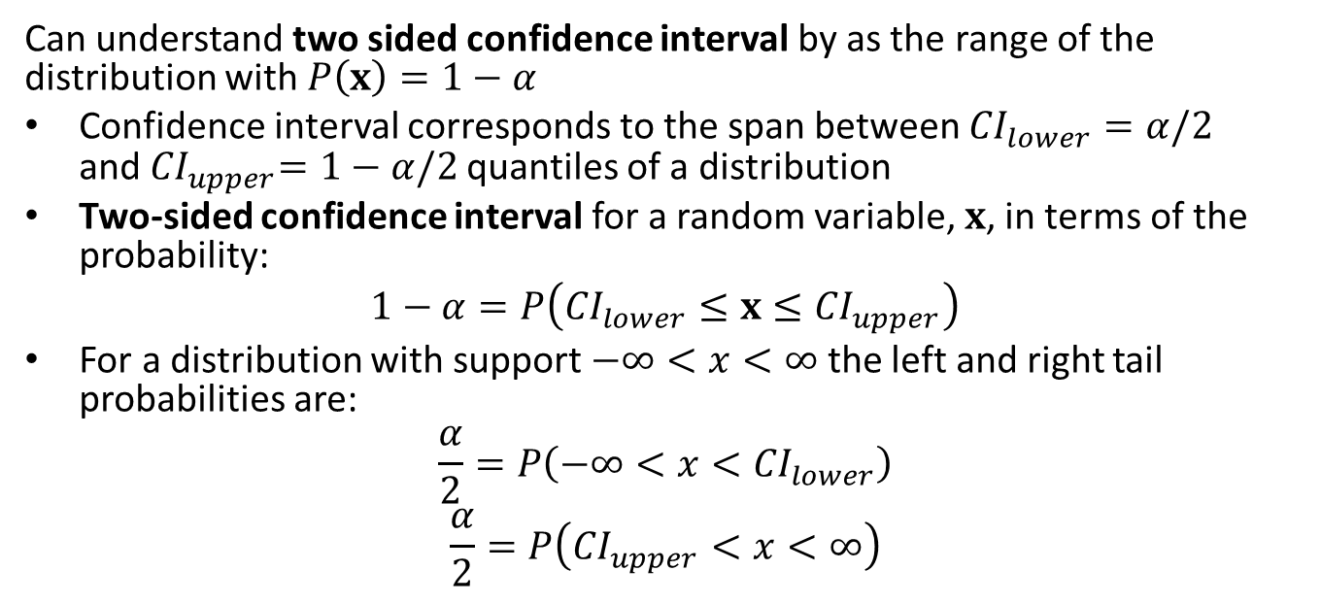
Confidence Intervals; the Key to Inference
Can understand two sided confidence interval by as the range of the distribution with $P\left(x\right)=1−α$
Confidence interval corresponds to the span between ${CI}_{lower}=α/2$ and${ CI}_{upper}=1−α/2$ quantiles of a distribution
Two-sided confidence interval for a random variable, $x$, in terms of the probability:
$$1−α=P\left({CI}_{lower}≤x≤{CI}_{upper}\right)$$
For a distribution with support $−∞<x<∞$ the left and right tail probabilities are:
$$\frac{α}{2}=P\left(−∞<x<{CI}_{lower}\right)$$
$$\frac{α}{2}=P\left({CI}_{upper}<x<∞\right)$$
Notes:
pper

Slide 13
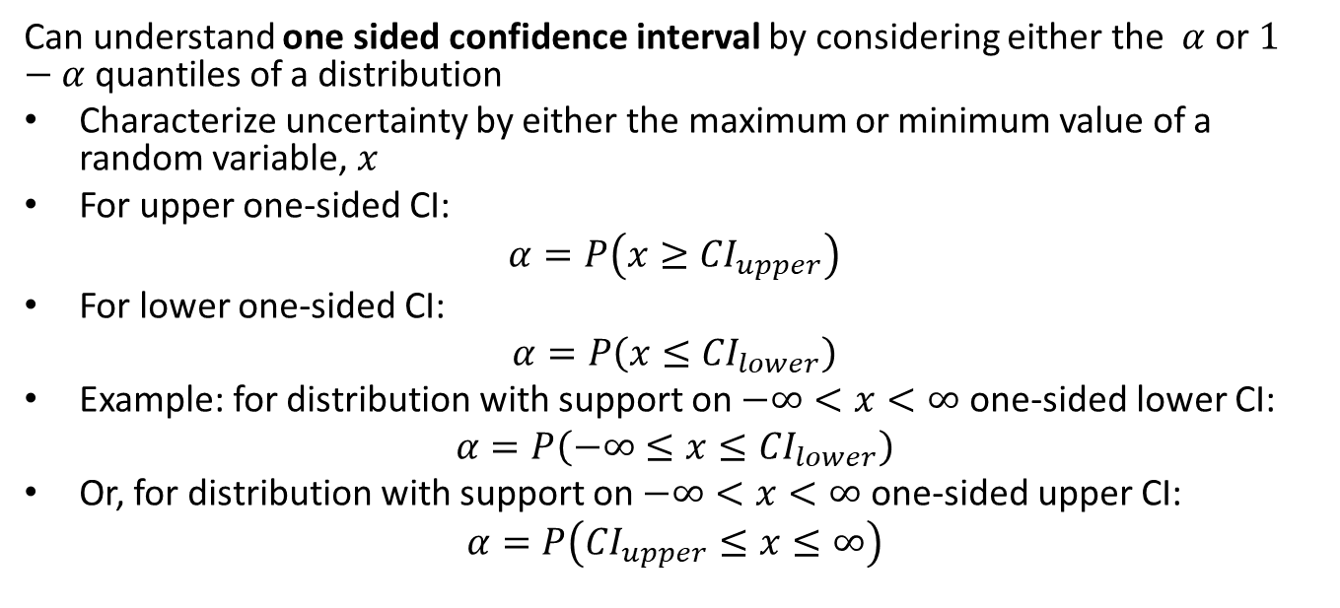
Confidence Intervals; the Key to Inference
Can understand one sided confidence interval by considering either the $α$ or $1−α$ quantiles of a distribution
Characterize uncertainty by either the maximum or minimum value of a random variable, $x$
For upper one-sided CI:
$$α=P\left(x≥{CI}_{upper}\right)$$
For lower one-sided CI:
$$α=P\left(x≤{CI}_{lower}\right)$$
Example: for distribution with support on $−∞<x<∞$ one-sided lower CI:
$$α=P\left(−∞≤x≤{CI}_{lower}\right)$$
Or, for distribution with support on $−∞<x<∞$ one-sided upper CI:
$$α=P\left({CI}_{upper}≤x≤∞\right)$$

Slide 14
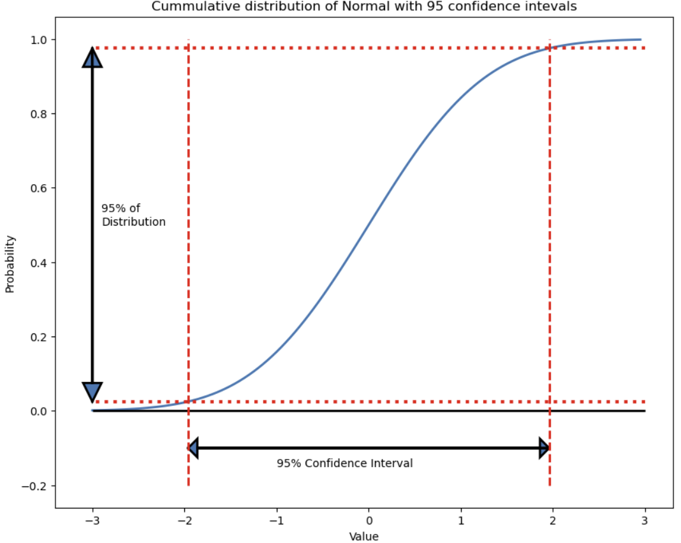
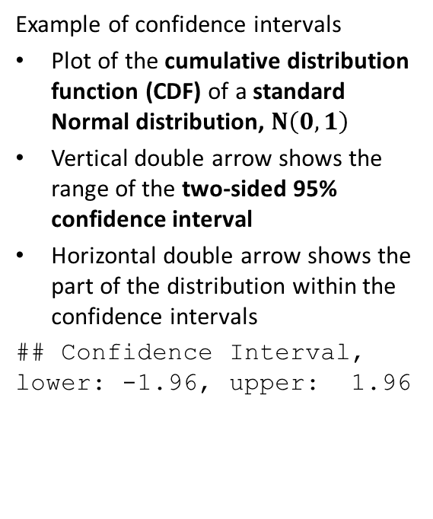
Example; confidence intervals of the Normal distribution
Example of confidence intervals
Plot of the cumulative distribution function (CDF) of a standard Normal distribution, $N\left(0,1\right)$
Vertical double arrow shows the range of the two-sided 95% confidence interval
Horizontal double arrow shows the part of the distribution within the confidence intervals
## Confidence Interval, lower: -1.96, upper: 1.96

Slide 15
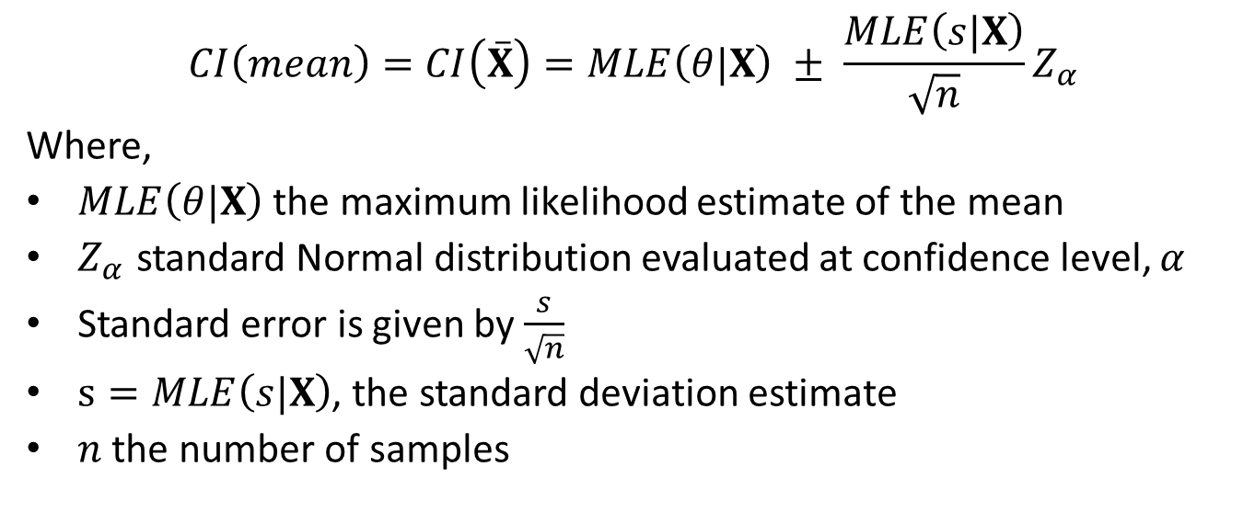
Example, Inference for the mean
$$CI\left(mean\right)=CI\left(\overset{‾}{X}\right)=MLE\left(θ|X\right) ± \frac{MLE\left(s|X\right)}{\sqrt[ ]{n}}Z_{α}$$
Where,
$MLE\left(θ|X\right)$ the maximum likelihood estimate of the mean
$Z_{α}$ standard Normal distribution evaluated at confidence level, $α$
Standard error is given by $\frac{s}{\sqrt[ ]{n}}$
$s=MLE\left(s|X\right)$, the standard deviation estimate
$n$ the number of samples

Slide 16
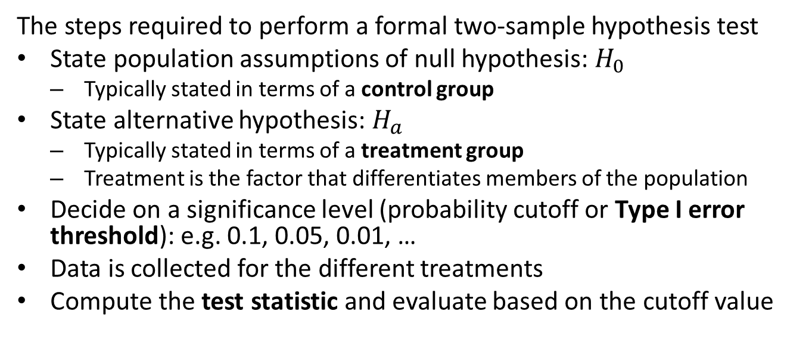
Hypothesis testing steps
The steps required to perform a formal two-sample hypothesis test
State population assumptions of null hypothesis: $H_{0}$
Typically stated in terms of a control group
State alternative hypothesis: $H_{a}$
Typically stated in terms of a treatment group
Treatment is the factor that differentiates members of the population
Decide on a significance level (probability cutoff or Type I error threshold): e.g. 0.1, 0.05, 0.01, …
Data is collected for the different treatments
Compute the test statistic and evaluate based on the cutoff value

Slide 17
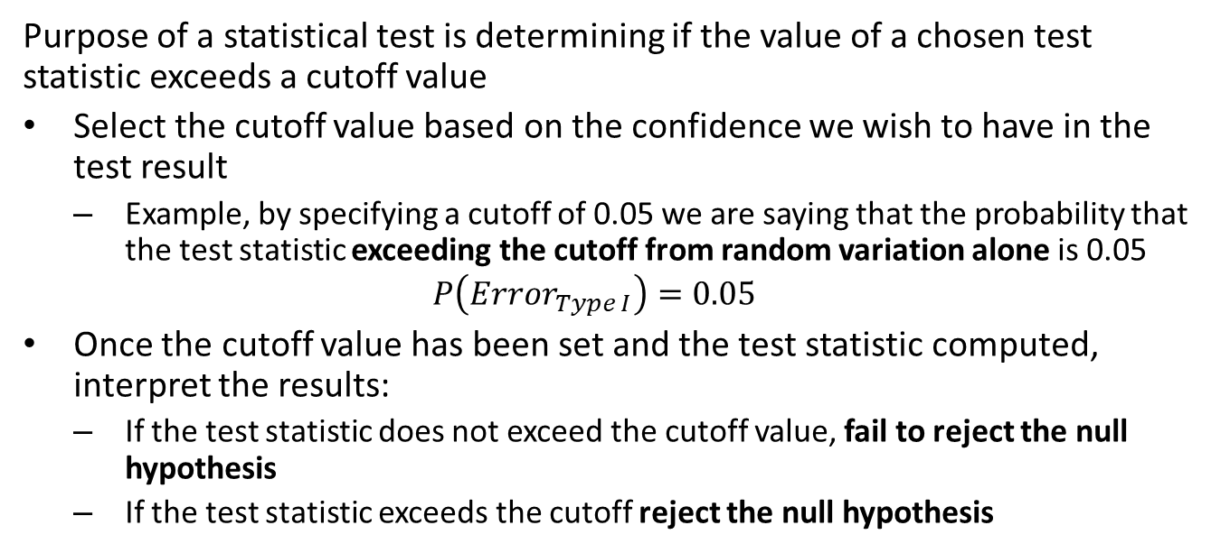
Confidence and Hypothesis Testing
Purpose of a statistical test is determining if the value of a chosen test statistic exceeds a cutoff value
Select the cutoff value based on the confidence we wish to have in the test result
Example, by specifying a cutoff of 0.05 we are saying that the probability that the test statistic exceeding the cutoff from random variation alone is 0.05
$$P\left({Error}_{Type I}\right)=0.05$$
Once the cutoff value has been set and the test statistic computed, interpret the results:
If the test statistic does not exceed the cutoff value, fail to reject the null hypothesis
If the test statistic exceeds the cutoff reject the null hypothesis

Slide 18
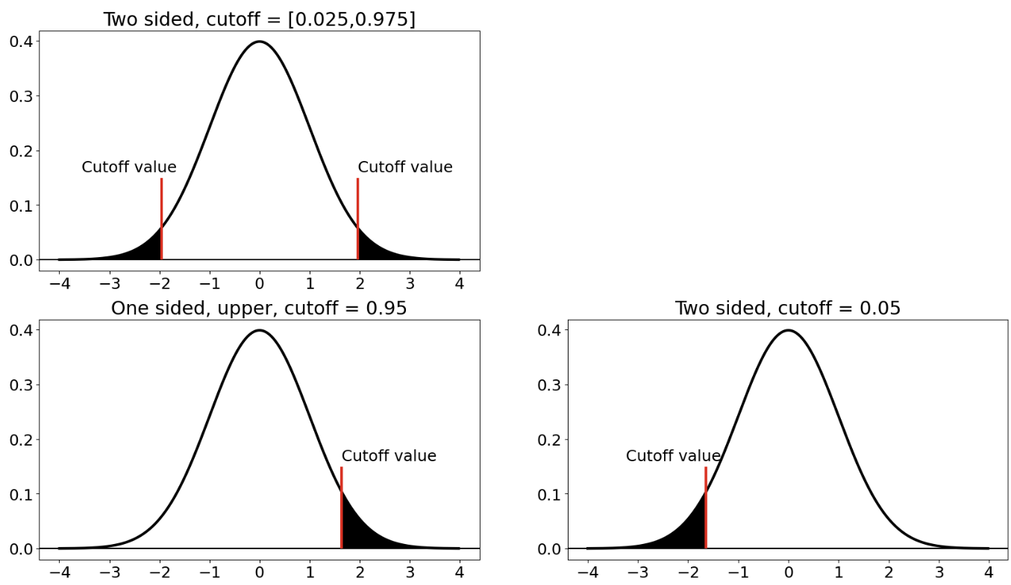
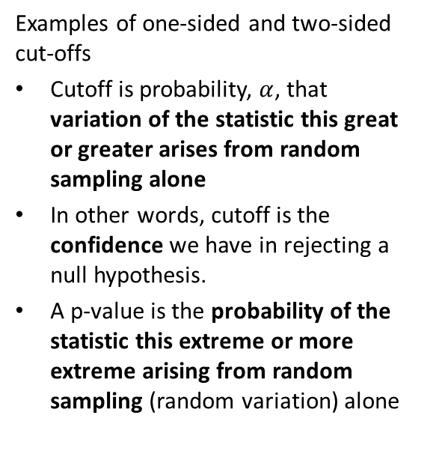
Cutoffs for Hypothesis Tests
Examples of one-sided and two-sided cut-offs
Cutoff is probability, $α$, that variation of the statistic this great or greater arises from random sampling alone
In other words, cutoff is the confidence we have in rejecting a null hypothesis.
A p-value is the probability of the statistic this extreme or more extreme arising from random sampling (random variation) alone

Slide 19
Interpreting Hypothesis Tests
Test statistic used as a decision rule
Only two possible outcomes
Reject the null-hypothesis: not the same as accepting the alternative hypothesis
Fail to reject the null hypothesis: not the same as accepting the null hypothesis
Failing to rejecting the null hypothesis can occur for several reasons
The alternative hypothesis was false to begin with
There is not enough evidence for the effect size
Roughly speaking, the effect size is the difference of the test statistic in the population under the different treatments

Slide 20
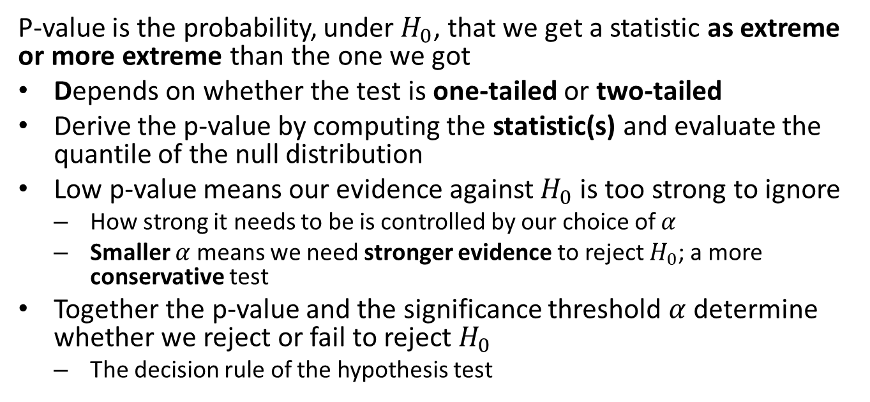
The P-Value
P-value is the probability, under $H_{0}$, that we get a statistic as extreme or more extreme than the one we got
Depends on whether the test is one-tailed or two-tailed
Derive the p-value by computing the statistic(s) and evaluate the quantile of the null distribution
Low p-value means our evidence against $H_{0}$ is too strong to ignore
How strong it needs to be is controlled by our choice of $α$
Smaller $α$ means we need stronger evidence to reject $H_{0}$; a more conservative test
Together the p-value and the significance threshold $α$ determine whether we reject or fail to reject $H_{0}$
The decision rule of the hypothesis test

Slide 21
Summary
Statistical inference seeks to characterize the uncertainty in estimates
Statistics are estimates of population parameters
Statistical inferences must consider the uncertainty in the estimates
Confidence intervals quantify uncertainty in statistical estimates
Two-sided confidence intervals: express confidence that a value is within some range around the point estimate
One-sided confidence intervals: express confidence that the point estimate is greater or less than some range of values
Hypothesis tests based on the confidence we have that variation in statistic arises from sampling variation alone

