Slide 1

Models Categorical Variables and Nonlinear Responses
Steve Elston
Copyright 2018, 2019, 2020, 2021, 2022, 2023 2024, Stephen F Elston. All rights reserved.

Slide 2
Review
Linear models are a flexible and widely used class of models
Fit model coefficients by least squares estimation
Least squares computes maximum likelihood point estimate
Produces Normally distributed residuals
Can use many types of predictor variables, linear and nonlinear
Model is linear in parameters
We prefer the simplest model that does the job
Parsimonious model has the fewest parameters required to explain the data
The principle of Occam’s razor

Slide 3
Review
Linear models are interpretable and idea for inference
Repose to changes in independent variables is predictable
Model parameters provide quantitative sensitivity to changes in independent variables
Model fit can be tested
Reject hypothesis of null model
Reject hypothesis of non-significant model coefficients
Compare models by variance explained, properties of residuals and confidence intervals of model parameters

Slide 4
Review
When evaluating any machine learning model consider all evaluation methods available
No one method best all of the time
Test for homoscedastic Normally distributed residuals
Residual Plots
Formal tests – Omnibus, Jarque-Bera, etc.
Are model and its coefficients statistically significant?
F-test on model significance
t-test on model parameter significance
Different methods highlight different problems with your model
Don’t forget to check that the model must make sense for your application!

Slide 5
Review
There are a number of assumptions in linear models that you overlook at your peril!
The independent or predictor variables should be independent of one another
This is rarely true in practice
Multi-collinearity between features makes the model under-determined
We want numeric features or predictors have zero mean and about the same scale
Intercept is the mean of the response variable
Predictors with a large numeric range must not dominate training
Values of each predictor or independent variables should be iid
If variance changes with sample, the coefficient cannot be constant
If predictor values have serial correlation the iid assumption is violated - use time series models

Slide 6
Introduction

Slide 7
Introduction
Generalize the linear model to accommodate non-Normally distributed variables
Working with categorical variables
One-hot encoding of categorical variables
Working with contrasts
Interpreting effect sizes
Applying effect adjustments
Building models with nonlinear and non-Normal response
Use generalized linear model (GLM) for nonlinear response
GLM for Binomial, categorical, Poisson, etc., regression
Link function transforms nonlinear model to linear model
Evaluating nonlinear response models
Compare model performance with deviance

Slide 8
Working with Categorical Variables

Slide 9
Working with Categorical Variables
Linear models, like nearly all machine learning models, use numeric features
How do we use categorical indendent variables in linear models?
Need to transform categories to numeric variables with one hot encoding
Each category becomes a binary dummy variable, encoded [0,1]
Only one dummy variable has nonzero value, encoding the category
Note: for high-cardinality categorical variables use embedding algorithms – beyond the scope of this course

Slide 10
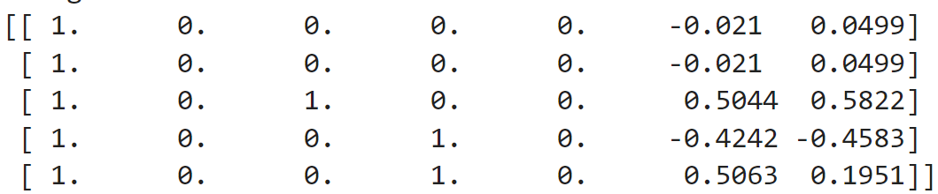
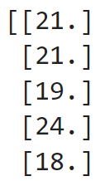

Working with Categorical Variables
Example: We can construct the model matrices for the auto data using the patsy package
Create design matrix with an intercept term
from patsy import dmatrices Y, X = dmatrices('city_mpg ~ C(body_style) + curb_weight + engine_size', data=auto_data) print(X[:5])
The design matrix, $X$:
Repones array, $Y$:
Wait! Why are there only 4 dummy variables for 5 levels of the `body_style`?

Slide 11
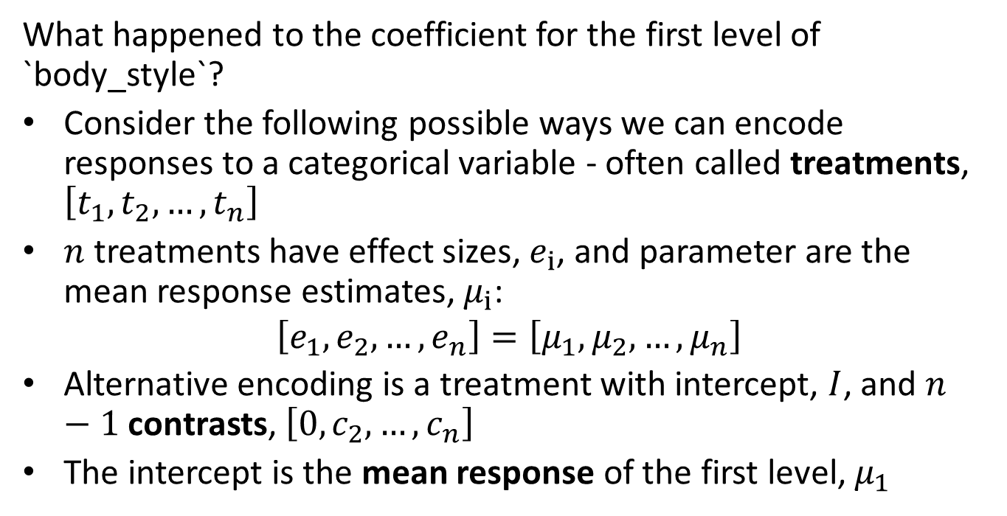
Working with Categorical Variables
What happened to the coefficient for the first level of `body_style`?
Consider the following possible ways we can encode responses to a categorical variable - often called treatments, $\left[t_{1},t_{2},…,t_{n}\right]$
$n$ treatments have effect sizes, $e_{i}$, and parameter are the mean response estimates, $μ_{i}$:
$$\left[e_{1},e_{2},…,e_{n}\right]=\left[μ_{1},μ_{2},…,μ_{n}\right]$$
Alternative encoding is a treatment with intercept, $I$, and $n−1$ contrasts, $\left[0,c_{2},…,c_{n}\right]$
The intercept is the mean response of the first level, $μ_{1}$

Slide 12
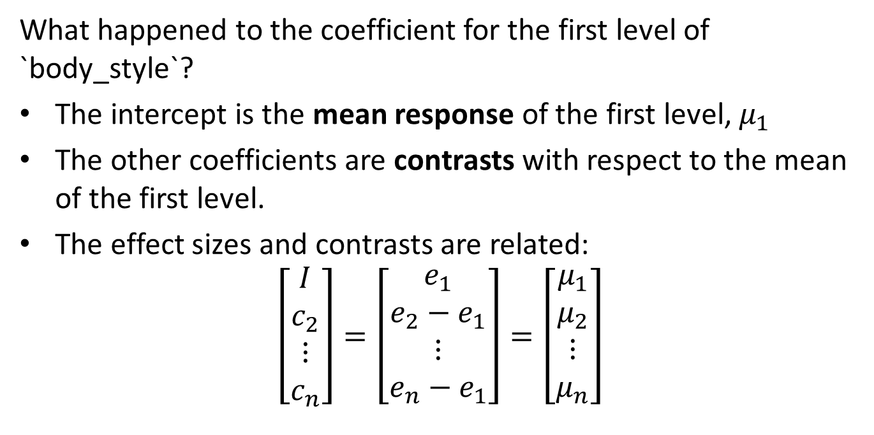
Working with Categorical Variables
What happened to the coefficient for the first level of `body_style`?
The intercept is the mean response of the first level, $μ_{1}$
The other coefficients are contrasts with respect to the mean of the first level.
The effect sizes and contrasts are related:
$$\left[\begin{matrix}I \\ c_{2} \\ ⋮ \\ c_{n}\end{matrix}\right]=\left[\begin{matrix}e_{1} \\ e_{2}−e_{1} \\ ⋮ \\ e_{n}−e_{1}\end{matrix}\right]=\left[\begin{matrix}μ_{1} \\ μ_{2} \\ ⋮ \\ μ_{n}\end{matrix}\right]$$

Slide 13
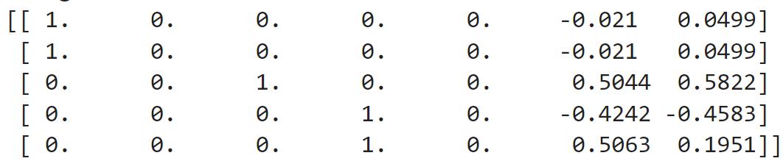

Working with Categorical Variables
Example: We can construct the model matrices for the auto data using the patsy package
Design matrix with no intercept term
from patsy import dmatrices Y, X = dmatrices('city_mpg ~ -1 + C(body_style) + curb_weight + engine_size', data=auto_data) print(X[:5])
The design matrix, $X$:
Repones array, $Y$:
There are now 5 dummy variables for 5 levels of the `body_style`

Slide 14
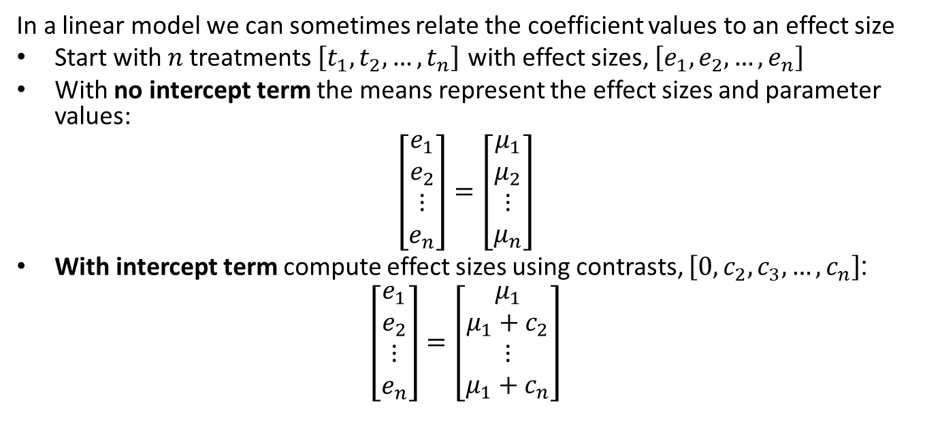
Working with Categorical Variables
In a linear model we can sometimes relate the coefficient values to an effect size
Start with $n$ treatments $\left[t_{1},t_{2},…,t_{n}\right]$ with effect sizes, $\left[e_{1},e_{2},…,e_{n}\right]$
With no intercept term the means represent the effect sizes and parameter values:
$$\left[\begin{matrix}e_{1} \\ e_{2} \\ ⋮ \\ e_{n}\end{matrix}\right]=\left[\begin{matrix}μ_{1} \\ μ_{2} \\ ⋮ \\ μ_{n}\end{matrix}\right]$$
With intercept term compute effect sizes using contrasts, $\left[0,c_{2},c_{3},…,c_{n}\right]$:
$$\left[\begin{matrix}e_{1} \\ e_{2} \\ ⋮ \\ e_{n}\end{matrix}\right]=\left[\begin{matrix}μ_{1} \\ μ_{1}+c_{2} \\ ⋮ \\ μ_{1}+c_{n}\end{matrix}\right]$$

Slide 15
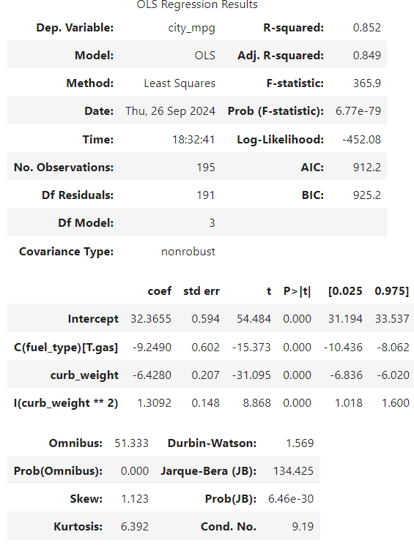
Working with Categorical Variables
Example: Constructing linear model with intercept and mixed variable types
city_mpg ~ C(fuel_type) + curb_weight + I(curb_weight**2)
All coefficients are significant
The intercept is the mean for the diesel cars
The coefficient for gas cars is the contrast with respect to diesel cars
Coefficients for centered curb_weight variables

Slide 16
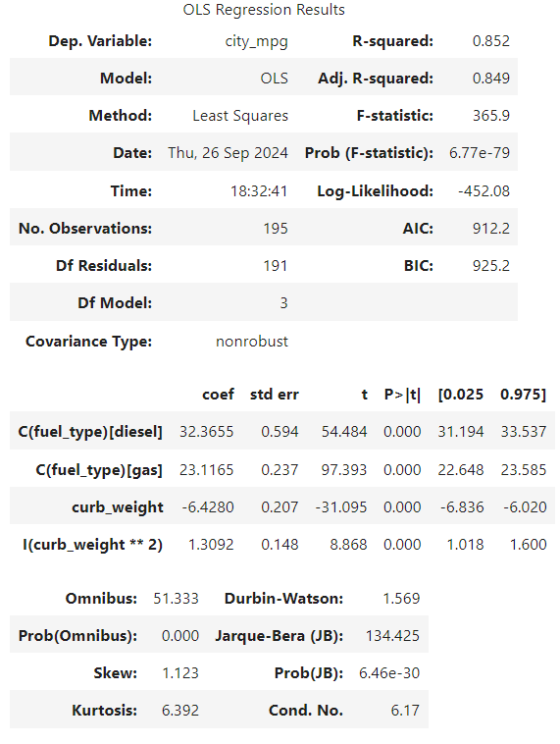
Working with Categorical Variables
Example: Constructing linear model without intercept and mixed variable types
city_mpg ~ -1 + C(fuel_type) + curb_weight + I(curb_weight**2)
All coefficients are significant
The coefficients for diesel and gas cars are the means for each fuel type
Coefficients for centered curb_weight variables are the same as model with contrasts

Slide 17
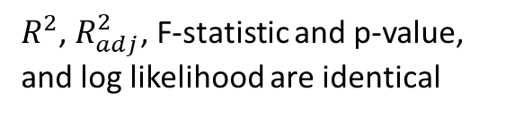
Working with Categorical Variables
Example: Constructing linear model with intercept and mixed variable types
$R^{2}$, $R_{adj}^{2}$, F-statistic and p-value, and log likelihood are identical
Intercept and mean of diesel coefficients identical
Coefficients of weight variables identical

Slide 18
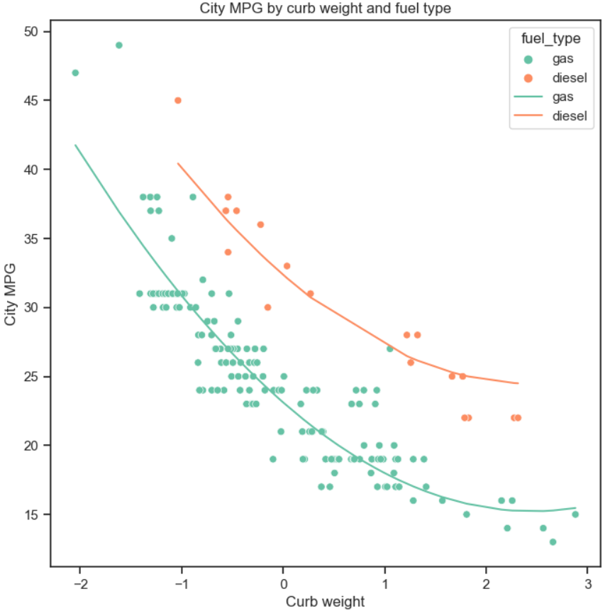
Working with Categorical Variables
Example: Constructing linear model with intercept and mixed variable types
Plot of regression model prediction on scatter plot of observations
Model computes response (predictions) specific to fuel type
Response is identical between models

Slide 19
Working with Categorical Variables
In a linear model we can often relate the coefficient values to an effect size
Assumes the treatments are orthogonal
In other words, applied one at a time
e.g. a case can only be in one category
Assumes that the model coefficients are statistically independent
Coefficients are dependent in overfit model
Interpret with care!
Don’t over-interpret your model
Conditions in real world hard to verify, particularly for observational data

Slide 20
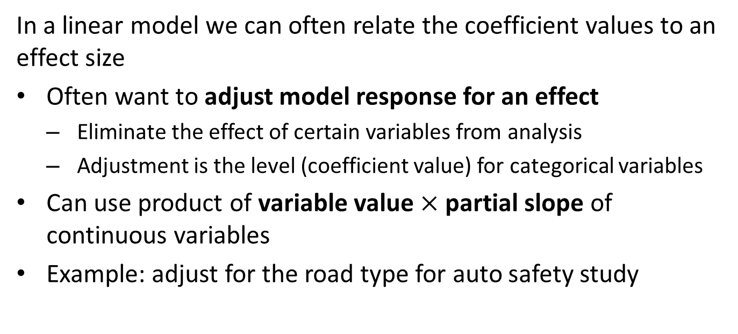
Working with Categorical Variables
In a linear model we can often relate the coefficient values to an effect size
Often want to adjust model response for an effect
Eliminate the effect of certain variables from analysis
Adjustment is the level (coefficient value) for categorical variables
Can use product of variable value $×$ partial slope of continuous variables
Example: adjust for the road type for auto safety study

Slide 21
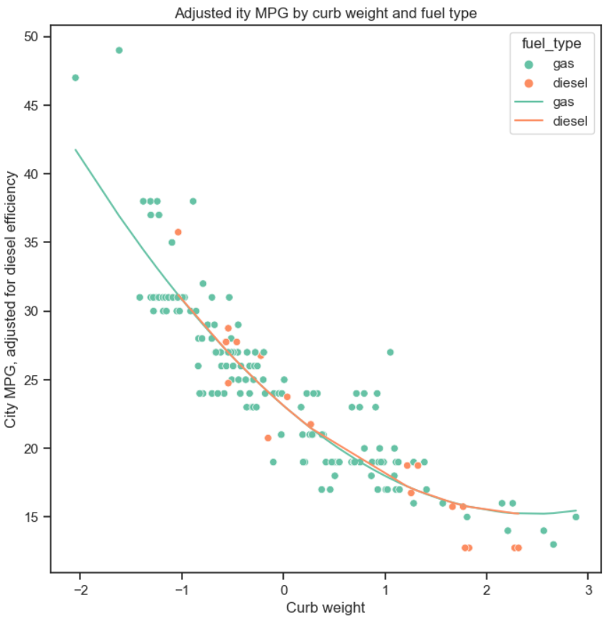
Working with Categorical Variables
Example: Applying adjustment for fuel type
Plot of regression model prediction on scatter plot of observations
Apply adjustment to diesel cars
Adjust diesel car observations by contrast
Adjust model response by fuel type contrast value for diesel cars
Model response for the two fuel types is now the same!
We have eliminated the effect of fuel type

Slide 22
Models with Nonlinear Responses

Slide 23
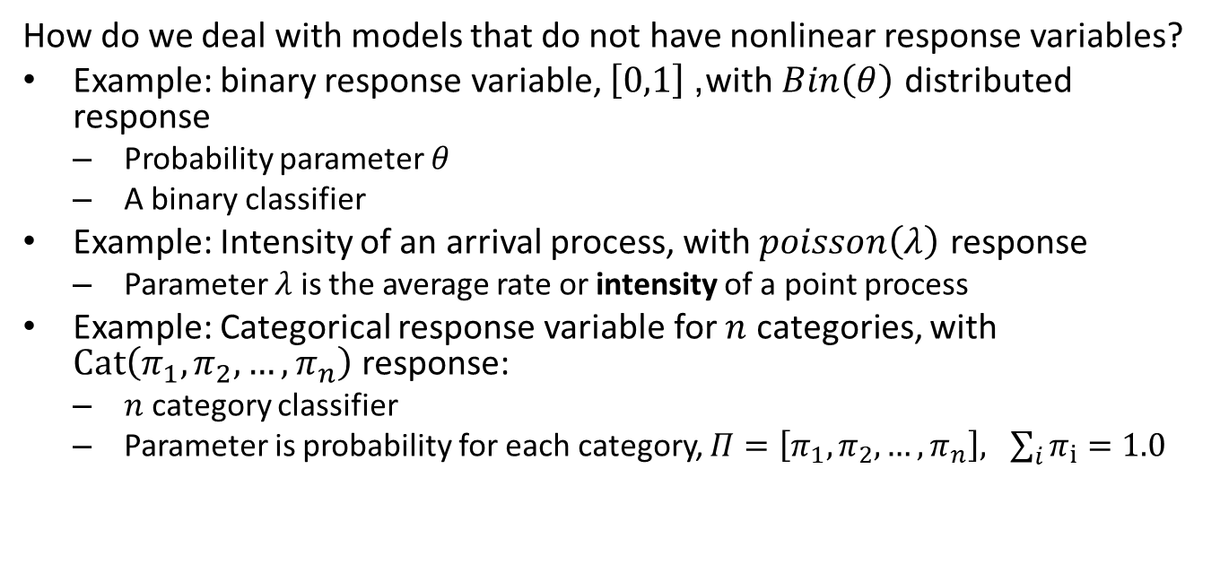
Models with Nonlinear Response
How do we deal with models that do not have nonlinear response variables?
Example: binary response variable, $\left[0,1\right]$, with $Bin\left(θ\right)$ distributed response
Probability parameter $θ$
A binary classifier
Example: Intensity of an arrival process, with $poisson\left(λ\right)$ response
Parameter $λ$ is the average rate or intensity of a point process
Example: Categorical response variable for $n$ categories, with $Cat\left(π_{1},π_{2},…,π_{n}\right)$ response:
$n$ category classifier
Parameter is probability for each category, $Π=\left[π_{1},π_{2},…,π_{n}\right], \sum_{i}{π_{i}=1.0}$

Slide 24
Models with Nonlinear Response
The generalized linear model (GLM) is a framework for non-Normal or nonlinear response models
Nonlinear response is not Normally distributed
Use a link function to transform to a linear model
Linear model has Normally distributed response
Link function transform nonlinear response to Normal distribution
To compute the nonlinear response
Start with a linear model, OLS
Transform response with inverse link function
Use GLM framework for all exponential family response distributions

Slide 25
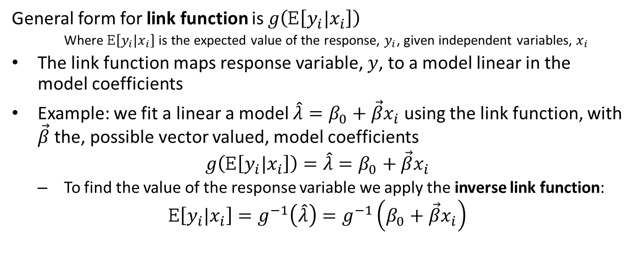
The Generalized Linear Model
General form for link function is $g\left(E\left[y_{i}|x_{i}\right]\right)$
Where $E\left[y_{i}|x_{i}\right]$ is the expected value of the response, $y_{i}$, given independent variables, $x_{i}$
The link function maps response variable, $y$, to a model linear in the model coefficients
Example: we fit a linear a model $\hat{λ}=β_{0}+\vec{β}x_{i}$ using the link function, with $\vec{β}$ the, possible vector valued, model coefficients
$$g\left(E\left[y_{i}|x_{i}\right]\right)=\hat{λ}=β_{0}+\vec{β}x_{i}$$
To find the value of the response variable we apply the inverse link function:
$$E\left[y_{i}|x_{i}\right]=g^{−1}\left(\hat{λ}\right)=g^{−1}\left(β_{0}+\vec{β}x_{i}\right)$$

Slide 26
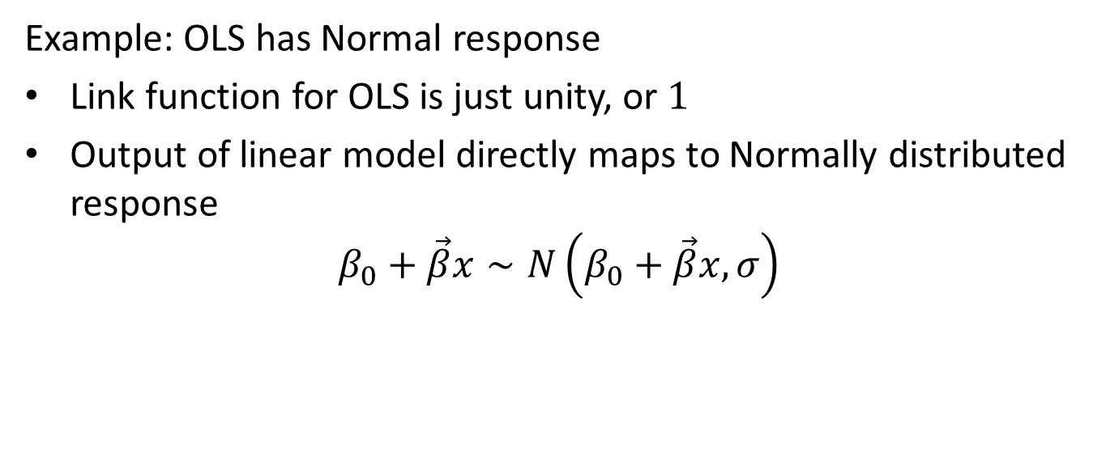
The Generalized Linear Model
Example: OLS has Normal response
Link function for OLS is just unity, or $1$
Output of linear model directly maps to Normally distributed response
$$β_{0}+\vec{β}x∼N\left(β_{0}+\vec{β}x,σ\right)$$

Slide 27
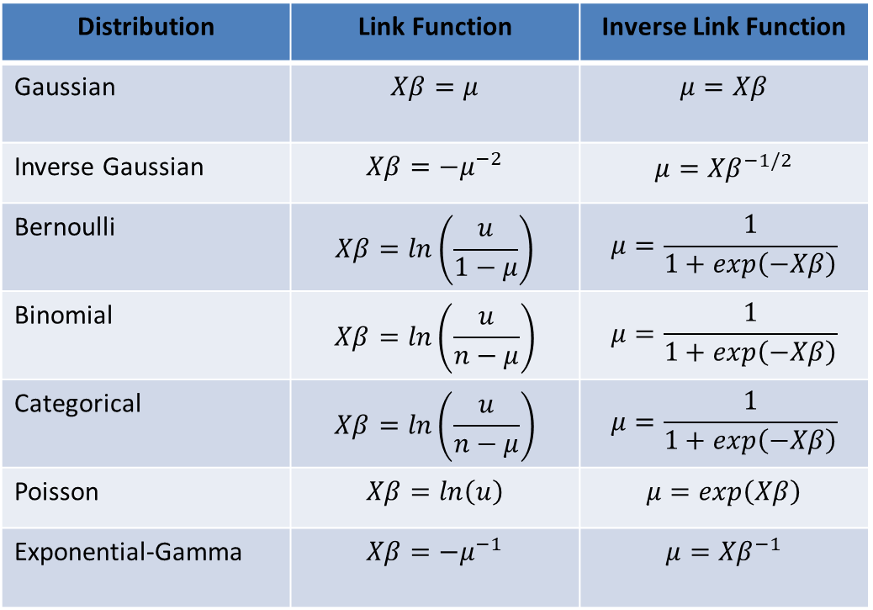
The Generalized Linear Model
Distribution | Link Function | Inverse Link Function
Gaussian | $$Xβ=μ$$ | $$μ=Xβ$$
Inverse Gaussian | $$Xβ=−μ^{−2}$$ | $$μ={Xβ}^{−1/2}$$
Bernoulli | $$Xβ=ln\left(\frac{u}{1−μ}\right)$$ | $$μ=\frac{1}{1+exp\left(−Xβ\right)}$$
Binomial | $$Xβ=ln\left(\frac{u}{n−μ}\right)$$ | $$μ=\frac{1}{1+exp\left(−Xβ\right)}$$
Categorical | $$Xβ=ln\left(\frac{u}{n−μ}\right)$$ | $$μ=\frac{1}{1+exp\left(−Xβ\right)}$$
Poisson | $$Xβ=ln\left(u\right)$$ | $$μ=exp\left(Xβ\right)$$
Exponential-Gamma | $$Xβ=−μ^{−1}$$ | $$μ={Xβ}^{−1}$$
Example Link functions
Supported in statsmodels
Supported in Scikit-Learn

Slide 28
The Logistic Regression Model
Construct a generalized linear model using a Binomial distribution
Commonly known as logistic regression
Logistic regression widely used as a classifier
Logistic regression is linear model, with a binary response or label values, {False, True} or {0, 1}
Response computed as a log likelihood, leading to a Binomial distributed response
Categorical response is simple extension to categorical distribution
One Binomial to many
Many Binomial to many

Slide 29
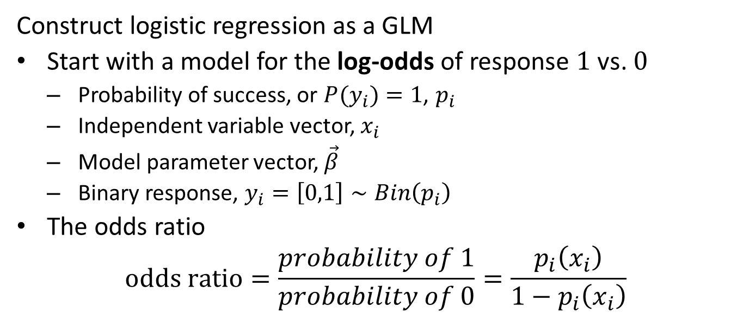
The Logistic Regression Model
Construct logistic regression as a GLM
Start with a model for the log-odds of response $1$ vs. $0$
Probability of success, or ${P(y}_{i})=1$, $p_{i}$
Independent variable vector, $x_{i}$
Model parameter vector, $\vec{β}$
Binary response, $y_{i}=\left[0,1\right]∼Bin\left(p_{i}\right)$
The odds ratio
$$odds ratio=\frac{probability of 1}{probability of 0}=\frac{p_{i}\left(x_{i}\right)}{1−p_{i}\left(x_{i}\right)}$$

Slide 30
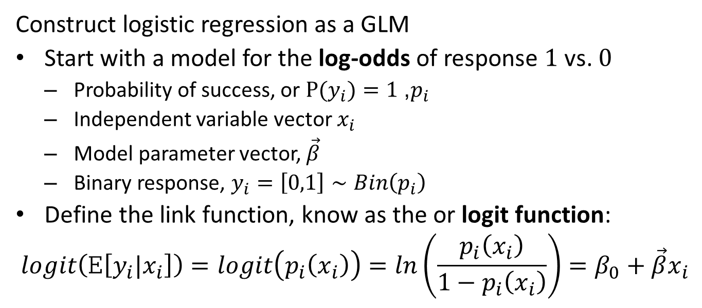
The Logistic Regression Model
Construct logistic regression as a GLM
Start with a model for the log-odds of response $1$ vs. $0$
Probability of success, or ${P(y}_{i})=1$, $p_{i}$
Independent variable vector $x_{i}$
Model parameter vector, $\vec{β}$
Binary response, $y_{i}=\left[0,1\right]∼Bin\left(p_{i}\right)$
Define the link function, know as the or logit function:
$$logit\left(E\left[y_{i}|x_{i}\right]\right)=logit\left(p_{i}\left(x_{i}\right)\right)=ln\left(\frac{p_{i}\left(x_{i}\right)}{1−p_{i}\left(x_{i}\right)}\right)=β_{0}+{\vec{β}x}_{i}$$

Slide 31
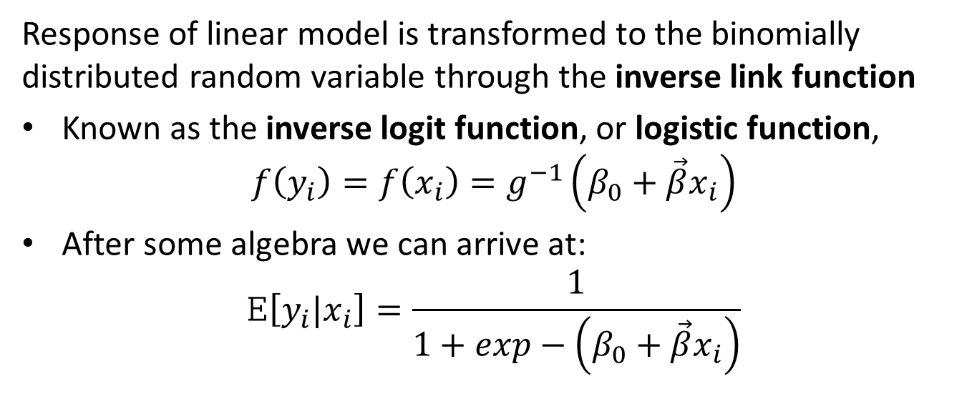
The Logistic Regression Model
Response of linear model is transformed to the binomially distributed random variable through the inverse link function
Known as the inverse logit function, or logistic function,
$$f\left(y_{i}\right)=f\left(x_{i}\right)=g^{−1}\left(β_{0}+\vec{β}x_{i}\right)$$
After some algebra we can arrive at:
$$E\left[y_{i}|x_{i}\right]=\frac{1}{1+exp−\left(β_{0}+\vec{β}x_{i}\right)}$$

Slide 32
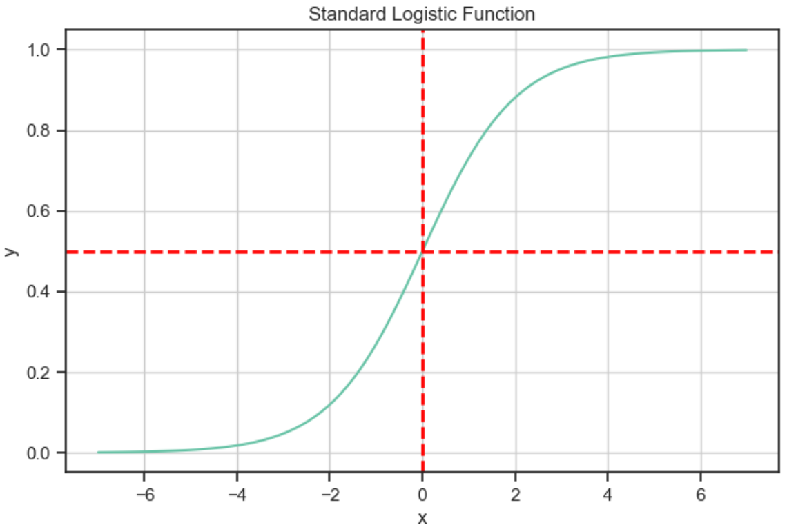
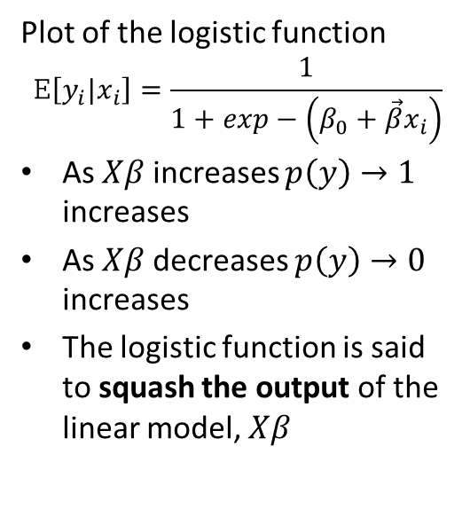

Logistic Regression Model
Plot of the logistic function
$$E\left[y_{i}|x_{i}\right]=\frac{1}{1+exp−\left(β_{0}+\vec{β}x_{i}\right)}$$
As $Xβ$ increases $p\left(y\right)→1$ increases
As $Xβ$ decreases $p\left(y\right)→0$ increases
The logistic function is said to squash the output of the linear model, $Xβ$
$$p(y)$$

Slide 33
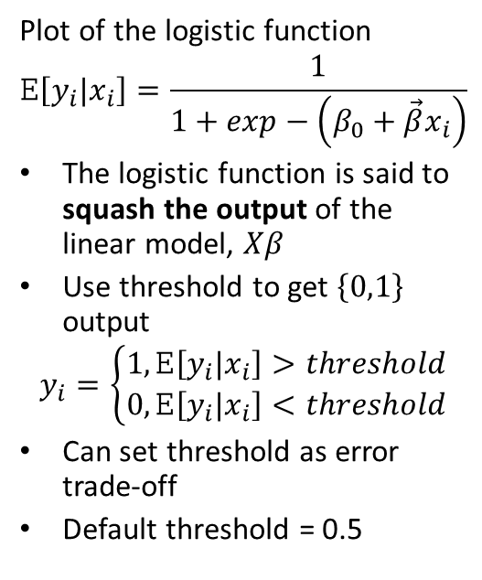
Logistic Regression Model
Plot of the logistic function
$$E\left[y_{i}|x_{i}\right]=\frac{1}{1+exp−\left(β_{0}+\vec{β}x_{i}\right)}$$
The logistic function is said to squash the output of the linear model, $Xβ$
Use threshold to get $\left\{0,1\right\}$ output
$$y_{i}=\left\{\begin{matrix}1, E\left[y_{i}|x_{i}\right]>threshold \\ 0, E\left[y_{i}|x_{i}\right]<threshold\end{matrix}\right.$$
Can set threshold as error trade-off
Default threshold = 0.5
$$p(y)$$

Slide 34
Evaluation of Classifiers
How can we evaluate a classifier’s accuracy?
Determine proportions of test cases which are classified as:
True Positives (TP): Are positive and should be positive
True Negatives (TN): Are negative and should be negative
False Positives (FP): Classified as positive but are actually negative; Type I errors
False Negatives (FN): Classified as negative but are actually positive; Type II errors
Organize these metrics into a confusion matrix
 | Classified Negative | Classified Positive
True Negative | TN | FP
True Positive | FN | TP

Slide 35
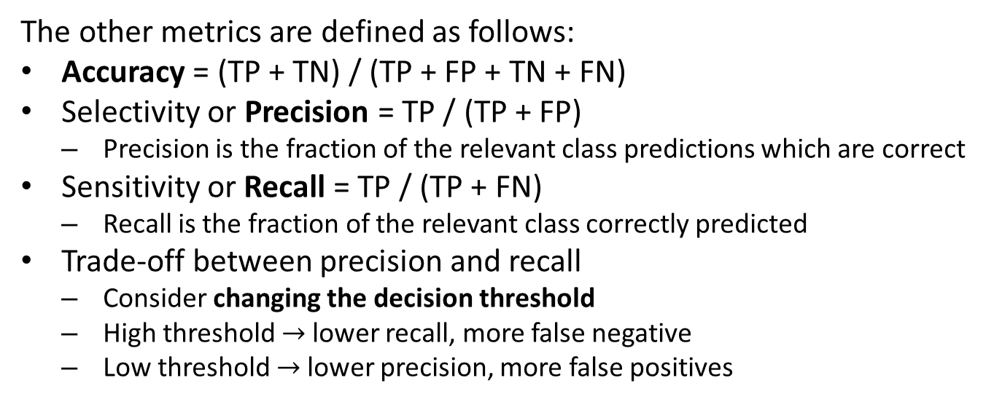
Evaluation of Classifiers
The other metrics are defined as follows:
Accuracy = (TP + TN) / (TP + FP + TN + FN)
Selectivity or Precision = TP / (TP + FP)
Precision is the fraction of the relevant class predictions which are correct
Sensitivity or Recall = TP / (TP + FN)
Recall is the fraction of the relevant class correctly predicted
Trade-off between precision and recall
Consider changing the decision threshold
High threshold $→$ lower recall, more false negative
Low threshold $→$ lower precision, more false positives

Slide 36
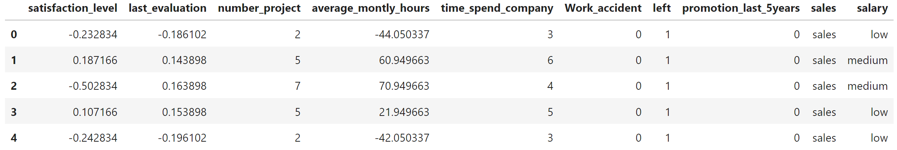
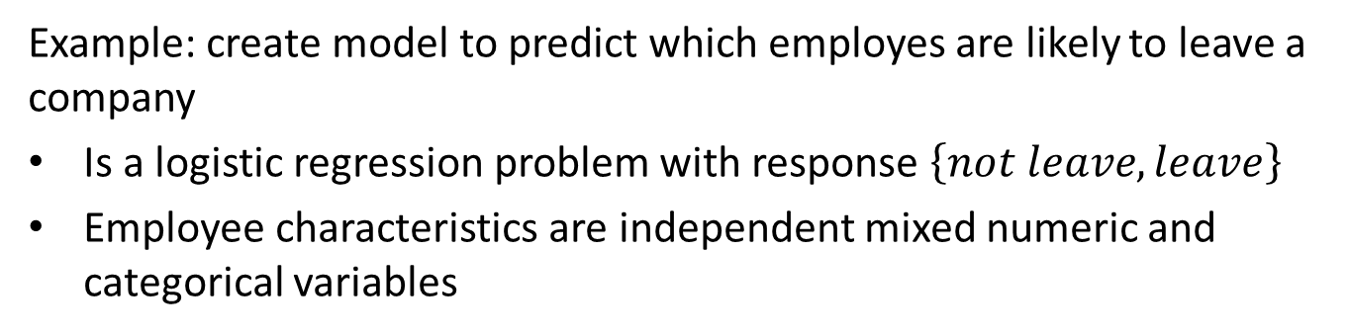
Example of Logistic Regression
Example: create model to predict which employes are likely to leave a company
Is a logistic regression problem with response $\left\{not leave, leave\right\}$
Employee characteristics are independent mixed numeric and categorical variables

Slide 37
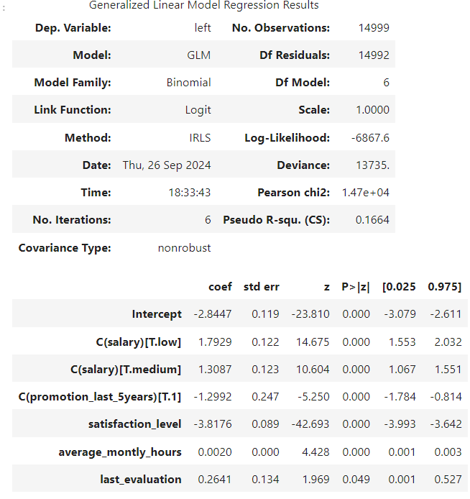
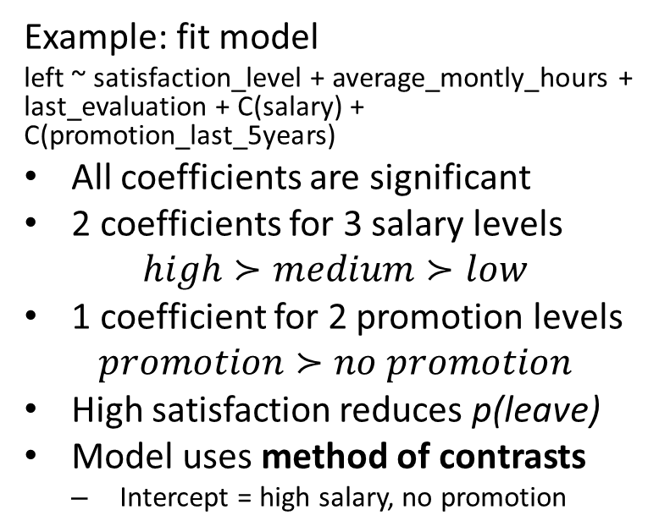
Example of Logistic Regression
Example: fit model
left ~ satisfaction_level + average_montly_hours + last_evaluation + C(salary) + C(promotion_last_5years)
All coefficients are significant
2 coefficients for 3 salary levels
$$high≻medium≻low$$
1 coefficient for 2 promotion levels
$$promotion≻no promotion$$
High satisfaction reduces p(leave)
Model uses method of contrasts
Intercept = high salary, no promotion

Slide 38
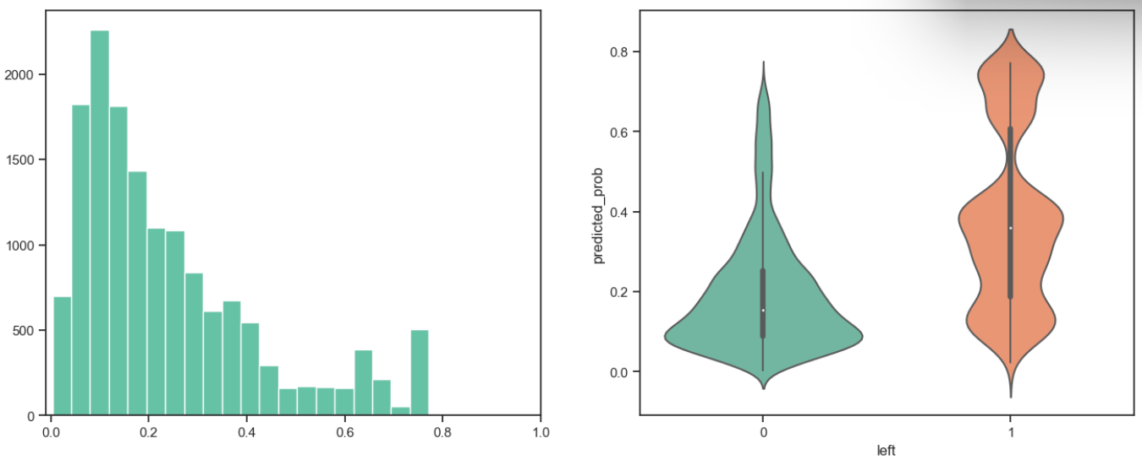
Evaluation of Classifiers
How can we evaluate a classifier’s?
Determine proportions of test cases which are classified as {no leave, leave}
Logistic function computes probability of class
Examine probabilities by known response (label)
Threshold of 0.5 is not optimal in this case, high false negative

Slide 39
Evaluation of Classifiers
How can we evaluate a classifier’s accuracy?
Examine probabilities by known response (label))
Threshold of 0.35 gives better balance of error types
No threshold value will eliminate errors!

Slide 40
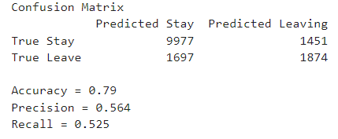
Example of Logistic Regression
Example: Evaluation of model predictions
Use decision threshold = 0.35
Examine confusion matrix
Diagonal terms are correctly classified
Errors are the off-diagonal terms
Watch out!! The relatively high accuracy of this model is deceptive
Low precision and recall from high error rate

Slide 41
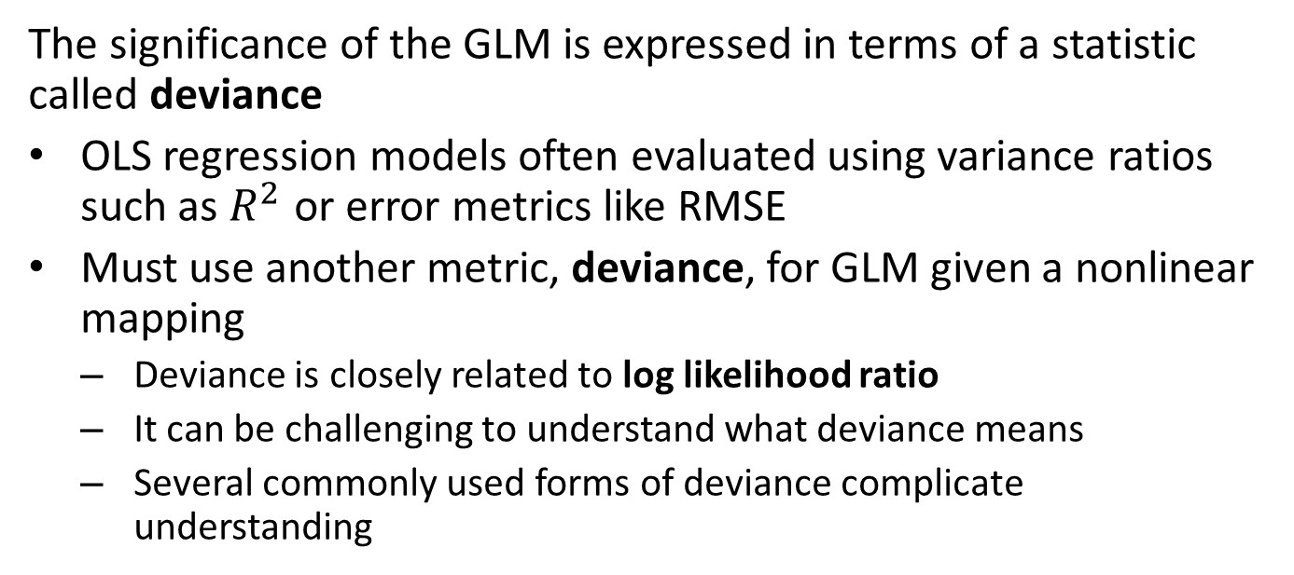
What is Deviance?
The significance of the GLM is expressed in terms of a statistic called deviance
OLS regression models often evaluated using variance ratios such as $R^{2}$ or error metrics like RMSE
Must use another metric, deviance, for GLM given a nonlinear mapping
Deviance is closely related to log likelihood ratio
It can be challenging to understand what deviance means
Several commonly used forms of deviance complicate understanding

Slide 42
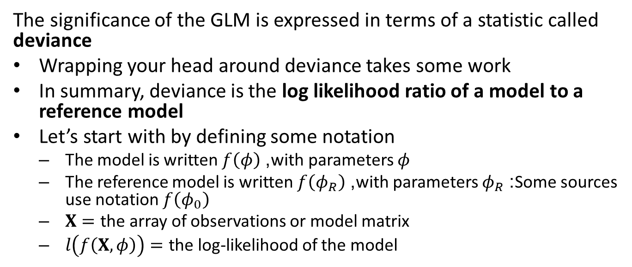
What is Deviance?
The significance of the GLM is expressed in terms of a statistic called deviance
Wrapping your head around deviance takes some work
In summary, deviance is the log likelihood ratio of a model to a reference model
Let’s start with by defining some notation
The model is written $f\left(φ\right)$, with parameters $φ$
The reference model is written $f\left(φ_{R}\right)$, with parameters $φ_{R}$: Some sources use notation $f\left(φ_{0}\right)$
$X=$ the array of observations or model matrix
$l\left(f\left(X,φ\right)\right)=$ the log-likelihood of the model

Slide 43
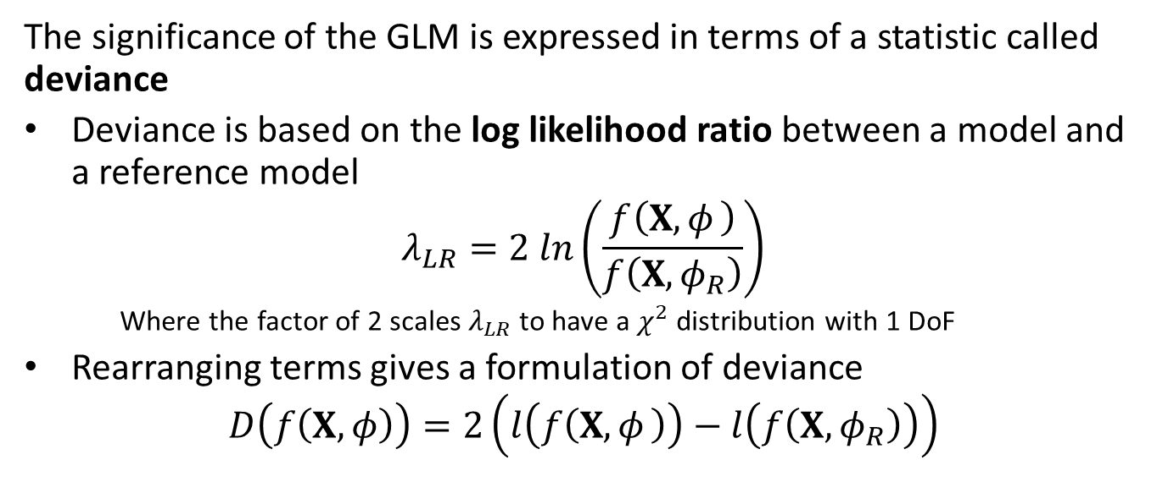
What is Deviance?
The significance of the GLM is expressed in terms of a statistic called deviance
Deviance is based on the log likelihood ratio between a model and a reference model
$$λ_{LR}=2 ln\left(\frac{f\left(X,φ_{ }\right)}{f\left(X, φ_{R}\right)}\right)$$
Where the factor of 2 scales $λ_{LR}$ to have a $χ^{2}$ distribution with 1 DoF
Rearranging terms gives a formulation of deviance
$$D\left(f\left(X,φ\right)\right)=2\left(l\left(f\left(X,φ_{ }\right)\right)−l\left(f\left(X,φ_{R}\right)\right)\right)$$

Slide 44
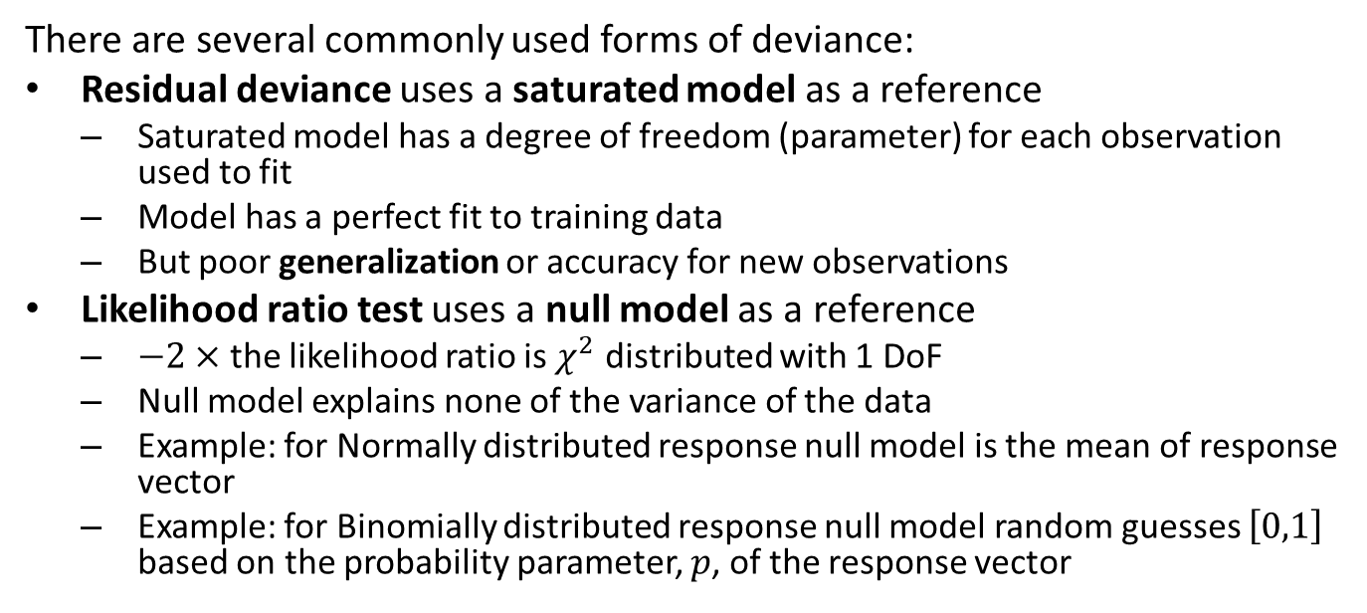
What is Deviance?
There are several commonly used forms of deviance:
Residual deviance uses a saturated model as a reference
Saturated model has a degree of freedom (parameter) for each observation used to fit
Model has a perfect fit to training data
But poor generalization or accuracy for new observations
Likelihood ratio test uses a null model as a reference
$−2×$ the likelihood ratio is $χ^{2}$ distributed with 1 DoF
Null model explains none of the variance of the data
Example: for Normally distributed response null model is the mean of response vector
Example: for Binomially distributed response null model random guesses $\left[0,1\right]$ based on the probability parameter, $p$, of the response vector

Slide 45
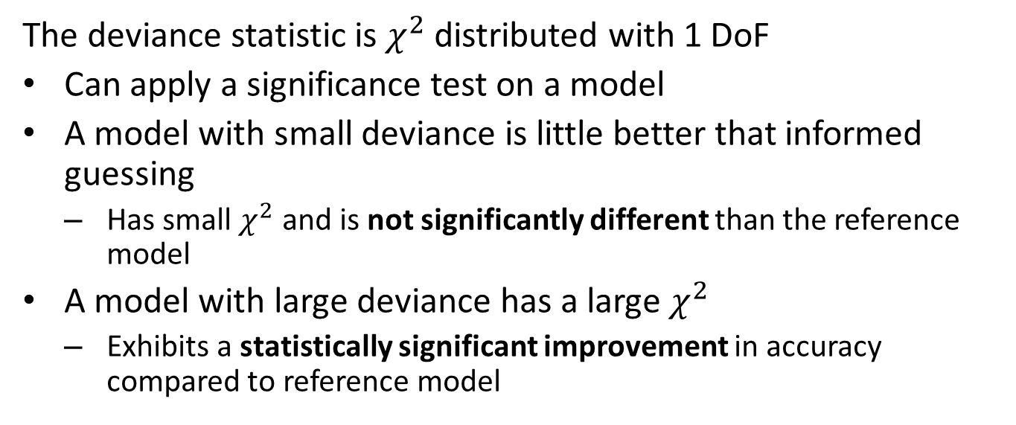
What is Deviance?
The deviance statistic is $χ^{2}$ distributed with 1 DoF
Can apply a significance test on a model
A model with small deviance is little better that informed guessing
Has small $χ^{2}$ and is not significantly different than the reference model
A model with large deviance has a large $χ^{2}$
Exhibits a statistically significant improvement in accuracy compared to reference model

Slide 46
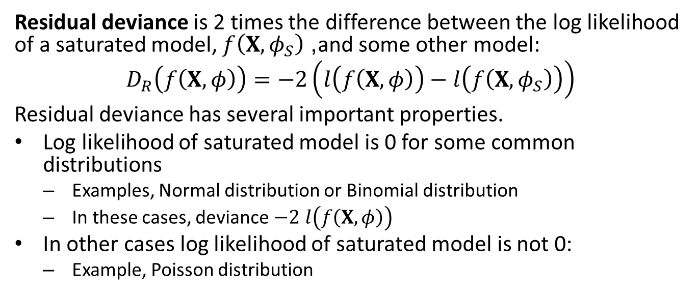
Residual Deviance
Residual deviance is 2 times the difference between the log likelihood of a saturated model, $f\left(X,φ_{S}\right)$, and some other model:
$$D_{R}\left(f\left(X,φ\right)\right)=−2\left(l\left(f\left(X,φ\right)\right)−l\left(f\left(X,φ_{S}\right)\right)\right)$$
Residual deviance has several important properties.
Log likelihood of saturated model is 0 for some common distributions
Examples, Normal distribution or Binomial distribution
In these cases, deviance $−2 l\left(f\left(X,φ\right)\right)$
In other cases log likelihood of saturated model is not 0:
Example, Poisson distribution

Slide 47
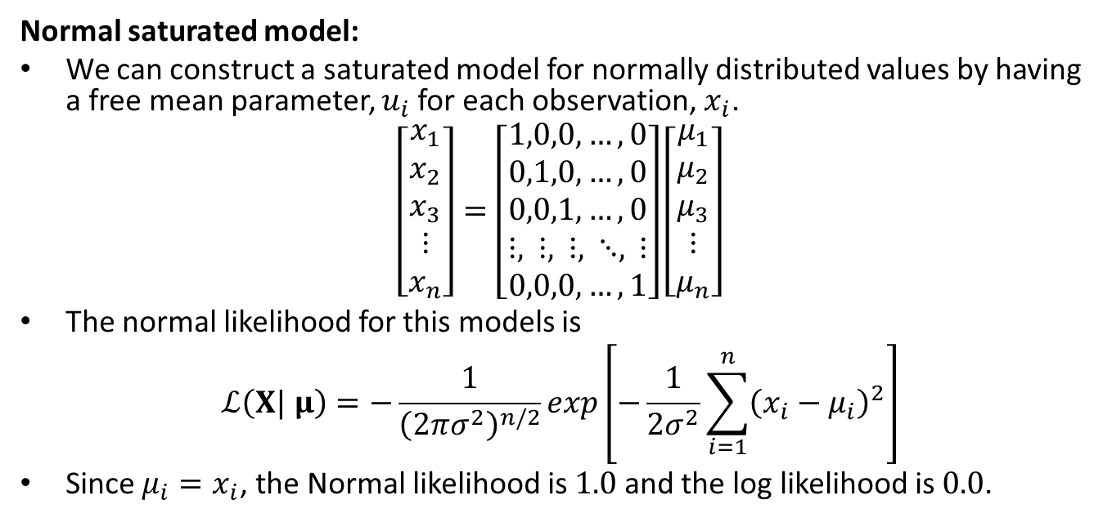
Residual Deviance
Normal saturated model:
We can construct a saturated model for normally distributed values by having a free mean parameter, $u_{i}$ for each observation, $x_{i}$.
$$\left[\begin{matrix}x_{1} \\ x_{2} \\ x_{3} \\ ⋮ \\ x_{n}\end{matrix}\right]=\left[\begin{matrix}1,0,0,…,0 \\ 0,1,0,…,0 \\ 0,0,1,…,0 \\ ⋮, ⋮, ⋮, ⋱, ⋮ \\ 0,0,0,…,1\end{matrix}\right]\left[\begin{matrix}μ_{1} \\ μ_{2} \\ μ_{3} \\ ⋮ \\ μ_{n}\end{matrix}\right]$$
The normal likelihood for this models is
$$ℒ\left(X| μ\right)=−\frac{1}{{\left(2πσ^{2}\right)}^{n/2}}exp\left[−\frac{1}{2σ^{2}}\sum_{i=1}^{n}{{\left(x_{i}−μ_{i}\right)}^{2}}\right]$$
Since $μ_{i}=x_{i}$, the Normal likelihood is $1.0$ and the log likelihood is $0.0$.

Slide 48
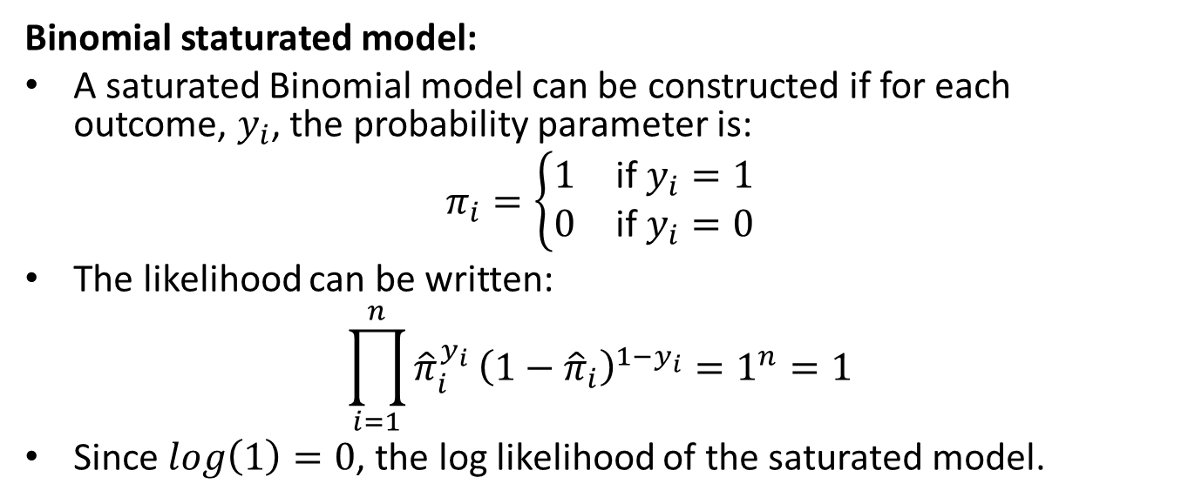
Residual Deviance
Binomial staturated model:
A saturated Binomial model can be constructed if for each outcome, $y_{i}$, the probability parameter is:
$$π_{i}=\left\{\begin{matrix}1 & \text{if} y_{i}=1 \\ 0 & \text{if} y_{i}=0\end{matrix}\right.$$
The likelihood can be written:
$$\prod_{i=1}^{n}{{\hat{π}}_{i}^{y_{i}}}{\left(1−{\hat{π}}_{i}\right)}^{1−y_{i}}=1^{n}=1$$
Since $log\left(1\right)=0$, the log likelihood of the saturated model.

Slide 49
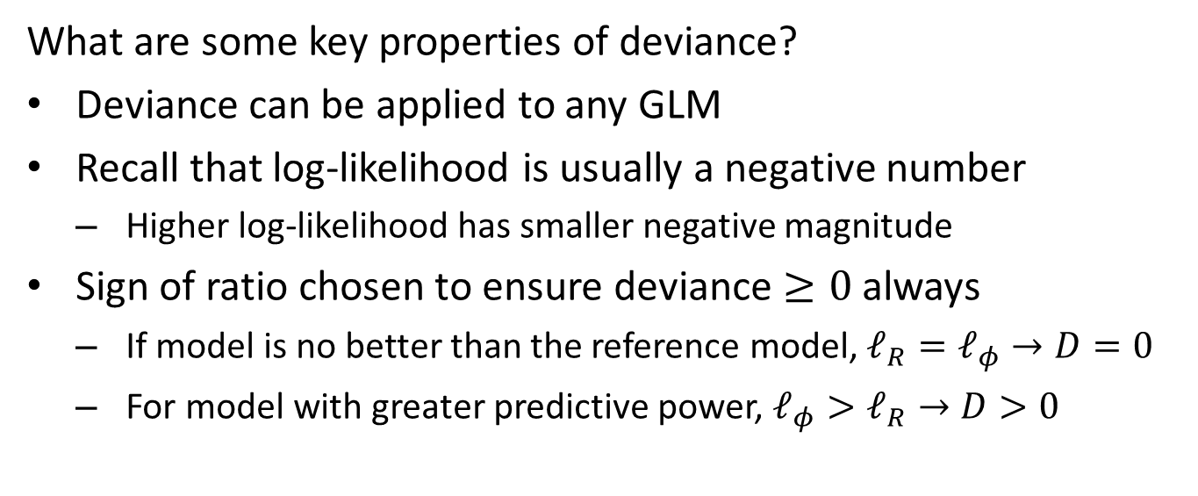
Properties of Deviance
What are some key properties of deviance?
Deviance can be applied to any GLM
Recall that log-likelihood is usually a negative number
Higher log-likelihood has smaller negative magnitude
Sign of ratio chosen to ensure deviance $≥0$ always
If model is no better than the reference model, $𝓁_{R}=𝓁_{φ}→D=0$
For model with greater predictive power, $𝓁_{φ}>𝓁_{R}→D>0$

Slide 50
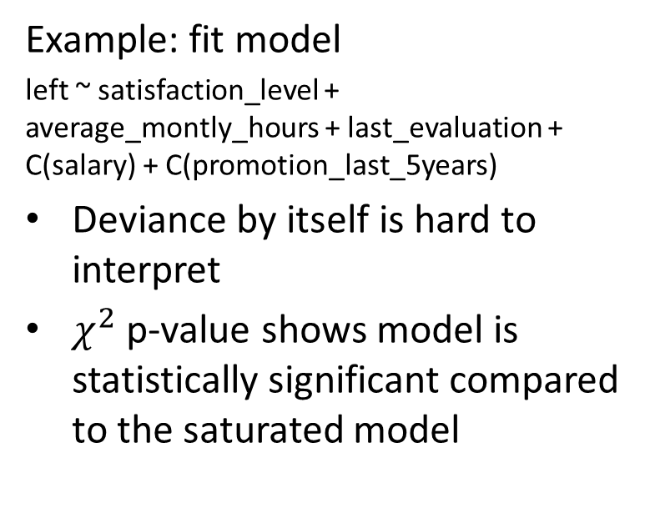
Example of Logistic Regression
Example: fit model
left ~ satisfaction_level + average_montly_hours + last_evaluation + C(salary) + C(promotion_last_5years)
Deviance by itself is hard to interpret
$χ^{2}$ p-value shows model is statistically significant compared to the saturated model

Slide 51
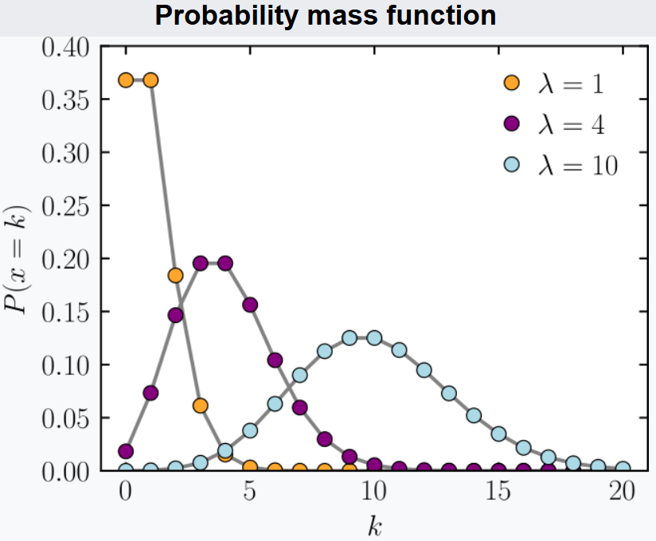
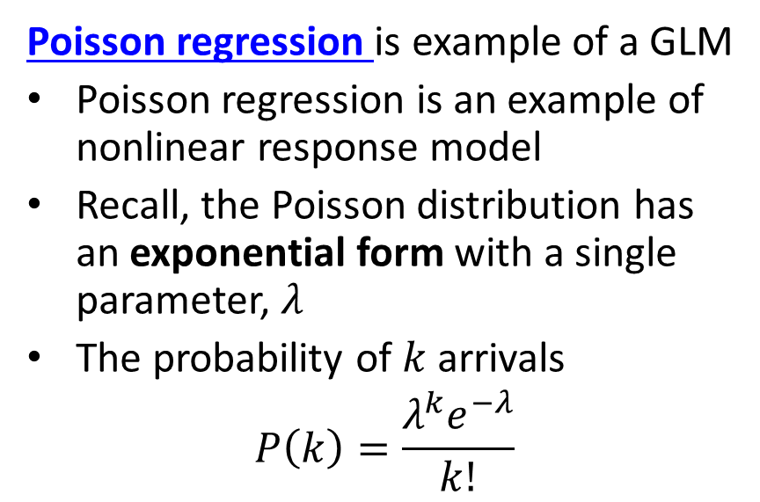
Poisson Regression as GLM
Poisson regression is example of a GLM
Poisson regression is an example of nonlinear response model
Recall, the Poisson distribution has an exponential form with a single parameter, $λ$
The probability of $k$ arrivals
$$P\left(k\right)=\frac{λ^{k}e^{−λ}}{k!}$$
Figure from Wiki Commons

Slide 52
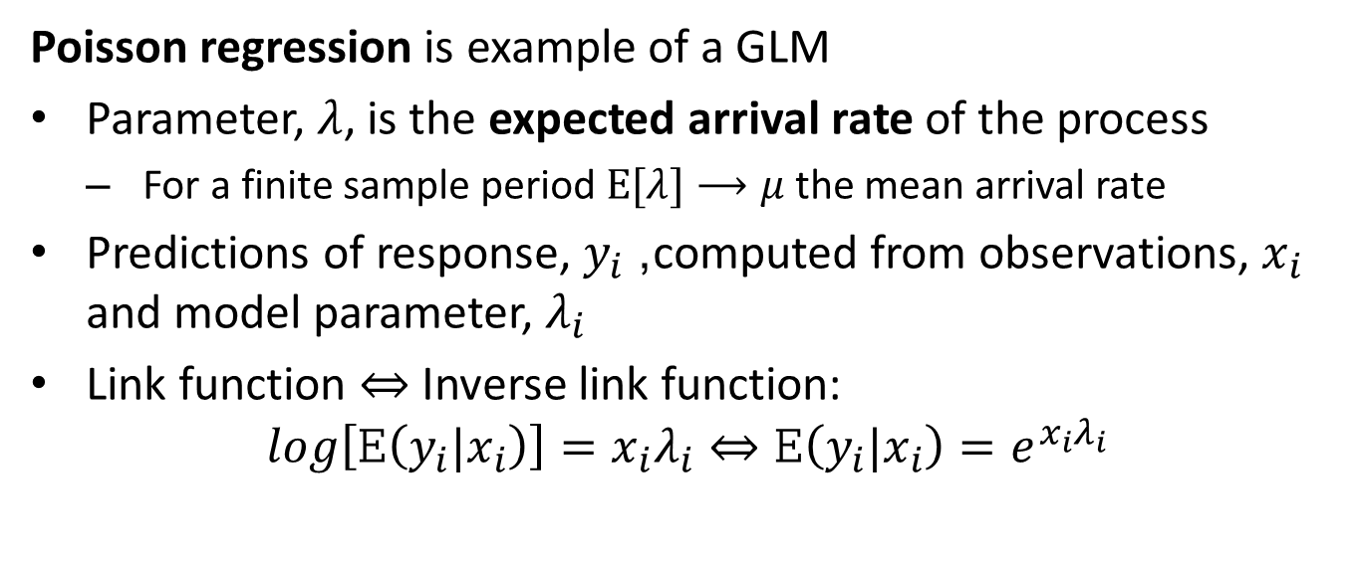
Poisson Regression as GLM
Poisson regression is example of a GLM
Parameter, $λ$, is the expected arrival rate of the process
For a finite sample period $E[λ]⟶μ$ the mean arrival rate
Predictions of response, $y_{i}$, computed from observations, $x_{i}$ and model parameter, $λ_{i}$
Link function $⇔$ Inverse link function:
$$log\left[E\left(y_{i}|x_{i}\right)\right]=x_{i}λ_{i}⇔E\left(y_{i}|x_{i}\right)=e^{x_{i}λ_{i}}$$

Slide 53
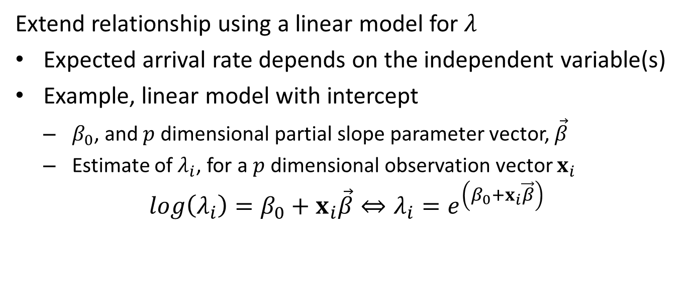
Poisson Regression as GLM
Extend relationship using a linear model for $λ$
Expected arrival rate depends on the independent variable(s)
Example, linear model with intercept
$β_{0}$, and $p$ dimensional partial slope parameter vector, $\vec{β}$
Estimate of $λ_{i}$, for a $p$ dimensional observation vector $x_{i}$
$$log\left(λ_{i}\right)=β_{0}+x_{i}\vec{β}⇔λ_{i}=e^{\left(β_{0}+x_{i}\vec{β}\right)}$$

Slide 54
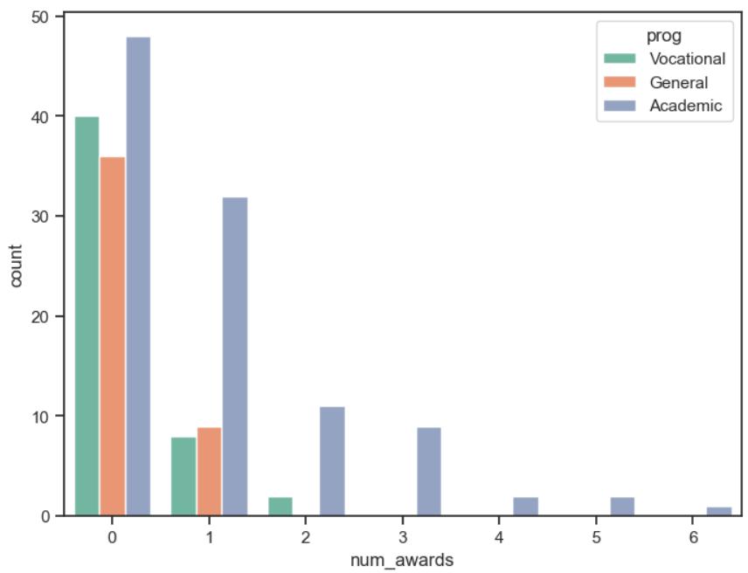
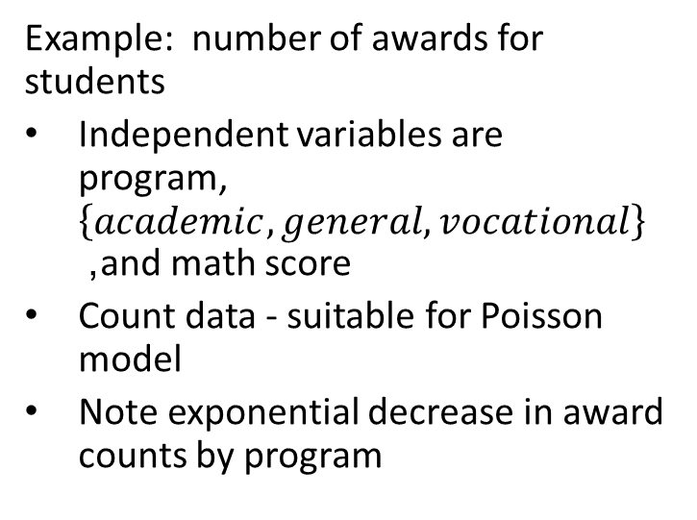
Poisson Regression Example
Example: number of awards for students
Independent variables are program,$\left\{academic, general, vocational\right\}$ , and math score
Count data - suitable for Poisson model
Note exponential decrease in award counts by program

Slide 55
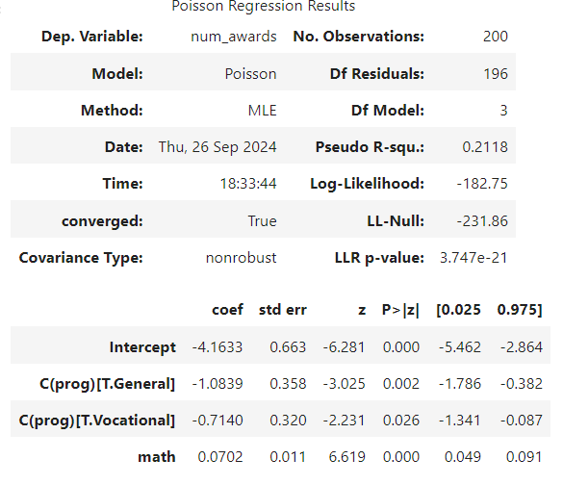
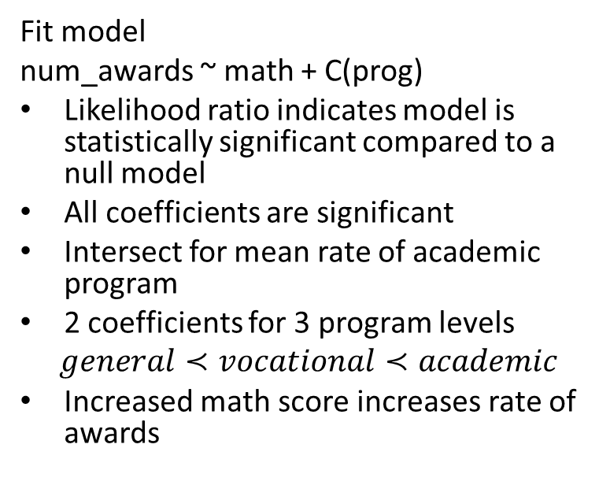
Poisson Regression Example
Fit model
num_awards ~ math + C(prog)
Likelihood ratio indicates model is statistically significant compared to a null model
All coefficients are significant
Intersect for mean rate of academic program
2 coefficients for 3 program levels
$$general≺vocational≺academic$$
Increased math score increases rate of awards

Slide 56
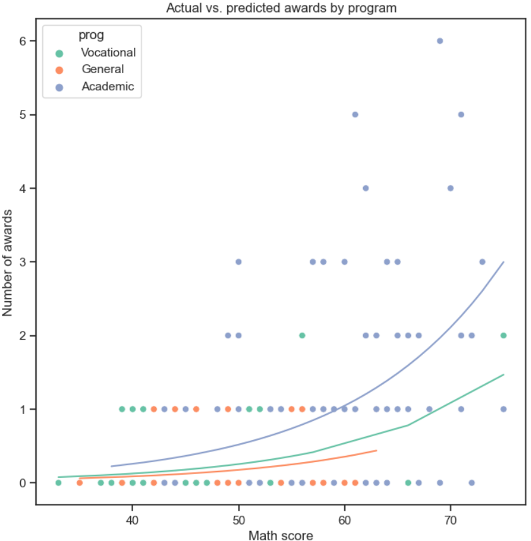
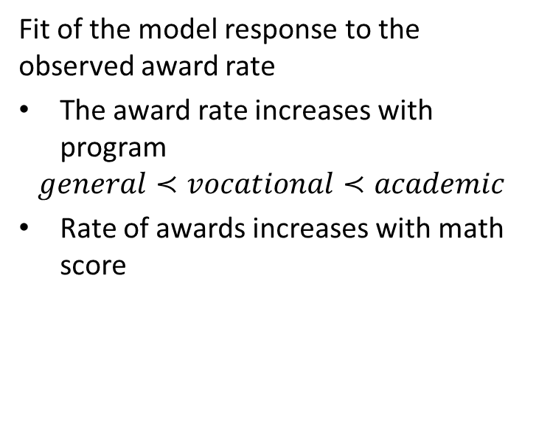
Poisson Regression Example
Fit of the model response to the observed award rate
The award rate increases with program
$$general≺vocational≺academic$$
Rate of awards increases with math score

Slide 57
Summary
Categorical variables are encoded in model matrix
Categorical variables encoded with one hot encoding
n dummy variables with no intercept
n-1 dummy variables encode contrasts to intercept variable
Either encoding gives same model results
Can adjust observations and response for effects

Slide 58
Summary
Models with nonlinear response have non-Normal distributions
The generalized linear model (GLM) accommodates nonlinear response distributions
Link function transforms to linear model
Inverse link function transforms from Normal distribution to response distribution
Evaluating Binomial response models
Confusion matrix organizes
Compute metrics from elements of confusion matrix
Use multiple evaluation criteria
Compare model performance with deviance

