Slide 1

CSCI E-25
Computer Vision
Building Blocks of Deep Learning for CV
Steve Elston
Copyright 2021, 2022, 2023, 2024, 2025, 2026, Stephen F Elston. All rights reserved.

Slide 2
Building Blocks of Deep Learning
Deep learning for computer vision
Deep neural networks have revolutionized many areas of machine learning
  Object classification
  Object detection
  Segmentation
  Optical flow
  3-D geometry
  Generative models
  …
Many types of deep neural networks used in CV
  Fully connected NNs or preceptrons – our focus this week
  Convolutional NNs create complex feature maps – next week
  Transformers use attention between image features – two weeks from now
  Many others …

Slide 3
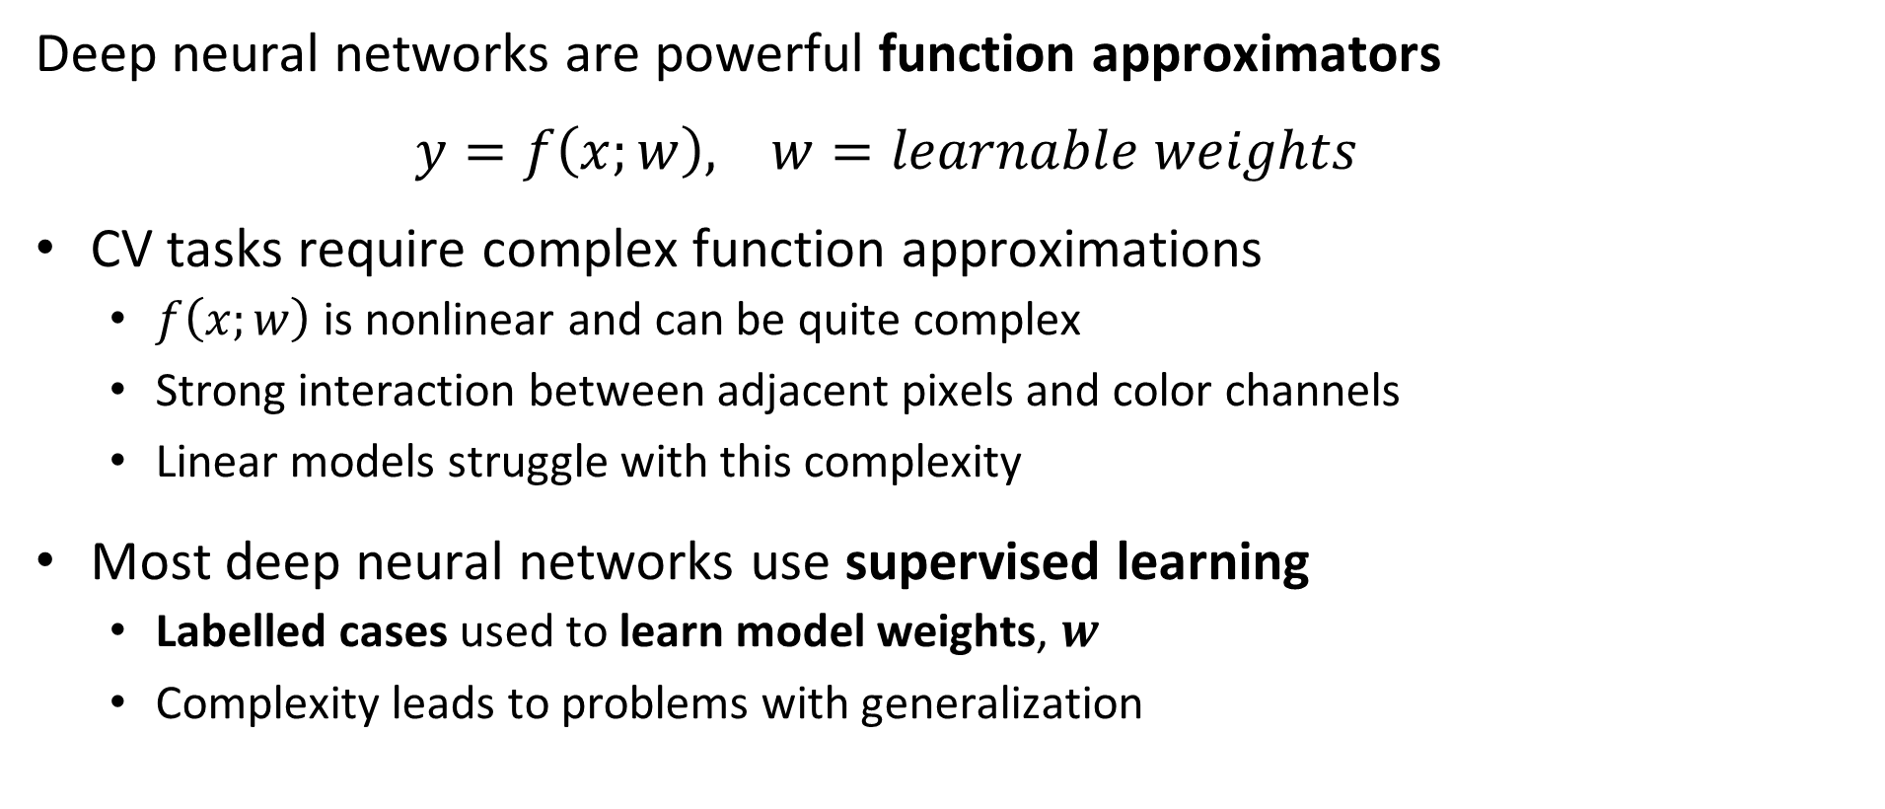
Function Approximation with Deep Neural Networks
Deep neural networks are powerful function approximators
$y=f\left(x;w\right), w=learnable weights$
CV tasks require complex function approximations
  $f\left(x;w\right)$is nonlinear and can be quite complex
  Strong interaction between adjacent pixels and color channels
  Linear models struggle with this complexity
Most deep neural networks use supervised learning
  Labelled cases used to learn model weights, $w$
  Complexity leads to problems with generalization

Slide 4
Essential Elements of AI Agents
Representation
Inference
Input = X
Output = Y
Learning

Slide 5
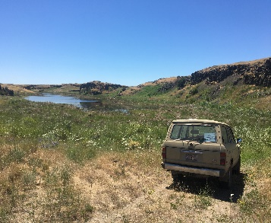
Why Fully Connected Neural Networks in CV
Pipelines for many CV tasks require fully connected NNs
CNNs and transformers
Flatten feature map
Inference
Input Image
Backbone network learns feature map
Multi-dimensional feature map
Task specific NN

Slide 6
Building Blocks of Deep Learning
Key points for this lesson
Predictive tasks vs. generative tasks
Preceptrons and forward propagation
Depth, breath and model capacity
Nonlinearity and activation functions
Loss functions
Architectures of deep NNs
Learning, overfitting and regularization for deep NNs

Slide 7
Predictive vs. Generative Models

Slide 8
Predictive vs. Generative CV tasks
CV tasks can be formulated using a predictive or generative framework
Predictive tasks lean to predict a task specific result
  Object classification
  Object detection
  Segmentation
  Optical flow
  3-D geometry
  …
Generative tasks learn to generate new images
Generative and predictive models have learned parameters

Slide 9
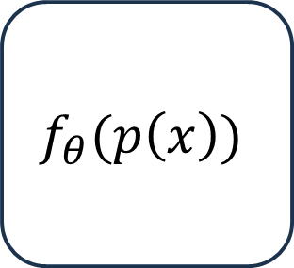
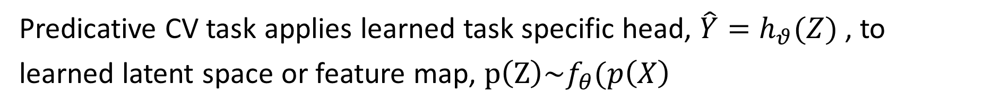
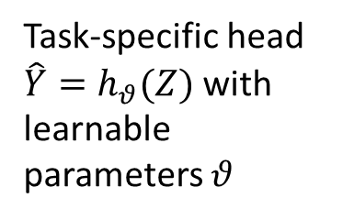
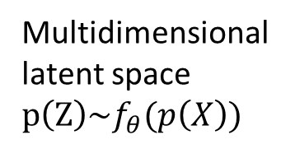
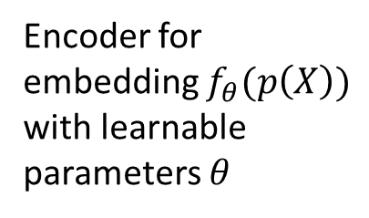
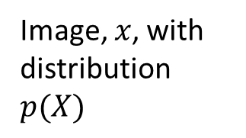
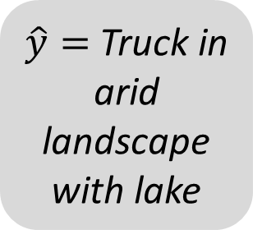
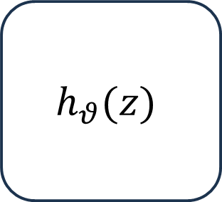
Predictive Models for CV
Predicative CV task applies learned task specific head, $\hat{Y}=h_{θ}(Z)$ , to learned latent space or feature map, $p\left(Z\right)\sim f_{θ}(p\left(X\right)$
Encoder for embedding $f_{θ}(p\left(X\right))$ with learnable parameters $θ$
Task-specific head $\hat{Y}=h_{θ}(Z)$ with learnable parameters $θ$
Multidimensional latent space $p\left(Z\right)\sim f_{θ}(p\left(X\right))$
Image, $x$, with distribution $p(X)$
Prediction
$$f_{θ}(p\left(x\right))$$
z
$$h_{θ}(z)$$
$\hat{y}=$Truck in arid landscape with lake
Input Image

Slide 10

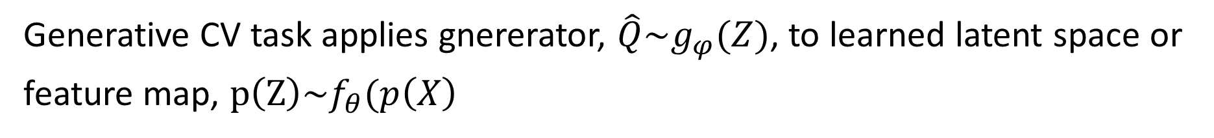
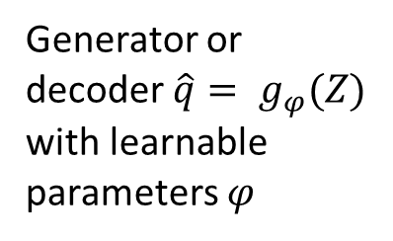
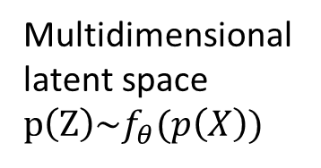
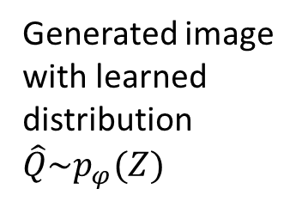
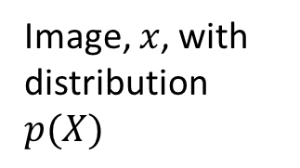
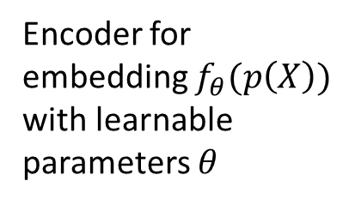
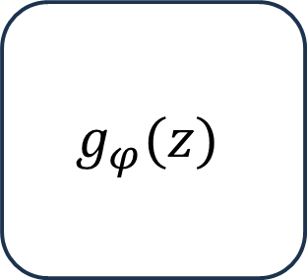
Predictive Models for CV
Generative CV task applies gnererator, $\hat{Q}\sim g_{φ}(Z)$, to learned latent space or feature map, $p\left(Z\right)\sim f_{θ}(p\left(X\right)$
Encoder for embedding $f_{θ}(p\left(X\right))$ with learnable parameters $θ$
Generator or decoder $\hat{q}= g_{φ}(Z)$ with learnable parameters $φ$
Generated image with learned distribution $\hat{Q}\sim p_{φ}(Z)$
Multidimensional latent space $p\left(Z\right)\sim f_{θ}(p\left(X\right))$
Image, $x$, with distribution $p(X)$
$$f_{θ}(p\left(x\right))$$
z
$$g_{φ}(z)$$
Input Image

Slide 11
Predictive vs. Generative CV tasks
An increasing number of CV tasks can be preformed with a predictive or generative framework
Image segmentation
Optical flow
Super resolution
3-D depth maps
…

Slide 12
Perceptrons and Forward Propagation

Slide 13
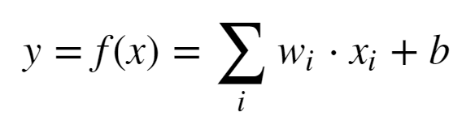
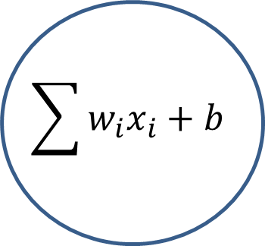
Representation: Linear Neural Network
Proposed by McCulloch and Pitts (1943)
X₁
w₁
$$\sum{w_{i}x_{i}+b}$$
w₂
X₂
Y
w₃
X₃

Slide 14

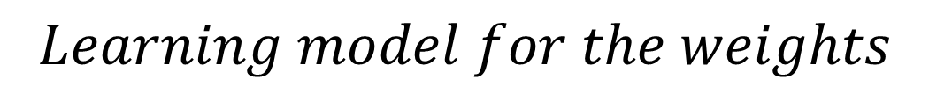


Representation: Linear Neural Network
Early learning model for a neural network - Heeb (1949)
X₁
$$Learning model for the weights$$
w₁
$$w_{ij}=x_{i}x_{j}$$
w₂
Σ + b
$$Δw_{ij}=ηx_{i}x_{j}$$
X₂
Y
w₃
$$Where, η is the learning rate$$
X₃
But, this is just linear regression!

Slide 15
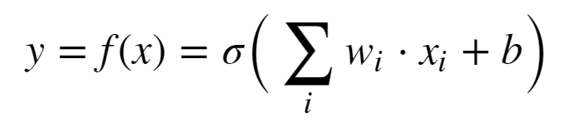
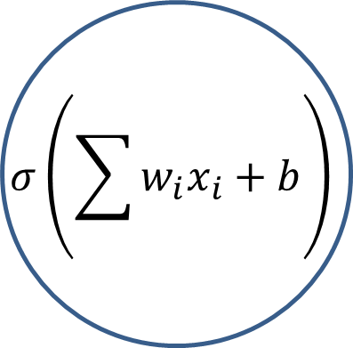
Representation: Perceptron
Use of nonlinear activation proposed by Rosenblatt (1962)
X₁
w₁
$$σ\left(\sum{w_{i}x_{i}+b}\right)$$
w₂
X₂
Y
w₃
X₃
Minsky and Papert (1969) showed the perceptron cannot represent an exclusive OR (XOR)
This is just logistic regression!

Slide 16
We Need a Better Deep Representation
By mid-1980s need for architecture with hidden layers for greater model capacity was recognized, the multi-layer perceptron (MLP)
Multiple units in hidden layers
  Input layer
  Multiple hidden layers
  Output layer
Nonlinear activations in units
Learned weights for complex function approximation
Fully connected between units in adjacent layers
Can solve XOR problem and much more!

Slide 17
We Need a Better Deep Representation
w¹₁₁
S₁ = σ_{h}(Σ )
w²₁
X₁
w¹₁₂
w¹₂₁
S₃ = Σ
X₂
w²₂
w¹₂₂
S₂ = σ_{h}(Σ )
_{Input Layer}
_{Hidden Layer}
_{Output Layer}

Slide 18
We Need a Better Deep Representation
What is the output of the simple network?
Process called forward propagation
Start with the output of the hidden layer:
S₁ = σ(Σ_{i} x_{i} * W¹_{1i})
S₂ = σ(Σ_{i} x_{i} * W¹_{2i})
Next, compute the output of the output layer
S₃ = Σ_{j} W²_{j} * σ(Σ_{i} x_{i} * W¹_{ji})

Slide 19
Model Depth, Width and Capacity

Slide 20
Model Capacity
The universal approximation theorem, Hornik (1991), tells us that an infinitely wide hidden layer can represent any function
Usefulness limited:
  It’s nice to know we can represent complex functions
  But, completely infeasible in practice
What can we do?
  Trade depth for breath

Slide 21
Model Capacity
Model capacity is fundamentally related to the bias-variance trade-off of machine learning
  Low-capacity models have high bias but low variance
  High-capacity models have low bias but high variance
High-capacity models have a tendency to be overfit
We have more to say about this problem in another lesson

Slide 22
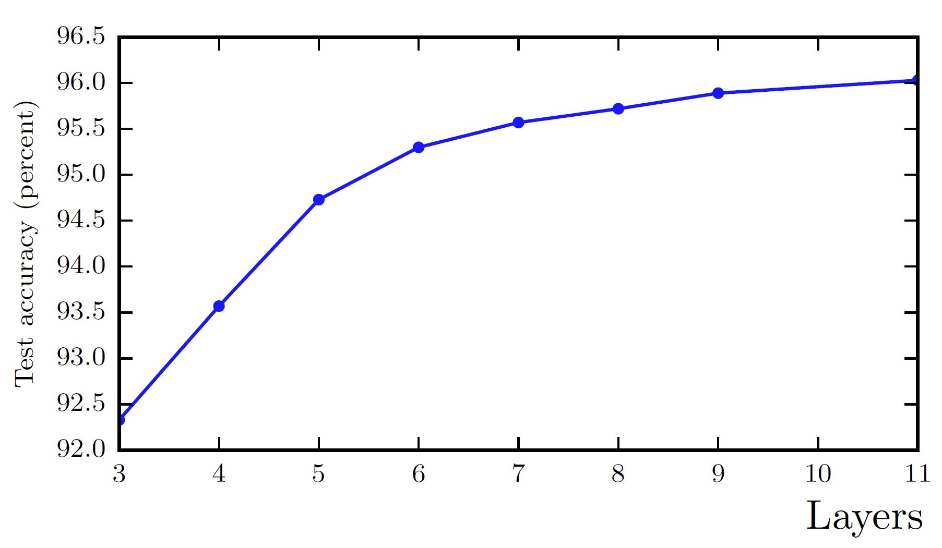
Model Capacity
  Model capacity with increasing depth. From Goodfellow et. al. 2014.

Slide 23
Nonlinearity and Activation Functions

Slide 24
Activation functions
Nonlinear activation is key to achieving good function approximation.
Many activation functions have been tried, here are a few:
Function | How Used? | Comments
Sigmoid | Binary classifier output layer | Historically the most used
Softmax | Multi-class output layer | For categorical distribution
Linear | Numeric output layer | Regression models
Rectilinear/ leaky RELU | Hidden layers | Widely used to avoid vanishing gradient
Gaussian Error Linear Unit | Hidden layers | Better gradient propagation than Leaky RELU
Tanh | Binary classifier output layers Other specialized applications | Better gradient properties than sigmoid

Slide 25
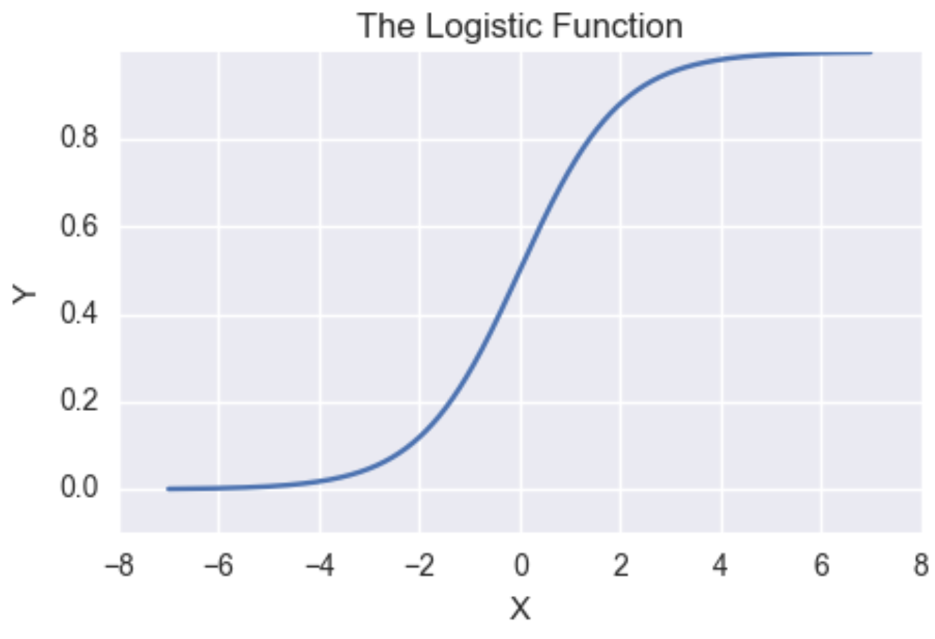
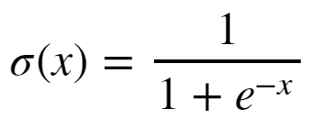
Activation functions
Sigmoid has vanishing gradients
Near-0 gradient
Near-0 gradient

Slide 26
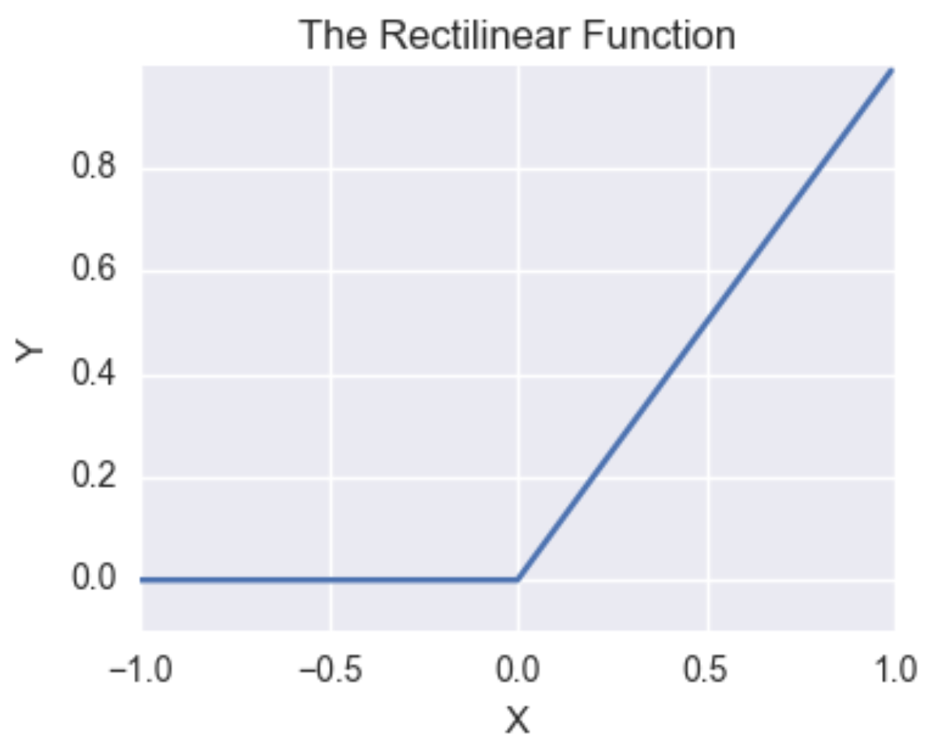

Activation functions
Rectilinear function has constant gradient for positive values
Constant gradient
Gradient of Leaky ReLU < 0

Slide 27
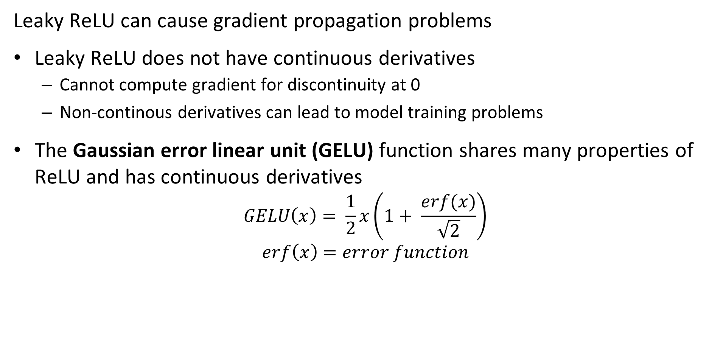
Activation Functions
Leaky ReLU can cause gradient propagation problems
Leaky ReLU does not have continuous derivatives
  Cannot compute gradient for discontinuity at 0
  Non-continous derivatives can lead to model training problems
The Gaussian error linear unit (GELU) function shares many properties of ReLU and has continuous derivatives
$$GELU\left(x\right)= \frac{1}{2}x\left(1+ \frac{erf(x)}{\sqrt{2}}\right)$$
$$erf\left(x\right)=error function$$

Slide 28
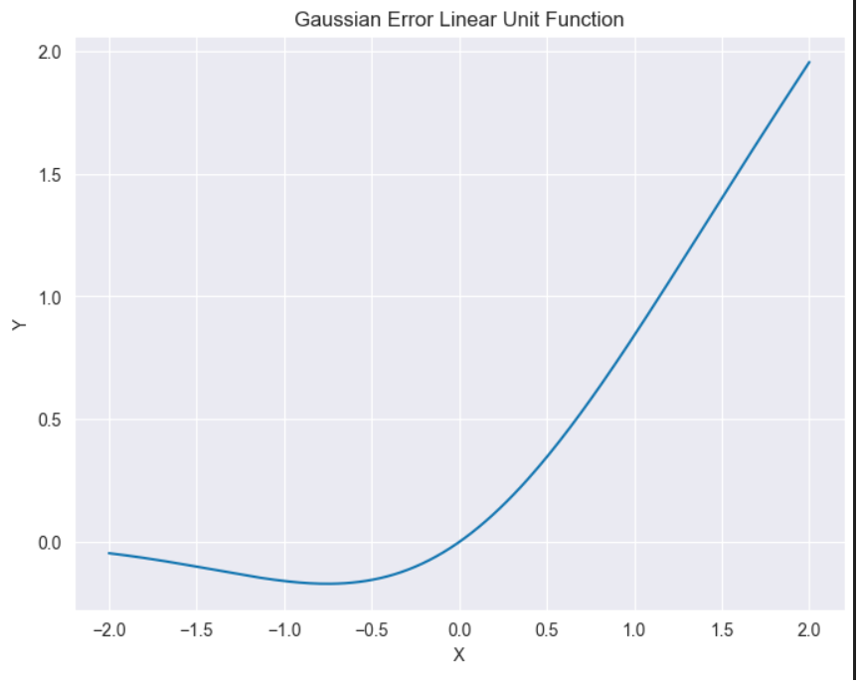
Activation functions
GELU function has continuous derivatives
Near constant gradient of GELU > 0
Gradient defined at 0

Slide 29
Learning Weights with Backpropagation

Slide 30
The Backpropagation Algorithm
To find function approximation, f(x), we need to learn model weights
The primary algorithm we use to learn model weights is known as backpropagation
Backpropagation was applied to learning (system identification) for control problems as early as 1960 by Henry Kelly and 1961 by Arthur Bryson for dynamic programming
First applied to neural networks by Paul Werbos in 1974
In 1986 by Rumelhart, Hinton and Williams showed that backpropagation was effective for learning the weights of multiple hidden layers
  The era of deep learning had begun!!

Slide 31
The Backpropagation Algorithm
w¹₁₁
X₁
S₁ = σ_{h}(Σ )
w²₁
w¹₁₂
w¹₂₁
S₃ = Σ
J(W)
X₂
w²₂
w¹₂₂
S₂ = σ_{h}(Σ )
Y
_{Input Layer}
_{Hidden Layer}
_{Output Layer}
_{Loss Function}

Slide 32
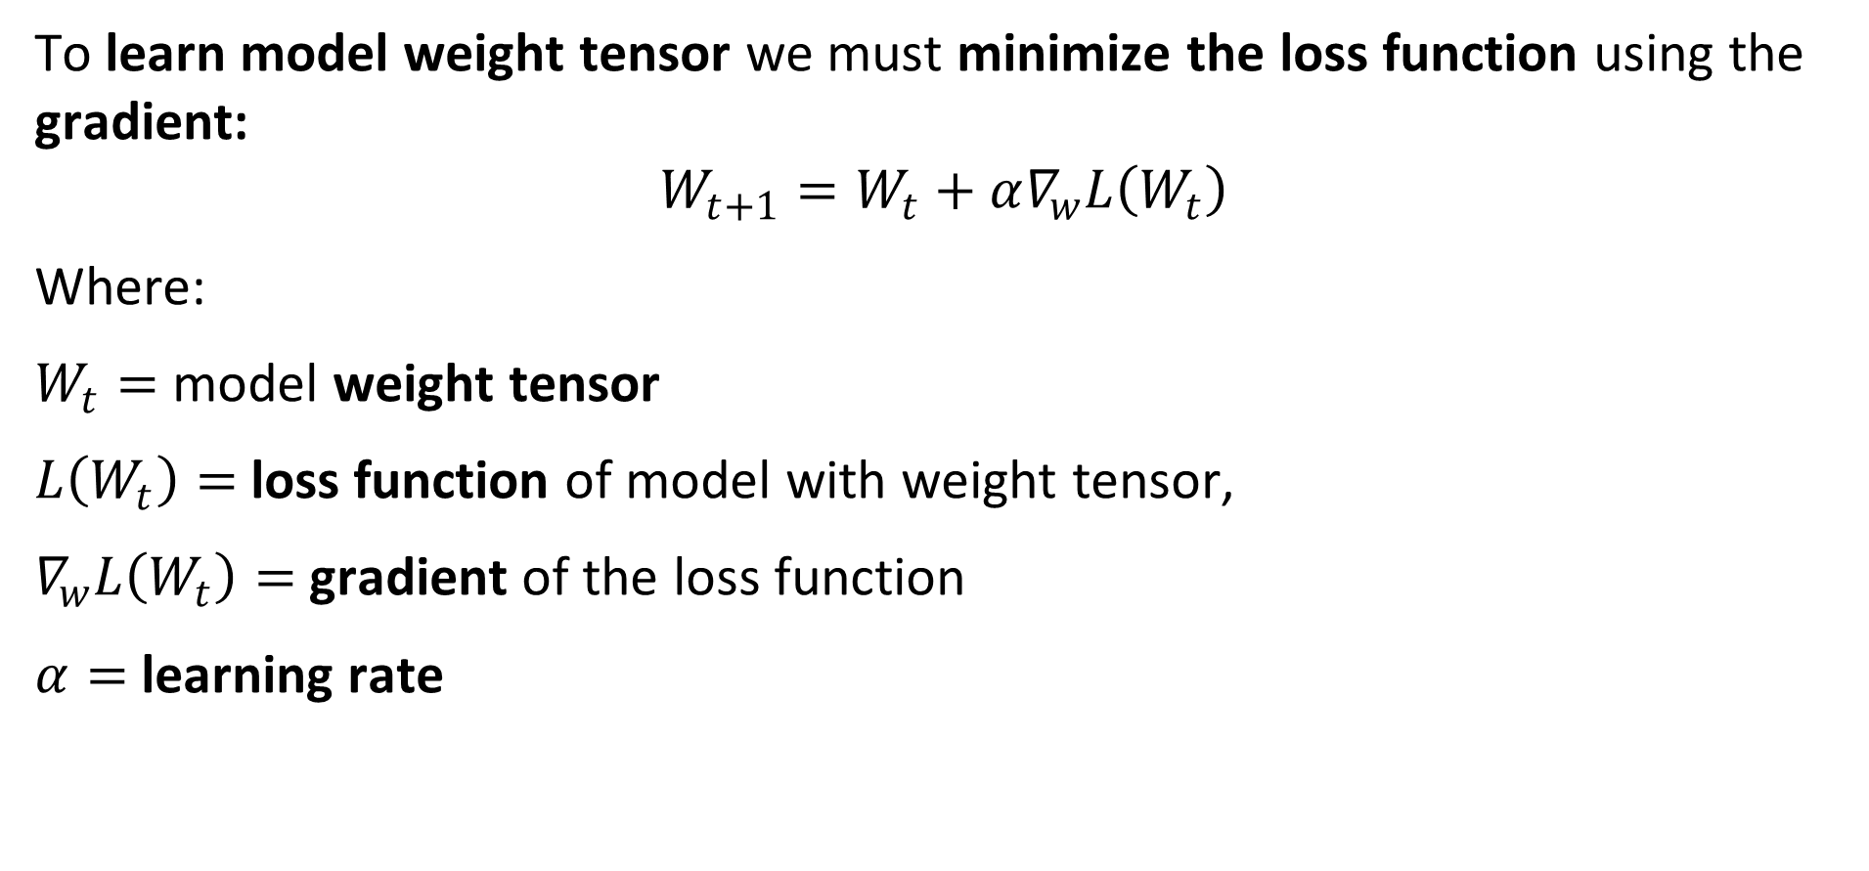
The Backpropagation Algorithm
To learn model weight tensor we must minimize the loss function using the gradient:
$$W_{t+1}=W_{t}+α∇_{w}L\left(W_{t}\right)$$
Where:
$W_{t}=$ model weight tensor
$L\left(W_{t}\right)=$ loss function of model with weight tensor,
$∇_{w}L\left(W_{t}\right)=$ gradient of the loss function
$α=$ learning rate

Slide 33
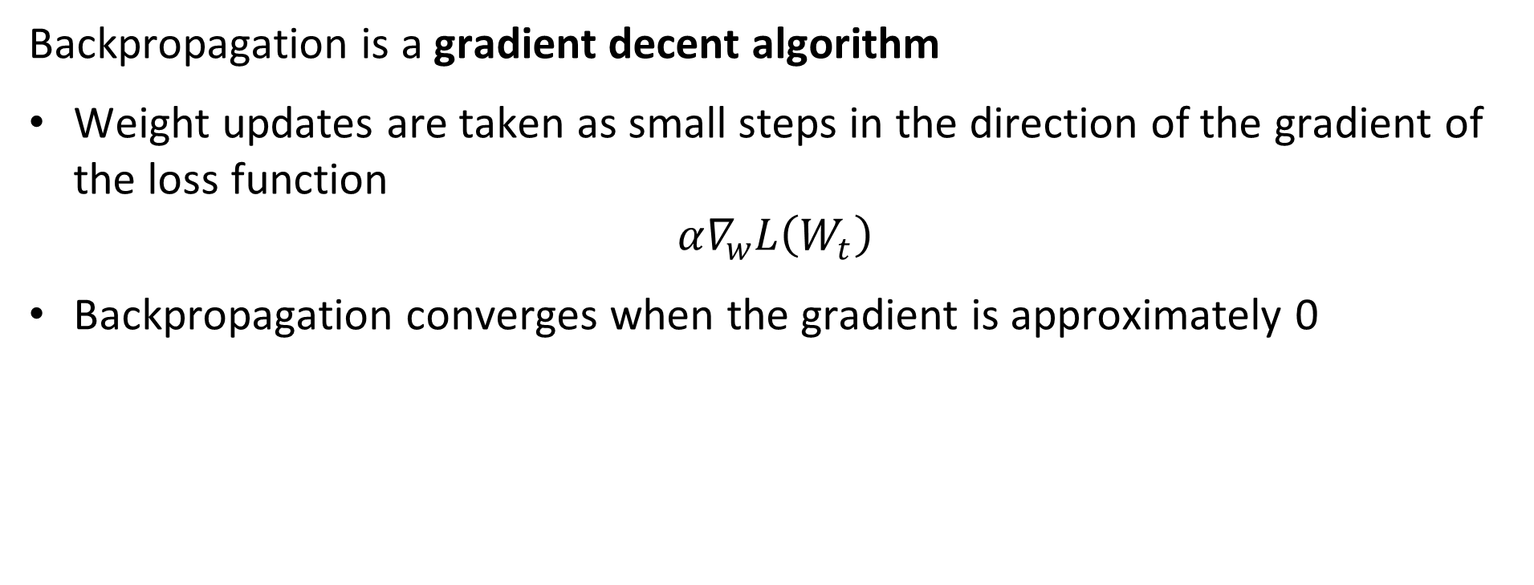
The Back Propagation Algorithm
Backpropagation is a gradient decent algorithm
Weight updates are taken as small steps in the direction of the gradient of the loss function
$$α∇_{w}L\left(W_{t}\right)$$
Backpropagation converges when the gradient is approximately 0

Slide 34
Loss Functions

Slide 35
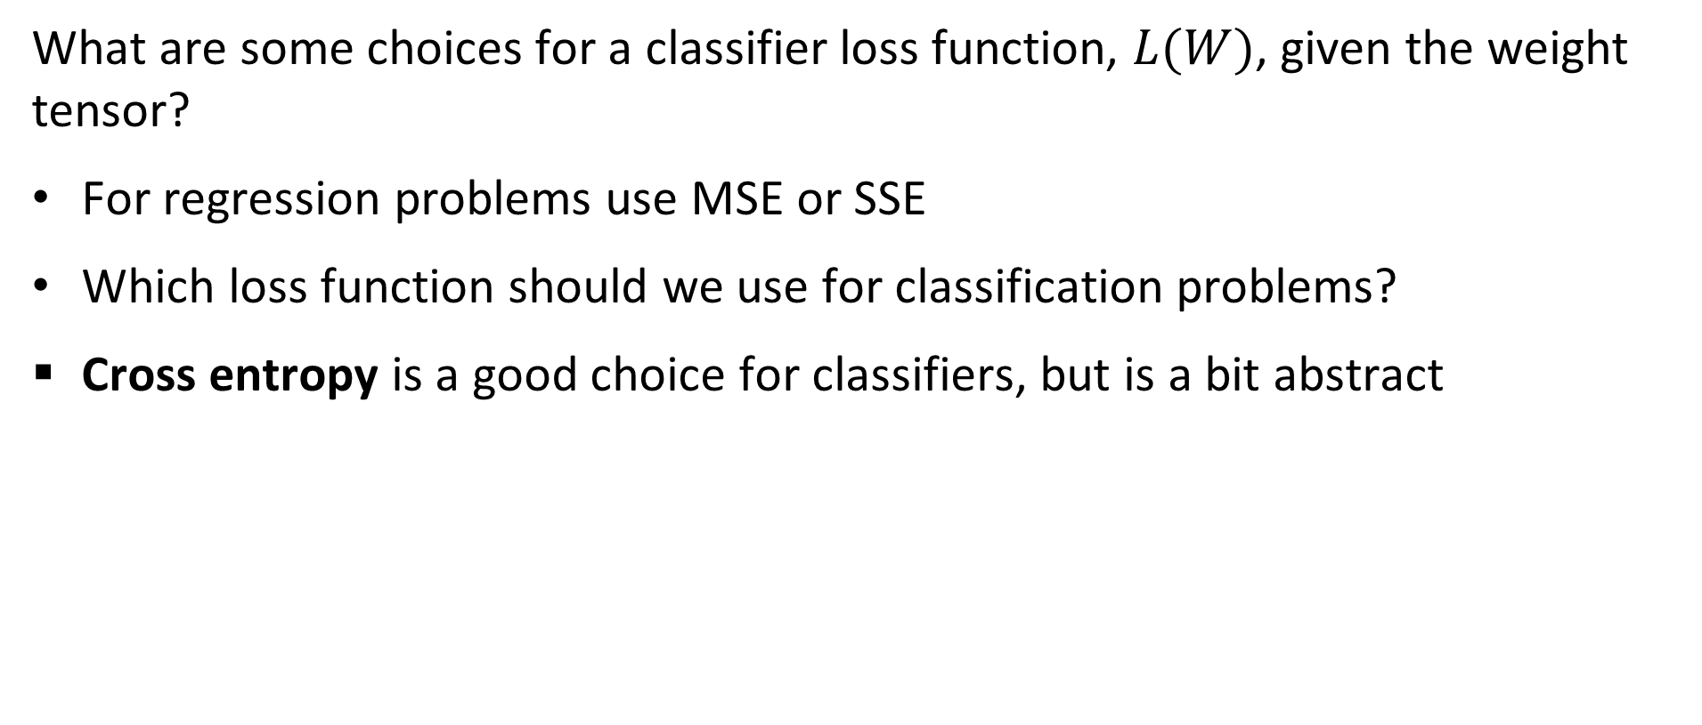
Loss Functions for Training Neural Networks
What are some choices for a classifier loss function, $L(W)$, given the weight tensor?
For regression problems use MSE or SSE
Which loss function should we use for classification problems?
Cross entropy is a good choice for classifiers, but is a bit abstract

Slide 36
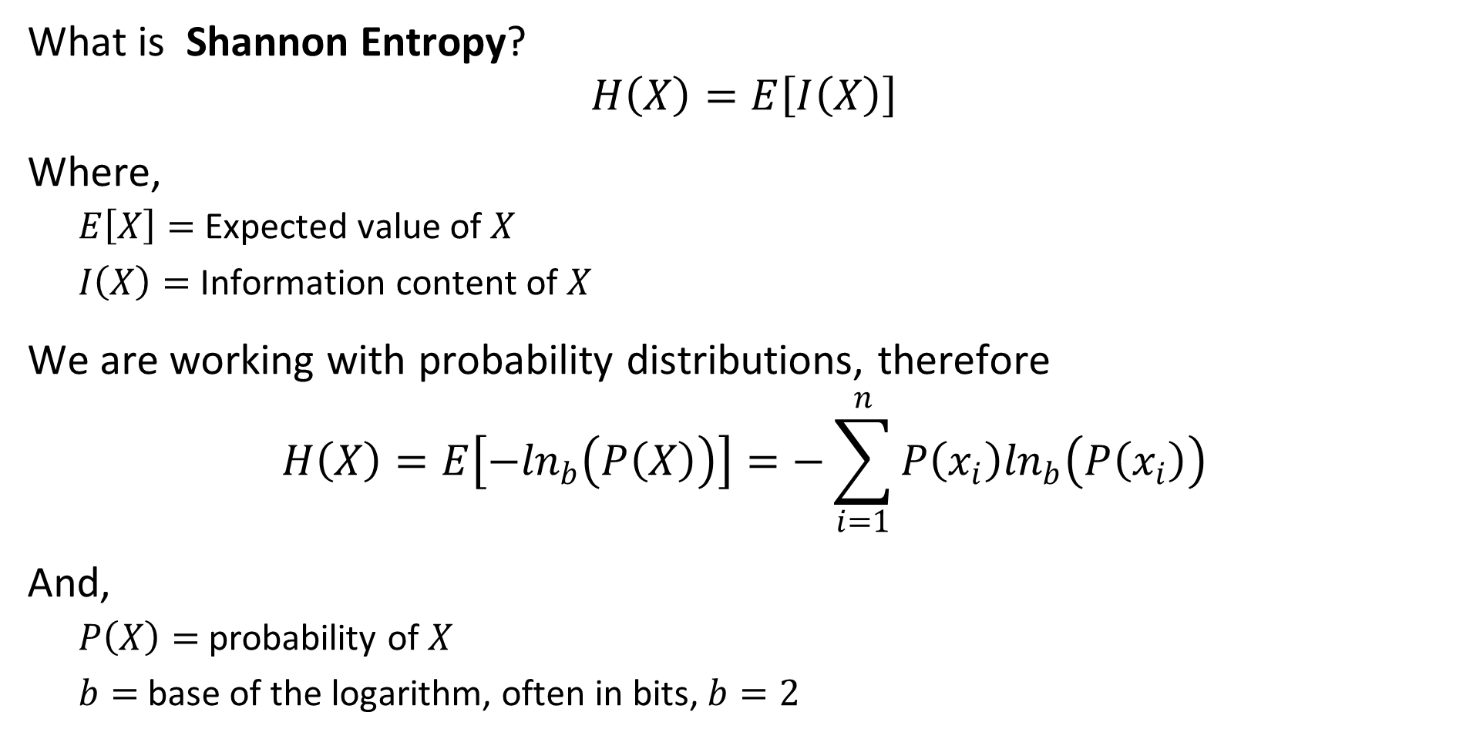
Loss Functions for Training Neural Networks
What is Shannon Entropy?
$$H\left(X\right)=E\left[I\left(X\right)\right]$$
Where,
  $E\left[X\right]=$ Expected value of $X$
  $I\left(X\right)=$ Information content of $X$
We are working with probability distributions, therefore
$$H\left(X\right)=E\left[−\ln_{b}\left(P\left(X\right)\right)\right]=−\sum_{i=1}^{n}{P\left(x_{i}\right)\ln_{b}\left(P\left(x_{i}\right)\right)}$$
And,
  $P\left(X\right)=$ probability of $X$
  $b=$ base of the logarithm, often in bits, $b=2$

Slide 37
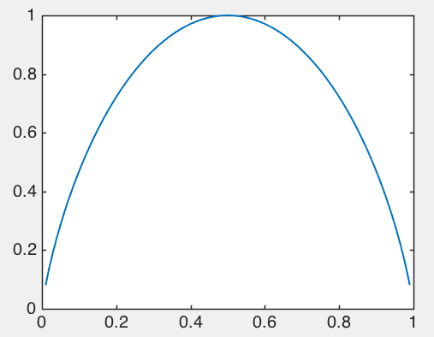
Loss Functions for Training Neural Networks
Entropy changes with the probability of an event
Example binary variable:
Max entropy when max uncertainty,
p = 0.5 – can’t predict next event
Min entropy when certainty, p = [0,1] – no uncertainty about next event
Entropy [p,1-p]
Probability p

Slide 38
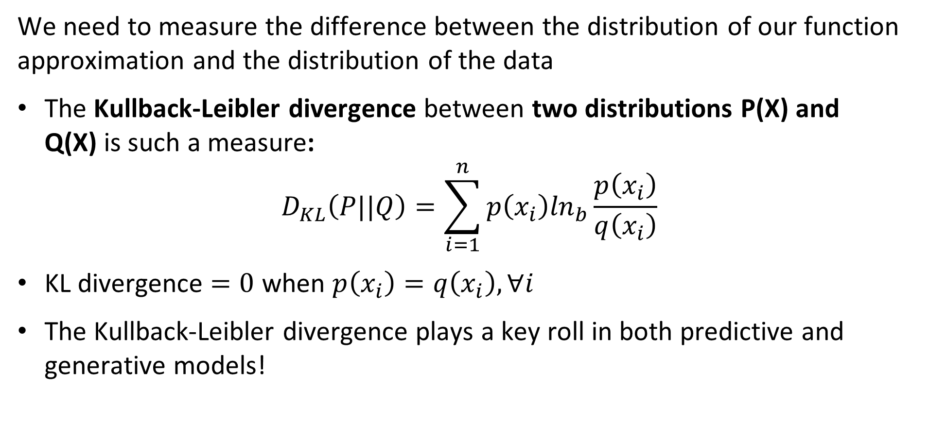
Loss Functions for Training Neural Networks
We need to measure the difference between the distribution of our function approximation and the distribution of the data
The Kullback-Leibler divergence between two distributions P(X) and Q(X) is such a measure:
$$D_{KL}\left(P||Q\right)=\sum_{i=1}^{n}{p\left(x_{i}\right)\ln_{b}\frac{p\left(x_{i}\right)}{q\left(x_{i}\right)}}$$
KL divergence $=0$ when $p\left(x_{i}\right)=q\left(x_{i}\right),∀i$
The Kullback-Leibler divergence plays a key roll in both predictive and generative models!

Slide 39
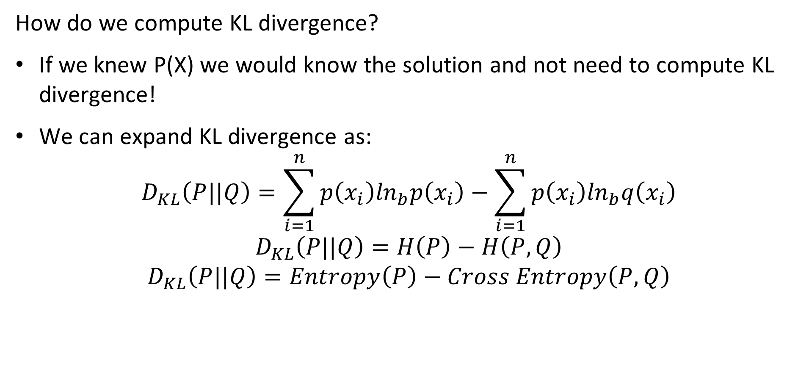
Loss Functions for Training Neural Networks
How do we compute KL divergence?
If we knew P(X) we would know the solution and not need to compute KL divergence!
We can expand KL divergence as:
$$D_{KL}\left(P||Q\right)=\sum_{i=1}^{n}{p\left(x_{i}\right)\ln_{b}p\left(x_{i}\right)−\sum_{i=1}^{n}{p\left(x_{i}\right)\ln_{b}q\left(x_{i}\right)}}$$
$$D_{KL}\left(P||Q\right)=H\left(P\right)−H\left(P,Q\right)$$
$$D_{KL}\left(P||Q\right)=Entropy\left(P\right)−Cross Entropy\left(P,Q\right)$$

Slide 40
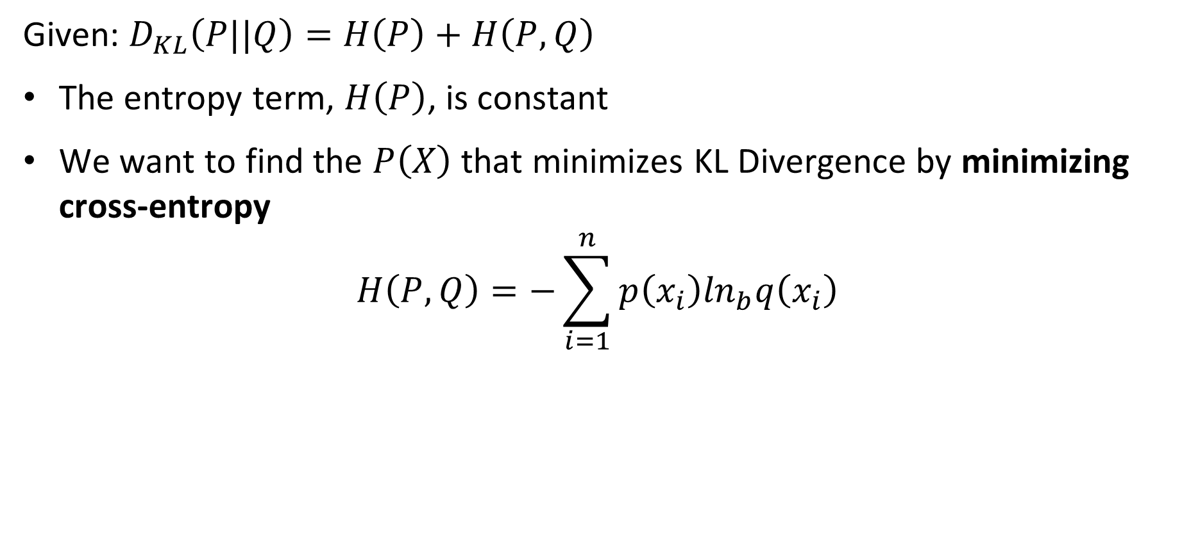
Loss Functions for Training Neural Networks
Given: $D_{KL}\left(P||Q\right)=H\left(P\right)+H\left(P,Q\right)$
The entropy term, $H\left(P\right)$, is constant
We want to find the $P\left(X\right)$ that minimizes KL Divergence by minimizing cross-entropy
$$H\left(P,Q\right)=−\sum_{i=1}^{n}{p\left(x_{i}\right)\ln_{b}q\left(x_{i}\right)}$$

Slide 41
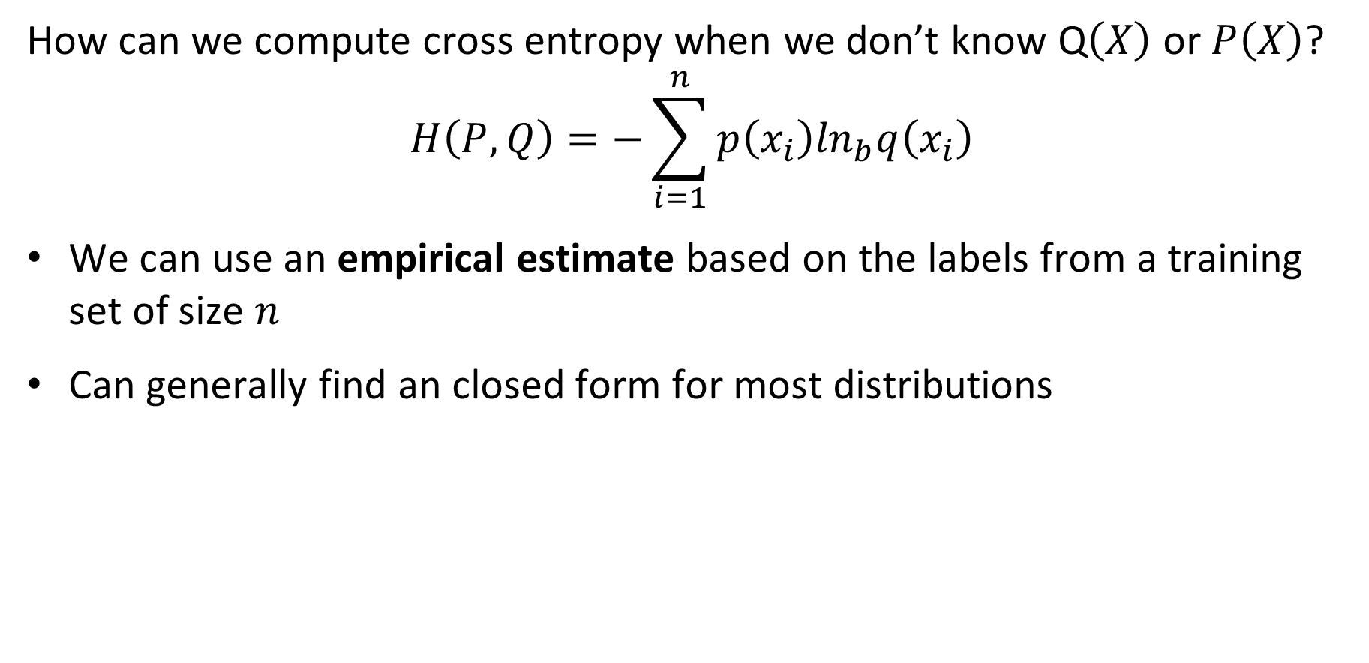
Loss Functions for Training Neural Networks
How can we compute cross entropy when we don’t know Q$\left(X\right)$ or $P\left(X\right)$?
$$H\left(P,Q\right)=−\sum_{i=1}^{n}{p\left(x_{i}\right)\ln_{b}q\left(x_{i}\right)}$$
We can use an empirical estimate based on the labels from a training set of size $n$
Can generally find an closed form for most distributions

Slide 42
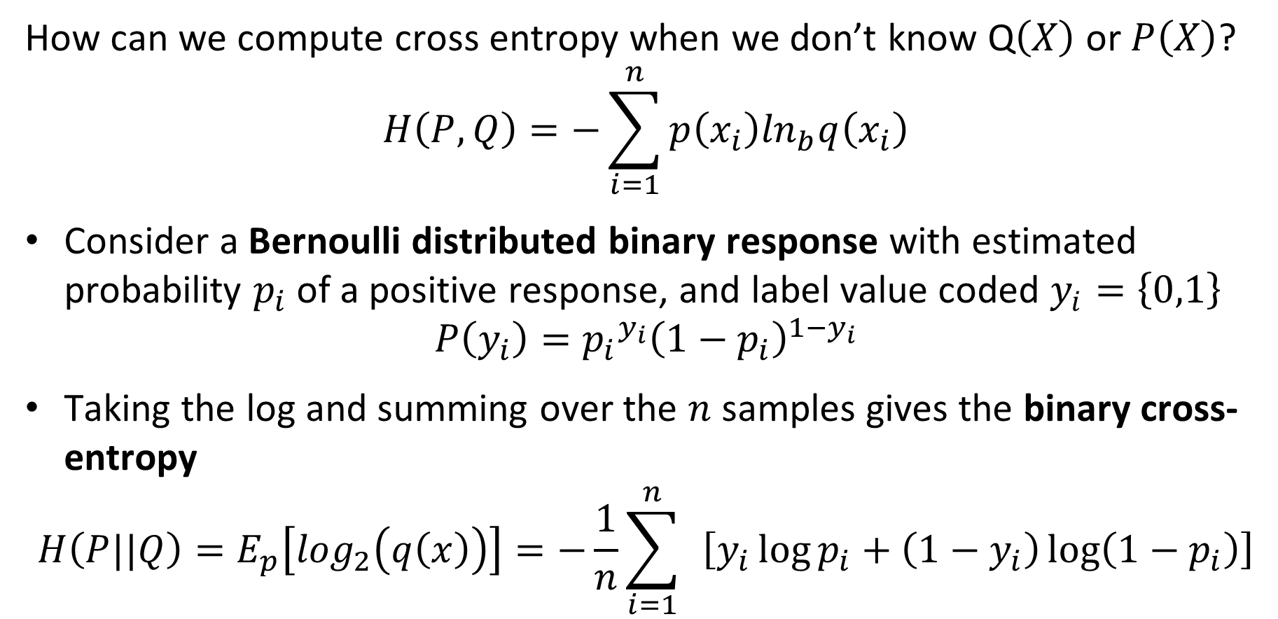
Loss Functions for Training Neural Networks
How can we compute cross entropy when we don’t know Q$\left(X\right)$ or $P\left(X\right)$?
$$H\left(P,Q\right)=−\sum_{i=1}^{n}{p\left(x_{i}\right)\ln_{b}q\left(x_{i}\right)}$$
Consider a Bernoulli distributed binary response with estimated probability $p_{i}$ of a positive response, and label value coded $y_{i}=\left\{0,1\right\}$
$$P\left(y_{i}\right)={p_{i}}^{y_{i}}{\left(1−p_{i}\right)}^{1−y_{i}}$$
Taking the log and summing over the $n$ samples gives the binary cross-entropy
$$H\left(P||Q\right)=E_{p}\left[\log_{2}\left(q\left(x\right)\right)\right]=−\frac{1}{n}\sum_{i=1}^{n}{ }\left[y_{i}\log{p_{i}}+\left(1−y_{i}\right)\log\left(1−p_{i}\right)\right]$$

Slide 43
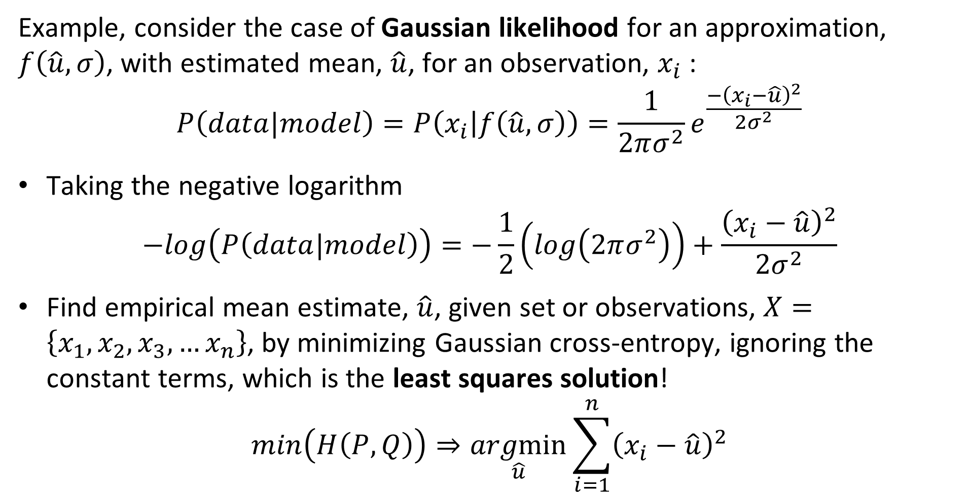
Loss Functions for Training Neural Networks
Example, consider the case of Gaussian likelihood for an approximation, $f\left(\hat{u},σ\right)$, with estimated mean, $\hat{u}$, for an observation, $x_{i}$:
$$P\left(data|model\right)=P\left(x_{i} | f\left(\hat{u},σ\right)\right)=\frac{1}{2πσ^{2}}e^{\frac{−{\left(x_{i}−\hat{u}\right)}^{2}}{2σ^{2}}}$$
Taking the negative logarithm
$$−log\left(P\left(data|model\right)\right)=−\frac{1}{2}\left(log\left(2πσ^{2}\right)\right)+\frac{{\left(x_{i}−\hat{u}\right)}^{2}}{2σ^{2}}$$
Find empirical mean estimate, $\hat{u}$, given set or observations, $X=\left\{x_{1},x_{2},x_{3},…x_{n}\right\}$, by minimizing Gaussian cross-entropy, ignoring the constant terms, which is the least squares solution!
$$min\left(H\left(P,Q\right)\right)⇒\underset{\hat{u}}{argmin}{\sum_{i=1}^{n}{{\left(x_{i}−\hat{u}\right)}^{2}}}$$

Slide 44

Performance Metrics for Deep NNs
How can we measure the performance of deep neural networks?
Use the same metrics used for other machine learning algorithms
RMSE, $R^{2}$, etc. for regression
Accuracy, precision, recall, F1, etc. for classification

Slide 45
Regularization for Deep Learning Models

Slide 46
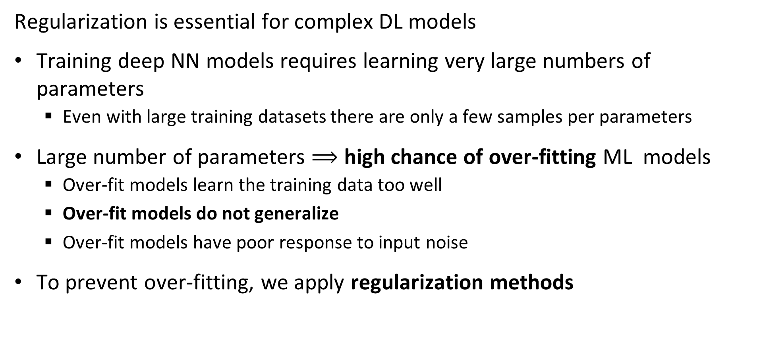
Regularization for Deep Learning
Regularization is essential for complex DL models
Training deep NN models requires learning very large numbers of parameters
  Even with large training datasets there are only a few samples per parameters
Large number of parameters $⟹$ high chance of over-fitting ML models
  Over-fit models learn the training data too well
  Over-fit models do not generalize
  Over-fit models have poor response to input noise
To prevent over-fitting, we apply regularization methods

Slide 47
Regularization for Deep Learning
Regularization is essential for complex DL models
Classical regularization routinely applied
  L2, L1, ElasticNet
  Reduced learning rate – Key to training NN models!
  Early stopping – Quit before overfitting starts!
Deep NN specific regularization methods
  Dropout regularization
  Batch normalization
  Weight decay – slowly forget weights during training
  Activation normalization

Slide 48
Dropout Regularization

Slide 49
Dropout regularization
Overfit deep network models tend to suffer from a problem of co-adaptation
With limited training data weight tensors become adapted to the training data
Such a model is unlikely to generalize
We need a way to break the co-adaptation of the weight tensor
Note: Recently, some researchers have questioned the co-adaptation theory, but there is no consensus for an alternative theory

Slide 50
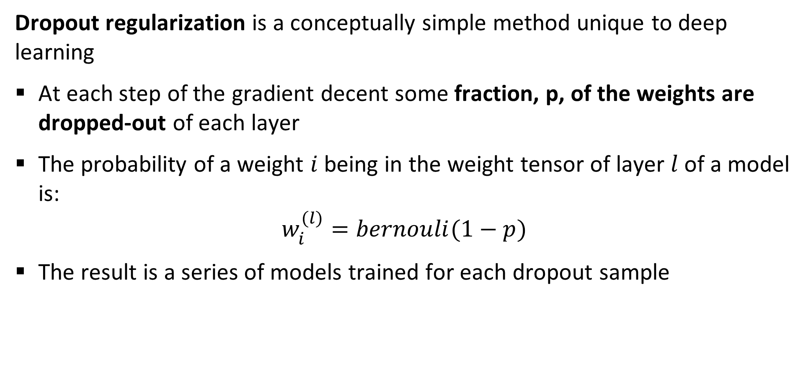
Dropout regularization
Dropout regularization is a conceptually simple method unique to deep learning
At each step of the gradient decent some fraction, p, of the weights are dropped-out of each layer
The probability of a weight $i$ being in the weight tensor of layer $l$ of a model is:
$$w_{i}^{(l)}=bernouli(1−p)$$
The result is a series of models trained for each dropout sample

Slide 51
Dropout regularization
Dropout regularization is a conceptually simple method unique to deep learning
The result is a series of models trained for each dropout sample
The final model is geometric mean of the individual models
Weight values are clipped in a small range as a further regularization
Result is an ensemble model!
For full details see the readable paper by Srivastava et. al., 2014 http://www.cs.toronto.edu/~rsalakhu/papers/srivastava14a.pdf

Slide 52
Dropout regularization
Let’s look at a simple example of a network with one hidden layer:
O
h₁
h₂
h₃
h₄
i₁
i₂

Slide 53
Dropout regularization
Let’s look at a simple example of a network with one hidden layer, $p\sim 0.3$:
O
O
O
O
h₁
h₂
h₃
h₄
h₁
h₂
h₃
h₄
h₁
h₂
h₃
h₄
h₁
h₂
h₃
h₄
i₁
i₂
i₁
i₂
i₁
i₂
i₁
i₂
O
O
O
O
h₁
h₂
h₃
h₄
h₁
h₂
h₃
h₄
h₁
h₂
h₃
h₄
h₁
h₂
h₃
h₄
i₁
i₂
i₁
i₂
i₁
i₂
i₁
i₂
A few possibilities of random dropout of weights creating new models

Slide 54
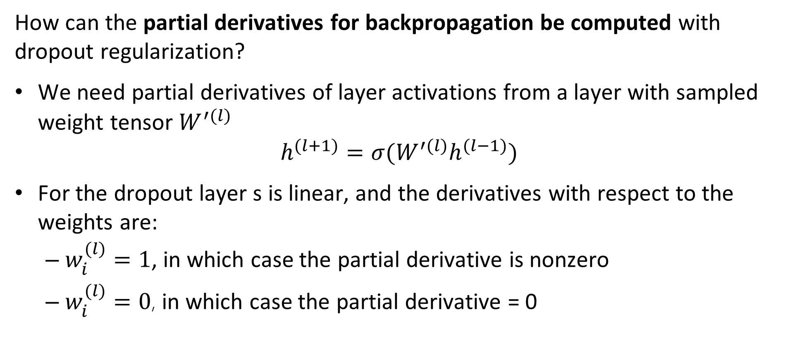
Dropout regularization
How can the partial derivatives for backpropagation be computed with dropout regularization?
We need partial derivatives of layer activations from a layer with sampled weight tensor $W_{ }^{′(l)}$
$$h_{ }^{(l+1)}=σ(W_{ }^{′(l)}h_{ }^{(l−1)})$$
For the dropout layer s is linear, and the derivatives with respect to the weights are:
  $w_{i}^{(l)}=1$, in which case the partial derivative is nonzero
  $w_{i}^{(l)}=0$, in which case the partial derivative = 0

Slide 55
Batch Normalization

Slide 56
Batch Normalization
In deep neural networks there is a high chance that units in a hidden layer have a large range of output values
  Leads to difficulty computing the gradient
  Slows convergence
A solution is to normalize the output of the hidden layers in the network as a batch
This simple idea can be really effective
For more details see Sergey and Szegedy, 2015
For alternative view of smoothing gradient, see Santurkar, et. al., 2019

Slide 57
Weight Decay

Slide 58
Weight decay
Weight decay prevents high learning in high-capacity models from becoming stuck
Learning for high capacity (large number of parameter models) can become stuck at local minimums of the loss function
Weight decay forces a small amount of ‘un-learning’ to move toward better optimum
Typically use an exponential decay schedule

Slide 59
Architectures for Fully Connected NNs

Slide 60
Architectures for Fully Connected NNs
Fully connected networks have multiple layers
Layers connected into sequential networks
Capacity of model determined by:
  Depth or number of layers
  Width of the layers in units
Deeper and wider models have greater capacity
Deeper and wider models are harder to train
  More parameters
  Require greater regularization
  Consume more CPU/GPU capacity

Slide 61
Architectures for Fully Connected NNs
Example of sequential model
Set the shape of the expected input tensor with unknown number of images
Define a hidden layer with 512 units with ReLu activation
L2 regularization applied to kernel weights
Dropout regularization layer
Output layer with 10 units using softmax activation for multi-class classification
nndo = models.Sequential()
nndo.add(layers.Input(shape=(28*28,)))
nndo.add(layers.Dense(512,
activation = 'relu’,
kernel_regularizer=regularizers.l2(0.0002)
))
nndo.add(layers.Dropout(rate=0.1))
nndo.add(layers.Dense(10,
activation = 'softmax'))

Slide 62
Training Deep NN Models

Slide 63
Training Deep Neural Networks
CV tasks require high-capacity models
High-capacity models are difficult to train
Trade-off between training time (epochs) and over-fitting
  Slower training less likely to over-fit
  Slower training requires more epochs (time) and CPU/GPU use
Large toolbox to prevent overfitting of high-capacity CV models
  Apply multiple regularizations simultaneously, L1, L2, dropout, weight decay
  Lower learning rate reduces overfitting

Slide 64
Training Deep Neural Networks
CV tasks require high-capacity models
High-capacity models are difficult to train
Essential to pick suitable learning rate
  High learning rates good initially, but lead to overfitting
  Low learning rates require excessive computing to converge
Variable learning rates are often good choice
  Learning rate decays with epochs
  Linear decay
  Exponential weight decay
  Etc.

Slide 65
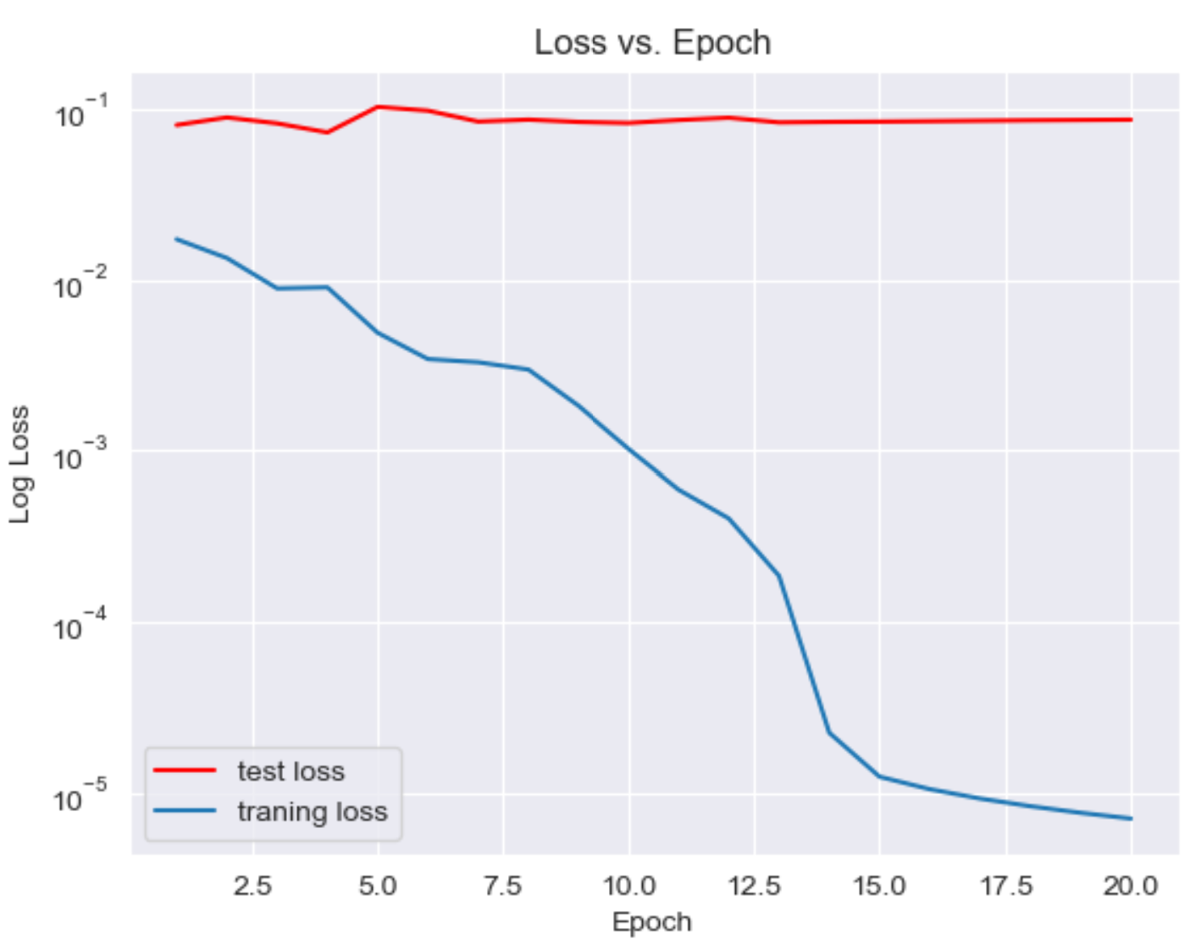
Training Deep Neural Networks
CV tasks require high-capacity models
Example of model not learning:
Too high of learning rate
Validation loss not decreasing
Insufficient regularization
Loss curves show erratic behaviour
Divergence between training and test loss

Slide 66
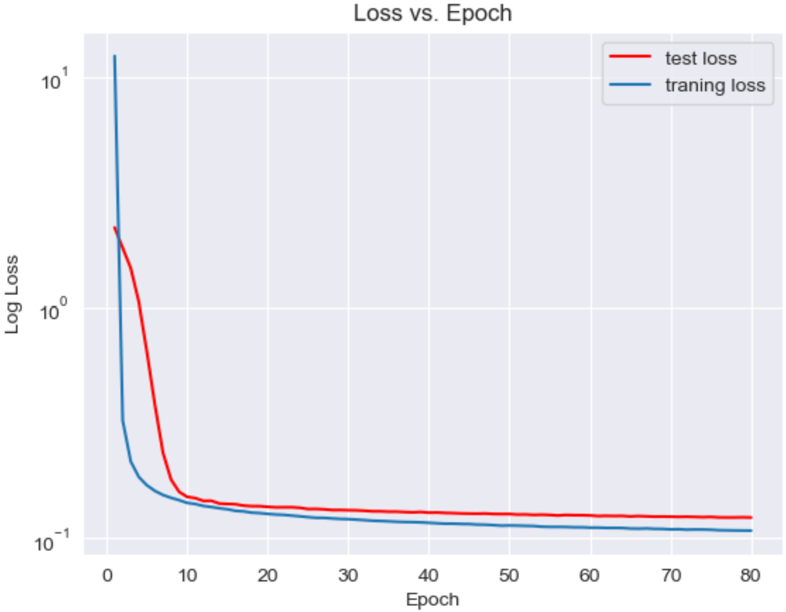
Training Deep Neural Networks
CV tasks require high capacity models
Example of poor (fixed and aggressive) learning rate:
Notice sharp elbow in loss curves
Learning slow after only 10 epochs, but continues after 80 epochs
Smooth curves indicate sufficient regularization

Slide 67
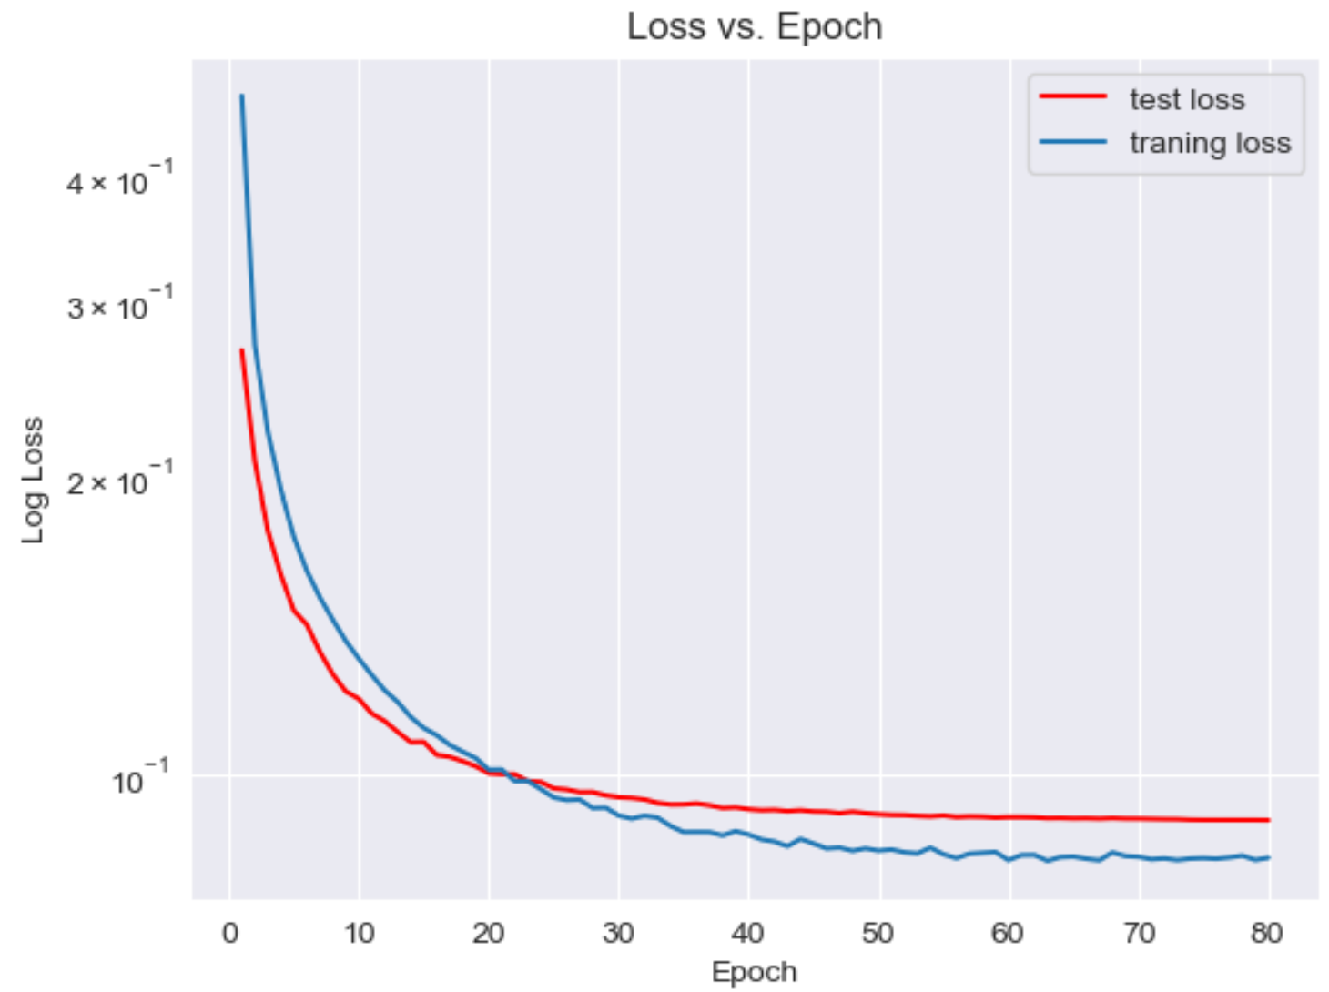
Training Deep Neural Networks
CV tasks require high capacity models
Example of good learning:
Exponential decay learning rate
Multiple regularizations
  L2
  Dropout
  Weight decay
Loss curves decrease smoothly with little learning at end of epochs

Slide 68
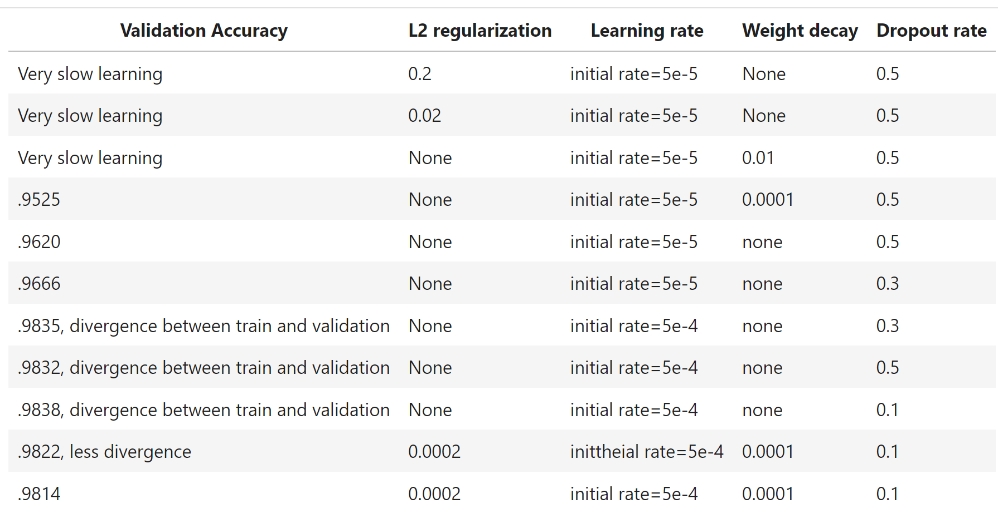
Training Deep Neural Networks
Training high-capacity models requires significant experimentation

Slide 69
Training deep NN Models
Example of training NN model
Define an exponentially decaying learning rate
Compile the model
  Define optimizer with learning rate schedule and decay
  Specify loss function
  Specify performance metric
Fit the model with training dataset
  Limit number of training epochs – 80 is a small number!
  Batch size for optimizer
  Define dataset for model validation
nndo lr_schedule = ExponentialDecay(
initial_learning_rate=5e-4,
decay_steps=1000,
decay_rate=0.9)
nndo.compile(
optimizer=RMSprop(
learning_rate=lr_schedule,
weight_decay=0.0001),
loss = 'categorical_crossentropy’,
metrics = ['accuracy’])
history_do =nndo.fit(train_images,
train_labels,
epochs = 80,
batch_size = 128,
validation_data = (test_images, test_labels))

Slide 70
Summary
Key points for this lesson
Generative vs. predictive CV tasks
Preceptron and forward propagation
Depth, breath and model capacity
Nonlinearity and activation functions
Loss functions
Regularization for deep learning
Learning and overfitting in deep NNs

Slide 71
Computing gradients and the chain rule

Slide 72
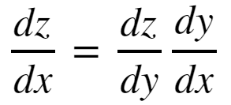
The Chain Rule of Calculus
In order to compute the gradients of the loss function though the layers of a deep neural network we need to apply the chain rule of calculus
To consider a function z = f(y), where y = g(x); then z = f(g(x)). Then the derivative of z with respect to x is:

Slide 73
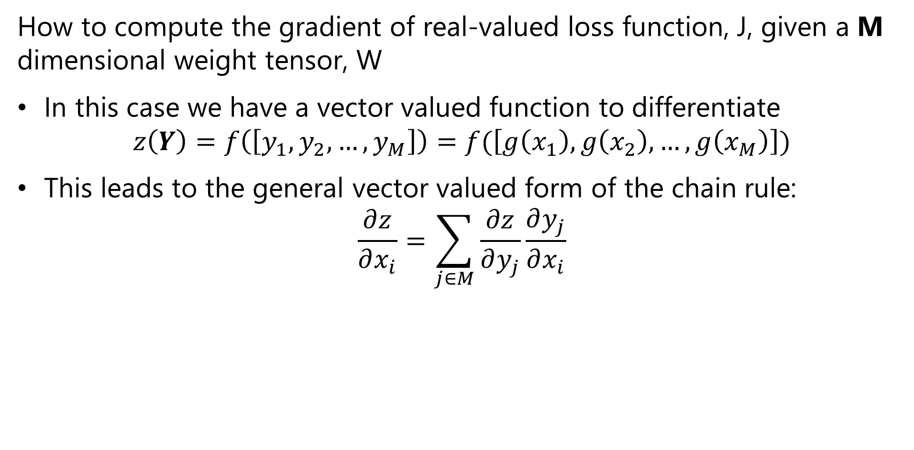
The Chain Rule of Calculus
How to compute the gradient of real-valued loss function, J, given a M dimensional weight tensor, W
In this case we have a vector valued function to differentiate
$$z\left(Y\right)=f\left(\left[y_{1},y_{2},…,y_{M}\right]\right)=f(\left[g\left(x_{1}\right),g\left(x_{2}\right),…,g\left(x_{M}\right)\right])$$
This leads to the general vector valued form of the chain rule:
$$\frac{∂z}{∂x_{i}}=\sum_{j∈M}{\frac{∂z}{∂y_{j}}\frac{∂y_{j}}{∂x_{i}}}$$

Slide 74
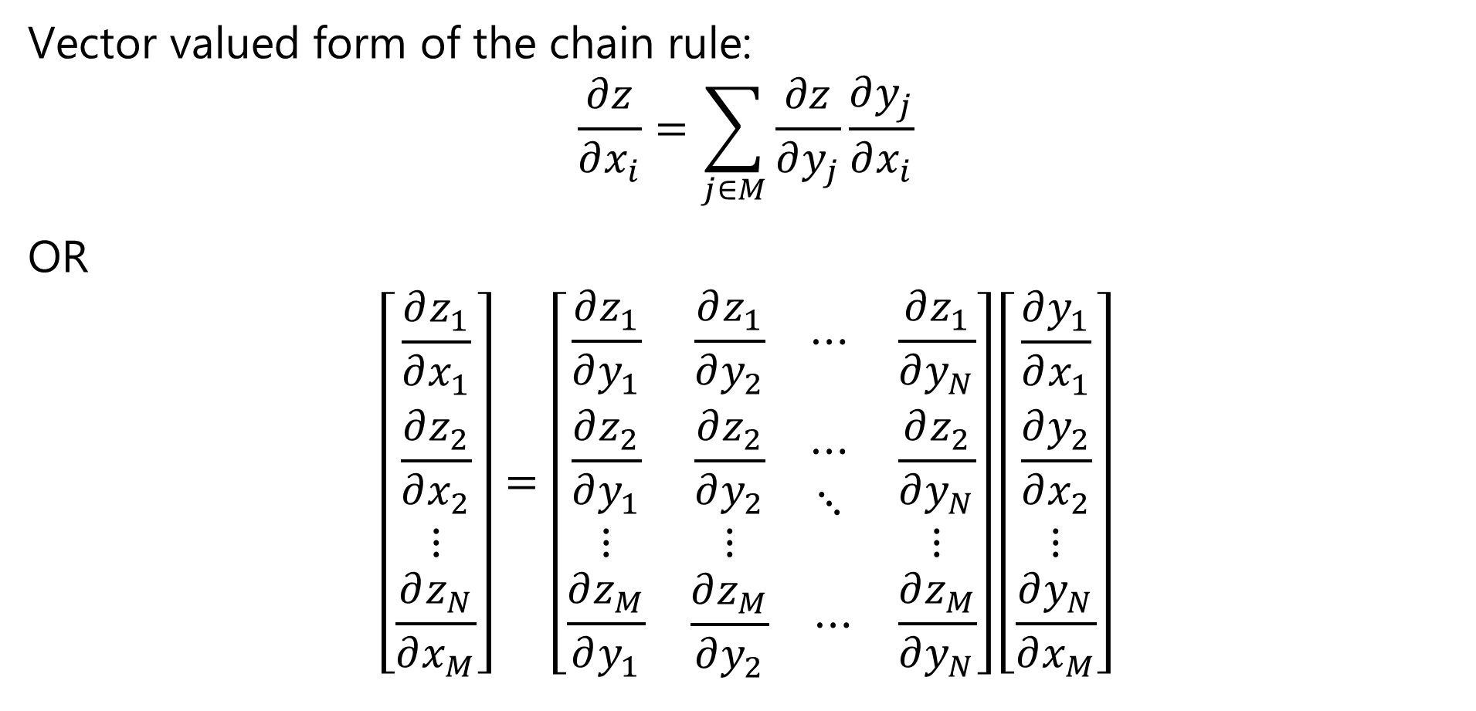
The Chain Rule of Calculus
Vector valued form of the chain rule:
$$\frac{∂z}{∂x_{i}}=\sum_{j∈M}{\frac{∂z}{∂y_{j}}\frac{∂y_{j}}{∂x_{i}}}$$
OR
$$\left[\begin{matrix}\frac{∂z_{1}}{∂x_{1}} \\ \frac{∂z_{2}}{∂x_{2}} \\ \begin{matrix}⋮ \\ \frac{∂z_{N}}{∂x_{M}}\end{matrix}\end{matrix}\right]=\left[\begin{matrix}\frac{∂z_{1}}{∂y_{1}} & \begin{matrix}\frac{∂z_{1}}{∂y_{2}} & ⋯\end{matrix} & \frac{∂z_{1}}{∂y_{N}} \\ \begin{matrix}\frac{∂z_{2}}{∂y_{1}} \\ ⋮\end{matrix} & \begin{matrix}\begin{matrix}\frac{∂z_{2}}{∂y_{2}} \\ ⋮\end{matrix} & \begin{matrix}⋯ \\ ⋱\end{matrix}\end{matrix} & \begin{matrix}\frac{∂z_{2}}{∂y_{N}} \\ ⋮\end{matrix} \\ \frac{∂z_{M}}{∂y_{1}} & \begin{matrix}\frac{∂z_{M}}{∂y_{2}} & ⋯\end{matrix} & \frac{∂z_{M}}{∂y_{N}}\end{matrix}\right]\left[\begin{matrix}\frac{∂y_{1}}{∂x_{1}} \\ \frac{∂y_{2}}{∂x_{2}} \\ \begin{matrix}⋮ \\ \frac{∂y_{N}}{∂x_{M}}\end{matrix}\end{matrix}\right]$$

Slide 75

The Chain Rule of Calculus
We define the $n×m$ Jacobian Matrix, $J$, as:
$$J^{T}=\left[\begin{matrix}\frac{∂z_{1}}{∂y_{1}} & \begin{matrix}\frac{∂z_{1}}{∂y_{2}} & ⋯\end{matrix} & \frac{∂z_{1}}{∂y_{N}} \\ \begin{matrix}\frac{∂z_{2}}{∂y_{1}} \\ ⋮\end{matrix} & \begin{matrix}\begin{matrix}\frac{∂z_{2}}{∂y_{2}} \\ ⋮\end{matrix} & \begin{matrix}⋯ \\ ⋱\end{matrix}\end{matrix} & \begin{matrix}\frac{∂z_{2}}{∂y_{N}} \\ ⋮\end{matrix} \\ \frac{∂z_{M}}{∂y_{1}} & \begin{matrix}\frac{∂z_{M}}{∂y_{2}} & ⋯\end{matrix} & \frac{∂z_{M}}{∂y_{N}}\end{matrix}\right]$$

Slide 76



The Chain Rule of Calculus
In matrix notation the vector valued gradient then becomes:
Where, = is the nxm Jacobian matrix of partial derivatives
= the gradient of z with respect to y

Slide 77
Example: Computing a Gradient
w¹₁₁
X₁
S₁ = σ_{h}(Σ )
w²₁
w¹₁₂
w¹₂₁
S₃ = Σ
J(W)
X₂
w²₂
w¹₂₂
S₂ = σ_{h}(Σ )
Y
_{Input Layer}
_{Hidden Layer}
_{Output Layer}
_{Loss Function}

Slide 78


Example: Computing a Gradient
Start with forward propagation relationships
The output of the hidden units are computed as:
The output unit relation is:

Slide 79


Example: Computing a Gradient
Goal is to compute the gradient:
The loss function is:

Slide 80

Example: Computing a Gradient
Start with the easier case of the gradient with respect to the output tensor.
Applying the chain rule yields:

Slide 81



Example: Computing a Gradient
The first partial derivative is:
The second partial derivative is:
And the gradient with respect to the output tensor is then:

Slide 82

Example: Computing a Gradient
The gradient with respect to the input tensor is a bit more complicated
Apply the chain rule twice to get:

Slide 83



Example: Computing a Gradient
The output layer has linear activation so the left most partial derivative is just 1.
The middle partial derivative :
The right most partial derivative, given ReLU activation:

Slide 84

Example: Computing a Gradient
The gradient with respect to the input weights is then:

Slide 85
Automatic Differentiation
In practice, how do we perform the differentiation
Computing all the required derivatives by hand is impractical
  Complexity grows with NN depth
  Too many opportunities for error
Use automatic differentiation
  Automatic differentiators handle the complexity of deep architectures
  Automatic differentiators built into all deep learning platforms
See the review paper by Baydin et.al. (2015) or the TensorFlow automatic differentiation tutorial

