Slide 1

CSCI E-25 Computer Vision
Machine Learning for Computer Vision
Steve Elston
Copyright 2021, 2022, 2023, 2024, Stephen F Elston. All rights reserved.

Slide 2
Machine Learning and Computer Vision
How is machine learning applied in computer vision?
Machine learning has had a dramatic impact on CV starting in the 1980s
Many modern CV applications of machine learning:
Object recognition
Object detection
Image stitching
Motion and pose models
Generative models
Segmentation
3-D scene reconstruction
…

Slide 3
Machine Learning and Computer Vision
In the era of deep learning, why study linear models?
Linear models are widely used and flexible class of models
Linear models are easy to understand
Most basic concepts used for linear models apply to deep NNs
Linear models are highly scalable

Slide 4
Machine Learning and Computer Vision
Many ML algorithms are applied to CV problems
Linear models
Widely used and flexible class of models
Most basic concepts used for linear models apply to other ML models
Our focus today
K-nearest neighbours
Support vector machines
Tree models and tree ensembles
Bayes and naïve Bayes models
Deep neural networks – more on these starting next week!
…

Slide 5
Machine Learning and Computer Vision
Key points for this lesson
The formulation of linear machine learning models
Basic machine learning workflow
Formulation of CV features for machine learning
The relationship between bias, variance and model capacity
Theory of binary classifiers
Theory of multi-class classifiers
Classifier evaluation
We apply these concepts to deep NN models in subsequent lessons

Slide 6
Review of Linear Models

Slide 7
Why linear models?
Understandable and interpretable
Generalize well, if properly fit
Highly scalable – computationally efficient
Can approximate fairly complex functions
Despite ascendancy of deep learning linear models still widely applied to CV problems
A basis of understanding complex models
Many non-linear models are locally linear at convergence
e.g. we can learn a lot about the convergence of DL models from linear approximations

Slide 8
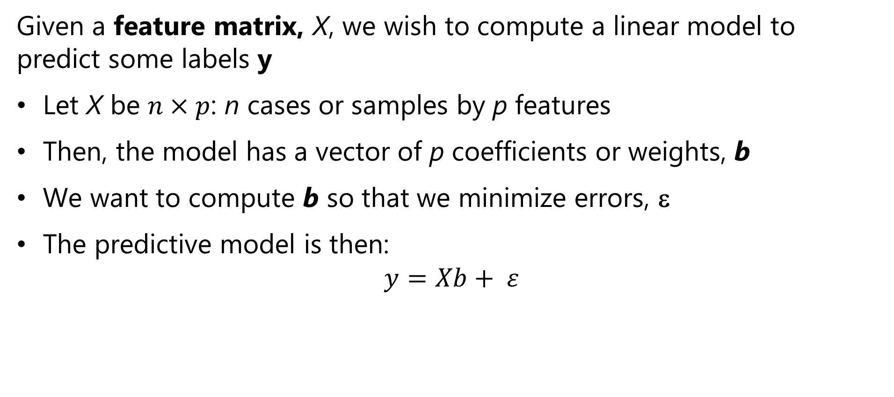
Review of Linear Models
Given a feature matrix, X, we wish to compute a linear model to predict some labels y
Let X be $n×p$: n cases or samples by p features
Then, the model has a vector of p coefficients or weights, b
We want to compute b so that we minimize errors, ε
The predictive model is then:
$$y=Xb+ ε$$

Slide 9
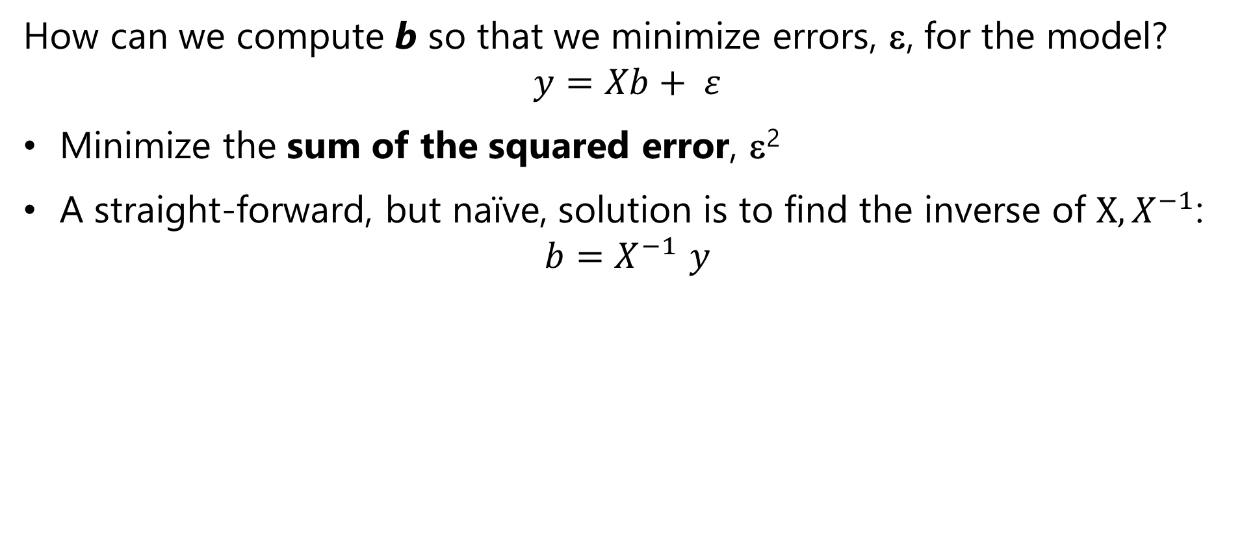
Review of Linear Models
How can we compute b so that we minimize errors, ε, for the model?
$$y=Xb+ ε$$
Minimize the sum of the squared error, ε²
A straight-forward, but naïve, solution is to find the inverse of $X, X^{−1}$:
$$b{=X}^{−1}y$$

Slide 10
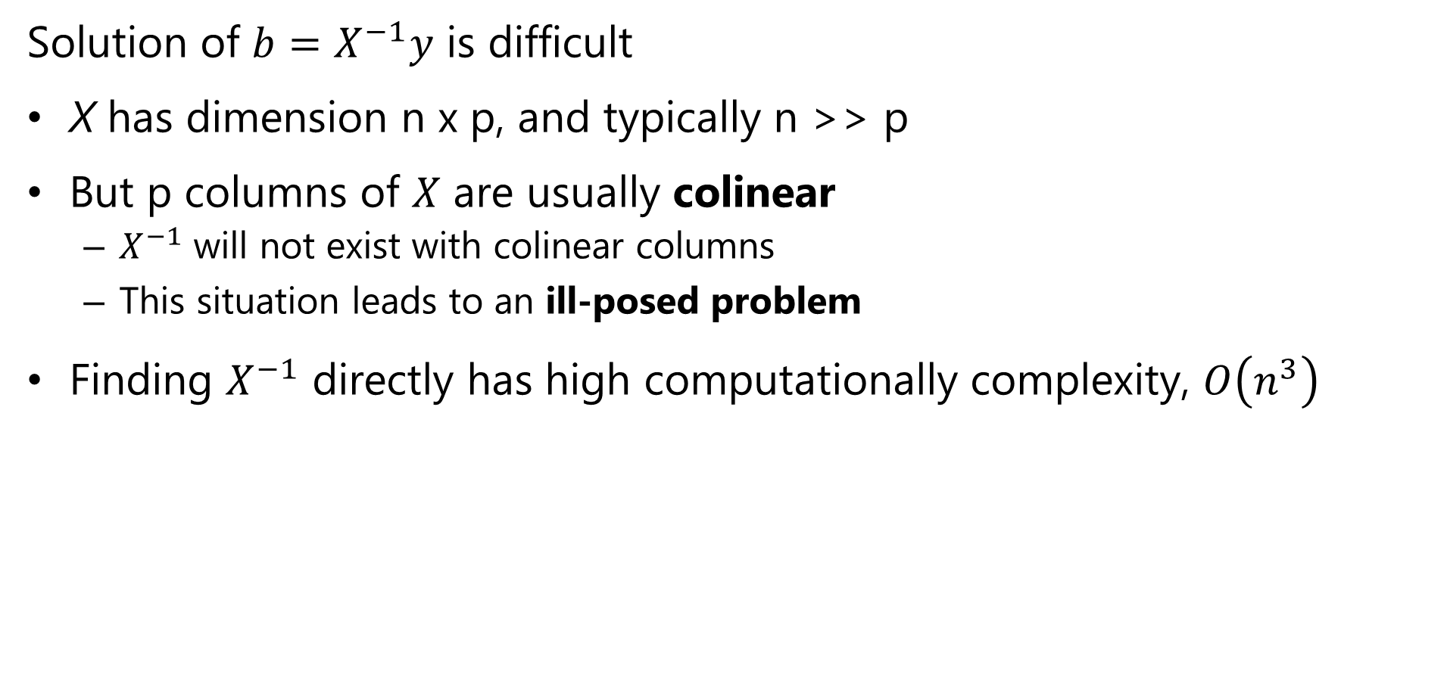
Review of Linear Models
Solution of $b=X^{−1}y$ is difficult
X has dimension n x p, and typically n >> p
But p columns of $X$ are usually colinear
$X^{−1}$ will not exist with colinear columns
This situation leads to an ill-posed problem
Finding $X^{−1}$ directly has high computationally complexity, $O\left(n^{3}\right)$

Slide 11
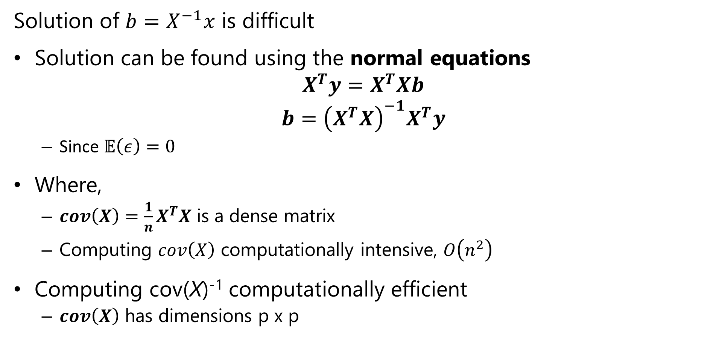
Review of Linear Regression Problem
Solution of $b=X^{−1}x$ is difficult
Solution can be found using the normal equations
$$X^{T}y=X^{T}Xb$$
$$b={\left(X^{T}X\right)}^{−1}X^{T}y$$
Since $𝔼\left(ε\right)=0$
Where,
$cov\left(X\right)=\frac{1}{n}X^{T}X$ is a dense matrix
Computing $cov\left(X\right)$ computationally intensive, $O\left(n^{2}\right)$
Computing cov(X)⁻¹ computationally efficient
$cov\left(X\right)$ has dimensions p x p

Slide 12
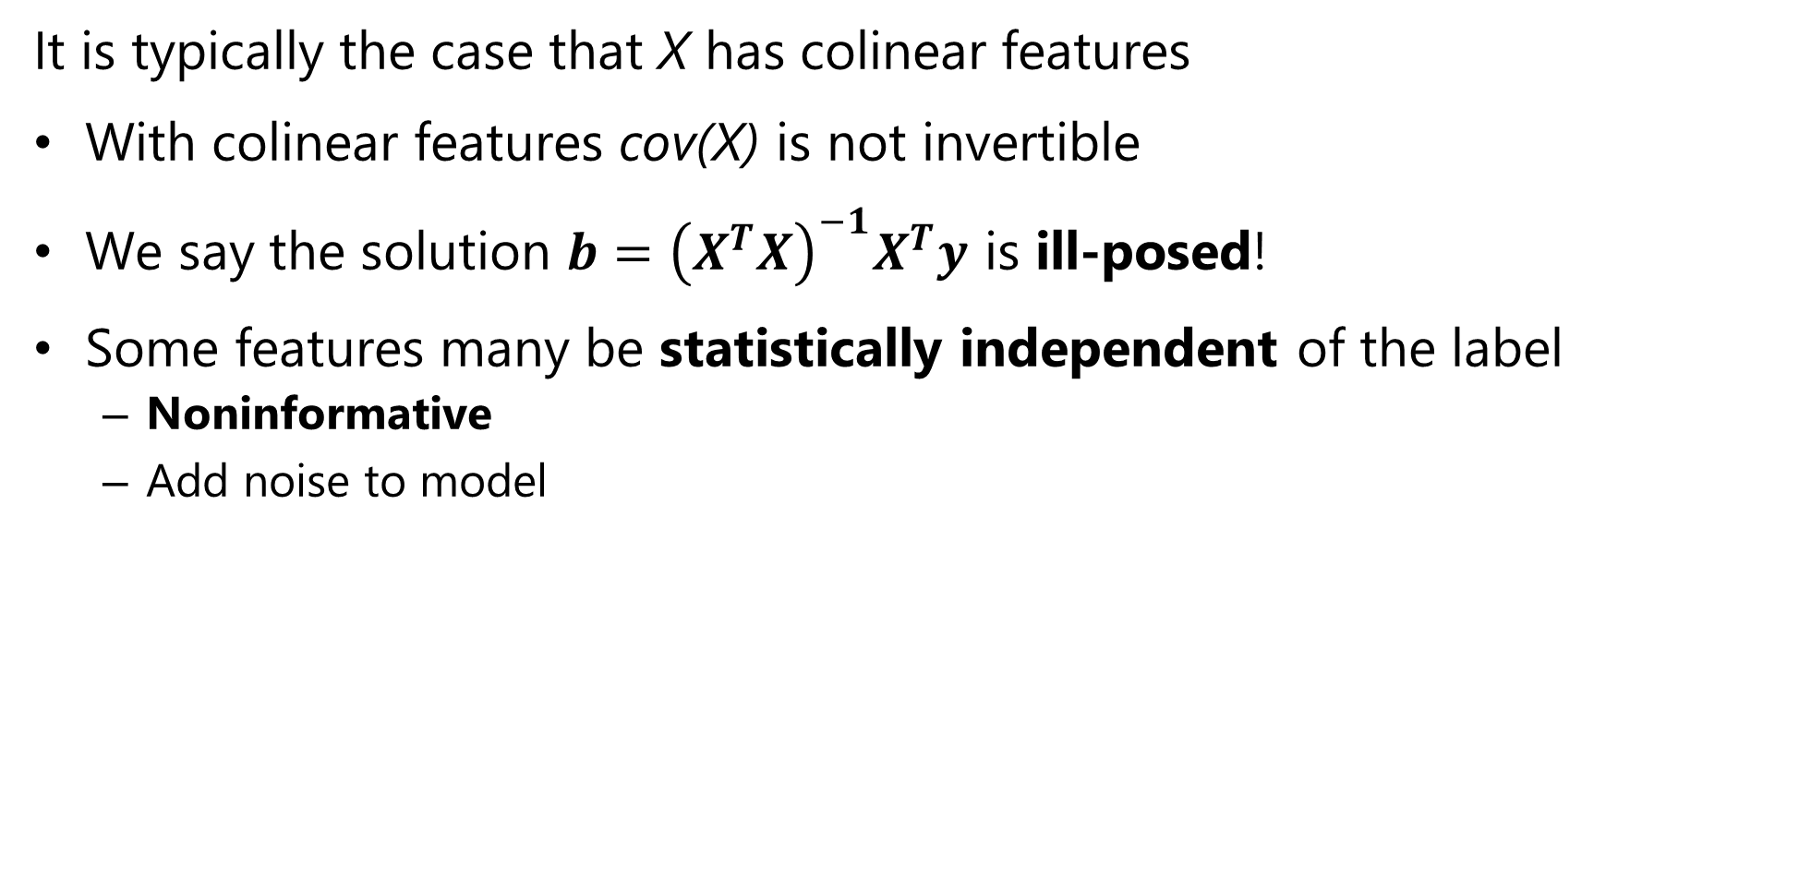
What could possibly go wrong?
It is typically the case that X has colinear features
With colinear features cov(X) is not invertible
We say the solution $b={\left(X^{T}X\right)}^{−1}X^{T}y$ is ill-posed!
Some features many be statistically independent of the label
Noninformative
Add noise to model

Slide 13
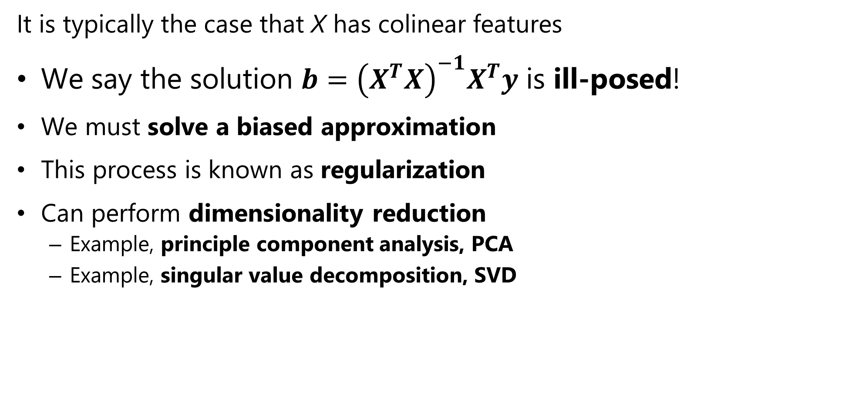
What could possibly go wrong?
It is typically the case that X has colinear features
We say the solution $b={\left(X^{T}X\right)}^{−1}X^{T}y$ is ill-posed!
We must solve a biased approximation
This process is known as regularization
Can perform dimensionality reduction
Example, principle component analysis, PCA
Example, singular value decomposition, SVD

Slide 14
Machine Learning with Image Data

Slide 15
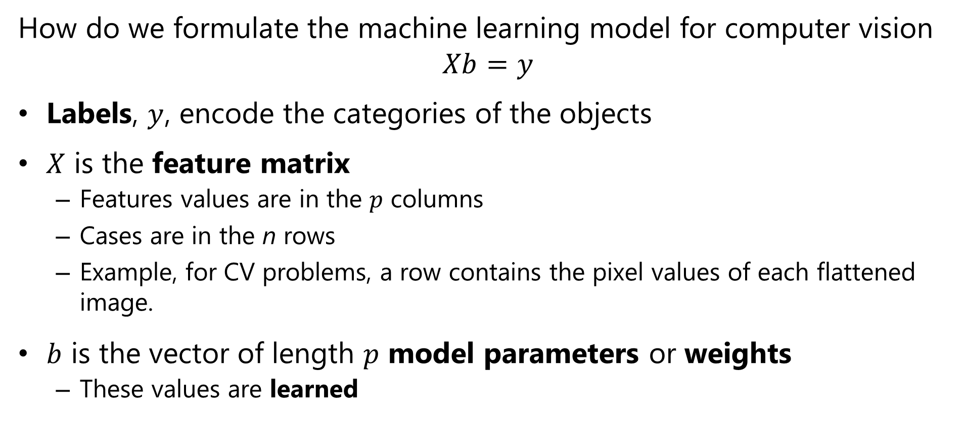
Formulating a Computer Vision Machine Learning Model
How do we formulate the machine learning model for computer vision
$$Xb=y$$
Labels, $y$, encode the categories of the objects
$X$ is the feature matrix
Features values are in the $p$ columns
Cases are in the n rows
Example, for CV problems, a row contains the pixel values of each flattened image.
$b$ is the vector of length $p$ model parameters or weights
These values are learned

Slide 16
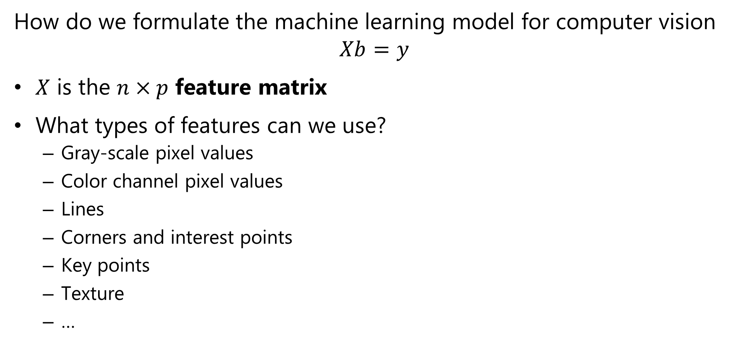
Formulating a Computer Vision Machine Learning Model
How do we formulate the machine learning model for computer vision
$$Xb=y$$
$X$ is the $n×p$ feature matrix
What types of features can we use?
Gray-scale pixel values
Color channel pixel values
Lines
Corners and interest points
Key points
Texture
…

Slide 17
How Can We Work With Image Data?
How to prepare image pixel values for machine learning?
0,0
1,0
Must flatten the image into a feature vector
Example: start with a d-2 gray-scale image
Flatten to a 1-d feature vector
For color image concatenate channel feature vectors
.
.
.
0 ,0
0 ,1
. . .
0 ,M-1
1 ,0
1 ,1
. . .
1 ,M-1
N-2,0
2 ,0
2 ,1
. . .
2 ,M-1
N-1,0
Flatten
3 ,0
3 ,1
. . .
3 ,M-1
.
.
.
.
.
.
.
.
.
0,M-1
N-2 ,0
N-2 ,1
. . .
N-2 ,M-1
1,M-1
N-1,0
N-1,1
. . .
N-1,M-1
.
.
.
N-2,M-1
N-1,M-1

Slide 18
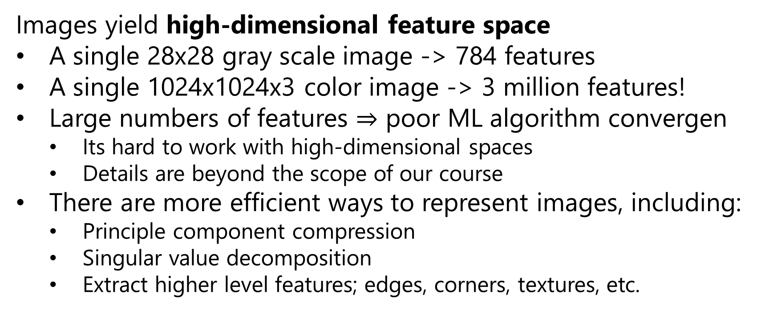
How Can We Work With Image Data?
Images yield high-dimensional feature space
A single 28x28 gray scale image -> 784 features
A single 1024x1024x3 color image -> 3 million features!
Large numbers of features $⇒$ poor ML algorithm convergen
Its hard to work with high-dimensional spaces
Details are beyond the scope of our course
There are more efficient ways to represent images, including:
Principle component compression
Singular value decomposition
Extract higher level features; edges, corners, textures, etc.

Slide 19
How Can We Work With Image Data?
Images yield high-dimensional feature space
Deep neural networks are flexible high-capacity machine learning models
Deep neural networks learn features
Under right conditions improve performance over hand engineered features
Much more on this topic starting next week!

Slide 20
Review Binary Classification

Slide 21
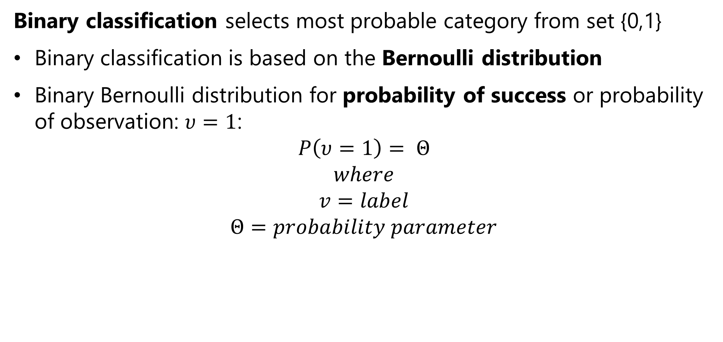
Review of Binary Classification
Binary classification selects most probable category from set {0,1}
Binary classification is based on the Bernoulli distribution
Binary Bernoulli distribution for probability of success or probability of observation: $υ=1$:
$$P\left(υ=1\right)= Θ$$
$$where$$
$$v=label$$
$$Θ=probability parameter$$

Slide 22
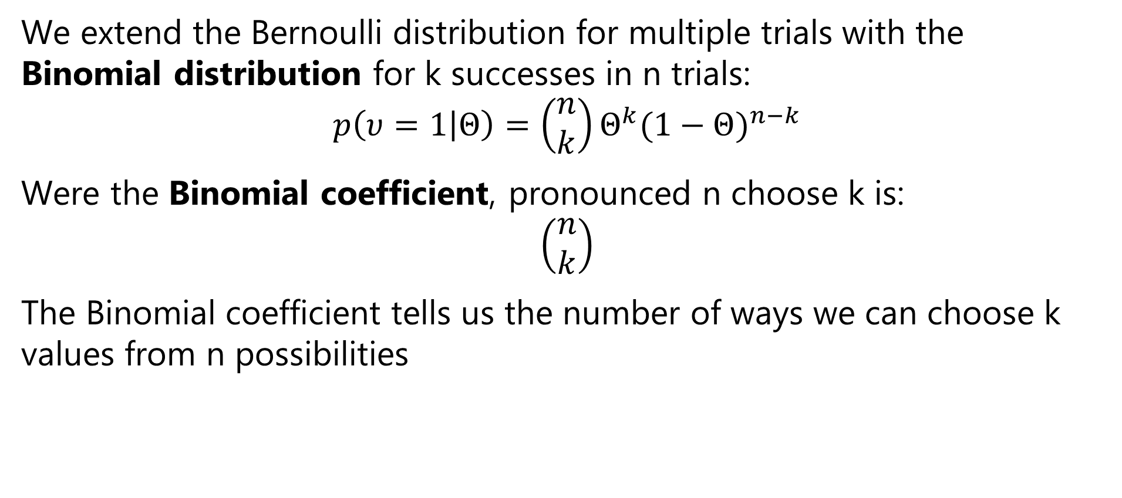
Review of Binary Classification
We extend the Bernoulli distribution for multiple trials with the Binomial distribution for k successes in n trials:
$$p\left(υ=1 | Θ\right)=\left(\begin{matrix}n \\ k\end{matrix}\right)Θ^{k}{(1−Θ)}^{n−k}$$
Were the Binomial coefficient, pronounced n choose k is:
$$\left(\begin{matrix}n \\ k\end{matrix}\right)$$
The Binomial coefficient tells us the number of ways we can choose k values from n possibilities

Slide 23
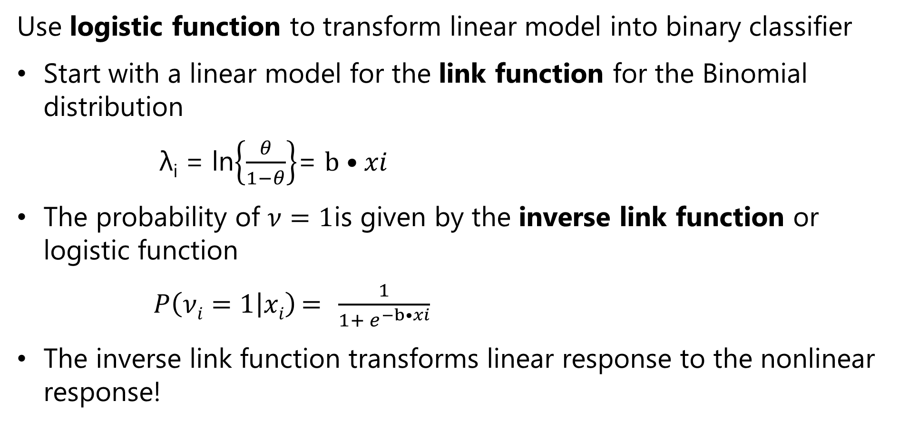
Review of Binary Classification
Use logistic function to transform linear model into binary classifier
Start with a linear model for the link function for the Binomial distribution
λ_{i} = ln$\left\{\frac{θ}{1−θ}\right\}$= $b•xi$
The probability of $ν=1$is given by the inverse link function or logistic function
$P\left(νi=1 | xi\right)={ ^{ }\frac{1}{1+ e^{−b•xi}}}$
The inverse link function transforms linear response to the nonlinear response!

Slide 24
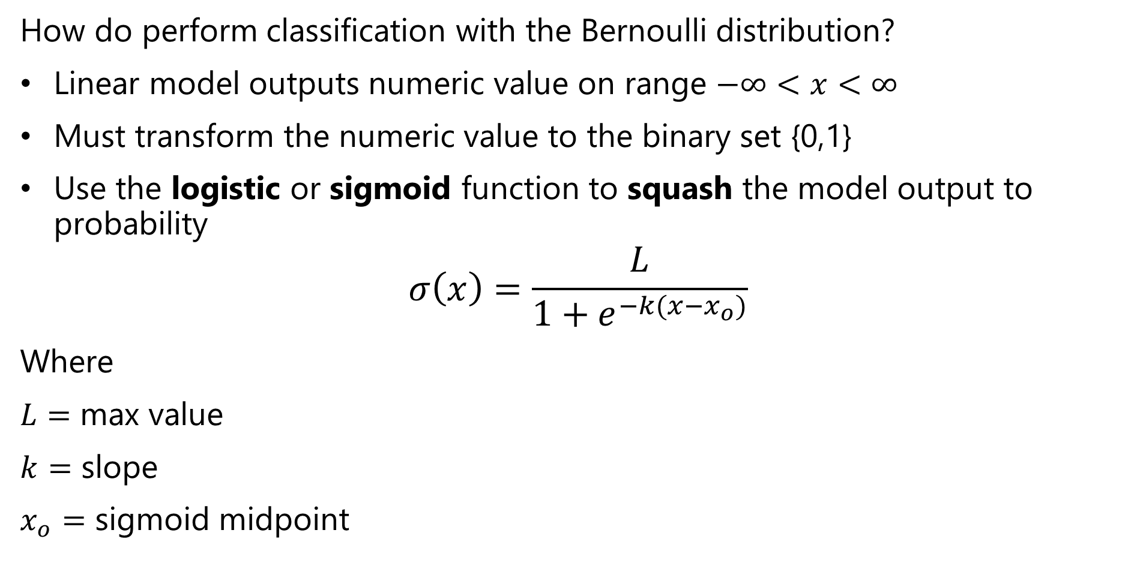
Review of Binary Classification
How do perform classification with the Bernoulli distribution?
Linear model outputs numeric value on range $−∞<x<∞$
Must transform the numeric value to the binary set {0,1}
Use the logistic or sigmoid function to squash the model output to probability
$$σ\left(x\right)=\frac{L}{1+e^{−k(x−x_{o})}}$$
Where
$L=$ max value
$k=$ slope
$x_{o}=$ sigmoid midpoint

Slide 25
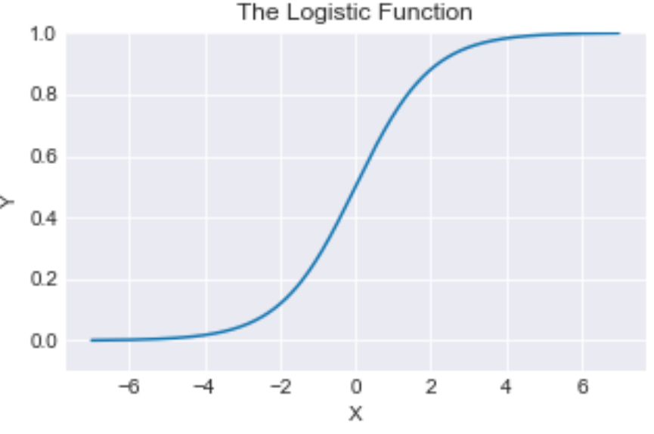
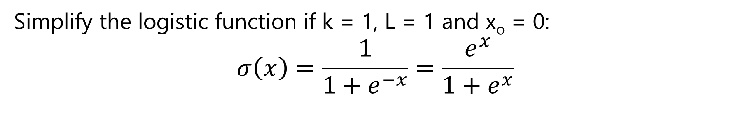
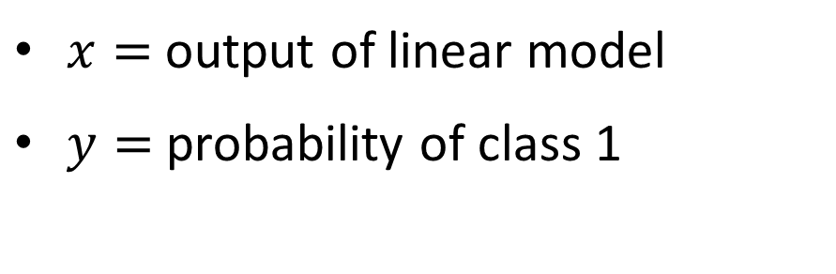
Review of Binary Classification
Simplify the logistic function if k = 1, L = 1 and x_{o} = 0:
$$σ\left(x\right)=\frac{1}{1+e^{−x}}=\frac{e^{x}}{1+e^{x}}$$
$x=$ output of linear model
$y=$ probability of class 1

Slide 26
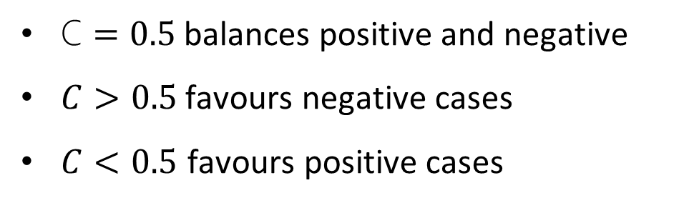
Review of Binary Classification
Example: Cut off for binary classification
Cutoff, C, applied to the cumulative distribution function for the positive and negative cases
C $=0.5$ balances positive and negative
$C>0.5$ favours negative cases
$C<0.5$ favours positive cases

Slide 27
Multi-Class Classification

Slide 28
Multi-Class Classifiers
Many applications of multi-class classifiers
Images can contain many types of objects
A binary classifier is not useful for general object classification
We need a multi-class classifier

Slide 29
Multi-Class Classifiers
How can we create multi-class classifiers?
Approach
A hierarchy of binary classifiers
Use a multi-class distribution
Hierarchical binary classifiers
One vs. many
One vs. one

Slide 30
Multi-Class Classifiers
Classify using possible binary splits
Several possible approaches
One class vs. all others
Continue until all classes identified
Every class vs. every other class
Apply to all possible pairs

Slide 31
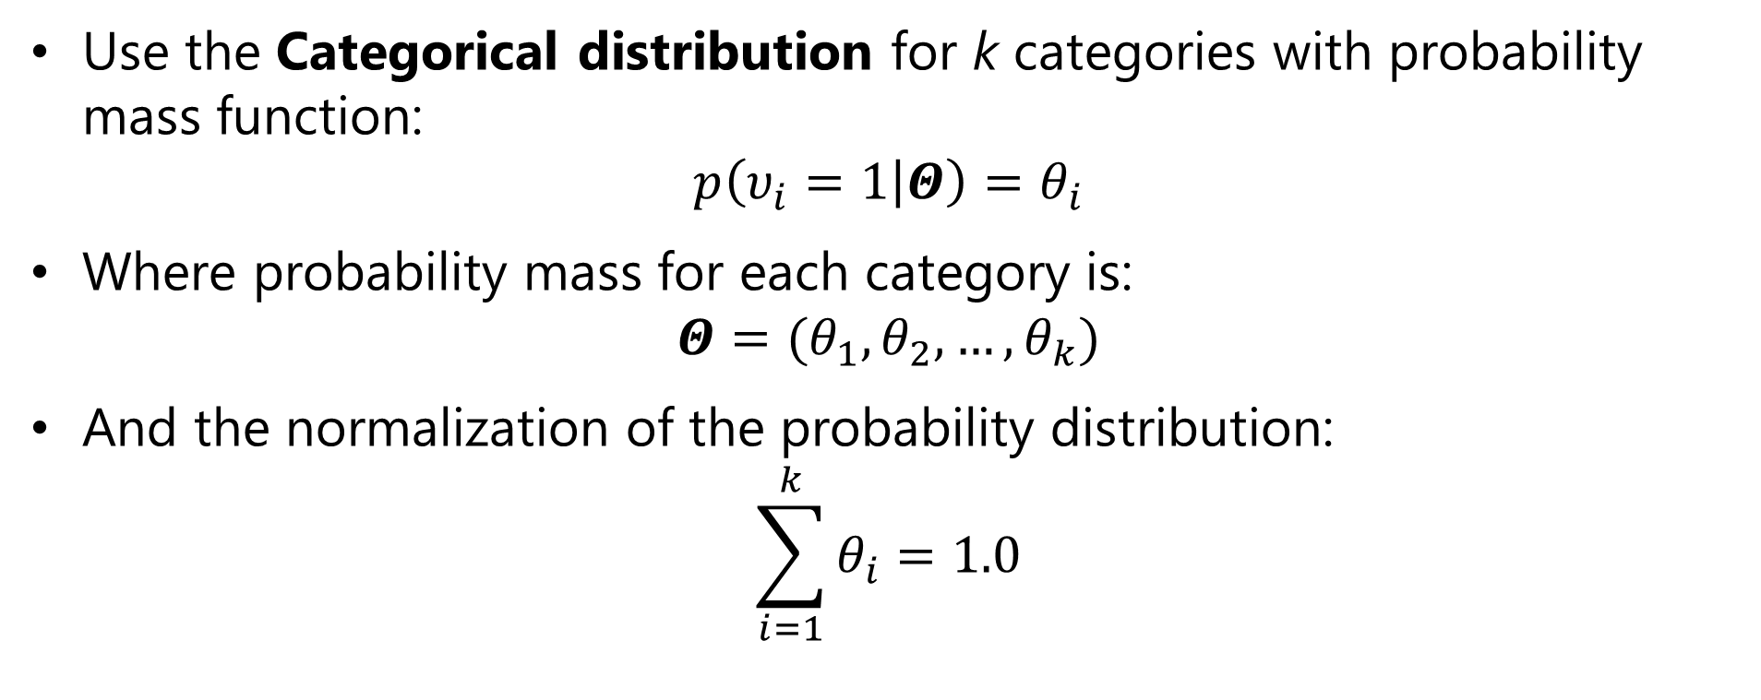
Classification with the Categorical Distribution
What is the distribution for multi-class problems?
Use the Categorical distribution for k categories with probability mass function:
$$p\left(υ_{i}=1 | Θ\right)=θ_{i}$$
Where probability mass for each category is:
$$Θ=(θ_{1},θ_{2},…,θ_{k})$$
And the normalization of the probability distribution:
$$\sum_{i=1}^{k}{θ_{i}}=1.0$$

Slide 32
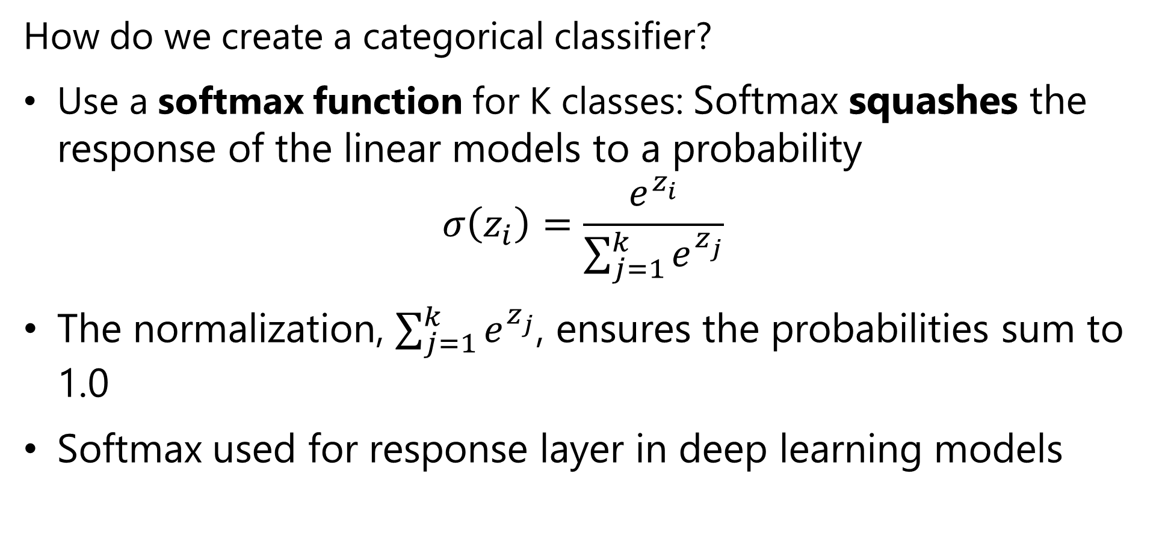
Classification with the Categorical Distribution
How do we create a categorical classifier?
Use a softmax function for K classes: Softmax squashes the response of the linear models to a probability
$$σ\left(z_{i}\right)=\frac{e^{z_{i}^{ }}}{\sum_{j=1}^{k}{e^{z_{j}^{ }}}}$$
The normalization, $\sum_{j=1}^{k}{e^{z_{j}^{ }}}$, ensures the probabilities sum to 1.0
Softmax used for response layer in deep learning models

Slide 33
Classification with the Categorical Distribution
What is the output of softmax?
One probability value for each category, K
For example, if we have 10 categories, there are 10 softmax output values
Take the max as the most probable category
Or take top-k as likely candidates
Label must be one-hot encoded
Binary value for each possible category
Only one 1, others 0 for each case

Slide 34
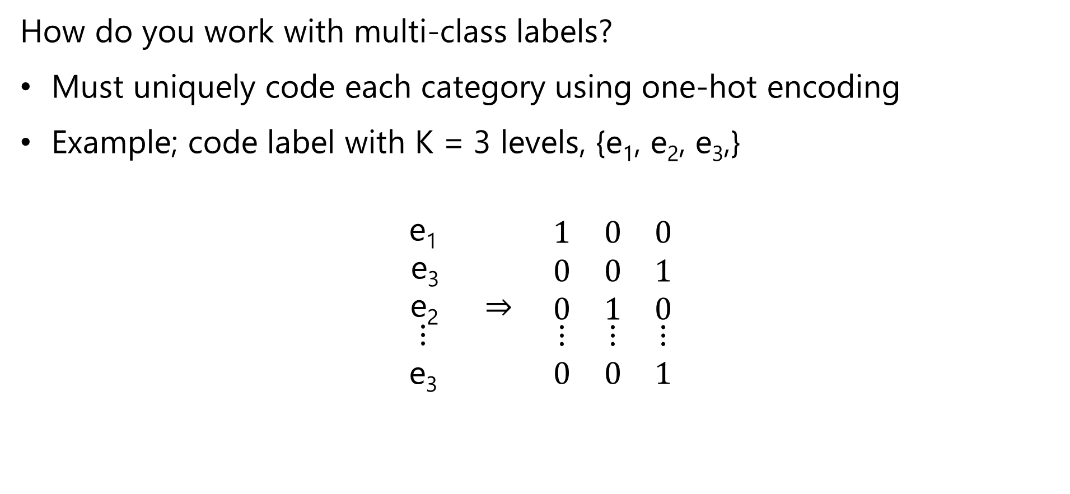
Coding Multi-Class Labels
How do you work with multi-class labels?
Must uniquely code each category using one-hot encoding
Example; code label with K = 3 levels, {e₁, e₂, e₃,}
$$\begin{matrix}\text{e}\text{1} & & \\ \text{e}\text{3} & & \\ \text{e}\text{2} & ⇒ & \end{matrix}\begin{matrix}1 & 0 & 0 \\ 0 & 0 & 1 \\ 0 & 1 & 0\end{matrix}$$
$$\begin{matrix}⋮ & & \\ \text{e}\text{3} & & \end{matrix}\begin{matrix}⋮ & ⋮ & ⋮ \\ 0 & 0 & 1\end{matrix}$$
Label One-hot encoding

Slide 35
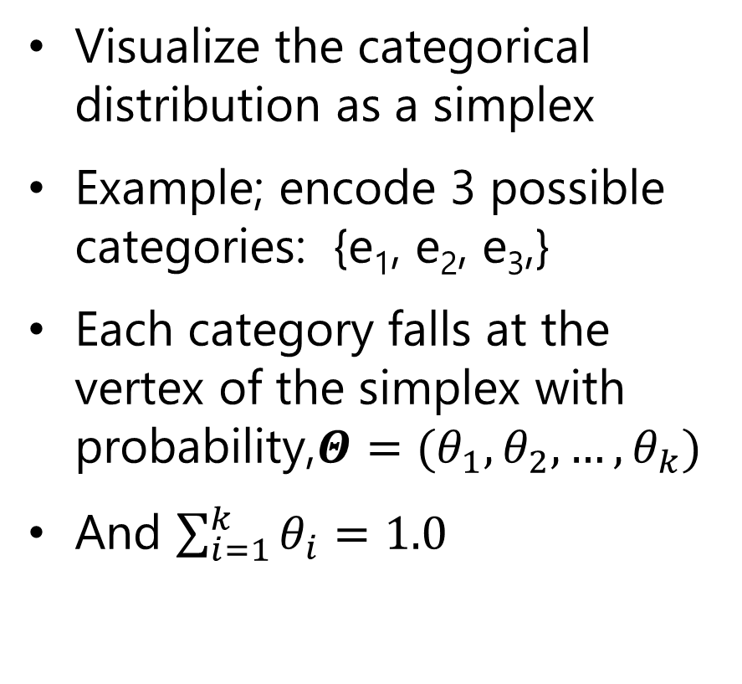
Classification with the Categorical Distribution
Visualize the categorical distribution as a simplex
Example; encode 3 possible categories: {e₁, e₂, e₃,}
Each category falls at the vertex of the simplex with probability,$Θ=(θ_{1},θ_{2},…,θ_{k})$
And $\sum_{i=1}^{k}{θ_{i}}=1.0$
(0,0, e₃)
(0,e₂,0)
(e₁,0,0)

Slide 36
(0,0,4)
(1,0,3)
(0,3,1)
(1,1,2)
(2,0,2)
C
(0,2,2)
(2,1,1)
(1,2,1)
(3,0,1)
(0,3,1)
B
A
(4,0,0)
(0,4,0)
(3,1,0)
(2,2,0)
(1,3,0)

Slide 37
Bias, Variance and Model Capacity

Slide 38
The Bias-Variance Trade-Off
Machine learning algorithms learn a function approximation:
f(X, b) = y, where X is the feature vector, b is the parameter vector and y is the label
We say that a complex function has high capacity
High capacity model can approximate complex relationships
High capacity model has large number of parameters or weights
But, may not generalize well
May learn the training data too well!

Slide 39
The Bias-Variance Trade-Off
High capacity models fit training data well
Overfit models exhibit high variance
Do not generalize well; exhibit brittle behavior
Error_{training} << Error_{test}
Low capacity models have high bias
Generalize well -> low variance
Do not fit training data well
Regularization adds bias
Strong regularization adds significant bias
Weak regularization leads to high variance

Slide 40
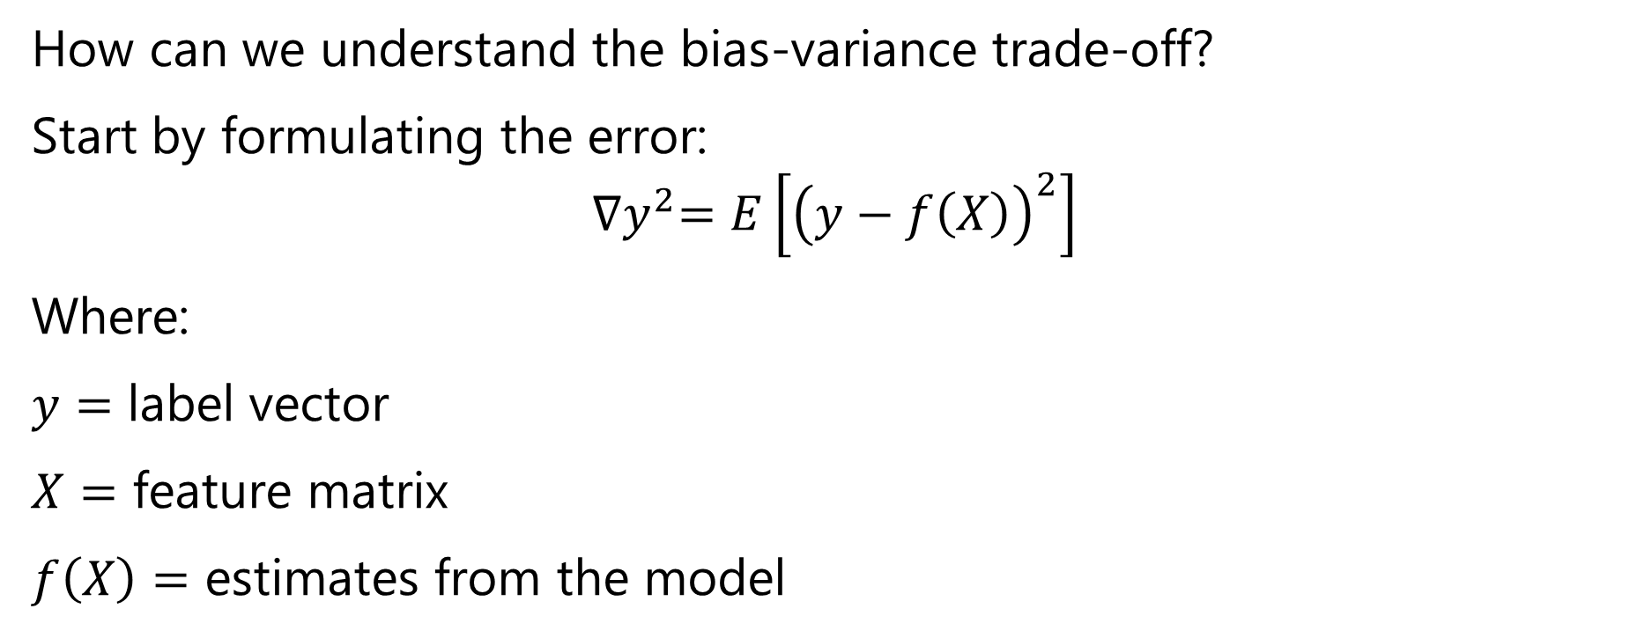
The Bias-Variance Trade-Off
How can we understand the bias-variance trade-off?
Start by formulating the error:
$${∇y}^{2}=E\left[{\left(y−f\left(X\right)\right)}^{2}\right]$$
Where:
$y=$ label vector
$X=$ feature matrix
$f\left(X\right)=$ estimates from the model

Slide 41
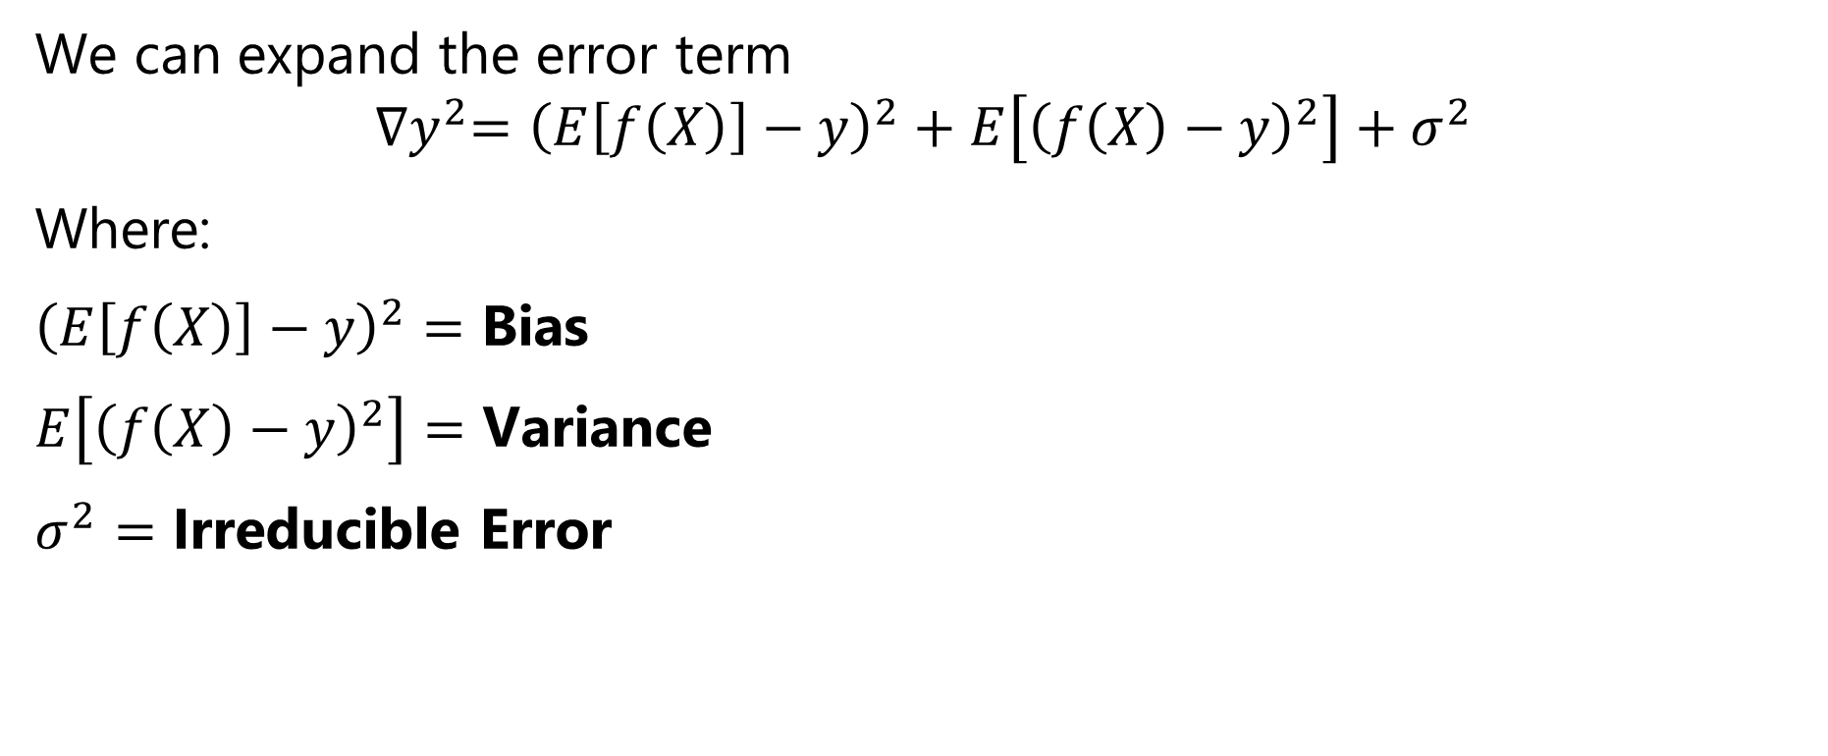
The Bias-Variance Trade-Off
We can expand the error term
$${∇y}^{2}={\left(E\left[f\left(X\right)\right]−y\right)}^{2}+E\left[{\left(f\left(X\right)−y\right)}^{2}\right]+σ^{2}$$
Where:
${\left(E\left[f\left(X\right)\right]−y\right)}^{2}=$ Bias
$E\left[{\left(f\left(X\right)−y\right)}^{2}\right]=$ Variance
$σ^{2}=$ Irreducible Error

Slide 42
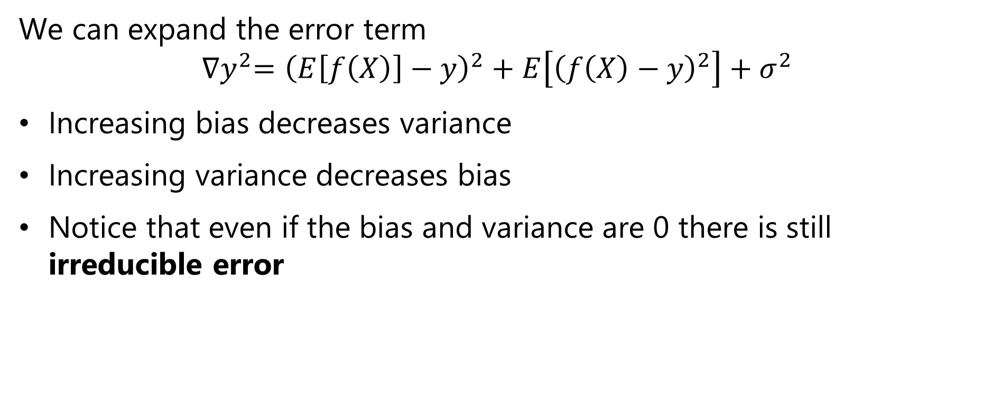
The Bias-Variance Trade-Off
We can expand the error term
$${∇y}^{2}={\left(E\left[f\left(X\right)\right]−y\right)}^{2}+E\left[{\left(f\left(X\right)−y\right)}^{2}\right]+σ^{2}$$
Increasing bias decreases variance
Increasing variance decreases bias
Notice that even if the bias and variance are 0 there is still irreducible error

Slide 43
The Bias-Variance Trade-Off
Variance
Bias
Test Error
Increasing bias
Increasing variance

Slide 44
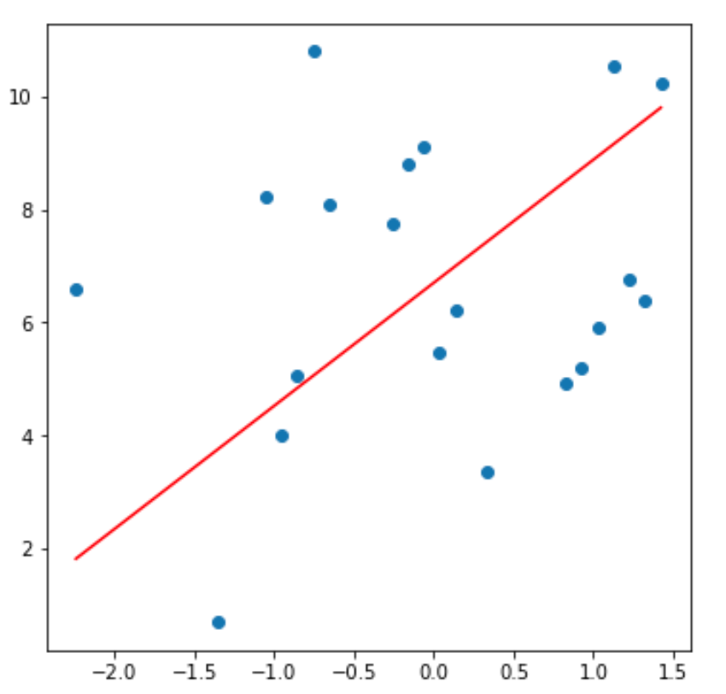
Model Capacity, Bias and Variance
Example: capacity, bias and variance for a polynomial model linear in coefficients
For a set of data values fit a strait line model, with 2 parameters
This model has high bias, since does not fit the training data well
Variance is limited since low capacity model produces consistent predictions

Slide 45
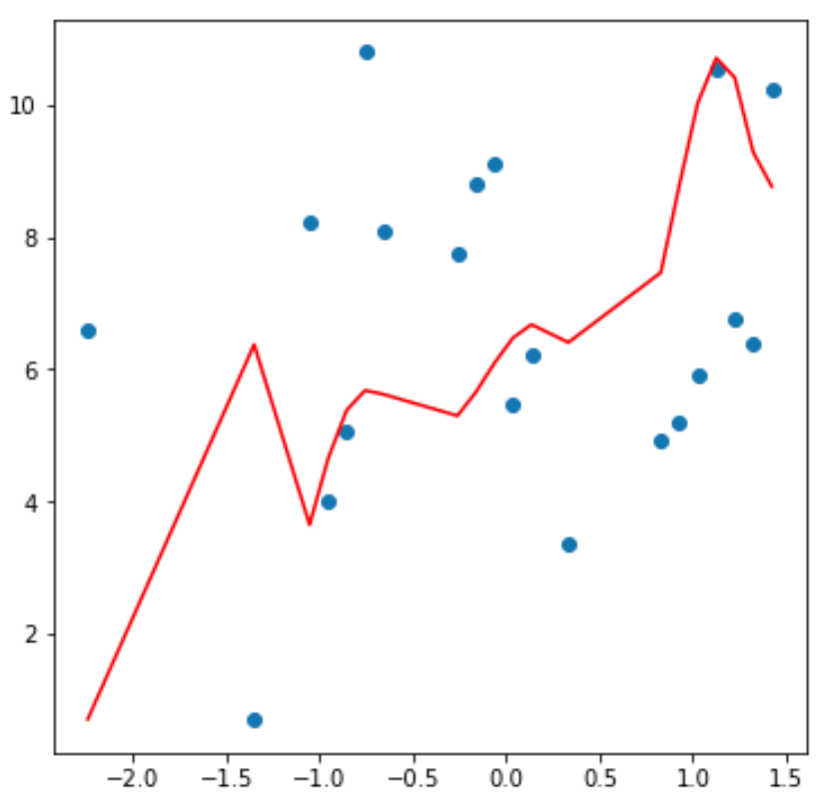
Model Capacity, Bias and Variance
Example: capacity, bias and variance for a polynomial model linear in coefficients
Fit same data with 12th order polynomial model with 13 parameters
The model has low bias, since it fits the training data fairly well
But the model will have high variance since predictions will be erratic
v

Slide 46
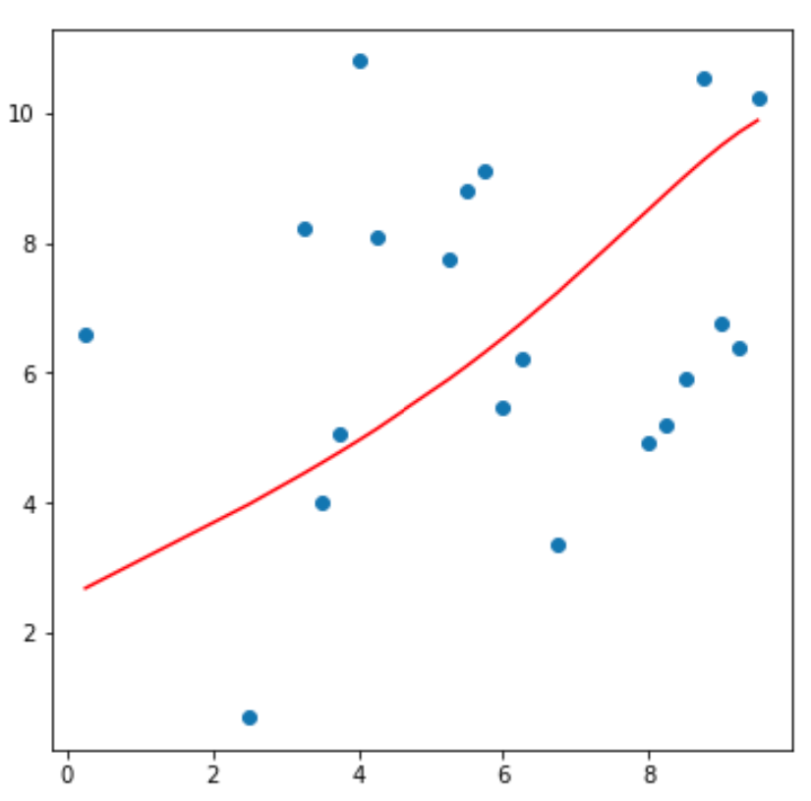
Model Capacity, Bias and Variance
Example: capacity, bias and variance for a polynomial model linear in coefficients
Models of many different capacities possible between the extremes
12th order model with strong regularization applied
Need to find an optimal trade-off point between bias and variance

Slide 47
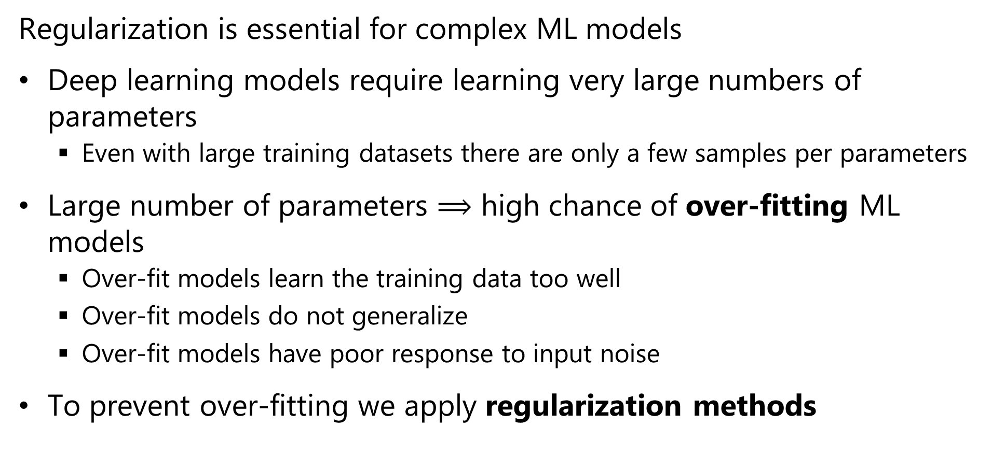
Regularization for Machine Learning
Regularization is essential for complex ML models
Deep learning models require learning very large numbers of parameters
Even with large training datasets there are only a few samples per parameters
Large number of parameters $⟹$ high chance of over-fitting ML models
Over-fit models learn the training data too well
Over-fit models do not generalize
Over-fit models have poor response to input noise
To prevent over-fitting we apply regularization methods

Slide 48
The L2 Regularization Method

Slide 49
l2 Regularization
L2 or Euclidean norm regularization is a widely used method
Over-fit models tend to have parameters (weights) with extreme values
One way to regularize models is to limit the values of the parameters
Limit the L2 norm of the model parameter vector
We add a small bias term to (greatly) reduce the variance

Slide 50
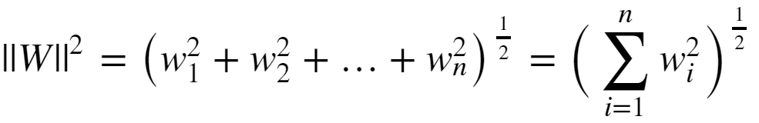

l2 Regularization
Limit the size of the model parameters is to constrain the l2 or Euclidian norm:
The regularized loss function is then:
Where λ is the regularization hyperparameter
Large λ increases bias but reduces variance
Small λ decreases bias and increases variance

Slide 51
l2 Regularization
How can you gain some intuition about l2 regularization?
X2
Β1 ~ 0
Β1 large
Β2 small
-Β1 = Β2
X1
Β2 ~ 0
Constant ||Β||²
l2 regularization is considered a soft constraint

Slide 52
L2 Regularization
How can you gain some intuition about l2 regularization?
Contours of J(W)_{MLE}
Min_{W} (J(W)_{MLE})
Constraint on model parameters binds
Initial W
Domain of Overfitting
Contours of ||W||²

Slide 53
l2 Regularization
l2 regularization goes by many names
Euclidian norm regularization
First published by Andrey Tikonov in late 1940s
Only published in English in 1977
Known as Tikhonov regularization
In the statistics literature often called ridge regression
In the engineering literature is referred to as pre-whitening

Slide 54
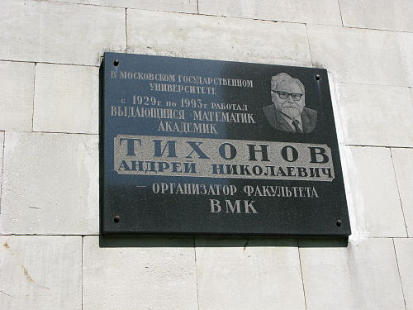
l2 Regularization
Plaque commemorating Andrey Tikhonov at Moscow Institute of Mathematics

Slide 55
L1 Regularization Methods

Slide 56
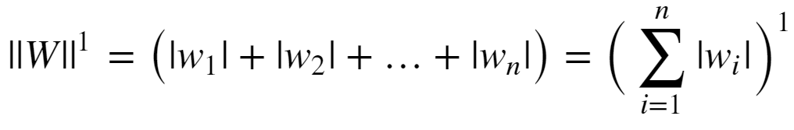
l1 Regularization
Regularization can be performed with other norms
The l1 (min-max) norm is another common choice
Conceptually, l1 norm limits the sum of the absolute values of the weights:
The l1 norm is also known as the Manhattan distance or taxi cab distance, since it is the distance traveled on a grid between two points.

Slide 57

l1 Regularization
Given the l1 norm of the weights, the loss function becomes:
Where α is the regularization hyperparameter
Large α increases bias but reduces variance
Small α decreases bias and increases variance
The l1 constraint drives some weights to exactly 0
This behavior leads to the term lasso regularization
L1 regularization provides a hard constraint on parameters
In contrast L2 provides soft constraints

Slide 58
l1 Regularization
A diagram helps develop some intuition on l1 regularization:
X2
Β1 = 0
X1
Β2 = 0
Constant ||Β||
L1 regularization is a hard constraint on the weights

Slide 59
L1 Regularization
A diagram helps develop some intuition on l1 regularization:
Contours of J(W)_{MLE}
Min_{W} (J(W)_{MLE})
Nonzero parameter
value
Initial W
Domain of Overfitting
Contours of ||W||¹

Slide 60
Early Stopping as Regularization

Slide 61
Early Stopping
Early stopping is an old and simple idea
Stop updating the model weights before the model becomes overfit
Early stopping is analogous to l2 regularization
We can formulate the regularized loss function as:
Where α is the regularization hyperparameter

Slide 62
Early Stopping
Early stopping has a simple geometric interpretation
Contours of J(W)_{MLE}
Min_{W} (J(W)_{MLE})
Early stopping point
Initial W
Domain of Overfitting
Contours of ||W||²

Slide 63
Machine Learning Workflow

Slide 64
Machine Learning Workflow
Which types of machine learning models do we use for computer vision problems?
Unsupervised: Models applied when ground-truth is unknown
Supervised: Models trained with known outcomes, or labels
Regression for predicting numeric values
Classifiers for predicting categories
Self-supervised: More on this later in the course
Initially, we focus on supervised classification

Slide 65
Machine Learning Workflow
How do we organize a machine learning workflow?
Define model and hyperparameters
Database
Split data to
Train
Test
Evaluate
Train Model
Test Model

Slide 66
Machine Learning Workflow
Supervised learning of model parameters using features with know labels
Define model and hyperparameters
Training features
Model training by minimizing errors with for known labels
Trained model
With
Learned model parameters
Training labels

Slide 67
Machine Learning Workflow
Supervised learning of model parameters using features with know labels
Test
features
Trained model
With
Learned model parameters
Evaluate model performance
Test
labels

Slide 68
Machine Learning Model Evaluation

Slide 69
Machine Learning Model Evaluation
How do we evaluate classification models?
Classifiers perform an hypothesis test with possible outcomes:
True positive (TP): Positive cases are correctly classified
True negative (TN): Negative cases are correctly classified
False positive (FP): Negative case erroneously classified as positive
False negative (FN): Positive case erroneously classified as negative
These quantities can be organised into a confusion matrix:
 | Actual Positive | Actual Negative
Classified Positive | TP | FP
Classified Negative | FN | TN

Slide 70
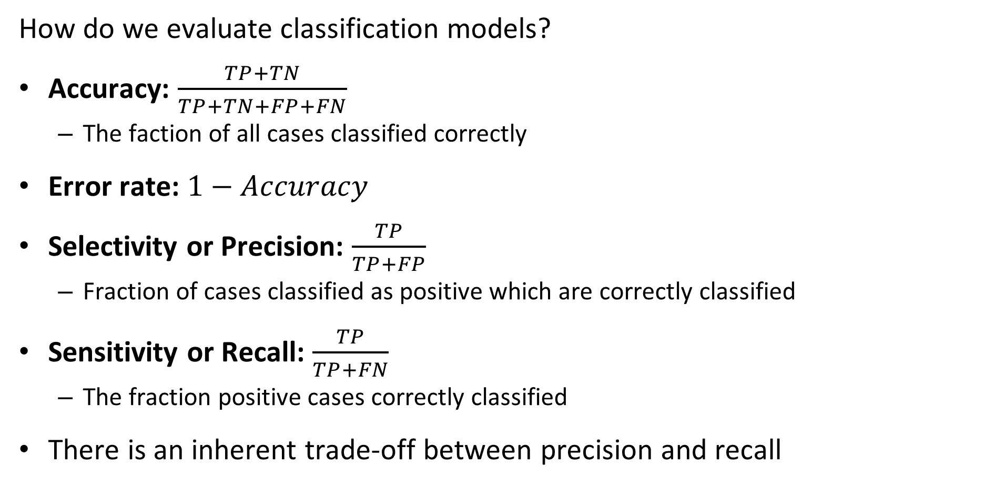
Machine Learning Model Evaluation
How do we evaluate classification models?
Accuracy: $\frac{TP+TN}{TP+TN+FP+FN}$
The faction of all cases classified correctly
Error rate: $1−Accuracy$
Selectivity or Precision: $\frac{TP}{TP+FP}$
Fraction of cases classified as positive which are correctly classified
Sensitivity or Recall: $\frac{TP}{TP+FN}$
The fraction positive cases correctly classified
There is an inherent trade-off between precision and recall

Slide 71
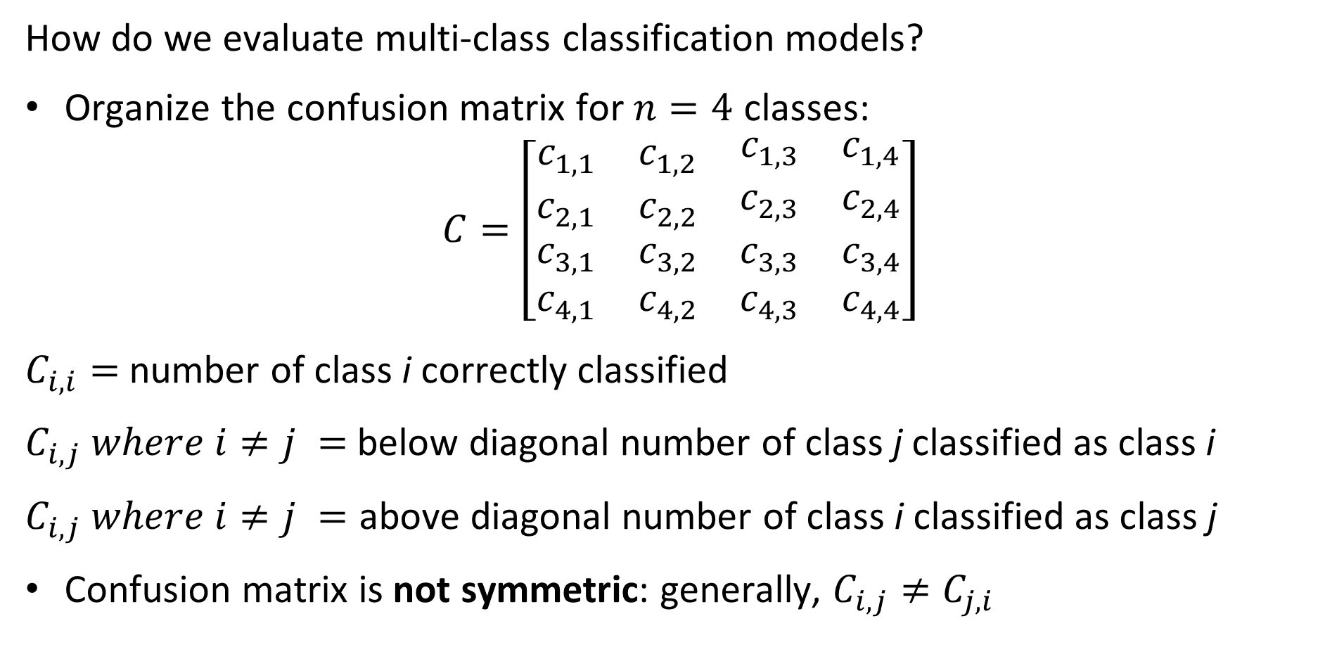
Machine Learning Model Evaluation
How do we evaluate multi-class classification models?
Organize the confusion matrix for $n=4$ classes:
$$C=\left[\begin{matrix}c_{1,1} & c_{1,2} & \begin{matrix}c_{1,3} & c_{1,4}\end{matrix} \\ c_{2,1} & c_{2,2} & \begin{matrix}c_{2,3} & c_{2,4}\end{matrix} \\ \begin{matrix}c_{3,1} \\ c_{4,1}\end{matrix} & \begin{matrix}c_{3,2} \\ c_{4,2}\end{matrix} & \begin{matrix}\begin{matrix}c_{3,3} \\ c_{4,3}\end{matrix} & \begin{matrix}c_{3,4} \\ c_{4,4}\end{matrix}\end{matrix}\end{matrix}\right]$$
$C_{i,i}=$number of class i correctly classified
$C_{i,j} where i≠j =$ below diagonal number of class j classified as class i
$C_{i,j} where i≠j =$ above diagonal number of class i classified as class j
Confusion matrix is not symmetric: generally, $C_{i,j}≠$ $C_{j,i}$

Slide 72
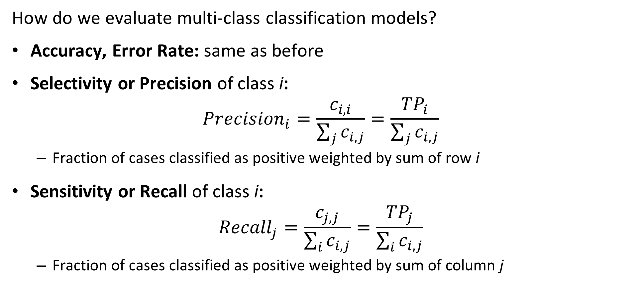
Machine Learning Model Evaluation
How do we evaluate multi-class classification models?
Accuracy, Error Rate: same as before
Selectivity or Precision of class i:
$${Precision}_{i}=\frac{c_{i,i}}{\sum_{j}{c_{i,j}}}=\frac{{TP}_{i}}{\sum_{j}{c_{i,j}}}$$
Fraction of cases classified as positive weighted by sum of row i
Sensitivity or Recall of class i:
$${Recall}_{j}=\frac{c_{j,j}}{\sum_{i}{c_{i,j}}}=\frac{{TP}_{j}}{\sum_{i}{c_{i,j}}}$$
Fraction of cases classified as positive weighted by sum of column j

Slide 73
Summary
Key points for this lesson
The formulation of linear machine learning models
Basic machine learning workflow
Formulation of CV features for machine learning
The relationship between bias, variance and model capacity
Theory of binary classifiers
Theory of multi-class classifiers
Evaluation of classifiers

