Slide 1

CSCI E-25 Computer Vision
Homography and Projections
Steve Elston
Copyright 2021, 2022, 2023, 2024 Stephen F Elston. All rights reserved.

Slide 2
Homography and Projections
How do we transform between light scattered off objects and projections on a camera image plane?
Use planar projective transformation to model projection of an object to a camera image plane
Use projection to transform one camera pose to another
Inverse transform from image planes to real-world object location
Planar transformations use projection matrix

Slide 3
Homography and Projections
Projections are used in many computer vision applications
Warping images to adjust for camera viewpoint, aka, camera pose
Tracking moving objects – a.k.a. optical flow
Stitching images together
3D computer vision
Integrating different imaging types, e.g. lidar and optical – beyond scope of our course
…

Slide 4
Projective Geometry
w
Projective transform changes view on image plane
Projections of 3 points on a line
Transformation projects one view to another on the image plane
Planar transformation have common Optical center
Image plane
Optical center
Projection 1
Projection 2

Slide 5
Projective Geometry
w
Location of points and lines in space is ambiguous in a single camera view
3 points along a line on different world planes
All 3 sets of points fall at the same points on the image plan
Planar transformation are ambigiuous
World
Plane 3
Image plane
World
Plane 1
Optical center
World
Plane 2

Slide 6
Stereo Vision Problem
Stereo vision is a canonical problem in computer vision
Can locate a point in 3-D space from location on 2 or more image planes
Requires a model for the cameras
Intrinsic properties of cameras
Scene extrinsic from cameras
Solve system of camera equations to locate point in 3-D space
w
Image plane 1
Image plane 2
x₁
x₂
Optical center 1
Optical center 2

Slide 7




Image alignment
Example: How to align images from two views?
Locate interest points
For patches around the interest points extract statistics - descriptors
Matching points are identified by descriptors
Images can be warped to match – use image transformations
A₁
B₃
A₂
A₃
B₁
B₂

Slide 8
Pinhole Camera Model

Slide 9
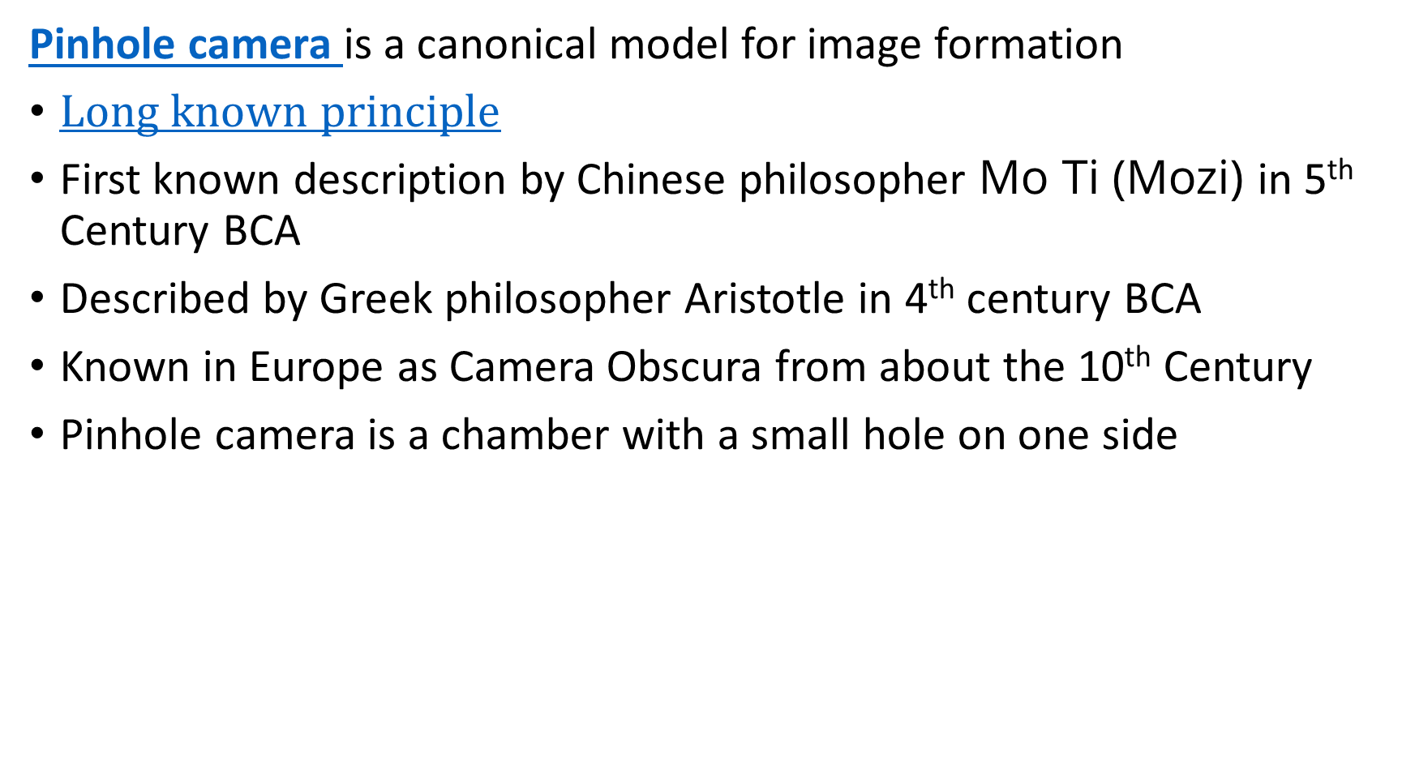
Pinhole Camera
Pinhole camera is a canonical model for image formation
$Long known principle$
First known description by Chinese philosopher Mo Ti (Mozi) in 5th Century BCA
Described by Greek philosopher Aristotle in 4th century BCA
Known in Europe as Camera Obscura from about the 10th Century
Pinhole camera is a chamber with a small hole on one side

Slide 10
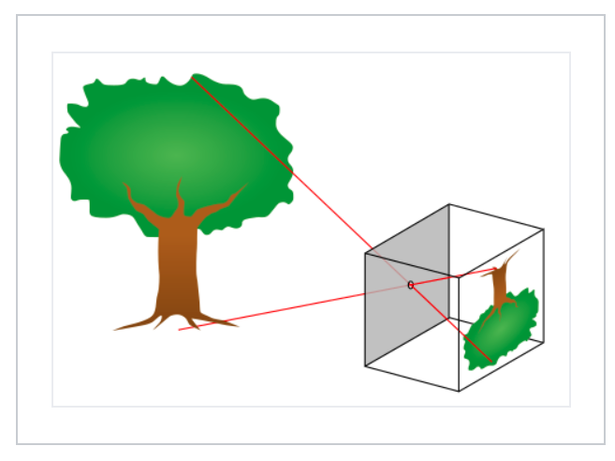
The Nature of Images
Basic image camera image formation
A camera forms an image from scattered light from an object
A pinhole camera or camera obscura forms an image by projecting light rays back to their source
Credit, Wikipedia commons

Slide 11
Pinhole Camera
Pinhole camera is a canonical model for image formation
Pinhole camera is a chamber with a small hole on one side
Image on side of chamber opposite hole
Use cartesian coordinates on the image plane
Pinhole is the origin of the coordinate system
Transform from real-world coordinates to image plane coordinates

Slide 12
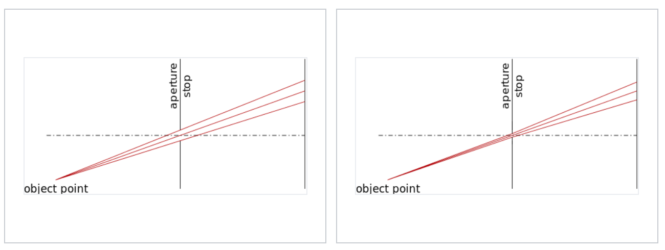
The Nature of Images
Basic image camera image formation
The smaller the aperture of the pinhole the light is focused to a point and the image is sharper, but less light passes
Aperture is parameterized by f-stops or f-number
Credit, Wikipedia commons

Slide 13
Coordinate Systems

Slide 14




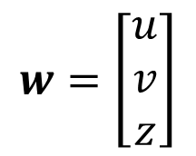



Cartesian Coordinates for Images
Pinhole camera model
Image plane, $z=1$
Object
$$w=\left[\begin{matrix}u \\ v \\ z\end{matrix}\right]$$
Pinhole at origin
Principal Point
O
$$z$$
Optic Axis, z
$$x$$
$$y$$
$$x=\left[\begin{matrix}x \\ y\end{matrix}\right]$$
Image
$$1$$
$$\tilde{z}$$

Slide 15
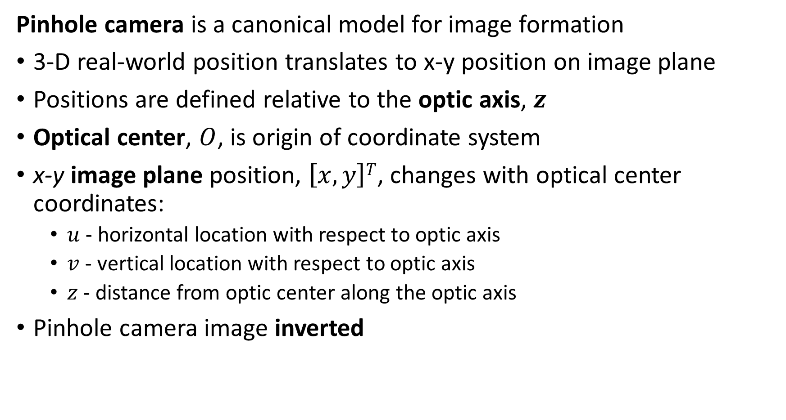
Pinhole Camera
Pinhole camera is a canonical model for image formation
3-D real-world position translates to x-y position on image plane
Positions are defined relative to the optic axis, $z$
Optical center, $O$, is origin of coordinate system
x-y image plane position, $\left[x,y\right]T$, changes with optical center coordinates:
$u$ - horizontal location with respect to optic axis
$v$ - vertical location with respect to optic axis
$z$ - distance from optic center along the optic axis
Pinhole camera image inverted

Slide 16
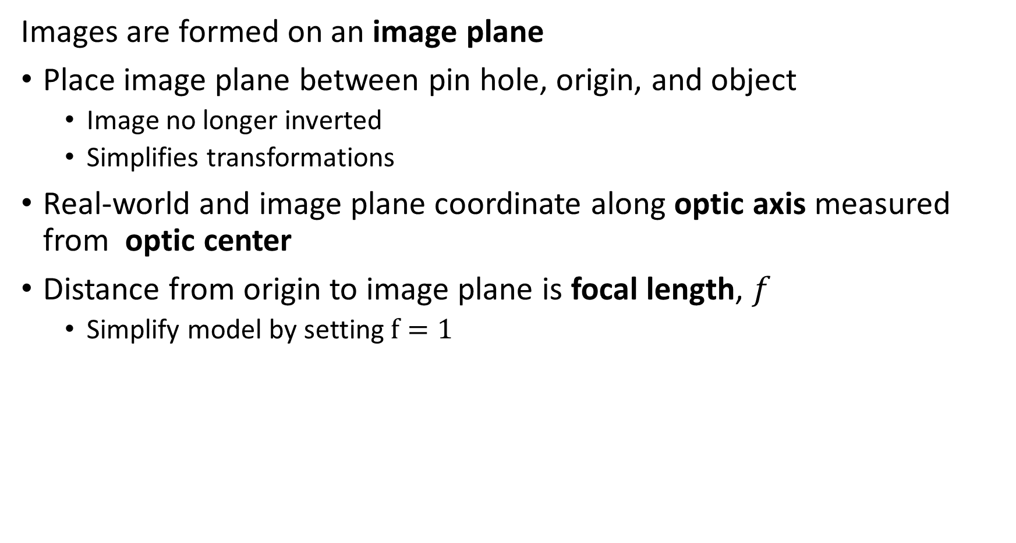
Coordinate System for Pinhole Camera
Images are formed on an image plane
Place image plane between pin hole, origin, and object
Image no longer inverted
Simplifies transformations
Real-world and image plane coordinate along optic axis measured from optic center
Distance from origin to image plane is focal length, $f$
Simplify model by setting $f=1$

Slide 17

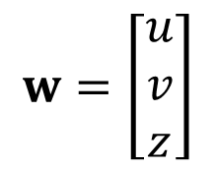





Pinhole Camera Model
Cartesian coordinates for a pinhole camera model
Image plane, $z=1$
$$w=\left[\begin{matrix}u \\ v \\ z\end{matrix}\right]$$
Pinhole at origin
$$x=\left[\begin{matrix}x \\ y\end{matrix}\right]$$
O
$$z$$
Principal Point
Optic Axis = z
$$x$$
$$y$$
$$f=1$$

Slide 18
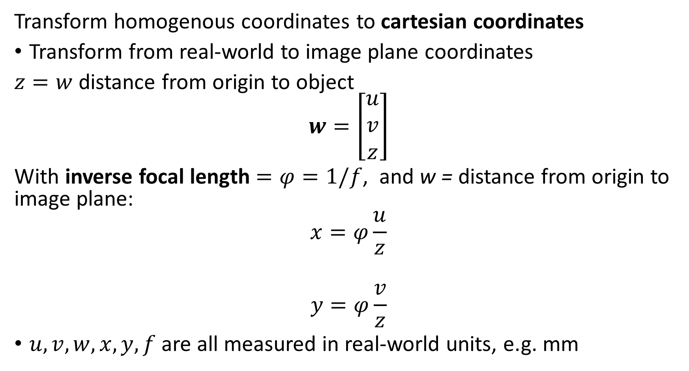
Cartesian Coordinates for Images
Transform homogenous coordinates to cartesian coordinates
Transform from real-world to image plane coordinates
$z=w$ distance from origin to object
$$w=\left[\begin{matrix}u \\ v \\ z\end{matrix}\right]$$
With inverse focal length $=φ=1/f$, and w = distance from origin to image plane:
$$x=φ\frac{u}{z}$$
$$y=φ\frac{v}{z}$$
$u, v, w, x, y, f$ are all measured in real-world units, e.g. mm

Slide 19


Focal Length
Changing focal length changes field of view a fixed distance
Image plane
Image plane
Field
of
view
Field
of
view
$$f_{ }$$
$${f′}_{ }$$
z
z
Short focal length
Long focal length

Slide 20
Transformations for Camera Model

Slide 21
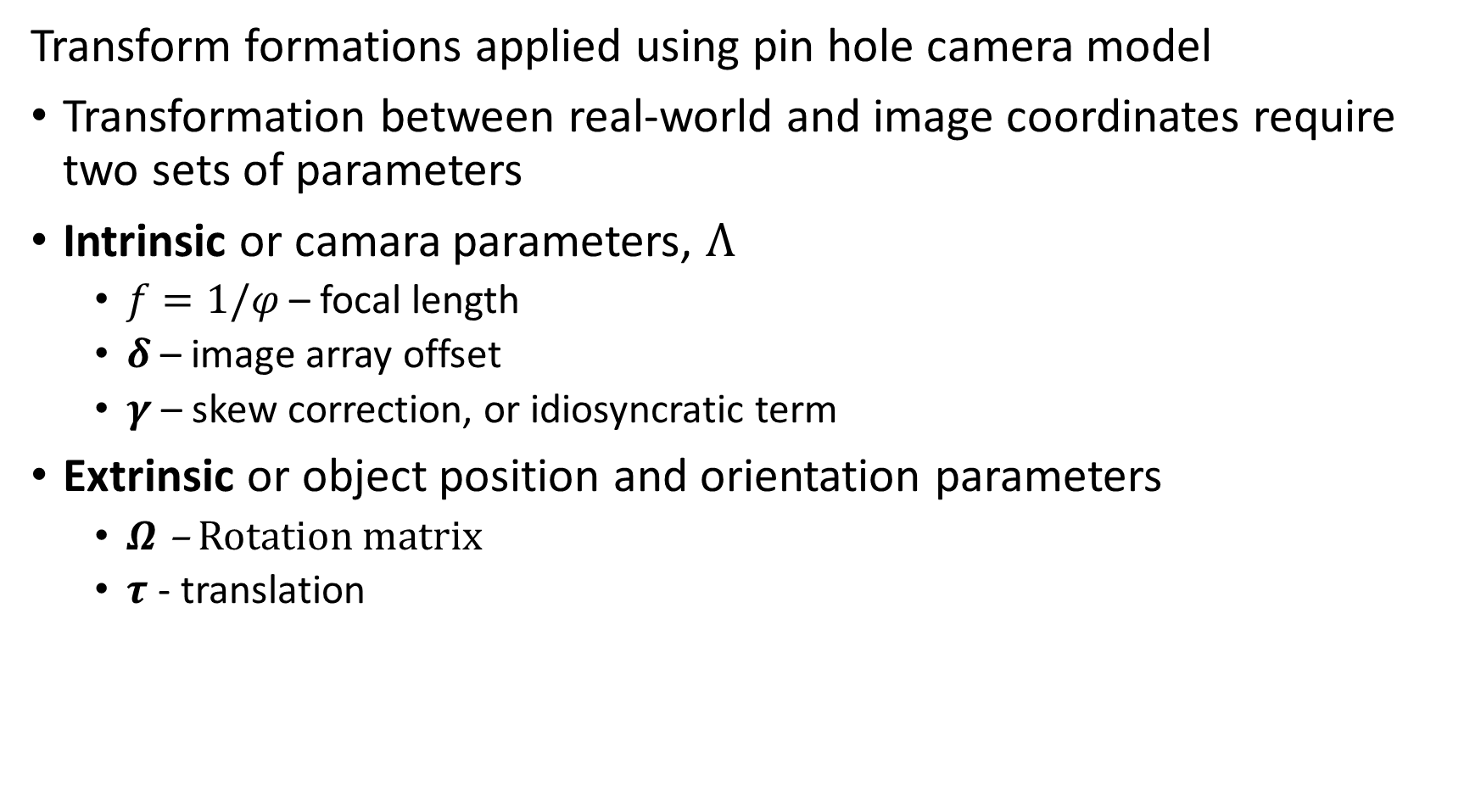
Transformations for Camera Model
Transform formations applied using pin hole camera model
Transformation between real-world and image coordinates require two sets of parameters
Intrinsic or camara parameters, $Λ$
$f=1/φ$ – focal length
$δ$ – image array offset
$γ$ – skew correction, or idiosyncratic term
Extrinsic or object position and orientation parameters
$Ω$ – Rotation matrix
$τ$ - translation

Slide 22
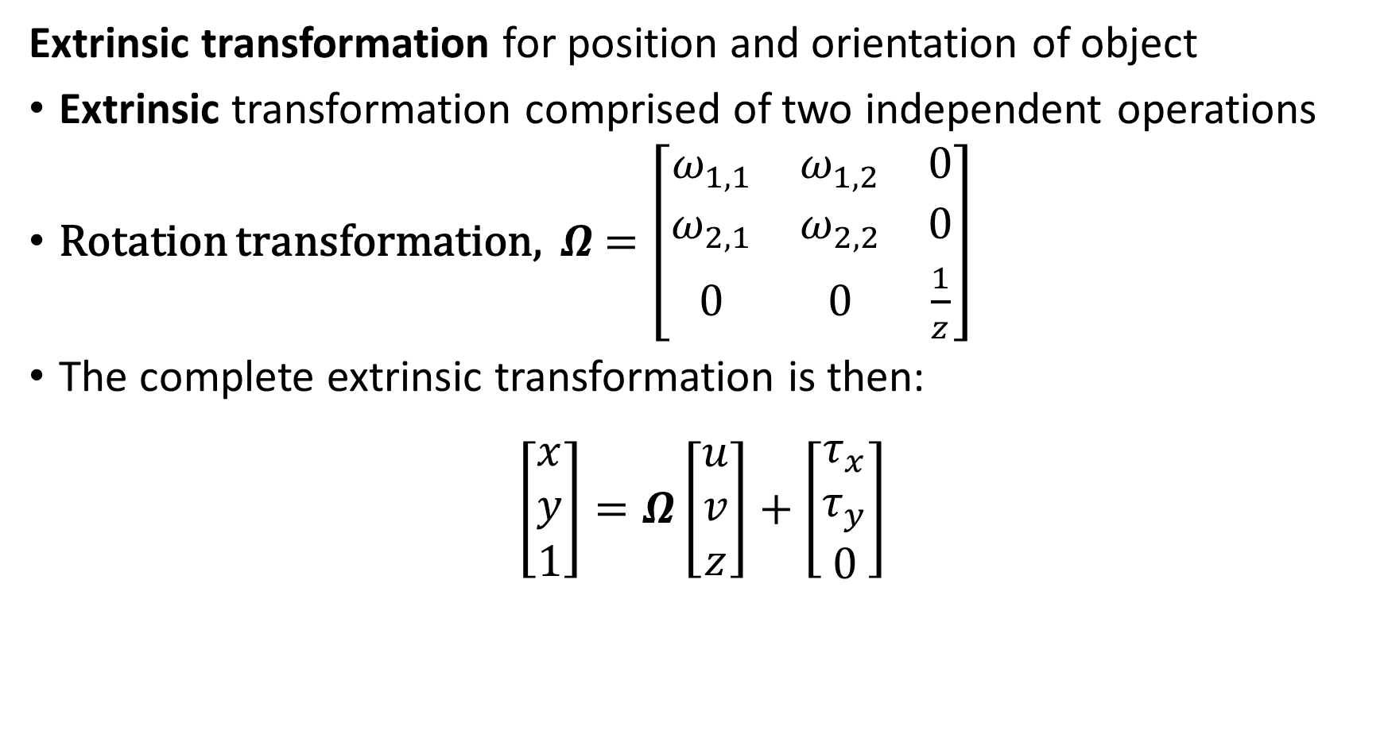
Transformations for Camera Model
Extrinsic transformation for position and orientation of object
Extrinsic transformation comprised of two independent operations
Rotation transformation, $Ω$ $=\left[\begin{matrix}ω_{1,1} & ω_{1,2} & 0 \\ ω_{2,1} & ω_{2,2} & 0 \\ 0 & 0 & \frac{1}{z}\end{matrix}\right]$
The complete extrinsic transformation is then:
$$\left[\begin{matrix}x \\ y \\ 1\end{matrix}\right]=Ω\left[\begin{matrix}u \\ v \\ z\end{matrix}\right]+\left[\begin{matrix}τ_{x} \\ τ_{y} \\ 0\end{matrix}\right]$$

Slide 23
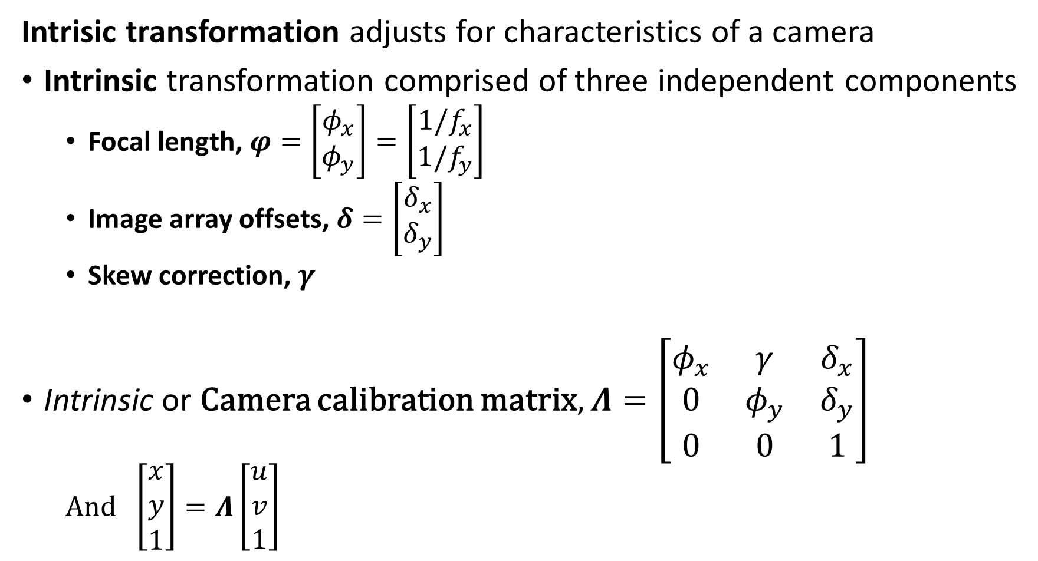
Transformations for Camera Model
Intrisic transformation adjusts for characteristics of a camera
Intrinsic transformation comprised of three independent components
Focal length, $φ=\left[\begin{matrix}φ_{x} \\ φ_{y}\end{matrix}\right]=\left[\begin{matrix}{1/f}_{x} \\ {1/f}_{y}\end{matrix}\right]$
Image array offsets, $δ=\left[\begin{matrix}δ_{x} \\ δ_{y}\end{matrix}\right]$
Skew correction, $γ$
Intrinsic or Camera calibration matrix, $Λ=\left[\begin{matrix}φ_{x} & γ & δ_{x} \\ 0 & φ_{y} & δ_{y} \\ 0 & 0 & 1\end{matrix}\right]$
And $\left[\begin{matrix}x \\ y \\ 1\end{matrix}\right]=Λ\left[\begin{matrix}u \\ v \\ 1\end{matrix}\right]$

Slide 24
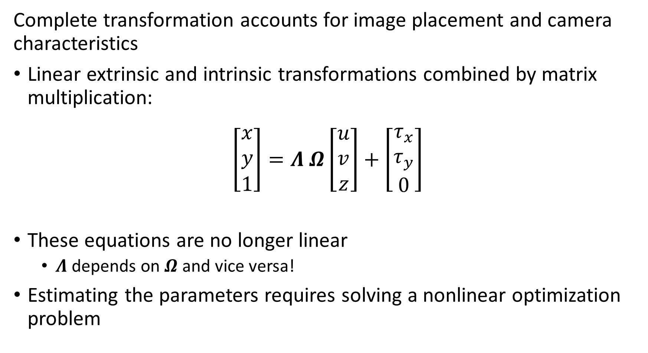
Transformations for Camera Model
Complete transformation accounts for image placement and camera characteristics
Linear extrinsic and intrinsic transformations combined by matrix multiplication:
$$\left[\begin{matrix}x \\ y \\ 1\end{matrix}\right]=Λ Ω\left[\begin{matrix}u \\ v \\ z\end{matrix}\right]+\left[\begin{matrix}τ_{x} \\ τ_{y} \\ 0\end{matrix}\right]$$
These equations are no longer linear
$Λ$ depends on $Ω$ and vice versa!
Estimating the parameters requires solving a nonlinear optimization problem

Slide 25

Transformations for Camera Model
How do we find the Intrinsic parameters of a camera?
Two ways to find intrinsic parameters
Learn from multiple camera views of scene – more on this later
Use multiple views of a known target
Wide variety of targets available commercially
Other suppliers

Slide 26
Homogeneous Coordinates

Slide 27
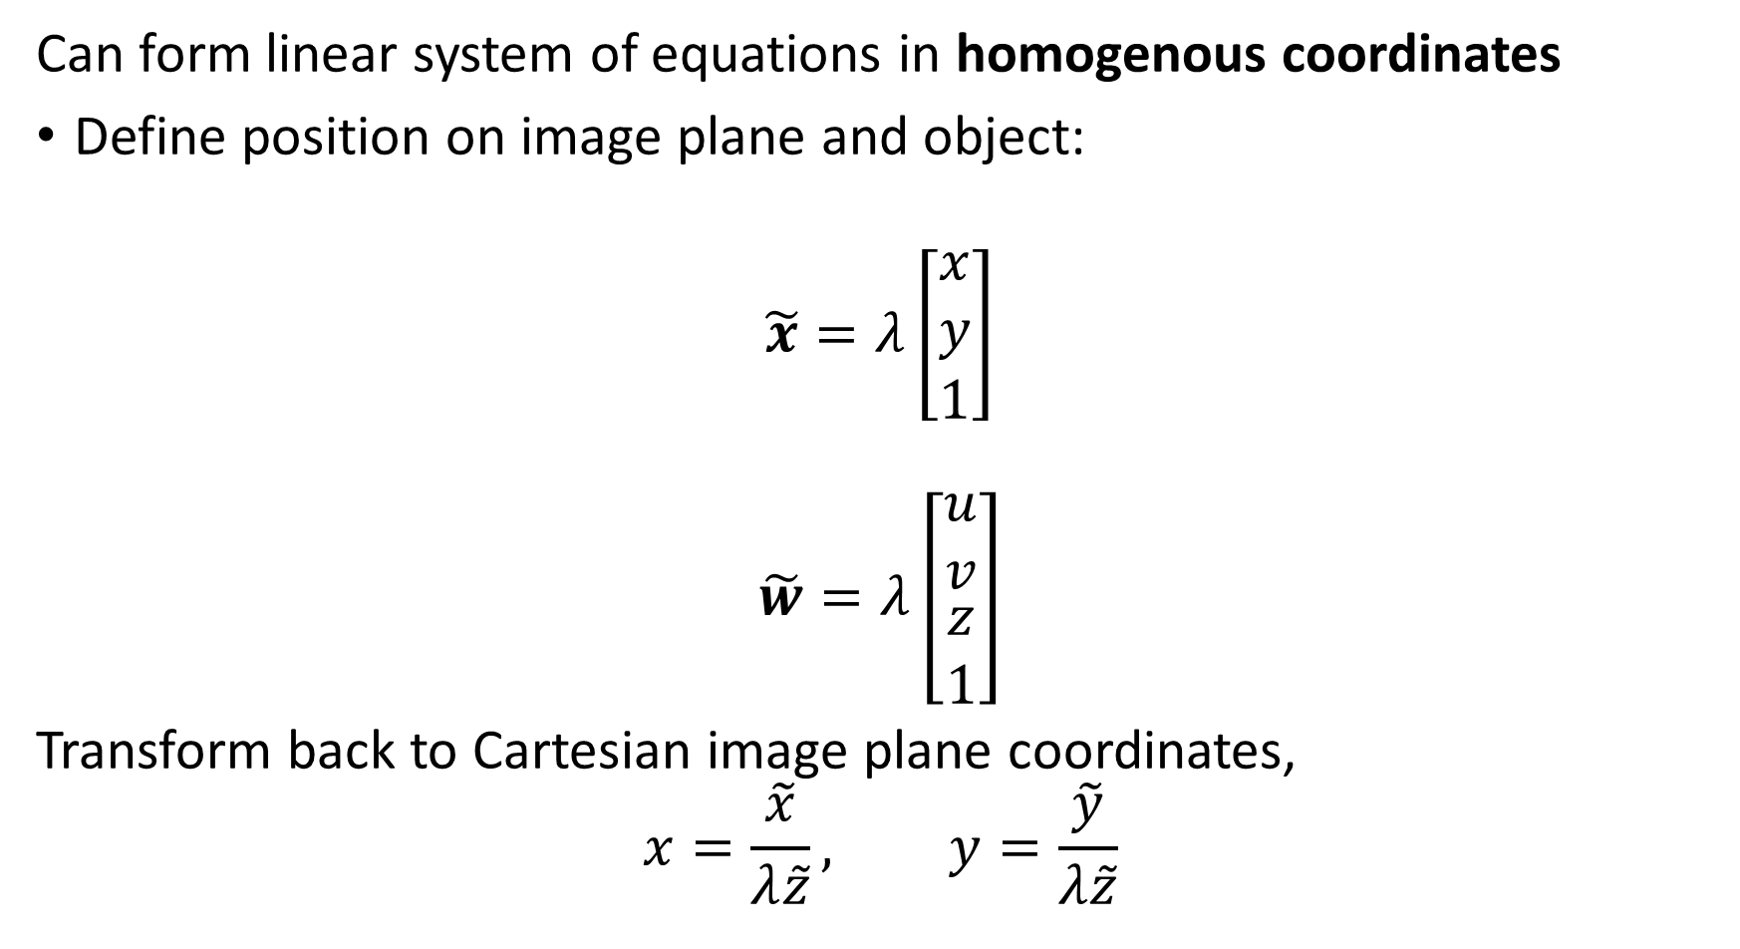
Homogenous Coordinates
Can form linear system of equations in homogenous coordinates
Define position on image plane and object:
$$\tilde{x}=λ\left[\begin{matrix}x \\ y \\ 1\end{matrix}\right]$$
$$\tilde{w}=λ\left[\begin{matrix}u \\ v \\ \begin{matrix}z \\ 1\end{matrix}\end{matrix}\right]$$
Transform back to Cartesian image plane coordinates,
$$x=\frac{\tilde{x}}{λ\tilde{z}}, y=\frac{\tilde{y}}{λ\tilde{z}}$$

Slide 28
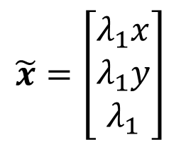

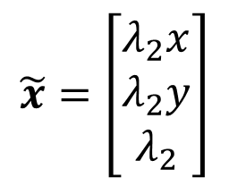
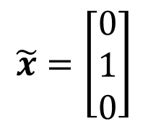
Pinhole Camera Model
Homogenous coordinates for a pinhole camera model
Image plane, $z=1$
$$\tilde{x}=\left[\begin{matrix}λ_{1}x \\ λ_{1}y \\ λ_{1}\end{matrix}\right]$$
$$\tilde{x}=\left[\begin{matrix}λ_{2}x \\ λ_{2}y \\ λ_{2}\end{matrix}\right]$$
Pinhole at origin
$$x=\left[\begin{matrix}x \\ y\end{matrix}\right]$$
O
$$z$$
Principal Point
Optic Axis
$$x$$
$$y$$
$$\tilde{x}=\left[\begin{matrix}0 \\ 1 \\ 0\end{matrix}\right]$$
$$φ=1$$

Slide 29
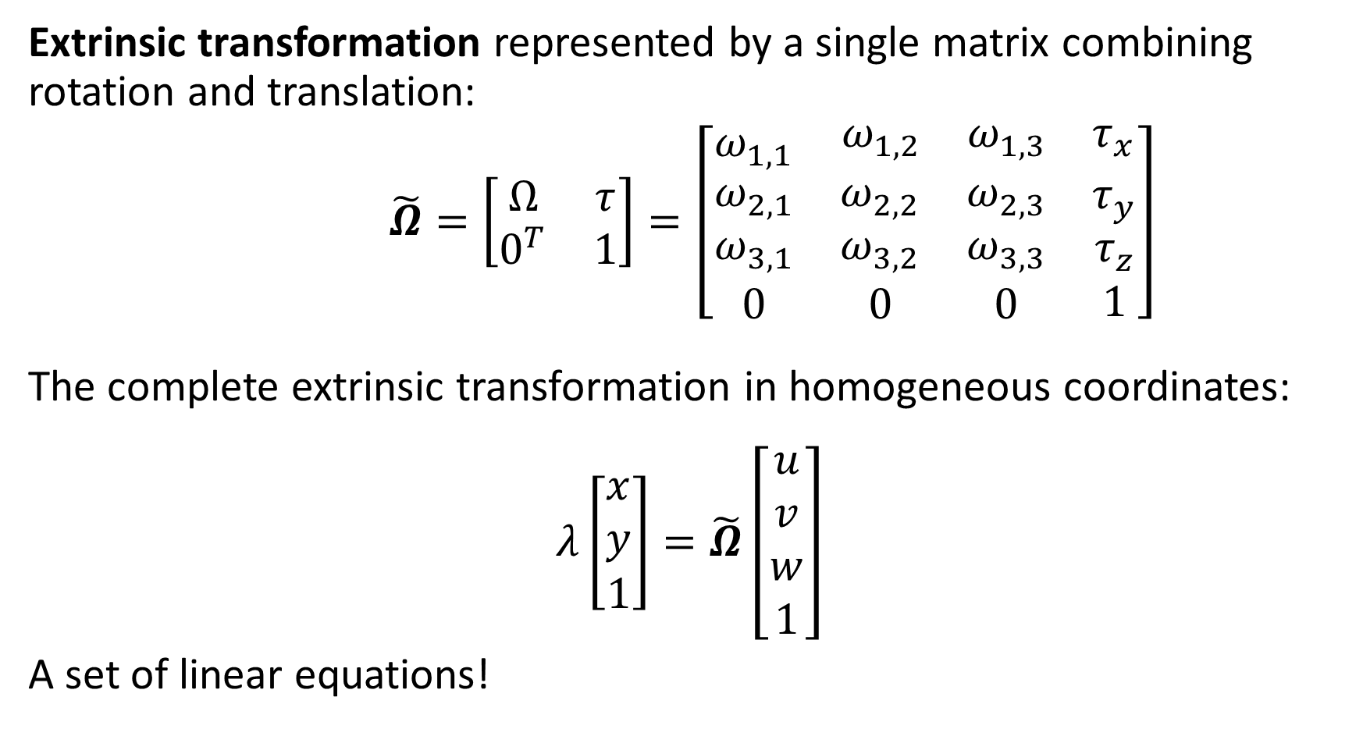
Homogenous Coordinates
Extrinsic transformation represented by a single matrix combining rotation and translation:
$\tilde{Ω}=\left[\begin{matrix}Ω & τ \\ 0^{T} & 1\end{matrix}\right]=\left[\begin{matrix}ω_{1,1} & \begin{matrix}ω_{1,2} & ω_{1,3} & τ_{x}\end{matrix} \\ \begin{matrix}ω_{2,1} \\ ω_{3,1} \\ 0\end{matrix} & \begin{matrix}\begin{matrix}ω_{2,2} \\ ω_{3,2} \\ 0\end{matrix} & \begin{matrix}ω_{2,3} \\ ω_{3,3} \\ 0\end{matrix} & \begin{matrix}τ_{y} \\ τ_{z} \\ 1\end{matrix}\end{matrix}\end{matrix}\right]$
The complete extrinsic transformation in homogeneous coordinates:
$$λ\left[\begin{matrix}x \\ y \\ 1\end{matrix}\right]=\tilde{Ω}\left[\begin{matrix}u \\ v \\ w \\ 1\end{matrix}\right]$$
A set of linear equations!

Slide 30
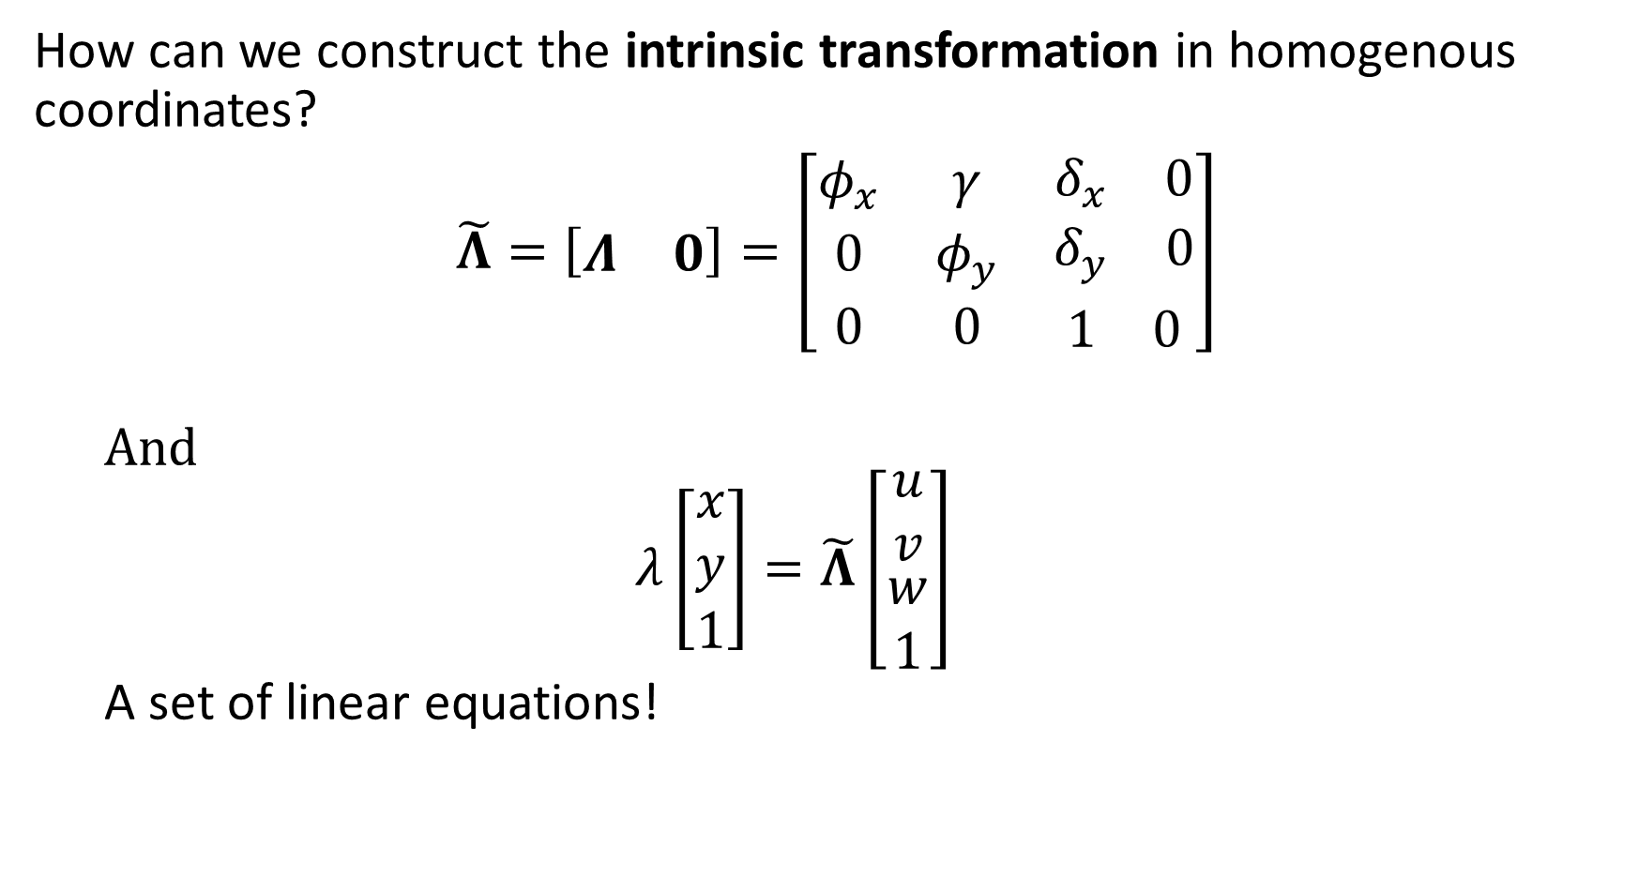
Homogenous Coordinates
How can we construct the intrinsic transformation in homogenous coordinates?
$\tilde{Λ}=\left[\begin{matrix}Λ & 0\end{matrix}\right]=\left[\begin{matrix}φ_{x} & γ & \begin{matrix}δ_{x} & 0\end{matrix} \\ 0 & φ_{y} & \begin{matrix}δ_{y} & 0\end{matrix} \\ 0 & 0 & \begin{matrix}1 & 0\end{matrix}\end{matrix}\right]$
And
$$λ\left[\begin{matrix}x \\ y \\ 1\end{matrix}\right]=\tilde{Λ}\left[\begin{matrix}u \\ v \\ \begin{matrix}w \\ 1\end{matrix}\end{matrix}\right]$$
A set of linear equations!

Slide 31
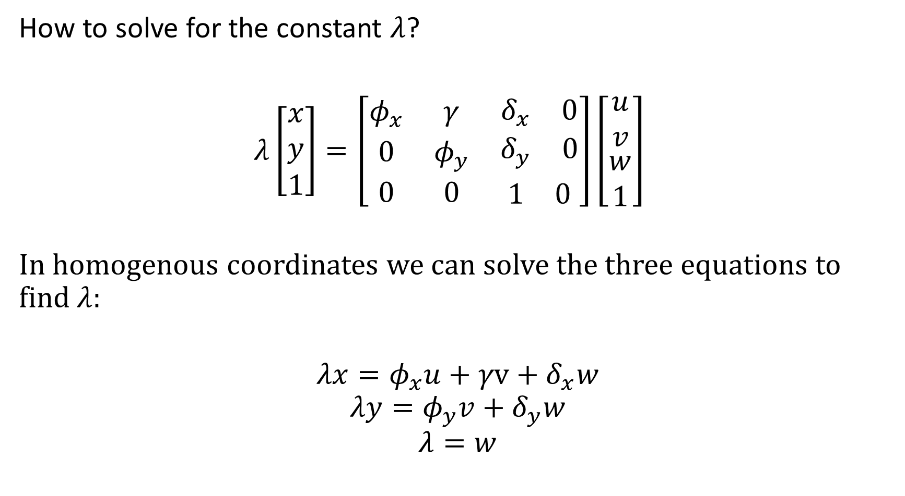
Homogenous Coordinates
How to solve for the constant $λ$?
$λ\left[\begin{matrix}x \\ y \\ 1\end{matrix}\right]=\left[\begin{matrix}φ_{x} & γ & \begin{matrix}δ_{x} & 0\end{matrix} \\ 0 & φ_{y} & \begin{matrix}δ_{y} & 0\end{matrix} \\ 0 & 0 & \begin{matrix}1 & 0\end{matrix}\end{matrix}\right]\left[\begin{matrix}u \\ v \\ \begin{matrix}w \\ 1\end{matrix}\end{matrix}\right]$
In homogenous coordinates we can solve the three equations to find $λ$:
$$λx=φ_{x}u+γv+δ_{x}w$$
$$λy=φ_{y}v+δ_{y}w$$
$$λ=w$$

Slide 32
Pinhole Camera Model in Homogeneous Coordinates
Homogenous coordinates for a pinhole camera model
Image plane, $z=1$
$$\tilde{x}=\left[\begin{matrix}λ_{1}x \\ λ_{1}y \\ λ_{1}\end{matrix}\right]$$
$$\tilde{x}=\left[\begin{matrix}λ_{2}x \\ λ_{2}y \\ λ_{2}\end{matrix}\right]$$
Pinhole at origin
$$x=\left[\begin{matrix}x \\ y\end{matrix}\right]$$
O
$$z$$
Principal Point
Optic Axis
$$x$$
$$y$$
$$\tilde{x}=\left[\begin{matrix}0 \\ 1 \\ 0\end{matrix}\right]$$
$$φ=1$$

Slide 33
Four Transformation Problems

Slide 34
Four Transform Problems
How can we simplify these planar transformations?
There are four levels of complexity
2-D Euclidean – Rotation and translation
2-D Similarity – Rotation, translation, and scaling
Affine - Rotation, translation, scaling, shearing
Projective – General transformation

Slide 35
Four Transform Problems
How can we simplify these planar transformations?
Model is restricted to planar transformations
Transformation matrices are constant over image
Assumes all objects in image are at a constant distance from image plane
How to overcome the limitations of the model?
Can apply transformations over patches of the image
Or, use a polynomial representation of parameters

Slide 36
Four Transformations
2-D Euclidean transformation
Planer operation
Applies rotation and translation
3 degrees of freedom
1 – rotation angle
2 - translation
Simple cases
Pure rotation – 1 DoF
Pure translation – 2 DoF
Preserves shape, size , parallel lines

Slide 37
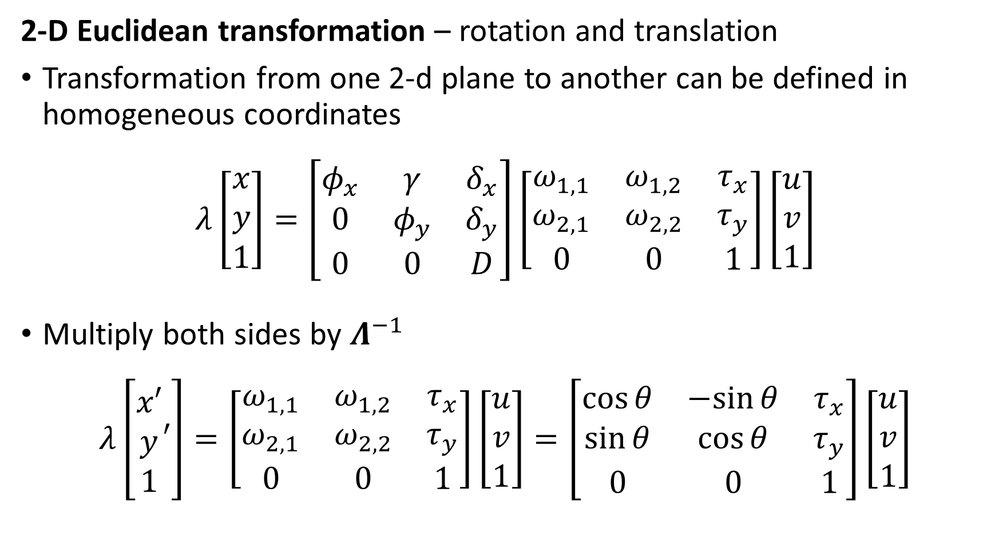
Four Transform Problems
2-D Euclidean transformation – rotation and translation
Transformation from one 2-d plane to another can be defined in homogeneous coordinates
$$λ\left[\begin{matrix}x \\ y \\ 1\end{matrix}\right]=\left[\begin{matrix}φ_{x} & γ & δ_{x} \\ 0 & φ_{y} & δ_{y} \\ 0 & 0 & D\end{matrix}\right]\left[\begin{matrix}ω_{1,1} & ω_{1,2} & τ_{x} \\ ω_{2,1} & ω_{2,2} & τ_{y} \\ 0 & 0 & 1\end{matrix}\right]\left[\begin{matrix}u \\ v \\ 1\end{matrix}\right]$$
Multiply both sides by $Λ^{−1}$
$$λ\left[\begin{matrix}x′ \\ y \\ 1\end{matrix}′\right]=\left[\begin{matrix}ω_{1,1} & ω_{1,2} & τ_{x} \\ ω_{2,1} & ω_{2,2} & τ_{y} \\ 0 & 0 & 1\end{matrix}\right]\left[\begin{matrix}u \\ v \\ 1\end{matrix}\right]=\left[\begin{matrix}\cos{θ} & −sin{θ} & τ_{x} \\ \sin{θ} & \cos{θ} & τ_{y} \\ 0 & 0 & 1\end{matrix}\right]\left[\begin{matrix}u \\ v \\ 1\end{matrix}\right]$$

Slide 38
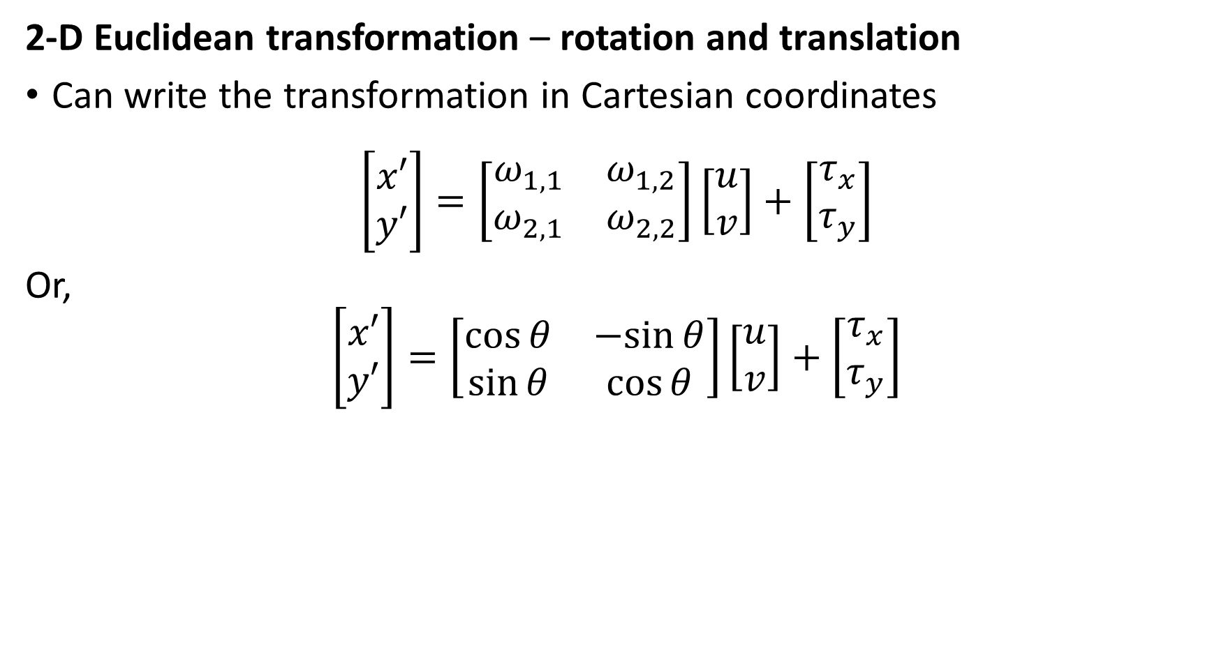
Four Transform Problems
2-D Euclidean transformation – rotation and translation
Can write the transformation in Cartesian coordinates
$$\left[\begin{matrix}x′ \\ y′\end{matrix}\right]=\left[\begin{matrix}ω_{1,1} & ω_{1,2} \\ ω_{2,1} & ω_{2,2}\end{matrix}\right]\left[\begin{matrix}u \\ v\end{matrix}\right]+\left[\begin{matrix}τ_{x} \\ τ_{y}\end{matrix}\right]$$
Or,
$$\left[\begin{matrix}x′ \\ y′\end{matrix}\right]=\left[\begin{matrix}\cos{θ} & −sin{θ} \\ \sin{θ} & \cos{θ}\end{matrix}\right]\left[\begin{matrix}u \\ v\end{matrix}\right]+\left[\begin{matrix}τ_{x} \\ τ_{y}\end{matrix}\right]$$

Slide 39

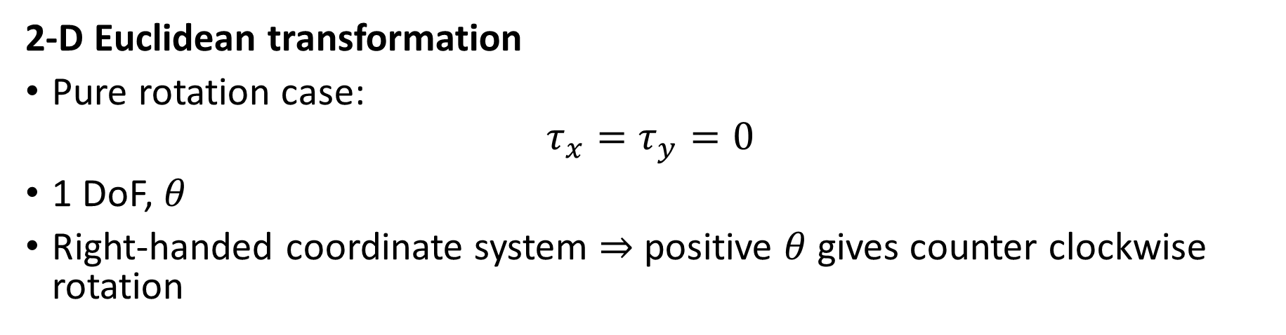
Four Transformations
2-D Euclidean transformation
Pure rotation case:
$$τ_{x}=τ_{y}=0$$
1 DoF, $θ$
Right-handed coordinate system $⇒$ positive $θ$ gives counter clockwise rotation
$$θ$$

Slide 40



Four Transformations
2-D Euclidean transformation
Pure translation case:
$$θ=0$$
2 DoF, $τ_{x},τ_{y}$
$$τ_{y}$$
$$τ_{x}$$

Slide 41




Four Transformations
2-D Euclidean transformation
Translation and rotation
3 DoF, $τ_{x},τ_{y},θ$
$$θ$$
$$τ_{y}$$
$$τ_{x}$$

Slide 42
Four Transformations
2-D similarity transformation
Planer operation
Applies rotation, translation and scale
4 degrees of freedom
1 – rotation angle
2 - translation
1 - scale
Preserves – shape, parallel lines

Slide 43
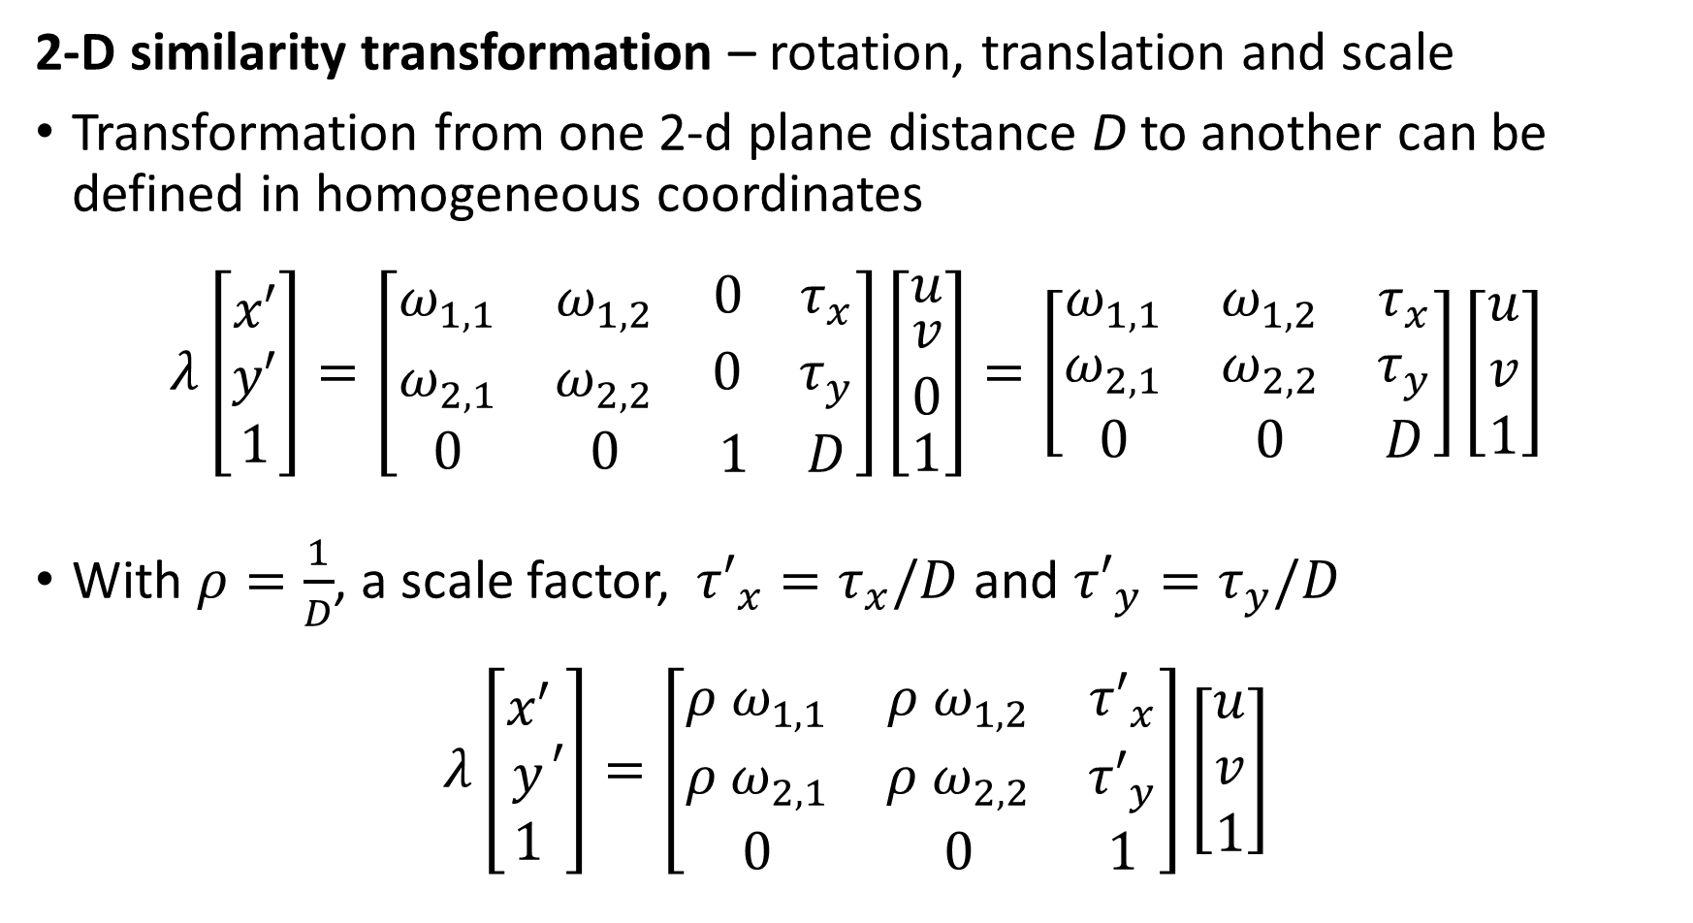
Four Transform Problems
2-D similarity transformation – rotation, translation and scale
Transformation from one 2-d plane distance D to another can be defined in homogeneous coordinates
$$λ\left[\begin{matrix}x′ \\ y′ \\ 1\end{matrix}\right]=\left[\begin{matrix}ω_{1,1} & ω_{1,2} & \begin{matrix}0 & τ_{x}\end{matrix} \\ ω_{2,1} & ω_{2,2} & \begin{matrix}0 & τ_{y}\end{matrix} \\ 0 & 0 & \begin{matrix}1 & D\end{matrix}\end{matrix}\right]\left[\begin{matrix}u \\ \begin{matrix}v \\ 0\end{matrix} \\ 1\end{matrix}\right]=\left[\begin{matrix}ω_{1,1} & ω_{1,2} & τ_{x} \\ ω_{2,1} & ω_{2,2} & τ_{y} \\ 0 & 0 & D\end{matrix}\right]\left[\begin{matrix}u \\ v \\ 1\end{matrix}\right]$$
With $ρ=\frac{1}{D}$, a scale factor, ${τ′}_{x}=τ_{x}/D$ and ${τ′}_{y}=τ_{y}/D$
$$λ\left[\begin{matrix}x′ \\ y \\ 1\end{matrix}′\right]=\left[\begin{matrix}{ρ ω}_{1,1} & {ρ ω}_{1,2} & {τ′}_{x} \\ {ρ ω}_{2,1} & ρ ω_{2,2} & {τ′}_{y} \\ 0 & 0 & 1\end{matrix}\right]\left[\begin{matrix}u \\ v \\ 1\end{matrix}\right]$$

Slide 44
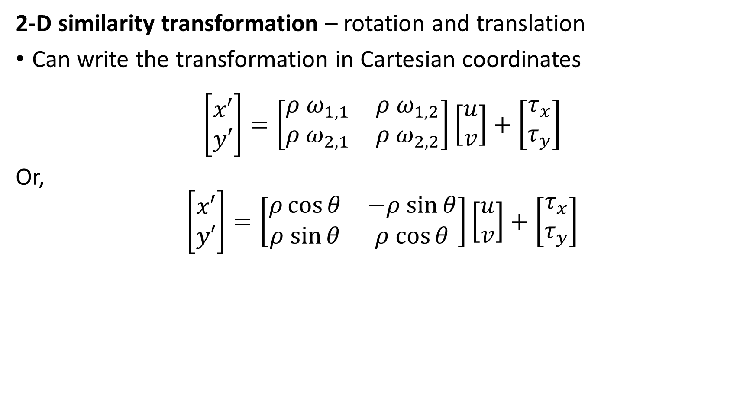
Four Transform Problems
2-D similarity transformation – rotation and translation
Can write the transformation in Cartesian coordinates
$$\left[\begin{matrix}x′ \\ y′\end{matrix}\right]=\left[\begin{matrix}{ρ ω}_{1,1} & {ρ ω}_{1,2} \\ ρ ω_{2,1} & {ρ ω}_{2,2}\end{matrix}\right]\left[\begin{matrix}u \\ v\end{matrix}\right]+\left[\begin{matrix}τ_{x} \\ τ_{y}\end{matrix}\right]$$
Or,
$$\left[\begin{matrix}x′ \\ y′\end{matrix}\right]=\left[\begin{matrix}ρ\cos{θ} & −ρ sin{θ} \\ ρ sin{θ} & ρ cos{θ}\end{matrix}\right]\left[\begin{matrix}u \\ v\end{matrix}\right]+\left[\begin{matrix}τ_{x} \\ τ_{y}\end{matrix}\right]$$

Slide 45



Four Transformations
$$ρ$$
2-D similarity transformation
Translation, rotation and scale
4 DoF, $τ_{x},τ_{y},θ,ρ$
$$ρ$$
$$θ$$
$$τ_{y}$$
$$τ_{x}$$

Slide 46
Four Transformations
Affine transformation
Applies rotation, translation, scale and shear
6 degrees of freedom
1 – rotation angle
2 - translation
2 – scale
1 - shear
Preserves – parallel lines

Slide 47
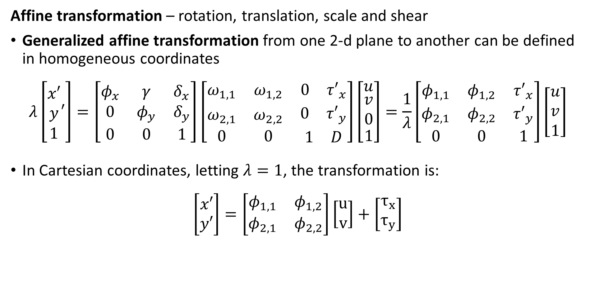
Four Transform Problems
Affine transformation – rotation, translation, scale and shear
Generalized affine transformation from one 2-d plane to another can be defined in homogeneous coordinates
$$λ\left[\begin{matrix}x′ \\ y \\ 1\end{matrix}′\right]=\left[\begin{matrix}φ_{x} & γ & δ_{x} \\ 0 & φ_{y} & δ_{y} \\ 0 & 0 & 1\end{matrix}\right]\left[\begin{matrix}ω_{1,1} & ω_{1,2} & \begin{matrix}0 & {τ′}_{x}\end{matrix} \\ ω_{2,1} & ω_{2,2} & \begin{matrix}0 & {τ′}_{y}\end{matrix} \\ 0 & 0 & \begin{matrix}1 & D\end{matrix}\end{matrix}\right]\left[\begin{matrix}u \\ \begin{matrix}v \\ 0\end{matrix} \\ 1\end{matrix}\right]=\frac{1}{λ}\left[\begin{matrix}φ_{1,1} & φ_{1,2} & {τ′}_{x} \\ φ_{2,1} & φ_{2,2} & {τ′}_{y} \\ 0 & 0 & 1\end{matrix}\right]\left[\begin{matrix}u \\ v \\ 1\end{matrix}\right]$$
In Cartesian coordinates, letting $λ=1$, the transformation is:
$$\left[\begin{matrix}x′ \\ y′\end{matrix}\right]=\left[\begin{matrix}φ_{1,1} & φ_{1,2} \\ φ_{2,1} & φ_{2,2}\end{matrix}\right]\left[\begin{matrix}u \\ v\end{matrix}\right]+\left[\begin{matrix}τ_{x} \\ τ_{y}\end{matrix}\right]$$

Slide 48
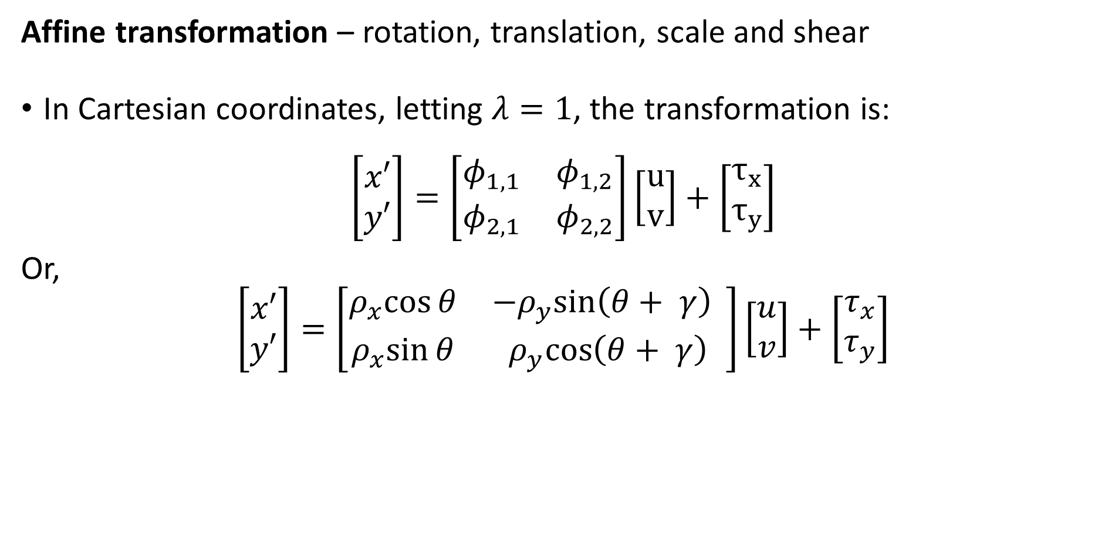
Four Transform Problems
Affine transformation – rotation, translation, scale and shear
In Cartesian coordinates, letting $λ=1$, the transformation is:
$$\left[\begin{matrix}x′ \\ y′\end{matrix}\right]=\left[\begin{matrix}φ_{1,1} & φ_{1,2} \\ φ_{2,1} & φ_{2,2}\end{matrix}\right]\left[\begin{matrix}u \\ v\end{matrix}\right]+\left[\begin{matrix}τ_{x} \\ τ_{y}\end{matrix}\right]$$
Or,
$$\left[\begin{matrix}x′ \\ y′\end{matrix}\right]=\left[\begin{matrix}ρ_{x}cos{θ} & −ρ_{y}sin\left(θ+ γ\right){ } \\ ρ_{x}sin{θ} & ρ_{y}cos\left(θ+ γ\right)\end{matrix}\right]\left[\begin{matrix}u \\ v\end{matrix}\right]+\left[\begin{matrix}τ_{x} \\ τ_{y}\end{matrix}\right]$$

Slide 49


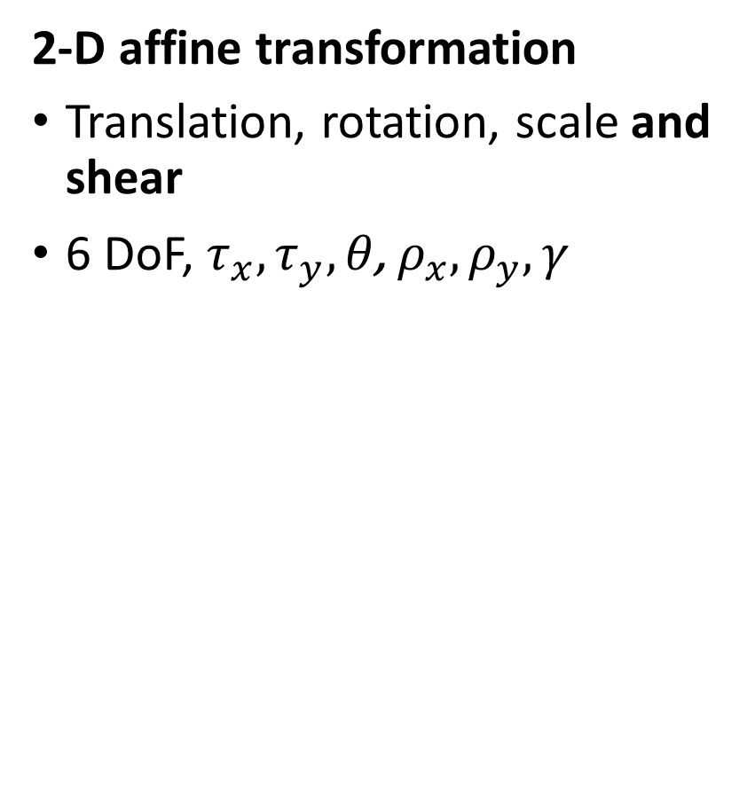

Four Transformations
2-D affine transformation
Translation, rotation, scale and shear
6 DoF, $τ_{x},τ_{y},{θ\text{,} \text{ρ}}_{x},{\text{ρ}}_{y},γ$
$$ρ_{y}$$
$$γ$$
$$ρ_{x}$$
$$θ$$
$$τ_{y}$$
$$τ_{x}$$

Slide 50
Four Transformations
Projective transformation or homography
Applies general transformation
8 degrees of freedom
Preserves – straight lines, but nothing else

Slide 51
Projective Transform
Homogenous coordinates projective transform is the most general case
Image plane, $z=1$
$$\tilde{x}=\left[\begin{matrix}λ_{1}x \\ λ_{1}y \\ λ_{1}\end{matrix}\right]$$
$$\tilde{x}=\left[\begin{matrix}λ_{2}x \\ λ_{2}y \\ λ_{2}\end{matrix}\right]$$
Pinhole at origin
$$x=\left[\begin{matrix}x \\ y\end{matrix}\right]$$
O
$$z$$
Principal Point
Optic Axis
$$x$$
$$y$$
$$\tilde{x}=\left[\begin{matrix}0 \\ 1 \\ 0\end{matrix}\right]$$
$$φ=1$$

Slide 52
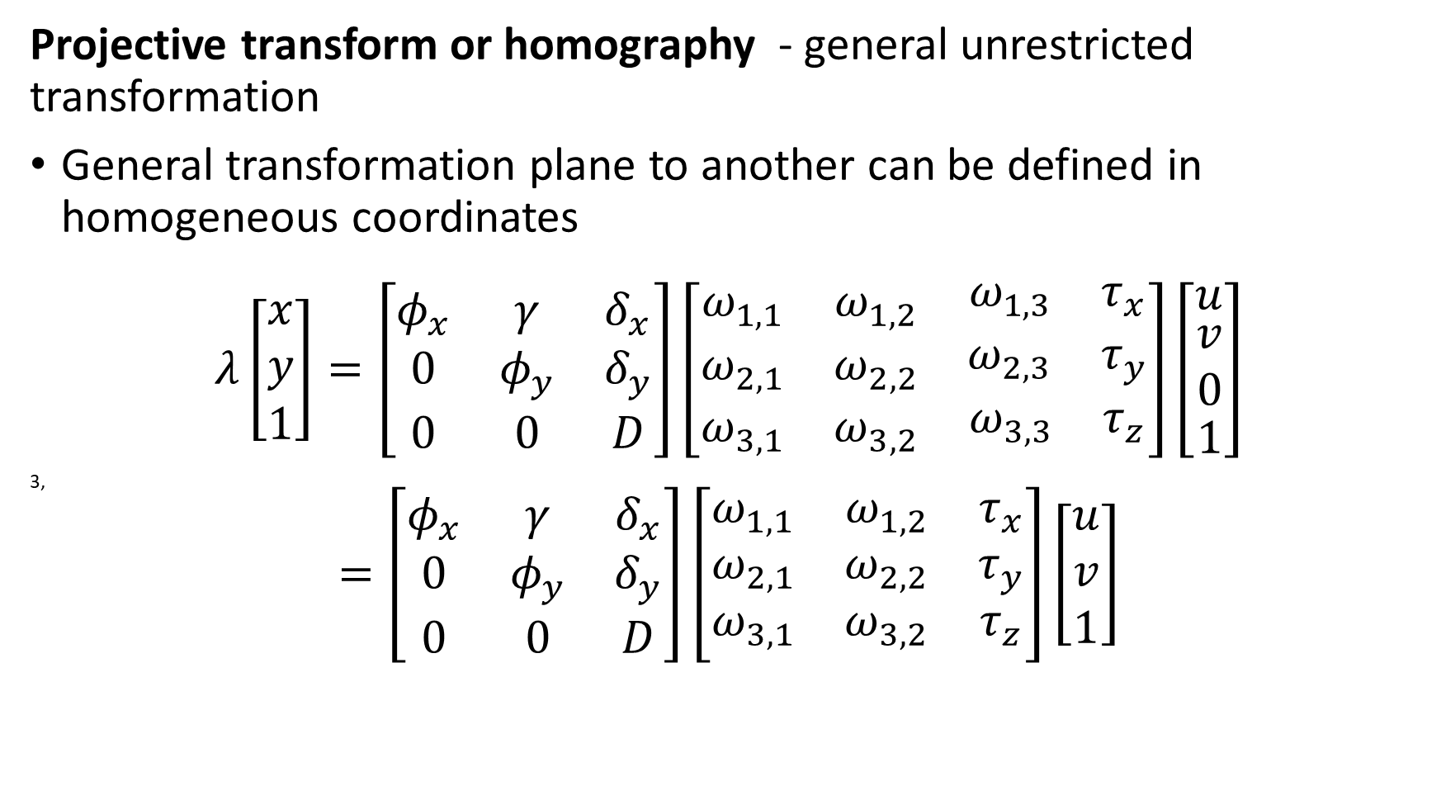
Four Transform Problems
Projective transform or homography - general unrestricted transformation
General transformation plane to another can be defined in homogeneous coordinates
$$λ\left[\begin{matrix}x \\ y \\ 1\end{matrix}\right]=\left[\begin{matrix}φ_{x} & γ & δ_{x} \\ 0 & φ_{y} & δ_{y} \\ 0 & 0 & D\end{matrix}\right]\left[\begin{matrix}ω_{1,1} & ω_{1,2} & \begin{matrix}ω_{1,3} & τ_{x}\end{matrix} \\ ω_{2,1} & ω_{2,2} & \begin{matrix}ω_{2,3} & τ_{y}\end{matrix} \\ ω_{3,1} & ω_{3,2} & \begin{matrix}ω_{3,3} & τ_{z}\end{matrix}\end{matrix}\right]\left[\begin{matrix}u \\ \begin{matrix}v \\ 0\end{matrix} \\ 1\end{matrix}\right]$$
3,
$$=\left[\begin{matrix}φ_{x} & γ & δ_{x} \\ 0 & φ_{y} & δ_{y} \\ 0 & 0 & D\end{matrix}\right]\left[\begin{matrix}ω_{1,1} & ω_{1,2} & τ_{x} \\ ω_{2,1} & ω_{2,2} & τ_{y} \\ ω_{3,1} & ω_{3,2} & τ_{z}\end{matrix}\right]\left[\begin{matrix}u \\ v \\ 1\end{matrix}\right]$$

Slide 53
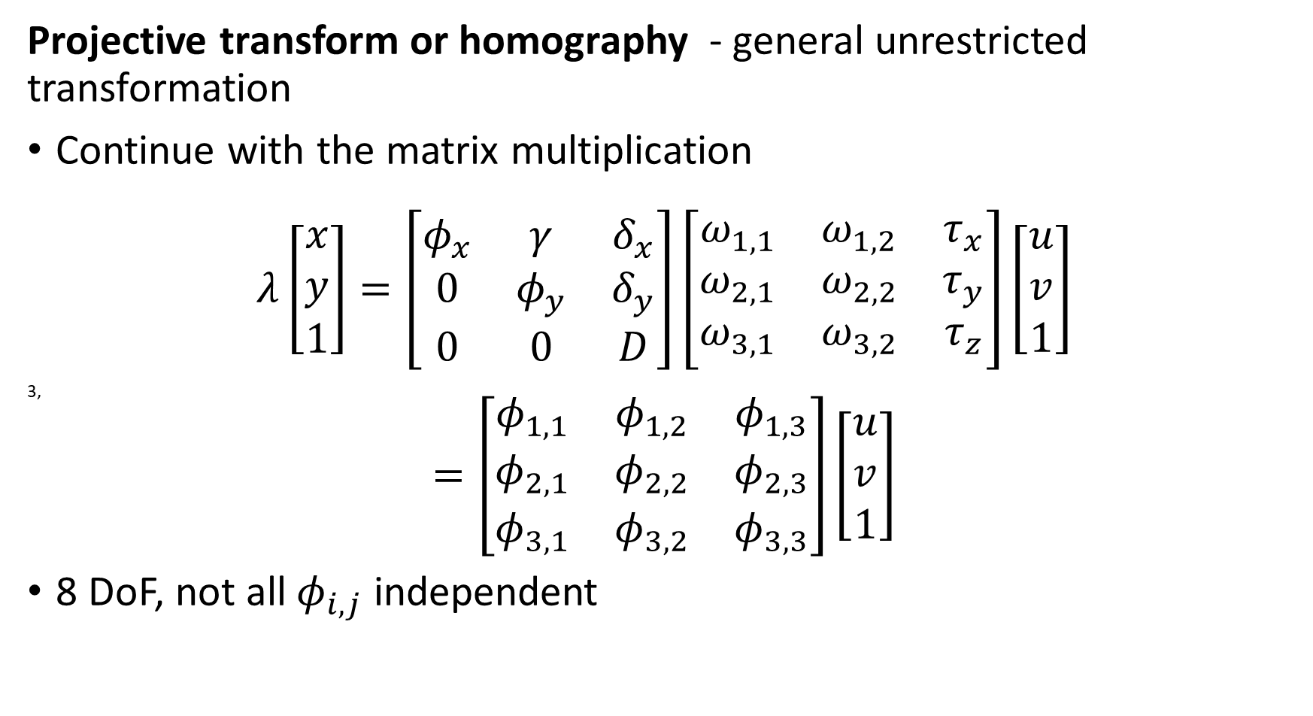
Four Transform Problems
Projective transform or homography - general unrestricted transformation
Continue with the matrix multiplication
$$λ\left[\begin{matrix}x \\ y \\ 1\end{matrix}\right]=\left[\begin{matrix}φ_{x} & γ & δ_{x} \\ 0 & φ_{y} & δ_{y} \\ 0 & 0 & D\end{matrix}\right]\left[\begin{matrix}ω_{1,1} & ω_{1,2} & τ_{x} \\ ω_{2,1} & ω_{2,2} & τ_{y} \\ ω_{3,1} & ω_{3,2} & τ_{z}\end{matrix}\right]\left[\begin{matrix}u \\ v \\ 1\end{matrix}\right]$$
3,
$$=\left[\begin{matrix}φ_{1,1} & φ_{1,2} & φ_{1,3} \\ φ_{2,1} & φ_{2,2} & φ_{2,3} \\ φ_{3,1} & φ_{3,2} & φ_{3,3}\end{matrix}\right]\left[\begin{matrix}u \\ v \\ 1\end{matrix}\right]$$
8 DoF, not all $φ_{i,j}$ independent

Slide 54
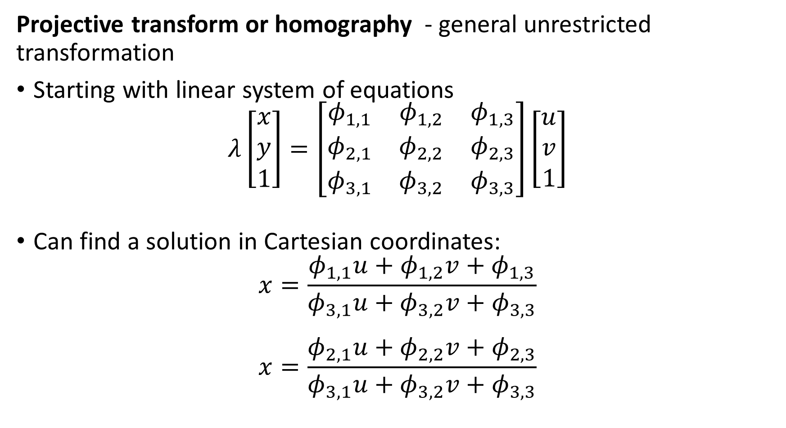
Four Transform Problems
Projective transform or homography - general unrestricted transformation
Starting with linear system of equations
$$λ\left[\begin{matrix}x \\ y \\ 1\end{matrix}\right]=\left[\begin{matrix}φ_{1,1} & φ_{1,2} & φ_{1,3} \\ φ_{2,1} & φ_{2,2} & φ_{2,3} \\ φ_{3,1} & φ_{3,2} & φ_{3,3}\end{matrix}\right]\left[\begin{matrix}u \\ v \\ 1\end{matrix}\right]$$
Can find a solution in Cartesian coordinates:
$$x=\frac{φ_{1,1}u+φ_{1,2}v+φ_{1,3}}{φ_{3,1}u+φ_{3,2}v+φ_{3,3}}$$
$$x=\frac{φ_{2,1}u+φ_{2,2}v+φ_{2,3}}{φ_{3,1}u+φ_{3,2}v+φ_{3,3}}$$

Slide 55
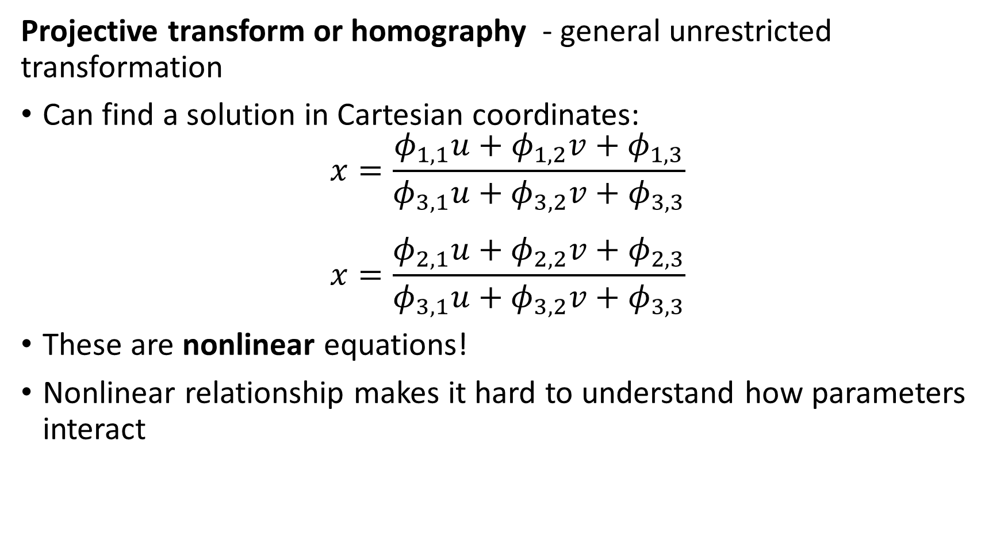
Four Transform Problems
Projective transform or homography - general unrestricted transformation
Can find a solution in Cartesian coordinates:
$$x=\frac{φ_{1,1}u+φ_{1,2}v+φ_{1,3}}{φ_{3,1}u+φ_{3,2}v+φ_{3,3}}$$
$$x=\frac{φ_{2,1}u+φ_{2,2}v+φ_{2,3}}{φ_{3,1}u+φ_{3,2}v+φ_{3,3}}$$
These are nonlinear equations!
Nonlinear relationship makes it hard to understand how parameters interact

Slide 56
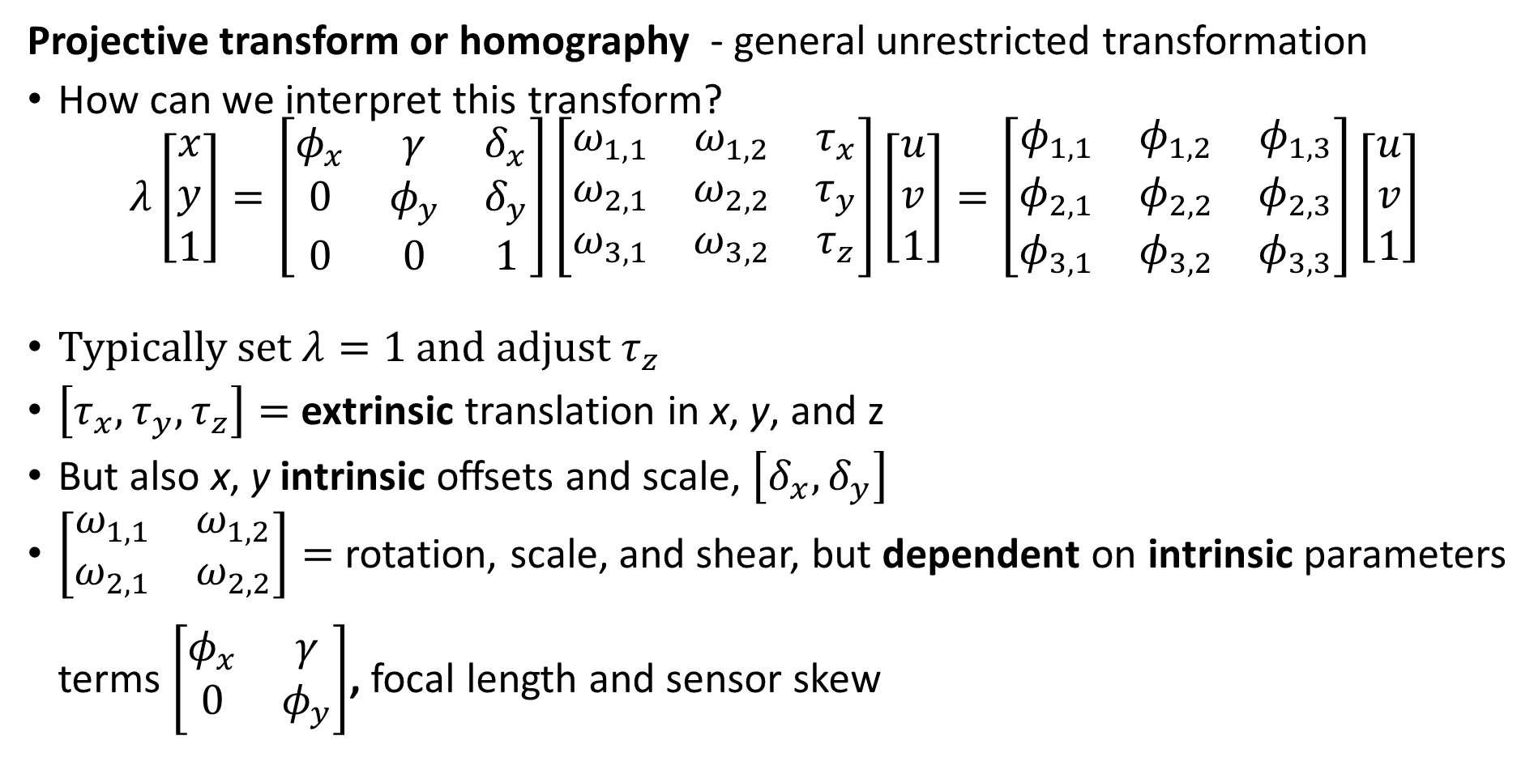
Four Transform Problems
Projective transform or homography - general unrestricted transformation
How can we interpret this transform?
$$λ\left[\begin{matrix}x \\ y \\ 1\end{matrix}\right]=\left[\begin{matrix}φ_{x} & γ & δ_{x} \\ 0 & φ_{y} & δ_{y} \\ 0 & 0 & 1\end{matrix}\right]\left[\begin{matrix}ω_{1,1} & ω_{1,2} & τ_{x} \\ ω_{2,1} & ω_{2,2} & τ_{y} \\ ω_{3,1} & ω_{3,2} & τ_{z}\end{matrix}\right]\left[\begin{matrix}u \\ v \\ 1\end{matrix}\right]=\left[\begin{matrix}φ_{1,1} & φ_{1,2} & φ_{1,3} \\ φ_{2,1} & φ_{2,2} & φ_{2,3} \\ φ_{3,1} & φ_{3,2} & φ_{3,3}\end{matrix}\right]\left[\begin{matrix}u \\ v \\ 1\end{matrix}\right]$$
Typically set $λ=1$ and adjust $τ_{z}$
$\left[τ_{x},τ_{y},τ_{z}\right]=$ extrinsic translation in x, y, and z
But also x, y intrinsic offsets and scale, $\left[δ_{x},δ_{y}\right]$
$\left[\begin{matrix}ω_{1,1} & ω_{1,2} \\ ω_{2,1} & ω_{2,2}\end{matrix}\right]=$ rotation, scale, and shear, but dependent on intrinsic parameters terms $\left[\begin{matrix}φ_{x} & γ \\ 0 & φ_{y}\end{matrix}\right]$, focal length and sensor skew

Slide 57
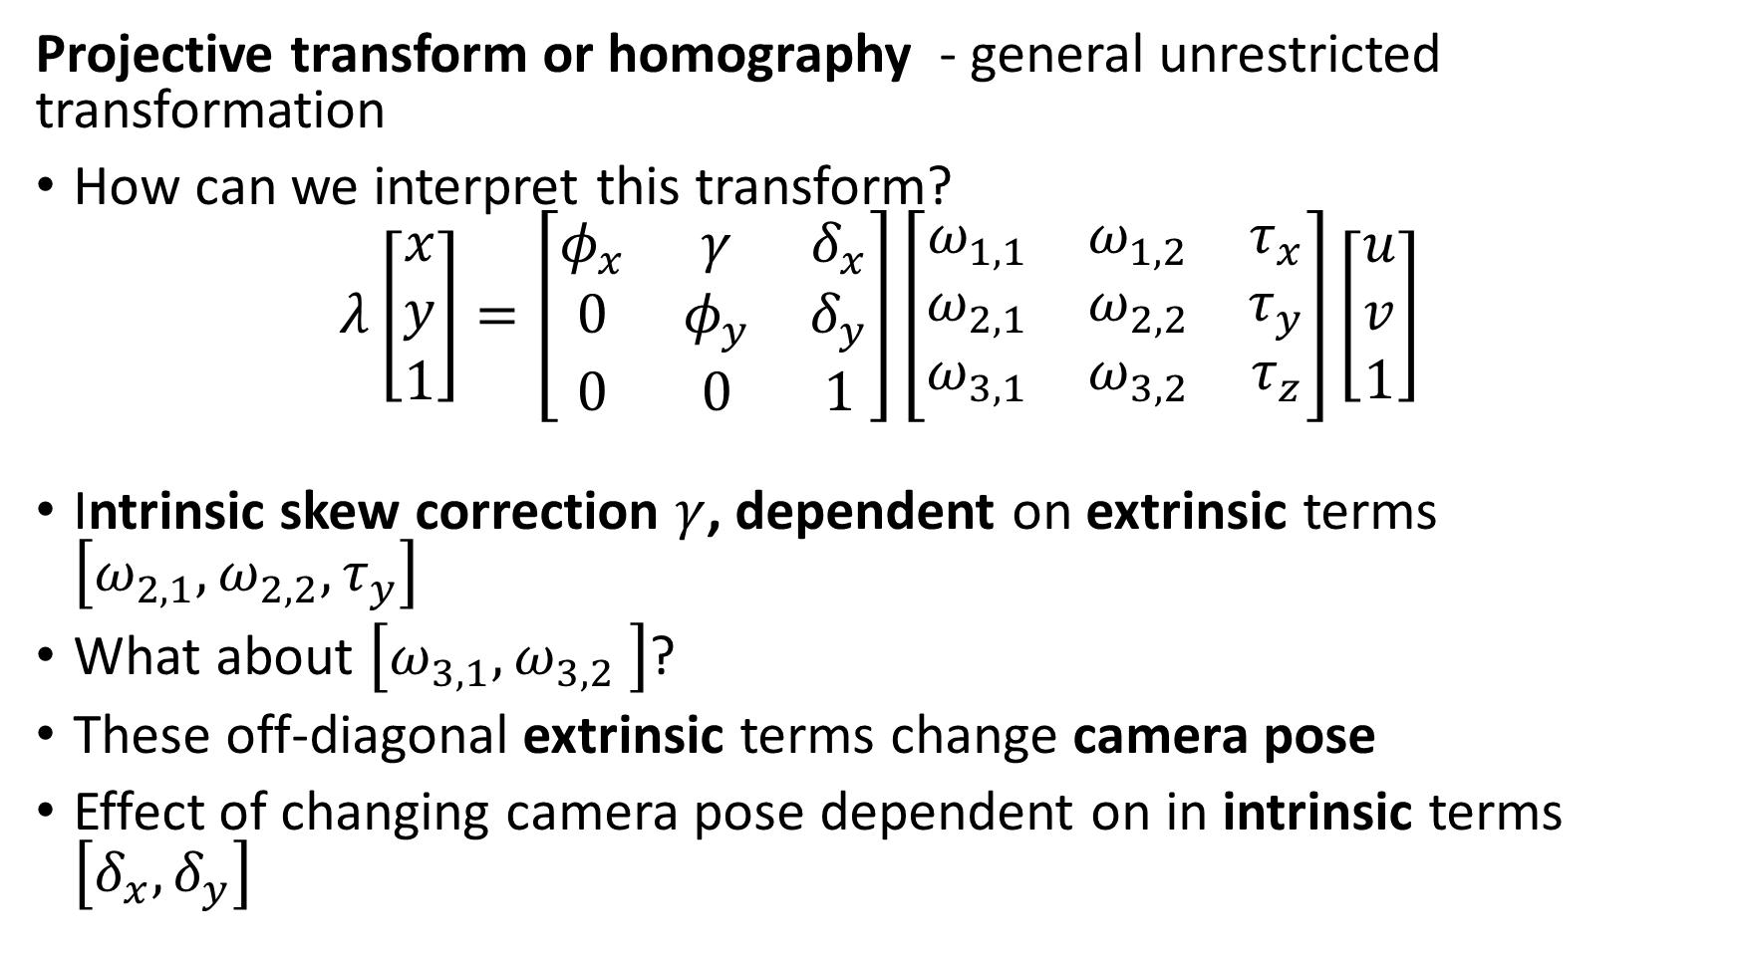
Four Transform Problems
Projective transform or homography - general unrestricted transformation
How can we interpret this transform?
$$λ\left[\begin{matrix}x \\ y \\ 1\end{matrix}\right]=\left[\begin{matrix}φ_{x} & γ & δ_{x} \\ 0 & φ_{y} & δ_{y} \\ 0 & 0 & 1\end{matrix}\right]\left[\begin{matrix}ω_{1,1} & ω_{1,2} & τ_{x} \\ ω_{2,1} & ω_{2,2} & τ_{y} \\ ω_{3,1} & ω_{3,2} & τ_{z}\end{matrix}\right]\left[\begin{matrix}u \\ v \\ 1\end{matrix}\right]$$
Intrinsic skew correction $γ$, dependent on extrinsic terms $\left[ω_{2,1},ω_{2,2},τ_{y}\right]$
What about $\left[ω_{3,1},ω_{3,2} \right]$?
These off-diagonal extrinsic terms change camera pose
Effect of changing camera pose dependent on in intrinsic terms $\left[δ_{x},δ_{y}\right]$

Slide 58
Summary
Planar transforms map between light scattered off objects and projections on a camera image plane
Planar projective transformation model based on pinhole camera
Use projection to transform one camera pose to another
Inverse transform from image planes to real-world object location
Planar transformations use projection matrix
2-D Euclidean – Rotation and translation
2-D Similarity – Rotation, translation, and scaling
Affine - Rotation, translation, scaling, shearing
Projective – General transformation

