Slide 1

CSCI E-25 Computer Vision
Optimization for Machine Learning
Steve Elston
Copyright 2021, 2022, 2023, 2024
Stephen F Elston. All rights reserved.

Slide 2
Optimization for Machine Learning
Key points for this lesson
Many ML algorithms learn weights or parameters using optimizations
With millions of weights, we need highly efficient and reliable algorithms for gradient descent
Properties of gradient descent algorithms
Convergence problems
Batch gradient descent
Stochastic gradient descent
Adaptive stochastic gradient descent

Slide 3
Quadratic Optimization and Gradient Descent

Slide 4

Optimization for Deep Neural Networks
Gradient descent is a widely used optimization method for machine learning
Neural networks learn weights using the backpropagation algorithm
Weights are learned using the gradient descent method
Where:

Slide 5
Local Convergence of Gradient Descent
Ideally, the loss function, J(W), is convex with respect to the weights
Contours of J(W)_{MLE}
Min_{W} (J(W)_{MLE})
Initial W
Convex loss function has one unique minimum
Convergence for convex loss function is guaranteed

Slide 6
Computing gradients and the chain rule

Slide 7
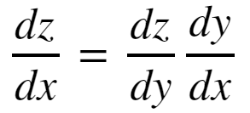
The Chain Rule of Calculus
In order to compute the gradients of the loss function though the layers of a deep neural network we need to apply the chain rule of calculus
To consider a function z = f(y), where y = g(x); then z = f(g(x)). Then the derivative of z with respect to x is:

Slide 8
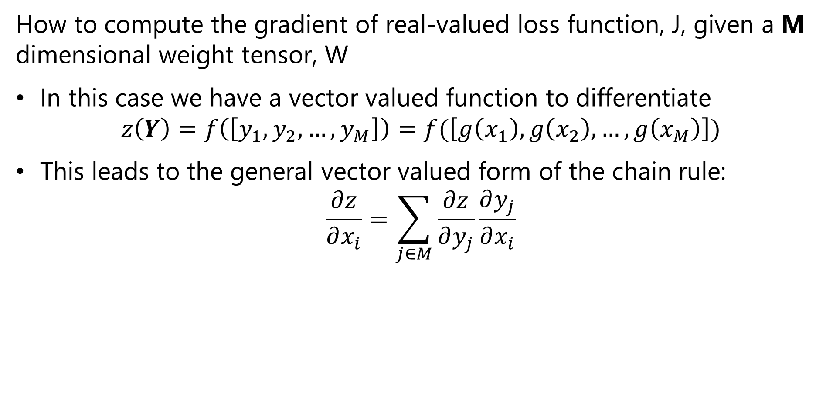
The Chain Rule of Calculus
How to compute the gradient of real-valued loss function, J, given a M dimensional weight tensor, W
In this case we have a vector valued function to differentiate
$$z\left(Y\right)=f\left(\left[y_{1},y_{2},…,y_{M}\right]\right)=f(\left[g\left(x_{1}\right),g\left(x_{2}\right),…,g\left(x_{M}\right)\right])$$
This leads to the general vector valued form of the chain rule:
$$\frac{∂z}{∂x_{i}}=\sum_{j∈M}{\frac{∂z}{∂y_{j}}\frac{∂y_{j}}{∂x_{i}}}$$

Slide 9
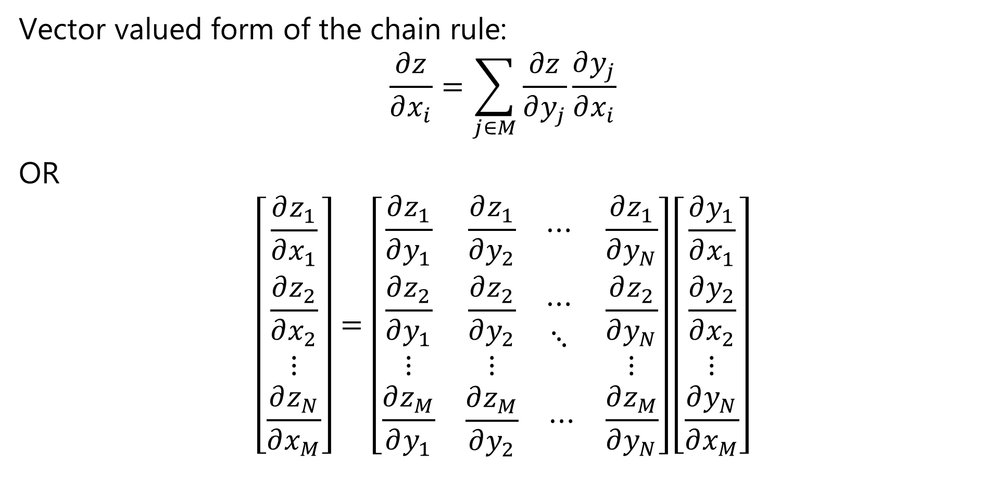
The Chain Rule of Calculus
Vector valued form of the chain rule:
$$\frac{∂z}{∂x_{i}}=\sum_{j∈M}{\frac{∂z}{∂y_{j}}\frac{∂y_{j}}{∂x_{i}}}$$
OR
$$\left[\begin{matrix}\frac{∂z_{1}}{∂x_{1}} \\ \frac{∂z_{2}}{∂x_{2}} \\ \begin{matrix}⋮ \\ \frac{∂z_{N}}{∂x_{M}}\end{matrix}\end{matrix}\right]=\left[\begin{matrix}\frac{∂z_{1}}{∂y_{1}} & \begin{matrix}\frac{∂z_{1}}{∂y_{2}} & ⋯\end{matrix} & \frac{∂z_{1}}{∂y_{N}} \\ \begin{matrix}\frac{∂z_{2}}{∂y_{1}} \\ ⋮\end{matrix} & \begin{matrix}\begin{matrix}\frac{∂z_{2}}{∂y_{2}} \\ ⋮\end{matrix} & \begin{matrix}⋯ \\ ⋱\end{matrix}\end{matrix} & \begin{matrix}\frac{∂z_{2}}{∂y_{N}} \\ ⋮\end{matrix} \\ \frac{∂z_{M}}{∂y_{1}} & \begin{matrix}\frac{∂z_{M}}{∂y_{2}} & ⋯\end{matrix} & \frac{∂z_{M}}{∂y_{N}}\end{matrix}\right]\left[\begin{matrix}\frac{∂y_{1}}{∂x_{1}} \\ \frac{∂y_{2}}{∂x_{2}} \\ \begin{matrix}⋮ \\ \frac{∂y_{N}}{∂x_{M}}\end{matrix}\end{matrix}\right]$$

Slide 10

The Chain Rule of Calculus
We define the $n×m$ Jacobian Matrix, $J$, as:
$$J^{T}=\left[\begin{matrix}\frac{∂z_{1}}{∂y_{1}} & \begin{matrix}\frac{∂z_{1}}{∂y_{2}} & ⋯\end{matrix} & \frac{∂z_{1}}{∂y_{N}} \\ \begin{matrix}\frac{∂z_{2}}{∂y_{1}} \\ ⋮\end{matrix} & \begin{matrix}\begin{matrix}\frac{∂z_{2}}{∂y_{2}} \\ ⋮\end{matrix} & \begin{matrix}⋯ \\ ⋱\end{matrix}\end{matrix} & \begin{matrix}\frac{∂z_{2}}{∂y_{N}} \\ ⋮\end{matrix} \\ \frac{∂z_{M}}{∂y_{1}} & \begin{matrix}\frac{∂z_{M}}{∂y_{2}} & ⋯\end{matrix} & \frac{∂z_{M}}{∂y_{N}}\end{matrix}\right]$$

Slide 11
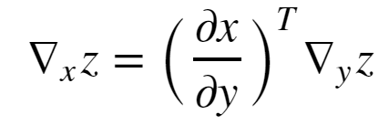


The Chain Rule of Calculus
In matrix notation the vector valued gradient then becomes:
Where, = is the nxm Jacobian matrix of partial derivatives
= the gradient of z with respect to y

Slide 12
Quadratic Optimization and the Hessian

Slide 13


Local Convergence of Gradient Descent
Expand loss function to understand convergence properties of gradient descent:
Where:

Slide 14
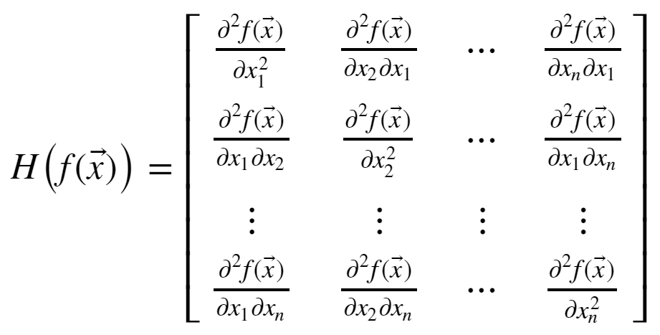
Local Convergence of Gradient Descent
How can you understand the Hessian matrix?
The Hessian is the matrix of all partial derivatives of the gradient
Properties of the Hessian determine convergence rate

Slide 15
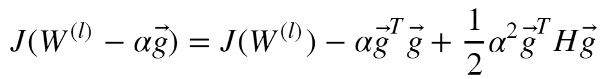

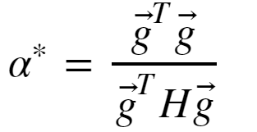
Local Convergence of Gradient Descent
How can we solve this convex optimization problem?
Given a step size α we can rewrite the above quadradic equation:
The minimum occurs where the gradient is 0:
And, with optimal step size:

Slide 16
Local Convergence of Gradient Descent
Real-world loss functions are typically not convex
There can be multiple minimums and maximums; a multi-modal loss function
Finding the globally optimal solution is hard!
The minimum reached by an optimizer depends on the starting value of W
In practice, we are happy with a good local solution, if not, the globally optimal solution
First order optimization found to perform as well, or better, than second order

Slide 17
Properties of Gradients

Slide 18

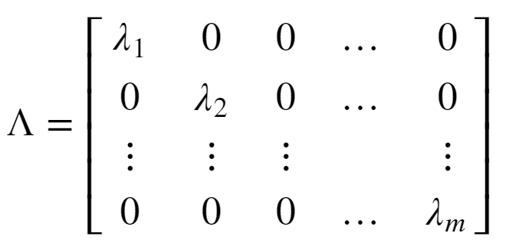
The Nature of Gradients
Convergence of quadratic optimization depends on the Hessian
To understand the behavior of the Hessian we need to examine the eigenvalues
A square matrix can be decomposed into eigenvalues and eigenvectors:
Where Q is the matrix of unitary eigenvectors
The eigenvalues are a diagonal matrix

Slide 19
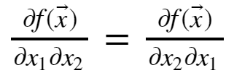
The Nature of Gradients
Some key properties of the Hessian matrix:
The Hessian is symmetric since
For a convex loss function the Hessian has all positive eigenvalues; it is positive definite – a maximum
At a maximum point the Hessian has all negative eigenvalues; it is negative definite - minimum
The Hessian has some positive and some negative eigenvalues at a saddle point
Saddle points are problematic since direction of descent to the minimum is unclear
If Hessian has some very small eigenvalues, the gradient is low and convergence will be slow

Slide 20
The Nature of Gradients
Some key properties of the Hessian matrix:
The Hessian is symmetric since
For a convex loss function the Hessian has all positive eigenvalues; it is positive definite – a maximum
At a maximum point the Hessian has all negative eigenvalues; it is negative definite - minimum
The Hessian has some positive and some negative eigenvalues at a saddle point
Saddle points are problematic since direction of descent to the minimum is unclear
If Hessian has some very small eigenvalues, the gradient is low and convergence will be slow

Slide 21
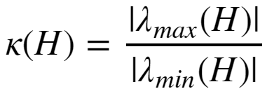
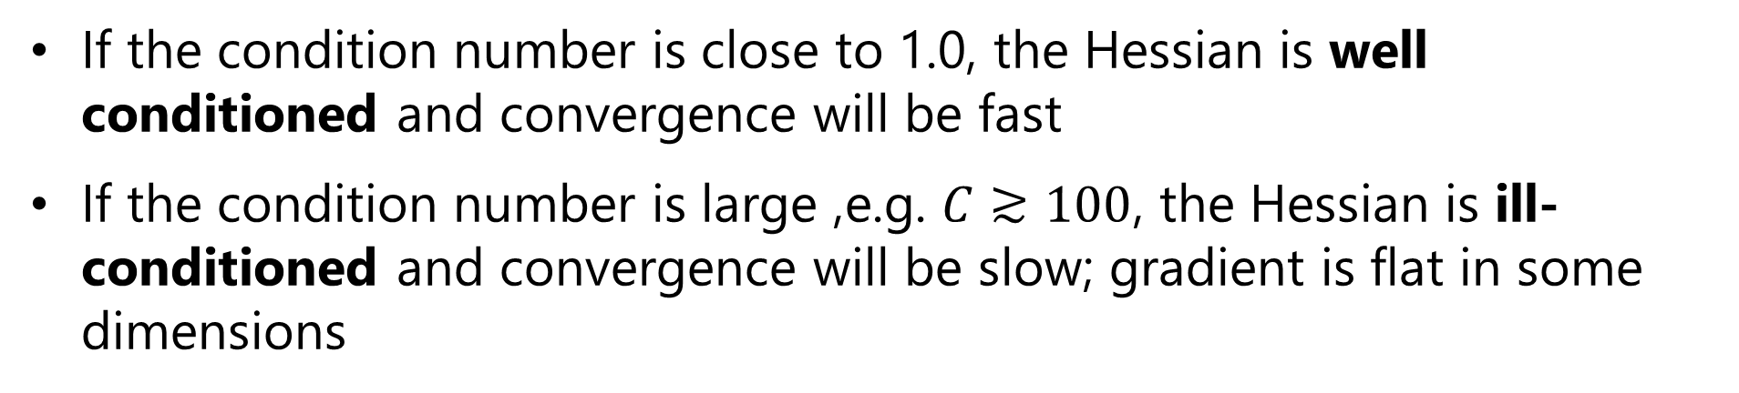
The Nature of Gradients
For quadratic optimization, the rate of convergence is determined by the condition number of the Hessian:
Where:
If the condition number is close to 1.0, the Hessian is well conditioned and convergence will be fast
If the condition number is large ,e.g. $C≳100$, the Hessian is ill-conditioned and convergence will be slow; gradient is flat in some dimensions

Slide 22
The Nature of Gradients
Example of well-conditioned and ill-conditioned gradients:
Min_{W} (J(W)_{MLE})
Min_{W} (J(W)_{MLE})
well-conditioned gradient
ill-conditioned gradient

Slide 23
Vanishing and Exploding Gradient Problems
There is no guarantee that the gradient of the loss function is well behaved
The gradient can vanish
Flat spots in the gradient – Hessian with small eigenvalues
Imagine a loss function with a long narrow valley
Ill-conditioned Hessian
Slow convergence
The gradient can explode
Sudden changes in the gradient; falling off a cliff!
Ill-conditioned Hessian
Very large step; optimizer over-shoots the minimum point

Slide 24


Vanishing and Exploding Gradient Problems
What happens to the eigenvalues of the Hessian?
Consider an n layer NN with linear activation
The gradient is just the weight tensor, W, with eigen decomposition:
Multiplying the n weight tensors for the multi-layer NN:
If the eigenvalue << 1.0, the gradient vanishes
If the eigenvalue >> 1.0, the gradient explodes

Slide 25
Vanishing and Exploding Gradient Problems
What can be done about extreme gradient problems?
Dealing with vanishing gradient can be difficult
Normalization of input values
Regularization is essential!
ResNets – recall last week’s lesson
Dealing with exploding gradients is easy
Gradient clipping prevents extreme values

Slide 26

Convex vs. Non-Convex Optimization
Gradient descent is well-behaved with convex loss function
Only 1 global minimum
From any starting point the gradient leads to global minimum
Hessian is always positive definite – Only positive eigenvalues
Convex loss
Poorly conditioned

Slide 27

Convex vs. Non-Convex Optimization
Gradient descent can be problematic with nonconvex loss function
There is a global minimum
Possibly many local minimums
Minimum found with gradient descent depends on starting point
A good minimum may be good enough
Hessian positive definite at any minimum, but globally who knows??
Nonconvex loss

Slide 28
Convex vs. Non-Convex Optimization
Gradient descent can be problematic with nonconvex loss function
Can get stuck at saddle point!
Gradient is ambiguous at saddle point
Hessian is not positive definite
?
?
Nonconvex loss

Slide 29
Batch Gradient Descent Algorithms

Slide 30
Batch Gradient Descent
Recall the basic gradient descent equation:
Where:
The gradients of the multi-layer NN are computed using the chain rule

Slide 31
Batch Gradient Descent
Can we use the gradient descent equation directly?
Yes, we can
Iterate the weight tensor relation until a stopping criteria or error tolerance is reached:
||W^{t+1} – W^{t}|| < tolerance
But;
Must compute the gradient for all weights at one time as a batch at each step
Does not scale if there are a large number of weights

Slide 32
Stochastic Gradient Descent

Slide 33
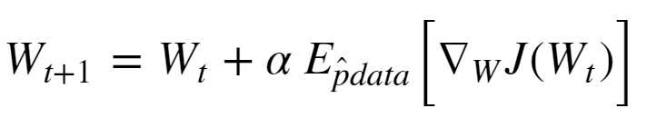


Stochastic Gradient Descent
Need a highly scalable gradient descent algorithm
Stochastic gradient descent is just such a method
The weight tensor update for stochastic gradient descent follows this relationship:
Where:
is the Bernoulli sampled mini-batch
is the expected value of the gradient given the Bernoulli
sample

Slide 34
Stochastic Gradient Descent
Stochastic gradient descent is massively scalable
Stochastic gradient descent is known to converge well in practice
Empirically, using mini-batch samples provide a better exploration of the loss function space
Can help solution escape from small local gradient problems
Sampling is dependent on mini-batch size

Slide 35
Stochastic Gradient Descent
Stochastic gradient descent algorithm
Random_sort(cases)
while(grad > stopping_criteria):
mini-batch = sample_next_n(cases)
grad = compute_expected_grad(mini_batch)
weights = update_weights(weights, grad)
Notice that the addition rounds repeat the samples
In practice this does not create much bias
For large samples this may not happen

Slide 36
Improving Convergence of SGD

Slide 37



Stochastic Gradient Descent with Momentum
Momentum improves convergence of SGD
Stochastic gradient descent is slow to converge if flat spots in the gradient are encountered – Hessian with small eigenvalues
What is a solution?
Add momentum to the gradient;
Where:
Analogy with Newtonian mechanics
Momentum maintains the trajectory of the descent through flat gradient regions

Slide 38
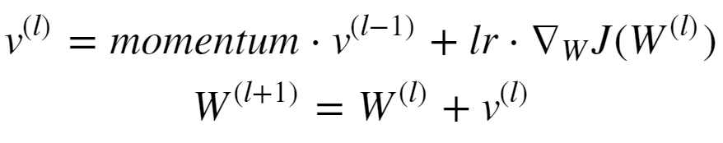


Stochastic Gradient Descent with Momentum
Letting the mass be 1.0 update the weight tensor in two steps:
Where:
Notice the algorithm now has two hyperparameters

Slide 39
Adaptive Stochastic Gradient Descent
How can we improve convergence with a variable learning rate?
A single learning rate is not likely to be optimal
Far from the minimum, a large learning rate speeds convergence
Near the minimum a small learning rate prevents over-shooting the minimum
Use a manually created learning schedule
Introduces additional hyperparameters
Use an adaptive algorithm
Learning rate is adjusted based on the estimates of the gradient

Slide 40
Selecting Initial Weight Values
To prevent weights from becoming linearly dependent the initial values must be randomly selected
Otherwise, some weight values are never learned
Simple truncated Gaussian or Uniform distributed values work well in practice
This process is referred as adding fuzz to the initial values
Many other initialization schemes have been developed
For example, see the Keras initializers documentation

Slide 41
Appendix: Review of Eigenvectors and Eigenvalues

Slide 42
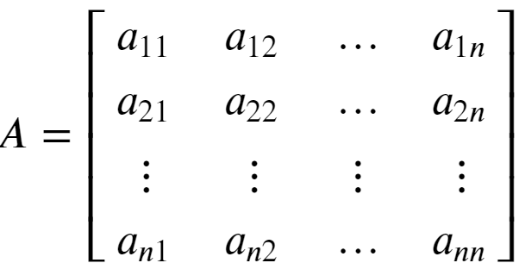
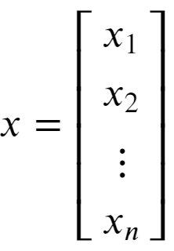

Review of Eigenvalues
Eigenvalues are characteristic roots or characteristic values of a linear system
Start with a square n x n matrix A, and vector x:
Then, an eigenvalue of A has the property:

Slide 43
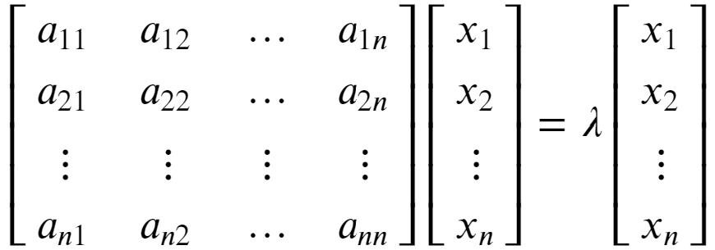


Review of Eigenvalues
Eigenvalues are characteristic roots or characteristic values of a linear system
Rewrite the eigenvalue relationship:
To see that λ is a root of A we can rearrange as follows:

Slide 44

Review of Eigenvalues
Eigenvalues are characteristic roots or characteristic values of a linear system
An n x n matrix A will have n eigenvalues
Find eigenvalues by solving
Find n roots of the determinant:
For more detail on determinants see: https://en.wikipedia.org/wiki/Determinant

Slide 45


Review of Eigenvalues and Eigenvectors
Each eigenvalue of a square matrix is associated with an eigenvector
There is a left and right eigenvector for each eigenvalue
The right eigenvector has the following relationship to the matrix A and eigenvalue λ:
Notice that the right eigenvector is to the right of the matrix

Slide 46



Review of Eigenvalues and Eigenvectors
Each eigenvalue of a square matrix is associated with an eigenvector
There is also a left eigenvector with the following relationship to the matrix A and eigenvalue λ:
Notice that the left eigenvector is to the left of the matrix

Slide 47


Review of Eigenvalues and Eigenvectors
Each eigenvalue of a square matrix is associated with an eigenvector
The l2 norm of any eigenvector is 1:
This property means that the matrix of n eigenvectors, Q, is unitary
For a full rank matrix, each eigenvector is orthogonal to every other eigenvector, and linearly independent
Thus, for diagonal matrix of n eigenvalues, Λ, an n x n matrix, A, can be factored:

Slide 48


Review of Eigenvalues and Eigenvectors
Each eigenvalue of a square matrix is associated with an eigenvector
Given the eigenvalue-eigenvector factorization of the matrix A:
The inverse of A can be found:
And, A to the Nth power can be computed:
You can find more on eigenvalue-eigenvector decomposition: https://en.wikipedia.org/wiki/Eigendecomposition_of_a_matrix

Slide 49
Review of Eigenvalues
Eigenvalues are characteristic roots or characteristic values of a linear system
Start with a square n x n matrix A, and vector x:
Then, an eigenvalue of A has the property:

Slide 50
Review of Eigenvalues
Eigenvalues are characteristic roots or characteristic values of a linear system
Rewrite the eigenvalue relationship:
To see that λ is a root of A we can rearrange as follows:

Slide 51
Review of Eigenvalues
Eigenvalues are characteristic roots or characteristic values of a linear system
An n x n matrix A will have n eigenvalues
Find eigenvalues by solving
Solve n equations involving the determinant:
For more detail on determinants see: https://en.wikipedia.org/wiki/Determinant
Copyright 2020, Stephen F Elston. All rights reserved.

Slide 52
Review of Eigenvalues and Eigenvectors
Each eigenvalue of a square matrix is associated with an eigenvector
There is a left and right eigenvector for each eigenvalue
The right eigenvector has the following relationship to the matrix A and eigenvalue λ:
Notice that the right eigenvector is to the right of the matrix

Slide 53
Review of Eigenvalues and Eigenvectors
Each eigenvalue of a square matrix is associated with an eigenvector
There is also a left eigenvector with the following relationship to the matrix A and eigenvalue λ:
Notice that the right eigenvector is to the right of the matrix

Slide 54
Review of Eigenvalues and Eigenvectors
Each eigenvalue of a square matrix is associated with an eigenvector
The l2 norm of any eigenvector is 1:
This property means that the matrix of n eigenvectors, Q, is unitary
For a full rank matrix, each eigenvector is orthogonal to every other eigenvector, and linearly independent
Thus, for diagonal matrix of n eigenvalues, Λ, an n x n matrix, A, can be factored:

Slide 55
Review of Eigenvalues and Eigenvectors
Warning! – Advanced concepts ahead
Each eigenvalue of a square matrix is associated with an eigenvector
Given the eigenvalue-eigenvector factorization of the matrix A:
The inverse of A can be found:
You can find more on eigenvalue-eigenvector decomposition: https://en.wikipedia.org/wiki/Eigendecomposition_of_a_matrix

