Slide 1

When One Thing Depends on Another; Conditional Probability
Steve Elston
Copyright 2018, 2019, 2020, 2021, 2022, 2023 2024, 2025, 2026, Stephen F Elston. All rights reserved.

Slide 2
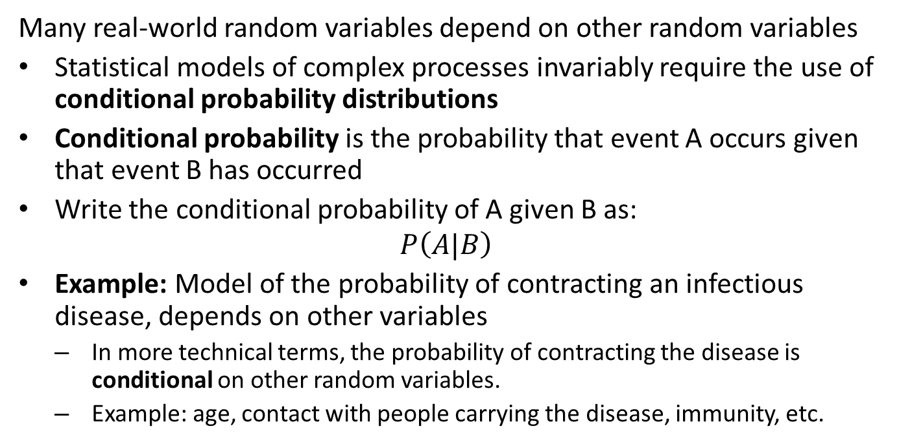
Introduction
Many real-world random variables depend on other random variables
Statistical models of complex processes invariably require the use of conditional probability distributions
Conditional probability is the probability that event A occurs given that event B has occurred
Write the conditional probability of A given B as:
$$P\left(A|B\right)$$
Example: Model of the probability of contracting an infectious disease, depends on other variables
In more technical terms, the probability of contracting the disease is conditional on other random variables.
Example: age, contact with people carrying the disease, immunity, etc.

Slide 3
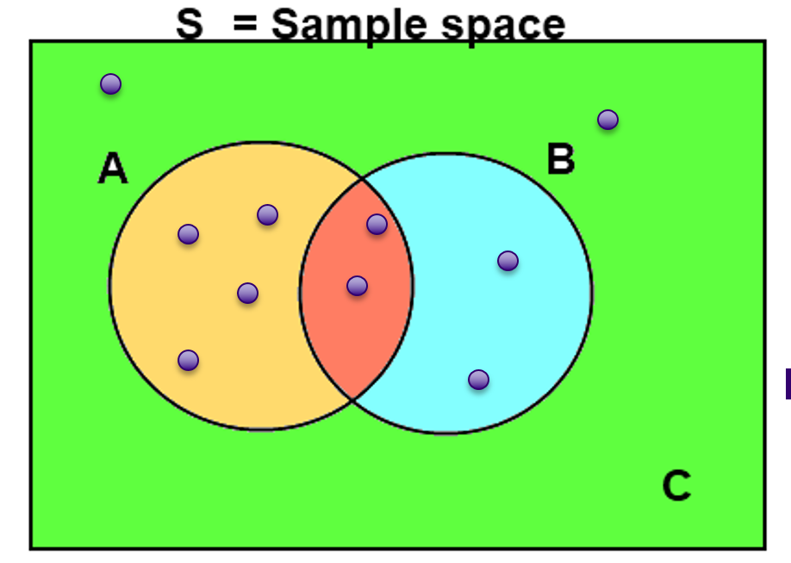
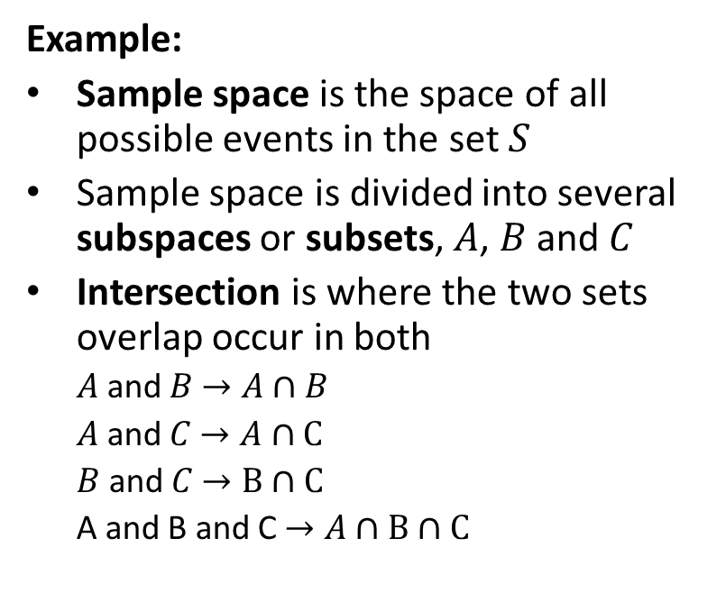
Properties of Conditional Probability
Example:
Sample space is the space of all possible events in the set $S$
Sample space is divided into several subspaces or subsets, $A$, $B$ and $C$
Intersection is where the two sets overlap occur in both
$A$ and $B$ $→A∩B$
$A$ and $C$ $→A∩C$
$B$ and $C$ $→B∩C$
A and B and C $→A∩B∩C$
Example of conditional probability of discrete events
credit, Wikipedia commons

Slide 4
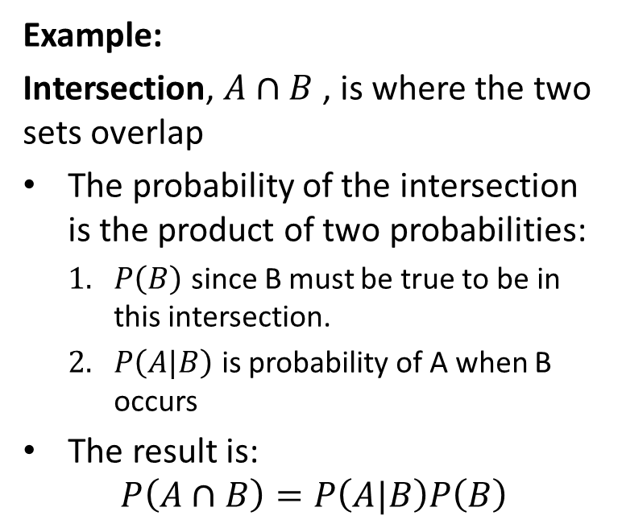
Properties of Conditional Probability
Example:
Intersection, $A∩B$ , is where the two sets overlap
The probability of the intersection is the product of two probabilities:
$P\left(B\right)$ since B must be true to be in this intersection.
$P\left(A|B\right)$ is probability of A when B occurs
The result is:
$$P\left(A∩B\right)=P\left(A|B\right)P\left(B\right)$$
Example of conditional probability of discrete events
credit, Wikipedia commons

Slide 5
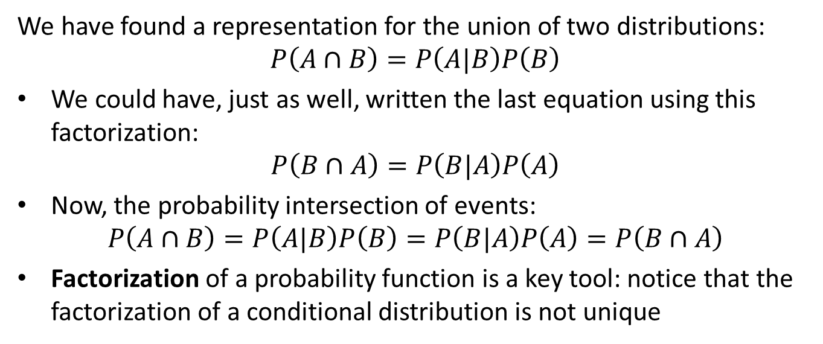
Properties of Conditional Probability
We have found a representation for the union of two distributions:
$$P\left(A∩B\right)=P\left(A|B\right)P\left(B\right)$$
We could have, just as well, written the last equation using this factorization:
$$P\left(B∩A\right)=P\left(B|A\right)P\left(A\right)$$
Now, the probability intersection of events:
$$P\left(A∩B\right)=P\left(A|B\right)P\left(B\right)=P\left(B|A\right)P\left(A\right)=P\left(B∩A\right)$$
Factorization of a probability function is a key tool: notice that the factorization of a conditional distribution is not unique

Slide 6
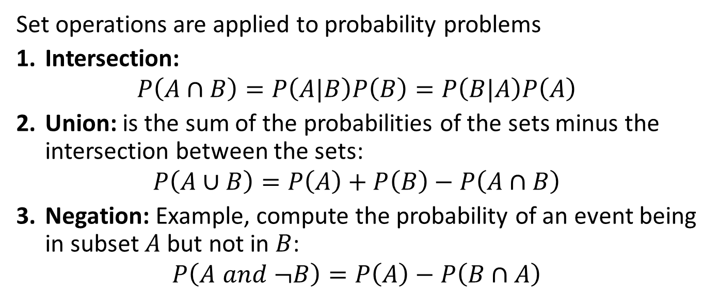
Set Operations and Probability
Set operations are applied to probability problems
Intersection:
$$P\left(A∩B\right)=P\left(A|B\right)P\left(B\right)=P\left(B|A\right)P\left(A\right)$$
Union: is the sum of the probabilities of the sets minus the intersection between the sets:
$$P\left(A∪B\right)=P\left(A\right)+P\left(B\right)−P\left(A∩B\right)$$
Negation: Example, compute the probability of an event being in subset $A$ but not in $B$:
$$P\left(A and ¬B\right)=P\left(A\right)−P\left(B∩A\right)$$

Slide 7
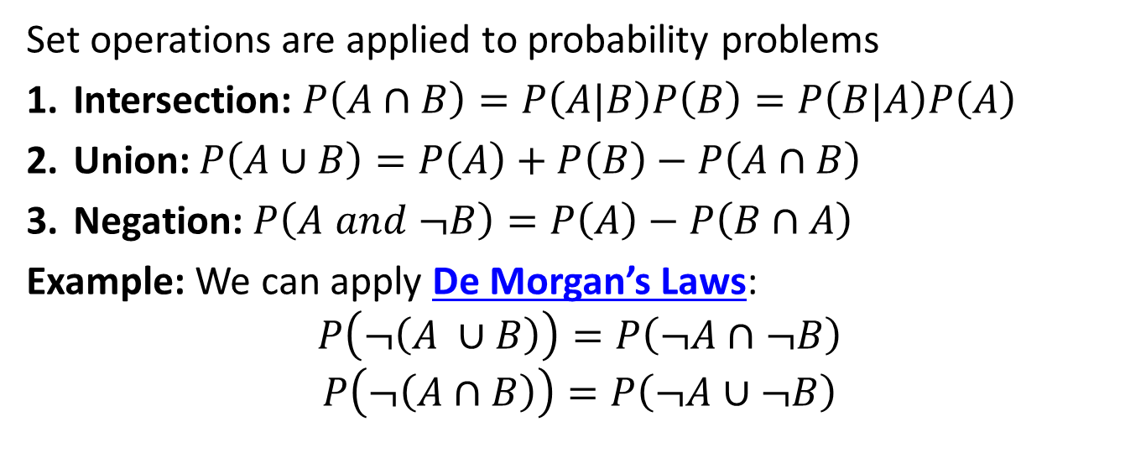
Set Operations and Probability
Set operations are applied to probability problems
Intersection: $P\left(A∩B\right)=P\left(A|B\right)P\left(B\right)=P\left(B|A\right)P\left(A\right)$
Union: $P\left(A∪B\right)=P\left(A\right)+P\left(B\right)−P\left(A∩B\right)$
Negation: $P\left(A and ¬B\right)=P\left(A\right)−P\left(B∩A\right)$
Example: We can apply De Morgan’s Laws:
$$P\left(¬\left(A ∪B\right)\right)=P\left(¬A∩¬B\right)$$
$$P\left(¬\left(A∩B\right)\right)=P\left(¬A∪¬B\right)$$

Slide 8
Independence and Mutual Exclusivity

Slide 9
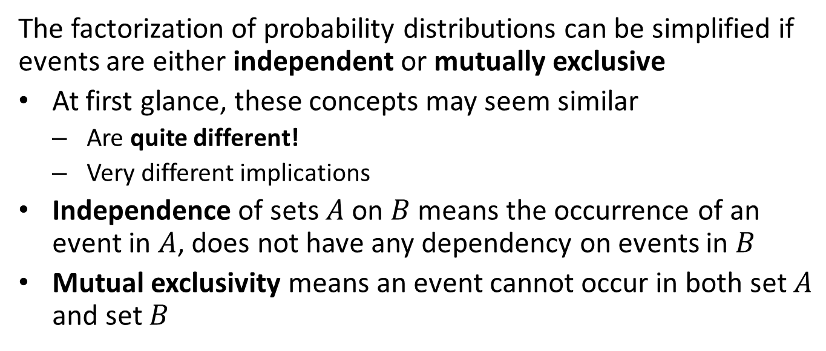
Independence and Mutual Exclusivity
The factorization of probability distributions can be simplified if events are either independent or mutually exclusive
At first glance, these concepts may seem similar
Are quite different!
Very different implications
Independence of sets $A$ on $B$ means the occurrence of an event in $A$, does not have any dependency on events in $B$
Mutual exclusivity means an event cannot occur in both set $A$ and set $B$

Slide 10
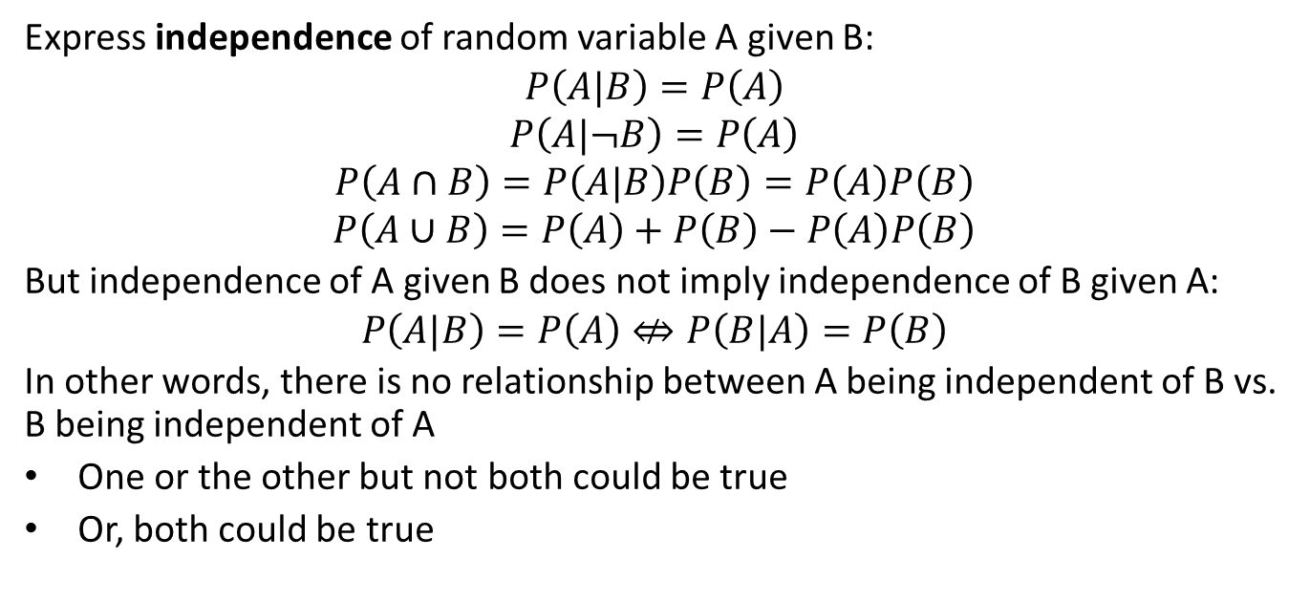
Independence
Express independence of random variable A given B:
$$P\left(A|B\right)=P\left(A\right)$$
$$P\left(A|¬B\right)=P\left(A\right)$$
$$P\left(A∩B\right)=P\left(A|B\right)P\left(B\right)=P\left(A\right)P\left(B\right)$$
$$P\left(A∪B\right)=P\left(A\right)+P\left(B\right)−P\left(A\right)P\left(B\right)$$
But independence of A given B does not imply independence of B given A:
$$P\left(A|B\right)=P\left(A\right)⇎P\left(B|A\right)=P\left(B\right)$$
In other words, there is no relationship between A being independent of B vs. B being independent of A
One or the other but not both could be true
Or, both could be true

Slide 11
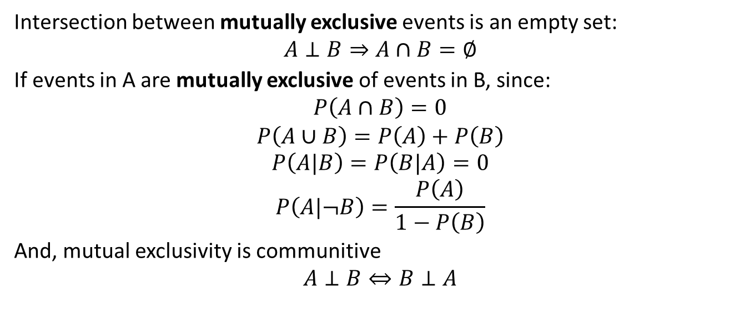
Mutual Exclusivity
Intersection between mutually exclusive events is an empty set:
$$A⊥B⇒A∩B=∅$$
If events in A are mutually exclusive of events in B, since:
$$P\left(A∩B\right)=0$$
$$P\left(A∪B\right)=P\left(A\right)+P\left(B\right)$$
$$P\left(A|B\right)=P\left(B|A\right)=0$$
$$P\left(A|¬B\right)=\frac{P\left(A\right)}{1−P\left(B\right)}$$
And, mutual exclusivity is communitive
$$A⊥B⇔B⊥A$$

Slide 12
Simple Conditional Probability Example

Slide 13
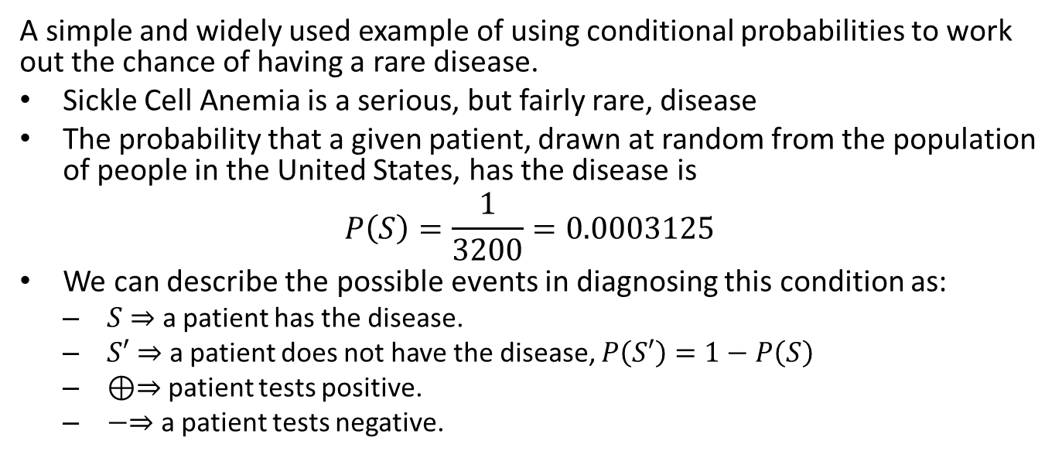
Conditional Probability Example
A simple and widely used example of using conditional probabilities to work out the chance of having a rare disease.
Sickle Cell Anemia is a serious, but fairly rare, disease
The probability that a given patient, drawn at random from the population of people in the United States, has the disease is
$$P\left(S\right)=\frac{1}{3200}=0.0003125$$
We can describe the possible events in diagnosing this condition as:
$S⇒$ a patient has the disease.
$S′⇒$ a patient does not have the disease, $P\left(S′\right)=1−P\left(S\right)$
$⊕⇒$ patient tests positive.
$−⇒$ a patient tests negative.

Slide 14

Conditional Probability Example
What if a medical company claims that it has developed a test that is 99% accurate?
We can write:
$P\left(S|⊕\right)=0.99$
$P\left(S′|−\right)=0.99$
On the surface, it seems that a 99% reliable test is rather good
On average, 99 people out of 100 who have the disease will be identified and treated
But, dig into the conditional probabilities and make sure!

Slide 15
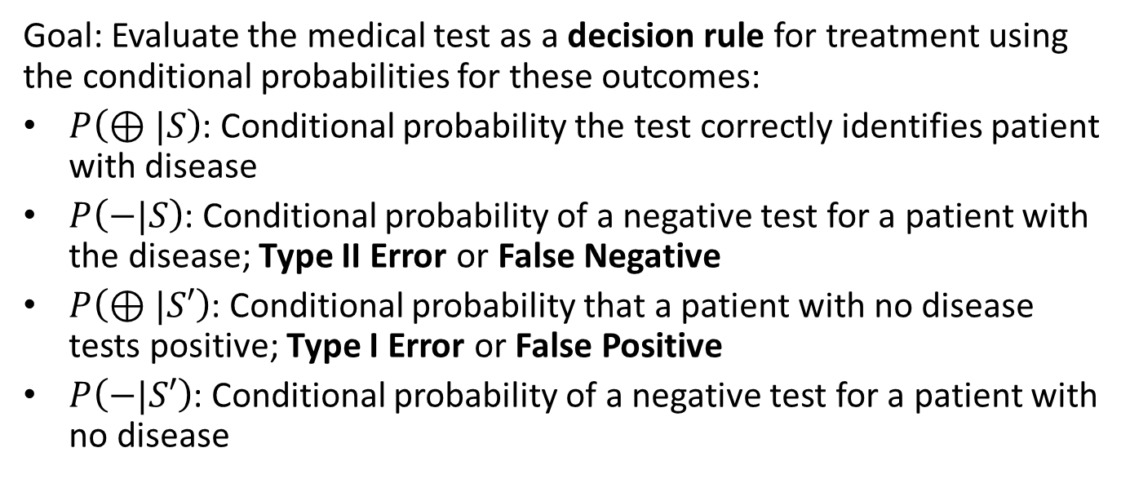
Conditional Probability Example
Goal: Evaluate the medical test as a decision rule for treatment using the conditional probabilities for these outcomes:
$P\left(⊕|S\right)$: Conditional probability the test correctly identifies patient with disease
$P\left(−|S\right)$: Conditional probability of a negative test for a patient with the disease; Type II Error or False Negative
$P\left(⊕|S′\right)$: Conditional probability that a patient with no disease tests positive; Type I Error or False Positive
$P\left(−|S′\right)$: Conditional probability of a negative test for a patient with no disease

Slide 16
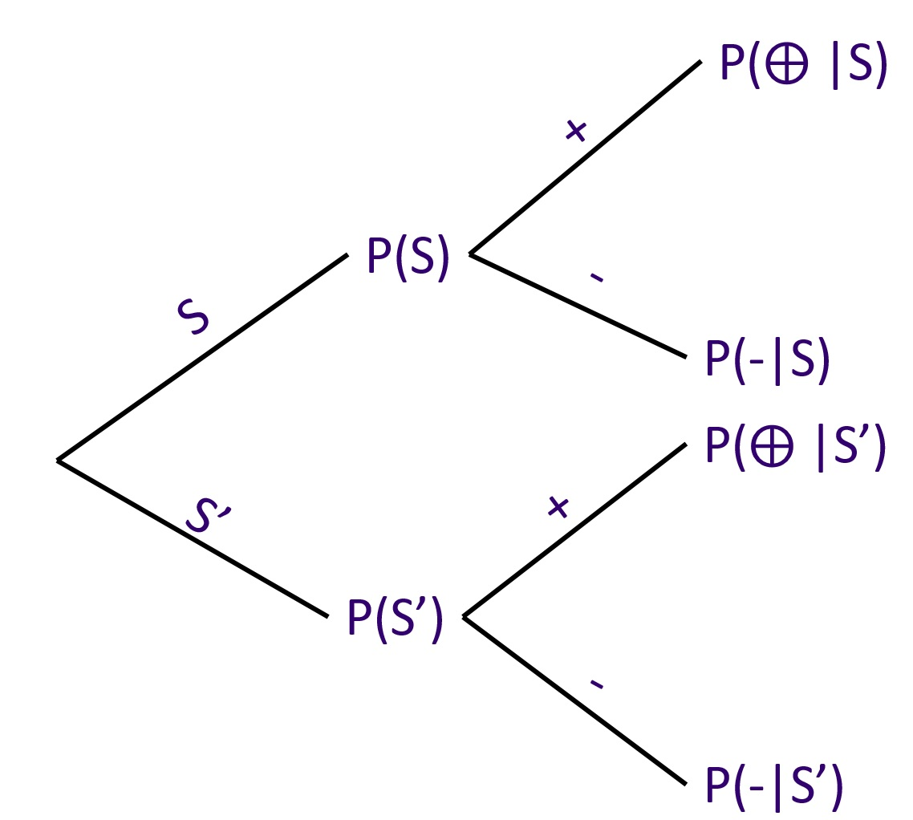
Conditional Probability Example
The directed acyclic graphical model (DAG) defines a conditional dependency structure
Multiply probabilities from root to leaves to get probabilities of outcomes
Sum the conditional probabilities of outcomes to ensure they add to 1.0
Graph showing dependency of conditional distribution

Slide 17
Conditional Probability Example
Four possible outcomes shown using a confusion matrix or truth table
Table shows conditional probabilities of each outcome
Tip: Make sure the numbers in your confusion matrix sum to 1.0
 | Positive Test | Negative Test
Disease | True Positive Rate | False Negative Rate
No Disease | False Positive Rate | True Negative Rate

Slide 18
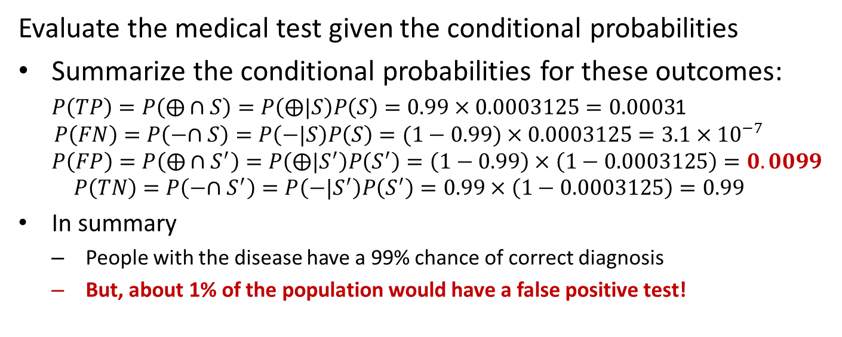
Conditional Probability Example
Evaluate the medical test given the conditional probabilities
Summarize the conditional probabilities for these outcomes:
$P\left(TP\right)=P\left(⨁∩S\right)=P\left(⨁|S\right)P\left(S\right)=0.99×0.0003125=0.0003$1
$$P\left(FN\right)=P\left(−∩S\right)=P\left(−|S\right)P\left(S\right)=(1−0.99)×0.0003125=3.1×{10}^{−7}$$
$$P\left(FP\right)=P\left(⨁∩S^{′}\right)=P\left(⨁|S^{′}\right)P\left(S^{′}\right)=\left(1−0.99\right)×\left(1−0.0003125\right)=0.0099$$
$$P\left(TN\right)=P\left(−∩S^{′}\right)=P\left(−|S^{′}\right)P\left(S^{′}\right)=0.99×\left(1−0.0003125\right)=0.99$$
In summary
People with the disease have a 99% chance of correct diagnosis
But, about 1% of the population would have a false positive test!

Slide 19
What is Likelihood?

Slide 20
Likelihood and Density Functions
Likelihood is a measure of how likely a parametric model is to generate the observed data
Start with a data sample, $X=\left[x_{1},x_{2},…,x_{n}\right]$
Likelihood of sample from a data generating process with a parametric density function, $f\left(X|θ\right)$
$f\left(X | θ\right)$ can be either a probability density function (PDF), for continuous distributions, or a probability mass function (PMF) of discrete distributions
The distribution parameter vector, $θ$, is fixed
For each observation, $x_{i}$, in $X=x_{1},x_{2},…,x_{n}$, the density is $f\left(x_{i}| θ\right)$

Slide 21
Likelihood
Likelihood is a measure of how likely a parametric model is to generate the observed data
Likelihood of sample from a data generating process with a parametric probability density, $f\left(X|θ\right)$
For the set of observations, $X=\left[x_{1},x_{2},…,x_{n}\right]$, the likelihood is the product of the densities:
$$ℒ\left(X| θ\right)=\prod_{i=1}^{n}{f}\left(x_{i}|θ\right)$$
In most practical cases, we work with the log likelihood, for observations, $X=x_{1},x_{2},…,x_{n}$, the log likelihood is expressed:
$$l\left(X| θ\right)=log\left(ℒ\left(X| θ\right)\right)=\sum_{i=1}^{n}{l}og\left(f\left(x_{i} | θ\right)\right)$$

Slide 22
Likelihood
Likelihood is a measure of how likely a parametric model is to generate the observed data sample
In most practical cases, we work with the log likelihood, for observations, $X=x_{1},x_{2},…,x_{n}$, the log likelihood is expressed:
$$l\left(X| θ\right)=log\left(ℒ\left(X| θ\right)\right)=\sum_{i=1}^{n}{l}og\left(f\left(x_{i} | θ\right)\right)$$
Use log-likelihood to work with the sum of log probabilities rather than the product
If the probabilities are small, the sum is numerically stable
The product of many small numbers is a very small number, which can lead to numerical underflow even for 64 or 128 bit floating point arithmetic

Slide 23
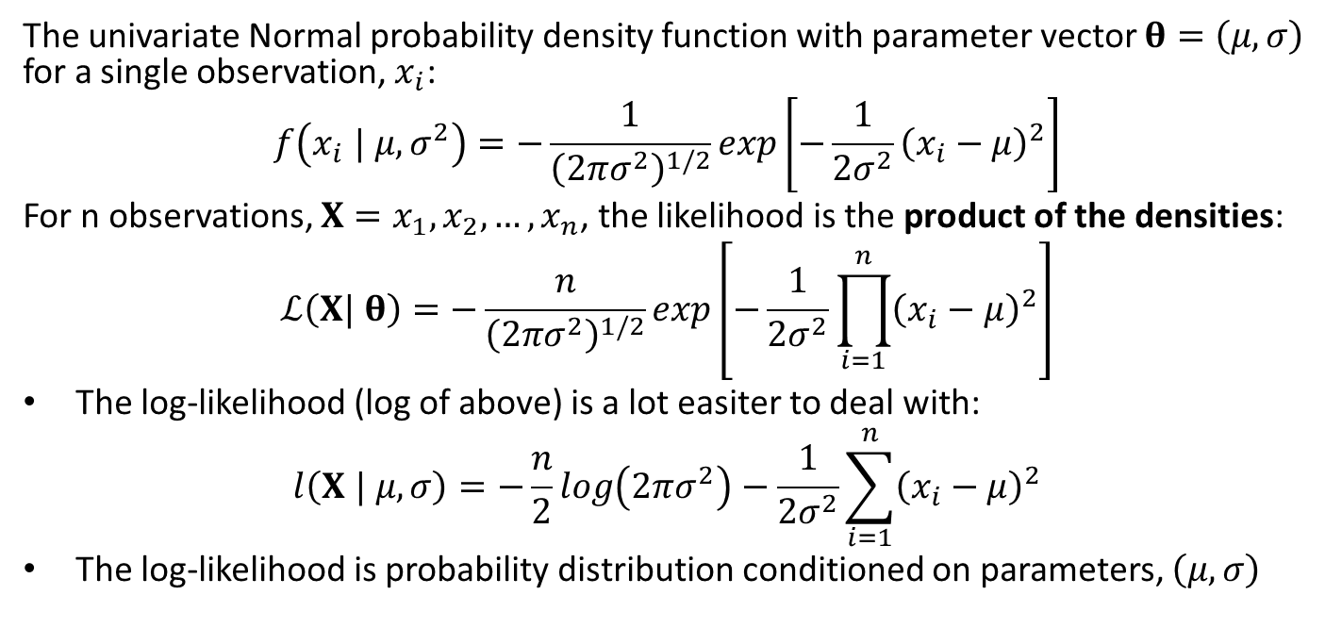
Normal Likelihood
The univariate Normal probability density function with parameter vector $θ=\left(μ,σ\right)$ for a single observation, $x_{i}$:
$$f\left(x_{i} | μ,σ^{2}\right)=−\frac{1}{{\left(2πσ^{2}\right)}^{1/2}}exp\left[−\frac{1}{2σ^{2}}{\left(x_{i}−μ\right)}^{2}\right]$$
For n observations, $X=x_{1},x_{2},…,x_{n}$, the likelihood is the product of the densities:
$$ℒ\left(X| θ\right)=−\frac{n}{{\left(2πσ^{2}\right)}^{1/2}}exp\left[−\frac{1}{2σ^{2}}\prod_{i=1}^{n}{{\left(x_{i}−μ\right)}^{2}}\right]$$
The log-likelihood (log of above) is a lot easiter to deal with:
$$l\left(X | μ,σ\right)=−\frac{n}{2}log\left(2πσ^{2}\right)−\frac{1}{2σ^{2}}\sum_{i=1}^{n}{{\left(x_{i}−μ\right)}^{2}}$$
The log-likelihood is probability distribution conditioned on parameters, $\left(μ,σ\right)$

Slide 24
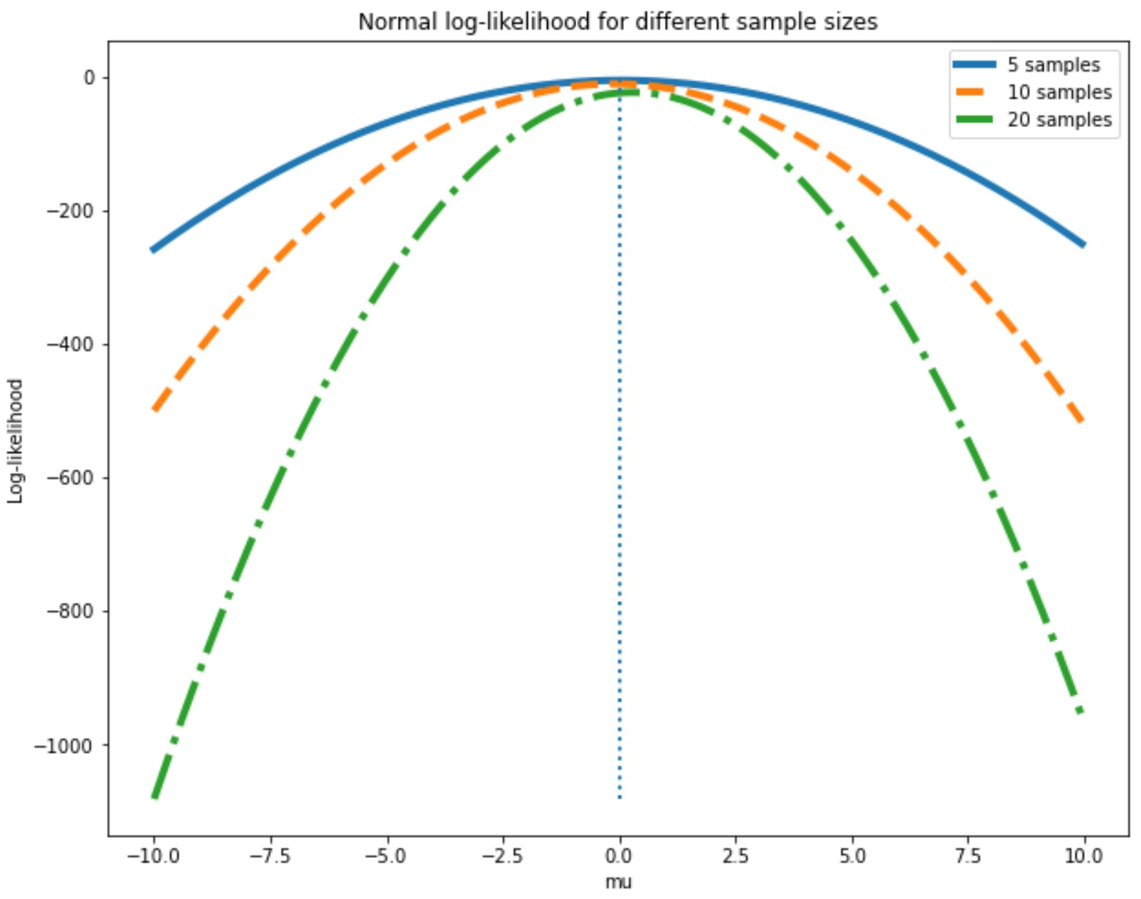
Normal Likelihood
An example to illustrate the foregoing concepts
Plot the likelihood for 5, 10 and 20 samples from a standard Normal distribution
Vary the parameter $μ$, with $σ$ fixed and known. The steps are:
A random sample is drawn from a standard Normal distribution
For the random sample the log-likelihood is computed at each parameter value, $μ$
Normal likelihood at different sample sizes

Slide 25
Normal Likelihood
An example to illustrate the foregoing concepts
Plot the likelihood for 5, 10 and 20 samples from a standard Normal distribution
Notice that as the number of observations increases so does the curvature of the likelihood.
Larger sample leads to less uncertainty in parameter estimate
Confidence interval decreases with increasing curvature!
A consequent of the law of large numbers
Normal likelihood at different sample sizes

Slide 26
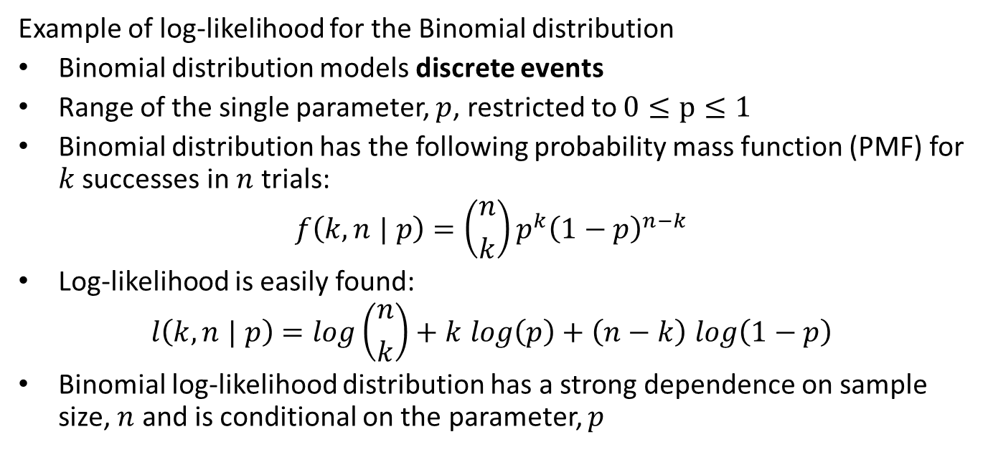
Binomial Likelihood
Example of log-likelihood for the Binomial distribution
Binomial distribution models discrete events
Range of the single parameter, $p$, restricted to $0≤p≤1$
Binomial distribution has the following probability mass function (PMF) for $k$ successes in $n$ trials:
$$f\left(k,n | p\right)=\left({n \atop k}\right)p^{k}{\left(1−p\right)}^{n−k}$$
Log-likelihood is easily found:
$$l\left(k,n | p\right)=log\left({n \atop k}\right)+k log\left(p\right)+\left(n−k\right) log\left(1−p\right)$$
Binomial log-likelihood distribution has a strong dependence on sample size, $n$ and is conditional on the parameter, $p$

Slide 27
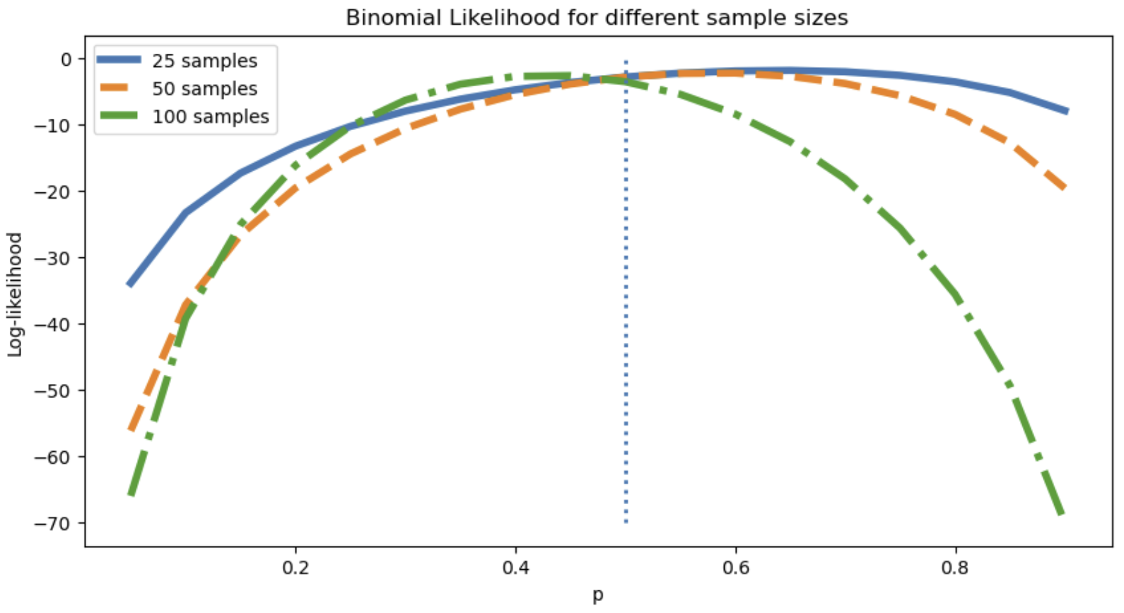
Binomial Likelihood
Example
Likelihood is a measure of how likely a parametric model is to generate the observed data sample
Binomial likelihood for sample sizes $\left[25, 50, 100\right]$ with $p=0.5$
Notice the variability in the likelihood curve for smaller samples
Likelihood has stronger curvature for larger samples - less uncertainty for maximum
Binomial likelihood at different sample sizes

Slide 28
Bayes Theorem

Slide 29
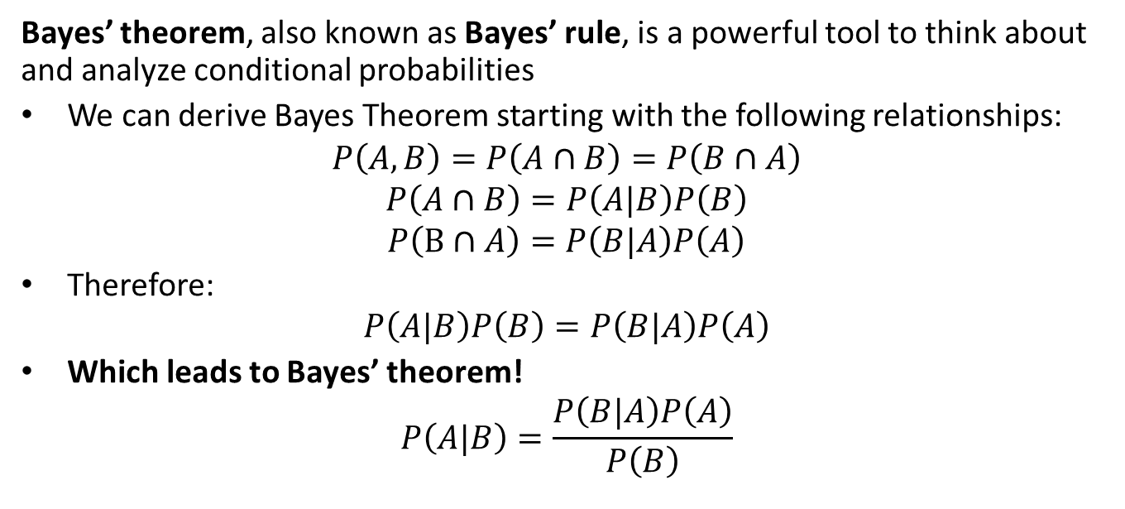
Conditional Distributions and Bayes’ Theorem
Bayes’ theorem, also known as Bayes’ rule, is a powerful tool to think about and analyze conditional probabilities
We can derive Bayes Theorem starting with the following relationships:
$$P\left(A,B\right)=P\left(A∩B\right)=P\left(B∩A\right)$$
$$P\left(A∩B\right)=P\left(A|B\right)P\left(B\right)$$
$$P\left(B∩A\right)=P\left(B|A\right)P\left(A\right)$$
Therefore:
$$P\left(A|B\right)P\left(B\right)=P\left(B|A\right)P\left(A\right)$$
Which leads to Bayes’ theorem!
$$P\left(A|B\right)=\frac{P\left(B|A\right)P\left(A\right)}{P\left(B\right)}$$

Slide 30
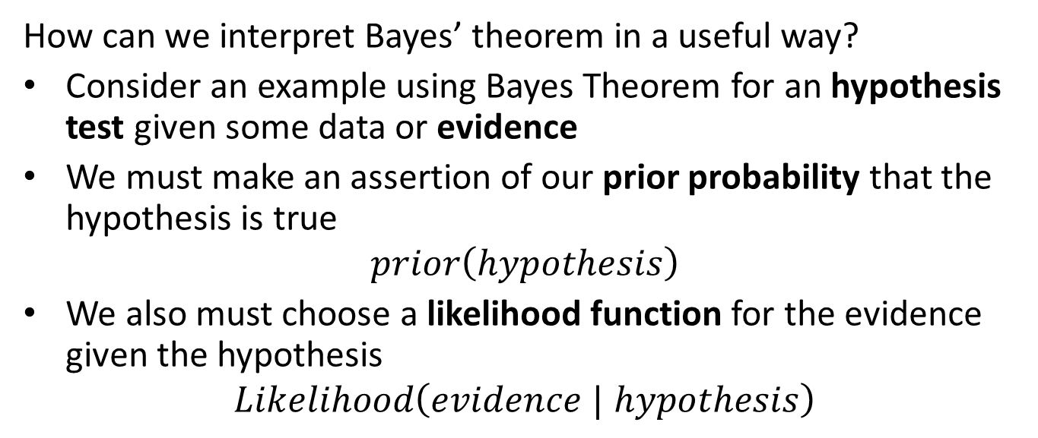
Interpreting Bayes Theorem
How can we interpret Bayes’ theorem in a useful way?
Consider an example using Bayes Theorem for an hypothesis test given some data or evidence
We must make an assertion of our prior probability that the hypothesis is true
$$prior\left(hypothesis\right)$$
We also must choose a likelihood function for the evidence given the hypothesis
$$Likelihood\left(evidence | hypothesis\right)$$

Slide 31
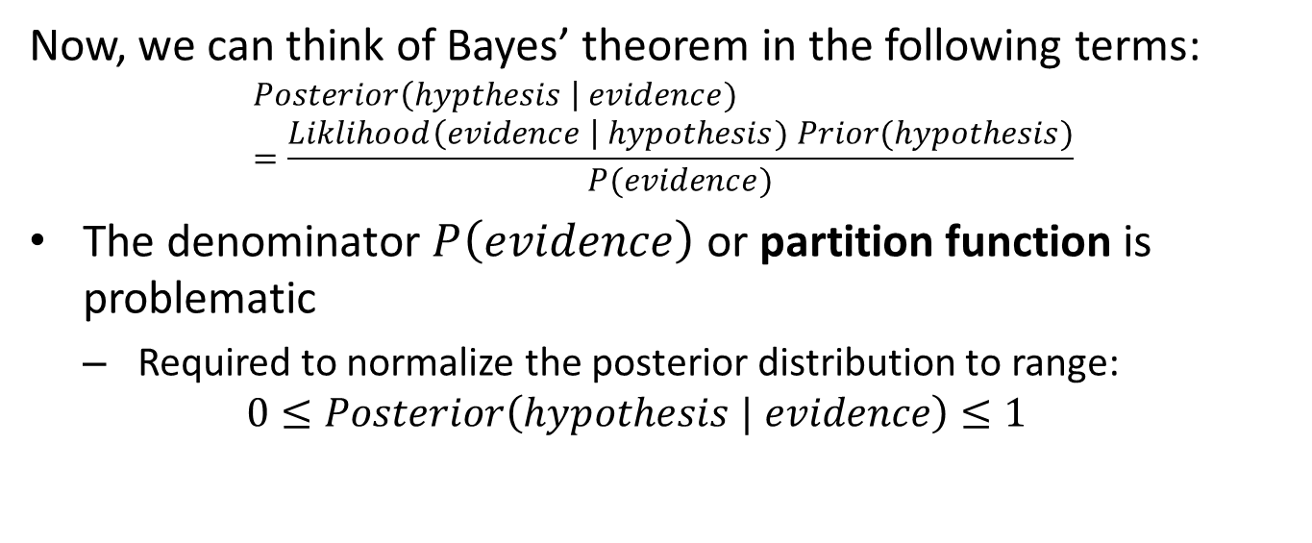
Interpreting Bayes Theorem
Now, we can think of Bayes’ theorem in the following terms:
$$Posterior\left(hypthesis \right| evidence)=\frac{Liklihood\left(evidence \right| hypothesis) Prior(hypothesis)}{P(evidence)}$$
The denominator $P\left(evidence\right)$ or partition function is problematic
Required to normalize the posterior distribution to range:
$$0≤Posterior\left(hypothesis | evidence\right)≤1$$

Slide 32
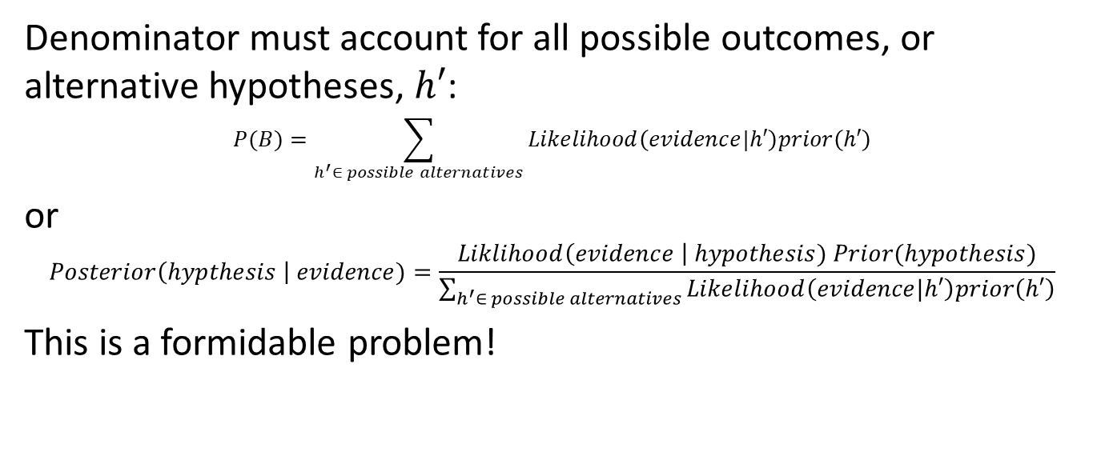
Interpreting Bayes Theorem
Denominator must account for all possible outcomes, or alternative hypotheses, $h′$:
$$P(B)=\sum_{h^{′}∈ possible alternatives}{Likelihood\left(evidence|h′\right)prior\left(h′\right)}$$
or
$$Posterior\left(hypthesis \right| evidence)=\frac{Liklihood\left(evidence \right| hypothesis) Prior(hypothesis)}{\sum_{h^{′}∈ possible alternatives}{Likelihood\left(evidence|h′\right)prior\left(h′\right)}}$$
This is a formidable problem!

Slide 33
Simple Bayes Distribution Example

Slide 34
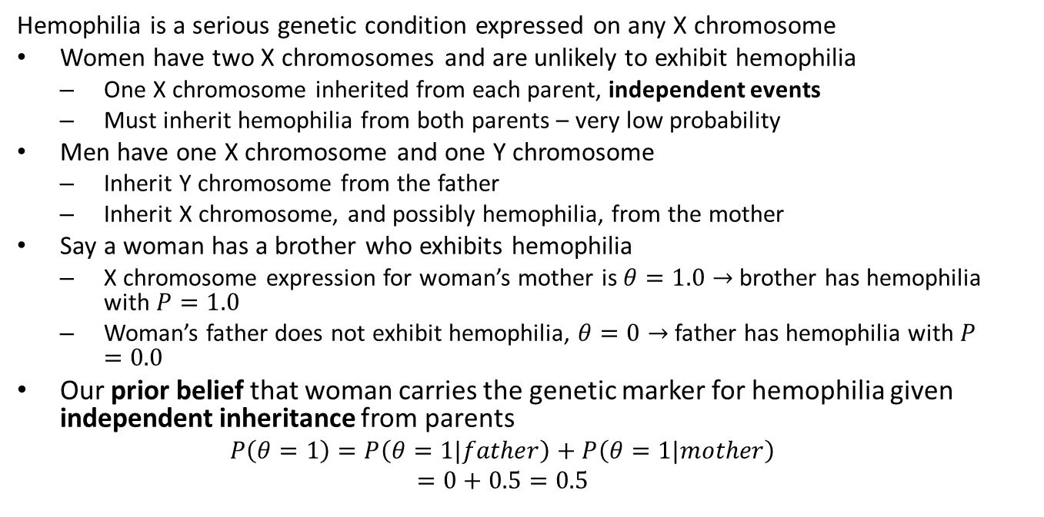
Bayes Theorem Example
Hemophilia is a serious genetic condition expressed on any X chromosome
Women have two X chromosomes and are unlikely to exhibit hemophilia
One X chromosome inherited from each parent, independent events
Must inherit hemophilia from both parents – very low probability
Men have one X chromosome and one Y chromosome
Inherit Y chromosome from the father
Inherit X chromosome, and possibly hemophilia, from the mother
Say a woman has a brother who exhibits hemophilia
X chromosome expression for woman’s mother is $θ=1.0→$ brother has hemophilia with $P=1.0$
Woman’s father does not exhibit hemophilia, $θ=0→$ father has hemophilia with $P=0.0$
Our prior belief that woman carries the genetic marker for hemophilia given independent inheritance from parents
$$P\left(θ=1\right)=P\left(θ=1|father\right)+P\left(θ=1|mother\right)$$
$$=0+0.5=0.5$$

Slide 35
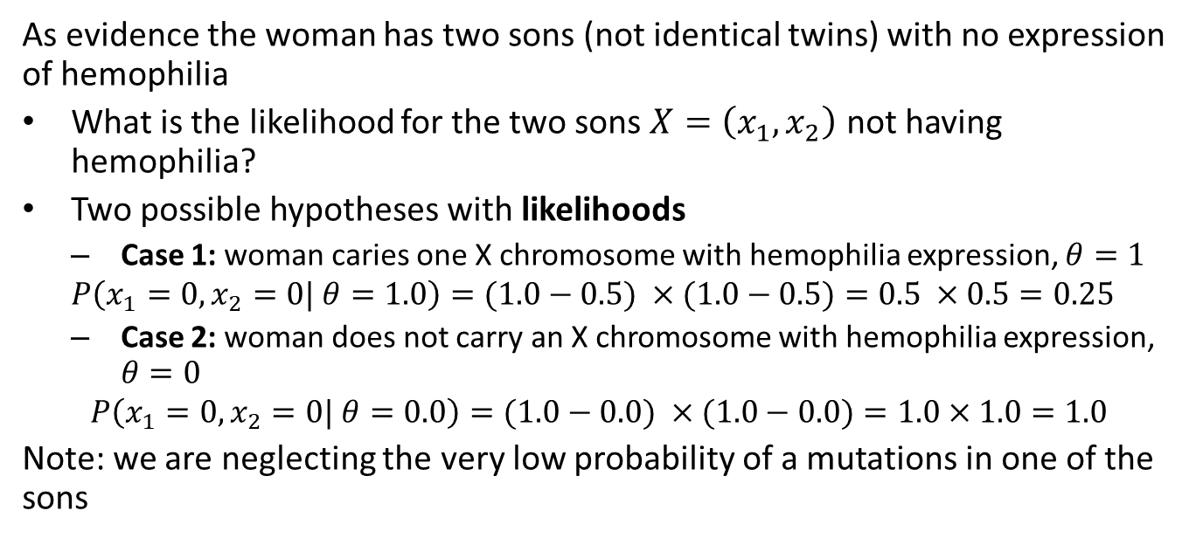
Bayes Theorem Example
As evidence the woman has two sons (not identical twins) with no expression of hemophilia
What is the likelihood for the two sons $X=\left(x_{1},x_{2}\right)$ not having hemophilia?
Two possible hypotheses with likelihoods
Case 1: woman caries one X chromosome with hemophilia expression, $θ=1$
$$P\left(x_{1}=0,x_{2}=0| θ=1.0\right)=(1.0−0.5) ×(1.0−0.5)=0.5 ×0.5=0.25$$
Case 2: woman does not carry an X chromosome with hemophilia expression, $θ=0$
$$P\left(x_{1}=0,x_{2}=0| θ=0.0\right)=(1.0−0.0) ×(1.0−0.0)=1.0×1.0=1.0$$
Note: we are neglecting the very low probability of a mutations in one of the sons

Slide 36
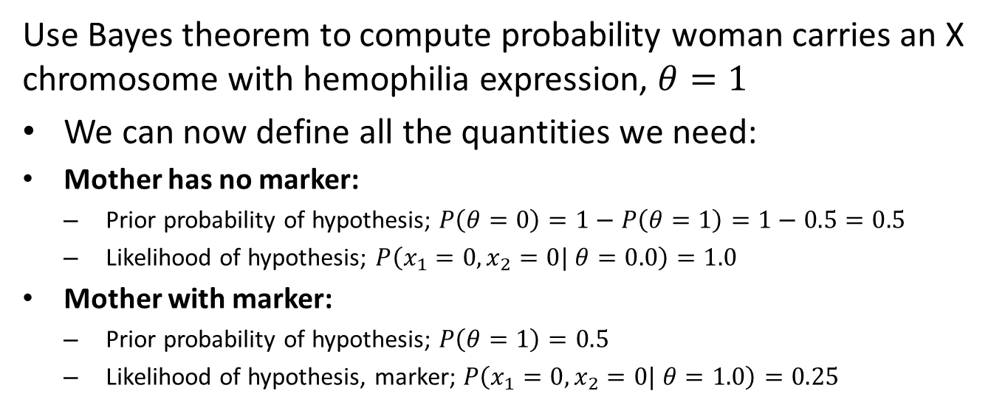
Bayes Theorem Example
Use Bayes theorem to compute probability woman carries an X chromosome with hemophilia expression, $θ=1$
We can now define all the quantities we need:
Mother has no marker:
Prior probability of hypothesis; $P\left(θ=0\right)=1−P\left(θ=1\right)=1−0.5=0.5$
Likelihood of hypothesis; $P\left(x_{1}=0,x_{2}=0| θ=0.0\right)=1.0$
Mother with marker:
Prior probability of hypothesis; $P\left(θ=1\right)=0.5$
Likelihood of hypothesis, marker; $P\left(x_{1}=0,x_{2}=0| θ=1.0\right)=0.25$

Slide 37
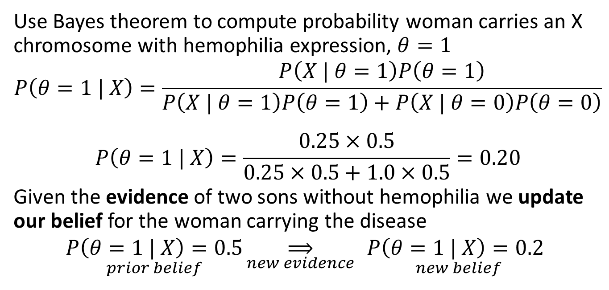
Bayes Theorem Example
Use Bayes theorem to compute probability woman carries an X chromosome with hemophilia expression, $θ=1$
$$P\left(θ=1 | X\right)=\frac{P\left(X | θ=1\right)P\left(θ=1\right)}{P\left(X | θ=1\right)P\left(θ=1\right)+P\left(X | θ=0\right)P\left(θ=0\right)}$$
$$P\left(θ=1 | X\right)=\frac{0.25×0.5}{0.25×0.5+1.0×0.5}=0.20$$
Given the evidence of two sons without hemophilia we update our belief for the woman carrying the disease
$$\underset{prior belief}{P\left(θ=1 | X\right)=0.5}\underset{new evidence}{⟹}{ }\underset{new belief}{P\left(θ=1 | X\right)=0.2}$$

Slide 38
Marginal Distributions

Slide 39
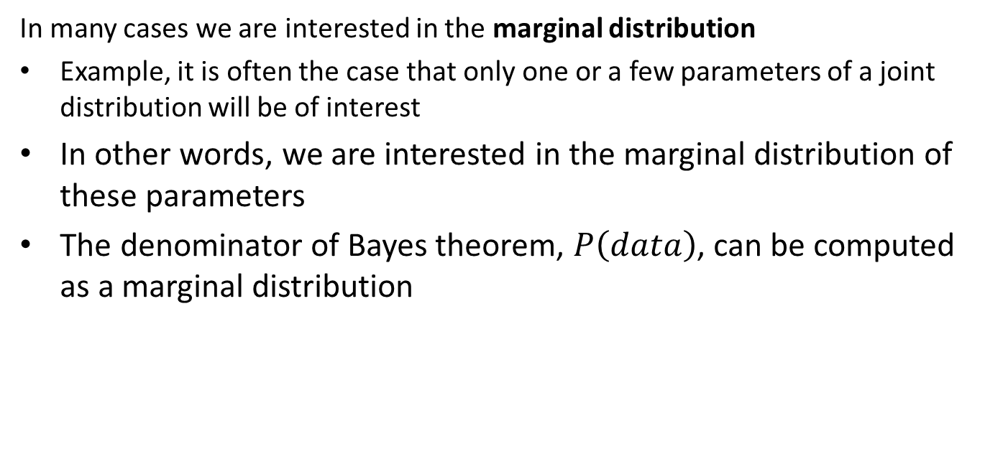
Marginal Distributions
In many cases we are interested in the marginal distribution
Example, it is often the case that only one or a few parameters of a joint distribution will be of interest
In other words, we are interested in the marginal distribution of these parameters
The denominator of Bayes theorem, $P\left(data\right)$, can be computed as a marginal distribution

Slide 40
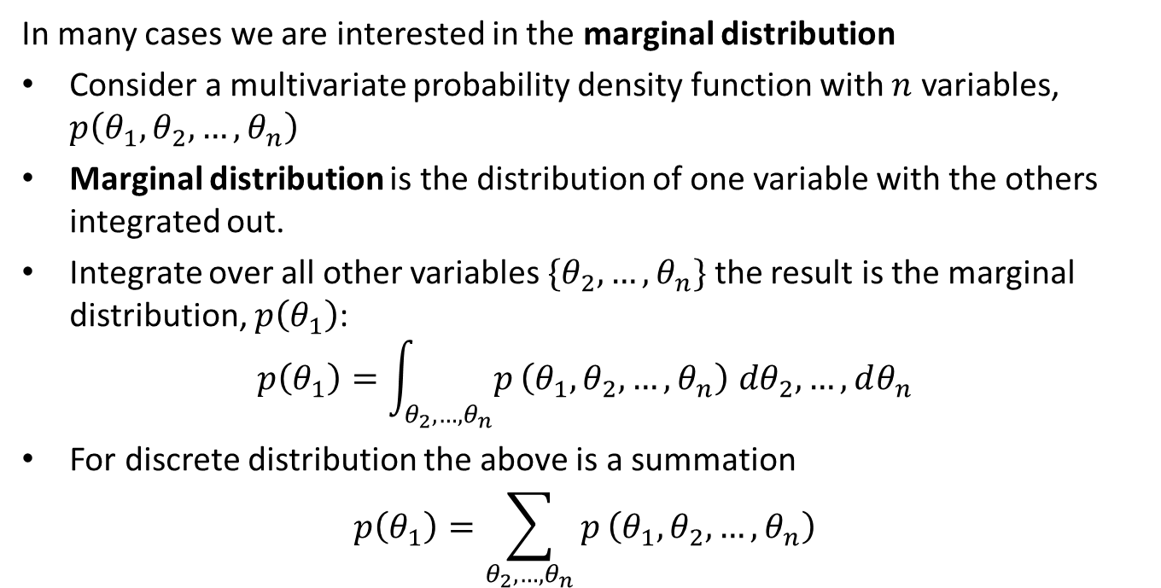
Marginal Distributions
In many cases we are interested in the marginal distribution
Consider a multivariate probability density function with $n$ variables, $p\left(θ_{1},θ_{2},…,θ_{n}\right)$
Marginal distribution is the distribution of one variable with the others integrated out.
Integrate over all other variables $\{θ_{2},…,θ_{n}\}$ the result is the marginal distribution, $p\left(θ_{1}\right)$:
$$p\left(θ_{1}\right)=\int_{θ_{2},…,θ_{n}}^{​}{p}\left(θ_{1},θ_{2},…,θ_{n}\right) dθ_{2},…,dθ_{n}$$
For discrete distribution the above is a summation
$$p\left(θ_{1}\right)=\sum_{θ_{2},…,θ_{n}}^{​}{p}\left(θ_{1},θ_{2},…,θ_{n}\right)$$

Slide 41
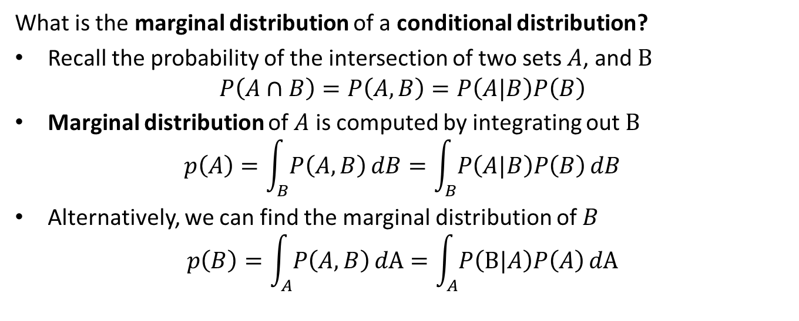
Marginal Distributions
What is the marginal distribution of a conditional distribution?
Recall the probability of the intersection of two sets $A$, and $B$
$$P\left(A∩B\right)=P\left(A,B\right)=P\left(A|B\right)P\left(B\right)$$
Marginal distribution of $A$ is computed by integrating out $B$
$$p\left(A\right)=\int_{B}^{​}{P\left(A,B\right)}dB=\int_{B}^{​}{P\left(A|B\right)P\left(B\right)}dB$$
Alternatively, we can find the marginal distribution of $B$
$$p\left(B\right)=\int_{A}^{​}{P\left(A,B\right)}dA=\int_{A}^{​}{P\left(B|A\right)P\left(A\right)}dA$$

Slide 42
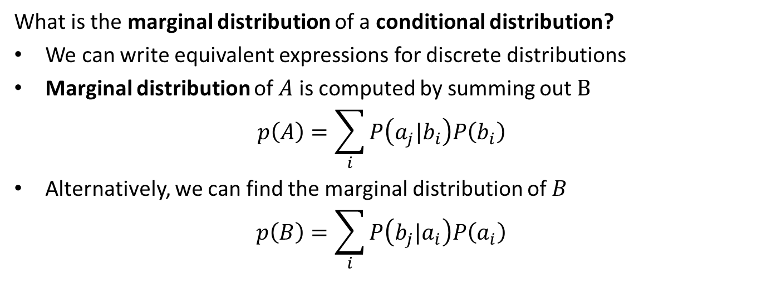
Marginal Distributions
What is the marginal distribution of a conditional distribution?
We can write equivalent expressions for discrete distributions
Marginal distribution of $A$ is computed by summing out $B$
$$p\left(A\right)=\sum_{i}{P\left(a_{j}|b_{i}\right)P\left(b_{i}\right)}$$
Alternatively, we can find the marginal distribution of $B$
$$p\left(B\right)=\sum_{i}{P\left(b_{j}|a_{i}\right)P\left(a_{i}\right)}$$

Slide 43
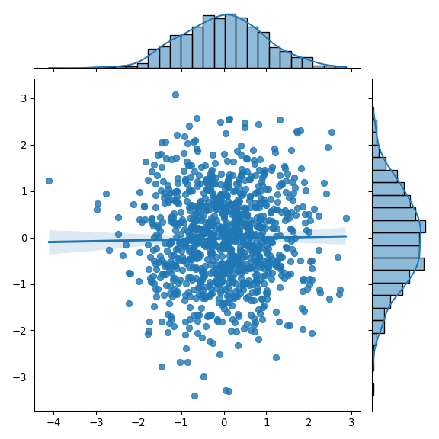
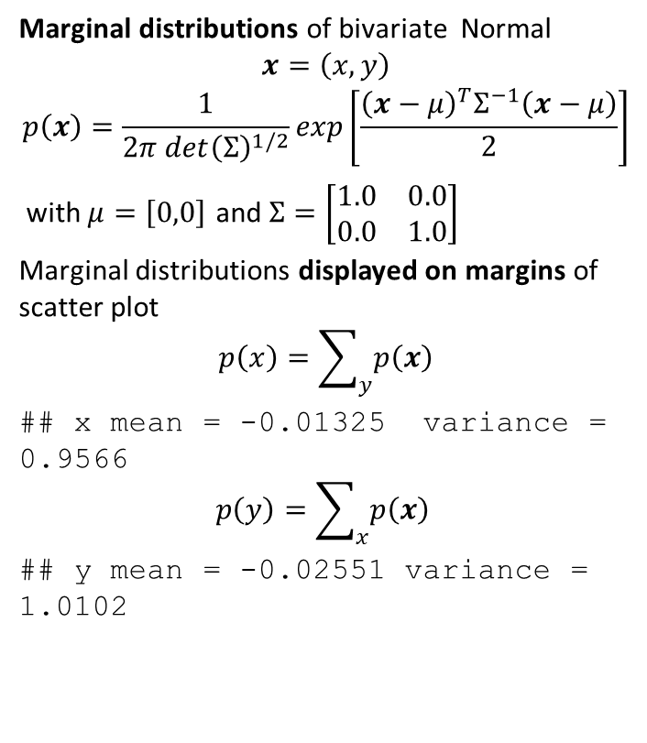
Example: Marginal Distribution
Marginal distributions of bivariate Normal
$$x=\left(x,y\right)$$
$$p\left(x\right)=\frac{1}{2π {det\left(Σ\right)}^{1/2}}exp\left[\frac{{\left(x−μ\right)}^{T}Σ^{−1}\left(x−μ\right)}{2}\right]$$
with $μ=\left[0,0\right]$ and $Σ=\left[\begin{matrix}1.0 & 0.0 \\ 0.0 & 1.0\end{matrix}\right]$
Marginal distributions displayed on margins of scatter plot
$$p\left(x\right)=\sum_{y}{p\left(x\right)}$$
## x mean = -0.01325 variance = 0.9566
$p\left(y\right)=\sum_{x}{p\left(x\right)}$ ## y mean = -0.02551 variance = 1.0102

Slide 44
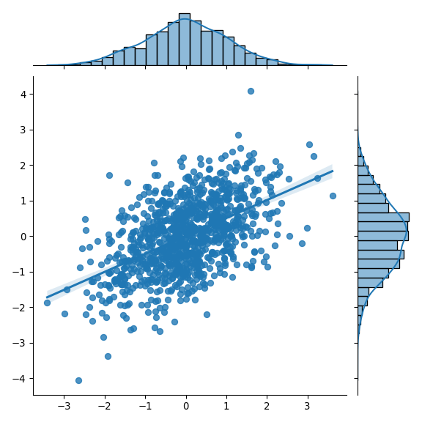
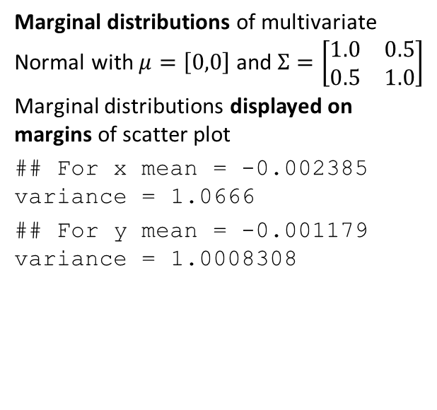
Example: Marginal Distribution
Marginal distributions of multivariate Normal with $μ=\left[0,0\right]$ and $Σ=\left[\begin{matrix}1.0 & 0.5 \\ 0.5 & 1.0\end{matrix}\right]$
Marginal distributions displayed on margins of scatter plot
## For x mean = -0.002385 variance = 1.0666 ## For y mean = -0.001179 variance = 1.0008308

Slide 45
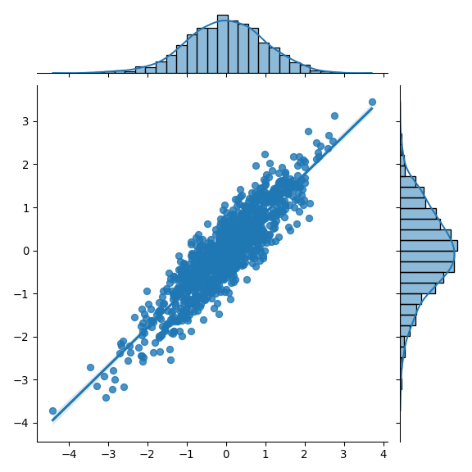
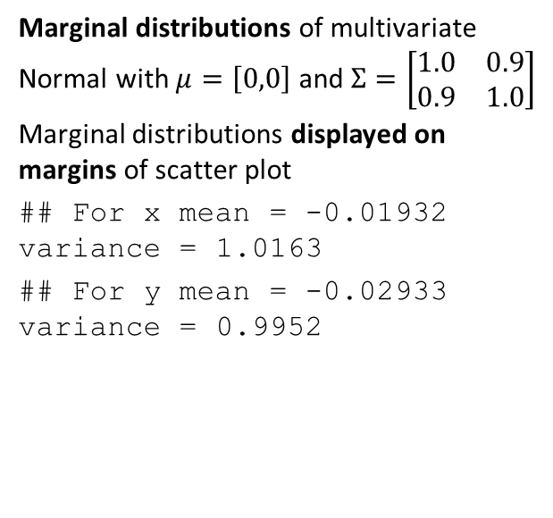
Example: Marginal Distribution
Marginal distributions of multivariate Normal with $μ=\left[0,0\right]$ and $Σ=\left[\begin{matrix}1.0 & 0.9 \\ 0.9 & 1.0\end{matrix}\right]$
Marginal distributions displayed on margins of scatter plot
## For x mean = -0.01932 variance = 1.0163 ## For y mean = -0.02933 variance = 0.9952

Slide 46
Expected Values

Slide 47
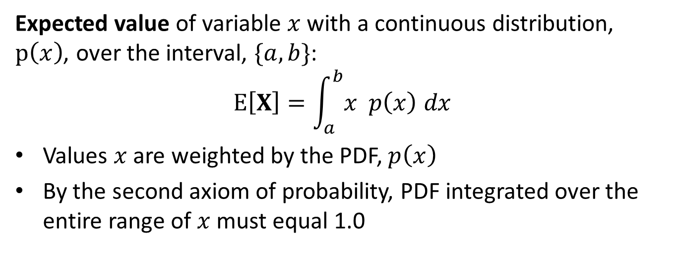
What do you expect: continuous distributions
Expected value of variable $x$ with a continuous distribution, $p\left(x\right)$, over the interval, $\{a,b\}$:
$$E\left[X\right]=\int_{a}^{b}{x} p\left(x\right) dx$$
Values $x$ are weighted by the PDF, $p\left(x\right)$
By the second axiom of probability, PDF integrated over the entire range of $x$ must equal 1.0

Slide 48
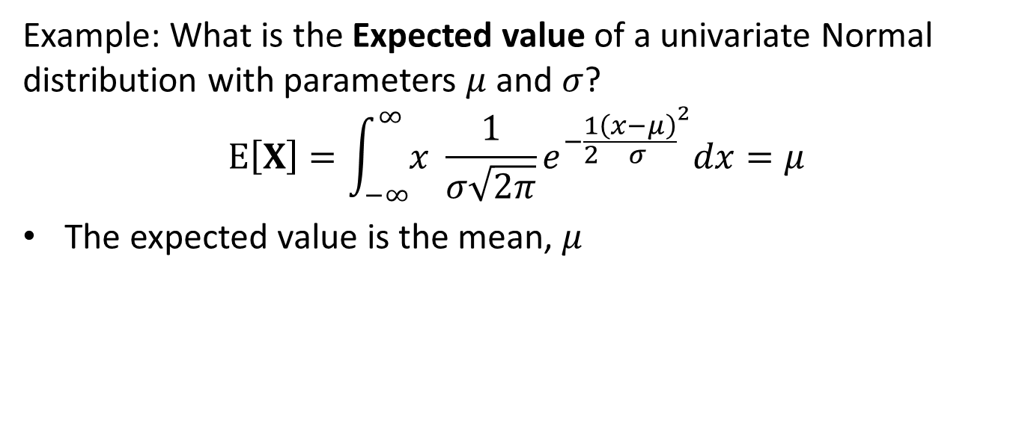
What do you expect: continuous distributions
Example: What is the Expected value of a univariate Normal distribution with parameters $μ$ and $σ$?
$$E\left[X\right]=\int_{−∞}^{∞}{x} \frac{1}{σ\sqrt{2π}}e^{−\frac{1}{2}{\frac{\left(x−μ\right)}{σ}}^{2}}dx=μ$$
The expected value is the mean, $μ$

Slide 49
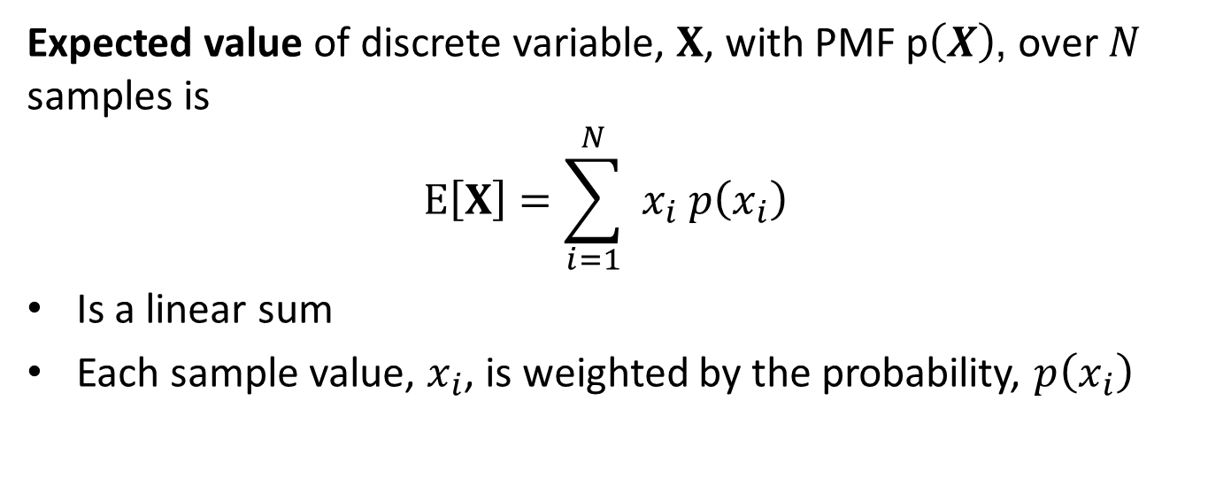
What do you expect: discrete distributions
Expected value of discrete variable, $X$, with PMF p$\left(X\right)$, over $N$ samples is
$$E\left[X\right]=\sum_{i=1}^{N}{ x_{i} p\left(x_{i}\right) }$$
Is a linear sum
Each sample value, $x_{i}$, is weighted by the probability, $p\left(x_{i}\right)$

Slide 50
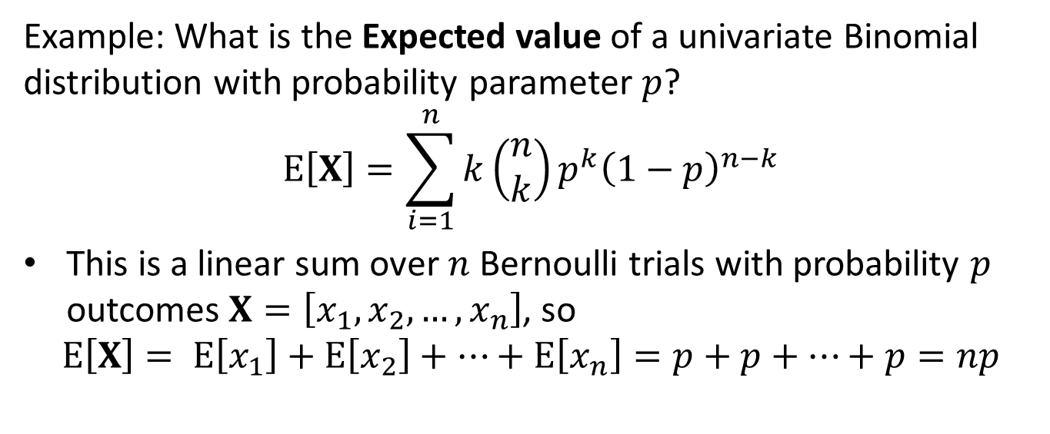
What do you expect: discrete distributions
Example: What is the Expected value of a univariate Binomial distribution with probability parameter $p$?
$$E\left[X\right]=\sum_{i=1}^{n}{k}\left(\begin{matrix}n \\ k\end{matrix}\right)p^{k}{\left(1−p\right)}^{n−k}$$
This is a linear sum over $n$ Bernoulli trials with probability $p$ outcomes $X=\left[x_{1},x_{2},…,x_{n}\right]$, so
$$E\left[X\right]= E\left[x_{1}\right]+E\left[x_{2}\right]+…+E\left[x_{n}\right]=p+p+…+p=np$$

Slide 51
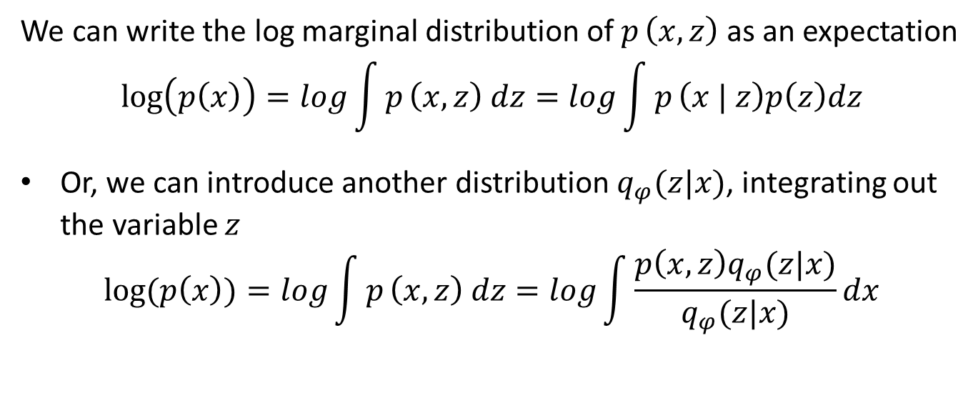
What do you expect: Expectation and Marginal Distribution
We can write the log marginal distribution of $p_{ }\left(x,z\right)$ as an expectation
$$\log\left(p\left(x\right)\right)=log\int{p_{ }\left(x,z\right) dz}=log\int{p_{ }\left(x | z\right)p\left(z\right)dz}$$
Or, we can introduce another distribution $q_{φ}(z|x)$, integrating out the variable $z$
$$log⁡(p\left(x\right))=log\int{p_{ }\left(x,z\right) dz}=log\int{\frac{p\left(x,z\right)q_{φ}(z|x)}{q_{φ}(z|x)}dx}$$

Slide 52
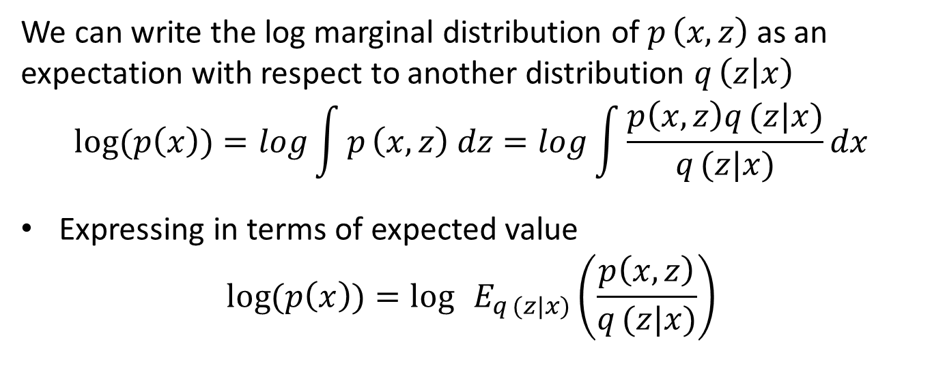
What do you expect: Expectation and Marginal Distribution
We can write the log marginal distribution of $p_{ }\left(x,z\right)$ as an expectation with respect to another distribution $q_{ }\left(z | x\right)$
$$log⁡(p\left(x\right))=log\int{p_{ }\left(x,z\right) dz}=log\int{\frac{p\left(x,z\right)q_{ }(z|x)}{q_{ }(z|x)}dx}$$
Expressing in terms of expected value
$$log⁡(p\left(x\right))=\log{ }E_{q_{ }(z|x)}\left(\frac{p\left(x,z\right)}{q_{ }(z|x)}\right)$$

Slide 53
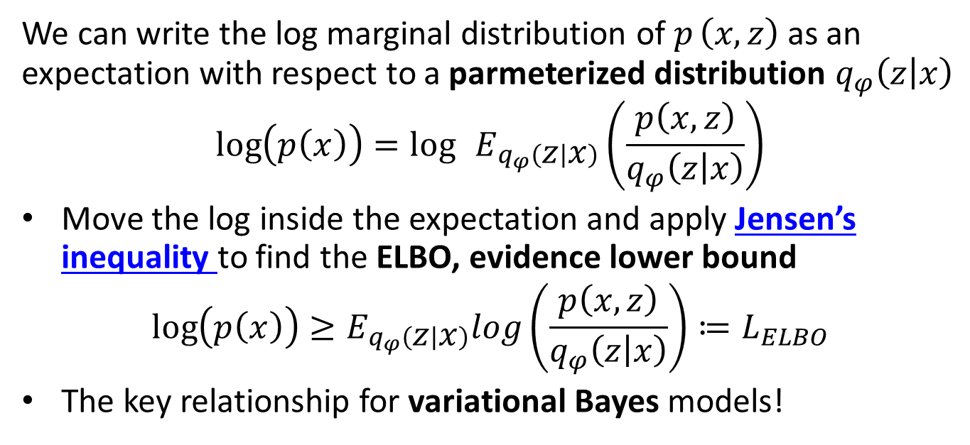
What do you expect: Expectation and Marginal Distribution
We can write the log marginal distribution of $p_{ }\left(x,z\right)$ as an expectation with respect to a parmeterized distribution $q_{φ}\left(z | x\right)$
$$\log\left(p\left(x\right)\right)=\log{ }E_{q_{φ}\left(z | x\right)}\left(\frac{p\left(x,z\right)}{q_{φ}\left(z | x\right)}\right)$$
Move the log inside the expectation and apply Jensen’s inequality to find the ELBO, evidence lower bound
$$\log\left(p\left(x\right)\right)≥E_{q_{φ}\left(z | x\right)}log\left(\frac{p\left(x,z\right)}{q_{φ}\left(z | x\right)}\right)≔L_{ELBO}$$
The key relationship for variational Bayes models!

Slide 54
Summary

Slide 55
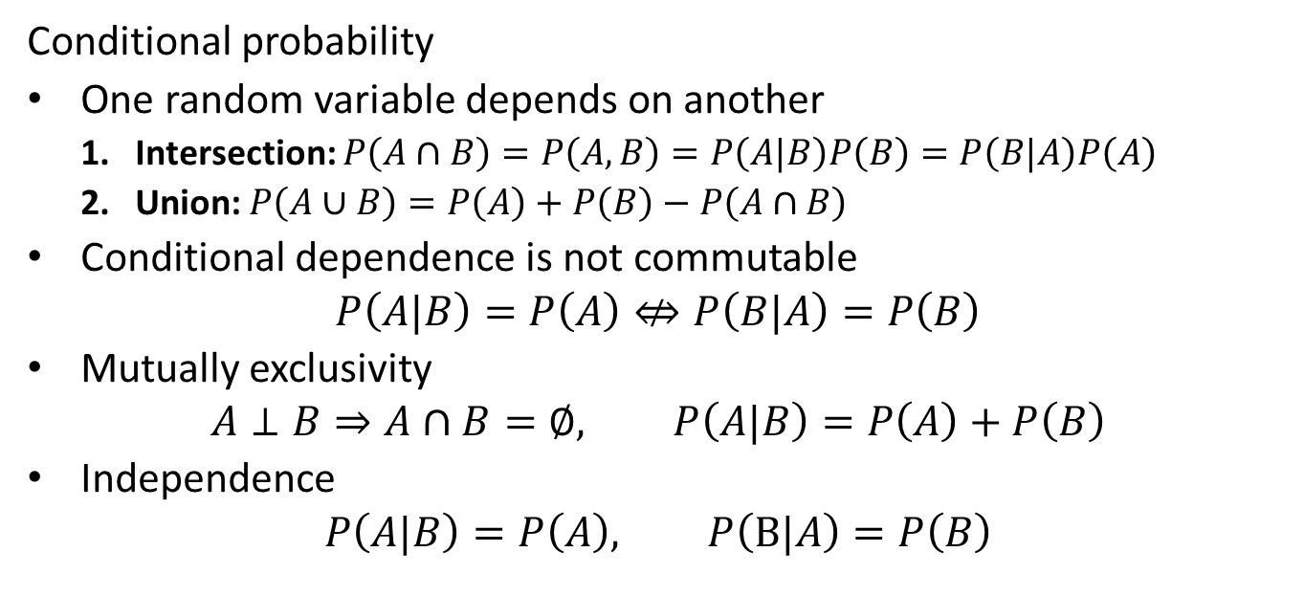
Summary
Conditional probability
One random variable depends on another
Intersection: $P\left(A∩B\right)=P\left(A,B\right)=P\left(A|B\right)P\left(B\right)=P\left(B|A\right)P\left(A\right)$
Union: $P\left(A∪B\right)=P\left(A\right)+P\left(B\right)−P\left(A∩B\right)$
Conditional dependence is not commutable
$$P\left(A|B\right)=P\left(A\right)⇎P\left(B|A\right)=P\left(B\right)$$
Mutually exclusivity
$$A⊥B⇒A∩B=∅, P\left(A|B\right)=P\left(A\right)+P\left(B\right)$$
Independence
$$P\left(A|B\right)=P\left(A\right), P\left(B|A\right)=P\left(B\right)$$

Slide 56
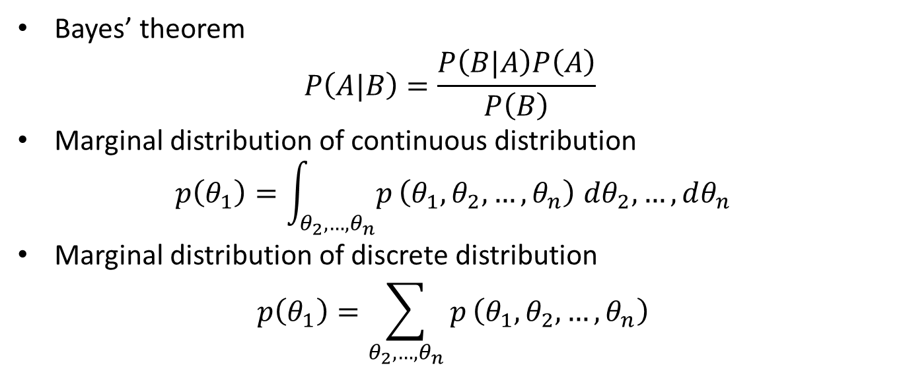
Summary
Bayes’ theorem
$$P\left(A|B\right)=\frac{P\left(B|A\right)P\left(A\right)}{P\left(B\right)}$$
Marginal distribution of continuous distribution
$$p\left(θ_{1}\right)=\int_{θ_{2},…,θ_{n}}^{​}{p}\left(θ_{1},θ_{2},…,θ_{n}\right) dθ_{2},…,dθ_{n}$$
Marginal distribution of discrete distribution
$$p\left(θ_{1}\right)=\sum_{θ_{2},…,θ_{n}}^{​}{p}\left(θ_{1},θ_{2},…,θ_{n}\right)$$

