Slide 1

CSCI E-25
Computer Vision
Regularization and Optimizationn for Machine Learning
Steve Elston
Copyright 2021, 2022, 2023, Stephen F Elston. All rights reserved.

Slide 2
Optimization and regularization for ML
Many widely used CV machine learning algorithms use optimization algorithms at the core
Object identification
Object detection
Image stitching
3-d vision
Motion tracking
Generative models
Notes:
jec

Slide 3
Optimization and regularization for ML
Many widely used CV machine learning algorithms use optimization algorithms at the core
Many machine learning algorithms use optimization to minimize a loss function
Optimization algorithms learn optimal model parameters
The more parameters and higher capacity the model, the harder it is to learn the model parameters
Notes:
jec

Slide 4
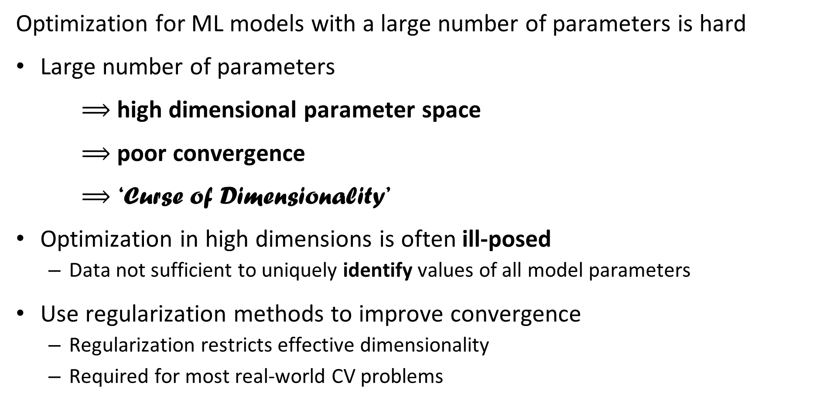
Optimization and regularization for ML
Optimization for ML models with a large number of parameters is hard
Large number of parameters
$⟹$ high dimensional parameter space
$⟹$ poor convergence
$⟹$ ‘Curse of Dimensionality’
Optimization in high dimensions is often ill-posed
  Data not sufficient to uniquely identify values of all model parameters
Use regularization methods to improve convergence
  Regularization restricts effective dimensionality
  Required for most real-world CV problems
Notes:
jec

Slide 5
Optimization and Regularization for Deep Neural Networks
Training deep neural networks requires learning a large number parameters
Millions of parameters is typical
Parameters are learned by gradient descent
  Requires optimization in high dimensions
  Must be executed on a large scale
The over-fit optimization problem is ill-posed – requires regularization
  Can have slow convergence
  May not have unique solution
  But, a good solution is often good enough

Slide 6
Introduction to Optimization and Regularization for Machine Learning
Representation
Inference
Input = X
Output = Y
Learning

Slide 7
Optimization for Machine Learning
Key points for this lesson
Many ML algorithms learn weights or parameters using optimizations
With millions of weights, we need highly efficient and reliable algorithms for gradient descent
Properties of gradient descent algorithms
  Convergence problems and over-fitting
  Batch gradient descent
  Stochastic gradient descent
  Adaptive stochastic gradient descent

Slide 8
Regularization for Machine Learning
Key points for this lesson
Deep learning models have very large numbers of parameters which must be learned.
  Even with large training datasets there may only be a few samples per parameters
Large number of parameters leads to high chance of over-fitting deep models
  Over-fit models do not generalize
  Over-fit models have poor response to input noise
To prevent over-fitting, we apply regularization methods

Slide 9
Introduction to Regularization for Deep Learning
Bias-variance trade-off
L2 regularization
L1 regularization
Early stopping
Dropout regularization
Batch normalization

Slide 10
Quadratic Optimization and Gradient Descent

Slide 11

Optimization for Deep Neural Networks
Gradient descent is a widely used optimization method for machine learning
Neural networks learn weights using the backpropagation algorithm
Weights are learned using the gradient descent method
Where:

Slide 12
Local Convergence of Gradient Descent
Ideally, the loss function, J(W), is convex with respect to the weights
Contours of J(W)_{MLE}
Min_{W} (J(W)_{MLE})
Initial W
Convex loss function has one unique minimum
Convergence for convex loss function is guaranteed

Slide 13


Local Convergence of Gradient Descent
Expand loss function to understand convergence properties of gradient descent:
Where:

Slide 14
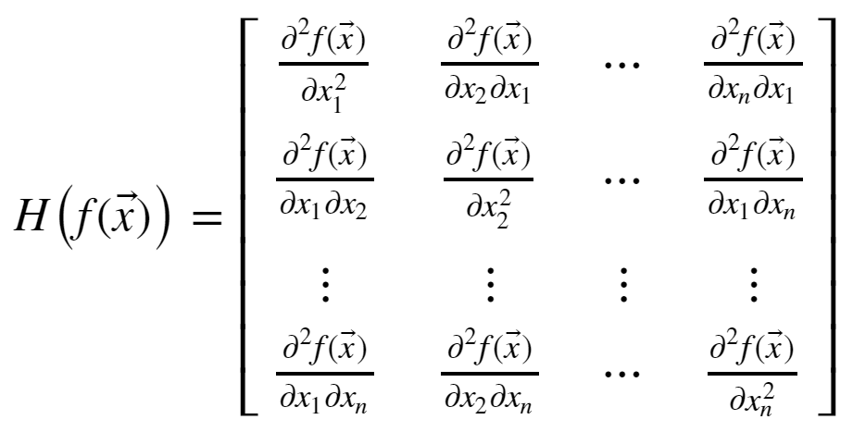
Local Convergence of Gradient Descent
How can you understand the Hessian matrix?
The Hessian is the matrix of all derivatives of the gradient
Properties of the Hessian determine convergence rate

Slide 15
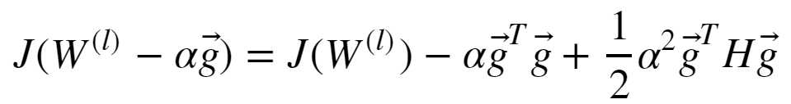

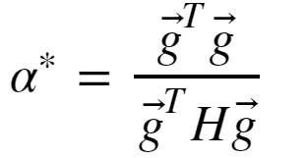
Local Convergence of Gradient Descent
How can we solve this convex optimization problem?
Given a step size α we can rewrite the above quadradic equation:
The minimum occurs where the gradient is 0:
And, with optimal step size:

Slide 16
Local Convergence of Gradient Descent
Real-world loss functions are typically not convex
There can be multiple minimums and maximums; a multi-modal loss function
Finding the globally optimal solution is hard!
The minimum reached by an optimizer depends on the starting value of W
In practice, we are happy with a good local solution, if not, the globally optimal solution
First order optimization found to perform as well, or better, than second order

Slide 17
Properties of Gradients

Slide 18

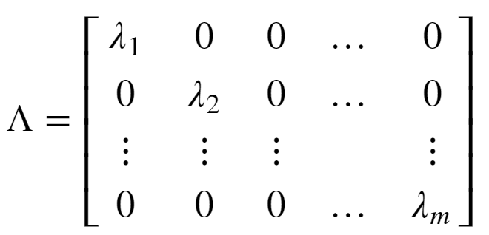
The Nature of Gradients
Convergence of quadratic optimization depends on the Hessian
To understand the behavior of the Hessian we need to examine the eigenvalues
A square matrix can be decomposed into eigenvalues and eigenvectors:
Where Q is the matrix of unitary eigenvectors
The eigenvalues are a diagonal matrix

Slide 19
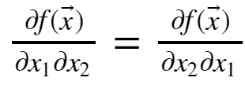
The Nature of Gradients
Some key properties of the Hessian matrix:
  The Hessian is symmetric since
  For a convex loss function the Hessian has all positive eigenvalues; it is positive definite – a minimum!
  At a maximum point the Hessian has all negative eigenvalues; it is negative definite
  The Hessian has some positive and some negative eigenvalues at a saddle point
  Saddle points are problematic since direction of descent to the minimum is unclear
  If Hessian has some very small eigenvalues, the gradient is low and convergence will be slow

Slide 20
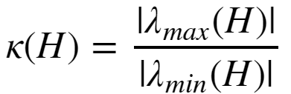
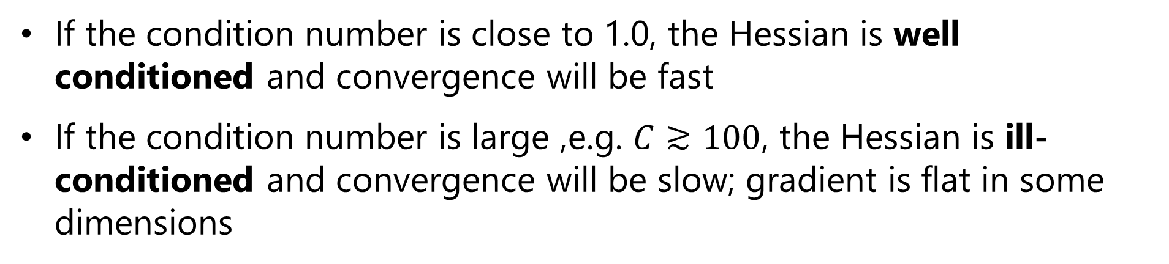
The Nature of Gradients
For quadratic optimization, the rate of convergence is determined by the condition number of the Hessian:
Where:
If the condition number is close to 1.0, the Hessian is well conditioned and convergence will be fast
If the condition number is large ,e.g. $C≳100$, the Hessian is ill-conditioned and convergence will be slow; gradient is flat in some dimensions

Slide 21
The Nature of Gradients
Example of well-conditioned and ill-conditioned gradients:
Min_{W} (J(W)_{MLE})
Min_{W} (J(W)_{MLE})
well-conditioned gradient
ill-conditioned gradient

Slide 22
Vanishing and Exploding Gradient Problems
There is no guarantee that the gradient of the loss function is well behaved
The gradient can vanish
  Flat spots in the gradient – Hessian with small eigenvalues
  Imagine a loss function with a long narrow valley
  Ill-conditioned Hessian
  Slow convergence
The gradient can explode
  Sudden changes in the gradient; falling off a cliff!
  Ill-conditioned Hessian
  Very large step; optimizer over-shoots the minimum point

Slide 23


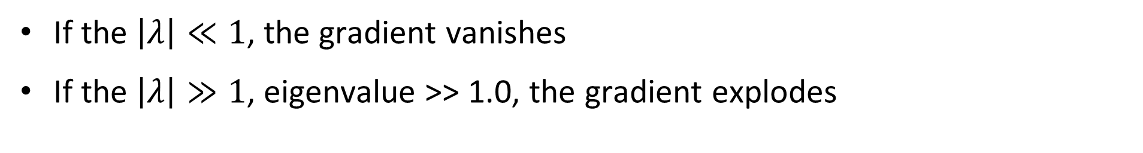
Vanishing and Exploding Gradient Problems
What happens to the eigenvalues of the Hessian?
Consider an n layer NN with linear activation
  The gradient is just the weight tensor, W, with eigen decomposition:
Multiplying the n weight tensors for the multi-layer NN:
If the $\left|λ\right|≪1$, the gradient vanishes
If the $\left|λ\right|≫1$, eigenvalue >> 1.0, the gradient explodes

Slide 24
Vanishing and Exploding Gradient Problems
What can be done about extreme gradient problems?
Dealing with vanishing gradient can be difficult
  Normalization of input values
  Regularization is essential!
  Batch normalization improves gradient
  ResNets – next week’s lesson
Dealing with exploding gradients is easy
  Gradient clipping prevents extreme values

Slide 25

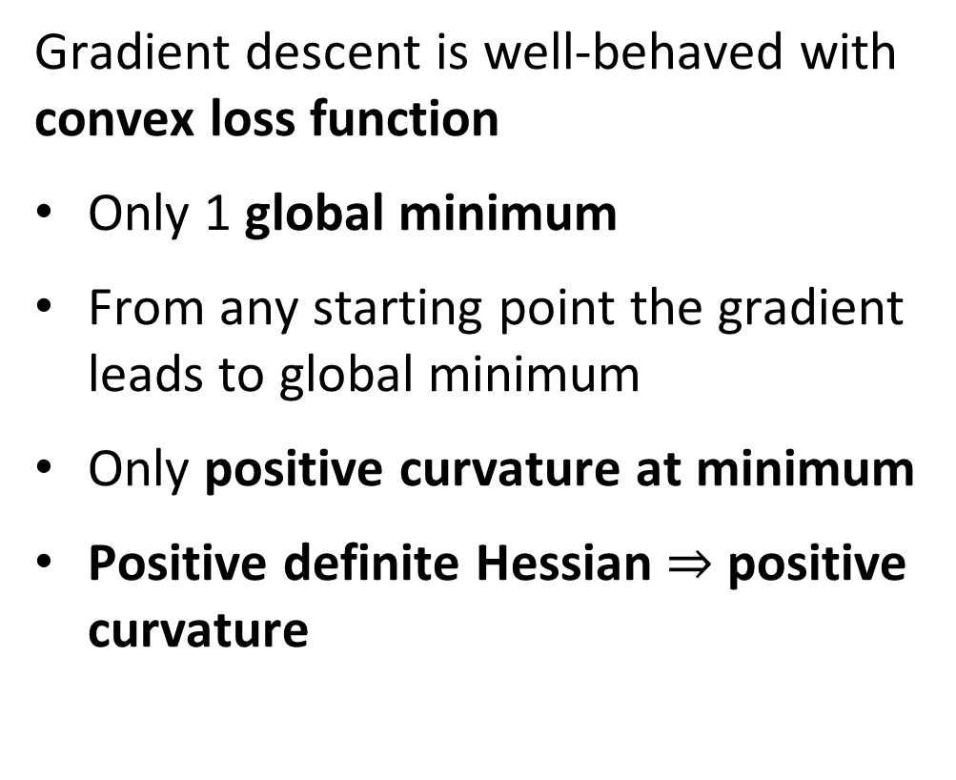
Convex vs. Non-Convex Optimization
Gradient descent is well-behaved with convex loss function
Only 1 global minimum
From any starting point the gradient leads to global minimum
Only positive curvature at minimum
Positive definite Hessian $⇒$ positive curvature
Convex loss
Poorly conditioned

Slide 26
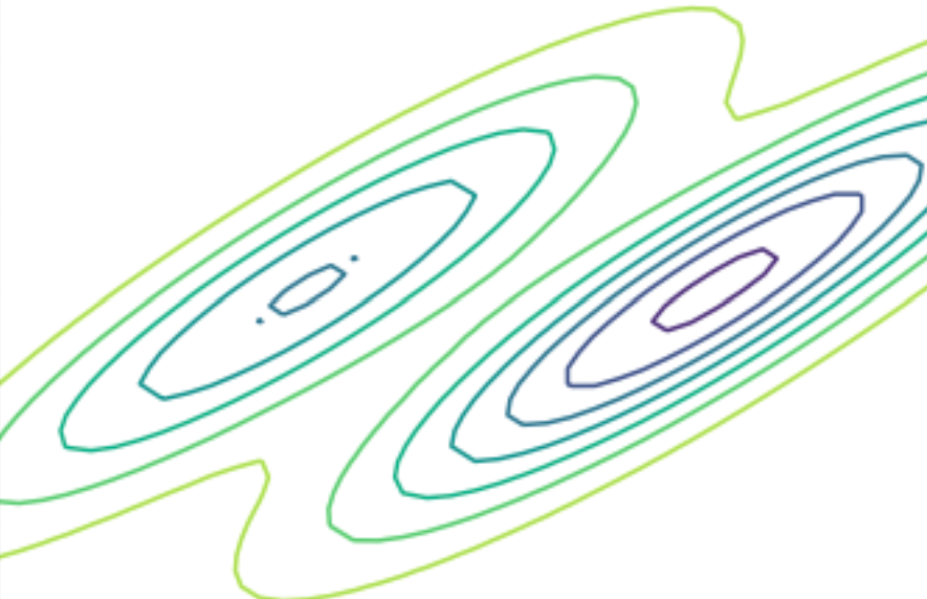
Convex vs. Non-Convex Optimization
Gradient descent can be problematic with nonconvex loss function
There is a global minimum
Possibly many local minimums
Minimum found with gradient descent depends on starting point
A good minimum may be good enough
Hessian negative definite at any minimum, but globally who knows??
Nonconvex loss

Slide 27
Convex vs. Non-Convex Optimization
Gradient descent can be problematic with nonconvex loss function
Can get stuck at saddle point!
Gradient is ambiguous at saddle point
Some dimensions with positive gradient, others with negative gradient
Hessian is not positive definite, so not minimum
?
?
Nonconvex loss

Slide 28
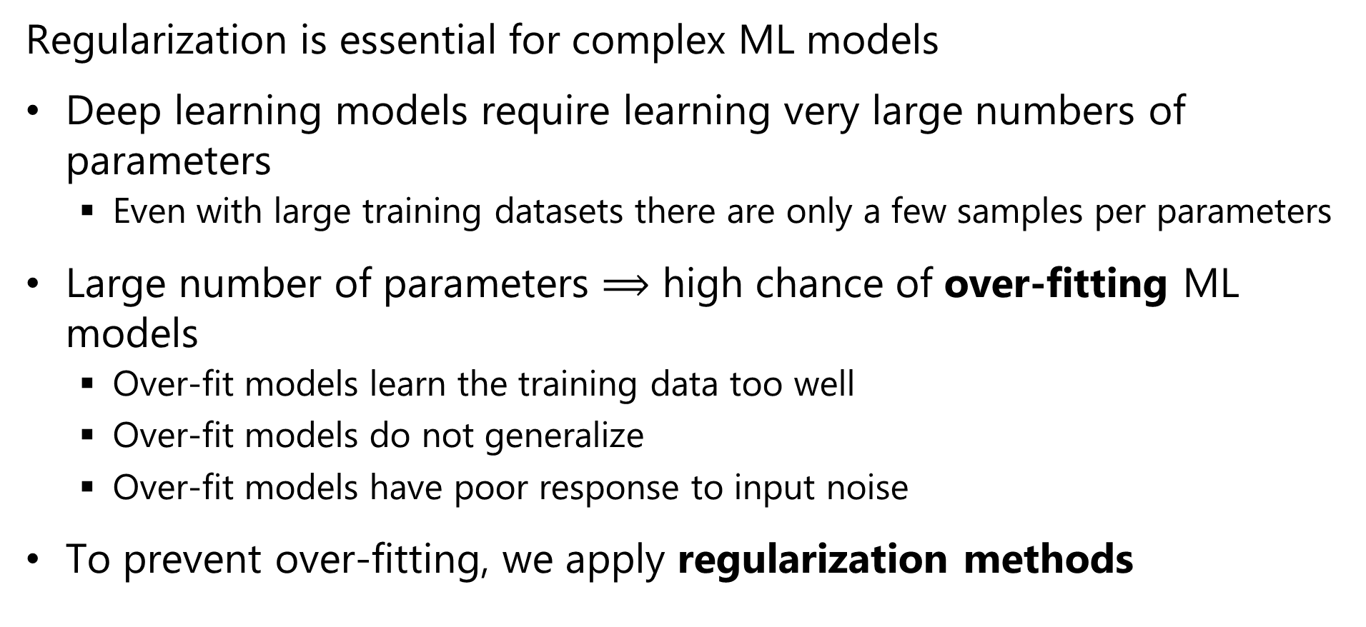
Regularization for Machine Learning
Regularization is essential for complex ML models
Deep learning models require learning very large numbers of parameters
  Even with large training datasets there are only a few samples per parameters
Large number of parameters $⟹$ high chance of over-fitting ML models
  Over-fit models learn the training data too well
  Over-fit models do not generalize
  Over-fit models have poor response to input noise
To prevent over-fitting, we apply regularization methods

Slide 29
The L2 Regularization Method

Slide 30
l2 Regularization
L2 or Euclidean norm regularization is a widely used method
Over-fit models tend to have parameters (weights) with extreme values
One way to regularize models is to limit the values of the parameters
Limit the L2 norm of the model parameter vector
We add a small bias term to (greatly) reduce the variance

Slide 31
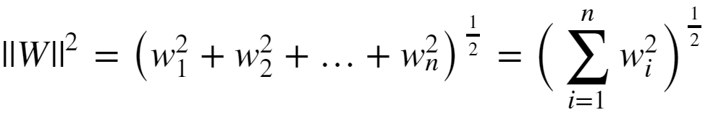

l2 Regularization
Limit the size of the model parameters is to constrain the l2 or Euclidian norm:
The regularized loss function is then:
Where λ is the regularization hyperparameter
  Large λ increases bias but reduces variance
  Small λ decreases bias and increases variance

Slide 32
l2 Regularization
How can you gain some intuition about l2 regularization?
X2
Β1 ~ 0
Β1 large
Β2 small
-Β1 = Β2
X1
Β2 ~ 0
Constant ||Β||²
l2 regularization is considered a soft constraint

Slide 33
L2 Regularization
How can you gain some intuition about l2 regularization?
Contours of J(W)_{MLE}
Min_{W} (J(W)_{MLE})
Constraint on model parameters binds
Initial W
Domain of Overfitting
Contours of ||W||²

Slide 34
l2 Regularization
l2 regularization goes by many names
Euclidian norm regularization
First published by Andrey Tikonov in late 1940s
  Only published in English in 1977
  Is known as Tikhonov regularization
In the statistics literature often called ridge regression
In the engineering literature is referred to as pre-whitening

Slide 35
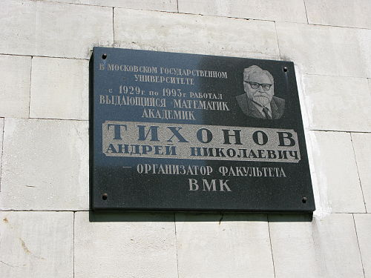
l2 Regularization
Plaque commemorating Andrey Tikhonov at Moscow Institute of Mathematics

Slide 36
Eigenvalues and Regularization

Slide 37



Eigenvalues and Regularization
l2 regularization with eigenvalue-eigenvector decomposition
A linear model with feature matrix, A, labels, x, and parameter vector b is written:
We want to find a solution:
The normal equations represent a computationally efficient approach:

Slide 38

Eigenvalues and Regularization
l2 regularization with eigenvalue-eigenvector decomposition
The n coefficients of the linear model are found with the normal equations:
The solution requires finding the inverse of a symmetric n x n covariance matrix
This matrix can be represented by its eigenvalue-eigenvector decomposition:

Slide 39

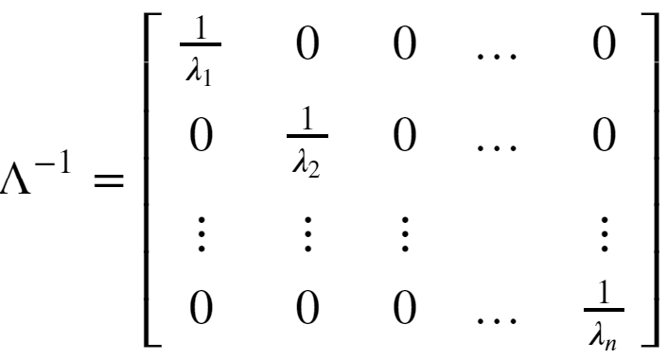
Eigenvalues and Regularization
l2 regularization with eigenvalue-eigenvector decomposition
We need the inverse of the symmetric matrix with decomposition:
Where

Slide 40
Eigenvalues and Regularization
l2 regularization with eigenvalue-eigenvector decomposition
Can compute the inverse of the symmetric covariance matrix with decomposition:
But, (A^{T}A)⁻¹ can be rank deficient!
In practice, many machine learning problems are rank deficient
The columns of a rank deficient matrix are not linearly independent
A rank deficient matrix has some zero eigenvalues
A matrix with m nonzero eigenvalues is said to have rank m

Slide 41


Eigenvalues and Regularization
l2 regularization with eigenvalue-eigenvector decomposition
For l2 regularization we introduce a small bias term, α²
The least-squares, or l2 minimization problem, is then:
With solution

Slide 42

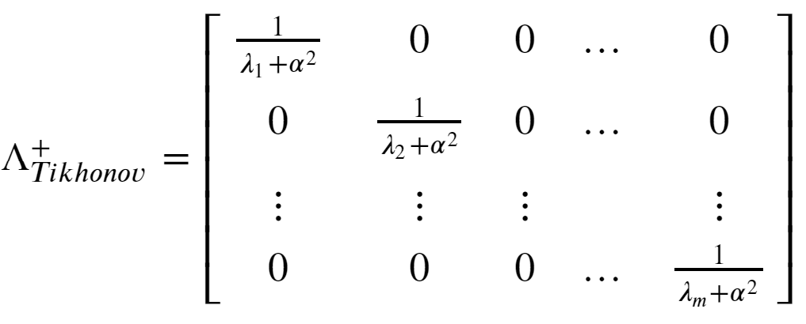
Eigenvalues and Regularization
l2 regularization with eigenvalue-eigenvector decomposition
For the inverse the eigenvalue matrix is:
Even for an eigenvalue, λ, of 0, the biased inverse becomes 1/ α²
Thus, the bias term, α², creates a ‘ridge’ of nonzero values on the diagonal ensuring the inverse exists and is stable.

Slide 43
Eigenvalues and Regularization
l2 regularization with eigenvalue-eigenvector decomposition
Consider the bias-variance trade off of the solution:
For α² = 0, there is no bias, but variance can be high
For a large value of α² , the inverse is stable and the variance is low, but the bias can be high

Slide 44
L1 Regularization Methods

Slide 45
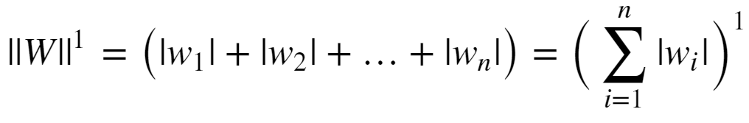
l1 Regularization
Regularization can be performed with other norms
The l1 (min-max) norm is another common choice
Conceptually, l1 norm limits the sum of the absolute values of the weights:
The l1 norm is also known as the Manhattan distance or taxi cab distance, since it is the distance traveled on a grid between two points.

Slide 46

l1 Regularization
Given the l1 norm of the weights, the loss function becomes:
Where α is the regularization hyperparameter
  Large α increases bias but reduces variance
  Small α decreases bias and increases variance
The l1 constraint drives some weights to exactly 0
  This behavior leads to the term lasso regularization
  L1 regularization provides a hard constraint on parameters
  In contrast L2 provides soft constraints

Slide 47
l1 Regularization
A diagram helps develop some intuition on l1 regularization:
X2
Β1 = 0
X1
Β2 = 0
Constant ||Β||
L1 regularization is a hard constraint on the weights

Slide 48
L1 Regularization
A diagram helps develop some intuition on l1 regularization:
Contours of J(W)_{MLE}
Min_{W} (J(W)_{MLE})
Nonzero parameter
value
Initial W
Domain of Overfitting
Contours of ||W||¹

Slide 49
Early Stopping as Regularization

Slide 50
Early Stopping
Early stopping is an old and simple idea
Stop updating the model weights before the model becomes overfit
Early stopping is analogous to l2 regularization
We can formulate the regularized loss function as:
Where α is the regularization hyperparameter

Slide 51
Early Stopping
Early stopping has a simple geometric interpretation
Contours of J(W)_{MLE}
Min_{W} (J(W)_{MLE})
Early stopping point
Initial W
Domain of Overfitting
Contours of ||W||²

Slide 52
Dropout Regularization

Slide 53
Dropout regularization
Overfit deep network models tend to suffer from a problem of co-adaptation
With limited training data weight tensors become adapted to the training data
Such a model is unlikely to generalize
We need a way to break the co-adaptation of the weight tensor
Note: Recently, some researchers have questioned the co-adaptation theory, but there is no consensus for an alternative theory

Slide 54
Dropout regularization
Dropout regularization is a conceptually simple method unique to deep learning
At each step of the gradient decent some fraction, p, of the weights are dropped-out of each layer
The result is a series of models trained for each dropout sample
The final model is a geometric mean of the individual models
Weight values are clipped in a small range as a further regularization
Result is an ensemble model!
For full details see the readable paper by Srivastava et. al., 2014 http://www.cs.toronto.edu/~rsalakhu/papers/srivastava14a.pdf

Slide 55
Dropout regularization
Let’s look at a simple example of a network with one hidden layer:
O
h₁
h₂
h₃
h₄
i₁
i₂

Slide 56
Dropout regularization
There are six of the possible models with 2 hidden units:
O
O
O
h₃
h₄
h₂
h₄
h₂
h₃
i₁
i₂
i₁
i₂
i₁
i₂
O
O
O
h₁
h₄
h₁
h₃
h₁
h₂
i₁
i₂
i₁
i₂
i₁
i₂
Can also sample models with 1 or 3 hidden units:

Slide 57




Dropout regularization
How can the partial derivatives for backpropagation be computed with dropout regularization?
The probability of a weight being in a given model is:
The forward propagation equations then become:

Slide 58


Dropout regularization
How can the partial derivatives for backpropagation be computed with dropout regularization?
We need partial derivatives of
For the dropout layer σ is linear, and the derivatives with respect to the weights are:
  , in which case the partial derivative = 1
  , in which case the partial derivative = 0

Slide 59
Batch Regularization

Slide 60
Batch Normalization
In deep neural networks there is a high chance that units in a hidden layer have a large range of output values
  Causes shifts in the covariance of the output values
  Leads to difficulty computing the gradient
  Slows convergence
A solution is to normalize the output of the hidden layers in the network as a batch
This simple idea can be really effective
For more details see Sergey and Szegedy, 2015: https://arxiv.org/pdf/1502.03167.pdf

Slide 61
Quadratic Optimization and Gradient Descent

Slide 62
Optimization for Deep Neural Networks
Gradient descent is a widely used optimization method for machine learning
Neural networks learn weights using the backpropagation algorithm
Weights are learned using the gradient descent method
Where:

Slide 63
Local Convergence of Gradient Descent
Ideally, the loss function, J(W), is convex with respect to the weights
Contours of J(W)_{MLE}
Min_{W} (J(W)_{MLE})
Initial W
Convex loss function has one unique minimum
Convergence for convex loss function is guaranteed

Slide 64
Local Convergence of Gradient Descent
Expand loss function to understand convergence properties of gradient descent:
Where:

Slide 65
Local Convergence of Gradient Descent
How can you understand the Hessian matrix?
The Hessian is the matrix of all derivatives of the gradient
Properties of the Hessian determine convergence rate

Slide 66
Local Convergence of Gradient Descent
How can we solve this convex optimization problem?
Given a step size α we can rewrite the above quadradic equation:
The minimum occurs where the gradient is 0:
And, with optimal step size:

Slide 67
Local Convergence of Gradient Descent
Real-world loss functions are typically not convex
There can be multiple minimums and maximums; a multi-modal loss function
Finding the globally optimal solution is hard!
The minimum reached by an optimizer depends on the starting value of W
In practice, we are happy with a good local solution, if not, the globally optimal solution
First order optimization found to perform as well, or better, than second order

Slide 68
Batch Gradient Descent Algorithms

Slide 69
Batch Gradient Descent
Recall the basic gradient descent equation:
Where:
The gradients of the multi-layer NN are computed using the chain rule

Slide 70
Batch Gradient Descent
Can we use the gradient descent equation directly?
Yes, we can
Iterate the weight tensor relation until a stopping criteria or error tolerance is reached:
    ||W^{t+1} – W^{t}|| < tolerance
But;
  Must compute the gradient for all weights at one time as a batch at each step
  Does not scale if there are a large number of weights

Slide 71
Stochastic Gradient Descent

Slide 72
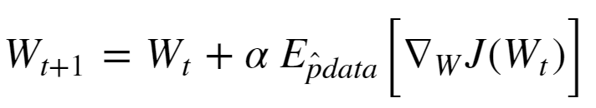


Stochastic Gradient Descent
Need a highly scalable gradient descent algorithm
Stochastic gradient descent is just such a method
The weight tensor update for stochastic gradient descent follows this relationship:
  Where:
  is the Bernoulli sampled mini-batch
  is the expected value of the gradient given the Bernoulli
  sample

Slide 73
Stochastic Gradient Descent
Stochastic gradient descent is massively scalable
Stochastic gradient descent is known to converge well in practice
Empirically, using mini-batch samples provide a better exploration of the loss function space
  Can help solution escape from small local gradient problems
  Sampling is dependent on mini-batch size

Slide 74
Stochastic Gradient Descent
Stochastic gradient descent algorithm
Random_sort(cases)
while(grad > stopping_criteria):
mini-batch = sample_next_n(cases)
grad = compute_expected_grad(mini_batch)
weights = update_weights(weights, grad)
Notice that the addition rounds repeat the samples
  In practice this does not create much bias
  For large samples this may not happen

Slide 75
Improving Convergence of SGD

Slide 76



Stochastic Gradient Descent with Momentum
Momentum improves convergence of SGD
Stochastic gradient descent is slow to converge if flat spots in the gradient are encountered – Hessian with small eigenvalues
What is a solution?
Add momentum to the gradient;
  Where:
Analogy with Newtonian mechanics
  Momentum maintains the trajectory of the descent through flat gradient regions

Slide 77
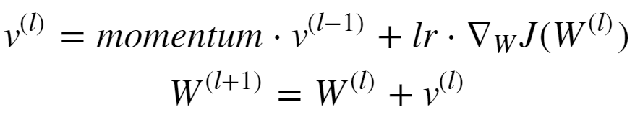


Stochastic Gradient Descent with Momentum
Letting the mass be 1.0 update the weight tensor in two steps:
Where:
Notice the algorithm now has two hyperparameters

Slide 78
Adaptive Stochastic Gradient Descent
How can we improve convergence with a variable learning rate?
A single learning rate is not likely to be optimal
  Far from the minimum, a large learning rate speeds convergence
  Near the minimum a small learning rate prevents over-shooting the minimum
Use a manually created learning schedule
  Introduces additional hyperparameters
Use an adaptive algorithm
  Learning rate is adjusted based on the estimates of the gradient

Slide 79
Selecting Initial Weight Values
To prevent weights from becoming linearly dependent the initial values must be randomly selected
  Otherwise, some weight values are never learned
Simple truncated Gaussian or Uniform distributed values work well in practice
  This process is referred as adding fuzz to the initial values
Many other initialization schemes have been developed
  For example, see the Keras initializers documentation

Slide 80
Appendix: Review of Eigenvectors and Eigenvalues

Slide 81
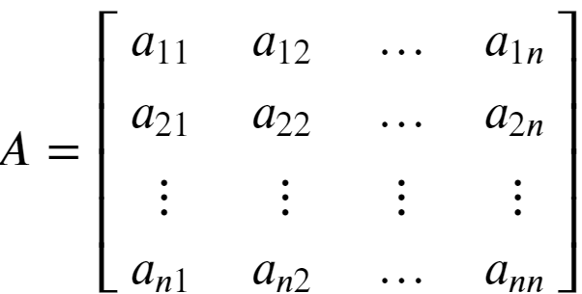
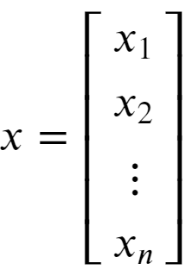

Review of Eigenvalues
Eigenvalues are characteristic roots or characteristic values of a linear system
Start with a square n x n matrix A, and vector x:
Then, an eigenvalue of A has the property:

Slide 82
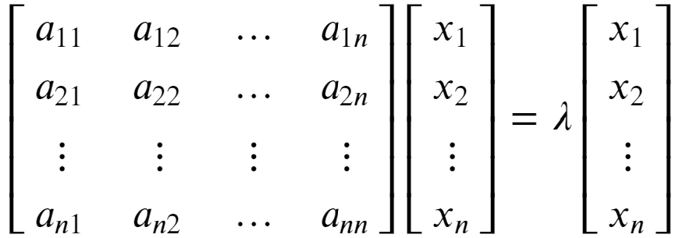


Review of Eigenvalues
Eigenvalues are characteristic roots or characteristic values of a linear system
Rewrite the eigenvalue relationship:
To see that λ is a root of A we can rearrange as follows:

Slide 83

Review of Eigenvalues
Eigenvalues are characteristic roots or characteristic values of a linear system
An n x n matrix A will have n eigenvalues
Find eigenvalues by solving
Find n roots of the determinant:
For more detail on determinants see: https://en.wikipedia.org/wiki/Determinant

Slide 84


Review of Eigenvalues and Eigenvectors
Each eigenvalue of a square matrix is associated with an eigenvector
There is a left and right eigenvector for each eigenvalue
The right eigenvector has the following relationship to the matrix A and eigenvalue λ:
Notice that the right eigenvector is to the right of the matrix

Slide 85



Review of Eigenvalues and Eigenvectors
Each eigenvalue of a square matrix is associated with an eigenvector
There is also a left eigenvector with the following relationship to the matrix A and eigenvalue λ:
Notice that the left eigenvector is to the left of the matrix

Slide 86


Review of Eigenvalues and Eigenvectors
Each eigenvalue of a square matrix is associated with an eigenvector
The l2 norm of any eigenvector is 1:
This property means that the matrix of n eigenvectors, Q, is unitary
For a full rank matrix, each eigenvector is orthogonal to every other eigenvector, and linearly independent
Thus, for diagonal matrix of n eigenvalues, Λ, an n x n matrix, A, can be factored:

Slide 87


Review of Eigenvalues and Eigenvectors
Each eigenvalue of a square matrix is associated with an eigenvector
Given the eigenvalue-eigenvector factorization of the matrix A:
The inverse of A can be found:
And, A to the Nth power can be computed:
You can find more on eigenvalue-eigenvector decomposition: https://en.wikipedia.org/wiki/Eigendecomposition_of_a_matrix

Slide 88
Review of Eigenvalues
Eigenvalues are characteristic roots or characteristic values of a linear system
Start with a square n x n matrix A, and vector x:
Then, an eigenvalue of A has the property:

Slide 89
Review of Eigenvalues
Eigenvalues are characteristic roots or characteristic values of a linear system
Rewrite the eigenvalue relationship:
To see that λ is a root of A we can rearrange as follows:

Slide 90
Review of Eigenvalues
Eigenvalues are characteristic roots or characteristic values of a linear system
An n x n matrix A will have n eigenvalues
Find eigenvalues by solving
Solve n equations involving the determinant:
For more detail on determinants see: https://en.wikipedia.org/wiki/Determinant
Copyright 2020, Stephen F Elston. All rights reserved.

Slide 91
Review of Eigenvalues and Eigenvectors
Each eigenvalue of a square matrix is associated with an eigenvector
There is a left and right eigenvector for each eigenvalue
The right eigenvector has the following relationship to the matrix A and eigenvalue λ:
Notice that the right eigenvector is to the right of the matrix

Slide 92
Review of Eigenvalues and Eigenvectors
Each eigenvalue of a square matrix is associated with an eigenvector
There is also a left eigenvector with the following relationship to the matrix A and eigenvalue λ:
Notice that the right eigenvector is to the right of the matrix

Slide 93
Review of Eigenvalues and Eigenvectors
Each eigenvalue of a square matrix is associated with an eigenvector
The l2 norm of any eigenvector is 1:
This property means that the matrix of n eigenvectors, Q, is unitary
For a full rank matrix, each eigenvector is orthogonal to every other eigenvector, and linearly independent
Thus, for diagonal matrix of n eigenvalues, Λ, an n x n matrix, A, can be factored:

Slide 94
Review of Eigenvalues and Eigenvectors
Warning! – Advanced concepts ahead
Each eigenvalue of a square matrix is associated with an eigenvector
Given the eigenvalue-eigenvector factorization of the matrix A:
The inverse of A can be found:
You can find more on eigenvalue-eigenvector decomposition: https://en.wikipedia.org/wiki/Eigendecomposition_of_a_matrix

