Slide 1

CSCI E-25 Computer Vision
Building Blocks of Deep Learning
Steve Elston
Copyright 2021, 2022, 2023, 2024, 2025, Stephen F Elston. All rights reserved.

Slide 2
Building Blocks of Deep Learning
Deep learning for computer vision
Deep neural networks have revolutionized many areas of machine learning
Object classification
Object detection
Segmentation
Optical flow
3-D geometry
Generative models
…
Many types of deep neural networks used in CV
Fully connected NNs – our focus this week
Convolutional NNs for feature extraction – next week
Many others …

Slide 3
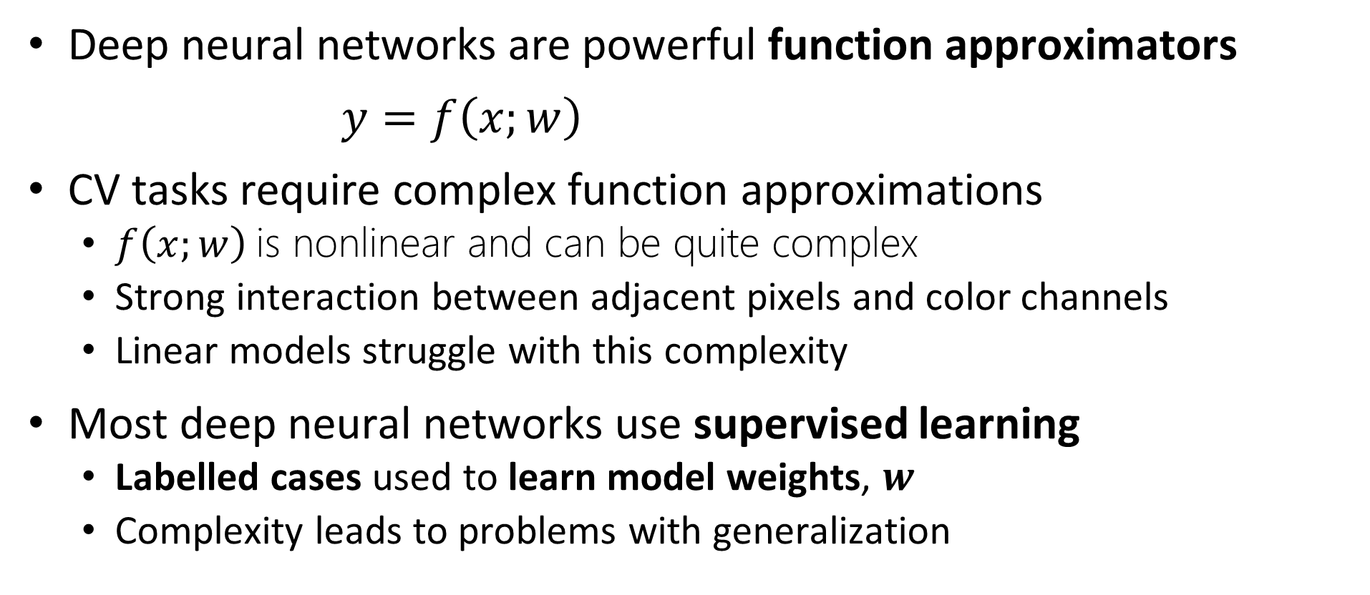
Function Approximation with Deep Neural Networks
Deep neural networks are powerful function approximators
$y=f\left(x;w\right)$
CV tasks require complex function approximations
$f\left(x;w\right)$is nonlinear and can be quite complex
Strong interaction between adjacent pixels and color channels
Linear models struggle with this complexity
Most deep neural networks use supervised learning
Labelled cases used to learn model weights, $w$
Complexity leads to problems with generalization

Slide 4
Essential Elements of AI Agents
Representation
Inference
Input = X
Output = Y
Learning

Slide 5
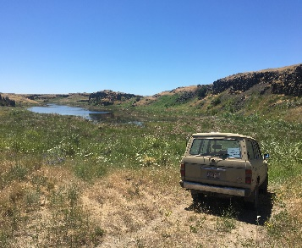
Why Fully Connected Neural Networks in CV
Pipelines for many CV tasks require fully connected NNs
CNNs and transformers
Flatten feature map
Inference
Input Image
Backbone network learns feature map
Multi-dimensional feature map
Task specific NN

Slide 6
Building Blocks of Deep Learning
Key points for this lesson
Preceptron and forward propagation
Depth, breath and model capacity
Nonlinearity and activation functions
Loss functions
Architectures of deep NNs
Learning in deep NNs

Slide 7
Perceptrons and Forward Propagation

Slide 8
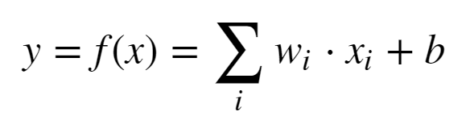
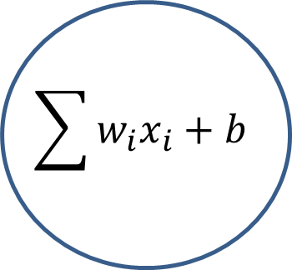
Representation: Linear Neural Network
Proposed by McCulloch and Pitts (1943)
X₁
w₁
$$\sum{w_{i}x_{i}+b}$$
w₂
X₂
Y
w₃
X₃

Slide 9

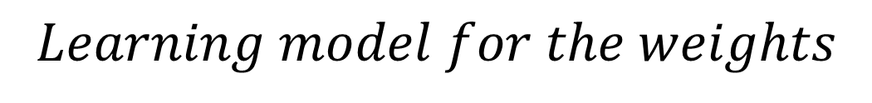


Representation: Linear Neural Network
Early learning model for a neural network - Heeb (1949)
X₁
$$Learning model for the weights$$
w₁
$$w_{ij}=x_{i}x_{j}$$
w₂
Σ + b
$$Δw_{ij}=ηx_{i}x_{j}$$
X₂
Y
w₃
$$Where, η is the learning rate$$
X₃
But, this is just linear regression!

Slide 10
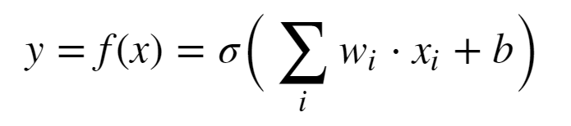
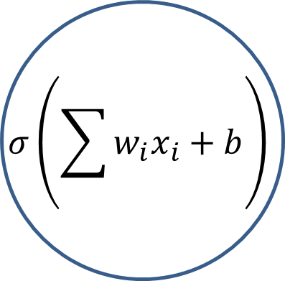
Representation: Perceptron
Use of nonlinear activation proposed by Rosenblatt (1962)
X₁
w₁
$$σ\left(\sum{w_{i}x_{i}+b}\right)$$
w₂
X₂
Y
w₃
X₃
Minsky and Papert (1969) showed the perceptron cannot represent an exclusive OR (XOR)
This is just logistic regression!

Slide 11
We Need a Better Deep Representation
By mid-1980s need for architecture with hidden layers for greater model capacity was recognized
Input layer
Multiple hidden layers
Output layer
Multiple units in layers
Nonlinear activations in units
Fully connect between units in layers
Learn weights for complex function approximation
Can solve XOR problem and much more!

Slide 12
We Need a Better Deep Representation
w¹₁₁
X₁
S₁ = σ_{h}(Σ )
w²₁
w¹₁₂
w¹₂₁
S₃ = Σ
X₂
w²₂
w¹₂₂
S₂ = σ_{h}(Σ )
_{Input Layer}
_{Hidden Layer}
_{Output Layer}

Slide 13
We Need a Better Deep Representation
What is the output of the simple network?
Process called forward propagation
Start with the output of the hidden layer:
S₁ = σ(Σ_{i} x_{i} * W¹_{1i})
S₂ = σ(Σ_{i} x_{i} * W¹_{2i})
Next, compute the output of the output layer
S₃ = Σ_{j} W²_{j} * σ(Σ_{i} x_{i} * W¹_{ji})

Slide 14
Model Depth, Width and Capacity

Slide 15
Model Capacity
The universal approximation theorem, Hornik (1991), tells us that an infinitely wide hidden layer can represent any function
Usefulness limited:
It’s nice to know we can represent complex functions
But, completely infeasible in practice
What can we do?
Trade depth for breath

Slide 16
Model Capacity
Model capacity is fundamentally related to the bias-variance trade-off of machine learning
Low-capacity models have high bias but low variance
High-capacity models have low bias but high variance
High-capacity models have a tendency to be overfit
We have more to say about this problem in another lesson

Slide 17
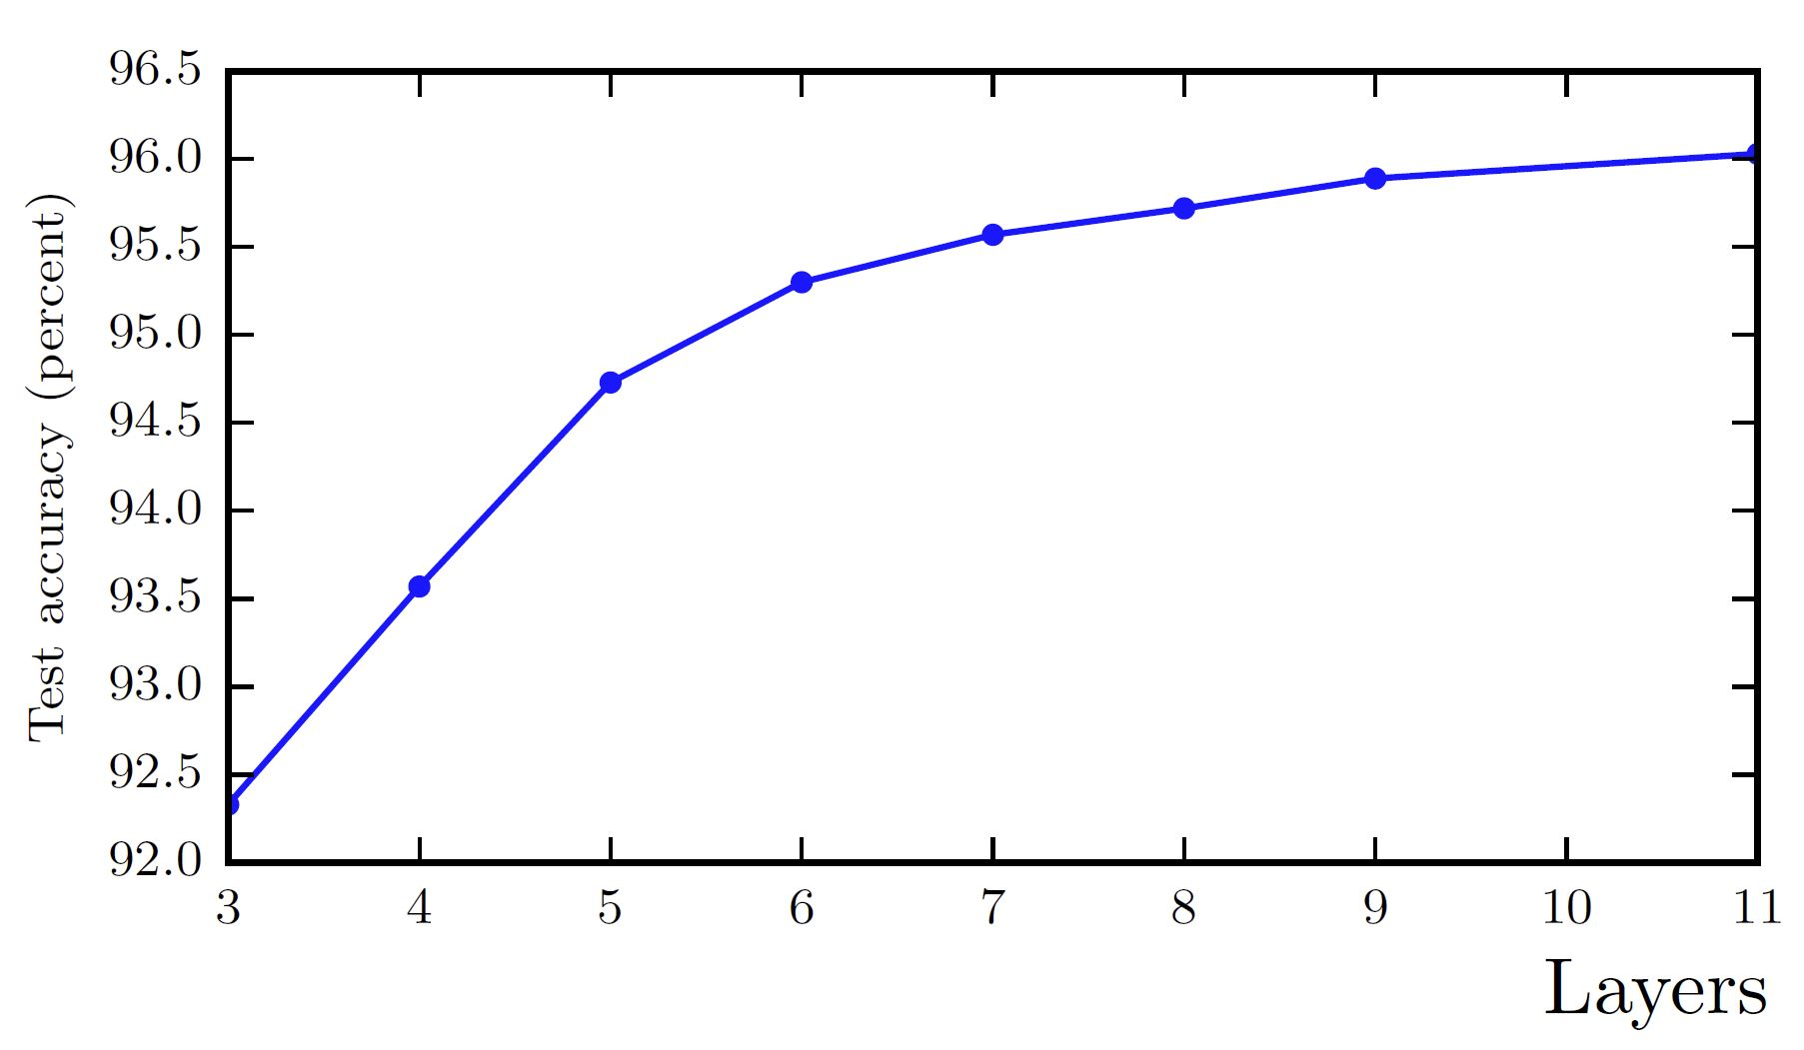
Model Capacity
Model capacity with increasing depth. From Goodfellow et. al. 2014.

Slide 18
Nonlinearity and Activation Functions

Slide 19
Activation functions
Nonlinear activation is key to achieving good function approximation.
Many activation functions have been tried, here are a few:
Function | How Used? | Comments
Sigmoid | Binary classifier output layer | Historically the most used
Softmax | Multi-class output layer | For categorical distribution
Linear | Numeric output layer | Regression models
Rectilinear | Hidden layers | Widely used to avoid vanishing gradient
Leak Rectilinear | Hidden layers | Widely used to avoid vanishing gradient
Tanh | Binary classifier output layers Other specialized applications | Better gradient properties than sigmoid

Slide 20
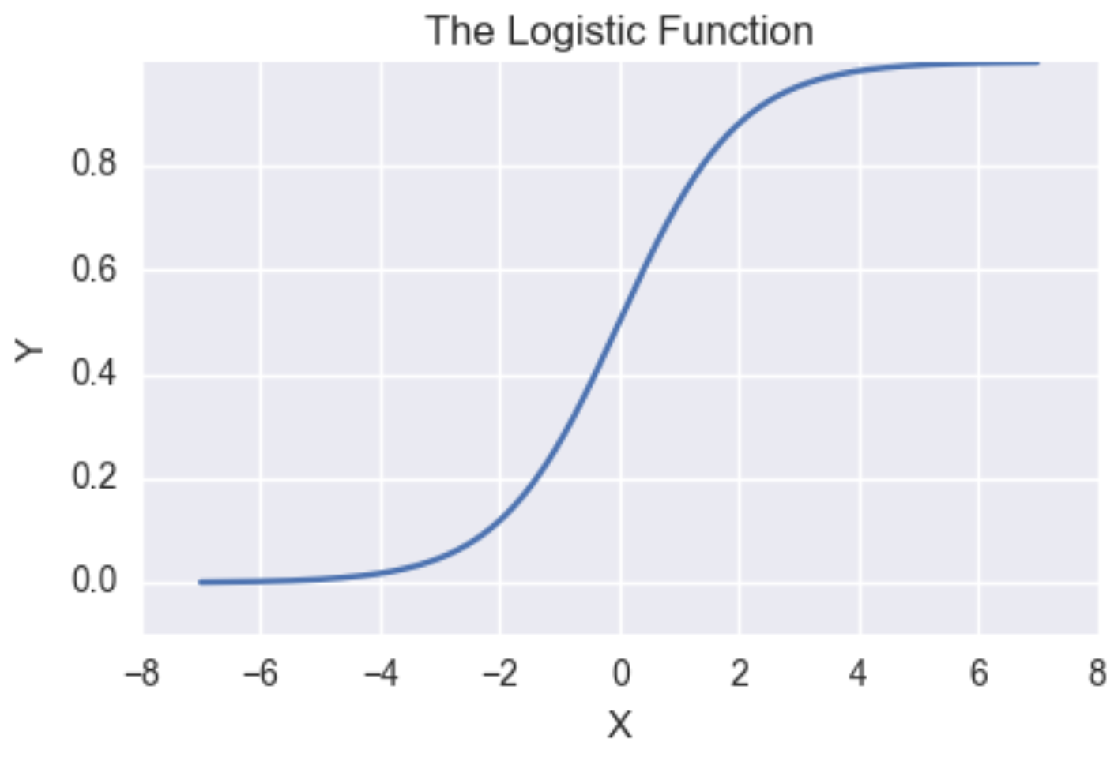
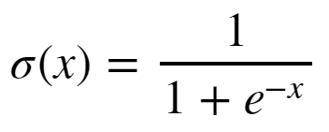
Activation functions
Sigmoid has vanishing gradients
Near-0 gradient
Near-0 gradient

Slide 21
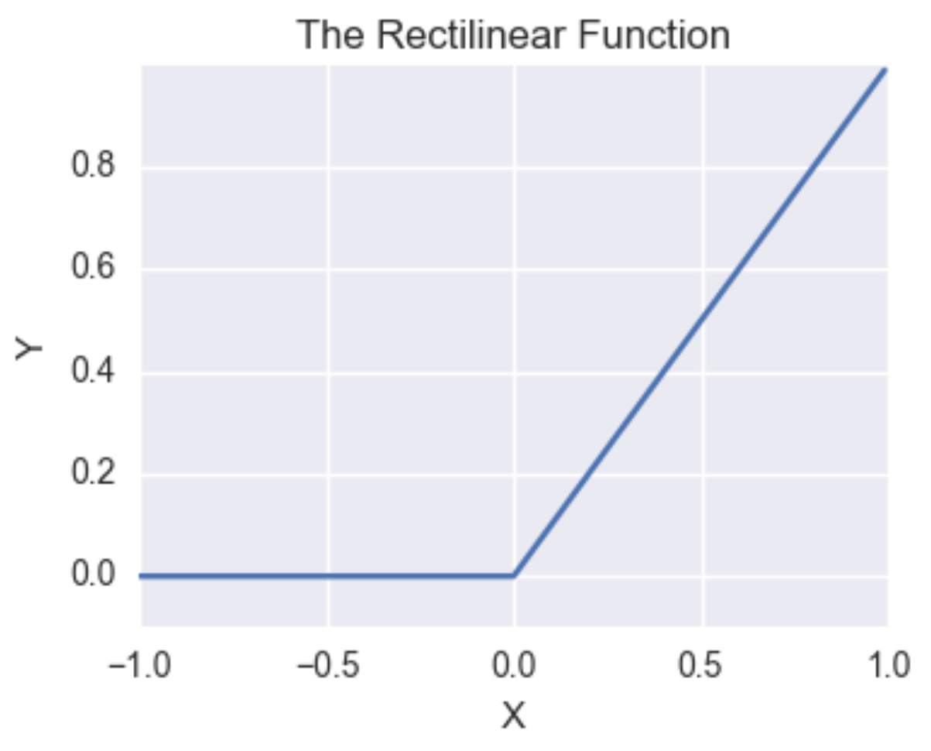

Activation functions
Rectilinear function has constant gradient for positive values
Constant gradient
Gradient of Leaky ReLU < 0

Slide 22
Learning Weights with Backpropagation

Slide 23
The Backpropagation Algorithm
To find function approximation, f(x), we need to learn model weights
The primary algorithm we use to learn model weights is known as backpropagation
Backpropagation was applied to learning (system identification) for control problems as early as 1960 by Henry Kelly and 1961 by Arthur Bryson for dynamic programming
First applied to neural networks by Paul Werbos in 1974
In 1986 by Rumelhart, Hinton and Williams showed that backpropagation was effective for learning the weights of multiple hidden layers
The era of deep learning had begun!!

Slide 24
The Backpropagation Algorithm
w¹₁₁
X₁
S₁ = σ_{h}(Σ )
w²₁
w¹₁₂
w¹₂₁
S₃ = Σ
J(W)
X₂
w²₂
w¹₂₂
S₂ = σ_{h}(Σ )
Y
_{Input Layer}
_{Hidden Layer}
_{Output Layer}
_{Loss Function}

Slide 25
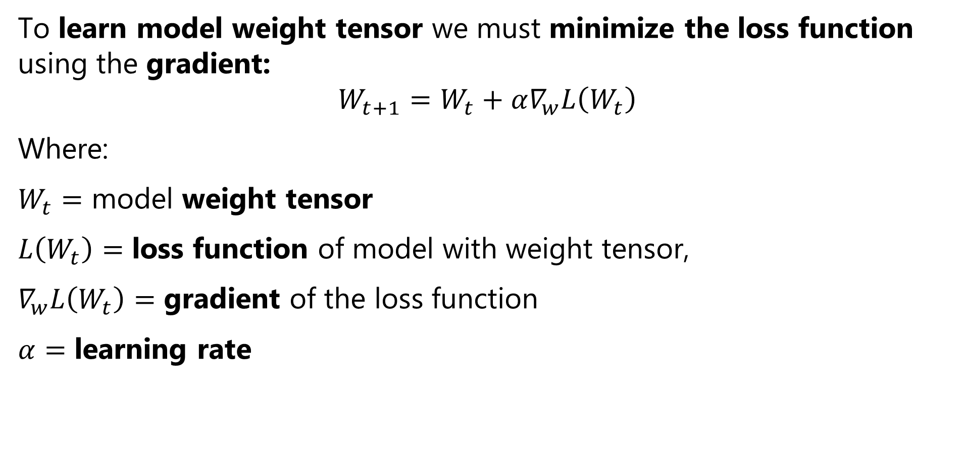
The Backpropagation Algorithm
To learn model weight tensor we must minimize the loss function using the gradient:
$$W_{t+1}=W_{t}+α∇_{w}L\left(W_{t}\right)$$
Where:
$W_{t}=$ model weight tensor
$L\left(W_{t}\right)=$ loss function of model with weight tensor,
$∇_{w}L\left(W_{t}\right)=$ gradient of the loss function
$α=$ learning rate

Slide 26
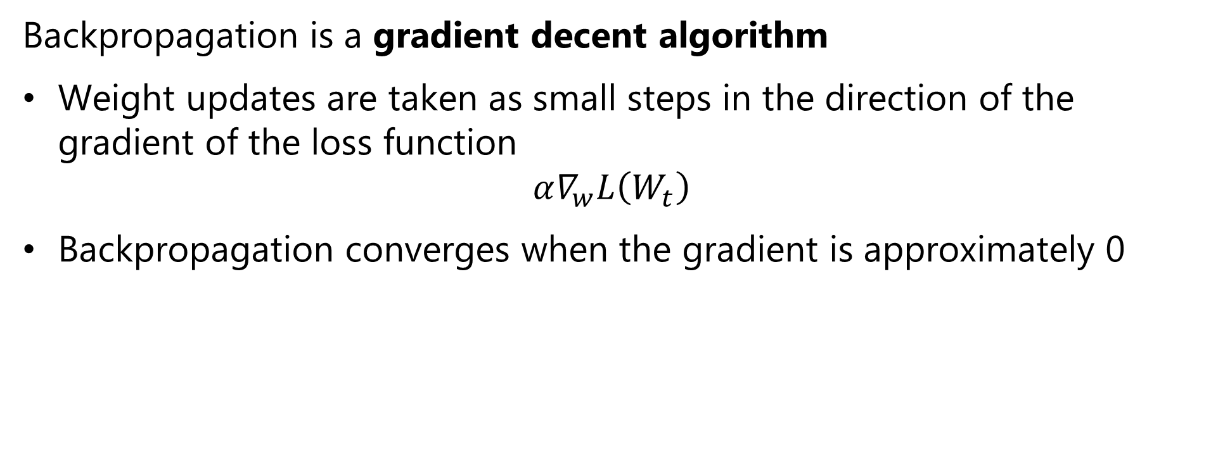
The Back Propagation Algorithm
Backpropagation is a gradient decent algorithm
Weight updates are taken as small steps in the direction of the gradient of the loss function
$$α∇_{w}L\left(W_{t}\right)$$
Backpropagation converges when the gradient is approximately 0

Slide 27
Loss Functions

Slide 28
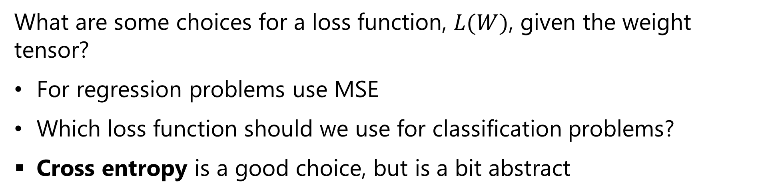
Loss Functions for Training Neural Networks
What are some choices for a loss function, $L(W)$, given the weight tensor?
For regression problems use MSE
Which loss function should we use for classification problems?
Cross entropy is a good choice, but is a bit abstract

Slide 29
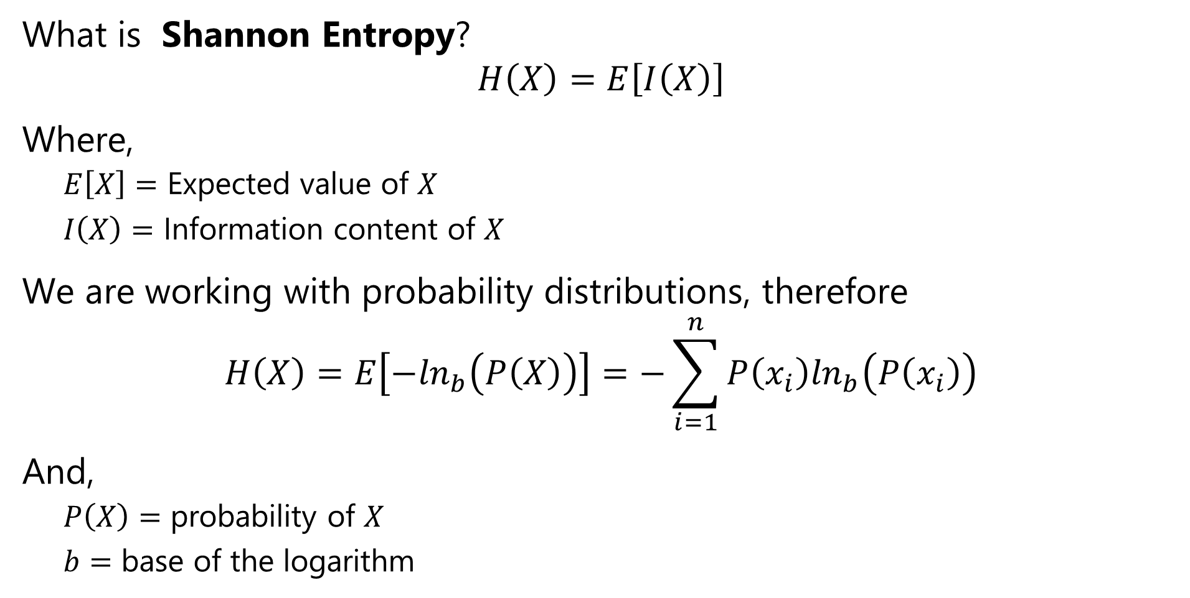
Loss Functions for Training Neural Networks
What is Shannon Entropy?
$$H\left(X\right)=E\left[I\left(X\right)\right]$$
Where,
$E\left[X\right]=$ Expected value of $X$
$I\left(X\right)=$ Information content of $X$
We are working with probability distributions, therefore
$$H\left(X\right)=E\left[−\ln_{b}\left(P\left(X\right)\right)\right]=−\sum_{i=1}^{n}{P\left(x_{i}\right)\ln_{b}\left(P\left(x_{i}\right)\right)}$$
And,
$P\left(X\right)=$ probability of $X$
$b=$ base of the logarithm

Slide 30
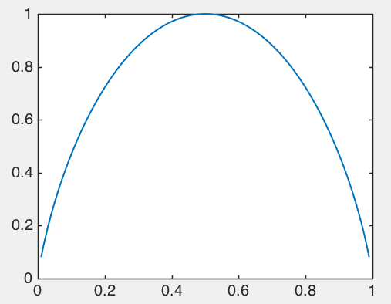
Loss Functions for Training Neural Networks
Entropy changes with the probability of an event
Example binary variable:
Max entropy when max uncertainty, p = 0.5 – can’t predict next event
Min entropy when certainty, p = [0,1] – no uncertainty about next event
Entropy [p,1-p]
Probability p

Slide 31
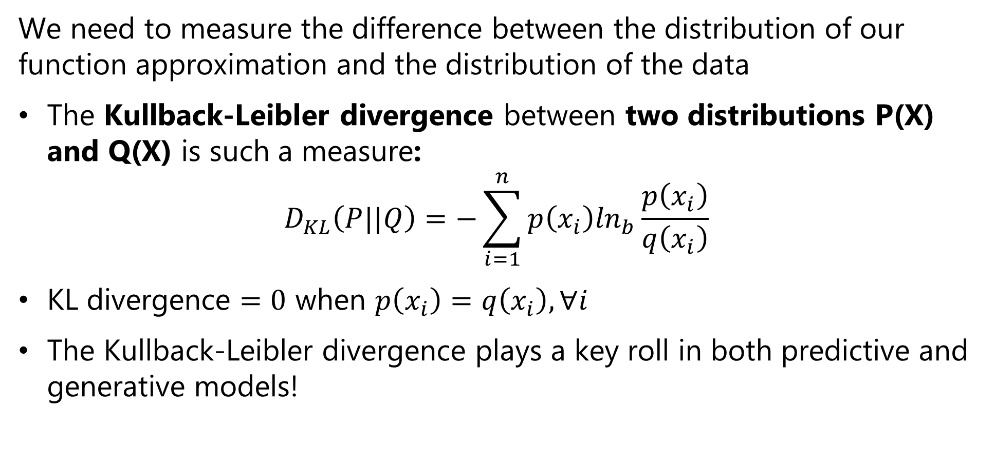
Loss Functions for Training Neural Networks
We need to measure the difference between the distribution of our function approximation and the distribution of the data
The Kullback-Leibler divergence between two distributions P(X) and Q(X) is such a measure:
$$D_{KL}\left(P||Q\right)=−\sum_{i=1}^{n}{p\left(x_{i}\right)\ln_{b}\frac{p\left(x_{i}\right)}{q\left(x_{i}\right)}}$$
KL divergence $=0$ when $p\left(x_{i}\right)=q\left(x_{i}\right),∀i$
The Kullback-Leibler divergence plays a key roll in both predictive and generative models!

Slide 32
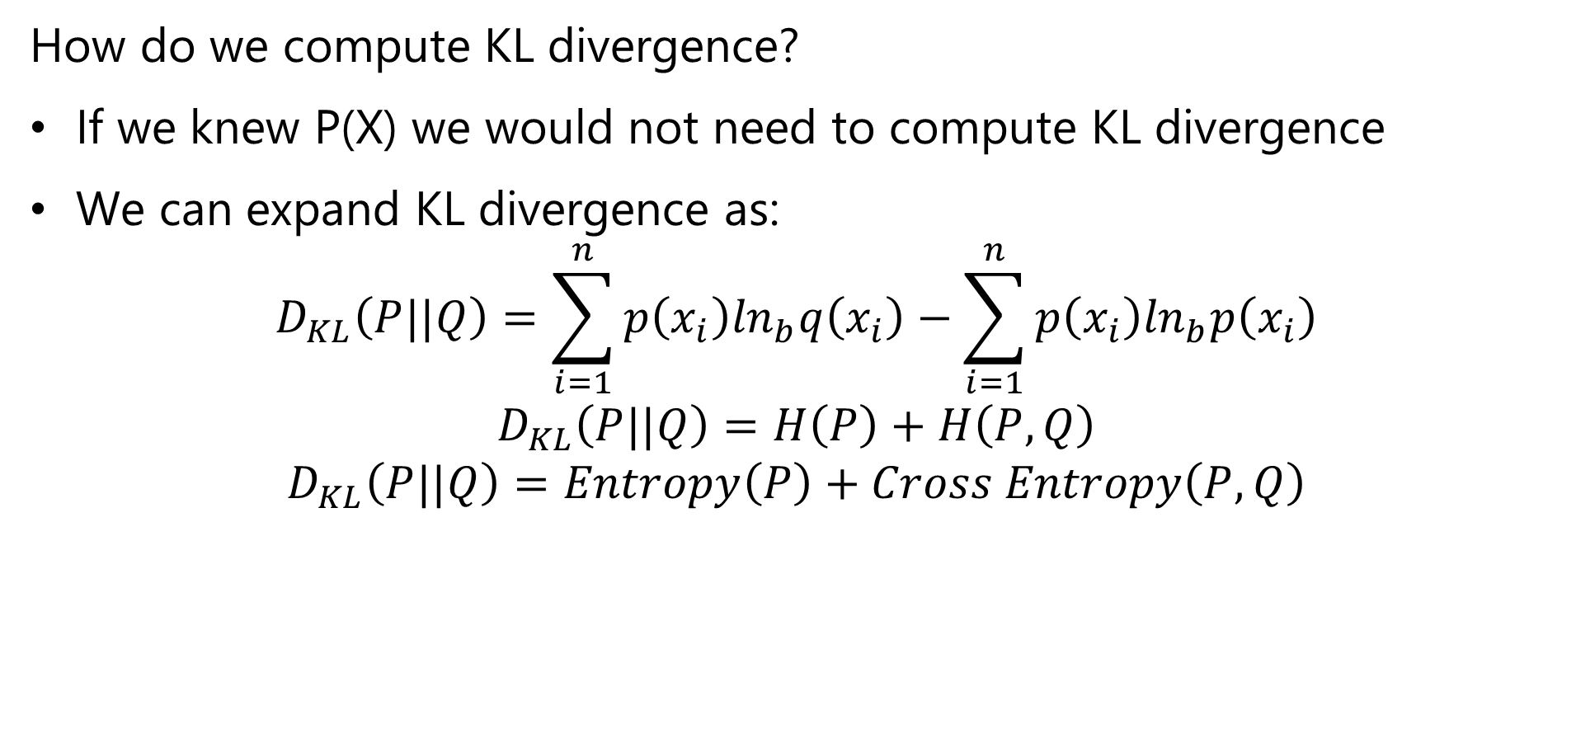
Loss Functions for Training Neural Networks
How do we compute KL divergence?
If we knew P(X) we would not need to compute KL divergence
We can expand KL divergence as:
$$D_{KL}\left(P||Q\right)=\sum_{i=1}^{n}{p\left(x_{i}\right)\ln_{b}q\left(x_{i}\right)}−\sum_{i=1}^{n}{p\left(x_{i}\right)\ln_{b}p\left(x_{i}\right)}$$
$$D_{KL}\left(P||Q\right)=H\left(P\right)+H\left(P,Q\right)$$
$$D_{KL}\left(P||Q\right)=Entropy\left(P\right)+Cross Entropy\left(P,Q\right)$$

Slide 33
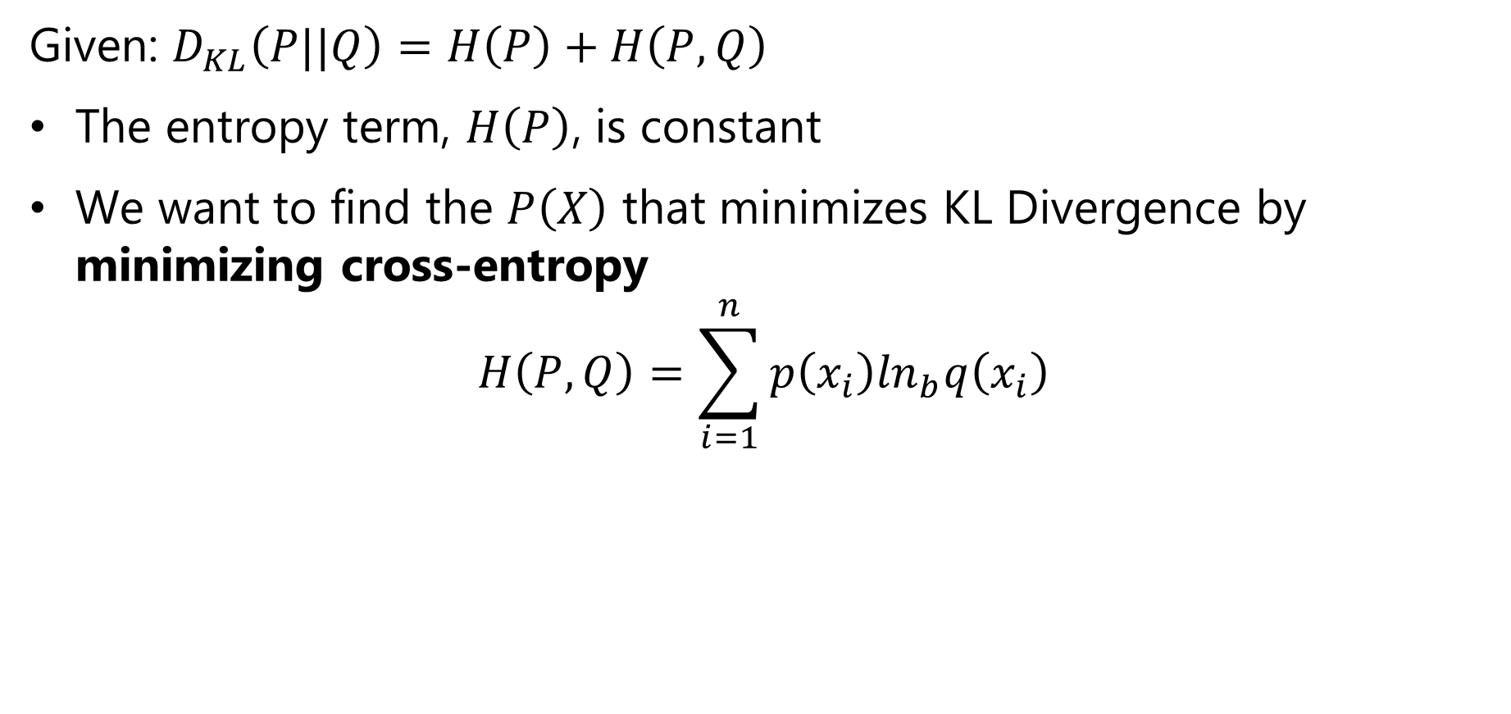
Loss Functions for Training Neural Networks
Given: $D_{KL}\left(P||Q\right)=H\left(P\right)+H\left(P,Q\right)$
The entropy term, $H\left(P\right)$, is constant
We want to find the $P\left(X\right)$ that minimizes KL Divergence by minimizing cross-entropy
$$H\left(P,Q\right)=\sum_{i=1}^{n}{p\left(x_{i}\right)\ln_{b}q\left(x_{i}\right)}$$

Slide 34
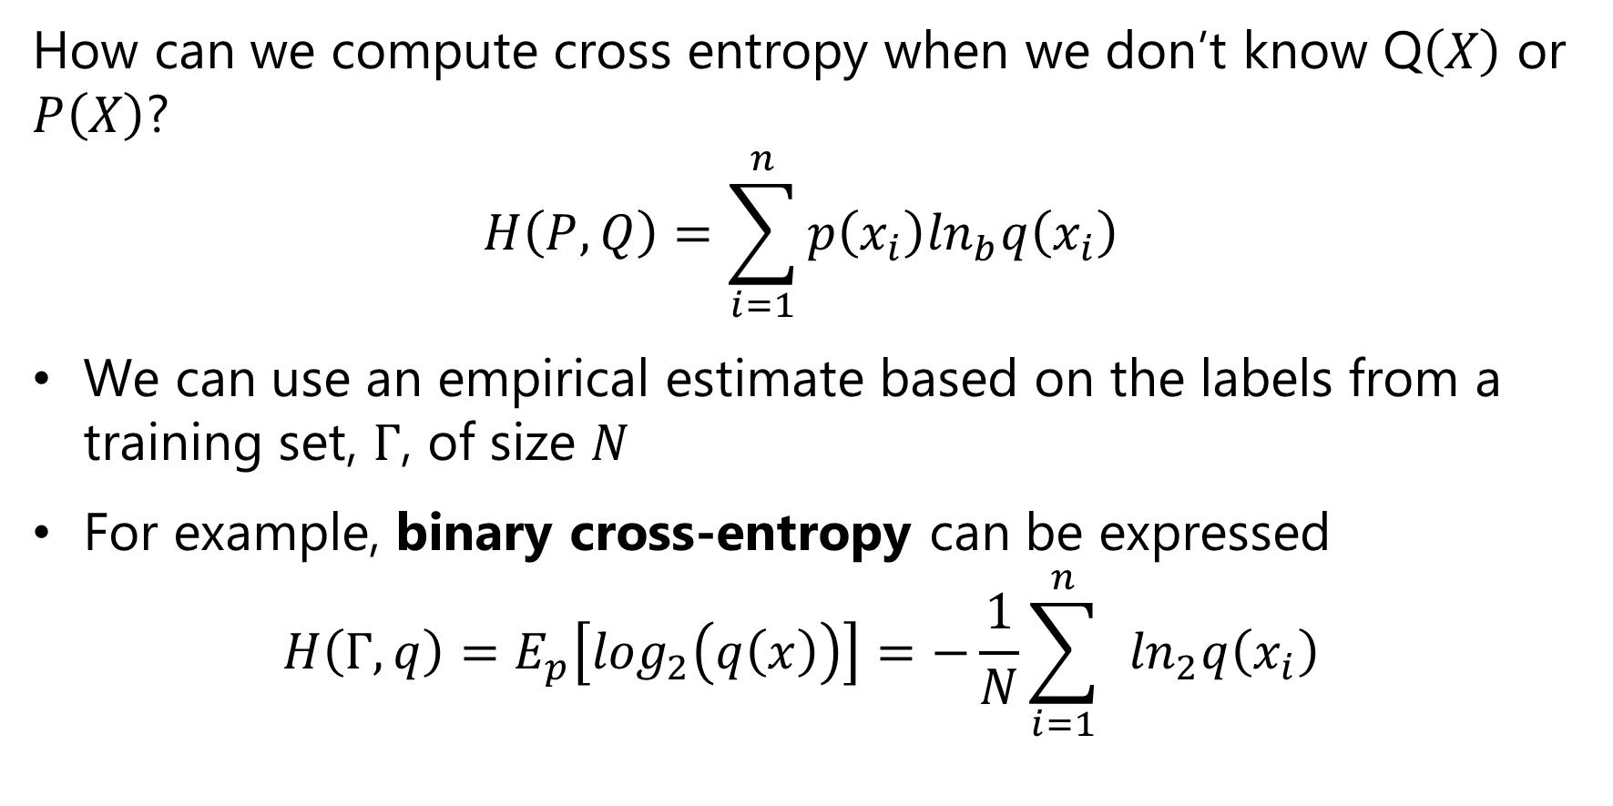
Loss Functions for Training Neural Networks
How can we compute cross entropy when we don’t know Q$\left(X\right)$ or $P\left(X\right)$?
$$H\left(P,Q\right)=\sum_{i=1}^{n}{p\left(x_{i}\right)\ln_{b}q\left(x_{i}\right)}$$
We can use an empirical estimate based on the labels from a training set, $Γ$, of size $N$
For example, binary cross-entropy can be expressed
$$H\left(Γ,q\right)=E_{p}\left[\log_{2}\left(q\left(x\right)\right)\right]=−\frac{1}{N}\sum_{i=1}^{n}{ }\ln_{2}q\left(x_{i}\right)$$

Slide 35
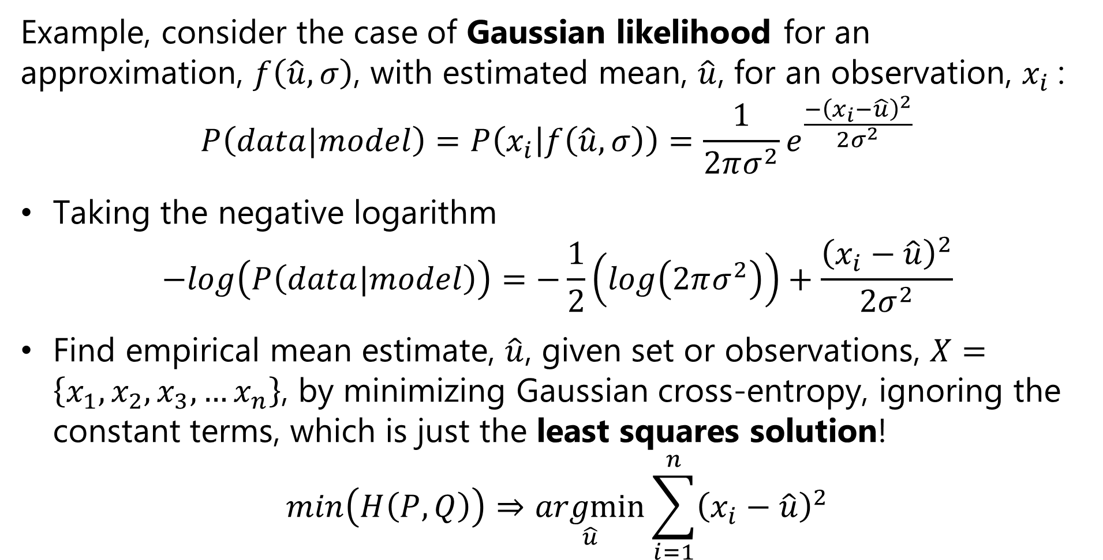
Loss Functions for Training Neural Networks
Example, consider the case of Gaussian likelihood for an approximation, $f\left(\hat{u},σ\right)$, with estimated mean, $\hat{u}$, for an observation, $x_{i}$:
$$P\left(data|model\right)=P\left(x_{i} | f\left(\hat{u},σ\right)\right)=\frac{1}{2πσ^{2}}e^{\frac{−{\left(x_{i}−\hat{u}\right)}^{2}}{2σ^{2}}}$$
Taking the negative logarithm
$$−log\left(P\left(data|model\right)\right)=−\frac{1}{2}\left(log\left(2πσ^{2}\right)\right)+\frac{{\left(x_{i}−\hat{u}\right)}^{2}}{2σ^{2}}$$
Find empirical mean estimate, $\hat{u}$, given set or observations, $X=\left\{x_{1},x_{2},x_{3},…x_{n}\right\}$, by minimizing Gaussian cross-entropy, ignoring the constant terms, which is just the least squares solution!
$$min\left(H\left(P,Q\right)\right)⇒\underset{\hat{u}}{argmin}{\sum_{i=1}^{n}{{\left(x_{i}−\hat{u}\right)}^{2}}}$$

Slide 36

Performance Metrics for Deep NNs
How can we measure the performance of deep neural networks?
Use the same metrics used for other machine learning algorithms
RMSE, $R^{2}$, etc. for regression
Accuracy, precision, recall, F1, etc. for classification

Slide 37
Regularization for Deep Learning Models

Slide 38
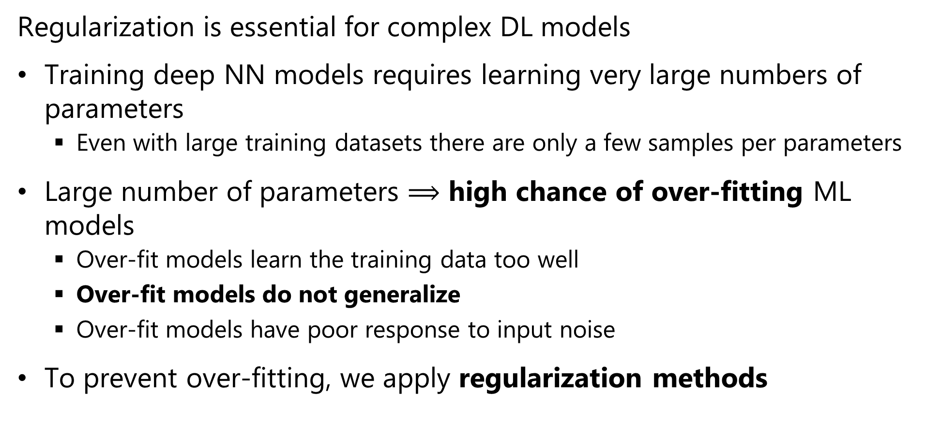
Regularization for Deep Learning
Regularization is essential for complex DL models
Training deep NN models requires learning very large numbers of parameters
Even with large training datasets there are only a few samples per parameters
Large number of parameters $⟹$ high chance of over-fitting ML models
Over-fit models learn the training data too well
Over-fit models do not generalize
Over-fit models have poor response to input noise
To prevent over-fitting, we apply regularization methods

Slide 39
Regularization for Deep Learning
Regularization is essential for complex DL models
Classical regularization routinely applied
L2, L1, ElasticNet
Reduced learning rate
Early stopping
Deep NN specific regularization methods
Dropout regularization
Batch normalization
Weight decay – slowly forget weights during training
Gradient normalization – More on this later

Slide 40
Dropout Regularization

Slide 41
Dropout regularization
Overfit deep network models tend to suffer from a problem of co-adaptation
With limited training data weight tensors become adapted to the training data
Such a model is unlikely to generalize
We need a way to break the co-adaptation of the weight tensor
Note: Recently, some researchers have questioned the co-adaptation theory, but there is no consensus for an alternative theory

Slide 42
Dropout regularization
Dropout regularization is a conceptually simple method unique to deep learning
At each step of the gradient decent some fraction, p, of the weights are dropped-out of each layer
The result is a series of models trained for each dropout sample
The final model is geometric mean of the individual models
Weight values are clipped in a small range as a further regularization
Result is an ensemble model!
For full details see the readable paper by Srivastava et. al., 2014 http://www.cs.toronto.edu/~rsalakhu/papers/srivastava14a.pdf

Slide 43
Dropout regularization
Let’s look at a simple example of a network with one hidden layer:
O
h₁
h₂
h₃
h₄
i₁
i₂

Slide 44
Dropout regularization
Six of the possible models with 2 hidden units:
O
O
O
h₃
h₄
h₂
h₄
h₂
h₃
i₁
i₂
i₁
i₂
i₁
i₂
O
O
O
h₁
h₄
h₁
h₃
h₁
h₂
i₁
i₂
i₁
i₂
i₁
i₂
Can also sample models with 1 or 3 hidden units – total of 14

Slide 45




Dropout regularization
How can the partial derivatives for backpropagation be computed with dropout regularization?
The probability of a weight being in a given model is:
The forward propagation equations then become:

Slide 46


Dropout regularization
How can the partial derivatives for backpropagation be computed with dropout regularization?
We need partial derivatives of
For the dropout layer σ is linear, and the derivatives with respect to the weights are:
, in which case the partial derivative = 1
, in which case the partial derivative = 0

Slide 47
Batch Normalization

Slide 48
Batch Normalization
In deep neural networks there is a high chance that units in a hidden layer have a large range of output values
Leads to difficulty computing the gradient
Slows convergence
A solution is to normalize the output of the hidden layers in the network as a batch
This simple idea can be really effective
For more details see Sergey and Szegedy, 2015
For alternative view of smoothing gradient, see Santurkar, et. al., 2019

Slide 49
Weight Decay

Slide 50
Weight decay
Weight decay prevents high learning in high-capacity models from becoming stuck
Learning for high capacity (large number of parameter models) can become stuck at local minimums of the loss function
Weight decay forces a small amount of ‘un-learning’ to move toward better optimum
Typically use an exponential decay schedule

Slide 51
Architectures for Fully Connected NNs

Slide 52
Architectures for Fully Connected NNs
Fully connected networks have multiple layers
Layers connected into sequential networks
Capacity of model determined by:
Depth or number of layers
Width of the layers in units
Deeper and wider models have greater capacity
Deeper and wider models are harder to train
More parameters
Require greater regularization
Consume more CPU/GPU capacity

Slide 53
Architectures for Fully Connected NNs
Example of sequential model
Set the shape of the expected input tensor with unknown number of images
Define a hidden layer with 512 units with ReLu activation
L2 regularization applied to kernel weights
Dropout regularization layer
Output layer with 10 units using softmax activation for multi-class classification
nndo = models.Sequential()
nndo.add(layers.Input(shape=(28*28,)))
nndo.add(layers.Dense(512,
activation = 'relu’,
kernel_regularizer=regularizers.l2(0.0002)
))
nndo.add(layers.Dropout(rate=0.1))
nndo.add(layers.Dense(10,
activation = 'softmax'))

Slide 54
Training Deep NN Models

Slide 55
Training Deep Neural Networks
CV tasks require high-capacity models
High-capacity models are difficult to train
Trade-off between training time (epochs) and over-fitting
Slower training less likely to over-fit
Slower training requires more epochs (time) and CPU/GPU use
Large toolbox to prevent overfitting of high-capacity CV models
Apply multiple regularizations simultaneously
Lower learning rate reduces overfitting

Slide 56
Training Deep Neural Networks
CV tasks require high-capacity models
High-capacity models are difficult to train
Essential to pick suitable learning rate
High learning rates good initially, but lead to overfitting
Low learning rates require excessive computing to converge
Variable learning rates are often good choice
Learning rate decays with epochs
Linear decay
Exponential decay
Etc.

Slide 57
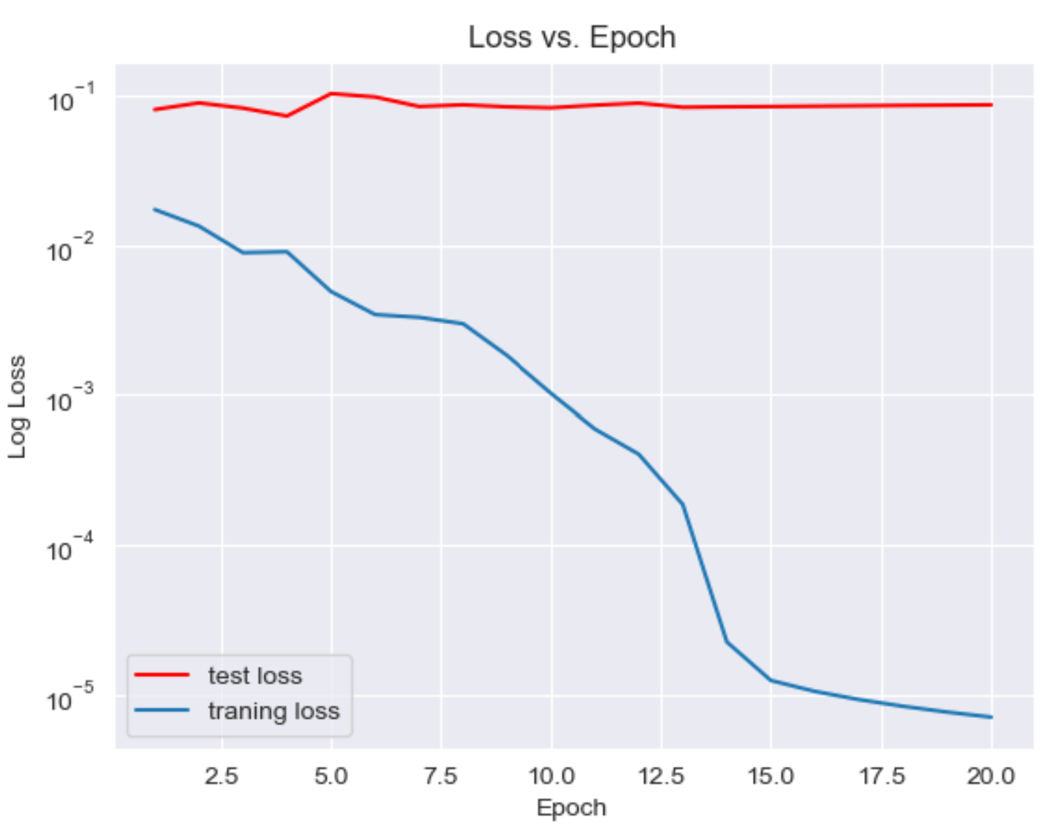
Training Deep Neural Networks
CV tasks require high-capacity models
Example of model not learning:
Too high of learning rate
Insufficient regularization
Loss curves show problems
Curves show erratic behaviour
Divergence between training and test loss

Slide 58
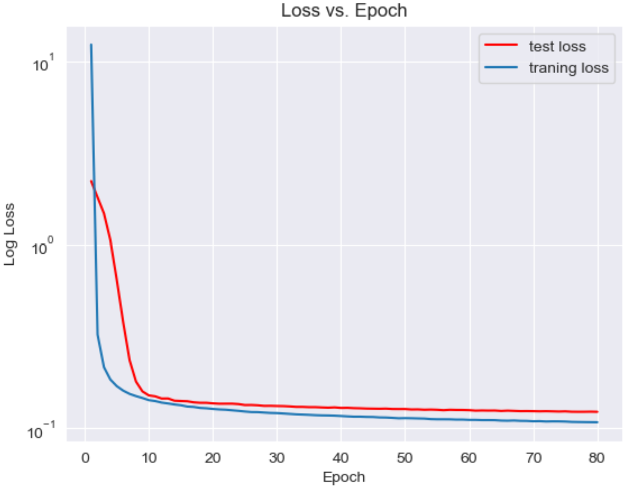
Training Deep Neural Networks
CV tasks require high capacity models
Example of poor (fixed and aggressive) learning rate:
Notice sharp elbow in loss curves
Learning continues, even after 80 epochs
Smooth curves indicate sufficient regularization

Slide 59
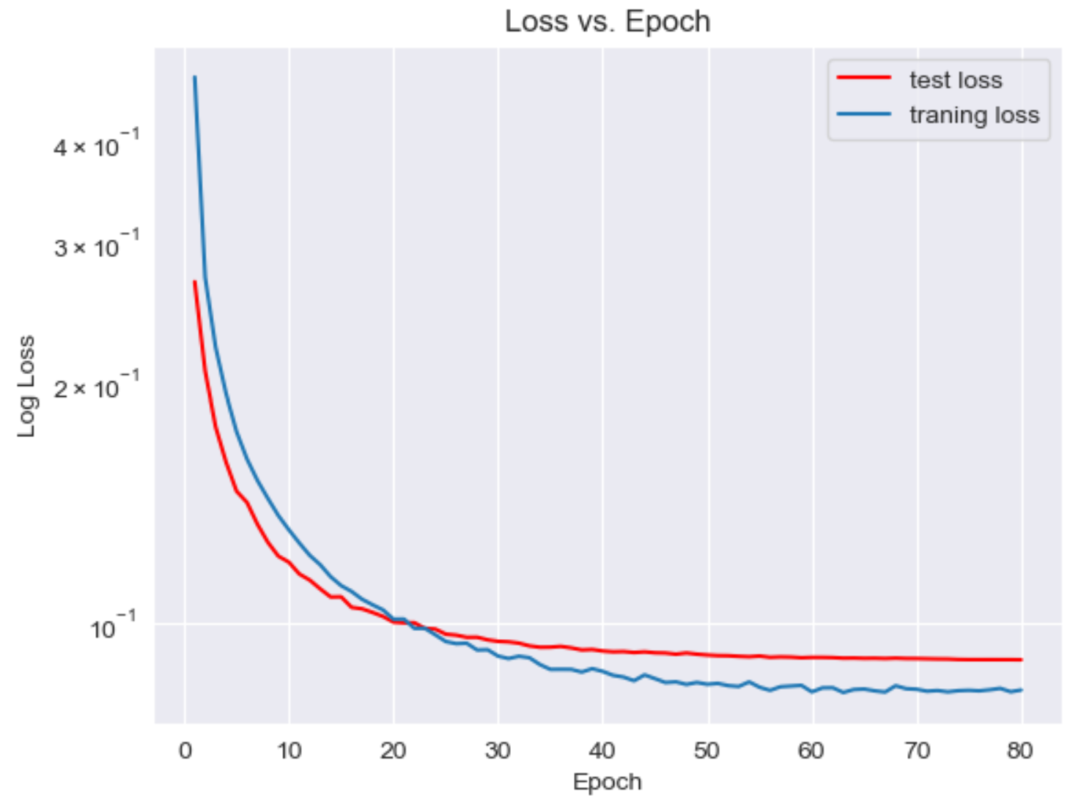
Training Deep Neural Networks
CV tasks require high capacity models
Example of good learning:
Exponential decay learning rate
Multiple regularizations
L2
Dropout
Weight decay
Loss curves decrease smoothly with little learning at end of epochs

Slide 60
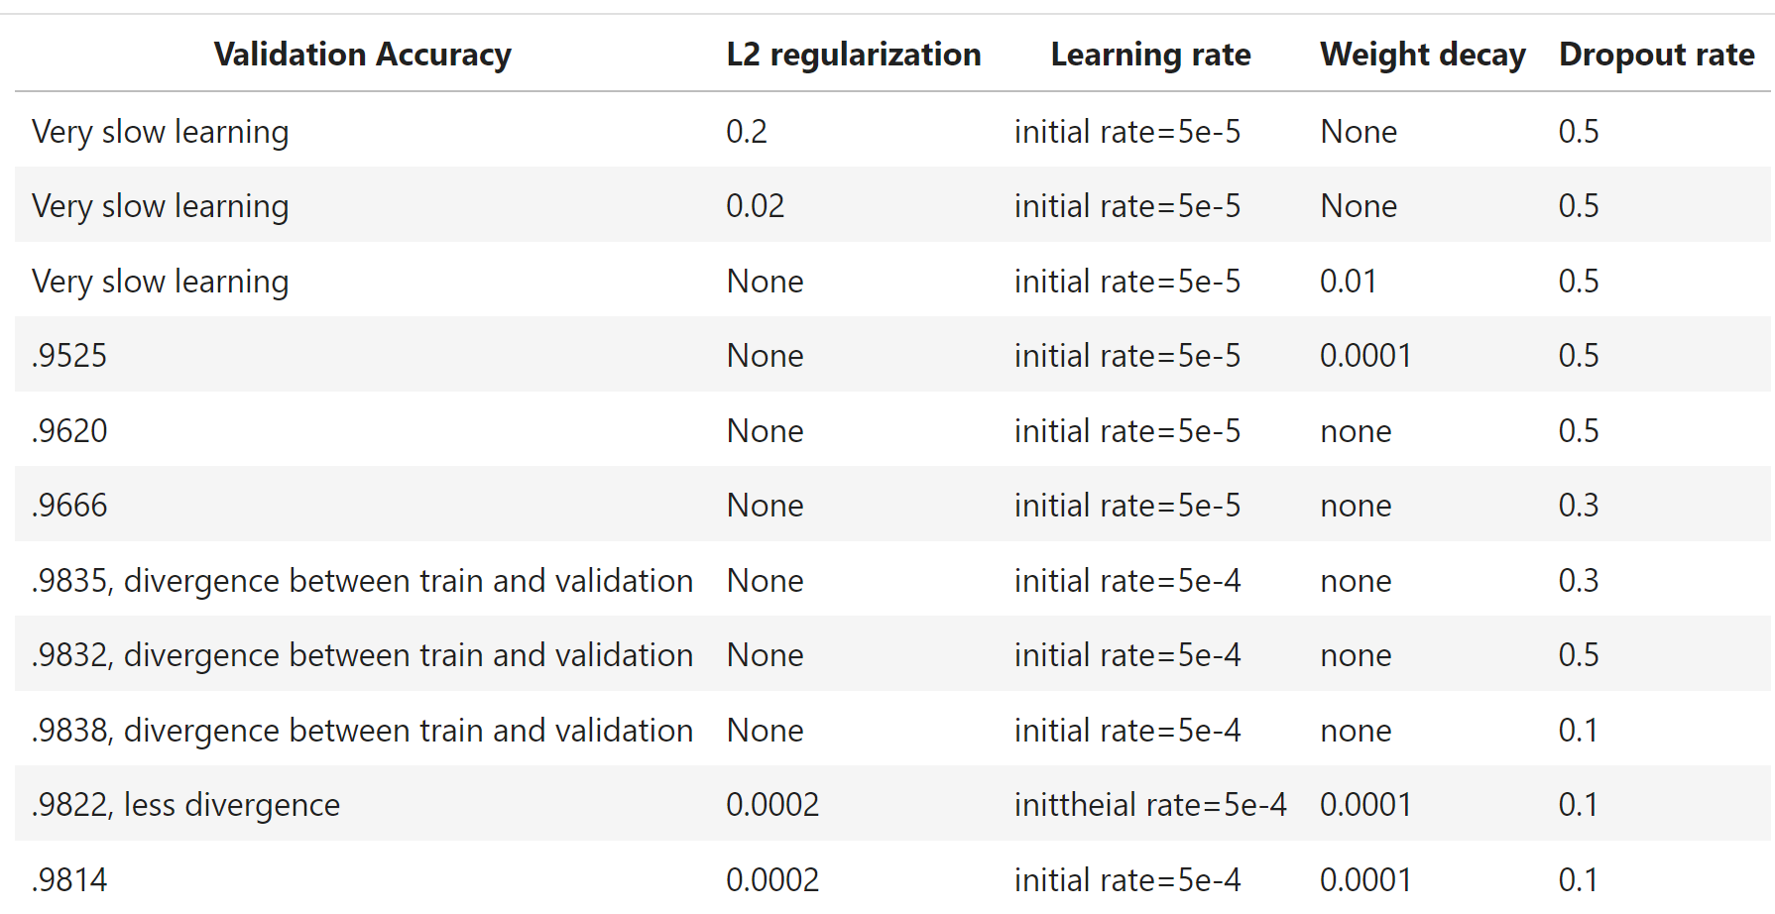
Training Deep Neural Networks
Training high-capacity models requires significant experimentation

Slide 61
Training deep NN Models
Example of training NN model
Define an exponentially decaying learning rate
Compile the model
Define optimizer with learning rate schedule and decay
Specify loss function
Specify performance metric
Fit the model with training dataset
Limit number of traning epochs – 80 is a small number!
Batch size for optimizer
Define dataset for model validation
nndo lr_schedule = ExponentialDecay(
initial_learning_rate=5e-4,
decay_steps=1000,
decay_rate=0.9)
nndo.compile(
optimizer=RMSprop(
learning_rate=lr_schedule,
weight_decay=0.0001),
loss = 'categorical_crossentropy’,
metrics = ['accuracy’])
history_do =nndo.fit(train_images,
train_labels,
epochs = 80,
batch_size = 128,
validation_data = (test_images, test_labels))

Slide 62
Model Deployment

Slide 63
Deployment of Deep NN Models
How can we deploy deep NN models to the edge?
Many applications use CV at the edge – a.k.a. Internet of Things (IoT)
Example: advanced smart phone photography
Example: security monitoring
Example: industrial inspection
…
Need to push CV processing to edge
Limited network bandwidth precludes central processing
Edge devices typically have limited computing and memory capacity
Can deploy solutions like TensorFlow Lite
Use fixed point or integer arithmetic
Give up a bit of accuracy massive reduction in computing and memory

Slide 64
Summary
Key points for this lesson
Preceptron and forward propagation
Depth, breath and model capacity
Nonlinearity and activation functions
Loss functions
Regularization for deep learning
Architecture for deep NNs
Learning in deep NNs

Slide 65
Computing gradients and the chain rule

Slide 66
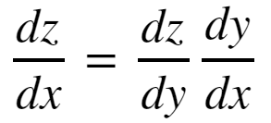
The Chain Rule of Calculus
In order to compute the gradients of the loss function though the layers of a deep neural network we need to apply the chain rule of calculus
To consider a function z = f(y), where y = g(x); then z = f(g(x)). Then the derivative of z with respect to x is:

Slide 67
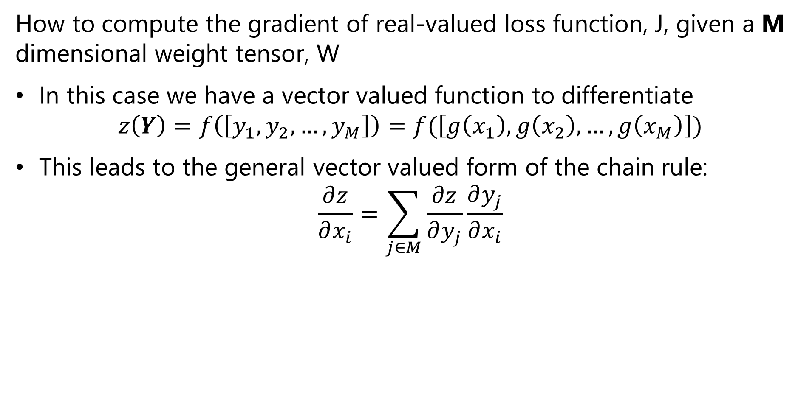
The Chain Rule of Calculus
How to compute the gradient of real-valued loss function, J, given a M dimensional weight tensor, W
In this case we have a vector valued function to differentiate
$$z\left(Y\right)=f\left(\left[y_{1},y_{2},…,y_{M}\right]\right)=f(\left[g\left(x_{1}\right),g\left(x_{2}\right),…,g\left(x_{M}\right)\right])$$
This leads to the general vector valued form of the chain rule:
$$\frac{∂z}{∂x_{i}}=\sum_{j∈M}{\frac{∂z}{∂y_{j}}\frac{∂y_{j}}{∂x_{i}}}$$

Slide 68
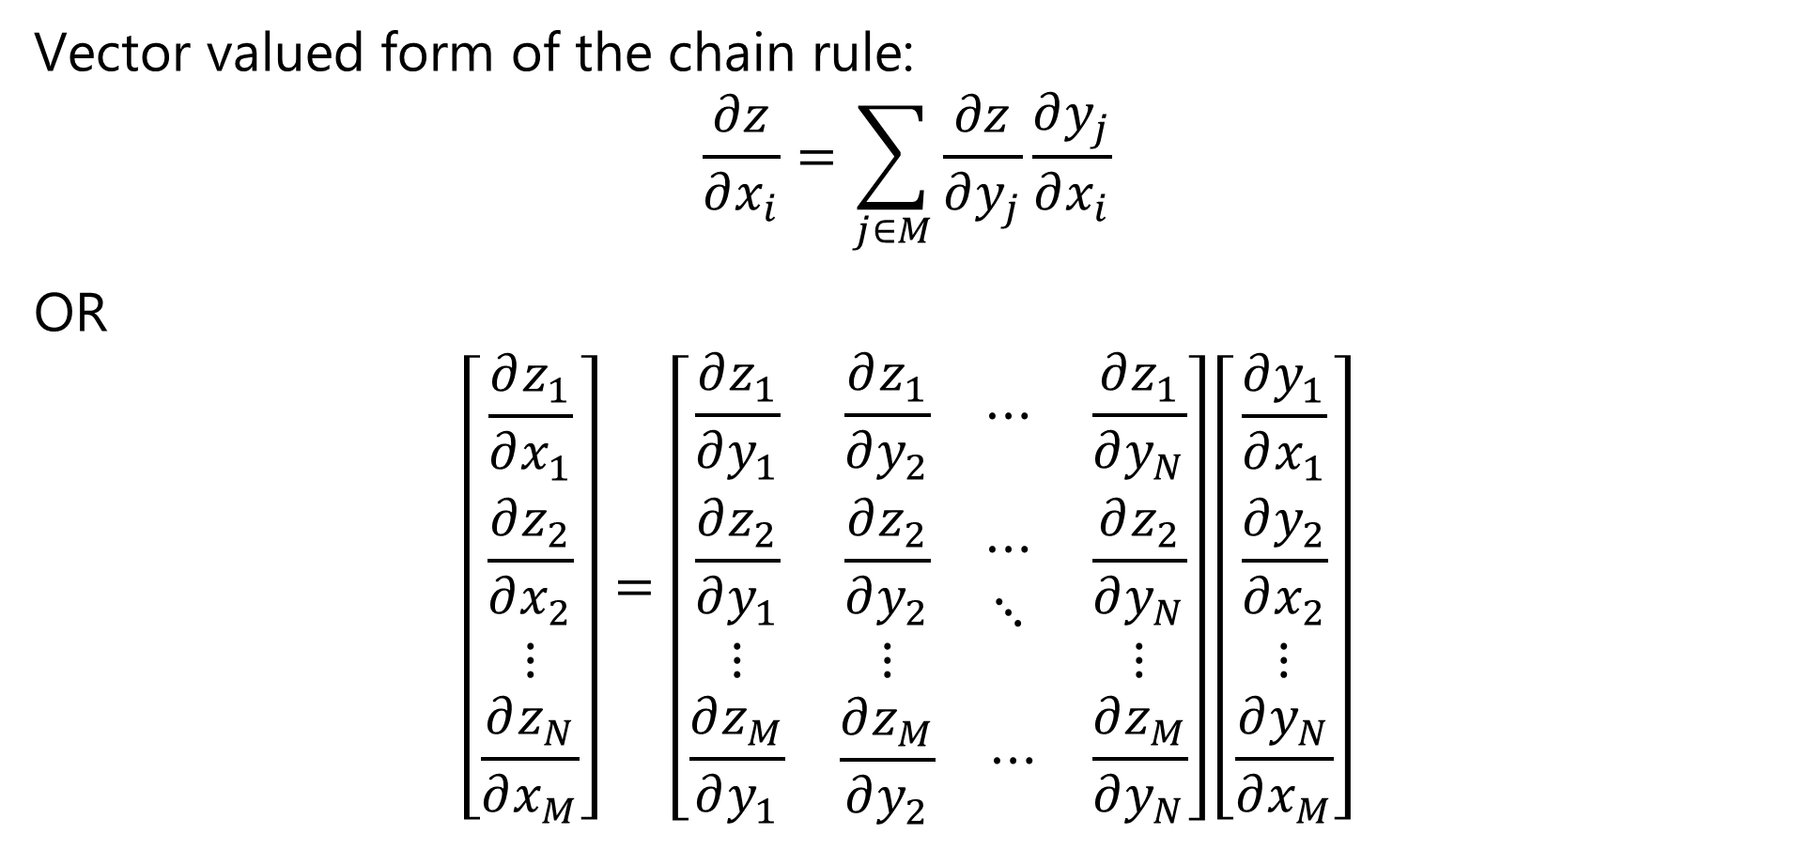
The Chain Rule of Calculus
Vector valued form of the chain rule:
$$\frac{∂z}{∂x_{i}}=\sum_{j∈M}{\frac{∂z}{∂y_{j}}\frac{∂y_{j}}{∂x_{i}}}$$
OR
$$\left[\begin{matrix}\frac{∂z_{1}}{∂x_{1}} \\ \frac{∂z_{2}}{∂x_{2}} \\ \begin{matrix}⋮ \\ \frac{∂z_{N}}{∂x_{M}}\end{matrix}\end{matrix}\right]=\left[\begin{matrix}\frac{∂z_{1}}{∂y_{1}} & \begin{matrix}\frac{∂z_{1}}{∂y_{2}} & ⋯\end{matrix} & \frac{∂z_{1}}{∂y_{N}} \\ \begin{matrix}\frac{∂z_{2}}{∂y_{1}} \\ ⋮\end{matrix} & \begin{matrix}\begin{matrix}\frac{∂z_{2}}{∂y_{2}} \\ ⋮\end{matrix} & \begin{matrix}⋯ \\ ⋱\end{matrix}\end{matrix} & \begin{matrix}\frac{∂z_{2}}{∂y_{N}} \\ ⋮\end{matrix} \\ \frac{∂z_{M}}{∂y_{1}} & \begin{matrix}\frac{∂z_{M}}{∂y_{2}} & ⋯\end{matrix} & \frac{∂z_{M}}{∂y_{N}}\end{matrix}\right]\left[\begin{matrix}\frac{∂y_{1}}{∂x_{1}} \\ \frac{∂y_{2}}{∂x_{2}} \\ \begin{matrix}⋮ \\ \frac{∂y_{N}}{∂x_{M}}\end{matrix}\end{matrix}\right]$$

Slide 69

The Chain Rule of Calculus
We define the $n×m$ Jacobian Matrix, $J$, as:
$$J^{T}=\left[\begin{matrix}\frac{∂z_{1}}{∂y_{1}} & \begin{matrix}\frac{∂z_{1}}{∂y_{2}} & ⋯\end{matrix} & \frac{∂z_{1}}{∂y_{N}} \\ \begin{matrix}\frac{∂z_{2}}{∂y_{1}} \\ ⋮\end{matrix} & \begin{matrix}\begin{matrix}\frac{∂z_{2}}{∂y_{2}} \\ ⋮\end{matrix} & \begin{matrix}⋯ \\ ⋱\end{matrix}\end{matrix} & \begin{matrix}\frac{∂z_{2}}{∂y_{N}} \\ ⋮\end{matrix} \\ \frac{∂z_{M}}{∂y_{1}} & \begin{matrix}\frac{∂z_{M}}{∂y_{2}} & ⋯\end{matrix} & \frac{∂z_{M}}{∂y_{N}}\end{matrix}\right]$$

Slide 70
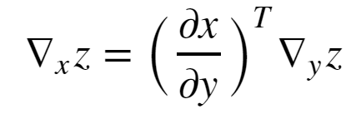


The Chain Rule of Calculus
In matrix notation the vector valued gradient then becomes:
Where, = is the nxm Jacobian matrix of partial derivatives
= the gradient of z with respect to y

Slide 71
Example: Computing a Gradient
w¹₁₁
X₁
S₁ = σ_{h}(Σ )
w²₁
w¹₁₂
w¹₂₁
S₃ = Σ
J(W)
X₂
w²₂
w¹₂₂
S₂ = σ_{h}(Σ )
Y
_{Input Layer}
_{Hidden Layer}
_{Output Layer}
_{Loss Function}

Slide 72
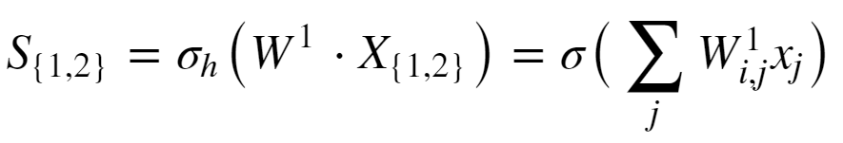
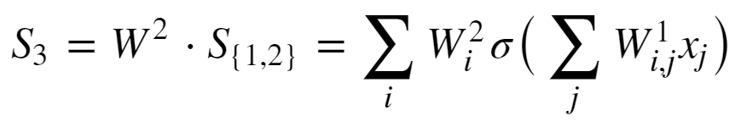
Example: Computing a Gradient
Start with forward propagation relationships
The output of the hidden units are computed as:
The output unit relation is:

Slide 73
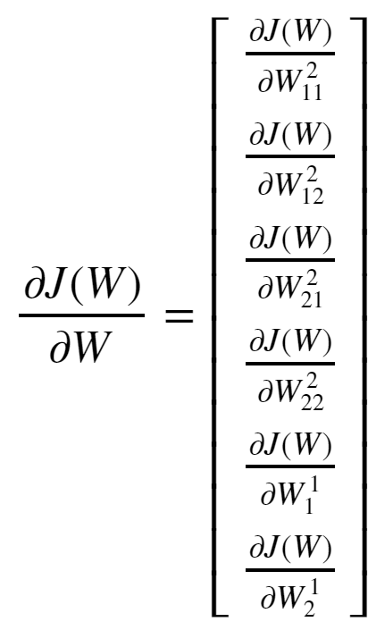
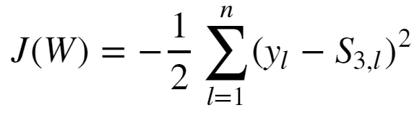
Example: Computing a Gradient
Goal is to compute the gradient:
The loss function is:

Slide 74
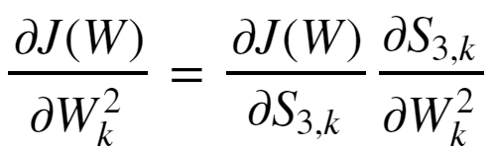
Example: Computing a Gradient
Start with the easier case of the gradient with respect to the output tensor.
Applying the chain rule yields:

Slide 75
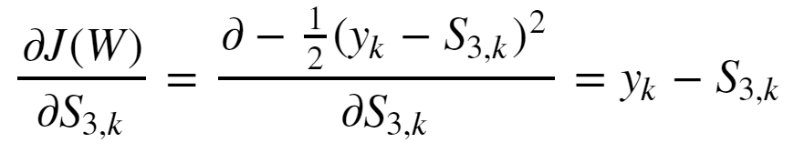
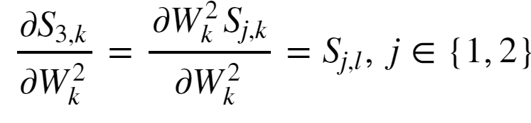
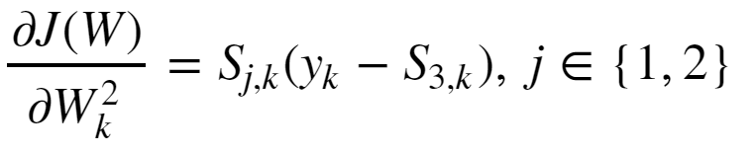
Example: Computing a Gradient
The first partial derivative is:
The second partial derivative is:
And the gradient with respect to the output tensor is then:

Slide 76
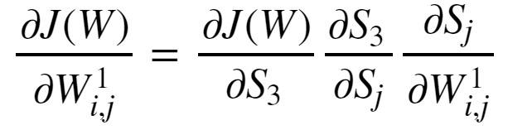
Example: Computing a Gradient
The gradient with respect to the input tensor is a bit more complicated
Apply the chain rule twice to get:

Slide 77
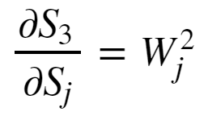
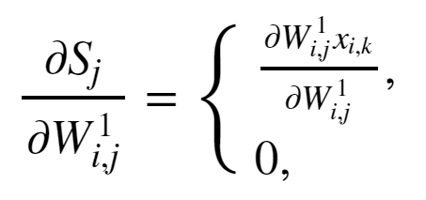
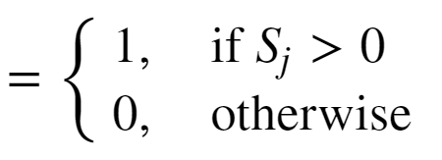
Example: Computing a Gradient
The output layer has linear activation so the left most partial derivative is just 1.
The middle partial derivative :
The right most partial derivative, given ReLU activation:

Slide 78
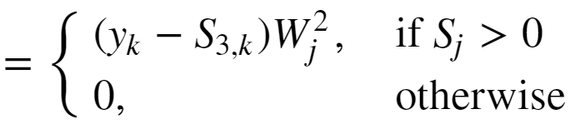
Example: Computing a Gradient
The gradient with respect to the input weights is then:

Slide 79
Automatic Differentiation
In practice, how do we perform the differentiation
Computing all the required derivatives by hand is impractical
Complexity grows with NN depth
Too many opportunities for error
Use automatic differentiation
Automatic differentiators handle the complexity of deep architectures
Automatic differentiators built into all deep learning platforms
See the review paper by Baydin et.al. (2015) or the TensorFlow automatic differentiation tutorial

