Slide 1

CSCI E-25 Computer Vision
Image Stitching
Steve Elston
Copyright 2022, 2023, 2024, 2025, 2026, Stephen F Elston. All rights reserved.

Slide 2
Image Stitching
The goal of image stitching is to create a mosaic image from multiple images from different camera poses
Mosaic should look like one continuous image
No seams
Consistent illumination and pixel values
Preserve straight lines
Must align and blend images to create a mosaic
In this lesson we examine some of the basic CV image stitching algorithms
For a detailed view of classical image stitching algorithms and image blending see Chapter 8 of Computer Vision: Algorithms and Applications, 2nd ed., Springer, 2022

Slide 3
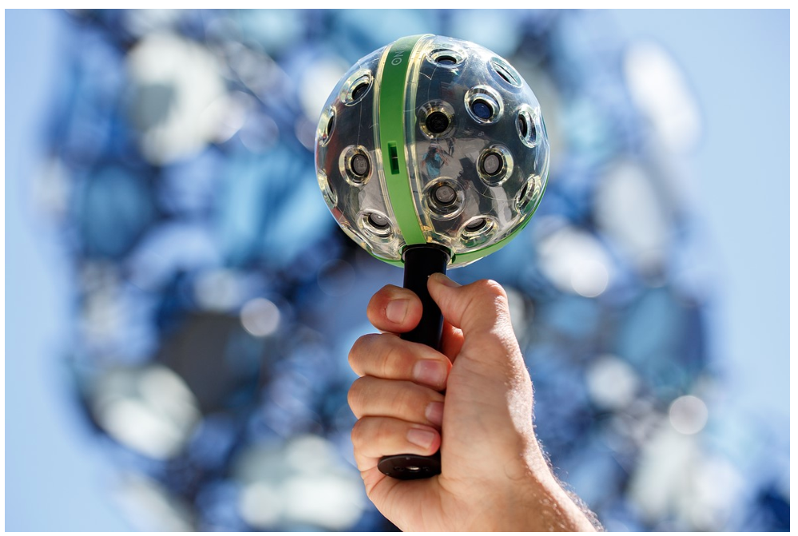
Image Stitching
Many applications of image stitching
Panoramic imaging
Remote sensing
Sport event photography
Augmented reality
Autonomous vehicles
Security systems
Medical imaging
Scientific imaging
etc,.
Example of sophisticated image stitching; A spherical camera from the now bankrupt Pano company

Slide 4
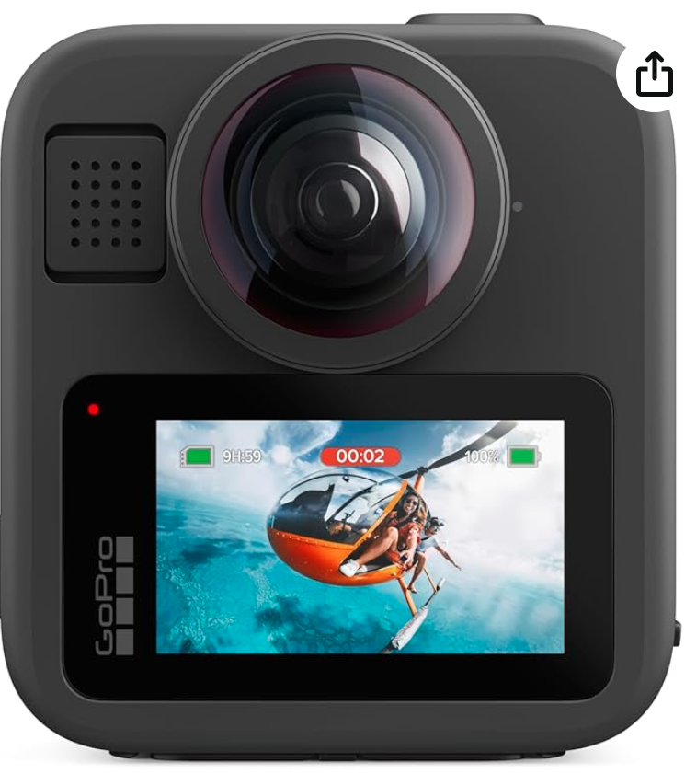
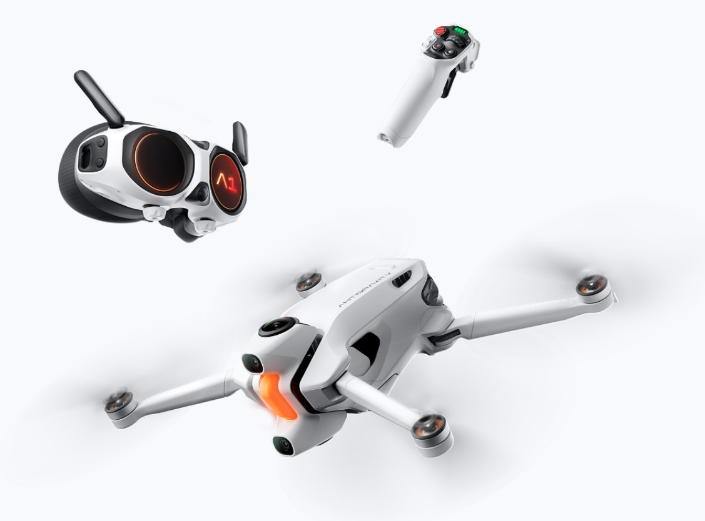
Image Stitching
Newer products use Pairs of ultra-short focal length lenses
GoPro MAX2 360 Camera
Drone and VR googles using 360-degree camera by Insta360
Notes:
gre

Slide 5
Optical Flow vs. Image Stitching
Compare optical flow models to projective transform models
Both` tasks use image matching and warping
Optical flow is a dense task estimated pixel-by-pixel
Warping on a pixel-by-pixel basis
Small motion is localize
Image stitching uses a projective transform to rectify images
Parameters for projective transformation models are estimated for large areas
A single transform is applied to the entire image or patches of image
Wide baseline difference between images
Cannot localize motion
Some optical flow algorithms use a projective transform to model global flow
Notes:
ima

Slide 6
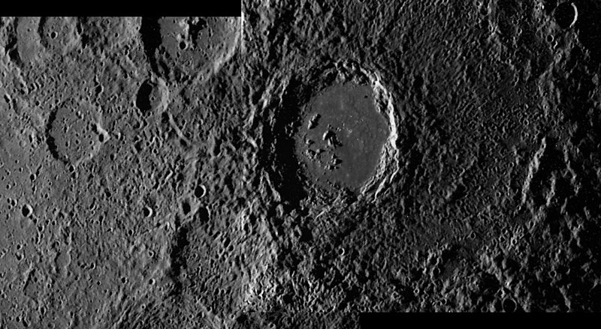
Image Stitching
Image stitching has a long history
Performed manually from 1920s into 1980s
Example, a mosaic image of the Hitomaro Mars crater – Mariner 9, 1970
Credit, Wikipedia commons

Slide 7
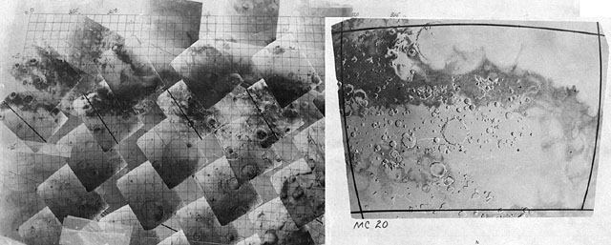
Image Stitching
Image stitching has a long history
Before CV methods photo mosaics were manually assembled for decades
Example, assembling Mariner 9 Mars images in 1970
Credit, The Planetary Society

Slide 8
Image Stitching
What are the steps for stitching images?
Take a sequence of images from different camera poses
E.g. rotate the camera about its optical center
Or, translate camera
Compute transformation to rectify a source image (R) to match overlapping area of the reference images (L)
Warp the source image onto the image plane of the reference image – right warped to left
Fuse images into mosaic
If more images, repeat steps 2-4
Crop mosaic to rectangle

Slide 9
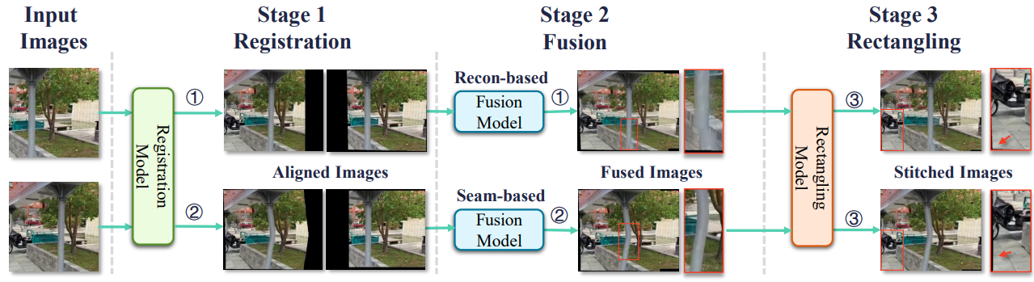
Image Stitching
Registration transforms the images to a common image plane
The image stitching pipeline has 4 stages
Compute transformation to reactify images
Fusion integrates the images and heals seams to form mosaic
Crop mosaics to rectangles

Slide 10
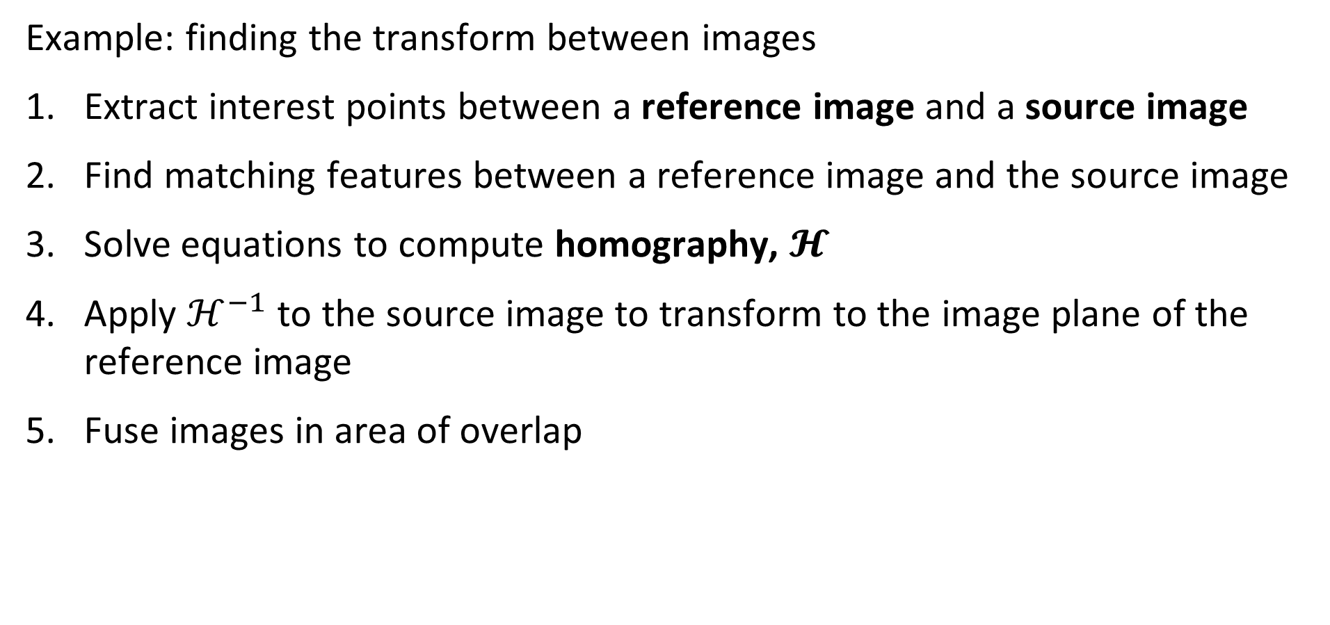
Image Stitching
Example: finding the transform between images
Extract interest points between a reference image and a source image
Find matching features between a reference image and the source image
Solve equations to compute homography, $𝓗$
Apply $ℋ^{−1}$ to the source image to transform to the image plane of the reference image
Fuse images in area of overlap

Slide 11
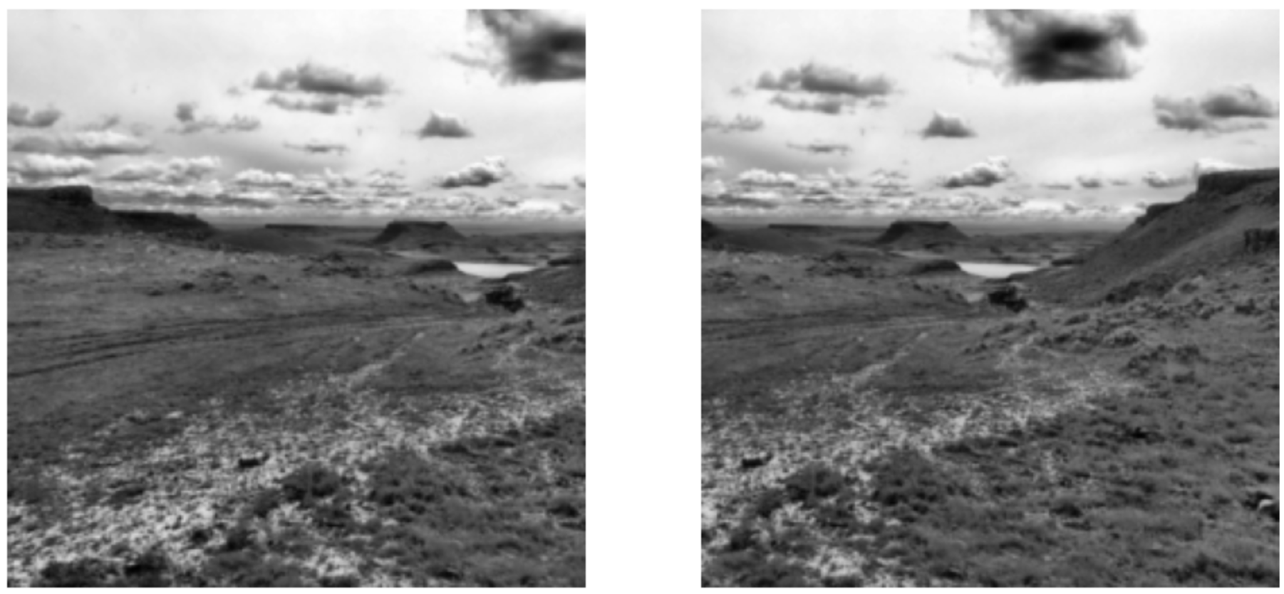
Image Stitching
Acquire multiple images by changes of camera pose

Slide 12
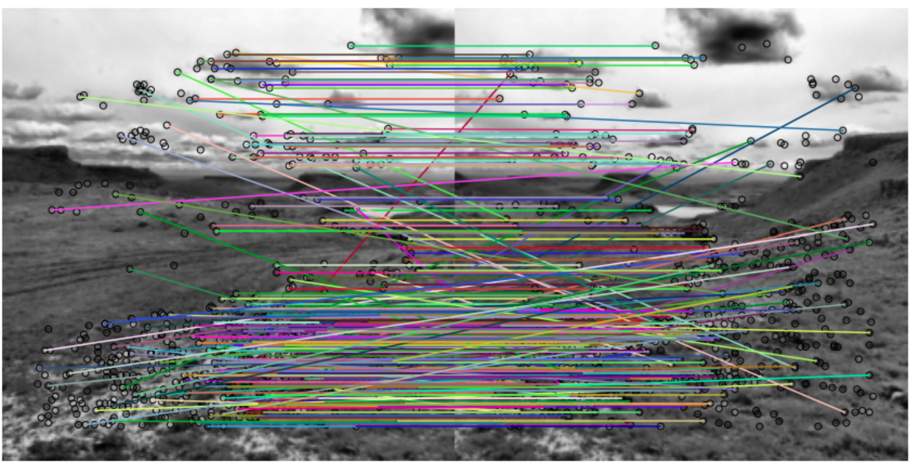
Image Stitching
Find interest points and match descriptors

Slide 13
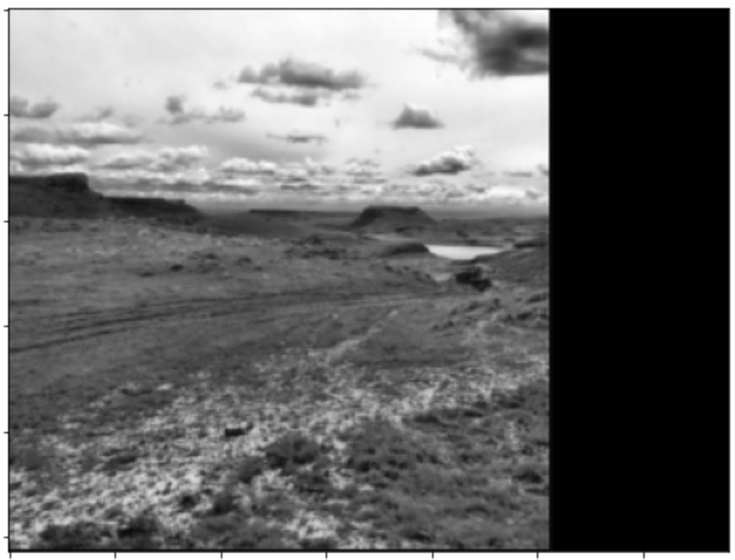
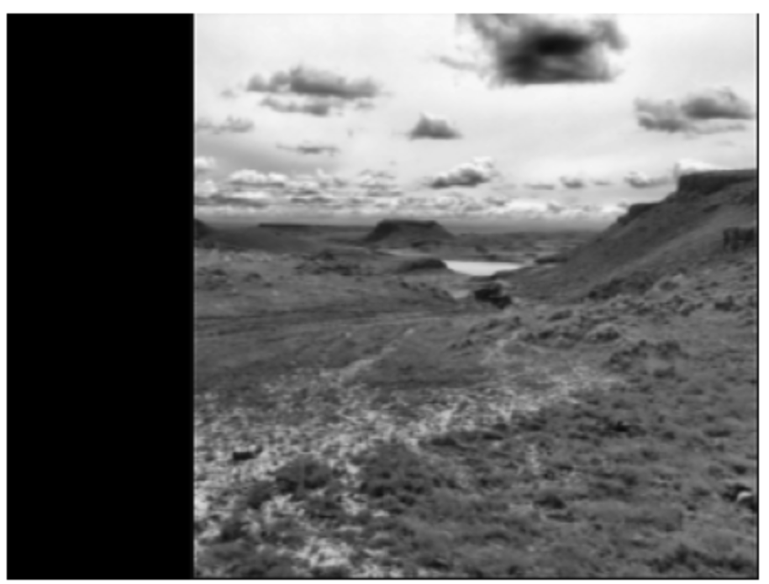
Image Stitching
Transform images to same image plane

Slide 14
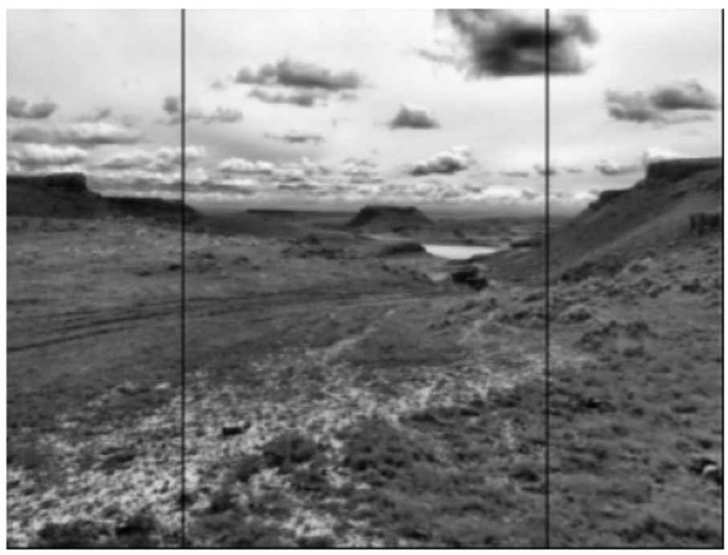
Image Stitching
Image mosaic formed
Region of overlap

Slide 15
Image Warping

Slide 16
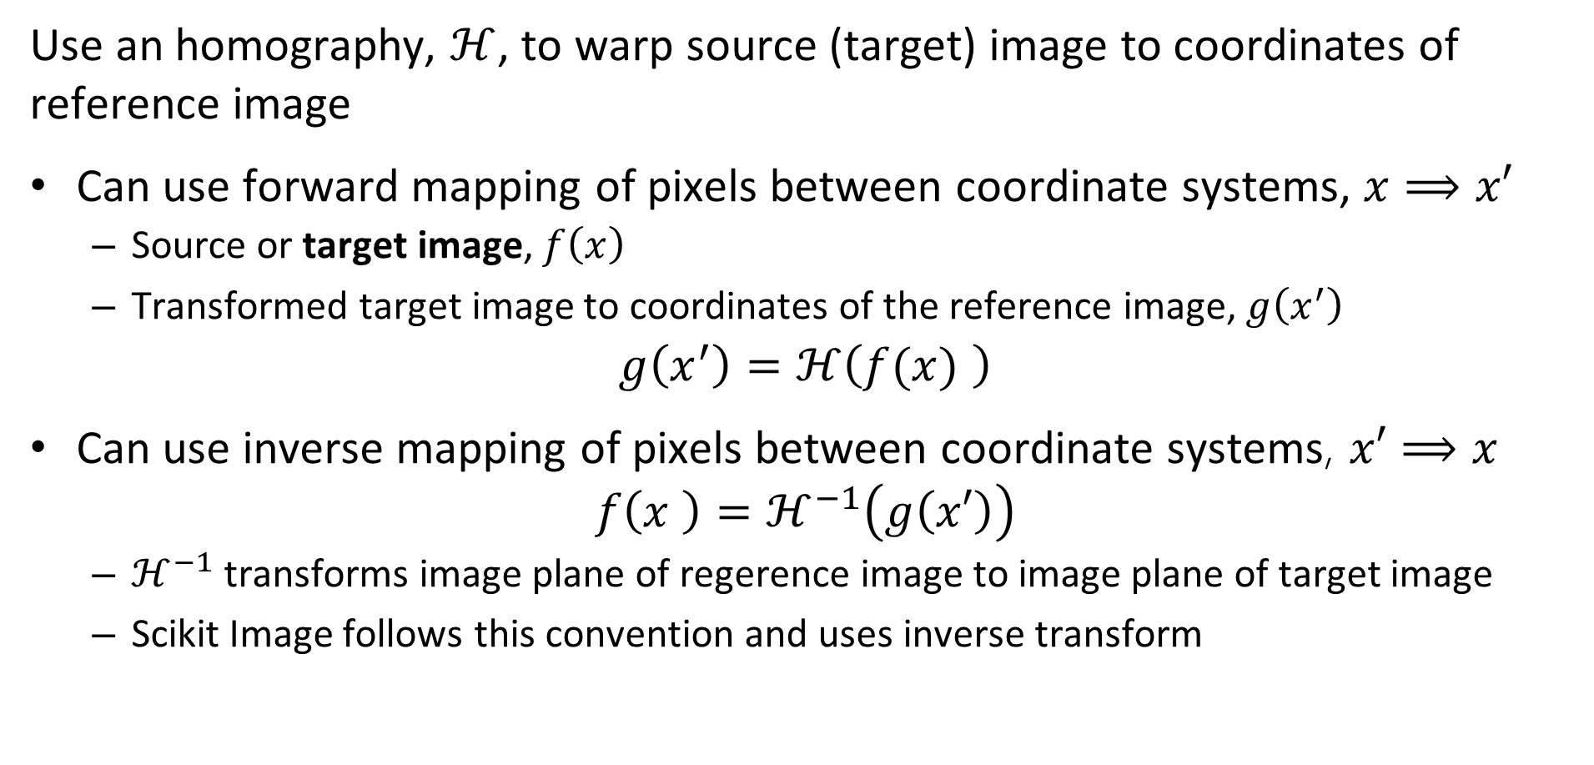
Image Warping
Use an homography, $ℋ$, to warp source (target) image to coordinates of reference image
Can use forward mapping of pixels between coordinate systems, $x⟹x′$
Source or target image, $f\left(x\right)$
Transformed target image to coordinates of the reference image, $g\left(x^{′}\right)$
$$g\left(x^{′}\right)=ℋ\left(f(x) \right)$$
Can use inverse mapping of pixels between coordinate systems, $x′⟹x$
$$f\left(x \right)=ℋ^{−1}\left(g\left(x′\right)\right)$$
$ℋ^{−1}$ transforms image plane of regerence image to image plane of target image
Scikit Image follows this convention and uses inverse transform
Notes:
n

Slide 17
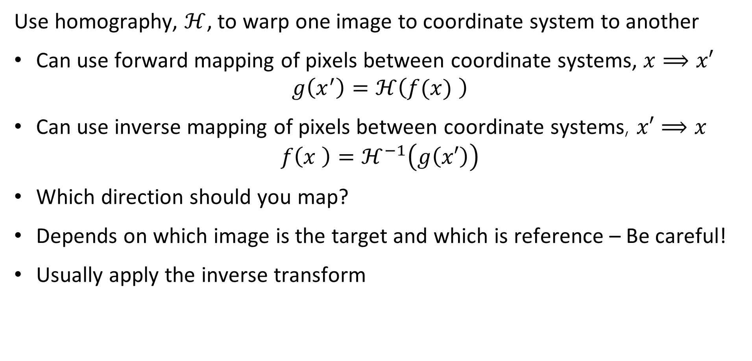
Image Warping
Use homography, $ℋ$, to warp one image to coordinate system to another
Can use forward mapping of pixels between coordinate systems, $x⟹x′$
$$g\left(x^{′}\right)=ℋ\left(f(x) \right)$$
Can use inverse mapping of pixels between coordinate systems, $x′⟹x$
$$f\left(x \right)=ℋ^{−1}\left(g\left(x′\right)\right)$$
Which direction should you map?
Depends on which image is the target and which is reference – Be careful!
Usually apply the inverse transform
Notes:
n

Slide 18
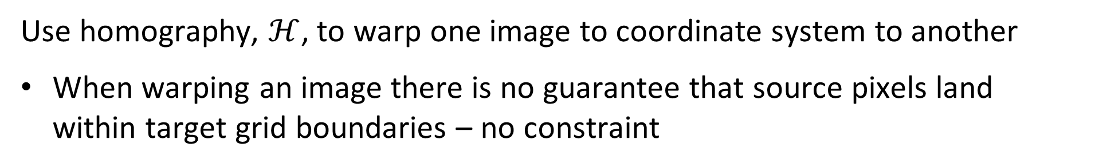

Image Warping
Use homography, $ℋ$, to warp one image to coordinate system to another
When warping an image there is no guarantee that source pixels land within target grid boundaries – no constraint
Homography, $ℋ$
Target Image
Pixel Grid
Source Image Pixel Grid
Warped Reference Image Pixel Grid
Notes:
n

Slide 19
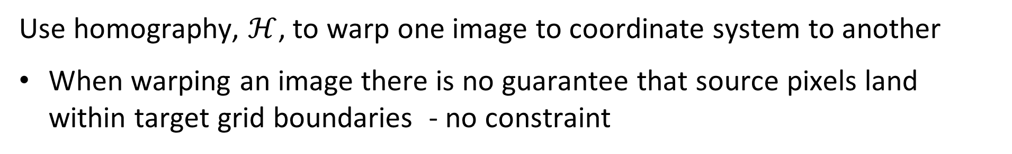
Image Warping
Use homography, $ℋ$, to warp one image to coordinate system to another
When warping an image there is no guarantee that source pixels land within target grid boundaries - no constraint
Values of warped pixel fall into several target pixels
Warped pixel values influence several cells
Apply other Composing methods
Target Image
Pixel Grid
Warped Regerence Image Pixel Grid
Notes:
n

Slide 20
Image Warping
When warping an image there is no guarantee that source pixels land within target grid boundaries - no constraint
Interpolate fill pixel values
Scikit Image supports several of possible methods
Nearest-neighbor
Bi-linear (default)
Bi-quadratic
Bi-cubic
Bi-quartic
Bi-quintic
Target Image
Pixel Grid
Warped Image Pixel Grid
Notes:
n

Slide 21
Planar Transformations for Image Stitching

Slide 22
Planar transformations
Can use different approximations for image stitching
Cylindrical coordinates
Assume camera rotates about an axis
Spherical coordinates
Allows unrestricted camera rotation
Planar
Good approximation if objects far from camera
Good approximation for small changes in camera pose
Our focus here for simplicity
See Sections 8.1 and 8.2 of Szeliski for in-depth formulation

Slide 23
Planar transformations
Planar transformation maps one image plan to another
Top view of two image planes with a common camera centre
Project one image plane onto the other
Homographies only accurate for single plane
Reference Image Plane
Homography projects plane
Target Image Plane
Camera Center

Slide 24
Planar transformations
A single homography only accurate transforms one plane
Homography can transform image planes with different camera centres
Applying same Homography to planes at different distances results in parallax error
Homography is exact transformation to image plane
Homography transformation to image plane results in parallax error
Camera Center
Camera Center

Slide 25
Four Transform Problems
Single planar homography imposes limitations
Model is restricted to planar transformations
Model assumes:
Low parallax
All objects in image are at a constant distance from image plane
Only small changes in camera pose
More complex model can accommodate more general transformations
Use non-planar geometry
Apply variable projective transform over image

Slide 26
Planar transformations
Can use different approximations for image stitching
Can use different planar transformation depending on changes in camera pose
2-D Euclidean – Rotation about optic axis and translation
3 DoF
2-D Similarity – Rotation, translation, and scaling
5 DoF
Affine - Rotation, translation, scaling, shearing
7 DoF
Projective – General transformation
8 DoF

Slide 27
Solving for Homographies

Slide 28
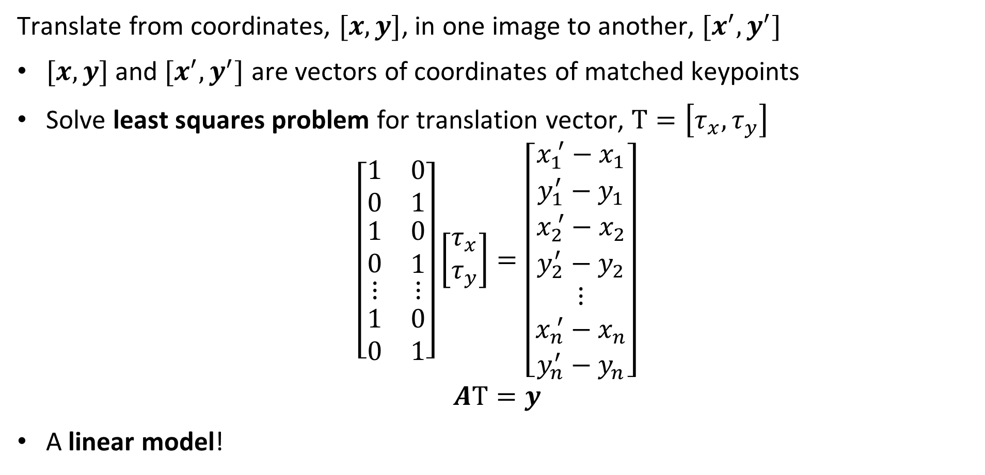
Pure translation
Translate from coordinates, $[x,y]$, in one image to another, $[x^{′},y^{′}]$
$[x,y]$ and $[x^{′},y^{′}]$ are vectors of coordinates of matched keypoints
Solve least squares problem for translation vector, $Τ=\left[τ_{x},τ_{y}\right]$
$$\left[\begin{matrix}1 & 0 \\ 0 & 1 \\ \begin{matrix}1 \\ 0 \\ \begin{matrix}⋮ \\ \begin{matrix}1 \\ 0\end{matrix}\end{matrix}\end{matrix} & \begin{matrix}0 \\ 1 \\ \begin{matrix}⋮ \\ \begin{matrix}0 \\ 1\end{matrix}\end{matrix}\end{matrix}\end{matrix}\right]\left[\begin{matrix}τ_{x} \\ τ_{y}\end{matrix}\right]=\left[\begin{matrix}x_{1}^{ ′}−x_{1} \\ y_{1}^{′}−y_{1} \\ \begin{matrix}x_{2}^{ ′}−x_{2} \\ y_{2}^{′}−y_{2} \\ \begin{matrix}⋮ \\ x_{n}^{ ′}−x_{n} \\ y_{n}^{′}−y_{n}\end{matrix}\end{matrix}\end{matrix}\right]$$
$$AΤ=y$$
A linear model!

Slide 29
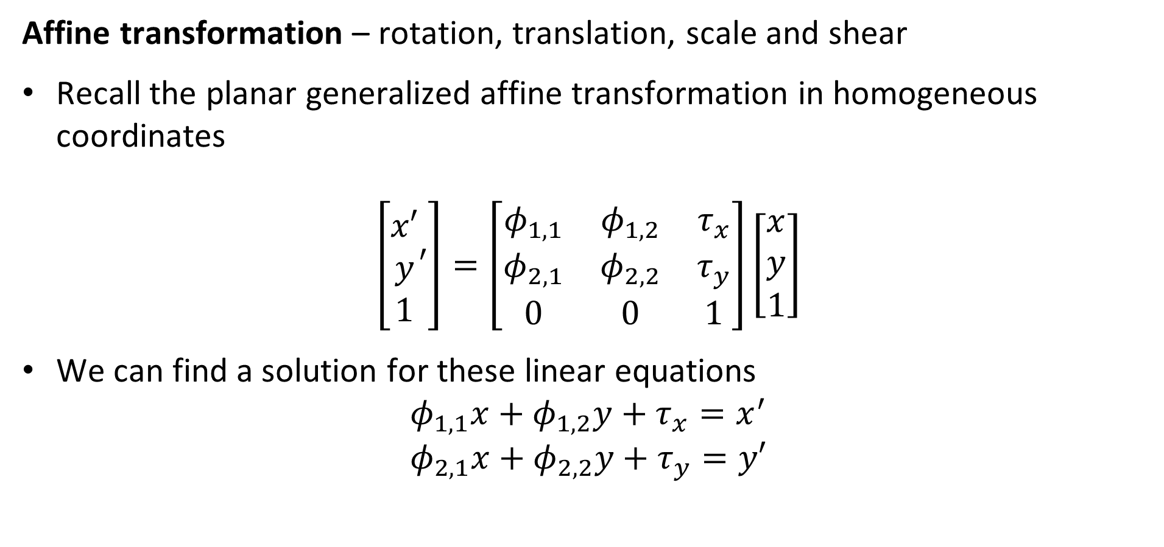
Affine transformation
Affine transformation – rotation, translation, scale and shear
Recall the planar generalized affine transformation in homogeneous coordinates
$$\left[\begin{matrix}x′ \\ y \\ 1\end{matrix}′\right]=\left[\begin{matrix}φ_{1,1} & φ_{1,2} & τ_{x} \\ φ_{2,1} & φ_{2,2} & τ_{y} \\ 0 & 0 & 1\end{matrix}\right]\left[\begin{matrix}x \\ y \\ 1\end{matrix}\right]$$
We can find a solution for these linear equations
$$φ_{1,1}x+φ_{1,2}y+τ_{x}=x^{′}$$
$$φ_{2,1}x+φ_{2,2}y+τ_{y}=y′$$

Slide 30
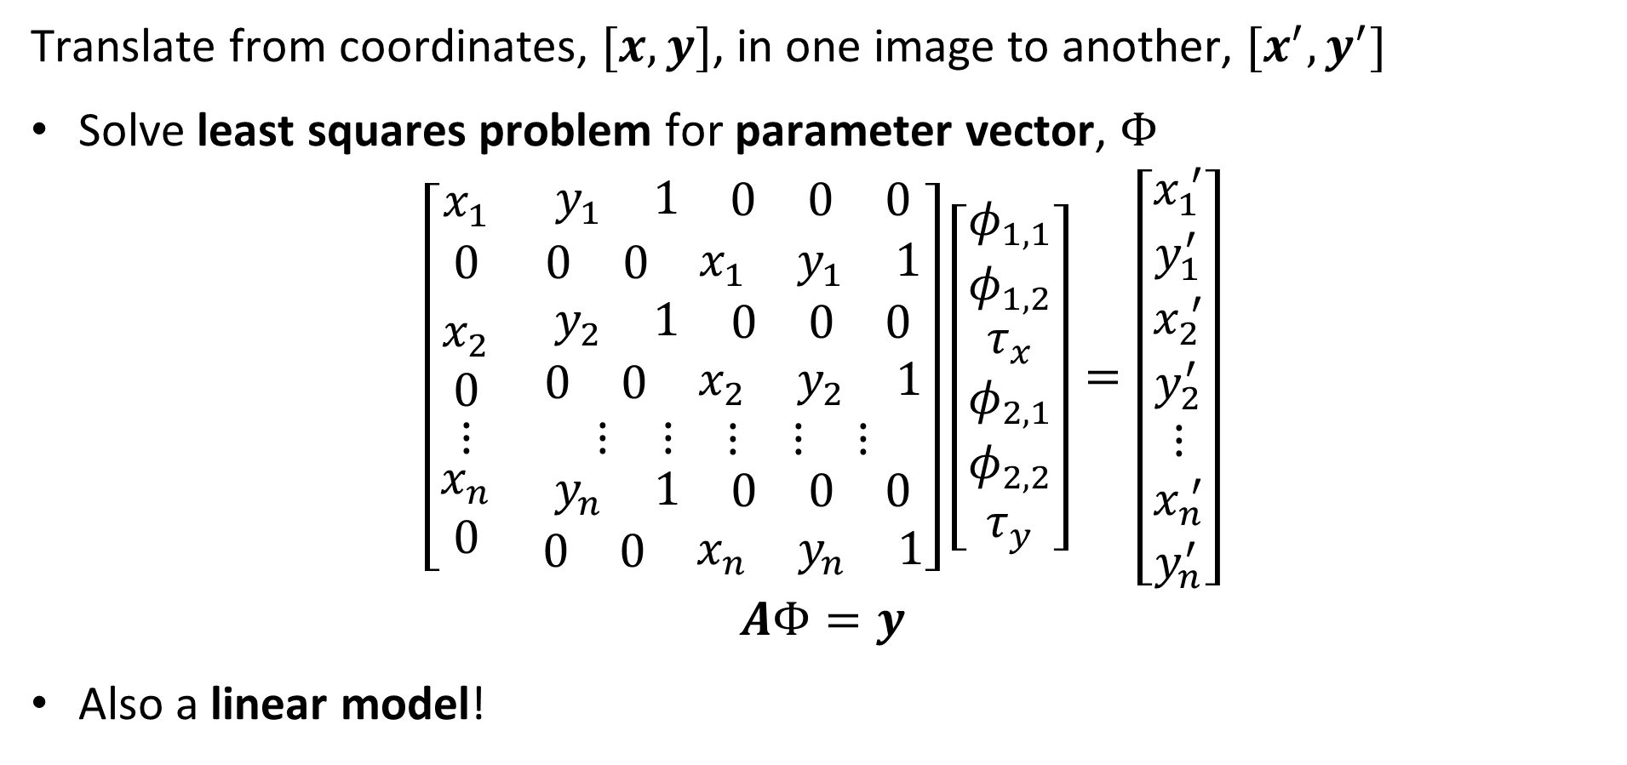
Affine transformation
Translate from coordinates, $[x,y]$, in one image to another, $[x^{′},y^{′}]$
Solve least squares problem for parameter vector, $Φ$
$$\left[\begin{matrix}x_{1} & \begin{matrix}y_{1} & 1 & \begin{matrix}0 & 0 & 0\end{matrix}\end{matrix} \\ 0 & \begin{matrix}0 & 0 & \begin{matrix}x_{1} & y_{1} & 1\end{matrix}\end{matrix} \\ \begin{matrix}x_{2} \\ 0 \\ \begin{matrix}⋮ \\ \begin{matrix}x_{n} \\ 0\end{matrix}\end{matrix}\end{matrix} & \begin{matrix}\begin{matrix}y_{2} & 1 & \begin{matrix}0 & 0 & 0\end{matrix}\end{matrix} \\ \begin{matrix}0 & 0 & \begin{matrix}x_{2} & y_{2} & 1\end{matrix}\end{matrix} \\ \begin{matrix}\begin{matrix}⋮ & ⋮ & \begin{matrix}⋮ & ⋮ & ⋮\end{matrix}\end{matrix} \\ \begin{matrix}\begin{matrix}y_{n} & 1 & \begin{matrix}0 & 0 & 0\end{matrix}\end{matrix} \\ \begin{matrix}0 & 0 & \begin{matrix}x_{n} & y_{n} & 1\end{matrix}\end{matrix}\end{matrix}\end{matrix}\end{matrix}\end{matrix}\right]\left[\begin{matrix}φ_{1,1} \\ φ_{1,2} \\ \begin{matrix}τ_{x} \\ φ_{2,1} \\ \begin{matrix}φ_{2,2} \\ τ_{y}\end{matrix}\end{matrix}\end{matrix}\right]=\left[\begin{matrix}x_{1}^{ ′} \\ y_{1}^{′} \\ \begin{matrix}x_{2}^{ ′} \\ y_{2}^{′} \\ \begin{matrix}⋮ \\ x_{n}^{ ′} \\ y_{n}^{′}\end{matrix}\end{matrix}\end{matrix}\right]$$
$$AΦ=y$$
Also a linear model!

Slide 31
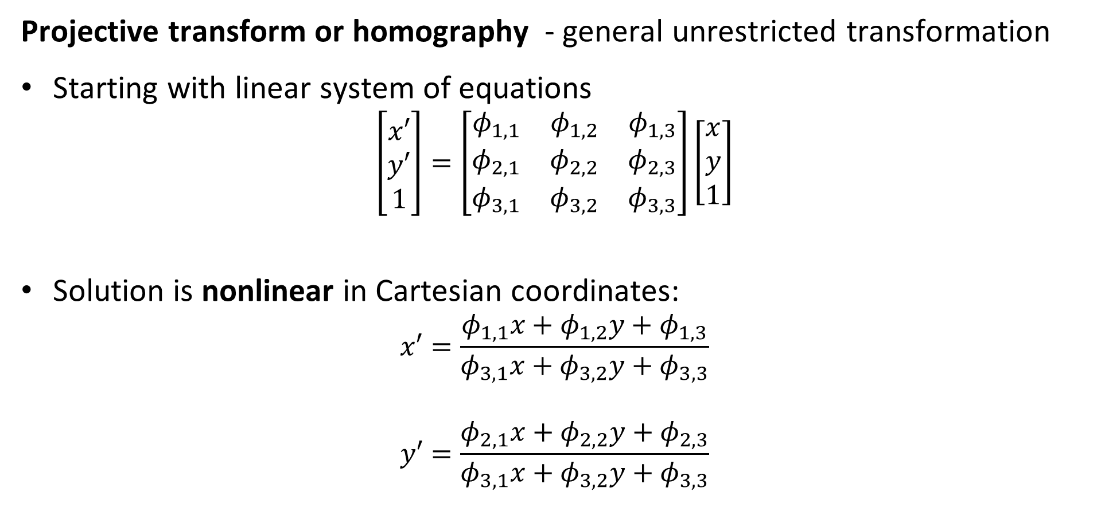
Projective transformation
Projective transform or homography - general unrestricted transformation
Starting with linear system of equations
$$\left[\begin{matrix}x′ \\ y′ \\ 1\end{matrix}\right]=\left[\begin{matrix}φ_{1,1} & φ_{1,2} & φ_{1,3} \\ φ_{2,1} & φ_{2,2} & φ_{2,3} \\ φ_{3,1} & φ_{3,2} & φ_{3,3}\end{matrix}\right]\left[\begin{matrix}x \\ y \\ 1\end{matrix}\right]$$
Solution is nonlinear in Cartesian coordinates:
$$x′=\frac{φ_{1,1}x+φ_{1,2}y+φ_{1,3}}{φ_{3,1}x+φ_{3,2}y+φ_{3,3}}$$
$$y′=\frac{φ_{2,1}x+φ_{2,2}y+φ_{2,3}}{φ_{3,1}x+φ_{3,2}y+φ_{3,3}}$$

Slide 32
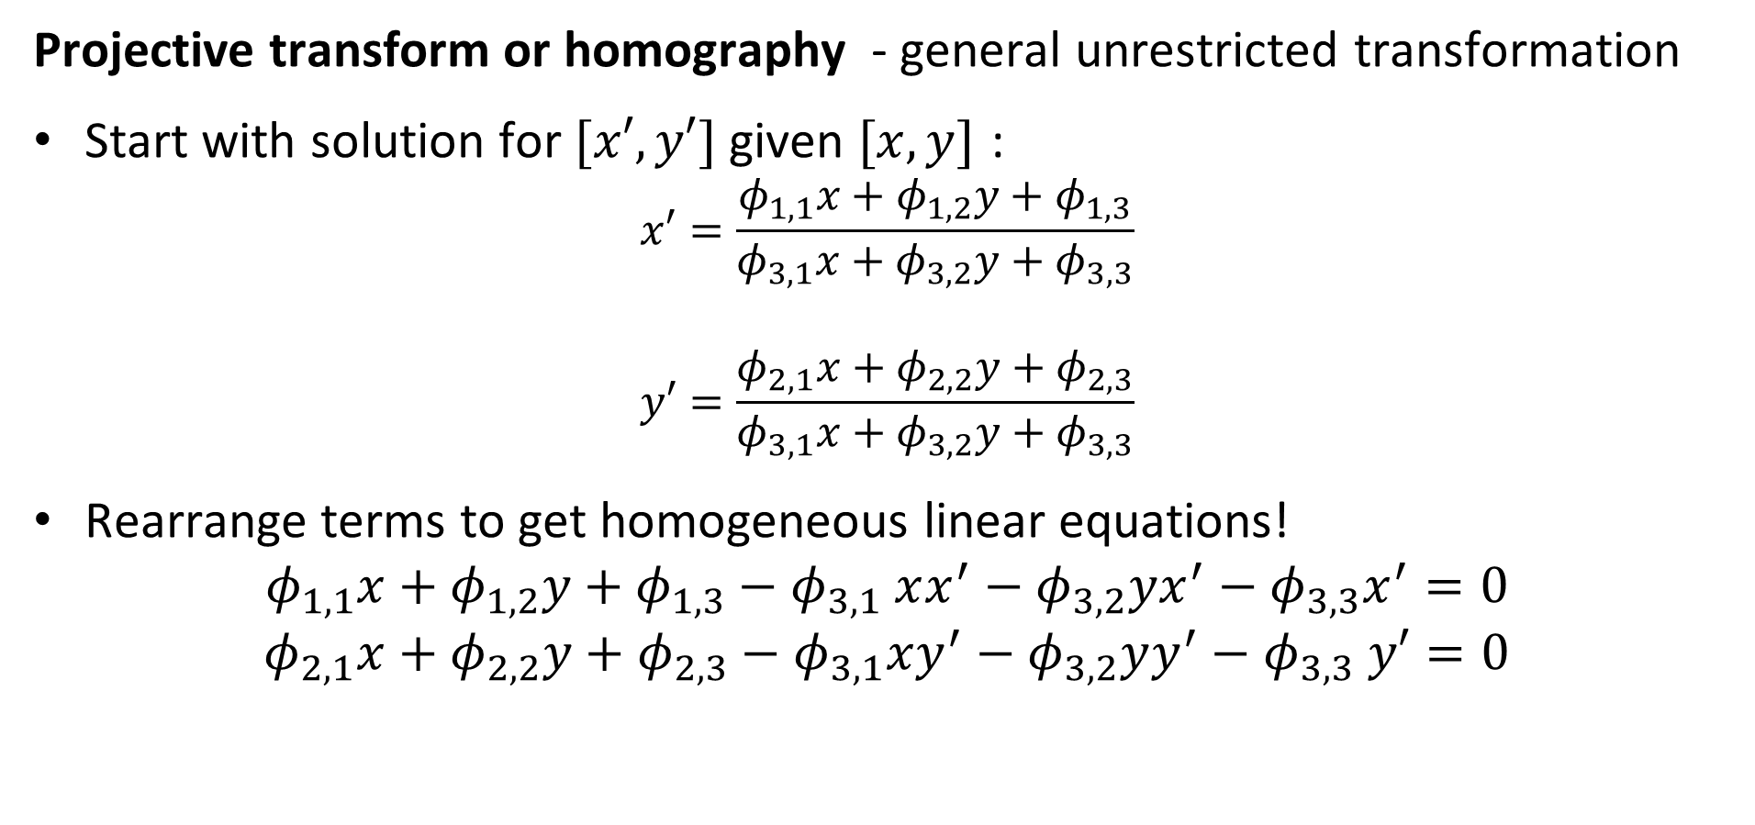
Projective transformation
Projective transform or homography - general unrestricted transformation
Start with solution for $[x′,y′]$ given $[x,y]$ :
$$x′=\frac{φ_{1,1}x+φ_{1,2}y+φ_{1,3}}{φ_{3,1}x+φ_{3,2}y+φ_{3,3}}$$
$$y′=\frac{φ_{2,1}x+φ_{2,2}y+φ_{2,3}}{φ_{3,1}x+φ_{3,2}y+φ_{3,3}}$$
Rearrange terms to get homogeneous linear equations!
$$φ_{1,1}x+φ_{1,2}y+φ_{1,3}{− φ}_{3,1}xx^{′}−φ_{3,2}yx^{′}−φ_{3,3}x^{′}=0$$
$$φ_{2,1}x+φ_{2,2}y+φ_{2,3}−φ_{3,1}xy^{′}−φ_{3,2}yy^{′}−φ_{3,3} y′=0$$

Slide 33
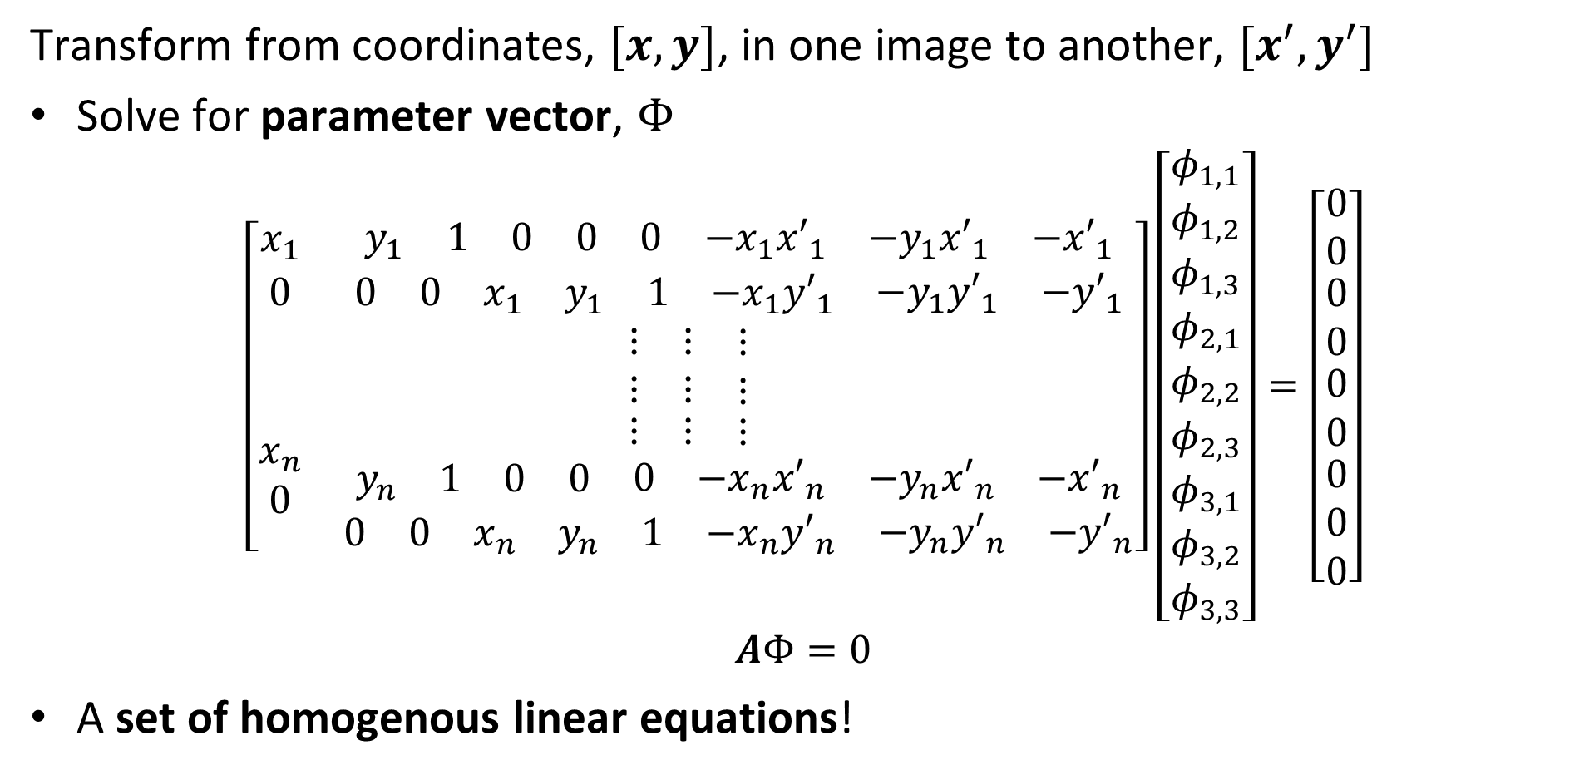
Projective transformation
Transform from coordinates, $[x,y]$, in one image to another, $[x^{′},y^{′}]$
Solve for parameter vector, $Φ$
$$\left[\begin{matrix}x_{1} & \begin{matrix}y_{1} & 1 & \begin{matrix}0 & 0 & \begin{matrix}0 & −x_{1}{x′}_{1} & \begin{matrix}{−y}_{1}{x′}_{1} & {−x′}_{1}\end{matrix}\end{matrix}\end{matrix}\end{matrix} \\ 0 & \begin{matrix}0 & 0 & \begin{matrix}x_{1} & y_{1} & \begin{matrix}1 & {−x}_{1}{y′}_{1} & \begin{matrix}{−y}_{1}{y′}_{1} & {−y′}_{1}\end{matrix}\end{matrix}\end{matrix}\end{matrix} \\ \begin{matrix} \\ \\ \begin{matrix} \\ \begin{matrix}x_{n} \\ 0\end{matrix}\end{matrix}\end{matrix} & \begin{matrix}\begin{matrix}⋮ & ⋮ & \begin{matrix}⋮ & & \end{matrix}\end{matrix} \\ \begin{matrix}⋮ & ⋮ & \begin{matrix}⋮ & & \end{matrix}\end{matrix} \\ \begin{matrix}\begin{matrix}⋮ & ⋮ & \begin{matrix}⋮ & & \end{matrix}\end{matrix} \\ \begin{matrix}\begin{matrix}y_{n} & 1 & \begin{matrix}0 & 0 & \begin{matrix}0 & {−x}_{n}{x′}_{n} & \begin{matrix}{−y}_{n}{x′}_{n} & {−x′}_{n}\end{matrix}\end{matrix}\end{matrix}\end{matrix} \\ \begin{matrix}0 & 0 & \begin{matrix}x_{n} & y_{n} & \begin{matrix}1 & {−x}_{n}{y′}_{n} & \begin{matrix}{−y}_{n}{y′}_{n} & {−y′}_{n}\end{matrix}\end{matrix}\end{matrix}\end{matrix}\end{matrix}\end{matrix}\end{matrix}\end{matrix}\right]\left[\begin{matrix}φ_{1,1} \\ φ_{1,2} \\ \begin{matrix}φ_{1,3} \\ φ_{2,1} \\ \begin{matrix}φ_{2,2} \\ \begin{matrix}φ_{2,3} \\ φ_{3,1} \\ \begin{matrix}φ_{3,2} \\ φ_{3,3}\end{matrix}\end{matrix}\end{matrix}\end{matrix}\end{matrix}\right]=\left[\begin{matrix}0 \\ 0 \\ \begin{matrix}0 \\ 0 \\ \begin{matrix}0 \\ 0 \\ \begin{matrix}0 \\ 0 \\ 0\end{matrix}\end{matrix}\end{matrix}\end{matrix}\right]$$
$$AΦ=0$$
A set of homogenous linear equations!

Slide 34
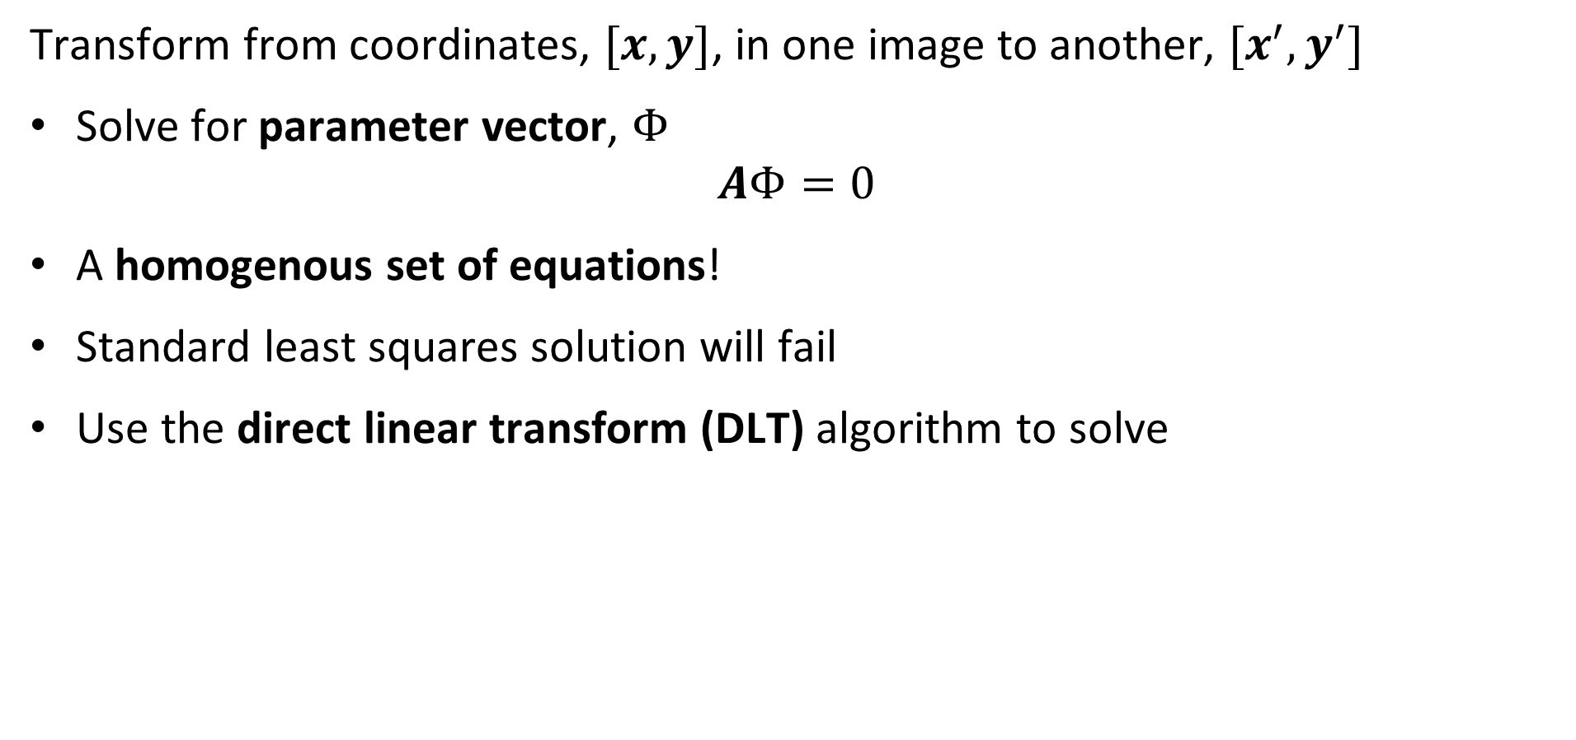
Projective transformation
Transform from coordinates, $[x,y]$, in one image to another, $[x^{′},y^{′}]$
Solve for parameter vector, $Φ$
$$AΦ=0$$
A homogenous set of equations!
Standard least squares solution will fail
Use the direct linear transform (DLT) algorithm to solve

Slide 35
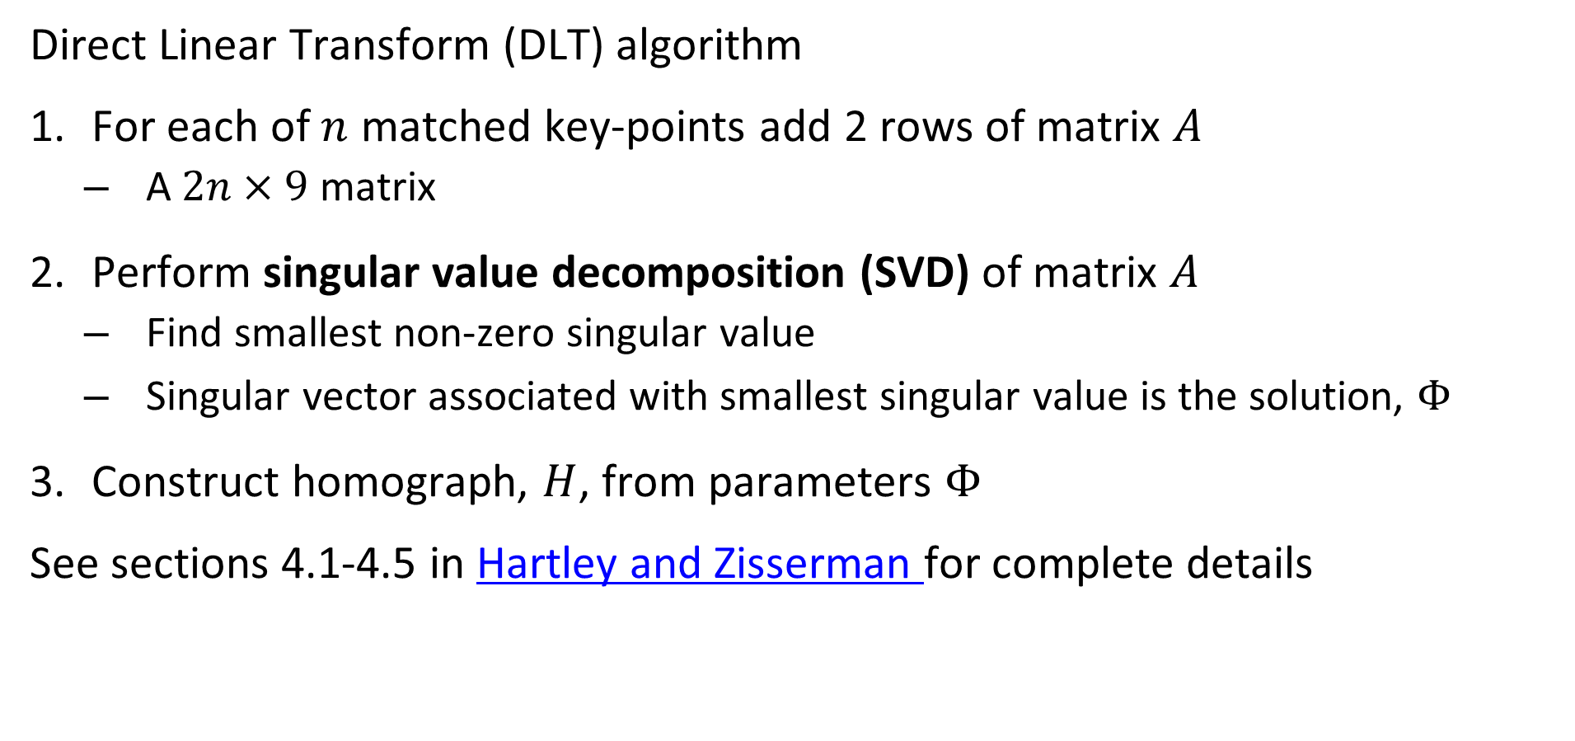
Projective transformation
Direct Linear Transform (DLT) algorithm
For each of $n$ matched key-points add 2 rows of matrix $A$
A $2n×9$ matrix
Perform singular value decomposition (SVD) of matrix $A$
Find smallest non-zero singular value
Singular vector associated with smallest singular value is the solution, $Φ$
Construct homograph, $H$, from parameters $Φ$
See sections 4.1-4.5 in Hartley and Zisserman for complete details

Slide 36
Outliers and RANSAC

Slide 37
Solving for the transformation parameters
$[x,y]$, $[x^{′},y^{′}]$, pairs found by using matched descriptors
Notice the obvious matching errors – These are outliers!

Slide 38
Solving for the transformation parameters
Use matching descriptors to find points fit transform parameters
Cannot use ordinary least squares because of outliners
Outliers exhibit undue influence on the solution
Need way to control influence of outliers
M-estimators, limit influence of outliers – e.g. Huber estimator
Resampling method to find only inliers for solution

Slide 39
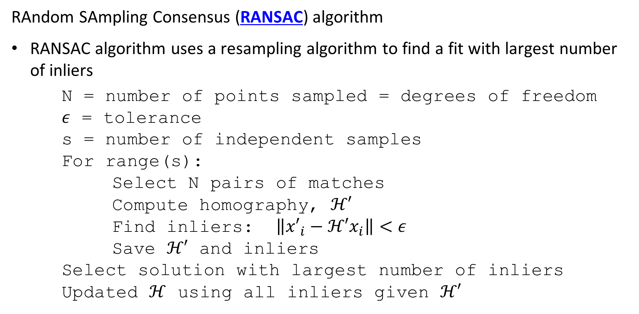
Solving for the transformation parameters
RAndom SAmpling Consensus (RANSAC) algorithm
RANSAC algorithm uses a resampling algorithm to find a fit with largest number of inliers
N = number of points sampled = degrees of freedom
$ε$ = tolerance
s = number of independent samples
For range(s):
Select N pairs of matches
Compute homography, $ℋ′$
Find inliers: $\left\|{x′}_{i}−ℋ′x_{i}\right\|<ε$
Save $ℋ′$ and inliers
Select solution with largest number of inliers
Updated $ℋ$ using all inliers given $ℋ′$
Notes:
N

Slide 40
Solving for the transformation parameters
RAndom SAmpling Concensus (RANSAC) algorithm example
s = 3
Let DoF = 2
Notes:
n

Slide 41
Solving for the transformation parameters
RAndom SAmpling Concensus (RANSAC) algorithm example
s = 3
Let DoF = 2
Select 2 points at random
Notes:
n

Slide 42
Solving for the transformation parameters
RAndom SAmpling Concensus (RANSAC) algorithm example
s = 3
Let DoF = 2
Select 2 points at random
Fit line
Notes:
n

Slide 43
Solving for the transformation parameters
RAndom SAmpling Concensus (RANSAC) algorithm example
s = 3
Let DoF = 2
Select 2 points at random
Fit line
Identify inliers = 7
Notes:
n

Slide 44
Solving for the transformation parameters
RAndom SAmpling Concensus (RANSAC) algorithm example
s = 3
Let DoF = 2
Select 2 points at random
Notes:
n

Slide 45
Solving for the transformation parameters
RAndom SAmpling Concensus (RANSAC) algorithm example
s = 3
Let DoF = 2
Select 2 points at random
Notes:
n

Slide 46
Solving for the transformation parameters
RAndom SAmpling Concensus (RANSAC) algorithm example
s = 3
Let DoF = 2
Select 2 points at random
Fit line
Notes:
n

Slide 47
Solving for the transformation parameters
RAndom SAmpling Concensus (RANSAC) algorithm example
s = 3
Let DoF = 2
Select 2 points at random
Fit line
Identify inliers = 5
Notes:
n

Slide 48
Solving for the transformation parameters
RAndom SAmpling Concensus (RANSAC) algorithm example
s = 3
Let DoF = 2
Select 2 points at random
Notes:
n

Slide 49
Solving for the transformation parameters
RAndom SAmpling Concensus (RANSAC) algorithm example
s = 3
Let DoF = 2
Select 2 points at random
Fit line
Notes:
n

Slide 50
Solving for the transformation parameters
RAndom SAmpling Concensus (RANSAC) algorithm example
S = 3
Let DoF = 2
Select 2 points at random
Fit line
Identify inliers = 11
Notes:
n

Slide 51
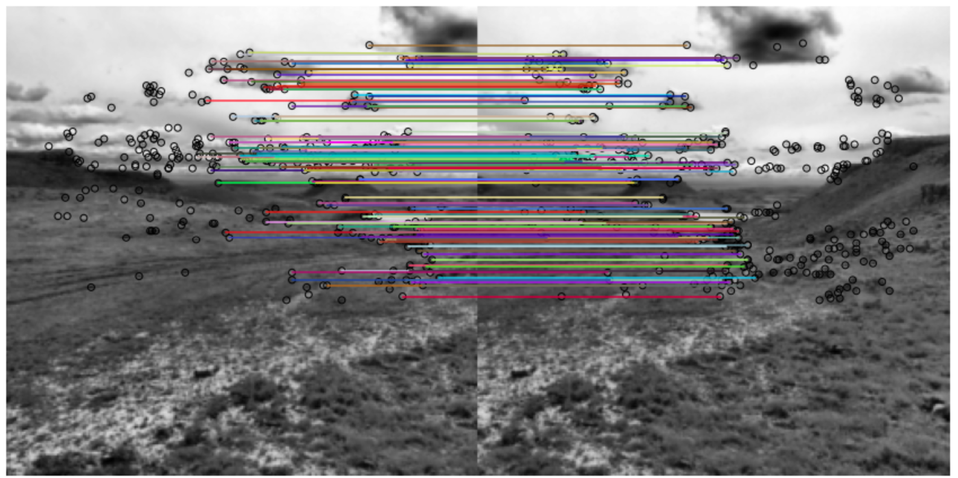
Solving for the transformation parameters
RAndom SAmpling Concensus (RANSAC) algorithm example
Least squares fit based only on inliers

Slide 52
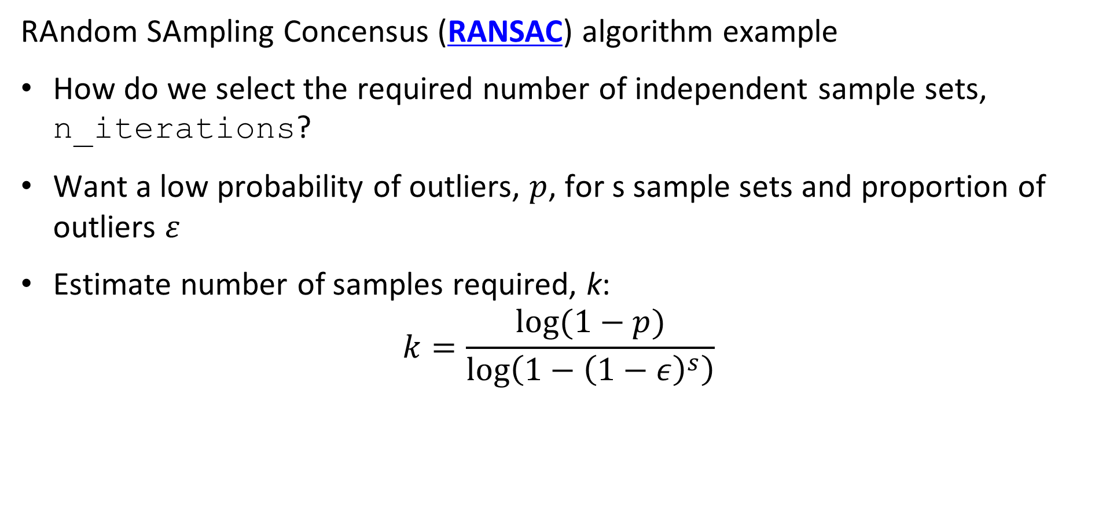
Solving for the transformation parameters
RAndom SAmpling Concensus (RANSAC) algorithm example
How do we select the required number of independent sample sets, n_iterations?
Want a low probability of outliers, $p$, for s sample sets and proportion of outliers $ε$
Estimate number of samples required, k:
$$k=\frac{log⁡(1−p)}{log\left(1−{\left(1−ε\right)}^{s}\right)⁡}$$
Notes:
n

Slide 53
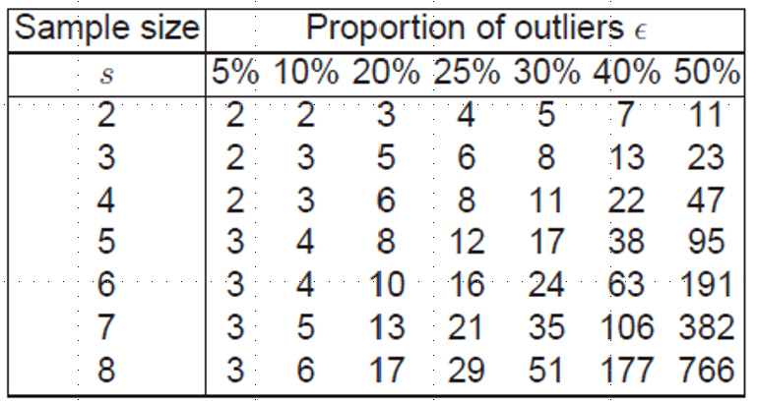
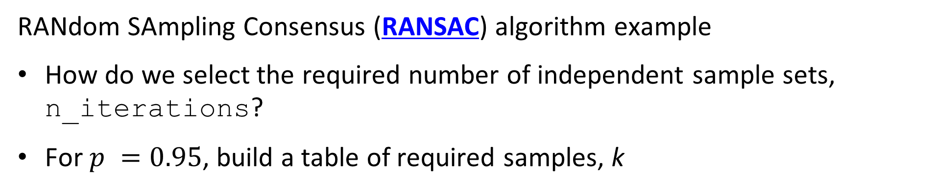
Solving for the transformation parameters
RANdom SAmpling Consensus (RANSAC) algorithm example
How do we select the required number of independent sample sets, n_iterations?
For $p =0.95$, build a table of required samples, k
Notes:
n

Slide 54
Solving for the transformation parameters
Improving the least squares fit.
The RANSAC algorithm uses only a limited number of inliers to fit a transform model
Limited number of observations increases variance of the estimated parameters
But, may not be enough inliers
Algorithm can fail, particularly when baseline is wide, minimal overlap
How can we improve this result?
Use the current set of inliers as exemplars to find other matches with similar slope
Compute least squares or DLT fit with larger number of observations
See Chapter 4 of Hartley and Zisserman for details
Notes:
n

Slide 55
Solving for the transformation parameters
Improving the least squares fit.
Planar projections introduce distortion in object locations near camera center
Least squares fit for planar projections is not guaranteed to be globally optimal
Use cylindrical or spherical coordinates
Less distortion if camera centers collocated
More likely to find globally optimal solution
See Szelisski, 2022, Section 8.2.3
Notes:
n

Slide 56
Neural Image Stitching Algorithms

Slide 57
Abbreviated Bibliography of (nearly) State of the Art Image Stitching Algorithms
Single-Perspective Warps in Natural Image Stitching, Liao and Li, 2018
Depth-Aware Multi-Grid Deep Homography Estimation with Contextual Correlation, Nei, et. al., 2021
Unsupervised Deep Image Stitching: Reconstructing Stitched Features to Images, Nie, et. al., 2021
Parallax Tolerant Unsupervised Deep Image Stitching, Nie, et. al., 2023
Reconstructing the Image Stitching Pipeline: Integrating Fusion and Rectangling into a Unified Inpainting Model, Xie, et. al., 2024
Notes:
n

Slide 58
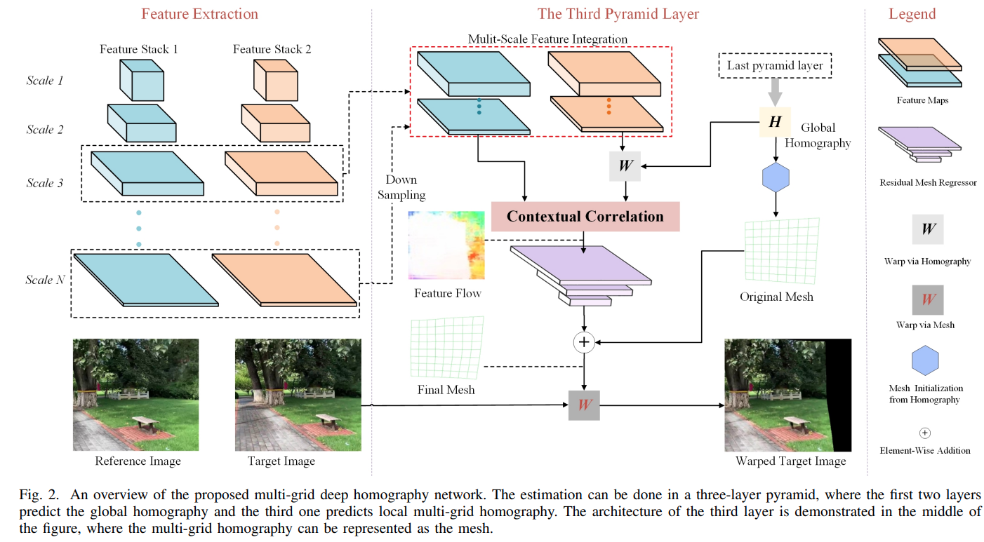
Multi-Scale Multi-Grid Image
Nei, et. al., 2023, use a deep convolutional architecture to perform wide-baseline stitching
1. CNN creates multi-scale feature map for reference (left) and target (right) images
2. Feature maps are up or down sampled and concatenated to dimension H′×𝑊′
3. Coase scale or global homograph computed using last pyramid layer feature map
4. Global homography used to warp target image
5. Contextual correlation measures alignment between target and reference images

Slide 59
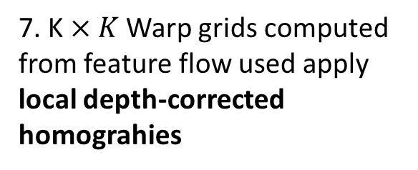
Multi-Scale Multi-Grid Image
Nei, et. al., 2023, use a deep convolutional architecture to perform wide-baseline stitching
6. Multiscale feature flow provides fine-grain small scale errors in homography
7. K$×K$ Warp grids computed from feature flow used apply local depth-corrected homograhies
8. Masked and warped target image akigned with reference image

Slide 60
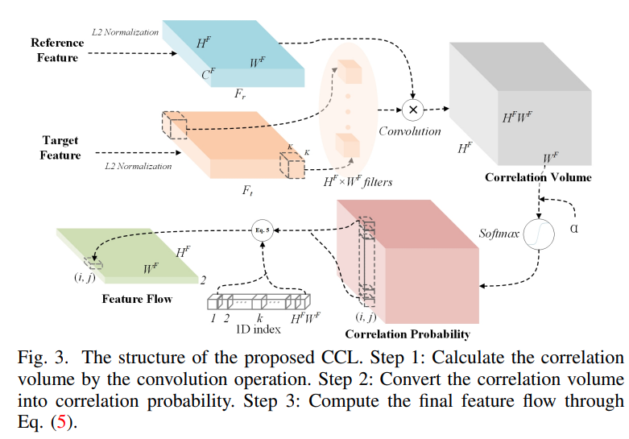
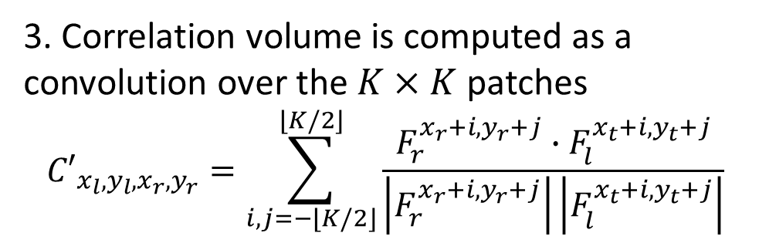
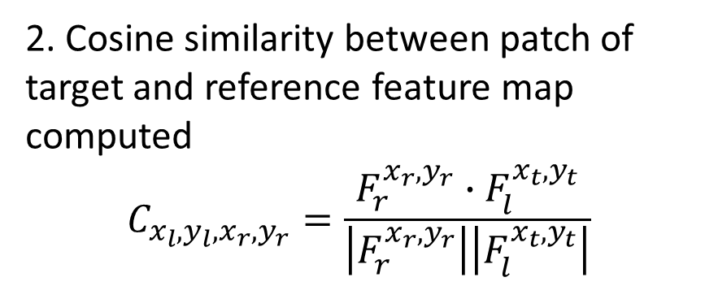
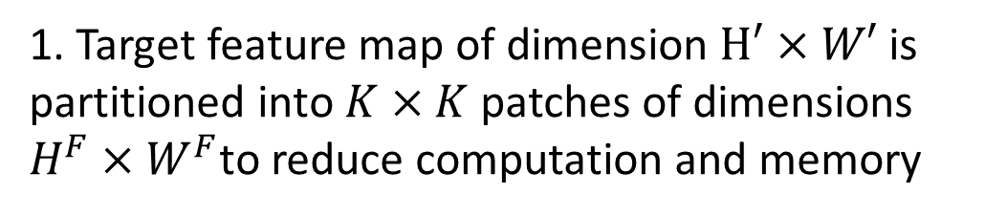
Multi-Scale Multi-Grid Image
Nei, et. al., 2023, use a deep convolutional architecture to perform wide-baseline stitching
1. Target feature map of dimension $H′×W′$ is partitioned into $K×K$ patches of dimensions $H^{F}×W^{F}$to reduce computation and memory
2. Cosine similarity between patch of target and reference feature map computed
$$C_{x_{l},y_{l},x_{r},y_{r}}=\frac{F_{r}^{x_{r},y_{r}}∙F_{l}^{x_{t},y_{t}}}{\left|F_{r}^{x_{r},y_{r}}\right|\left|F_{l}^{x_{t},y_{t}}\right|}$$
3. Correlation volume is computed as a convolution over the $K×K$ patches
$${C′}_{x_{l},y_{l},x_{r},y_{r}}=\sum_{i,j=−\left\lfloor K/2\right\rfloor }^{\left\lfloor K/2\right\rfloor }{\frac{F_{r}^{x_{r}+i,y_{r}+j}∙F_{l}^{x_{t}+i,y_{t}+j}}{\left|F_{r}^{x_{r}+i,y_{r}+j}\right|\left|F_{l}^{x_{t}+i,y_{t}+j}\right|}}$$

Slide 61
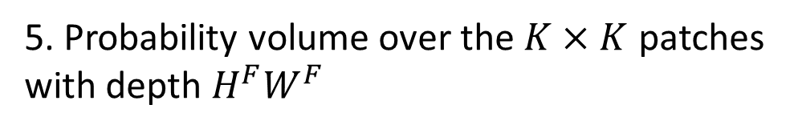
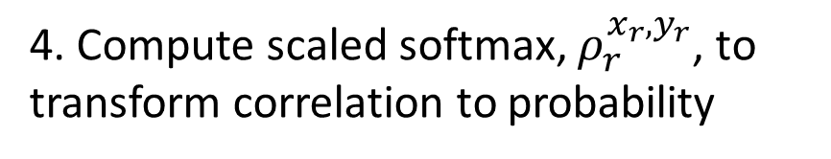
Multi-Scale Multi-Grid Image
Nei, et. al., 2023, use a deep convolutional architecture to perform wide-baseline stitching
4. Compute scaled softmax, $ρ_{r}^{x_{r},y_{r}}$, to transform correlation to probability
5. Probability volume over the $K×K$ patches with depth $H^{F}W^{F}$

Slide 62
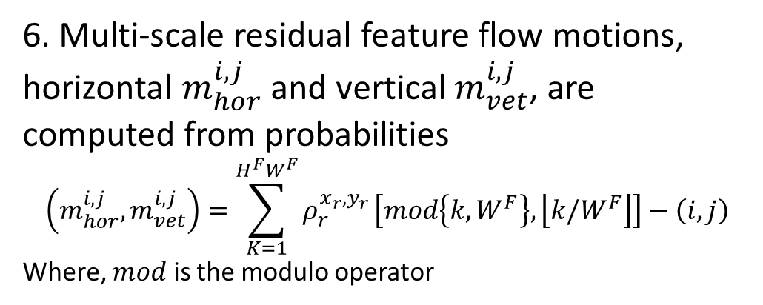
Multi-Scale Multi-Grid Image
Nei, et. al., 2023, use a deep convolutional architecture to perform wide-baseline stitching
6. Multi-scale residual feature flow motions, horizontal $m_{hor}^{i,j }$ and vertical $m_{vet}^{i,j }$, are computed from probabilities
$$\left(m_{hor}^{i,j },m_{vet}^{i,j }\right)=\sum_{K=1}^{H^{F}W^{F}}{ρ_{r}^{x_{r},y_{r}}}\left[mod\left\{k,W^{F}\right\},\left\lfloor k/W^{F}\right\rfloor \right]−\left(i,j\right)$$
Where, $mod$ is the modulo operator

Slide 63
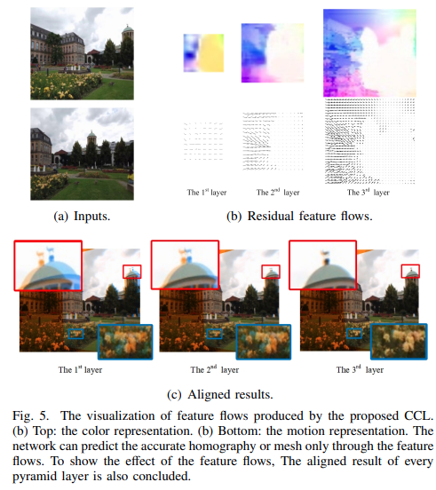
Multi-Scale Multi-Grid Image
Nei, et. al., 2023, use a deep convolutional architecture to perform wide-baseline stitching
Reference image
Multiscale residual flow maps
Target image
Progressively finer scale alignment between reference and target images as resolution of residual flow map increases

Slide 64
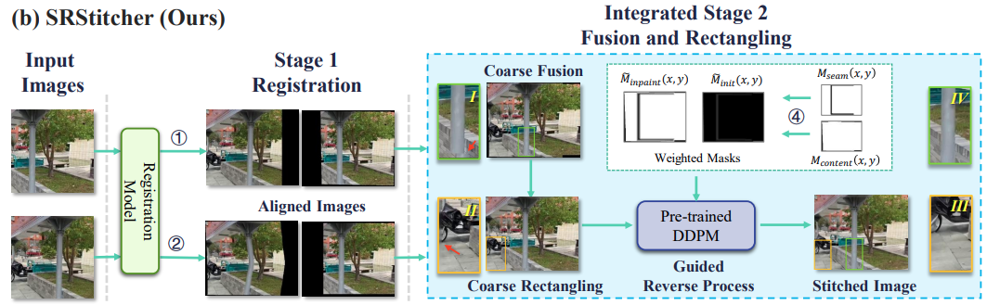
Filling Seams with Generative Diffusion Model
Xie, et. al., 2024, use a generative diffusion model to infill seams and edges of stitched images
3. Target image is warped and masks applied to each image
5. Stitched image with seams and edges filled by generative model
1. Target and reference images
4. Seams and edge artifacts from masks
2. Compute homography and align images
6. Notice straight lines are preserved

Slide 65
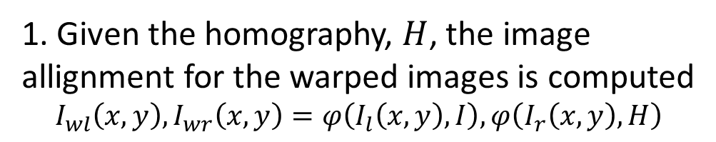
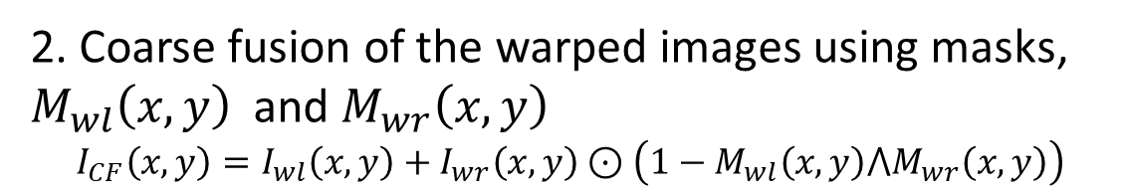
Filling Seams with Generative Diffusion Model
Xie, et. al., 2024, use a generative diffusion model to infill seams and edges of stitched images
2. Coarse fusion of the warped images using masks, $M_{wl}\left(x,y\right)$ and $M_{wr}\left(x,y\right)$
$$I_{CF}\left(x,y\right)=I_{wl}\left(x,y\right)+I_{wr}\left(x,y\right)⊙\left(1−M_{wl}\left(x,y\right)⋀M_{wr}\left(x,y\right)\right)$$
1. Given the homography, $H$, the image allignment for the warped images is computed
$$I_{wl}\left(x,y\right),I_{wr}\left(x,y\right)=φ\left(I_{l}\left(x,y\right),I\right),φ\left(I_{r}\left(x,y\right),H\right)$$

Slide 66
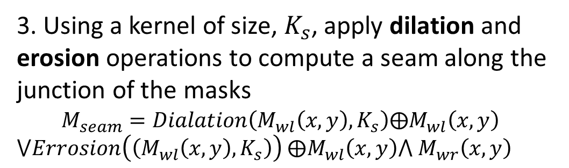
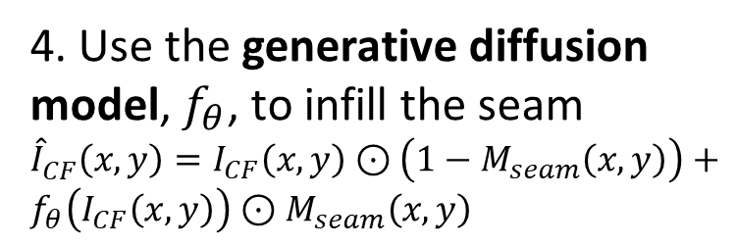
Filling Seams with Generative Diffusion Model
Xie, et. al., 2024, use a generative diffusion model to infill seams and edges of stitched images
3. Using a kernel of size, $K_{s}$, apply dilation and erosion operations to compute a seam along the junction of the masks
$$M_{seam}=Dialation\left(M_{wl}\left(x,y\right),K_{s}\right)⨁M_{wl}\left(x,y\right)$$
$⋁Errosion\left(\left(M_{wl}\left(x,y\right),K_{s}\right)\right)$ $⨁M_{wl}\left(x,y\right)⋀$ $M_{wr}\left(x,y\right)$
4. Use the generative diffusion model, $f_{θ}$, to infill the seam
${\hat{I}}_{CF}^{ }\left(x,y\right)=I_{CF}\left(x,y\right)$ $⊙\left(1−M_{seam}\left(x,y\right)\right)+f_{θ}\left(I_{CF}\left(x,y\right)\right)$ $⊙M_{seam}\left(x,y\right)$

Slide 67
Image Blending

Slide 68
Image Blending
How can we make the transitions in the mosaic less noticeable?
Region of overlap

Slide 69
Image Blending
How can we make the transitions in the mosaic less noticeable?
Blend one image into another over the region of overlap
Resulting pixel values are weighted sum of overlapping image pixel values
Blend different scales with pyramid
Blend R,G,B channels
Different blending function, linear, Gaussian, etc.
Adjust illumination
Equalize illumination between images in mosaic
Can still be problems, e.g. shadows
Notes:
n

Slide 70
Image Blending
Left and right weights
Use interpolation to find weights
Sum of interpolation weights must add to 1.0
Linearly weight pixel values over range of overlap
Sum weighted pixel values to form blended image
Region of overlap

Slide 71
Image Blending
How can we make the transitions in the mosaic less noticeable?
Compute Gaussian Laplacian pyramids of images for each color channel
Compute blending weights for each scale
Blend Laplacians scales using weights
Construct mosaic using weighted scales from pyramids
Example of image stitching with blending using Scikit Image in GitHub
Notes:
n

Slide 72
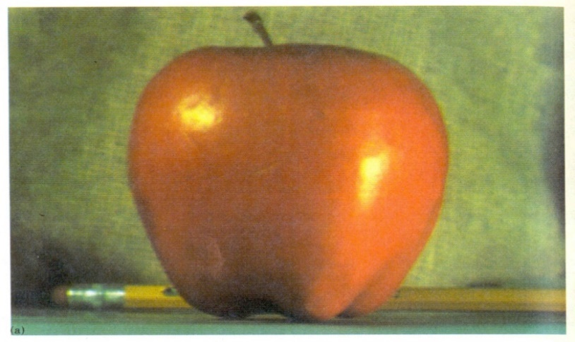
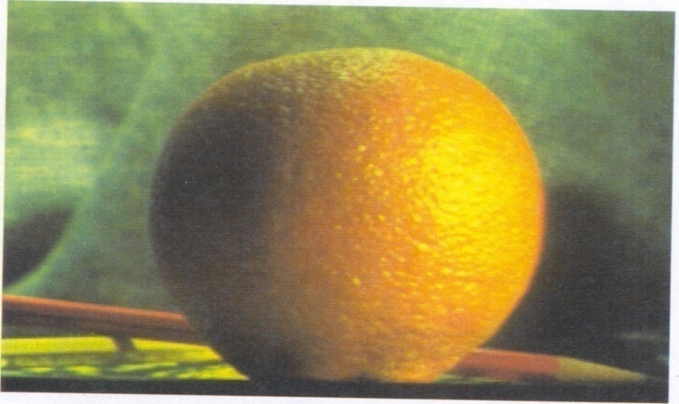
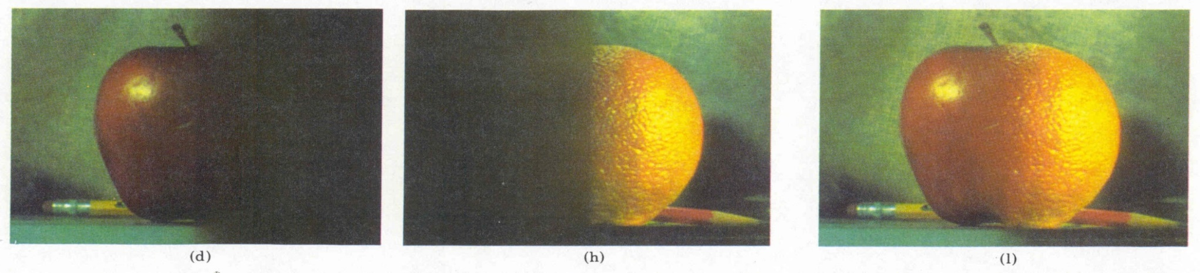
Image Blending
Image blending with scale pyramid is used in computer graphics
Burt, P. J. and Adelson, E. H., A multiresolution spline with applications to image mosaics, ACM Transactions on Graphics, 42(4), October 1983, 217-236.
Notes:
n

Slide 73
Image Blending
How can we make the transitions in the mosaic less noticeable?
There are several alternatives to weight blending
E.G., use image seam carving to minimize discontinuity
‘Low energy’ seam is less noticeable
Compute image energy
Find minimum energy path – classic graph theory problem – heuristic solution with dynamic programming
Join images along low energy seams
Algorithm widely used for image resizing
See Sections 8.3 and 8.4 of Szeliski for in-depth formulation of alignment and composting algorithms
Notes:
n

Slide 74
Summary

Slide 75
Summary
Key points for this lesson
The goal of image stitching is to create a mosaic image from multiple images from different camera poses
Overlapping portions of images are aligned using similar features
Image disparity has a wide baseline
Transformations are computed by solution of linear of equations
For projective transform use DLT algorithm
Use RANSAC to find solution with large number of outliers
SoA neural network algorithms produce consistently good results for wide baseline stitching
Use a diffusion model to heal seams
Images transformed and pixels interpolated
Image blending to improve result
Notes:
n

Slide 76
Review of Interest Points and Descriptors

Slide 77
Interest points and descriptors
Need interest points and descriptor which are scale and rotationally invariant
Interest points (key points)
Corners, edges, line intersections, etc.
High gradients
Ideally scale and rotationally invariant
Descriptors
Uniquely identify interest points
Use image characteristics within patch around interest point

Slide 78
Interest points and descriptors
Review of interest points and descriptors
Rotationally invariant interest point detectors
Harris, etc.
Increasingly neural networks; example with Keras
Descriptors
SHIFT
FAST
BRIEF
Etc
Or, alignment between features with neural network

Slide 79
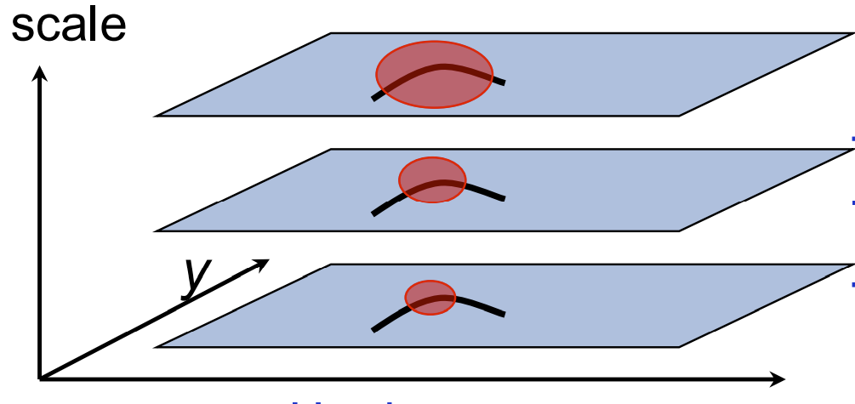
Multi-scale interest point detection
Pyramid structure enables extraction of interest points at several scales
Pyramid scales from fine to coarse in octaves
Features at each scale extracted
Can use a variety of interest point descriptor algorithms
SIFT
Neural network

