Slide 1

CSCI E-25 Computer Vision
Optical Flow
Steve Elston
Copyright 2022, 2023, 2024, 2025, 2026, Stephen F Elston. All rights reserved.

Slide 2
Optical Flow
Optical flow algorithms track image-to-image motion
Optical flow fields provide pixel-by-pixel (dense) motion from video
Optical flow algorithms have many applications:
Autonomous vehicles
Robotics
Action recognition
Augmented reality
Compressing and deblurring video
Object tracking
Science – e.g. measuring flow fields
Military sensors
….
Like many areas of CV, optical flow is being revolutionized by deep NN algorithms

Slide 3
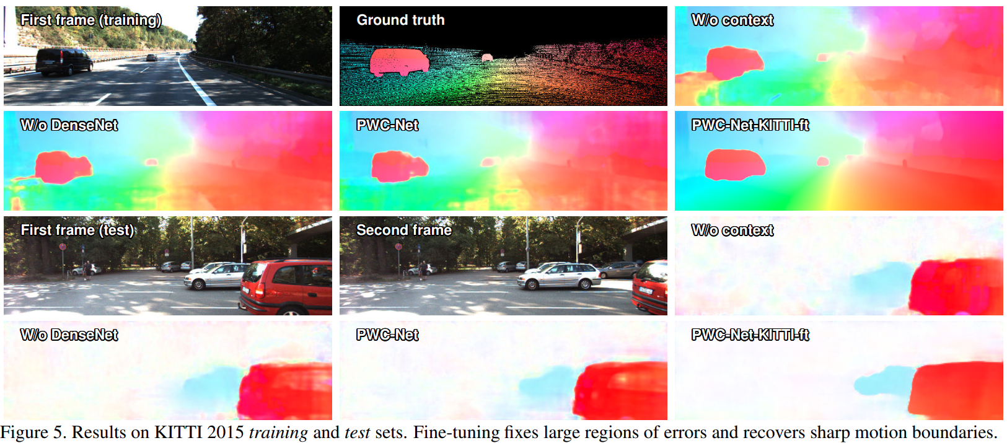
Optical Flow
Optical flow algorithms track pixel-level image-to-image motion
Credit Sun, et. al., 2018
TensorFlow implementation

Slide 4
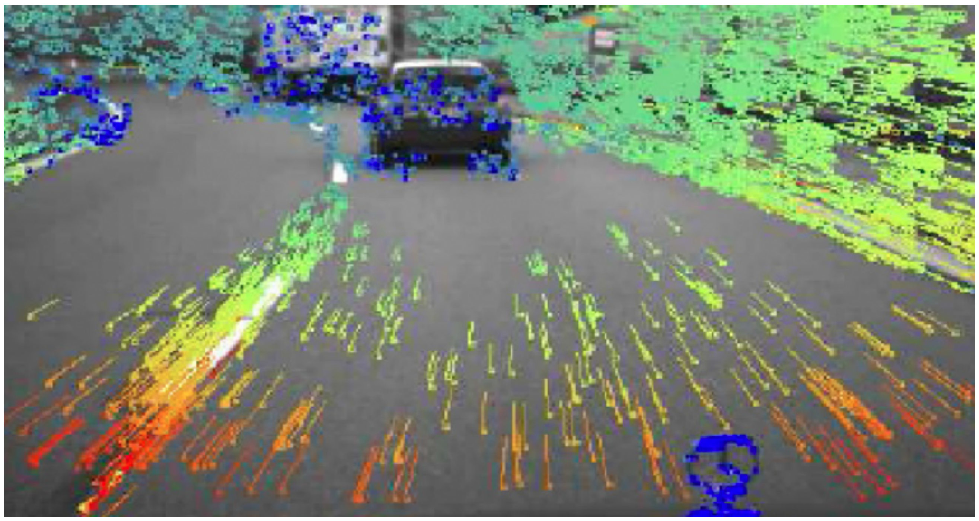
Optical Flow
Pixel-level optical flow field estimation for autonomous vehicles
Credit, Kris Kitani - CMU

Slide 5
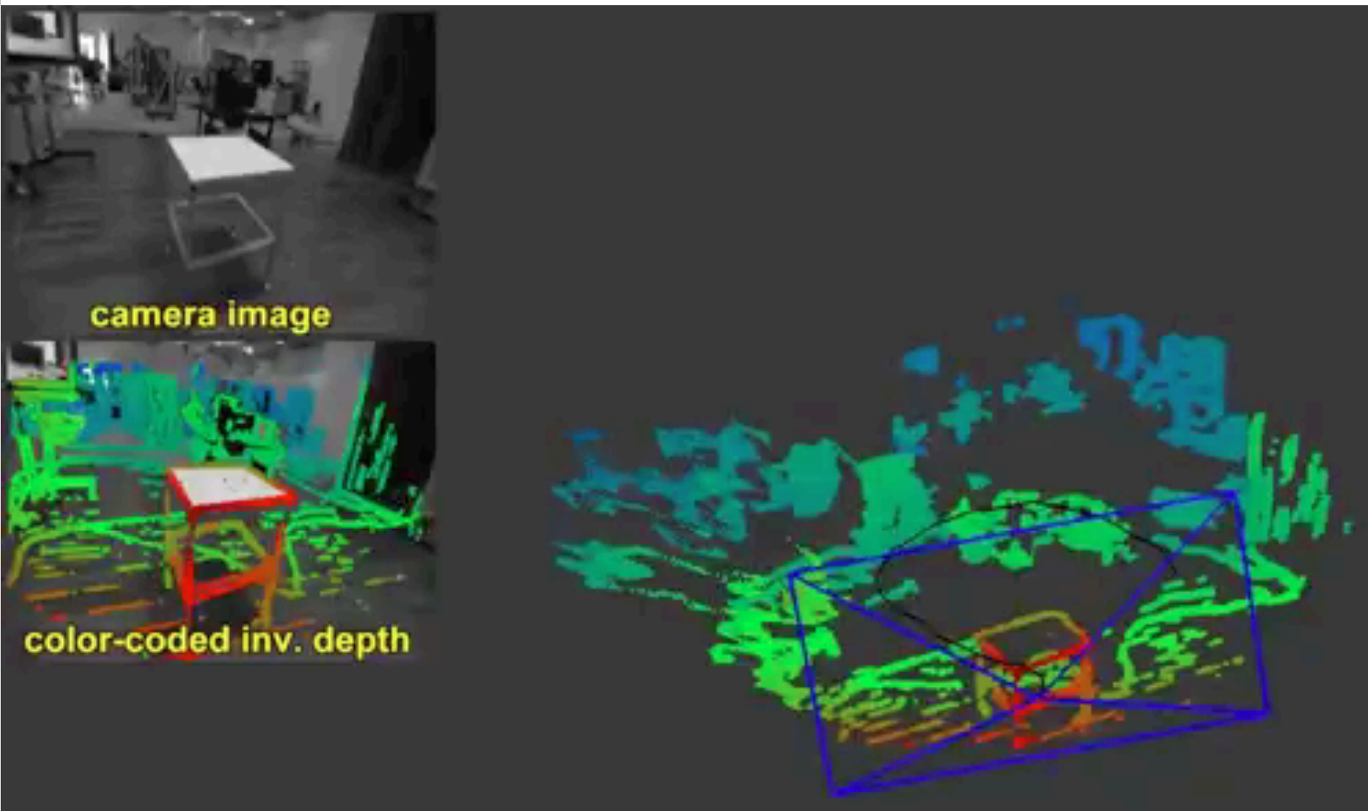
Optical Flow
Optical flow algorithms for mobile robot scene estimation using moving camera
Credit, Kris Kitani - CMU

Slide 6
Optical Flow
Overview of lesson
What is the relationship between optical flow and projective transforms?
Small movement, consistency assumptions, and the iterative Lucas-Kanade (iLK) algorithm
Relationship between depth, camera pose and optical flow
Regularization with the Horn-Schunck algorithm
Improving performance with the LV-L1 algorithm
Evaluation of optical flow algorithms
Deep NN algorithms for optical flow

Slide 7
Measuring Optical Flow is a Difficult Task
Several factors make optical flow a difficult task
Flow cannot be measured in regions of low or no gradient
Example: road surface in front of autonomous vehicle looks uniform
Example: The central pixels uniform area on and image have low contrast differences
Example: Motion is not visible in rotating low contrast disks
Example: Motion is difficult to detect in (semi) transparent objects
?
?
?
?
Notes:
ima

Slide 8
Measuring Optical Flow is a Difficult Task
Several factors make optical flow a difficult task
Limits of aperture obscure motion
Two objects in scene
Image plane of camera may not contain entire object
Motion perpendicular to visible edges is apparent
Motion parallel to edges is obscured!
?
?
Notes:
ima

Slide 9
Measuring Optical Flow is a Difficult Task
Several factors make optical flow a difficult task
Flow occurs at many independent scales
Example; camera moving in one direction objects moving in other directions
Example; small fast-moving ball and large slow-moving objects in scene
Example; flock of flying birds at different distances from the camera
Occlusions disrupt continuity of flow fields
Example: fast-moving object goes behind larger slow-moving object
Example: a car emerges from a tunnel
Notes:
ima

Slide 10

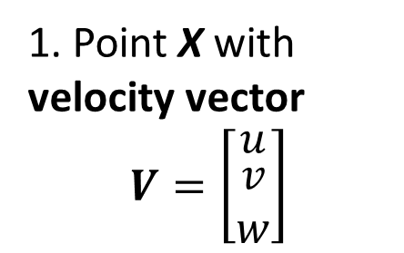





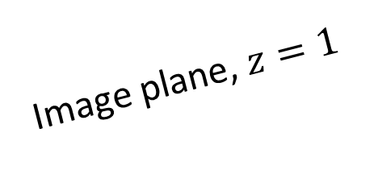
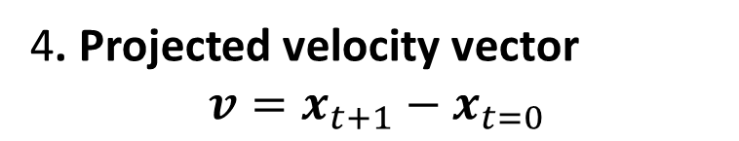
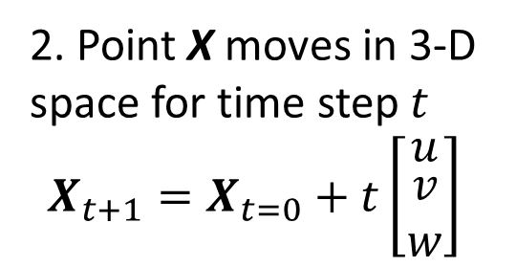

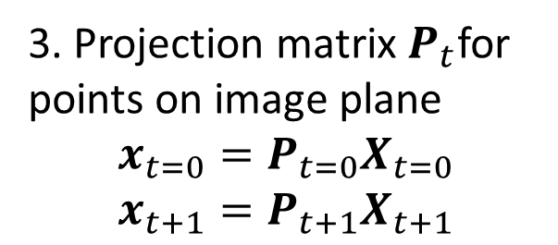
Measuring Optical Flow is a Difficult Task
5. 2-D image plane can only capture projection of 3-D motion parallel to image plane
3. Projection matrix$P_{t}$for points on image plane
$$x_{t=0}=P_{t=0}X_{t=0}$$
$$x_{t+1}=P_{t+1}X_{t+1}$$
Image plane, $z=1$
2. Point X moves in 3-D space for time step $t$
$$X_{t+1}=X_{t=0}+t\left[\begin{matrix}u \\ \begin{matrix}v \\ w\end{matrix}\end{matrix}\right]$$
$$y$$
v
$$x$$
$$u$$
$$X_{t+1}$$
$$v$$
$$x_{t+1}$$
$$z$$
$$w$$
O
$$x_{t}$$
$$X_{t=0}$$
1. Point X with velocity vector
$$V=\left[\begin{matrix}u \\ \begin{matrix}v \\ w\end{matrix}\end{matrix}\right]$$
4. Projected velocity vector
$$v=x_{t+1}−x_{t=0}$$

Slide 11
Optical Flow vs. Image Stitching
Compare optical flow models to projective transform models
Both booth tasks use image matching and warping
Parameters for projective transformation models are estimated for large areas
A single transform is applied to the entire image or patches of image
Cannot localize motion
Parameters for optical flow models are estimated pixel-by-pixel
Is a dense learning task
Warping on a pixel-by-pixel basis
Localizes motion
Some optical flow algorithms use a projective transform to model global flow
Notes:
ima

Slide 12
The Small Motion Consistency Assumptions

Slide 13
Small Motion and Consistency Assumptions
Assumptions about motion in video simplify a flow model
Frame to frame motion is small
Frame to frame illumination and color are constant
v
Track patch from time step to time step
u
v
u
t₂
v
u
t₁
t₀
Notes:
ima

Slide 14
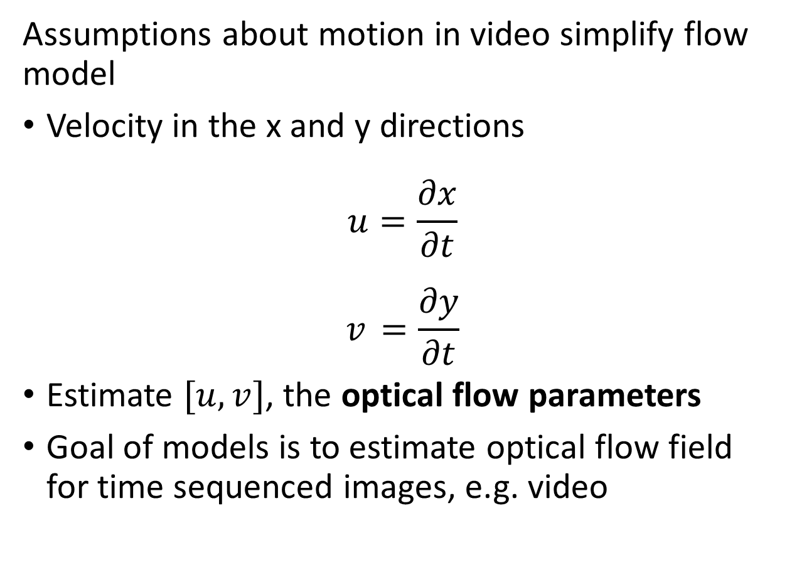
Small Motion and Consistency Assumptions
Assumptions about motion in video simplify flow model
Velocity in the x and y directions
$$u=\frac{∂x}{∂t}$$
$$v_{ }=\frac{∂y}{∂t}$$
Estimate $[u,v]$, the optical flow parameters
Goal of models is to estimate optical flow field for time sequenced images, e.g. video
v
u
Notes:
ima

Slide 15
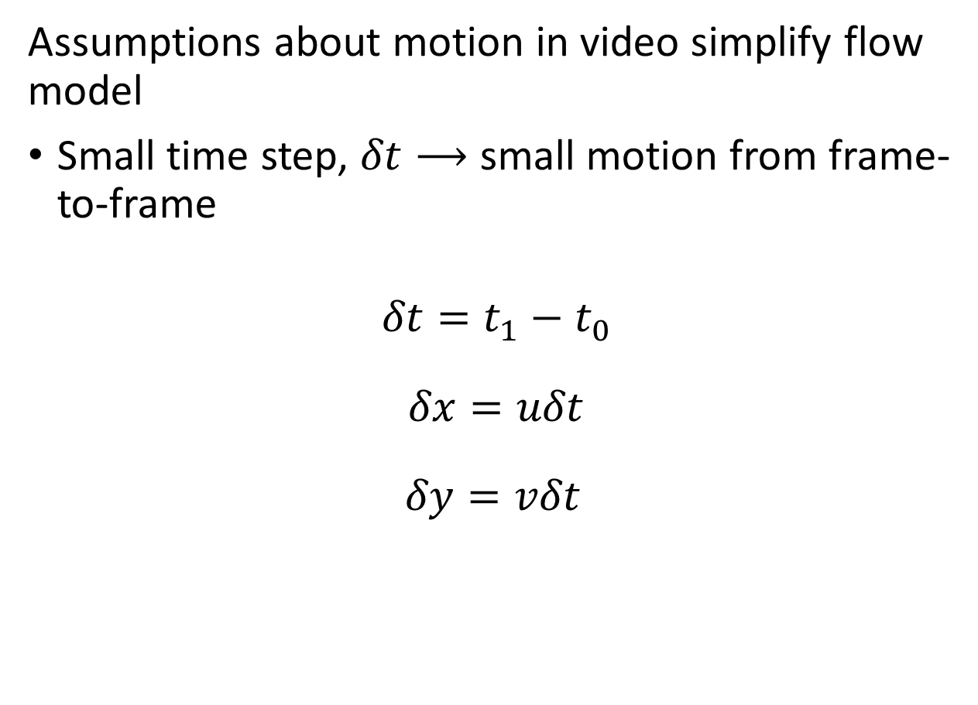
Small Motion and Consistency Assumptions
Assumptions about motion in video simplify flow model
Small time step, $δt⟶$ small motion from frame-to-frame
$${δt=t}_{1}−t_{0}$$
$$δx=uδt$$
$$δy={vδt}_{ }$$
Illumination in patch remains constant
v
u
v
u
t₁
t₀
Notes:
ima

Slide 16
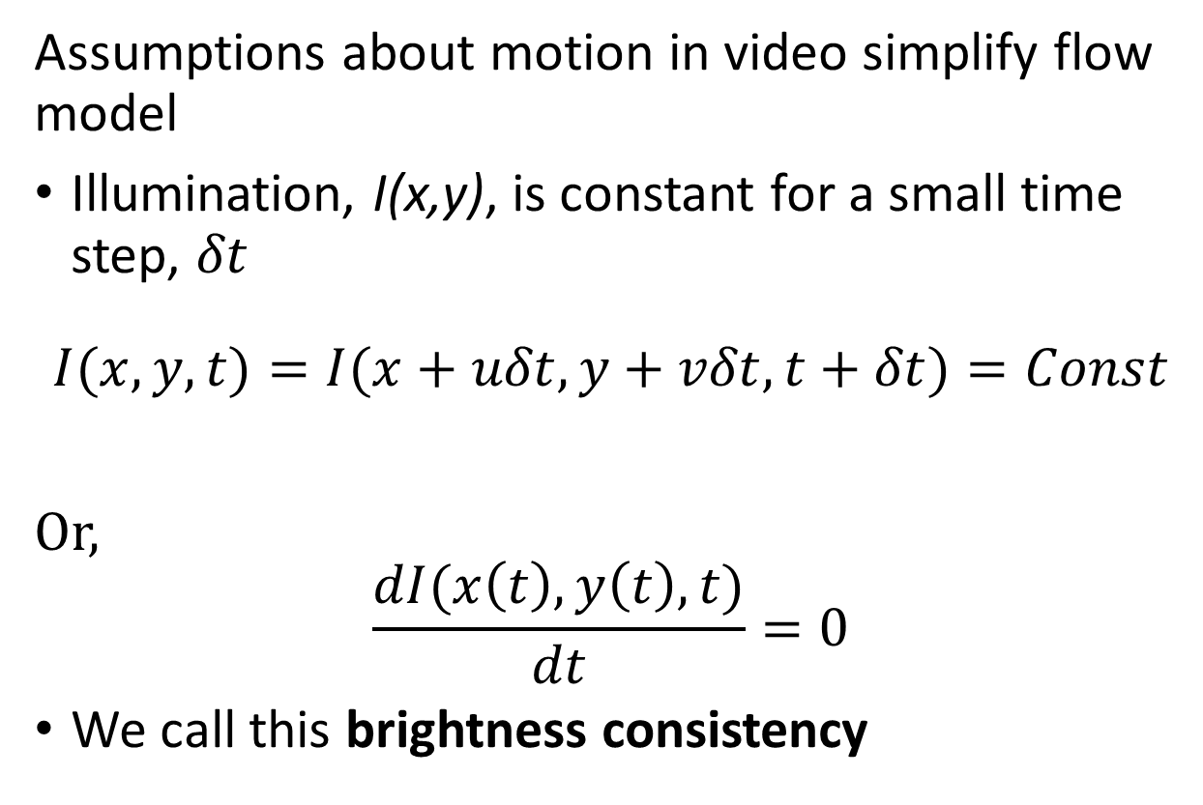
Small Motion and Consistency Assumptions
Assumptions about motion in video simplify flow model
Illumination, I(x,y), is constant for a small time step, $δt$
$$I(x,y,t)=I(x+uδt,y+vδt,t+δt)=Const$$
Or,
$$\frac{dI(x\left(t\right),y\left(t\right),t)}{dt}=0$$
We call this brightness consistency
Illumination in patch remains constant
v
u
v
u
t₁
t₀
Notes:
ima

Slide 17
The Lucas-Kanade Algorithm

Slide 18
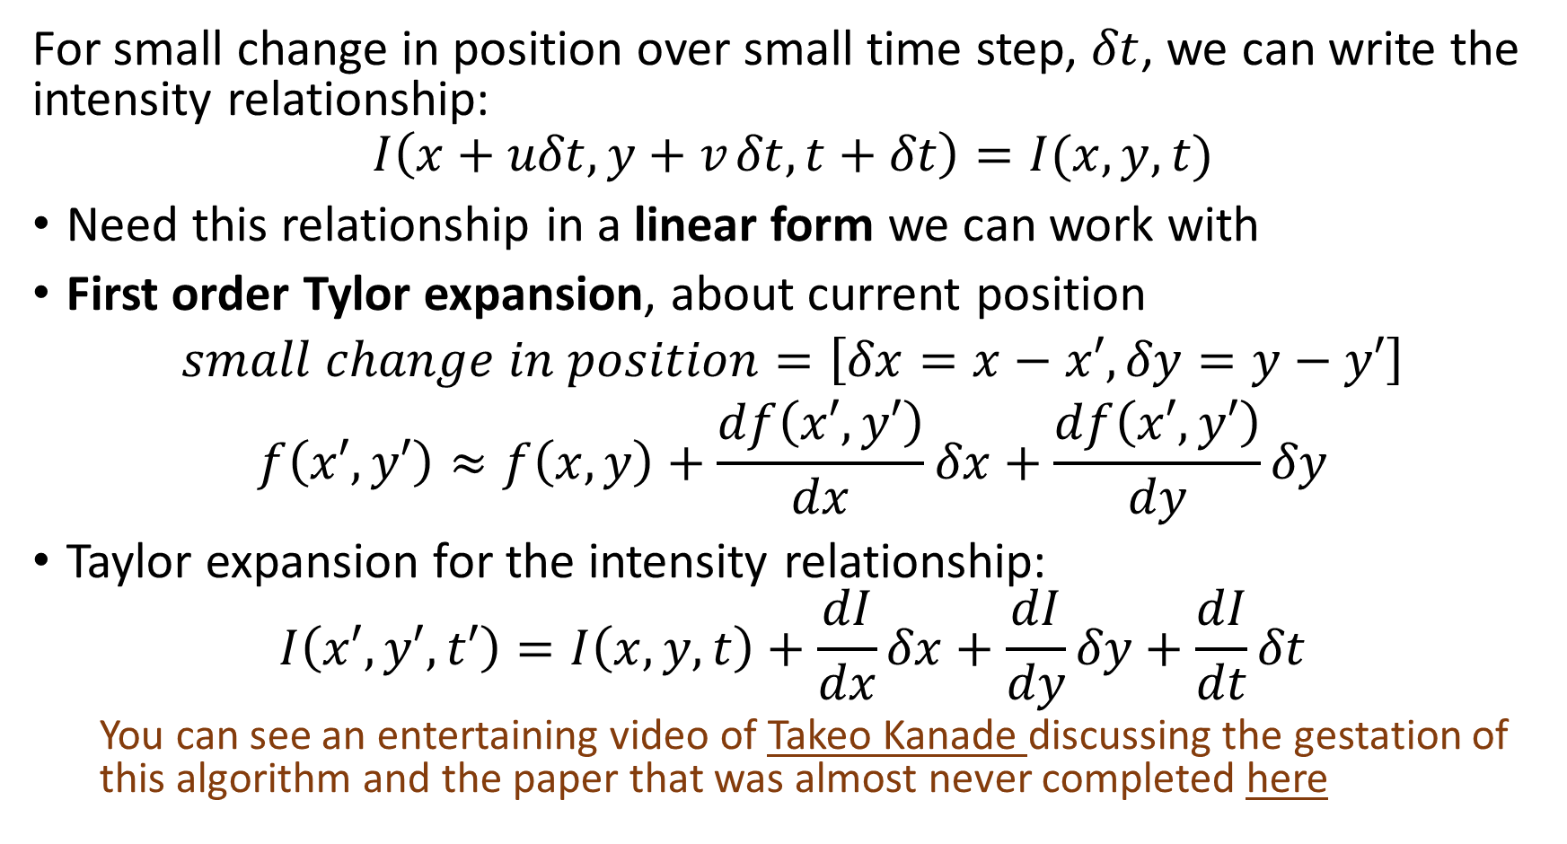
The Lucas-Kanade Algorithm
For small change in position over small time step, $δt$, we can write the intensity relationship:
$$I\left(x+uδt,y+v_{ }δt,t+δt\right)=I(x,y,t)$$
Need this relationship in a linear form we can work with
First order Tylor expansion, about current position
$$small change in position=\left[δx=x−x′,δy=y−y′\right]$$
$$f\left(x′,y′\right)≈f\left(x,y\right)+\frac{df\left(x′,y′\right)}{dx}δx+\frac{df\left(x′,y′\right)}{dy}δy$$
Taylor expansion for the intensity relationship:
$$I\left(x′,y′,t′\right)=I\left(x,y,t\right)+\frac{dI}{dx}δx+\frac{dI}{dy}δy+\frac{dI}{dt}δt$$
You can see an entertaining video of Takeo Kanade discussing the gestation of this algorithm and the paper that was almost never completed here
Notes:
ima

Slide 19
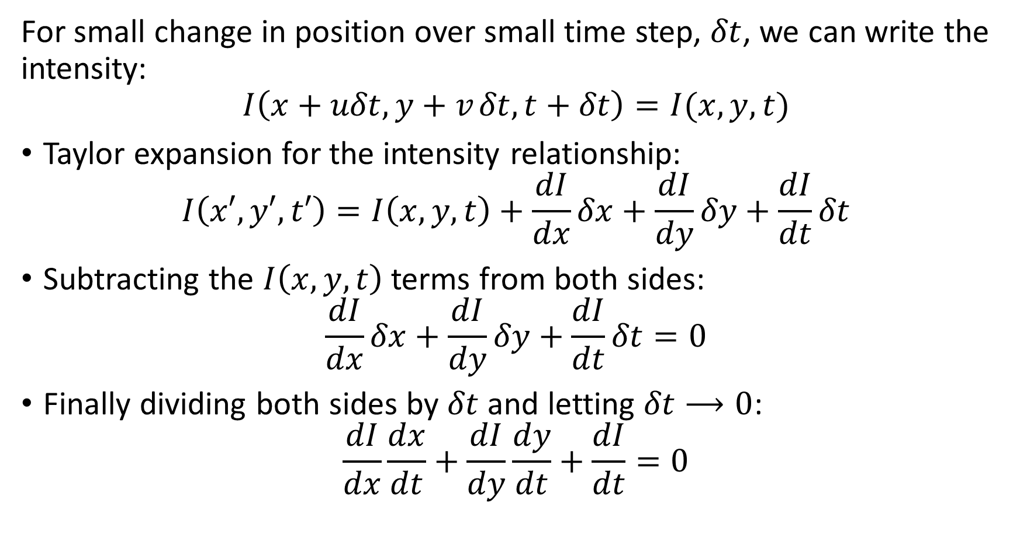
The Lucas-Kanade Algorithm
For small change in position over small time step, $δt$, we can write the intensity:
$$I\left(x+uδt,y+v_{ }δt,t+δt\right)=I(x,y,t)$$
Taylor expansion for the intensity relationship:
$$I\left(x′,y′,t′\right)=I\left(x,y,t\right)+\frac{dI}{dx}δx+\frac{dI}{dy}δy+\frac{dI}{dt}δt$$
Subtracting the $I\left(x,y,t\right)$ terms from both sides:
$$\frac{dI}{dx}δx+\frac{dI}{dy}δy+\frac{dI}{dt}δt=0$$
Finally dividing both sides by $δt$ and letting $δt⟶0$:
$$\frac{dI}{dx}\frac{dx}{dt}+\frac{dI}{dy}\frac{dy}{dt}+\frac{dI}{dt}=0$$
Notes:
ima

Slide 20
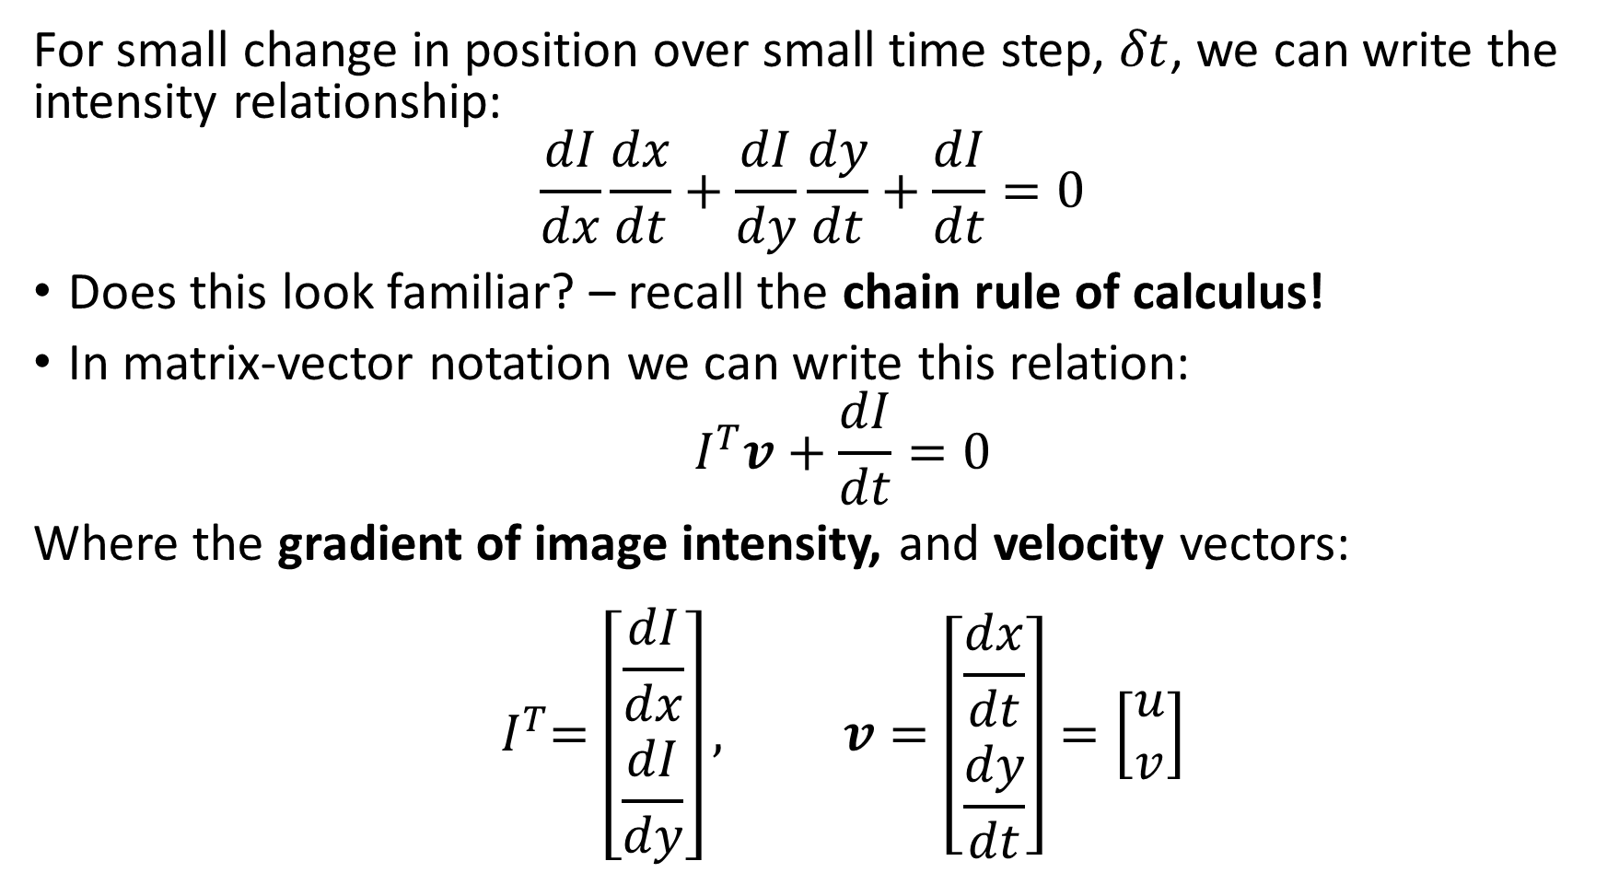
The Lucas-Kanade Algorithm
For small change in position over small time step, $δt$, we can write the intensity relationship:
$$\frac{dI}{dx}\frac{dx}{dt}+\frac{dI}{dy}\frac{dy}{dt}+\frac{dI}{dt}=0$$
Does this look familiar? – recall the chain rule of calculus!
In matrix-vector notation we can write this relation:
$${ I}^{T}v+\frac{dI}{dt}=0$$
Where the gradient of image intensity, and velocity vectors:
$${ I}^{T}=\left[\begin{matrix}\frac{dI}{dx} \\ \frac{dI}{dy}\end{matrix}\right], v=\left[\begin{matrix}\frac{dx}{dt} \\ \frac{dy}{dt}\end{matrix}\right]=\left[\begin{matrix}u \\ v\end{matrix}\right]$$
Notes:
ima

Slide 21
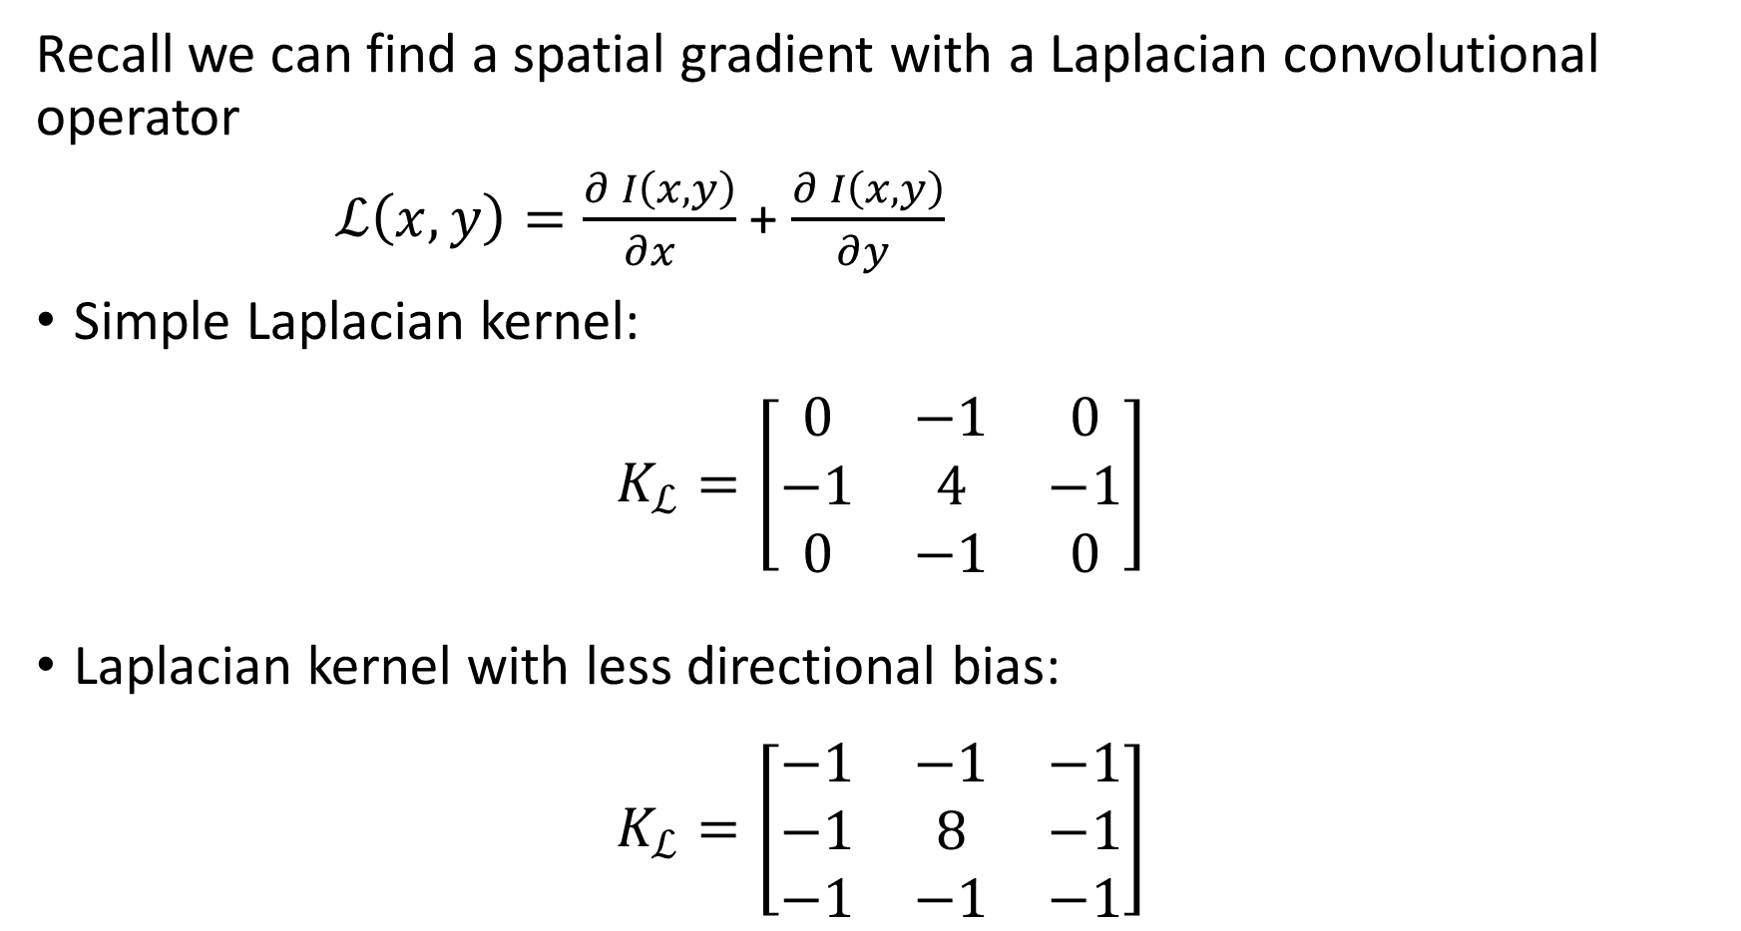
Finding spatial gradients
Recall we can find a spatial gradient with a Laplacian convolutional operator
$ℒ\left(x,y\right)=\frac{∂^{ }I\left(x,y\right)}{∂x^{ } }$ + $\frac{∂^{ }I\left(x,y\right)}{∂y^{ }}$
Simple Laplacian kernel:
$$K_{ℒ}=\left[\begin{matrix}0 & −1 & 0 \\ −1 & 4 & −1 \\ 0 & −1 & 0\end{matrix}\right]$$
Laplacian kernel with less directional bias:
$$K_{ℒ}=\left[\begin{matrix}−1 & −1 & −1 \\ −1 & 8 & −1 \\ −1 & −1 & −1\end{matrix}\right]$$

Slide 22
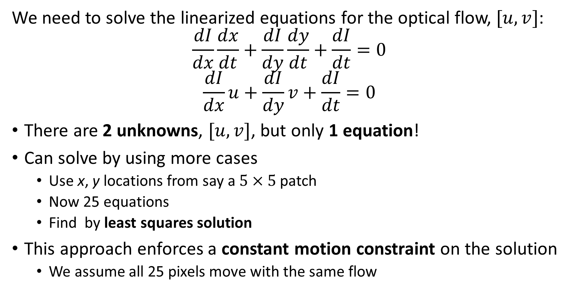
The Lucas-Kanade Algorithm
We need to solve the linearized equations for the optical flow, $[u,v]$:
$$\frac{dI}{dx}\frac{dx}{dt}+\frac{dI}{dy}\frac{dy}{dt}+\frac{dI}{dt}=0$$
$$\frac{dI}{dx}u+\frac{dI}{dy}v+\frac{dI}{dt}=0$$
There are 2 unknowns, $[u,v]$, but only 1 equation!
Can solve by using more cases
Use x, y locations from say a $5×5$ patch
Now 25 equations
Find by least squares solution
This approach enforces a constant motion constraint on the solution
We assume all 25 pixels move with the same flow
Notes:
ima

Slide 23
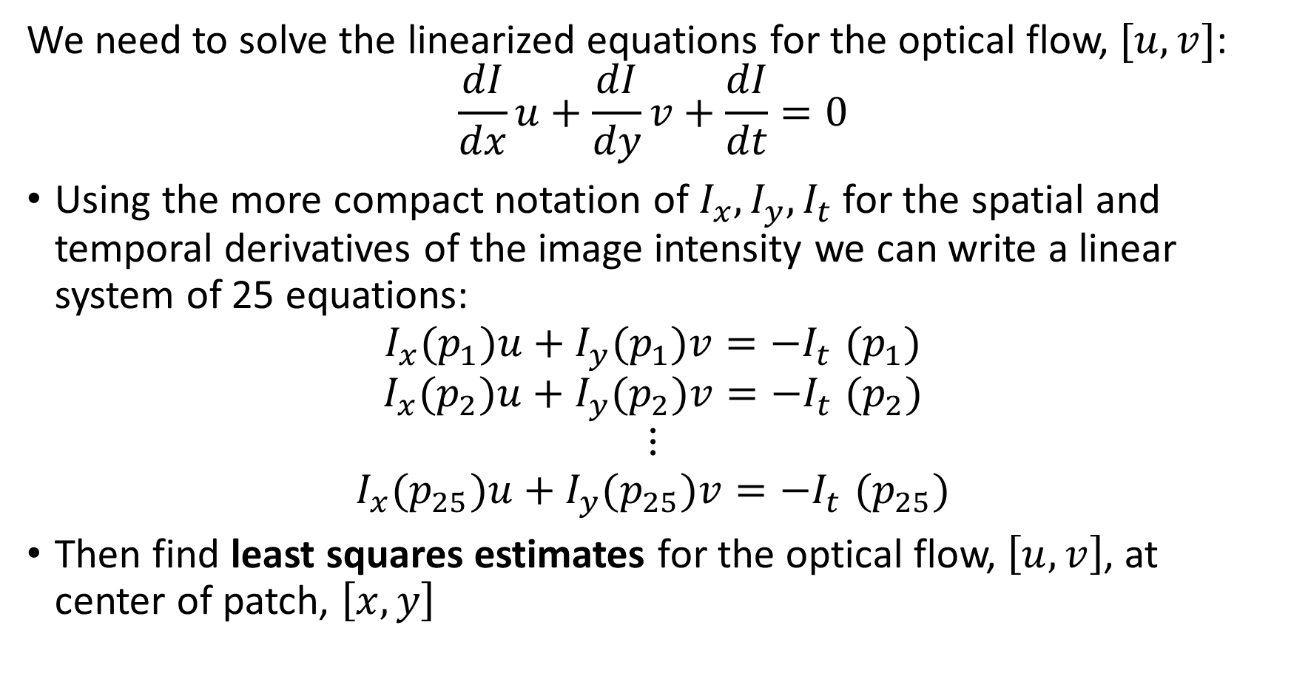
The Lucas-Kanade Algorithm
We need to solve the linearized equations for the optical flow, $[u,v]$:
$$\frac{dI}{dx}u+\frac{dI}{dy}v+\frac{dI}{dt}=0$$
Using the more compact notation of $I_{x},I_{y},I_{t}$ for the spatial and temporal derivatives of the image intensity we can write a linear system of 25 equations:
$$I_{x}(p_{1})u+I_{y}(p_{1})v{=−I}_{t}(p_{1})$$
$$I_{x}(p_{2})u+I_{y}(p_{2})v{=−I}_{t}(p_{2})$$
$$⋮$$
$$I_{x}(p_{25})u+I_{y}(p_{25})v{=−I}_{t}(p_{25})$$
Then find least squares estimates for the optical flow, $\left[u,v\right]$, at center of patch, $\left[x,y\right]$
Notes:
ima

Slide 24
Gradients and the Lucas-Kanade Algorithm

Slide 25
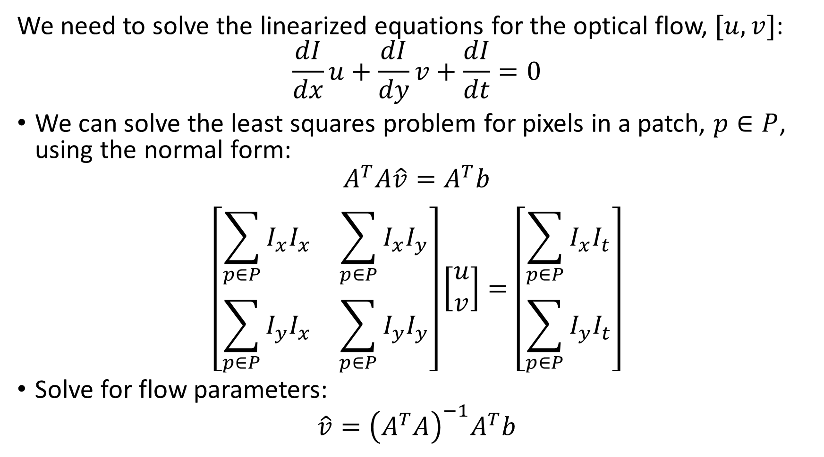
Pitfalls of Gradient Based Lucas-Kanade Algorithm
We need to solve the linearized equations for the optical flow, $[u,v]$:
$$\frac{dI}{dx}u+\frac{dI}{dy}v+\frac{dI}{dt}=0$$
We can solve the least squares problem for pixels in a patch, $p∈P$, using the normal form:
$$A^{T}A\hat{v}=A^{T}b$$
$$\left[\begin{matrix}\sum_{p∈P}{I_{x}I_{x}} & \sum_{p∈P}{I_{x}I_{y}} \\ \sum_{p∈P}{I_{y}I_{x}} & \sum_{p∈P}{I_{y}I_{y}}\end{matrix}\right]\left[\begin{matrix}u \\ v\end{matrix}\right]=\left[\begin{matrix}\sum_{p∈P}{I_{x}I_{t}} \\ \sum_{p∈P}{I_{y}I_{t}}\end{matrix}\right]$$
Solve for flow parameters:
$$\hat{v}={\left(A^{T}A\right)}^{−1}A^{T}b$$
Notes:
ima

Slide 26
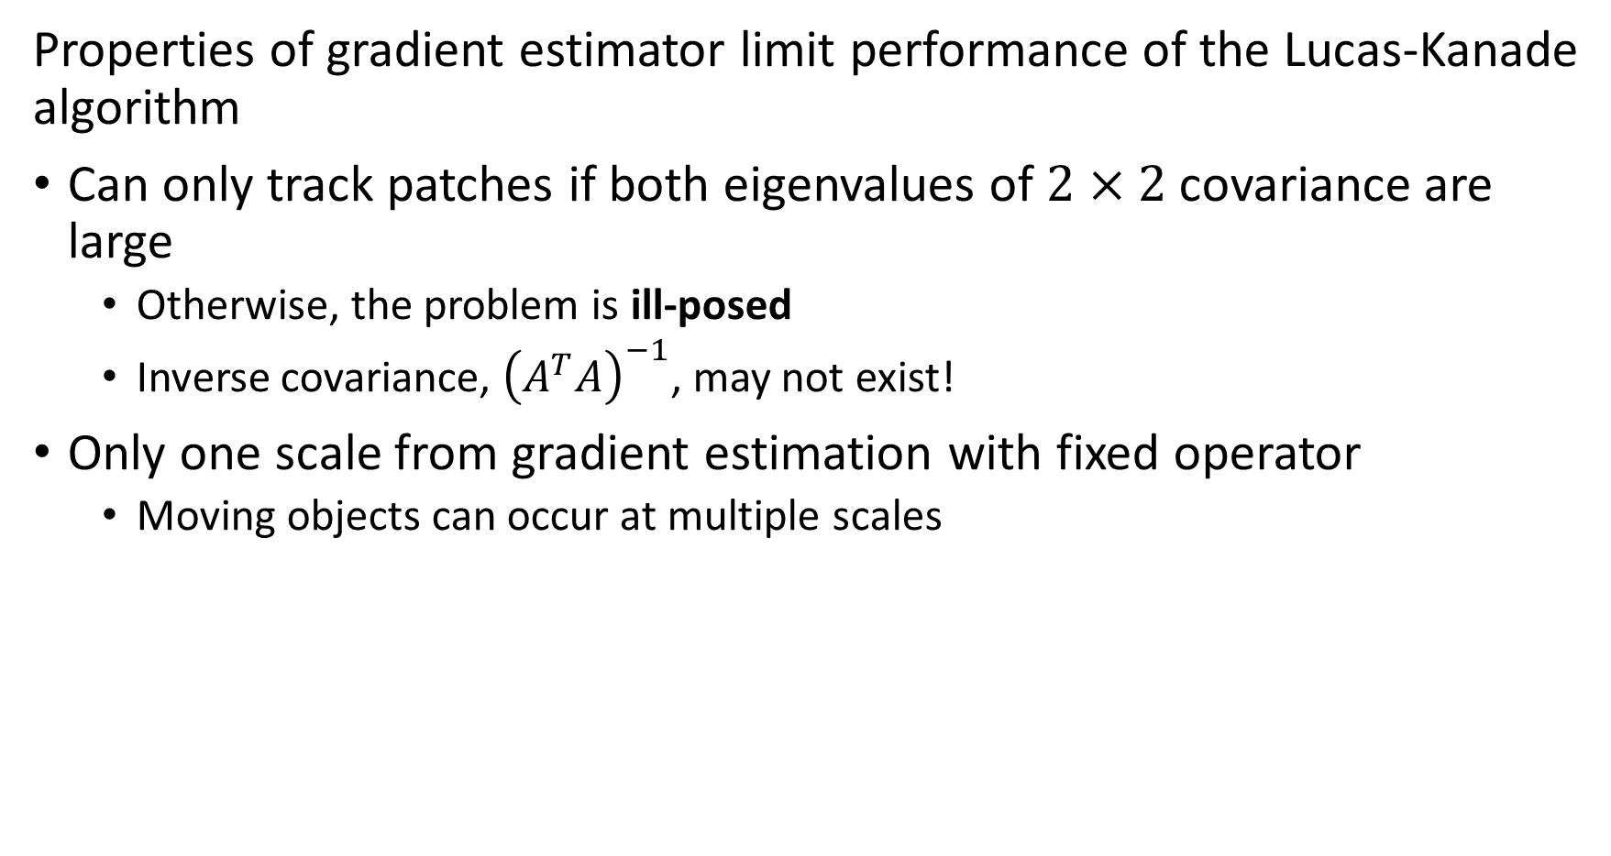
Pitfalls of gradient-based Lucas-Kanade algorithm
Properties of gradient estimator limit performance of the Lucas-Kanade algorithm
Can only track patches if both eigenvalues of $2×2$ covariance are large
Otherwise, the problem is ill-posed
Inverse covariance, ${\left(A^{T}A\right)}^{−1}$, may not exist!
Only one scale from gradient estimation with fixed operator
Moving objects can occur at multiple scales

Slide 27
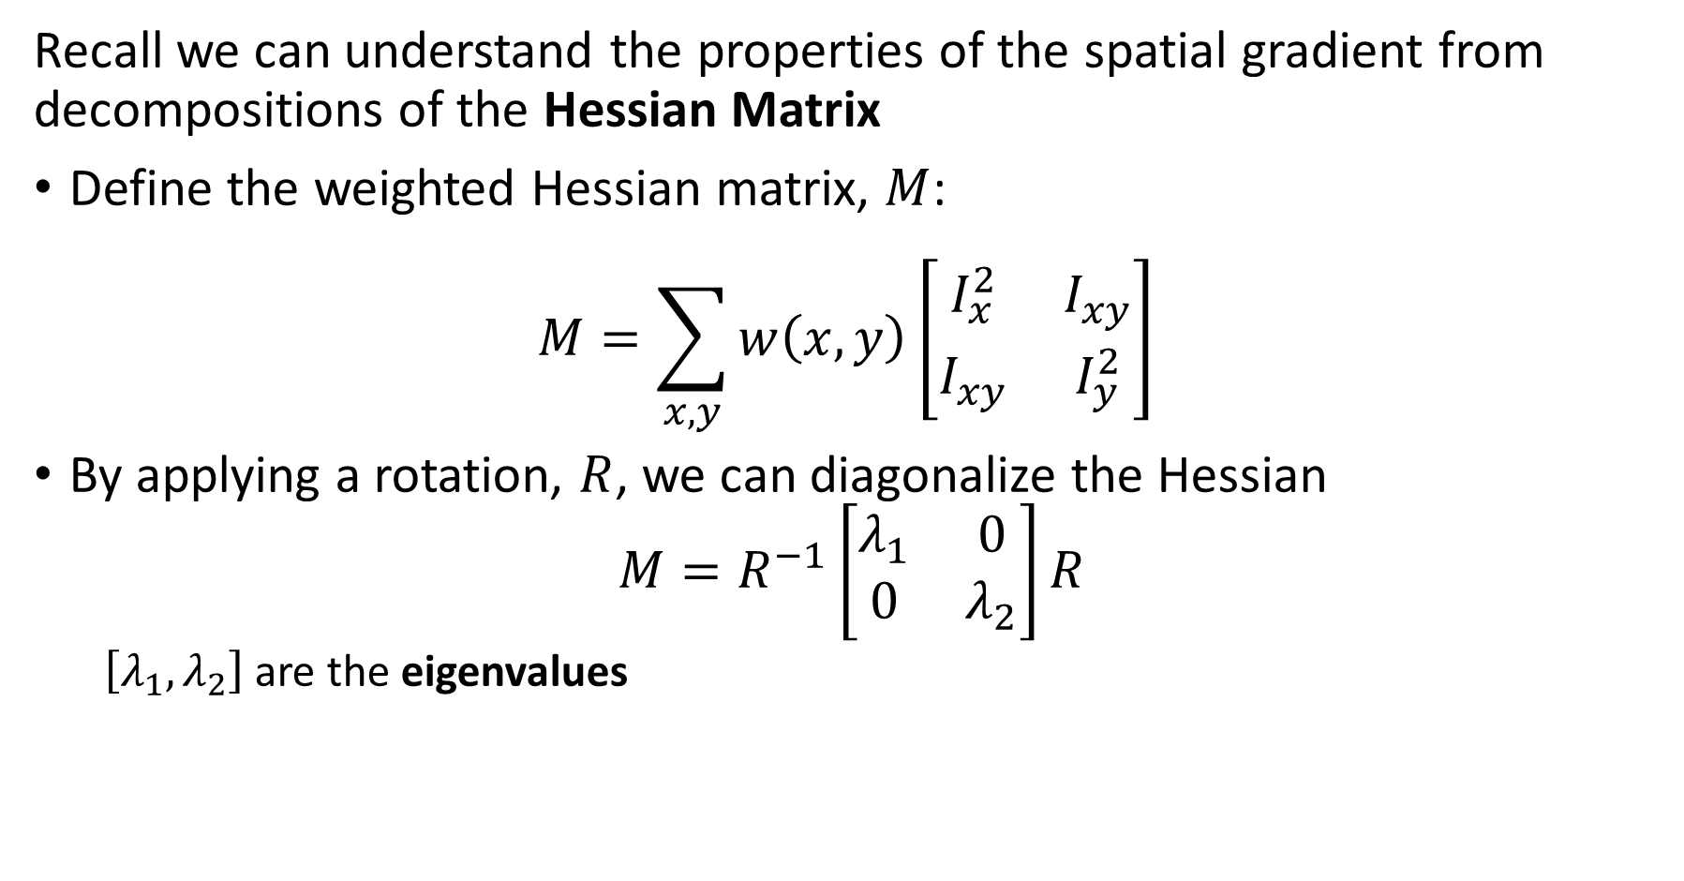
Properties of spatial gradients
Recall we can understand the properties of the spatial gradient from decompositions of the Hessian Matrix
Define the weighted Hessian matrix, $M$:
$$M=\sum_{x,y}{w\left(x,y\right)}{\left[\begin{matrix}I_{x}^{2} & I_{xy}^{ } \\ I_{xy}^{ } & I_{y}^{2}\end{matrix}\right]}^{ }$$
By applying a rotation, $R$, we can diagonalize the Hessian
$$M=R^{−1}\left[\begin{matrix}λ_{1} & 0 \\ 0 & λ_{2}\end{matrix}\right]R$$
$\left[λ_{1},λ_{2}\right]$ are the eigenvalues

Slide 28
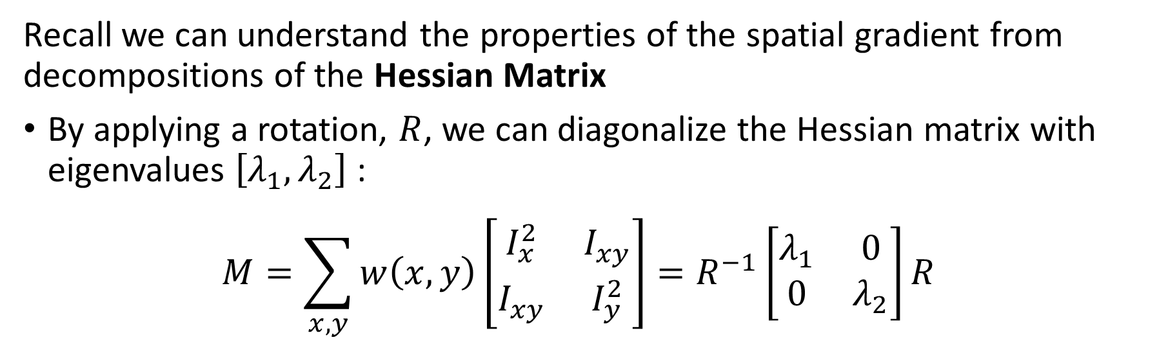
Properties of spatial gradients
Recall we can understand the properties of the spatial gradient from decompositions of the Hessian Matrix
By applying a rotation, $R$, we can diagonalize the Hessian matrix with eigenvalues $\left[λ_{1},λ_{2}\right]$:
$$M=\sum_{x,y}{w\left(x,y\right)}{\left[\begin{matrix}I_{x}^{2} & I_{xy}^{ } \\ I_{xy}^{ } & I_{y}^{2}\end{matrix}\right]=R^{−1}\left[\begin{matrix}λ_{1} & 0 \\ 0 & λ_{2}\end{matrix}\right]R }^{ }$$
Eigenvalues characterize the curvature
Eigenvalues parameterize curvature in the maximum and minimum directions
direction of the fastest change
direction of the slowest change
(λ_{max})^{-1/2}
(λ_{min})^{-1/2}

Slide 29
Properties of spatial gradients
Similar intensity: Small gradient in all directions
Gradients are better determined at interest points like corners
Areas of similar intensity have small eigenvalues, poorly determined optical flow
Edges have simple gradients perpendicular to the edges, ambiguous optical flow estimation
Other interest points have rapidly changing gradients in several directions, well-defined optical flow
Edge: Large perpendicular gradient, low parallel gradient
Interest point: Large gradients in all directions

Slide 30

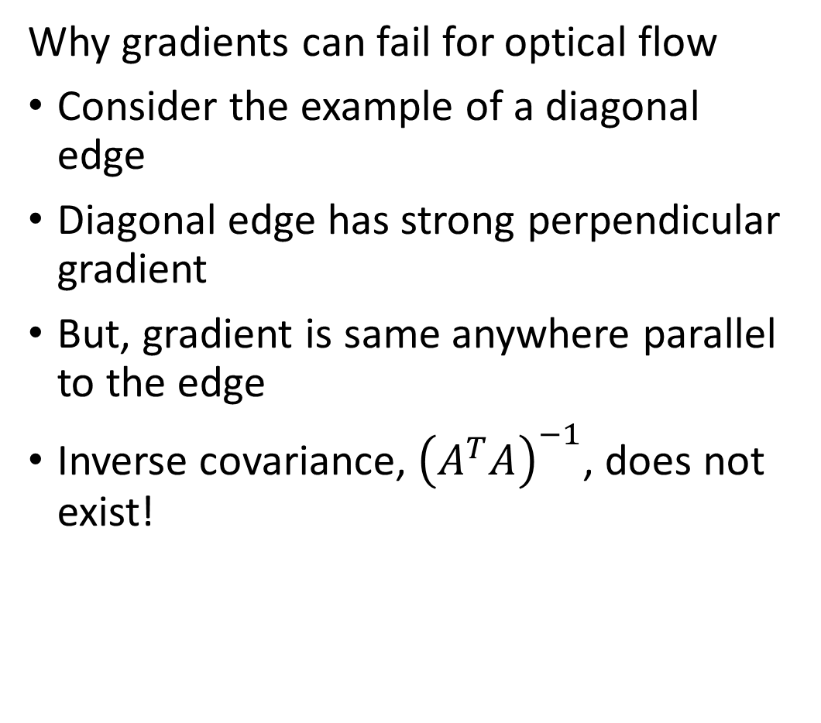
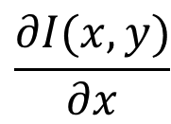
Properties of spatial gradients
Why gradients can fail for optical flow
Consider the example of a diagonal edge
Diagonal edge has strong perpendicular gradient
But, gradient is same anywhere parallel to the edge
Inverse covariance, ${\left(A^{T}A\right)}^{−1}$, does not exist!
$$\frac{∂I(x,y)}{∂y}$$
$$\frac{∂I(x,y)}{∂x}$$

Slide 31
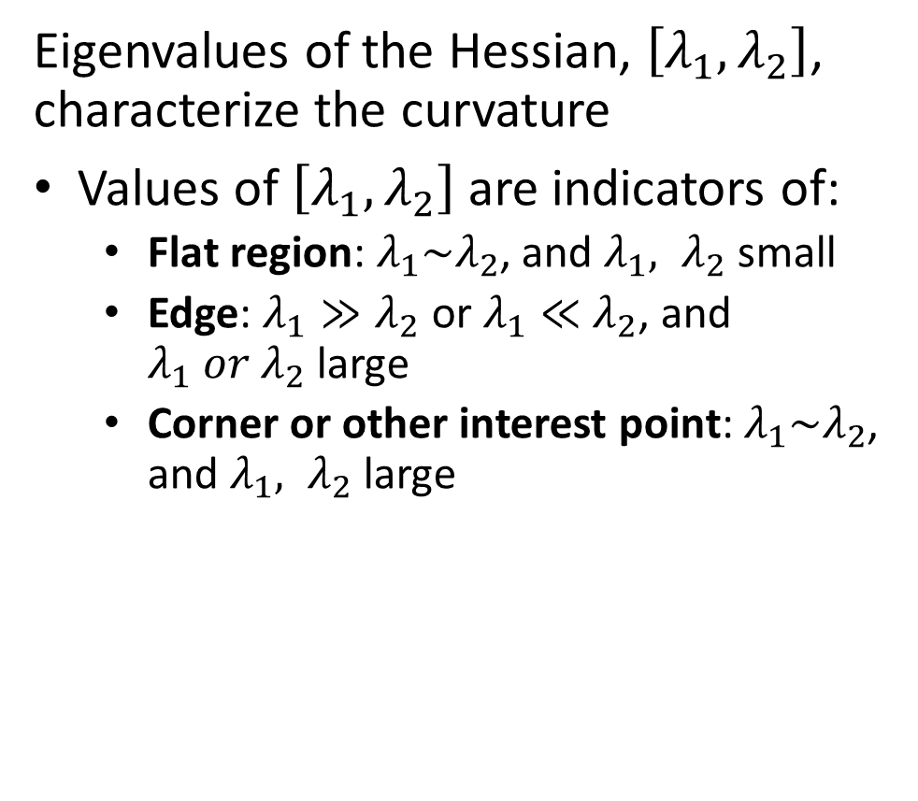
Properties of spatial gradients
Eigenvalues of the Hessian, $\left[λ_{1},λ_{2}\right]$, characterize the curvature
Values of $\left[λ_{1},λ_{2}\right]$ are indicators of:
Flat region: $λ_{1}\sim λ_{2}$, and $λ_{1}, λ_{2}$ small
Edge: $λ_{1}≫λ_{2}$ or $λ_{1}≪$ $λ_{2}$, and $λ_{1} or λ_{2}$ large
Corner or other interest point: $λ_{1}\sim λ_{2}$, and $λ_{1}, λ_{2}$ large
λ₂
“Edge” λ₂ >> λ₁
“Corner” λ₁ and λ₂ are large, λ₁ ~ λ₂; E increases in all directions
λ₁ and λ₂ are small; E is almost constant in all directions
“Flat” region
“Edge” λ₁ >> λ₂
λ₁

Slide 32
Dealing with Scale

Slide 33
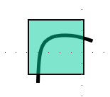
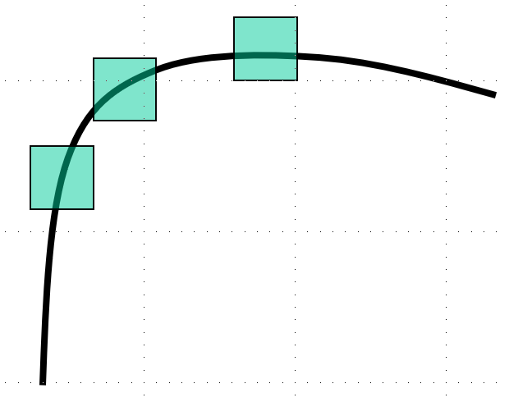
Problem with scale
How does the gradient change with feature scale
Gradient is not scale independent
1. Hessian has two large eigenvalues
2. Hessian is not translation invariant, only one large eigenvalue, no inverse!

Slide 34
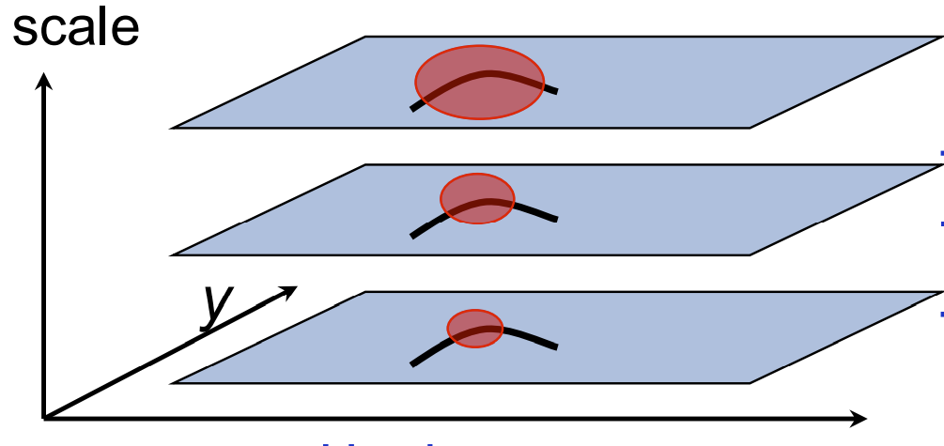
Multi-Scale Feature Identification
Pyramid structure enables extraction of interest points at several scales
Pyramid scales from fine to coarse in octaves
Features at each scale extracted
Allow flow to be computed at several scales
Small motion is scale dependent, so get wider range of velocities
x

Slide 35
Depth and Motion in 3D

Slide 36
Depth and Motion In 3D
Disparity can be computed using images from multiple camera poses
We have investigated disparity estimation using a fixed stereo camera array
But, can we estimate disparity by changing the pose of a single camera?
Yes!
We can estimate depth from changing camera poses
For additional details see Chapter 47 of Torralba, Isola and Freeman
Notes:
ima

Slide 37
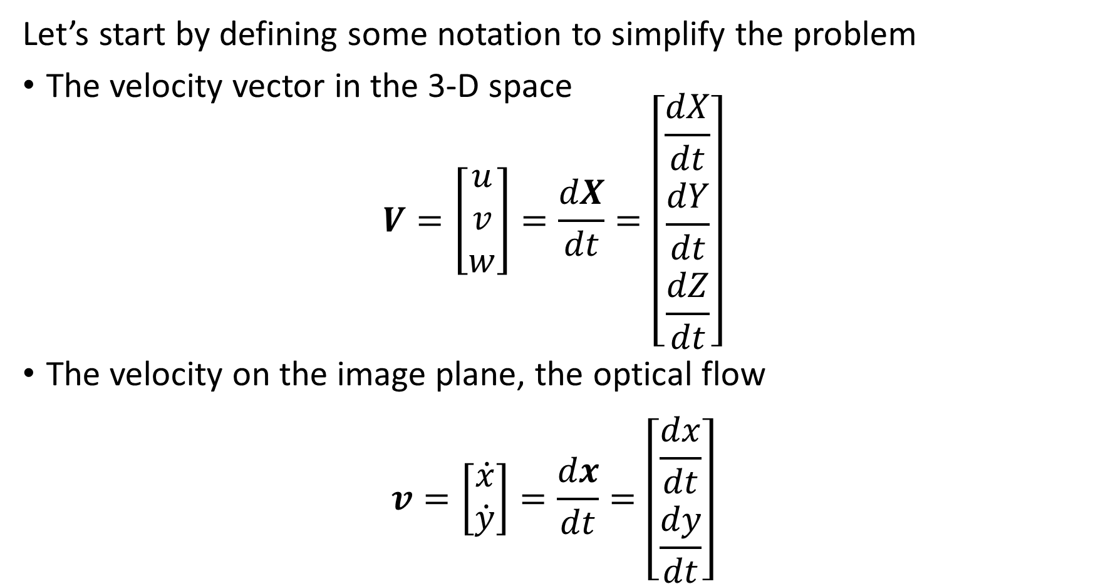
Depth and Motion In 3D
Let’s start by defining some notation to simplify the problem
The velocity vector in the 3-D space
$$V=\left[\begin{matrix}u \\ v \\ w\end{matrix}\right]=\frac{dX}{dt}=\left[\begin{matrix}\frac{dX}{dt} \\ \frac{dY}{dt} \\ \frac{dZ}{dt}\end{matrix}\right]$$
The velocity on the image plane, the optical flow
$$v=\left[\begin{matrix}\dot{x} \\ \dot{y}\end{matrix}\right]=\frac{dx}{dt}=\left[\begin{matrix}\frac{dx}{dt} \\ \frac{dy}{dt}\end{matrix}\right]$$
Notes:
ima

Slide 38
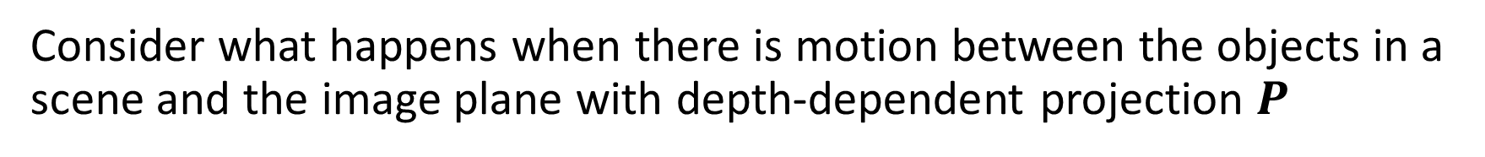
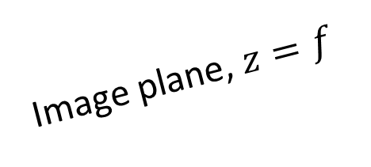
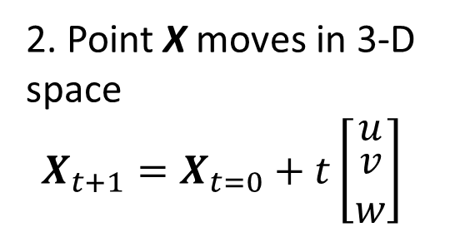
Depth and Motion in 3D
Consider what happens when there is motion between the objects in a scene and the image plane with depth-dependent projection $P$
3. Projection matrix$P_{t}$for points on image plane
$$x_{t=0}=P_{t=0}X_{t=0}$$
$$x_{t+1}=P_{t+1}X_{t+1}$$
Image plane, $z=f$
2. Point X moves in 3-D space
$$X_{t+1}=X_{t=0}+t\left[\begin{matrix}u \\ \begin{matrix}v \\ w\end{matrix}\end{matrix}\right]$$
$$y$$
v
$$x$$
$$u$$
$$X_{t+1}$$
$$v$$
$$x_{t+1}$$
$$z$$
$$w$$
O
$$x_{t}$$
$$X_{t=0}$$
1. Point X with velocity vector
$$V=\left[\begin{matrix}u \\ \begin{matrix}v \\ w\end{matrix}\end{matrix}\right]$$
4. Projected velocity vector
$$v=x_{t+1}−x_{t=0}$$

Slide 39
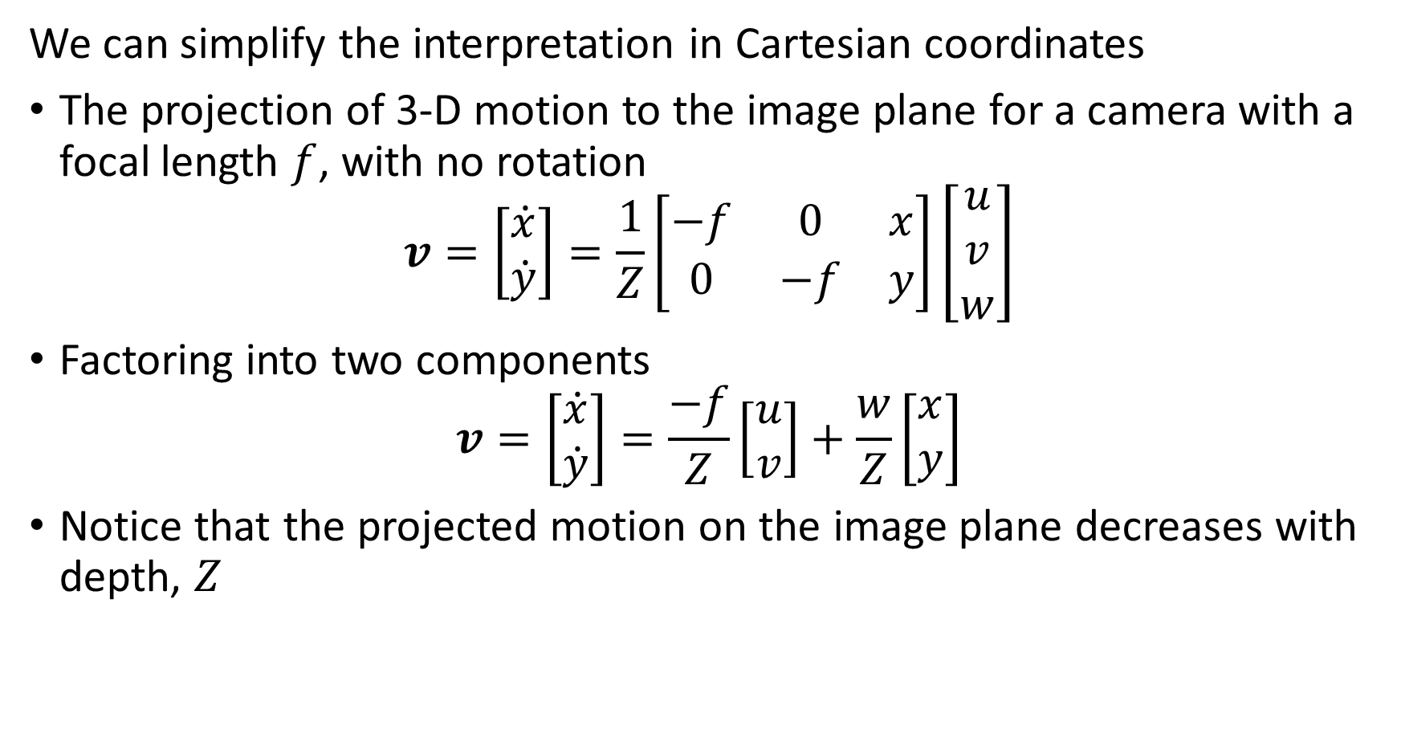
Depth and Motion In 3D
We can simplify the interpretation in Cartesian coordinates
The projection of 3-D motion to the image plane for a camera with a focal length $f$, with no rotation
$$v=\left[\begin{matrix}\dot{x} \\ \dot{y}\end{matrix}\right]=\frac{1}{Z}\left[\begin{matrix}−f & 0 & x \\ 0 & −f & y\end{matrix}\right]\left[\begin{matrix}u \\ v \\ w\end{matrix}\right]$$
Factoring into two components
$$v=\left[\begin{matrix}\dot{x} \\ \dot{y}\end{matrix}\right]=\frac{−f}{Z}\left[\begin{matrix}u \\ v\end{matrix}\right]+\frac{w}{Z}\left[\begin{matrix}x \\ y\end{matrix}\right]$$
Notice that the projected motion on the image plane decreases with depth, $Z$
Notes:
ima

Slide 40
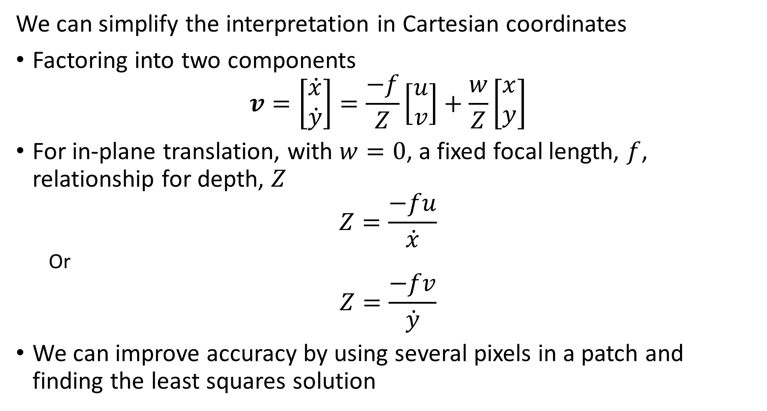
Depth and Motion In 3D
We can simplify the interpretation in Cartesian coordinates
Factoring into two components
$$v=\left[\begin{matrix}\dot{x} \\ \dot{y}\end{matrix}\right]=\frac{−f}{Z}\left[\begin{matrix}u \\ v\end{matrix}\right]+\frac{w}{Z}\left[\begin{matrix}x \\ y\end{matrix}\right]$$
For in-plane translation, with $w=0$, a fixed focal length, $f$, relationship for depth, $Z$
$$Z=\frac{−fu}{\dot{x}}$$
Or
$$Z=\frac{−fv}{\dot{y}}$$
We can improve accuracy by using several pixels in a patch and finding the least squares solution
Notes:
ima

Slide 41
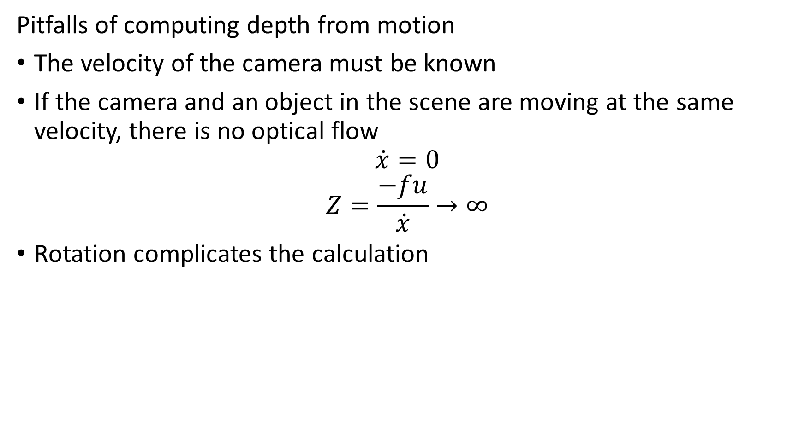
Depth and Motion In 3D
Pitfalls of computing depth from motion
The velocity of the camera must be known
If the camera and an object in the scene are moving at the same velocity, there is no optical flow
$$\dot{x}=0$$
$$Z=\frac{−fu}{\dot{x}}→∞$$
Rotation complicates the calculation
Notes:
ima

Slide 42
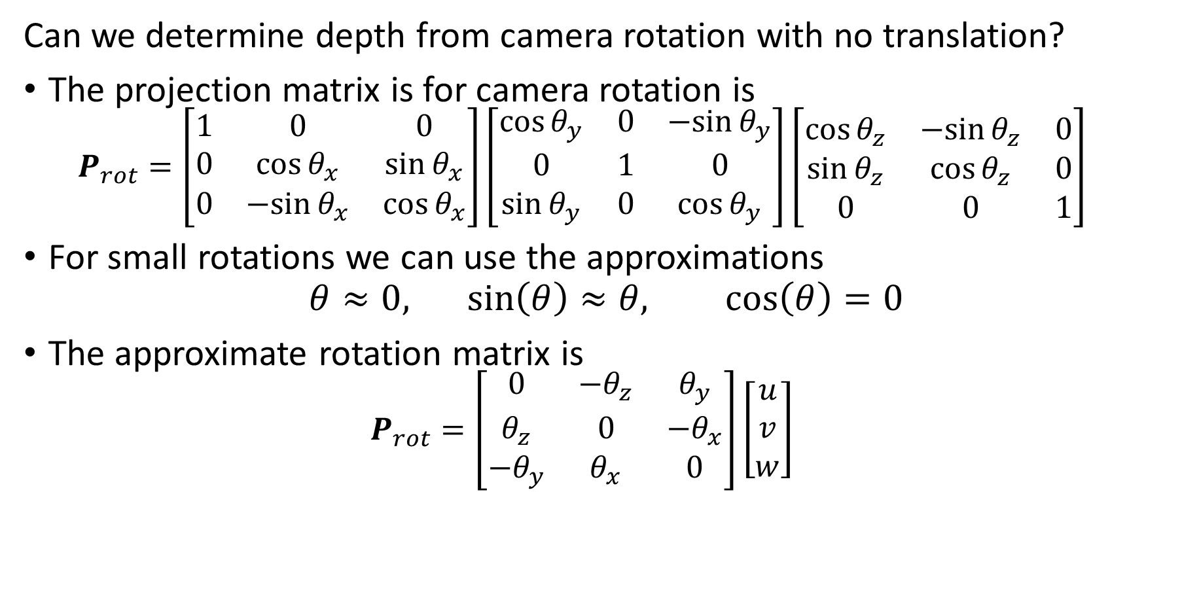
Depth and Motion In 3D
Can we determine depth from camera rotation with no translation?
The projection matrix is for camera rotation is
$$P_{rot}=\left[\begin{matrix}1 & 0 & 0 \\ 0 & \cos{θ_{x}} & \sin{θ_{x}} \\ 0 & −sin{θ_{x}} & \cos{θ_{x}}\end{matrix}\right]\left[\begin{matrix}\cos{θ_{y}} & 0 & −sin{θ_{y}} \\ 0 & 1 & 0 \\ \sin{θ_{y}} & 0 & \cos{θ_{y}}\end{matrix}\right]\left[\begin{matrix}\cos{θ_{z}} & −sin{θ_{z}} & 0 \\ \sin{θ_{z}} & \cos{θ_{z}} & 0 \\ 0 & 0 & 1\end{matrix}\right]$$
For small rotations we can use the approximations
$$θ≈0,\sin\left(θ\right)≈θ, \cos\left(θ\right)=0$$
The approximate rotation matrix is
$$P_{rot}=\left[\begin{matrix}0 & {−θ}_{z} & θ_{y} \\ θ_{z} & 0 & {−θ}_{x} \\ −θ_{y} & θ_{x} & 0\end{matrix}\right]\left[\begin{matrix}u \\ v \\ w\end{matrix}\right]$$
Notes:
ima

Slide 43
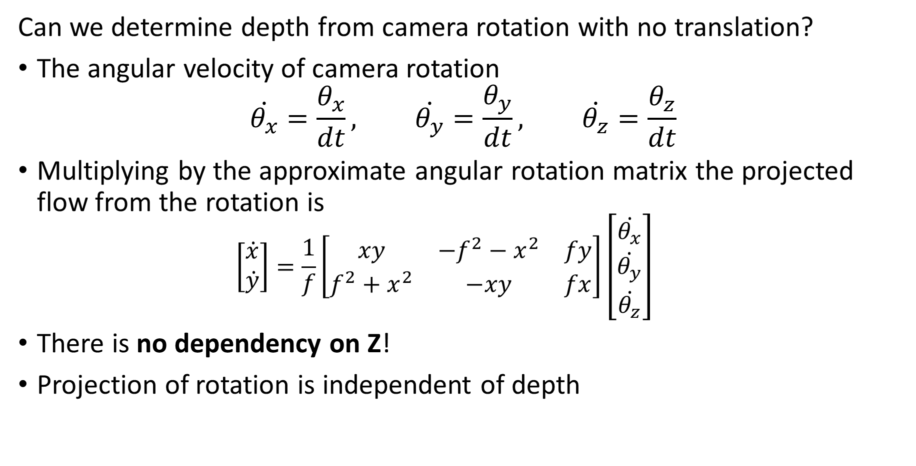
Depth and Motion In 3D
Can we determine depth from camera rotation with no translation?
The angular velocity of camera rotation
$$\dot{θ_{x}}=\frac{θ_{x}}{dt}, \dot{θ_{y}}=\frac{θ_{y}}{dt}, \dot{θ_{z}}=\frac{θ_{z}}{dt}$$
Multiplying by the approximate angular rotation matrix the projected flow from the rotation is
$$\left[\begin{matrix}\dot{x} \\ \dot{y}\end{matrix}\right]=\frac{1}{f}\left[\begin{matrix}xy & {−f}^{2}−x^{2} & fy \\ f^{2}+x^{2} & −xy & fx\end{matrix}\right]\left[\begin{matrix}\dot{θ_{x}} \\ \dot{θ_{y}} \\ \dot{θ_{z}}\end{matrix}\right]$$
There is no dependency on Z!
Projection of rotation is independent of depth
Notes:
ima

Slide 44
Iterative Lucas-Kanade Algorithm

Slide 45
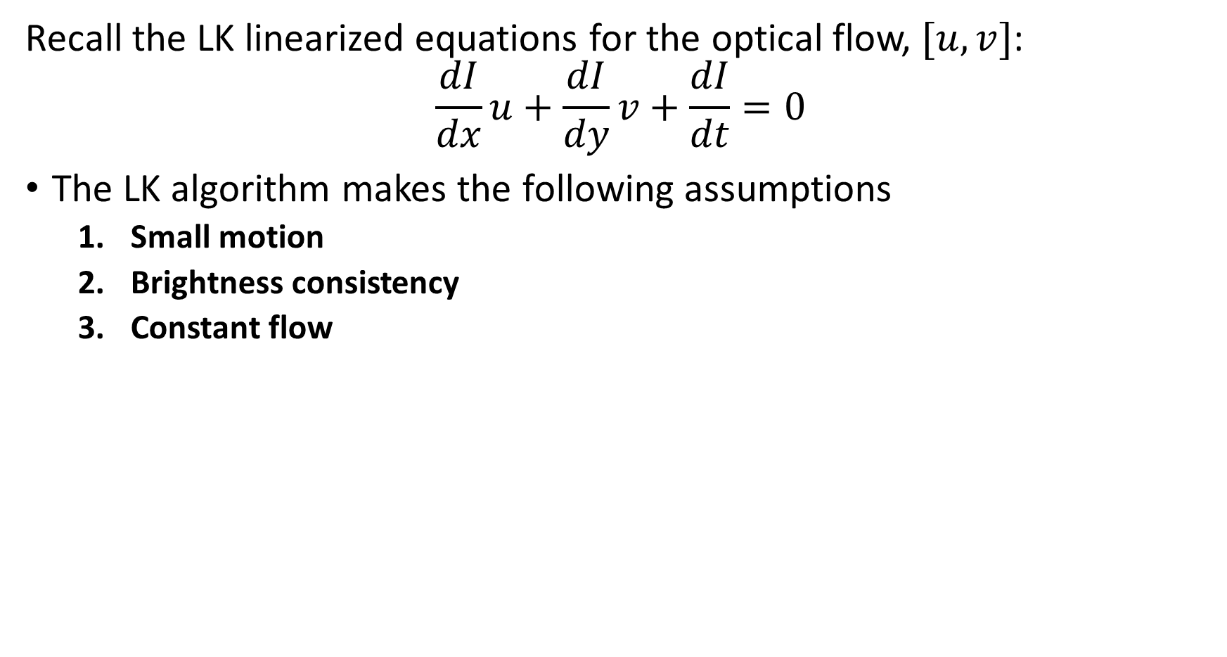
The Lucas-Kanade Algorithm
Recall the LK linearized equations for the optical flow, $[u,v]$:
$$\frac{dI}{dx}u+\frac{dI}{dy}v+\frac{dI}{dt}=0$$
The LK algorithm makes the following assumptions
Small motion
Brightness consistency
Constant flow
Notes:
ima

Slide 46
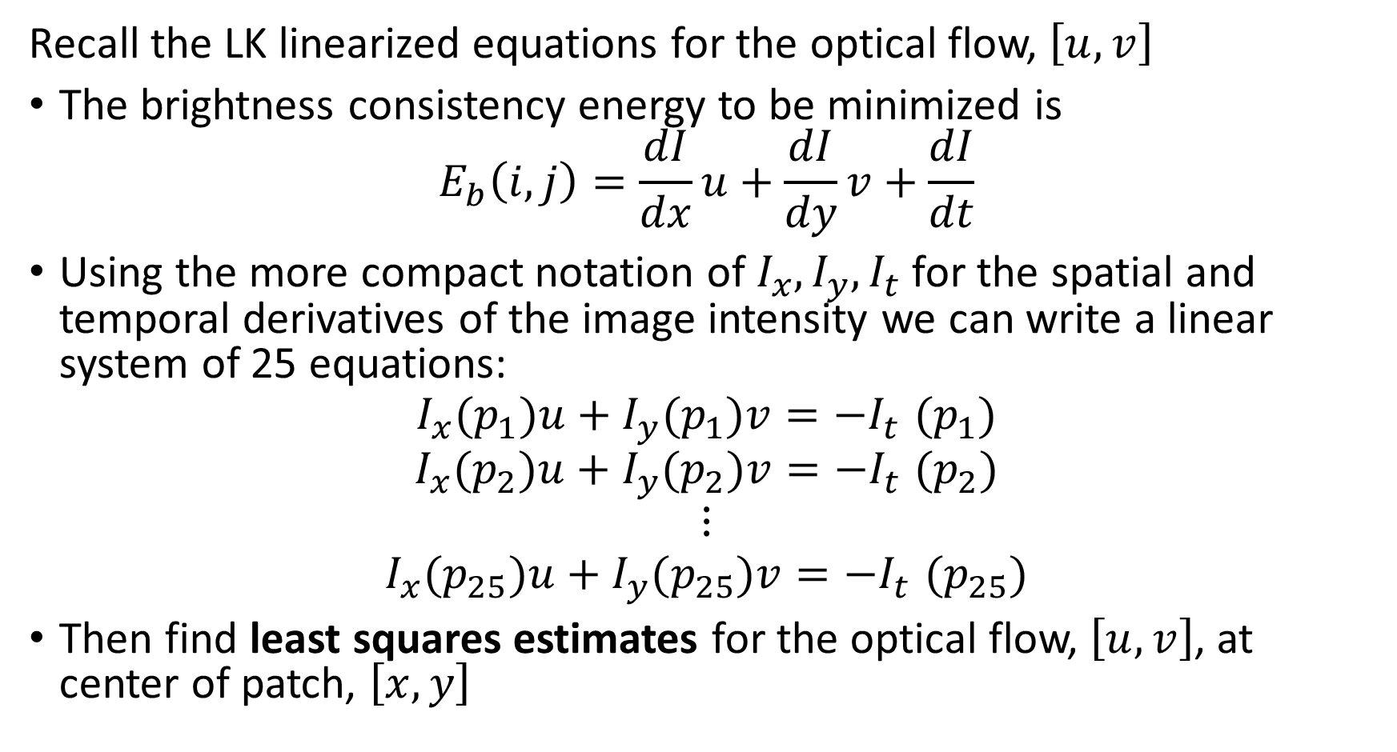
The Lucas-Kanade Algorithm
Recall the LK linearized equations for the optical flow, $\left[u,v\right]$
The brightness consistency energy to be minimized is
$$E_{b}\left(i,j\right)=\frac{dI}{dx}u+\frac{dI}{dy}v+\frac{dI}{dt}$$
Using the more compact notation of $I_{x},I_{y},I_{t}$ for the spatial and temporal derivatives of the image intensity we can write a linear system of 25 equations:
$$I_{x}(p_{1})u+I_{y}(p_{1})v{=−I}_{t}(p_{1})$$
$$I_{x}(p_{2})u+I_{y}(p_{2})v{=−I}_{t}(p_{2})$$
$$⋮$$
$$I_{x}(p_{25})u+I_{y}(p_{25})v{=−I}_{t}(p_{25})$$
Then find least squares estimates for the optical flow, $\left[u,v\right]$, at center of patch, $\left[x,y\right]$
Notes:
ima

Slide 47
Iterative Lucas-Kanade algorithm
We can apply the iterative Lucas-Kanade (ilk) algorithm
ilk applies the Lucas-Kanade algorithm large to small scale iteratively
Procedure iLK(image1, image2):
pyramid1 = LaplacianPyramid(image1)
pyramid2 = LaplacianPyramid(image2)
flow = zeros(pyramid.shape)
for scale in pyramid: # Loop from coarse to fine
flow = UpSample(flow) # Up sample flow to scale
warped_image = Warp(pyramid2(scale), flow) # Dense warp
# flow components updated for each scale
flow = LucasKanade(pyramid1(scale), warped_image) + flow
Filter(flow) # Post processing
return flow

Slide 48
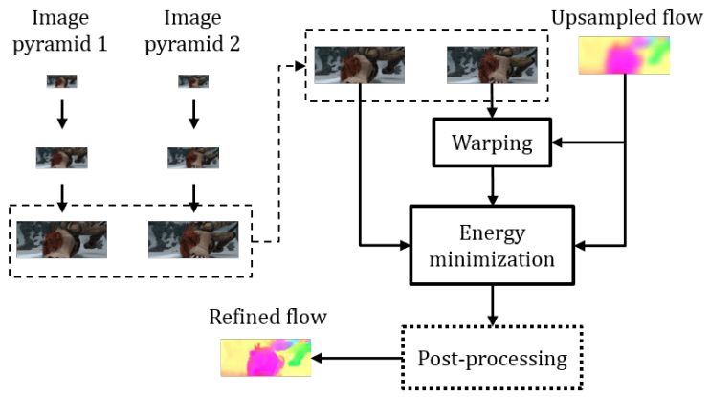
Iterative Lucas-Kanade algorithm
We can apply the iterative Lucas-Kanade (iKL) algorithm
iLK applies the Lucas-Kanade algorithm from large to small scale iteratively
Credit: Sun, et. al, 2018

Slide 49
The Horn-Shunck Algorithm

Slide 50
The Horn-Schunck Algorithm
The Horn-Schunck algorithm uses a different set of assumptions from Lucas-Kanade algorithm
Both algorithms assume small motion
Both methods enforce brightness consistency
Lucas-Kanade enforces constant flow
Horn-Schunck enforces smooth flow
The smooth flow constraint is a regularization method
Can find solution even when covariance eigenvalues are small or zero
Notes:
ima

Slide 51
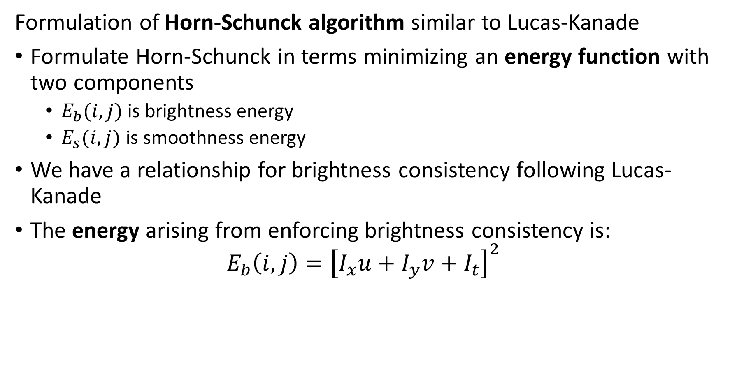
The Horn-Schunck Algorithm
Formulation of Horn-Schunck algorithm similar to Lucas-Kanade
Formulate Horn-Schunck in terms minimizing an energy function with two components
$E_{b}(i,j)$ is brightness energy
$E_{s}(i,j)$ is smoothness energy
We have a relationship for brightness consistency following Lucas-Kanade
The energy arising from enforcing brightness consistency is:
$$E_{b}\left(i,j\right)={\left[I_{x}u+I_{y}v+I_{t}\right]}^{2}$$
Notes:
ima

Slide 52








The Horn-Schunck Algorithm
Formulation of Horn-Schunck algorithm similar to Lucas-Kanade
How do we express the smoothness energy?
Start with neighbor relations for u and v
Compute the flow differences
i, j +1
i, j +1
i, j +1
i, j +1
i - 1, j
$$u$$
i + 1, j
i - 1, j
$$u$$
i + 1, j
i - 1, j
$$v$$
i + 1, j
i - 1, j
$$v$$
i + 1, j
i, j
i, j
i, j
i, j
i, j - 1
i, j - 1
i, j - 1
i, j - 1
$$u_{i,j}−u_{i+1,j}$$
$$u_{i,j}−u_{i,j+1}$$
$$v_{i,j}−v_{i+1,j}$$
$$v_{i,j}−v_{i,j+1}$$
Notes:
ima

Slide 53









The Horn-Schunck Algorithm
Formulation of Horn-Schunck algorithm similar to Lucas-Kanade
How do we express the smoothness energy?
$$E_{s}\left(i,j\right)=\frac{1}{4}\left[{\left(u_{i,j}−u_{i+1,j}\right)}^{2}+{\left(u_{i,j}−u_{i,j+1}\right)}^{2}+{\left(v_{i,j}−v_{i+1,j}\right)}^{2}+{\left(v_{i,j}−v_{i,j+1}\right)}^{2}\right]$$
i, j +1
i, j +1
i, j +1
i, j +1
i - 1, j
$$u$$
i + 1, j
i - 1, j
$$u$$
i + 1, j
i - 1, j
$$v$$
i + 1, j
i - 1, j
$$v$$
i + 1, j
i, j
i, j
i, j
i, j
i, j - 1
i, j - 1
i, j - 1
i, j - 1
$$u_{i,j}−u_{i+1,j}$$
$$u_{i,j}−u_{i,j+1}$$
$$v_{i,j}−v_{i+1,j}$$
$$v_{i,j}−v_{i,j+1}$$
Notes:
ima

Slide 54
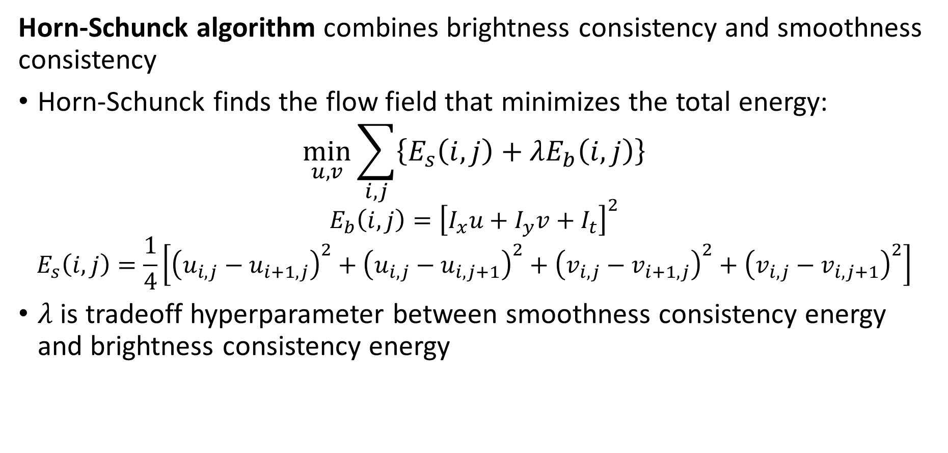
The Horn-Schunck Algorithm
Horn-Schunck algorithm combines brightness consistency and smoothness consistency
Horn-Schunck finds the flow field that minimizes the total energy:
$$\min_{u,v}{\sum_{i,j}{\left\{E_{s}\left(i,j\right)+λE_{b}\left(i,j\right)\right\}}}$$
$$E_{b}\left(i,j\right)={\left[I_{x}u+I_{y}v+I_{t}\right]}^{2}$$
$$E_{s}\left(i,j\right)=\frac{1}{4}\left[{\left(u_{i,j}−u_{i+1,j}\right)}^{2}+{\left(u_{i,j}−u_{i,j+1}\right)}^{2}+{\left(v_{i,j}−v_{i+1,j}\right)}^{2}+{\left(v_{i,j}−v_{i,j+1}\right)}^{2}\right]$$
$λ$ is tradeoff hyperparameter between smoothness consistency energy and brightness consistency energy
Notes:
ima

Slide 55
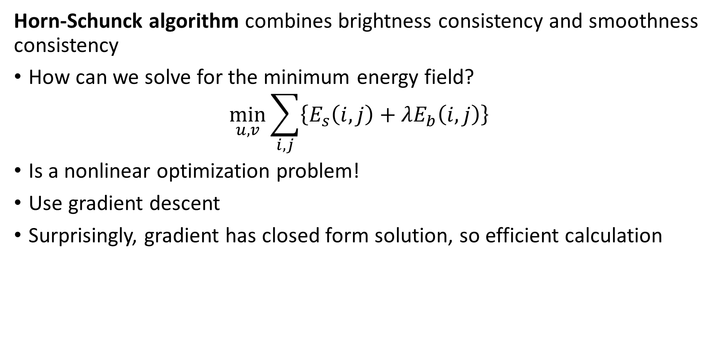
The Horn-Schunck Algorithm
Horn-Schunck algorithm combines brightness consistency and smoothness consistency
How can we solve for the minimum energy field?
$$\min_{u,v}{\sum_{i,j}{\left\{E_{s}\left(i,j\right)+λE_{b}\left(i,j\right)\right\}}}$$
Is a nonlinear optimization problem!
Use gradient descent
Surprisingly, gradient has closed form solution, so efficient calculation
Notes:
ima

Slide 56
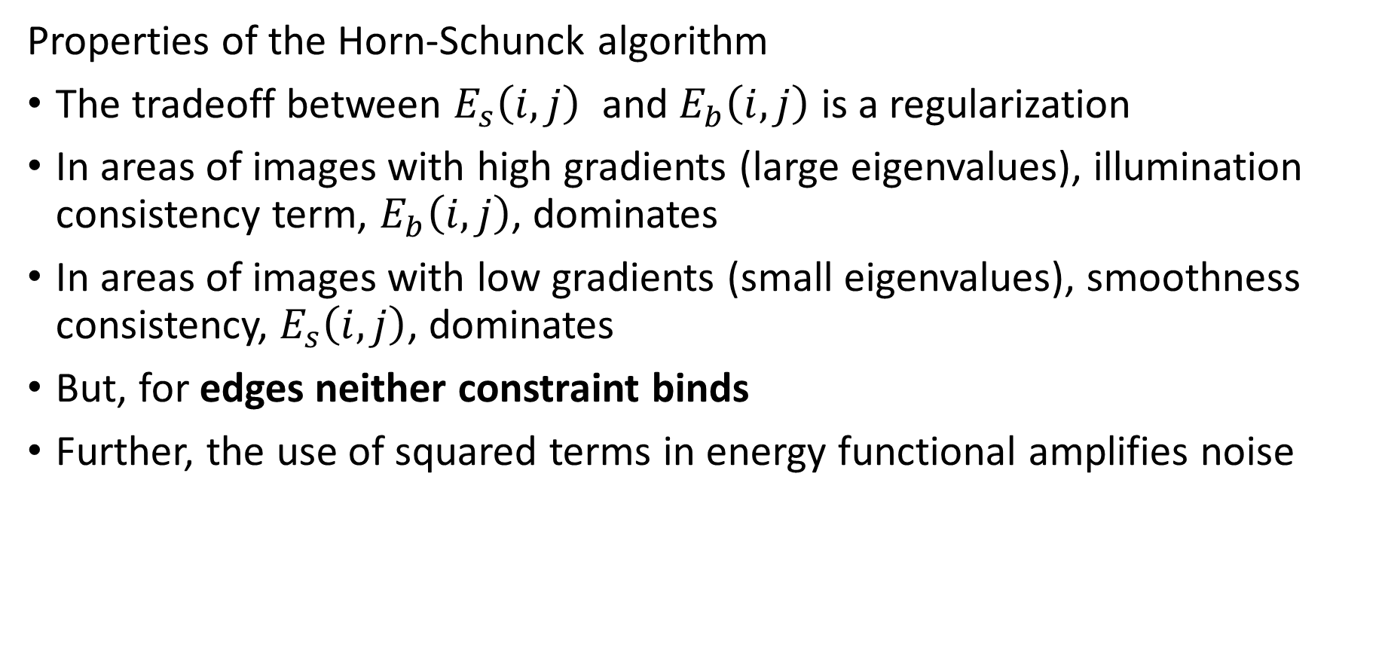
The Horn-Schunck Algorithm
Properties of the Horn-Schunck algorithm
The tradeoff between $E_{s}\left(i,j\right)$ and $E_{b}\left(i,j\right)$ is a regularization
In areas of images with high gradients (large eigenvalues), illumination consistency term, $E_{b}\left(i,j\right)$, dominates
In areas of images with low gradients (small eigenvalues), smoothness consistency, $E_{s}\left(i,j\right)$, dominates
But, for edges neither constraint binds
Further, the use of squared terms in energy functional amplifies noise
Notes:
ima

Slide 57
The TL-L1 Algorithm

Slide 58
The TV-L1 Algorithm
The TV-L1 algorithm overcomes some deficiencies of Horn-Schunck
Sánchez, et. al., 2013, proposed a generalization of the Horn-Schunck algorithm
Horn-Schunck is based on L2 (least squares) norm
Sensitive to noise and poor performance on edges
Sánchez, et. al. noted that other norms can be used, in particular the L1 norm
Less sensitive to noise
Better behavior with edges
Notes:
ima

Slide 59
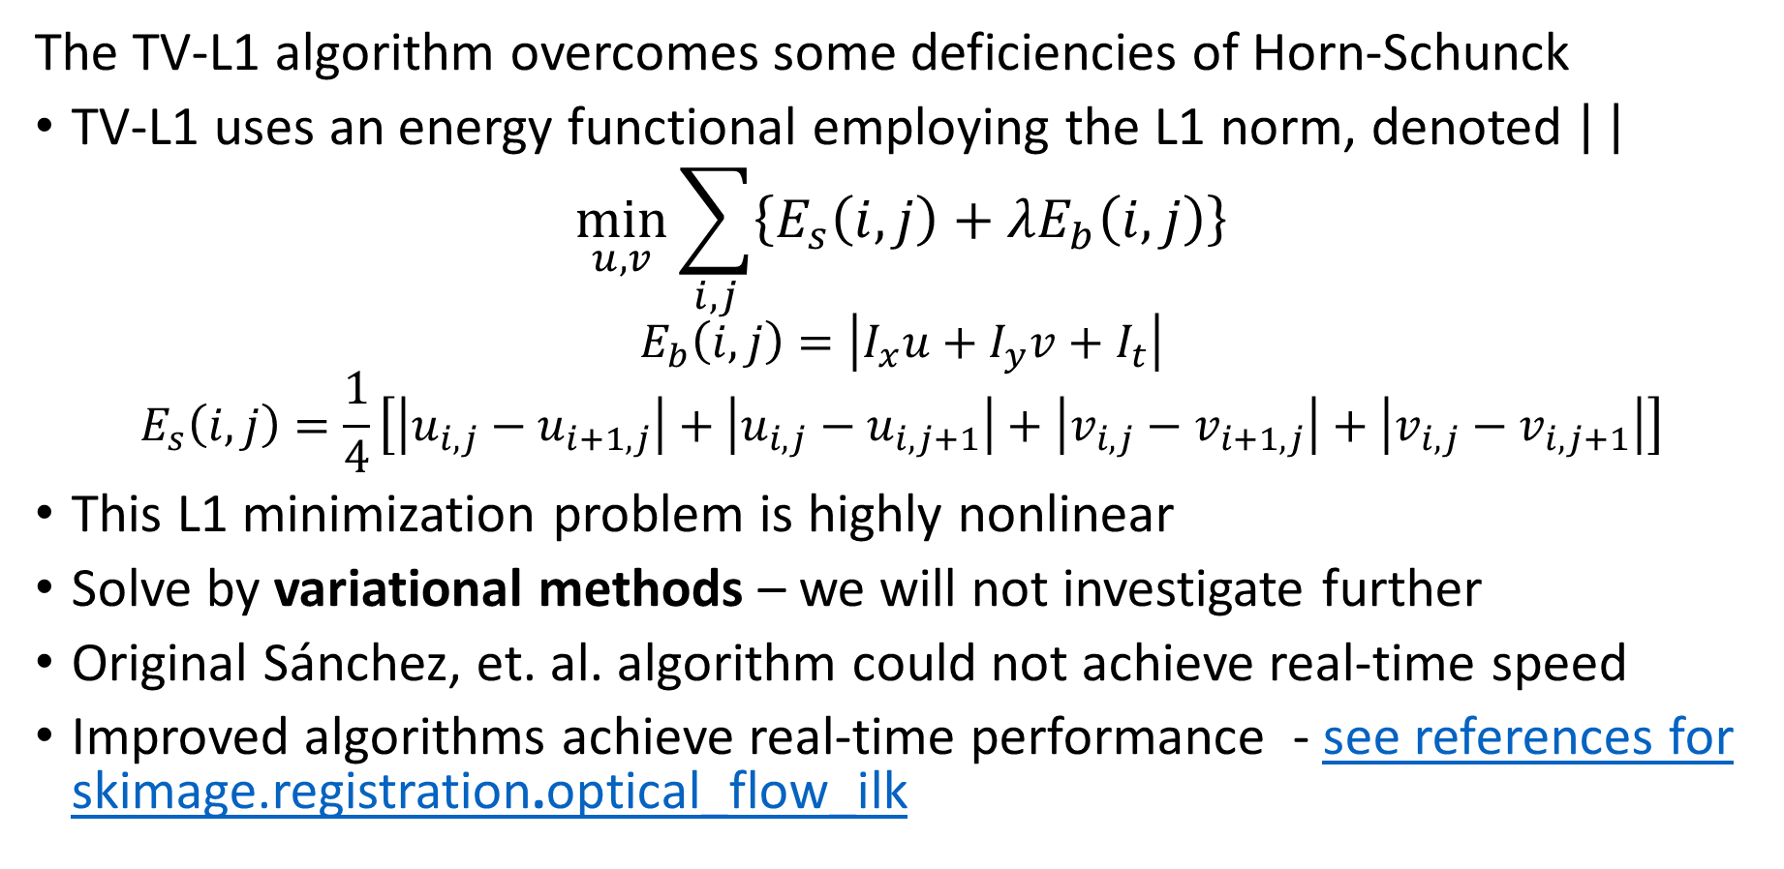
The TV-L1 Algorithm
The TV-L1 algorithm overcomes some deficiencies of Horn-Schunck
TV-L1 uses an energy functional employing the L1 norm, denoted
$$\min_{u,v}{\sum_{i,j}{\left\{E_{s}\left(i,j\right)+λE_{b}\left(i,j\right)\right\}}}$$
$$E_{b}\left(i,j\right)=\left|I_{x}u+I_{y}v+I_{t}\right|$$
$$E_{s}\left(i,j\right)=\frac{1}{4}\left[\left|u_{i,j}−u_{i+1,j}\right|+\left|u_{i,j}−u_{i,j+1}\right|+\left|v_{i,j}−v_{i+1,j}\right|+\left|v_{i,j}−v_{i,j+1}\right|\right]$$
This L1 minimization problem is highly nonlinear
Solve by variational methods – we will not investigate further
Original Sánchez, et. al. algorithm could not achieve real-time speed
Improved algorithms achieve real-time performance - see references for skimage.registration.optical_flow_ilk
Notes:
ima

Slide 60
Evaluation of Optical Flow Models

Slide 61
Evaluation of optical flow models
How can we evaluate optical flow models?
Choice of metric depends on the presence of labels
Metrics for labeled data
Average end point error (AEPE) distance between the predicted pixel location and ground-truth location
Average angular error (AEP) difference between predicted flow angle and ground truth angle
For unlabeled data
Average interpolation error (AIE) difference between two time-sequential images after warping
Interpolated flow accuracy (IFA) measures the coherence and smoothness of the flow field
Notes:
ima

Slide 62
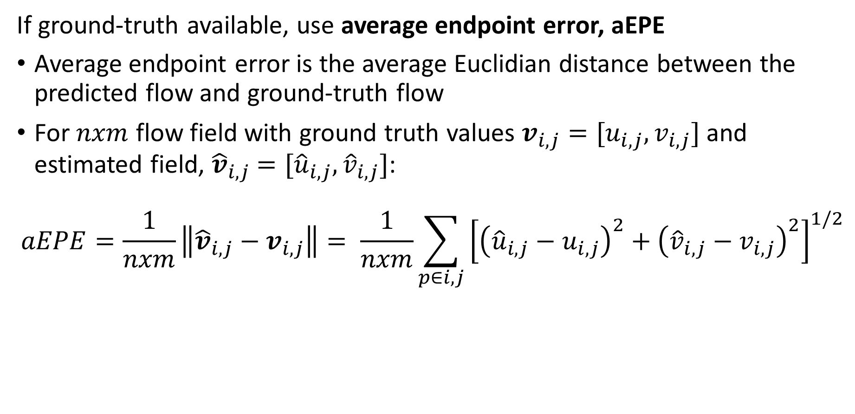
Evaluation of optical flow models
If ground-truth available, use average endpoint error, aEPE
Average endpoint error is the average Euclidian distance between the predicted flow and ground-truth flow
For $nxm$ flow field with ground truth values $v_{i,j}=[u_{i,j},v_{i,j}]$ and estimated field, ${\hat{v}}_{i,j}$ $=[{\hat{u}}_{i,j},{\hat{v}}_{i,j}]$:
$$aEPE=\frac{1}{nxm}\left\|{\hat{v}}_{i,j}−v_{i,j}\right\|= \frac{1}{nxm}\sum_{p∈i,j}{{\left[{\left({\hat{u}}_{i,j}−u_{i,j}\right)}^{2}+{\left({\hat{v}}_{i,j}−v_{i,j}\right)}^{2}\right]}^{1/2}}$$
Notes:
ima

Slide 63
Evaluation of optical flow models
How do we get labeled cases?
Very difficult to hand label real-world images
Often train on synthetic datasets
Flying Chairs, and Flying Chairs 2
FlyingThings 3D and SceneFlow datasets
Rely on generalization (transfer learning) to real-world cases
Notes:
ima

Slide 64
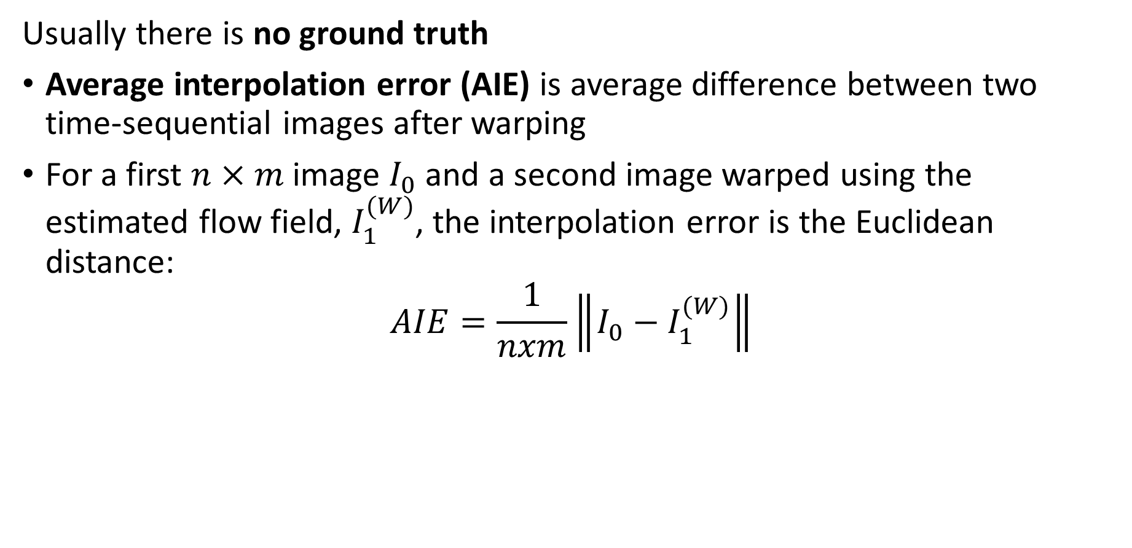
Evaluation of optical flow models
Usually there is no ground truth
Average interpolation error (AIE) is average difference between two time-sequential images after warping
For a first $n×m$ image $I_{0}$ and a second image warped using the estimated flow field, $I_{1}^{(W)}$, the interpolation error is the Euclidean distance:
$$AIE=\frac{1}{nxm}\left\|I_{0}−I_{1}^{(W)}\right\|$$
Notes:
ima

Slide 65
Deep Optical Flow Algorithms

Slide 66
Deep Optical Flow Algorithms
Deep NN algorithms are having an impact on practical optical flow estimation
A number of deep NN algorithms for optical flow have been proposed in recent years, starting around 2016
Early algorithms used pure NN architectures (mostly CNN) proved impractical:
Lower accuracy when compared to conventional algorithms, e.g. TV-L1
Too slow for real-time use
The PWC-Net algorithm, Sun, et. al., 2018, combines conventional and deep NN methods
PWC-Net is accuracy completive with conventional methods
Usually faster than TV-L1 at inference time!
Notes:
ima

Slide 67
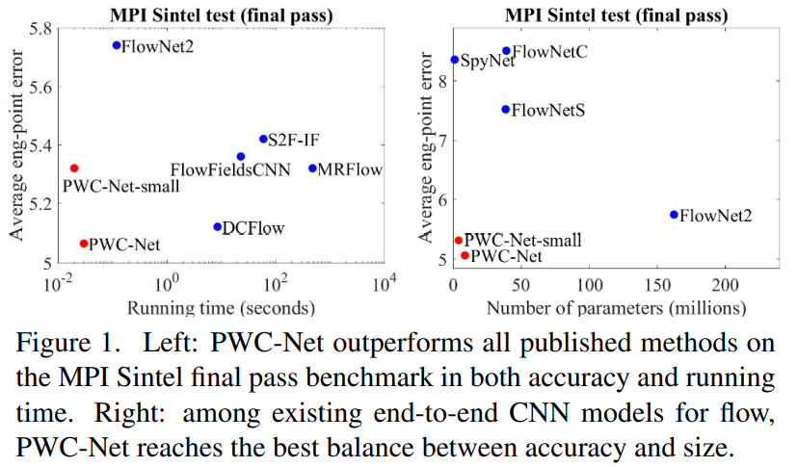
PWC-Net, an early successful optical flow network
Deep NN algorithms are having an impact on practical optical flow estimation
Comparison of NN optical flow algorithms, Sun, et. al., 2018
Notes:
ima

Slide 68
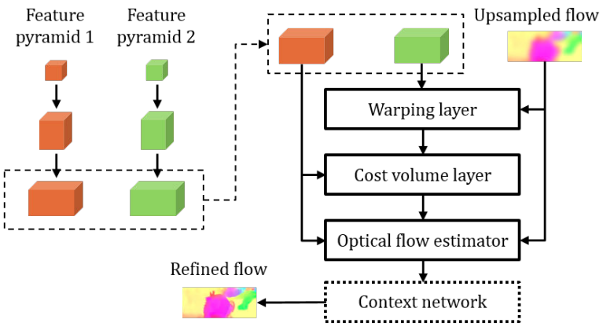
PWC-Net, an early successful optical flow network
The PWC-Net Algorithm
Start with image pyramids
Optimal image pyramid weights are learned as CNNs
Pyramid reduces pixel dimension by 2x per-layer
Pyramid layers have 16, 32, 64, 96, 128, 196 channels
Credit Sun, et. al., 2018
Notes:
ima

Slide 69

PWC-Net, an early successful optical flow network
The PWC-Net Algorithm
Image from pyramid 2 is warped with conventional algorithm
For warp at lth layer, $w^{l}$
$$c_{2,w}^{l}\left(x\right)=c_{2}^{l}\left(x+{up}_{2}\left(w^{l+1}\right)\left(x\right)\right)$$
$c_{ }^{0}=I$, input image
$c^{l}=$ pixel values at layer $l$
$x=$ pixel coordinates
Warping performed with up-sampled flow, ${up}_{2}$.
Credit Sun, et. al., 2018
Notes:
ima

Slide 70

PWC-Net, an early successful optical flow network
The PWC-Net Algorithm
Cost volume layer maintains array of feature matching costs of $n×m$ values at pyramid level, l
Matching cost is the dot product similarity between the feature (pixel) vector of the first image $c_{1 }^{l}(x_{1})$ and the feature vector of the warped second image, $c_{ 2,w}^{l}(x_{2})$
$$c^{l}\left(x_{1},x_{2}\right)=\frac{1}{n×m}{\left[c_{1}^{l}(x_{1})\right]}^{T}c_{ 2,w}^{1}(x_{2})$$
Limiting complexity to compute cost volume is key to performance
Filter to keep only near neighbor values with upper bound d to limit computation
$${\left|x_{1}−x_{2}\right|}_{∞}≤d$$
Credit Sun, et. al., 2018
Notes:
ima

Slide 71

PWC-Net, an early successful optical flow network
The PWC-Net Algorithm
CNN used to estimate optical flow
Training loss is least squares (Euclidian distance) between first image and warped second image, summed over levels of the pyramid
$$ℒ\left(θ\right)=\sum_{l_{0}}^{L}{a_{l}\sum_{x}^{ }{{\left\|w_{θ}^{l}\left(x\right)−w_{GT}^{l}\left(x\right)\right\|}_{2}+γ{\left\|θ\right\|}_{2}}}$$
$$w_{GT}^{l}\left(x\right)=ground truth$$
$$γ{\left\|θ\right\|}_{2}=L_{2} regularization term$$
Warp, $w_{θ}^{l}$, is learned by minimizing $ℒ\left(θ\right)$ with CNN
Credit Sun, et. al., 2018
Notes:
ima

Slide 72

PWC-Net, an early successful optical flow network
The PWC-Net Algorithm
Conventional filtering used for post processing to improve continuity of flow field
Composing is learned by minimizing robust training loss
$$ℒ\left(θ\right)=\sum_{l_{0}}^{L}{a_{l}\sum_{x}^{ }{{{\left|w_{θ}^{l}\left(x\right)−w_{GT}^{l}\left(x\right)\right|+ε+γ{\left\|θ\right\|}_{2}}^{ }}_{ }}}$$
$$\left|w_{θ}^{l}\left(x\right)−w_{GT}^{l}\left(x\right)\right|=L_{1} error$$
$$a_{l}=learnable weight$$
$$ε_{ }=noise term$$
$$ε≤1, supresses noise$$
Credit Sun, et. al., 2018
Notes:
ima

Slide 73
PWC-Net, an early successful optical flow network
PWC-Net algorithm tracking image-to-image motion
Credit Sun, et. al., 2018
TensorFlow implementation

Slide 74
RAFT, Fully Neural Algorithm
RAFT: Recurrent All-Pairs Field Transforms for Optical Flow, Teed and Dang, 2020, improves performance in several ways
A multi-scale correlation volume to measure alignment between images
Account for flow at multiple scales, large-scale slow motions and fast-moving small objects
Recurrent neural network to optimize warp
Flow has long and short range dependencies
Recurrent neural network accounts for range of dependencies
For a more detailed overview of recurrent neural networks applied to CV tasks see Chapter 25 of Torralba, Isola and Freeman

Slide 75




RAFT, Fully Neural Algorithm
RAFT: Recurrent All-Pairs Field Transforms for Optical Flow, Teed and Dang, 2020, improves performance in several ways
Recurrent neural network learns an update, $∇f$, between flow fields, $f_{1}$, $f_{2}$, at different ranges
Learned multi-scale feature pyramids for both images, $g_{θ}\left(I_{1}\right)$, $g_{θ}\left(I_{2}\right)$
Final flow field result
Context encoder for first image with different learned weights, $h_{φ}\left(I_{1}\right)$

Slide 76


RAFT, Fully Neural Algorithm
RAFT: Recurrent All-Pairs Field Transforms for Optical Flow, Teed and Dang, 2020, improves performance in several ways
For $D$ channels similarity is computed
$$C_{i,j,k,l}=\sum_{h=1}^{D}{g_{θ}{\left(I_{1}\right)}_{i,j,h}∙}g_{θ}{\left(I_{2}\right)}_{k,l,h}$$
Over limited range for efficiency, $\left\|dx\right\|≤r$
Correlation volume of dimension $W×H×W×H$

Slide 77


RAFT, Fully Neural Algorithm
RAFT: Recurrent All-Pairs Field Transforms for Optical Flow, Teed and Dang, 2020, improves performance in several ways
Recurrent relationship, similar to GRU, computes update to flow $∆F_{t}$
$$z_{t}=σ\left({Conv}_{3×3}\left(\left[h_{t−1},x_{t}\right],W_{z}\right)\right)$$
$$r_{t}=σ\left({Conv}_{3×3}\left(\left[h_{t−1},x_{t}\right],W_{r}\right)\right)$$
$${\tilde{h}}_{t}=tanh\left({Conv}_{3×3}\left(\left[{r_{t}⊙h}_{t−1},x_{t}\right],W_{h}\right)\right)$$
$$h_{t}=\left(1−z_{t}\right)⊙h_{t−1}+z_{t}⊙{\tilde{h}}_{t}$$
$x_{t}=$contamination of flow, context correlation
$h_{t}=$ a hidden state of recurrent network
Three learnable shared weight tensors, $W_{z}$, $W_{r}$, $W_{h}$

Slide 78

RAFT, Fully Neural Algorithm
RAFT: Recurrent All-Pairs Field Transforms for Optical Flow, Teed and Dang, 2020, improves performance in several ways
Example of RAFT results

Slide 79

NeuFlow 2: High Efficiency Optical Flow
NeuFlow 2, Zhang, et. al., 2024 is a high-performance optical flow algorithm optimized for edge devices
NeuFlow 2 has superior speed and accuracy
Note the inverted vertical scale
Unfortunately, the algorithm is not well described

Slide 80
NeuFlow 2: High Efficiency Optical Flow
NeuFlow 2, Zhang, et. al., 2024 is a high-performance optical flow algorithm optimized for edge devices
NeuFlow 2 is a lightweight hybrid CNN-transformer-based algorithm
Feature maps and context created with light-weight CNNs
Cross-attention provides flow at multiple scales
NeuFlow 2 computes flow field in two stages
A 1/16 scale global flow to capture large scale motion such as moving camera
Integrated 1/8 scale flow to capture fine scale motion such as fast moving objects
1/8 scale flow interpolated to full 1/1 scale
Using CNNs and fractional scale flow greatly increases inference speed

Slide 81

NeuFlow 2: High Efficiency Optical Flow
NeuFlow 2, Zhang, et. al., 2024 is a high-performance optical flow algorithm optimized for edge devices
4. 1/16 scale flow captures global motion, such as moving camera
5. Integrated 1/8 scale flow captures fine grain motion
2. 1/8 and 1/16 scale feature maps and context
1. Multi-scale CNN backbones
3. 16th scale cross attention
6. Up-sampled 1/1 scale flow map

Slide 82

RAFT, Fully Neural Algorithm
NeuFlow 2, Zhang, et. al., 2024 is a high-performance optical flow algorithm optimized for edge devices
2. Light-weight convolutional blocks down-sample and integrate multi-scale features
3. Fully convolutional network creates 1/8 and 1/16 scale feature and context maps
1. CNN pyramid with scale range 1/1 to 1/8

Slide 83


NeuFlow 2: High Efficiency Optical Flow
NeuFlow 2, Zhang, et. al., 2024 is a high-performance optical flow algorithm optimized for edge devices
Recurrent network iteratively refines flow map
Convolutional network integrates 1/8 and 1/16 scale flow
Notice recurrent loops

Slide 84

RAFT, Fully Neural Algorithm
NeuFlow 2, Zhang, et. al., 2024 is a high-performance optical flow algorithm optimized for edge devices
Example of NeuFlow 2 state-of-the-art performance

Slide 85
Short Bibliography For Further Reading
RIEF - Real-Time Intermediate Flow Estimation for Video Frame Interpolation, Haung, et. al, 2020
GMFlow: Learning Optical Flow via Global Matching, Xu, et. al., 2021
FlowFormer: A Transformer Architecture for Optical Flow, Haung, et. al., 2022
NeuFlow: Real-time, High-accuracy Optical Flow Estimation on Robots Using Edge Devices, Zhang, et. al., 2024
RPKNet: Recurrent Partial Kernel Network for Efficient Optical Flow Estimation, Morimitsu, et. al., 2024
Estimating optical flow: A comprehensive review of the state of the art, Alfarano, et. al., 2024
Other papers and benchmark datasets in Papers with Code

Slide 86
Summary Optical Flow
Key points:
Relationship between optical flow and projective transforms
Small movement and consistency assumptions and the iterative Lucas-Kanade (iLK) algorithm
Image pyramids for multiple scales
Relationship between camera pose and optical flow in 3D
Regularization with the Horn-Schunck algorithm
Improving performance with the LV-L1 algorithm smoothing constraint
Evaluation of optical flow algorithms
Hybrid deep NN and classical algorithms for optical flow to improve performance

