Slide 2
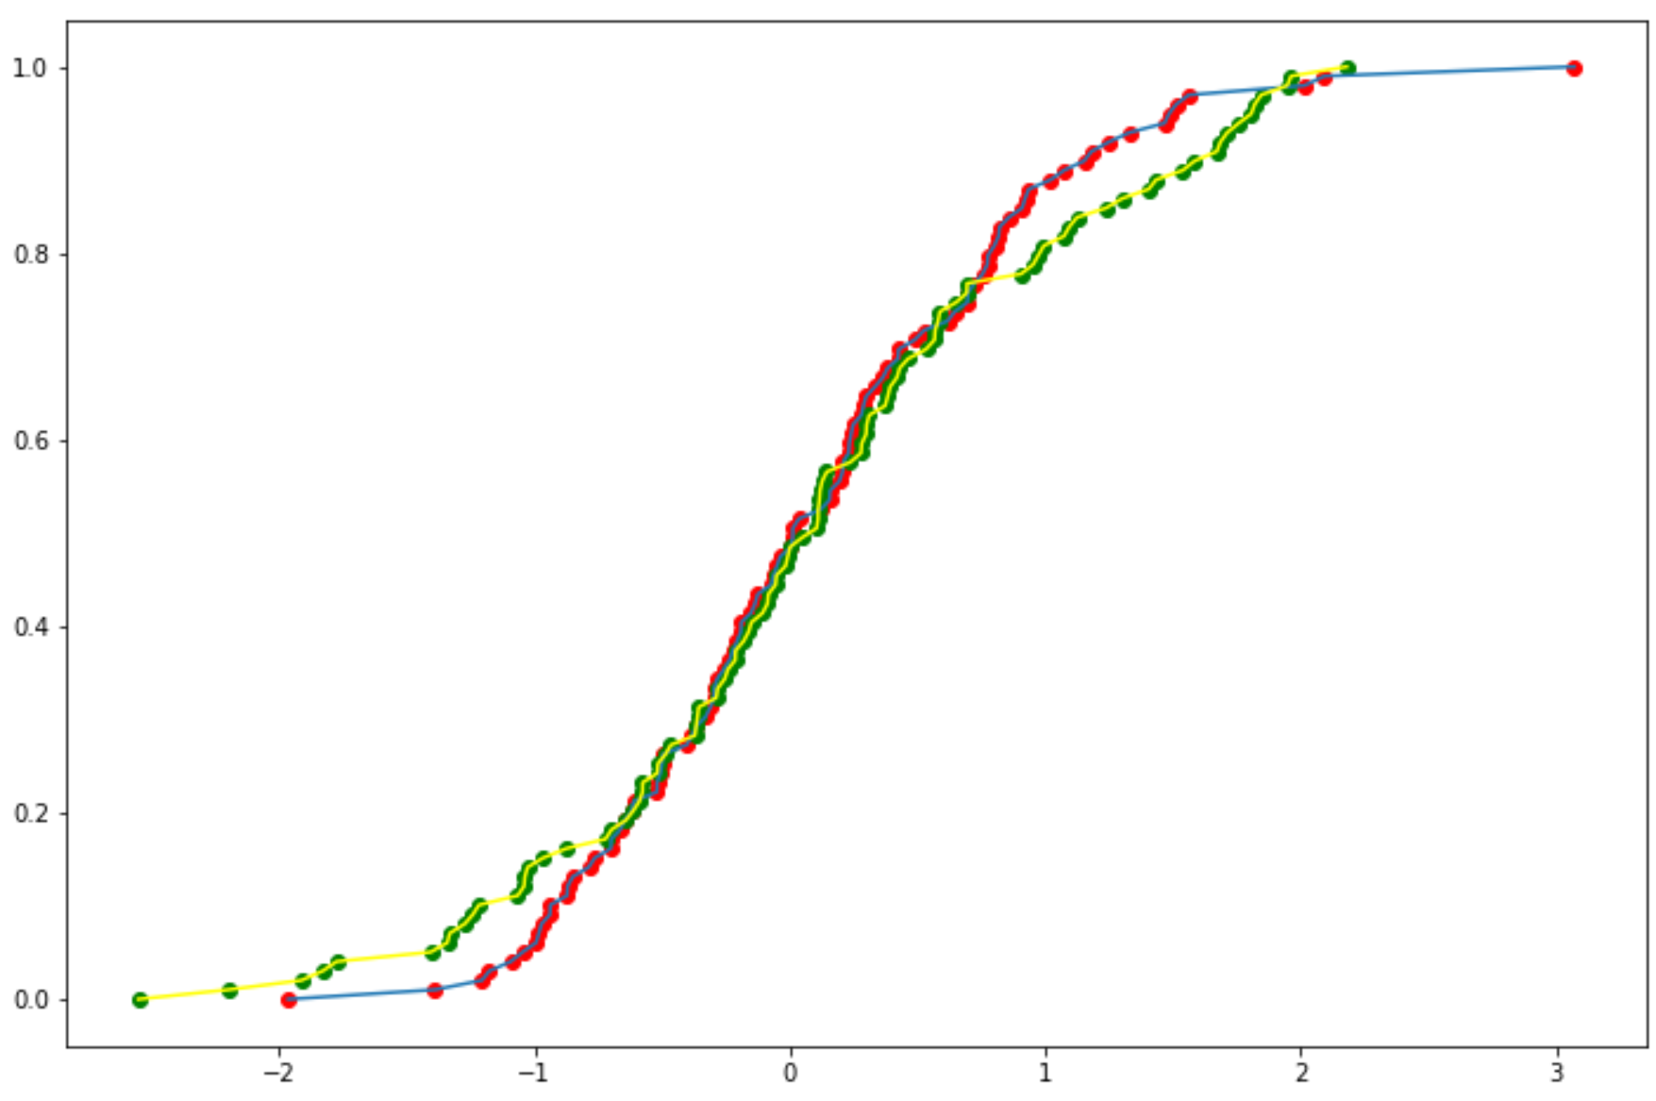
KS Statistic is Maximum Distance
Between CDF Curves

