Slide 1


Machine Learning 530
Lesson 3
Introduction to Recurrent Neural Networks
Steve Elston
Copyright 2018, 2019, 2022 Stephen F Elston. All rights reserved.

Slide 2
Start Recording!

Slide 3
Recurrent Neural Networks
Many data types are ordered sequences:
Numerical time series
Natural language
Speech
Recurrent neural networks operate on ordered sequences
Recurrent architecture first proposed by Rumelhart et. al. (1986)
The Long Short Term Memory (LSTM) network proposed by Hochreiter and Schmidhuber (1997)
LSTM and GRU networks now dominate speech recognition applications

Slide 4
Recurrent Neural Networks
Many applications of Recurrent Neural Networks (RNNs):
Machine translation
Speech recognition
Chat bots – sequence to sequence response
Captioning images
Sequence classification
Many more…
Above applications have been revolutionized by RNNs

Slide 5
Recurrent Neural Networks
Representation
Inference
Input = X
Output = Y
Learning

Slide 6
Recurrent Neural Networks
Lesson Overview
Basic recurrent NNs
Backpropagation through time
Embedding for NLP
Common RNN architectures
Loops, LSTM, GRU, bidirectional models
Regularization
Context and attention – Time permitting

Slide 7


Recurrence for Neural Networks
Recurrent neural networks are neural networks that learn recurrent functions
A recurrent function is a function that operates on itself
Consider a simple function:
The first recurrence step yields:
Recurrence can continue indefinitely

Slide 8
Recurrence for Neural Networks
Same function and weights are used for each time step
Only valid for stationary data
Distribution of stationary data is constant in time
Recurrence adds memory to the neural network
The recurrence relationship is causal; operates in time order
The length of the memory grows with each time step
Time scale changes with length
Can be problem with long sequences/memory
Memory from step to step; is non-Markov behaviour
1st order Markov process is stochastic process with no memory

Slide 9
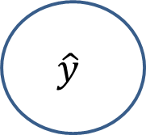
Basic RNN architecture
J(U,V,W)
Loss function
y
$$\hat{y}$$
Output layer
Output weight tensor
V
W
h
Recurrence with weight tensor W
Hidden layer
Input weight tensor
U
x
Input layer

Slide 10
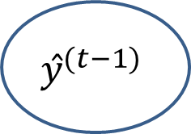
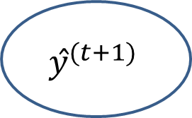
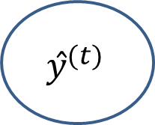
Basic RNN architecture
Unfold the recurrence relationship in time:
J(U,V,W) ^{(t-1)}
J(U,V,W) ^{(t)}
J(U,V,W) ^{(t+1)}
y ^{(t+1)}
y ^{(t-1)}
y ^{(t)}
$$ŷ^{(t−1)}$$
$$ŷ^{(t)}$$
$$ŷ^{(t+1)}$$
V
V
V
h^{(…)}
h^{(t-1)}
h^{(t)}
h^{(t+1)}
W
h^{(…)}
W
W
W
U
U
U
X^{(t-1)}
X^{(t)}
X^{(t+1)}
t-1
t
t+1

Slide 11




Basic RNN architecture
Forward propagation in RNNs
Value of recurrent layer
Activation of recurrent layer
Value of output layer
Activation of output layer
RNNs use shared weight tensors
Learn weights of RNNs using backpropagation through time

Slide 12

Latent variables in recurrent NN
What is the nature of the hidden unit, h?
These variables are latent, or unobservable
Latent variables embed feature map
If you are familiar, notice similarity to Kalman filter
J(U,V,W)
y
$$\hat{y}$$
V
W
h
Recurrence with weight tensor W
U
x

Slide 13
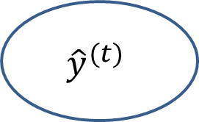
Single output RNN architecture
Single output RNN used to detect a particular sequence
J(U,V,W) ^{(τ)}
y ^{(τ)}
$${\hat{y}}^{(t)}$$
V
h^{(…)}
h^{(t-2)}
h^{(t-1)}
h^{(τ)}
W
h^{(…)}
W
W
W
U
U
U
X^{(t-2)}
X^{(t-1)}
X^{(τ)}

Slide 14
Single output RNN architecture
Single output RNN is difficult to train
Backpropagaton though time requires a gradient of the loss function
But single output RNN only produces value once
Can encounter very slow training

Slide 15
Embedding and Natural Language Processing
Embedding models create lower dimensional feature map for natural language processing (NLP)
Embedding layer creates feature map for RNN
Embedding Layer
Creates feature map
Recurrent Layers
Sequential model of features
Fully-connected
classifier Layers
Classify document

Slide 16
Embedding and Natural Language Processing
Embedding maps sparse Token space (typically words) to a dense lower dimensional feature space
Embedding models measure similarity
Queen
ship
king
woman
Bus
boat
man
car
Unfortunately, unclear how embedding models work

Slide 17

Embedding and Natural Language Processing
We can perform algebraic operations on embedding space
Example:
$$ship−car=bus$$
ship
Bus
boat
car

Slide 18
The Bag of Words Model and Text Preparation
Some NLP terminology:
A corpus is comprised of documents
Document can be email, news article, Tweet, book, paragraph, etc.
A document is comprised of tokens
Tokens can be words, sequences of words, etc.

Slide 19
The Bag of Words Model and Text Preparation
The bag of words model, or BOW model, is a basic NLP model
BOW assumes exchangeability of words
Order does not matter
Independent of grammar
BOW based on count of tokens
Term document matrix (TDM); words in rows, documents in columns
Document term matrix (DTM); documents in rows, words in columns
TDM and DTM are very sparse

Slide 20
The Bag of Words Model and Text Preparation
Preparing text for analysis
Normalize text
All characters to lower case
Remove punctuation
Remove numbers and special characters
Stop words are removed
Stop words are common words with no semantic value
Examples; ‘and’, ‘the’, ‘or’
Choice of stop words can be domain dependent
Document is tokenized
Token are typically words or sequence of words

Slide 21
RNN Architectures
Feedforward network
Output
Layer
Hidden
Layers
Input
Layer

Slide 22
RNN Architectures
Classification of input sequence
Output
Layer
Hidden
Layers
Input
Layer

Slide 23
Single output RNN architecture
Single output RNN used to detect a particular sequence
J(U,V,W) ^{(τ)}
y ^{(τ)}
$${\hat{y}}^{(t)}$$
V
h^{(…)}
h^{(t-2)}
h^{(t-1)}
h^{(τ)}
W
h^{(…)}
W
W
W
U
U
U
X^{(t-2)}
X^{(t-1)}
X^{(τ)}

Slide 24
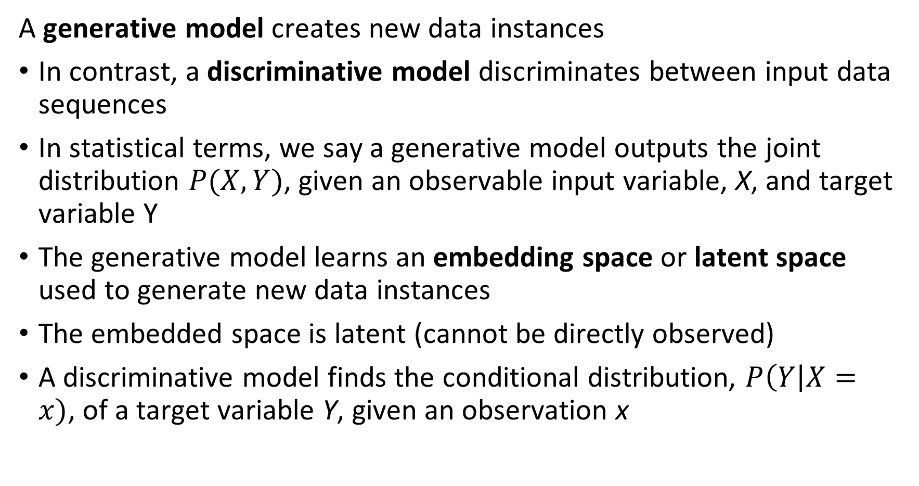
Generative Models
A generative model creates new data instances
In contrast, a discriminative model discriminates between input data sequences
In statistical terms, we say a generative model outputs the joint distribution $P(X,Y)$, given an observable input variable, X, and target variable Y
The generative model learns an embedding space or latent space used to generate new data instances
The embedded space is latent (cannot be directly observed)
A discriminative model finds the conditional distribution, $P\left(Y\right|X=x)$, of a target variable Y, given an observation x

Slide 25
Generative Models
Generative Models output new data cases
A generator learns an embedding space from data input
Generator produces output data from embedding space from input, z
A critic or discriminative model evaluates the quality of the output with feedback used to improve learning of embedding space
Training Data
Z
Critic
Embedding Space
Generator
Output

Slide 26
Sequence Generation with RNNs
Given an input value x, we want to generate an output sequence y
Activation is function of input and last output: Y_{t} = h_{t-1}(y_{t-1}, x)
Is a generative model
Train by minimizing the loss with respect to the desired response
Loss function = J(R, U, V, W)
Applications:
Response to question – chat bots
Caption images
Machine translation

Slide 27
RNN Architectures
Generative model where input vector generates output sequence
Output
Layer
Hidden
Layers
Input
Layer

Slide 28
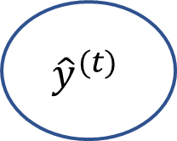
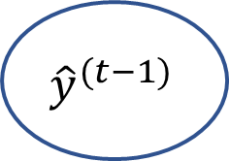
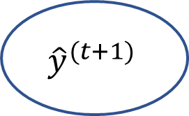
RNN Architectures
Generative model where input vector generates output sequence
J ^{(t-1)}
J ^{(t)}
J^{J(t+1)}
y ^{(t-1)}
y ^{(t)}
y ^{(t+1)}
y ^{(…)}
U
$${\hat{y}}^{(t−1)}$$
U
$${\hat{y}}^{(t)}$$
U
$${\hat{y}}^{(t+1)}$$
V
V
V
h^{(t-1)}
h^{(t)}
W
h^{(t+1)}
W
h^{(…)}
h^{(…)}
W
W
R
R
X
R
R

Slide 29
RNN Architectures
Sequence-to-sequence model – Generative
Output
Layer
Hidden
Layers
Input
Layer

Slide 30
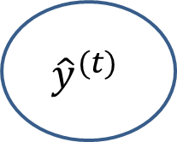
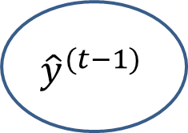

Sequence to Sequence RNN Architecture
J ^{(t-1)}
J ^{(t)}
J ^{(t+1)}
y ^{(t)}
y ^{(t+1)}
y ^{(…)}
$${\hat{y}}^{(t−1)}$$
$${\hat{y}}^{(t)}$$
$${\hat{y}}^{(t+1)}$$
U
U
V
V
V
h^{(t-1)}
h^{(t)}
W
h^{(t+1)}
W
h^{(…)}
h^{(…)}
W
W
R
R
R
X ^{(t-1)}
X ^{(t)}
X ^{(t+1)}

Slide 31
RNN Architectures
Sequence-to-sequence model with context and embedding
Output
Layer
Hidden
Layers
Embedding Layer
Input
Layer

Slide 32
Adding Depth to RNNs
Single recurrent layer has limited capacity
Adding additional recurrent layers adds capacity to the model
Adding depth to RNNs presents training problems
Vanishing and exploding gradients

Slide 33
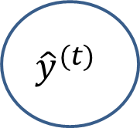
Adding Depth to RNNs
Loss function
$${\hat{y}}^{(t)}$$
J(U₁,U₂,V,W₁,W₂)
Output layer
Output weight tensor
W₂
V
Hidden recurrent layer
z
y
Hidden weight tensor
U₂
W₁
h
Hidden recurrent layer
Input weight tensor
U₁
x
Input layer

Slide 34
Adding Depth to RNNs
Training multiple recurrent layers can be problematic
Recurrence layers introduce delay
Delay affects the gradient
The loss function is slow to update
A possible solution is to add a skip loop to the recurrent layer
A skip loop is a recurrence loop with memory
The skip loop forces the recurrence relationship to be sensitive at each time step

Slide 35

Adding Depth to RNNs
Loss function
$${\hat{y}}^{(t)}$$
J(U₁,U₂,V,W₁,W₂)
Output layer
Output weight tensor
V
W₂
y
Hidden recurrent layer
z
Hidden weight tensor(s)
W₁
U₂
(…)
Hidden layer(s)
(…)
Skip loop
Input weight tensor
U₁
x
Input layer

Slide 36


Long-Short Term Memory
Problems training simple recurrent architectures have led to the development of better approaches
Vanishing and exploding gradients common
Consider the following recurrent relationship:
For a long recurrence, large n:
If > 1.0 the gradient grows exponentially
If < 1.0 the gradient vanishes

Slide 37
Long-Short Term Memory
How can one create a neural net for modeling sequences with stable gradients?
Memory lets the NN operate at multiple time scales
Forget gates break the recurrence relationship and stabilize the gradient
The Long-Short Term Memory (LSTM) neural network was an early architecture using memory and forget gates
LSTM used for speech recognition, handwriting generation, machine translation, etc.

Slide 38
Long-Short Term Memory
Output
X
Activation of forget gate
Self Loop
+
X
State
W
X
Input Gate
Forget Gate
Output Gate
U
Input

Slide 39
Gated Recurrent Units
LSTM networks are effective but a bit complex
Is there a simpler approach?
The Gated Recurrent Unit (GRU) architecture (Cho et. al., 2014)
Operates on multiple time scales
No memory units
Greatly simplifies the architecture
GRUs are widely applied in speech recognition, machine translations, etc.
Being replaced in some applications by transformer models
More on these later in the course

Slide 40


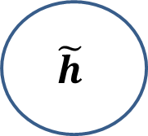
Gated Recurrent Units
Output determined by an exponential decay function
X
U
W
Stabilizes the gradient
h
$$\tilde{h}$$
IN
OUT

Slide 41
Bidirectional RNNs
Not all sequential relationships are causal
A natural language phrase can be parsed in both directions
Hand writing recognition can proceed from either end
Figure captioning has no preferred direction
For non-causal sequences we can use bidirectional RNNs
Bidirectional RNNs trained using BPTT in both directions

Slide 42



Bidirectional RNNs
J ^{(t-1)}
J ^{(t)}
J ^{(t+1)}
$${\hat{y}}^{(t−1)}$$
$${\hat{y}}^{(t)}$$
$${\hat{y}}^{(t+1)}$$
y ^{(t-1)}
y ^{(t)}
y ^{(t+1)}
V
V
V
S
S
S
g^{(…)}
Q
g^{(t-1)}
g^{(t)}
Q
g^{(t+1)}
Q
g^{(…)}
Q
R
R
R
h^{(…)}
h^{(t-1)}
h^{(t)}
h^{(t+1)}
h^{(…)}
W
W
W
W
U
U
U
X^{(t-1)}
X^{(t)}
X^{(t+1)}

Slide 43
Bidirectional RNN Architectures
Bidirectional sequence-to-sequence model with context and embedding
Output
Layer
Bidirectional
Hidden
Layers
Embedding Layer
Input
Layer

Slide 44
Regularization for RNNs
How can you regularize RNN training?
l1 and l2 regularization work
Use modified recurrent dropout regularization
Standard dropout regularization interferes with BPTT
Recurrent dropout regularization does not Bernoulli sample on each forward pass
Add a batch normalization layer to the recurrent layer
More on regularization next week!

Slide 45
Neural Machine Translation
Use neural networks as function approximators for machine translators
Architecture has three components:
Encoder for the input sequence
Context vector – a hidden state
Decoder generates output sequence
Finds maximum likelihood target sequence

Slide 46
NMT Architectures
Encoder-decoder model with context vector
…
y_{m}
y₂
y₁
Output sequence
…
…
Decoder
…
Encoder
Context
Input sequence
x₁
x₂
x_{n}

Slide 47

Neural Machine Translation
Use neural networks as function approximators for machine translators
The hidden state updates as a function last hidden state and input
Where, f() is the activation function of the LSTM
The encoder creates a sequence of hidden states given the input sequence

Slide 48
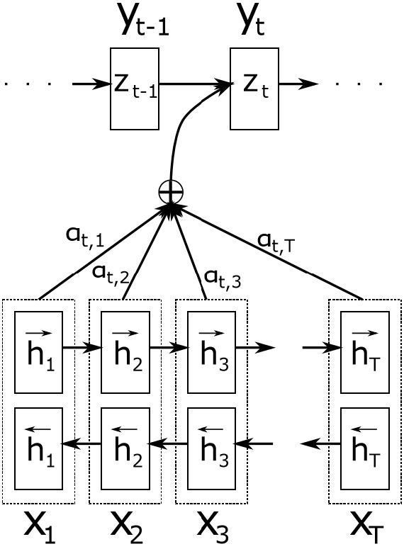


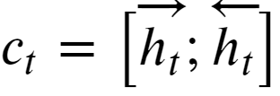
Neural Machine Translation
Use neural networks as function approximators for machine translators
The first layers of a NMT encoder network are a bidirectional RNN (BiRNN)
The hidden states of the forward layer are:
The hidden states of the reverse layer are:
And, the context is:

Slide 49

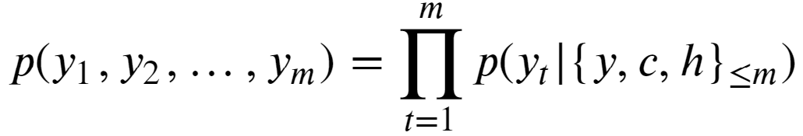
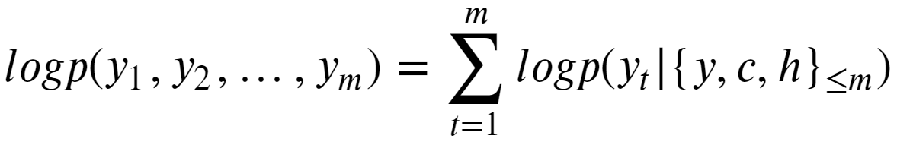
Neural Machine Translation
Use neural networks as function approximators for machine translators
Given weights, , the encoder uses the context and its hidden state
Taking logs of both sides, gives:

Slide 50

Attention Mechanism
Context is the input to decoder
A fixed context vector has limited representation
May compress information required for sequence generation
Translation accuracy decreases with sequence length
Need a better representation!
Use a context set:
The weights of the context give attention to the correct sequence in the decoder

Slide 51

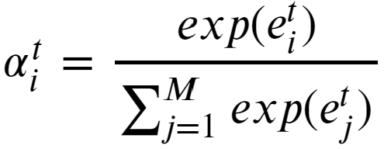
Attention Mechanism
How to compute the attention weights?
Compute attention score for context c_{i} as a function of pervious hidden state, context and previous attention weights:
The attention weights are updated:
The attention weights are the probability that decoder should attend to the context c_{i}

Slide 52
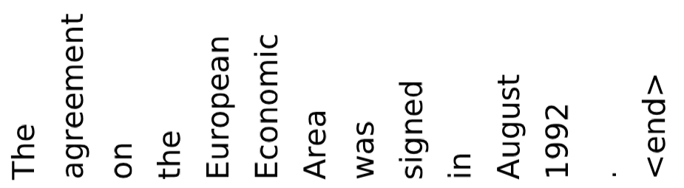
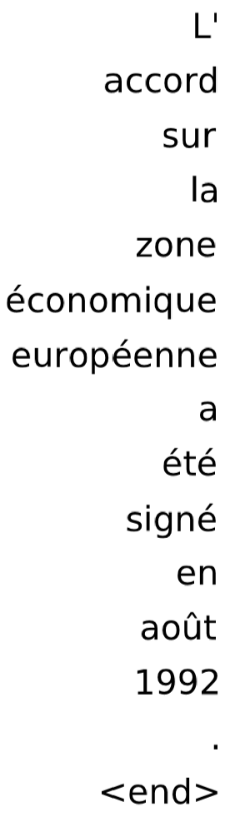

Attention Mechanism
Example of attention weights
Attention weights can be readily visualized
For the input sequence
And, the output sequence
Probabilities of attending the output sequence given the input sequence
Cho, et. al, Describing Multimedia Content using Attention-based Encoder–Decoder Networks, 2015

Slide 53

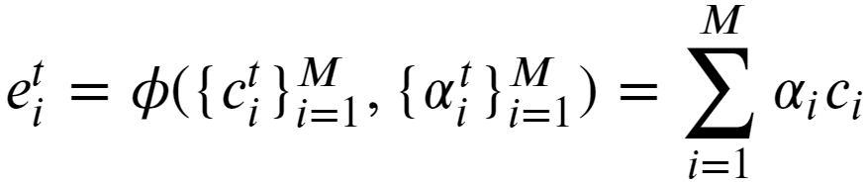
Attention Mechanism
How to compute the attention weights?
The scores used to update the context weight are a function of the current context set and the attention weights:
One possibility is to use linear combination of weighted context:

Slide 54
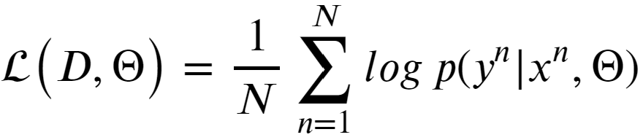
Attention Mechanism
How to compute the attention weights?
Use a neural network as a function approximator
The neural network has parameters, Θ, which maximize the log-likelihood
Where the data are the N input and output sequences of the training data;
For linear model, can compute all the derivatives and use backpropagation to train neural network with stochastic gradient decent

Slide 55
Recurrent Neural Networks
Key points
Basic recurrent NNs
Backpropagation through time
Embedding for NLP
Common RNN architectures
Loops, LSTM, GRU, bidirectional models
Regularization
Context and attention – Time permitting

