Slide 1


Machine Learning 530
Introduction to Monte Carlo Reinforcement Learning
Steve Elston
Copyright 2019, 2022, Stephen F Elston. All rights reserved.

Slide 2
Introduction to Monte Carlo Reinforcement Learning
What is Monte Carlo RL?
Review of Monte Carlo sampling
Monte Carlo state-value estimation
Monte Carlo RL algorithms
Monte Carol policy improvement

Slide 3
What is Monte Carlo Reinforcement Learning
Reinforcement learning is model free
No specified model
Learn from experience; rewards
Learn state-value for evaluation
Learn action-value for control
Monte Carlo agents takes samples of the values
Update average values with new samples
Monte Carlo agents must complete episodes
Can only update values once episode terminates
Monte Carlo RL is often used as a reference for performance of other algorithms

Slide 4
Introduction to Monte Carlo Reinforcement Learning
Model Type | Model? | State | Labeled Data | Loss Function
Model Type | Model? | State | Labeled Data | Loss Function
Supervised Learning | Yes | No | Yes | Error Metric
Model Type | Model? | State | Labeled Data | Loss Function
Supervised Learning | Yes | No | Yes | Error Metric
Unsupervised Learning | Yes | No | No | Error Metric
Model Type | Model? | State | Labeled Data | Loss Function
Supervised Learning | Yes | No | Yes | Error Metric
Unsupervised Learning | Yes | No | No | Error Metric
Reinforcement Learning | No | Yes | No | Reward

Slide 5
The Reinforcement Learning Agent
State
Environment…?
Rewards
Representation
{state,
action,
reward}
Inference
V(s)
Q(s,q)
π(s)
Actions
Learning
Monte Carlo
Agent

Slide 6
Introduction to Monte Carlo Reinforcement Learning
Model Type | Backup Type | Bootstrap | On/Off-Line
Model Type | Backup Type | Bootstrap | On/Off-Line
Bandit Agent | None | No | Online
Model Type | Backup Type | Bootstrap | On/Off-Line
Bandit Agent | None | No | Online
Dynamic Programming | Full | Yes | Offline
Model Type | Backup Type | Bootstrap | On/Off-Line
Bandit Agent | None | No | Online
Dynamic Programming | Full | Yes | Offline
Monte Carlo RL | Complete | No | Offline

Slide 7
Backup and Bootstrapping

Slide 8
Backup and Bootstrapping
Example of backup diagram
Backup diagram shows sequence of operations
s
1. Start Markov process in state s:
state = Open circle
max
2. Take action a that maximizes state-value:
action = Filled circle
a
r
3. Leads to successor states s’ with reward r
s’

Slide 9
Backup and Bootstrapping
Can bootstrap to iteratively find better approximations
Full backup computes rewards for all possible actions
Partial backup only computes one estimated reward
s
Each iteration backs up into a better estimates of state-value by looking one step ahead
Since reward for all actions are computed in this diagram, this algorithm is said to use a full backup
max
a
r
s’

Slide 10
Monte Carlo RL

Slide 11
Review of Monte Carlo Sampling
Monte Carlo methods randomly sample
Repetitive sampling creates a Markov chain
Sample values are averaged
Convergence of sample estimates by the weak law of large numbers

Slide 12
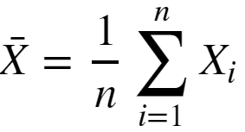


Review of Monte Carlo Sampling
Sample estimates converge by the weak law of large numbers
For expected value of underlying distributed, μ, use sample estimate of the mean
Then by the weak law of large numbers
as,

Slide 13
Monte Carlo State Value Estimation – Policy Evaluation
s
The backup diagram aids understand the MC RL state-value estimation algorithm
MC sampling algorithm:
Start in state, s
Take action, a, based on policy, π
Record reward, r
Transition to next state
Repeat above 2-4, until terminal state, t
MC value estimates are averaged over episodes
MC algorithm does not bootstrap
Complete backup
Strong convergence properties
High variance
Algorithm cannot work online
a
r
s
a
…
a
r
t

Slide 14
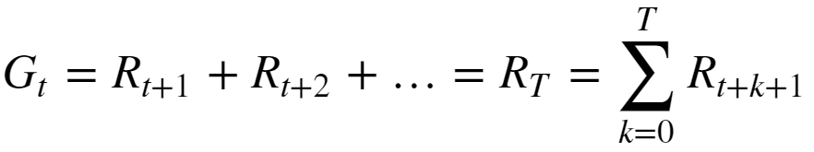
Monte Carlo State Value Estimation
Upon termination of the Markov chain, compute return
Process is episodic so do not need to discount
Average G_{t} over episodes for each state visited

Slide 15
Monte Carlo State Value Estimation
0
1
2
3
0
1
2
3
0
1
2
3
4
5
6
7
4
5
6
7
4
5
6
7
8
9
10
11
8
9
10
11
8
9
10
11
Σ_{t} r_{10,t} = r₁₀₋₉
Σ_{t} r_{10,t} = Σ_{t-1} r_{t} + r₉₋₈
Σ_{t} r_{10,t} = Σ_{t-1} r_{t} + r₈₋₉
0
1
2
3
0
1
2
3
0
1
2
3
4
5
6
7
4
5
6
7
4
5
6
7
8
9
10
11
8
9
10
11
8
9
10
11
Σ_{t} r_{10,t} = Σ_{t-1} r_{t} + r₉₋₅
Σ_{t} r_{10,t} = Σ_{t-1} r_{t} + r₅₋₁
Σ_{t} r_{10,t} = Σ_{t-1} r_{t} + r₁₋₀

Slide 16
Monte Carlo RL Algorithms
Return from Markov chain:
Bias-variance trade-off
MC gives an unbiased estimate of G_{t}
What about the variance of G_{t}?
Recall Weak Law of Large numbers:
, as
A infinitely large sample required to obtained low variance estimate
Estimate with finite sample will have high variance!

Slide 17
Monte Carlo RL Algorithms
s
Where to start the Markov chain?
From a specific stating state
Random start – e.g. Bernoulli sample
Random start samples entire environment
Typically use random start
Two possible sampling methods:
First visit Monte Carlo estimates returns from rewards of the first visit to a state in an episode
Every visit Monte Carlo accumulates the rewards for any visit to a state in an episode
Use first-visit MC in this course
a
r
s
a
…
a
r
t

Slide 18
First-Visit Monte Carlo Algorithm
0
1
2
3
0
1
2
3
0
1
2
3
4
5
6
7
4
5
6
7
4
5
6
7
8
9
10
11
8
9
10
11
8
9
10
11
Σ_{t} r_{10,t} = r₁₀₋₉
Σ_{t} r_{10,t} = Σ_{t-1} r_{t} + r₉₋₈
Σ_{t} r_{10,t} = Σ_{t-1} r_{t} + 0
...
Σ_{t} r_{8,t} = 0
Σ_{t} r_{9,t} = r₉₋₈
0
1
2
3
0
1
2
3
0
1
2
3
4
5
6
7
4
5
6
7
4
5
6
7
8
9
10
11
8
9
10
11
8
9
10
11
Σ_{t} r_{10,t} = Σ_{t-1} r_{t} + r₉₋₅
Σ_{t} r_{10,t} = Σ_{t-1} r_{t} + r₅₋₁
Σ_{t} r_{10,t} = Σ_{t-1} r_{t} + r₁₋₀
...
Σ_{t} r_{8,t} = r₉₋₅
...
Σ_{t} r_{5,t} = r₅₋₁
...
Σ_{t} r_{1,t} = r₁₋₀

Slide 19
Policy Evaluation

Slide 20
Policy Evaluation
We want our intelligent agent to follow an optimal policy
Policy evaluation is needed to compare policies
Can evaluate policy by value:
State value: expected value of being in a state
Action value: expected value of taking an action in a given state

Slide 21

State Value Policy Evaluation
Recall that a first order Markov process depends only on the current state, s
The probability of a state transition, and therefore the expected reward, is determined by the policy, π, and the transition probabilities of the Markov process
We can find the state-value of state s, given a policy π, as the expected value of the gain from the Bellman value equation:
Where

Slide 22
Policy Improvement

Slide 23
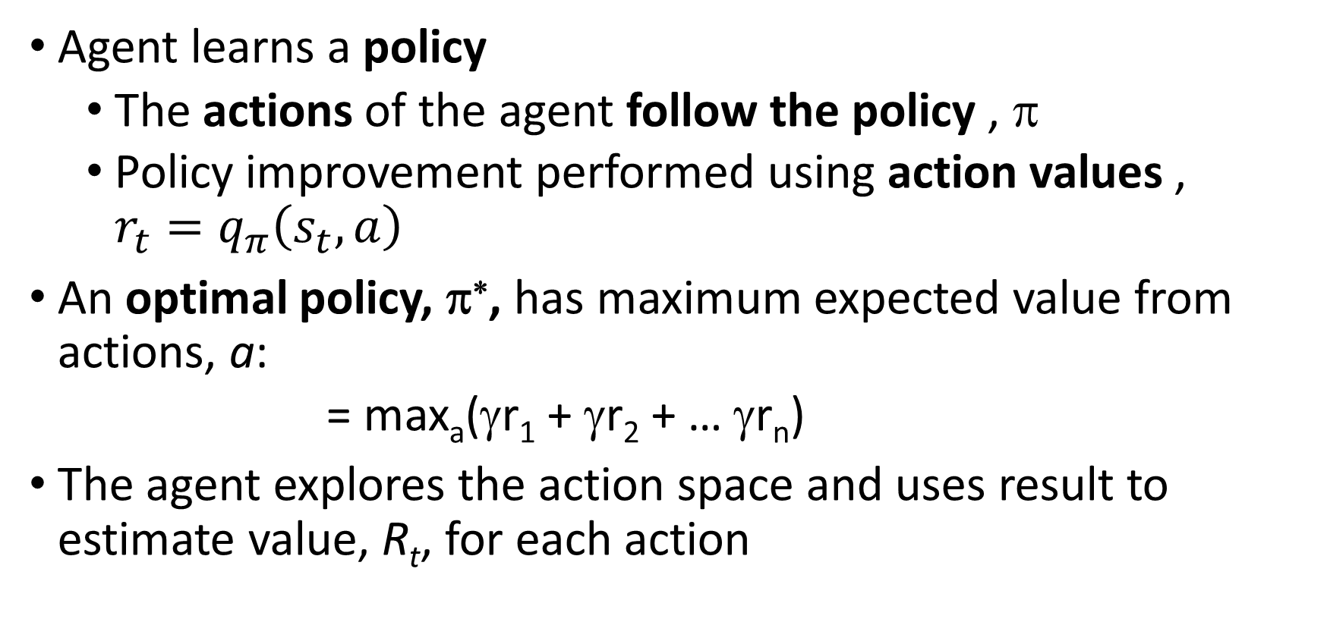
Policy
Agent learns a policy
The actions of the agent follow the policy , π
Policy improvement performed using action values , ${r_{t}=q}_{π}\left(s_{t},a\right)$
An optimal policy, π∗, has maximum expected value from actions, a:
= max_{a}(γr₁ + γr₂ + … γr_{n})
The agent explores the action space and uses result to estimate value, R_{t}, for each action

Slide 24
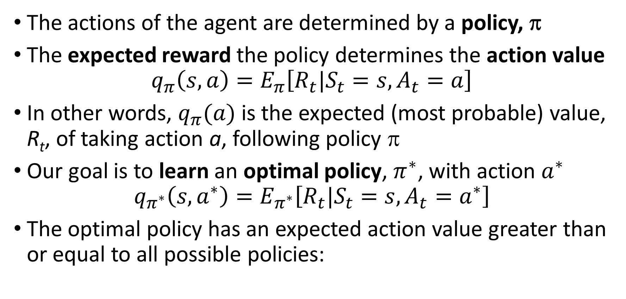
Policy
The actions of the agent are determined by a policy, π
The expected reward the policy determines the action value
$$q_{π}\left(s,a\right)=E_{π}\left[R_{t}|S_{t}=s,A_{t}=a\right]$$
In other words, $q_{π}(a)$ is the expected (most probable) value, R_{t}, of taking action a, following policy π
Our goal is to learn an optimal policy, $π^{∗}$, with action $a^{∗}$
$$q_{π^{∗}}\left(s,a^{∗}\right)=E_{π^{∗}}\left[R_{t}|S_{t}=s,A_{t}=a^{∗}\right]$$
The optimal policy has an expected action value greater than or equal to all possible policies:

Slide 25
Monte Carlo Policy Improvement - Control
How to perform policy improvement with Monte Carlo algorithms?
Policy improvement can be on-policy or off-policy
Basic Monte Carlo control is on-policy and updates the policy used for control
In off policy Monte Carlo control, agent follows a behavior policy and updates a target policy
In this course we focus on on-policy MC control
Off policy MC control more complicated
Learn from behavior policy
Requires importance sampling
Has significant bias
More on off-policy control in future lecture

Slide 26


Monte Carlo Policy Improvement - Control
How to perform policy improvement with Monte Carlo algorithms?
Recall the action-value the policy improvement theorem:
Where
The optimal policy may not be unique

Slide 27
Monte Carlo Policy Improvement - Control
Monte Carlo policy improvement, or control, samples action-values, q(s,a)
Rewards are accumulated for each action, a, from each state, s, following policy, π(s,a)
At end of episode return for each action, a, from each state, s, are computed
Action values are averaged over visits to state-action
After a specified number of episodes, the policy is updated
Greedy improvement
ε-greedy improvement
Above steps may be repeated

Slide 28
Exploration-Exploitation Tradeoff

Slide 29
Exploitation vs. Exploration
The agent following a greedy policy maximizes short-term reward
But, the greedy policy may not be optimal
Learning is stochastic
Action-value is high variance MC sample
There is always uncertainty in learned parameters
May be a better policy
Improve policy by mixing greedy exploitation with random exploration

Slide 30
Exploitation vs. Exploration
A greedy policy never improves once set
Must mix exploitation with exploration
At each step determine if exploit with greedy policy or explore
Explore with probability ε; e.g. take a random action
Exploit with greedy policy with probability (1 - ε)
Result is an ε-greedy policy
ε is small number; 0.05, 0.01, 0.001…..
Decrease ε as learning progresses: policy becomes greedier

Slide 31
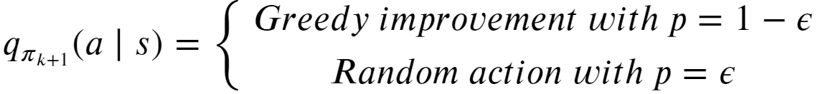
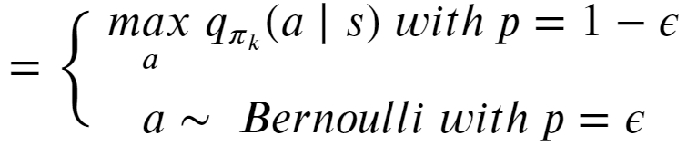
Monte Carlo Policy Improvement - Control
Update policy with ε-greedy improvement to find improved policy π_{k+1} at kth step of algorithm
Iterate until convergence – small change in policy evaluation
Result is an ε-greedy policy
ε is small number; 0.05, 0.01, 0.001…..
Decrease ε as learning progresses: policy becomes greedier

