Slide 1


Machine Learning 530
Introduction to Markov Processes
Steve Elston
Copyright 2019, 2022, Stephen F Elston. All rights reserved.

Slide 2
Introduction to Markov Processes
What is a Markov process?
Markov reward processes
Utility and Gain
Markov decision processes

Slide 3
Markov Processes

Slide 4




Introduction to Markov Processes
A Markov process has states
A Markov process transitions between states at discrete time steps
The probability of transition from one state to another for a first order Markov process is determined only by the current state:
Where, the history of states is,
And, the current state is
A first order Markov process has no memory

Slide 5
Example of Markov Processes
0.00001
0.98999
Old Car
Accident
0.01
0.01
0.99
0.000001
Old Breakdown
New Breakdown
1.0
0.0001
0.99
New Car
0.01
0.998999

Slide 6
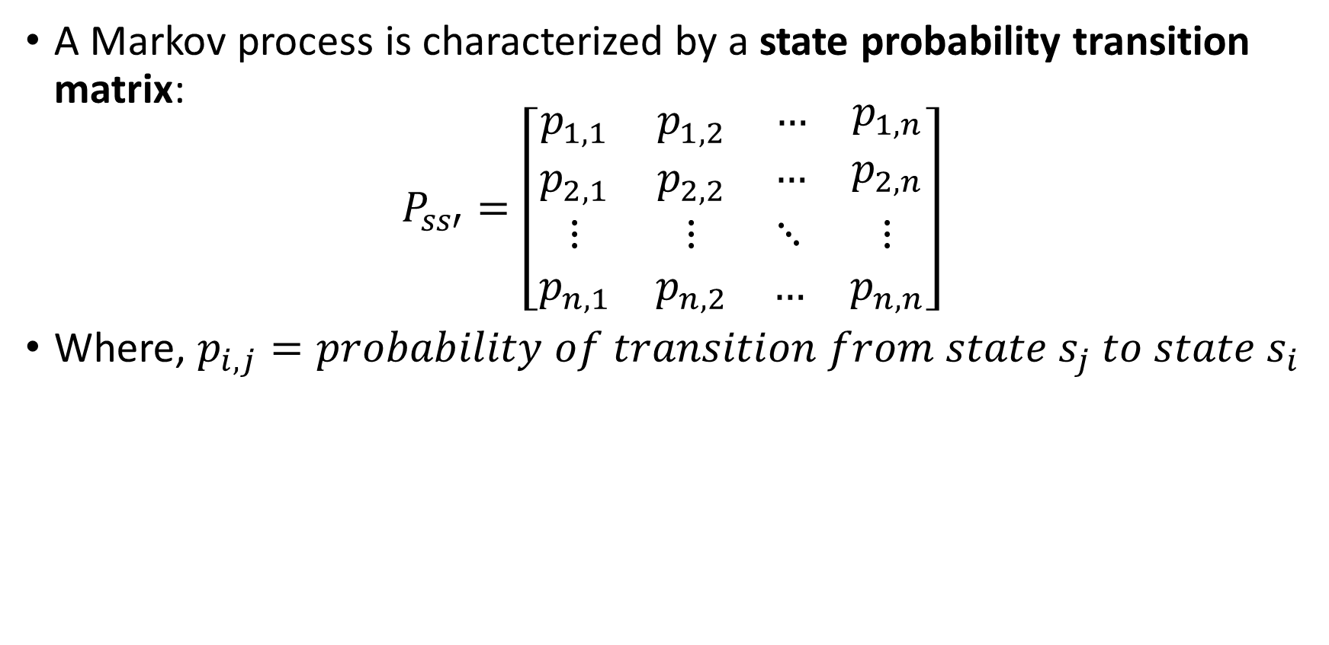
Introduction to Markov Processes
A Markov process is characterized by a state probability transition matrix:
$$P_{ss′}=\left[\begin{matrix}p_{1,1} & p_{1,2} & \begin{matrix}… & p_{1,n}\end{matrix} \\ p_{2,1} & p_{2,2} & \begin{matrix}… & p_{2,n}\end{matrix} \\ \begin{matrix}⋮ \\ p_{n,1}\end{matrix} & \begin{matrix}⋮ \\ p_{n,2}\end{matrix} & \begin{matrix}⋱ & ⋮ \\ … & p_{n,n}\end{matrix}\end{matrix}\right]$$
Where, $p_{i,j}=probability of transition from state s_{j} to state s_{i}$

Slide 7

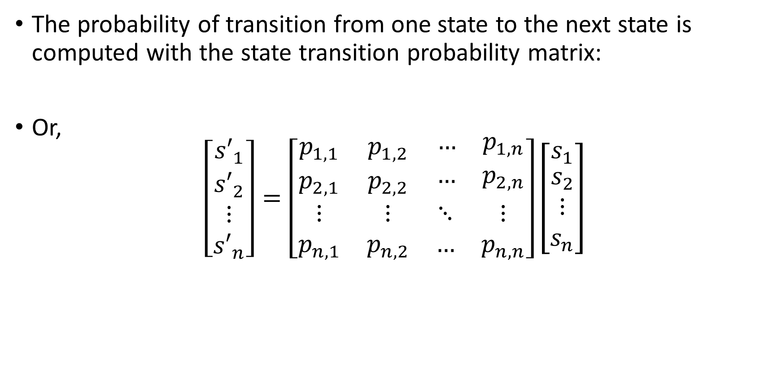
Introduction to Markov Processes
The probability of transition from one state to the next state is computed with the state transition probability matrix:
Or,
$$\left[\begin{matrix}{s′}_{1} \\ \begin{matrix}{s′}_{2} \\ ⋮ \\ {s′}_{n}\end{matrix}\end{matrix}\right]=\left[\begin{matrix}p_{1,1} & p_{1,2} & \begin{matrix}… & p_{1,n}\end{matrix} \\ p_{2,1} & p_{2,2} & \begin{matrix}… & p_{2,n}\end{matrix} \\ \begin{matrix}⋮ \\ p_{n,1}\end{matrix} & \begin{matrix}⋮ \\ p_{n,2}\end{matrix} & \begin{matrix}⋱ & ⋮ \\ … & p_{n,n}\end{matrix}\end{matrix}\right]\left[\begin{matrix}s_{1} \\ \begin{matrix}s_{2} \\ ⋮ \\ s_{n}\end{matrix}\end{matrix}\right]$$

Slide 8

Introduction to Markov Processes
A Markov chain is a sequence of Markov state transition processes
E.g. running a Markov process over several time steps creates a Markov chain
If the state transition probability matrix, , does not change with time, the Markov chain is stationary
Stationary Markov chains converge to a steady state
At steady state the state probabilities are unchanged

Slide 9
Markov Reward Processes

Slide 10
Example of Markov Reward Process
-100,000
-30
Old Car
Accident
-200
-3,000
-600
-50,000
Old Breakdown
New Breakdown
-30,000
-1,000
-100
New Car
-30,000
-50

Slide 11



Introduction to Markov Reward Processes
A Markov reward process generates a reward or change in utility for each state transition
Reward can be positive or negative
Reward may not follow simple monitary value
The inconvenience of a car breakdown may exceed the cost of repair
A piece of art has subjective aesthetic value
The reward function for a transition from state to state is defined:

Slide 12
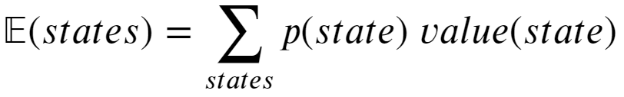
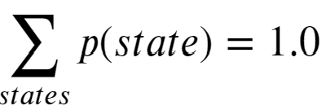
Introduction to Markov Reward
How can you compute expectation for a probabilistic process?
The expectation is the sum of the probability weighted values of a set of states
The normalization of the expectation is correct since:

Slide 13
Example of Markov Reward Process
Rª_{s} = -30 * 0.98999 = - 29.6997
Rª_{s} = -100,000 * 0.00001 = -1.0
Old Car
Accident
Rª_{s} = -200 * 0.01 = -2.0
Rª_{s} = -600 * 0.99 * 0.01 = -5.94
Old Breakdown
E[R(Old Car)] = - 29.6997 - 1.0 – 2.0 – 5.94 = -38.6397

Slide 14
Utility and Gain

Slide 15
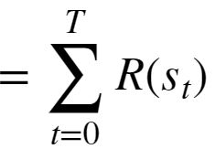


Utility and Gain
Utility is the sum of rewards in a Markov chain
Since the rewards are additive:
The above formulation works for an episodic process
An episodic process has a terminal state

Slide 16


Utility and Gain
What happens to the Utility for a continuous process
A continuous process has no termination state and the utility is unbounded
As
So, apply a discount factor at each time step:
Properties of discounted returns

Slide 17

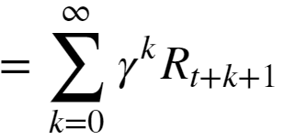

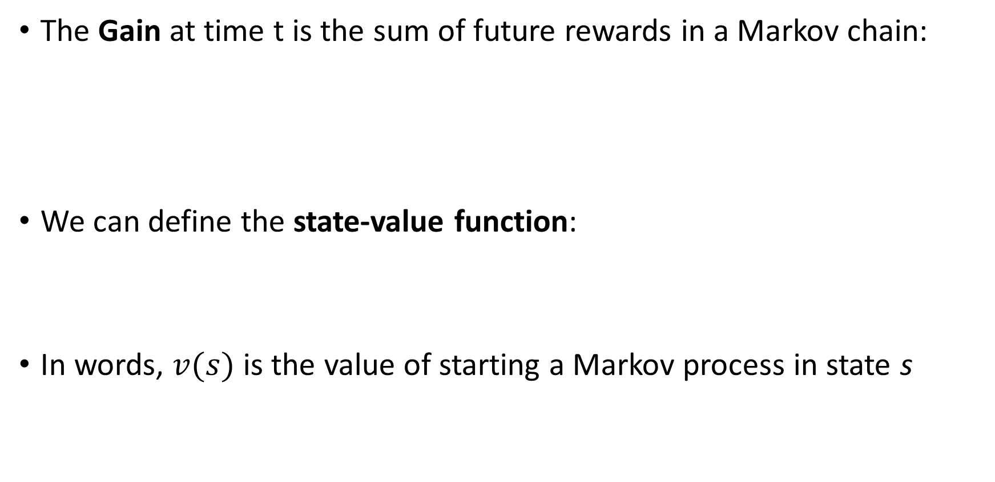
Utility and Gain
The Gain at time t is the sum of future rewards in a Markov chain:
We can define the state-value function:
In words, $v(s)$ is the value of starting a Markov process in state s

Slide 18
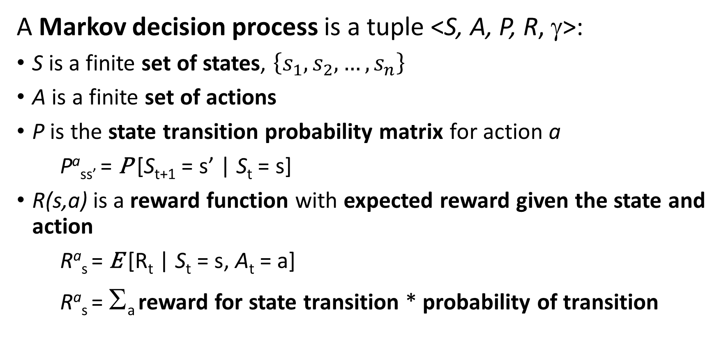
Introduction to Markov Decision Processes
A Markov decision process is a tuple <S, A, P, R, γ>:
S is a finite set of states, $\left\{s_{1},s_{2},…,s_{n}\right\}$
A is a finite set of actions
P is the state transition probability matrix for action a
Pª_{ss’} = P [S_{t+1} = s’ | S_{t} = s]
R(s,a) is a reward function with expected reward given the state and action
Rª_{s} = E [R_{t} | S_{t} = s, A_{t} = a]
Rª_{s} = Σ_{a} reward for state transition * probability of transition

Slide 19
Policy Improvement

Slide 20
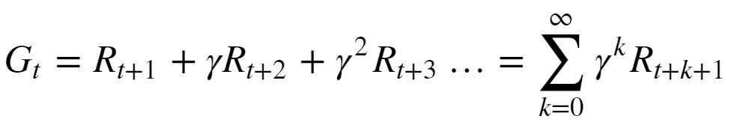


Policy Evaluation
Recall the definition of discounted return from the current time t
Where, R_{t+1} is the expected reward or change in utility over the possible state transitions from the current state, s, to all possible successor states, s’
And,
= the reward for the transition from state s to s’
= discount factor
In words, the gain is the sum of the expectation of rewards for all future possible state transitions

Slide 21
Introduction to Markov Decision Processes
A policy, π, is probability distribution over actions given states:
π(a|s) = P [A_{t} = a | S_{t} = s]
The policy fully defines agent behavior
The MDP depends only on current state, not history
A given policy is stationary; does not change in time

Slide 22

Optimal Policy for MDP
Actions of the agent are determined by a policy, π
The expectation of the policy determines the action-value
Goal is to learn an optimal policy
The optimal policy has an expected action-value greater than or equal to all possible policies:

