Slide 1


Machine Learning 530
Deep Function Approximation for Reinforcement Learning
Steve Elston
Copyright 2019, 2022, Stephen F Elston. All rights reserved.

Slide 2
RL with Function Approximation
Deep function approximators
Q-learning and function approximation
Deep Q Network algorithm
Double DQN algorithm
Prioritize replay

Slide 3

DQN Algorithm
How can deep Q-Learning be applied to function approximation?
Q-learning with function approximation known to not converge
Use two deep neural networks
The online networks updates the model weights as a regression problem
Not Q-learning
The target network computes the bootstrap estimates, , using fixed weights, w⁻
Weights of the target network are updated periodically
Indirect use of Q-learning algorithm!

Slide 4

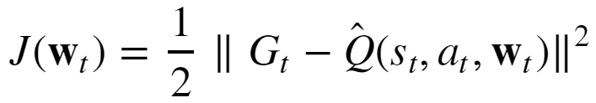
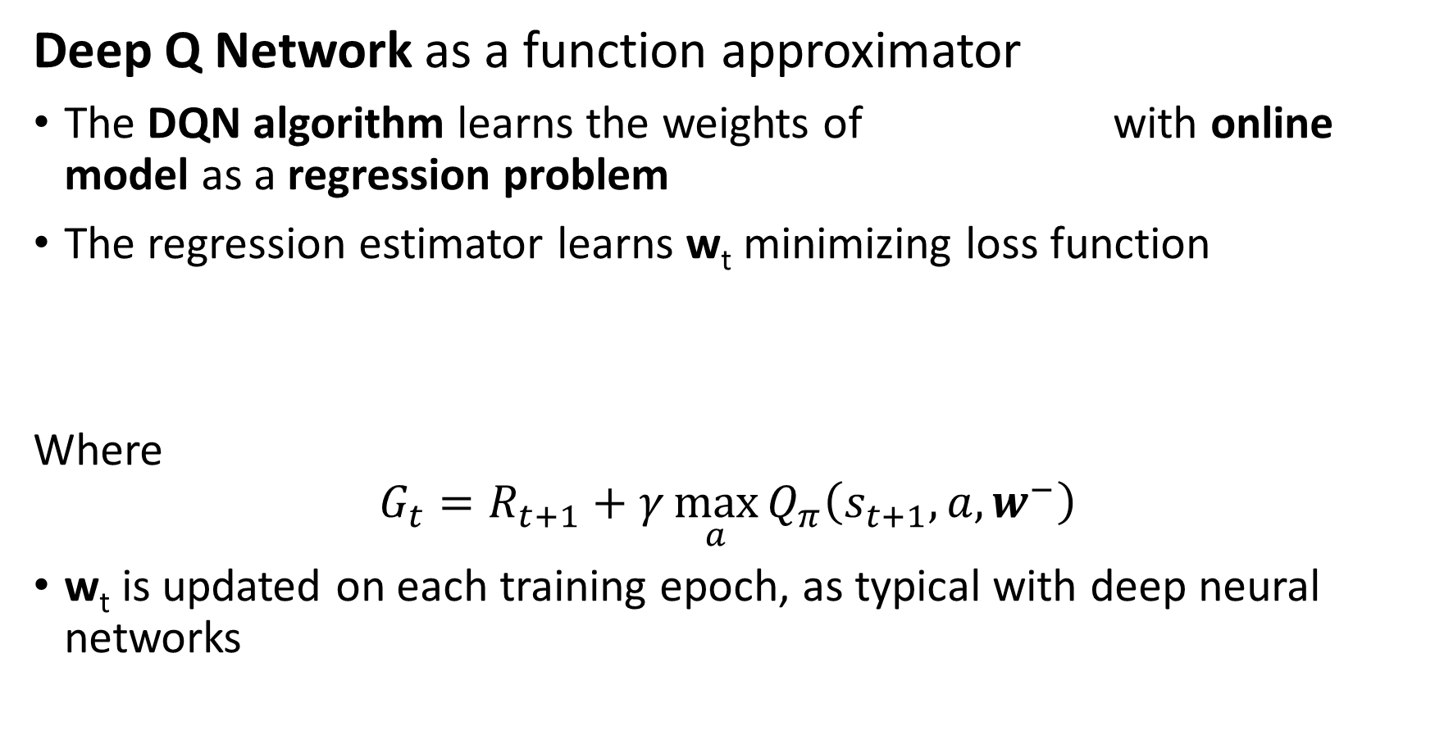
DQN Algorithm
Deep Q Network as a function approximator
The DQN algorithm learns the weights of with online model as a regression problem
The regression estimator learns w_{t} minimizing loss function
Where
$$G_{t}=R_{t+1}+γ\max_{a}{Q_{π}\left(s_{t+1},a,w^{−}\right)}$$
w_{t} is updated on each training epoch, as typical with deep neural networks

Slide 5
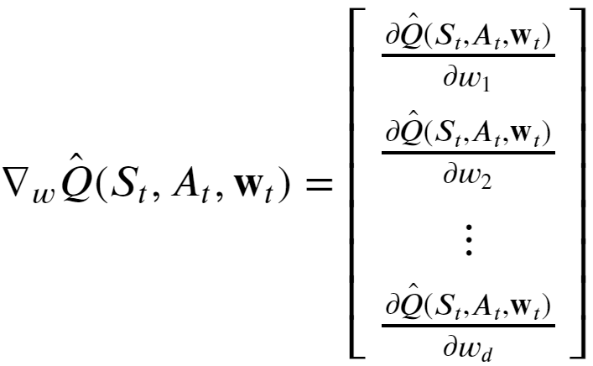
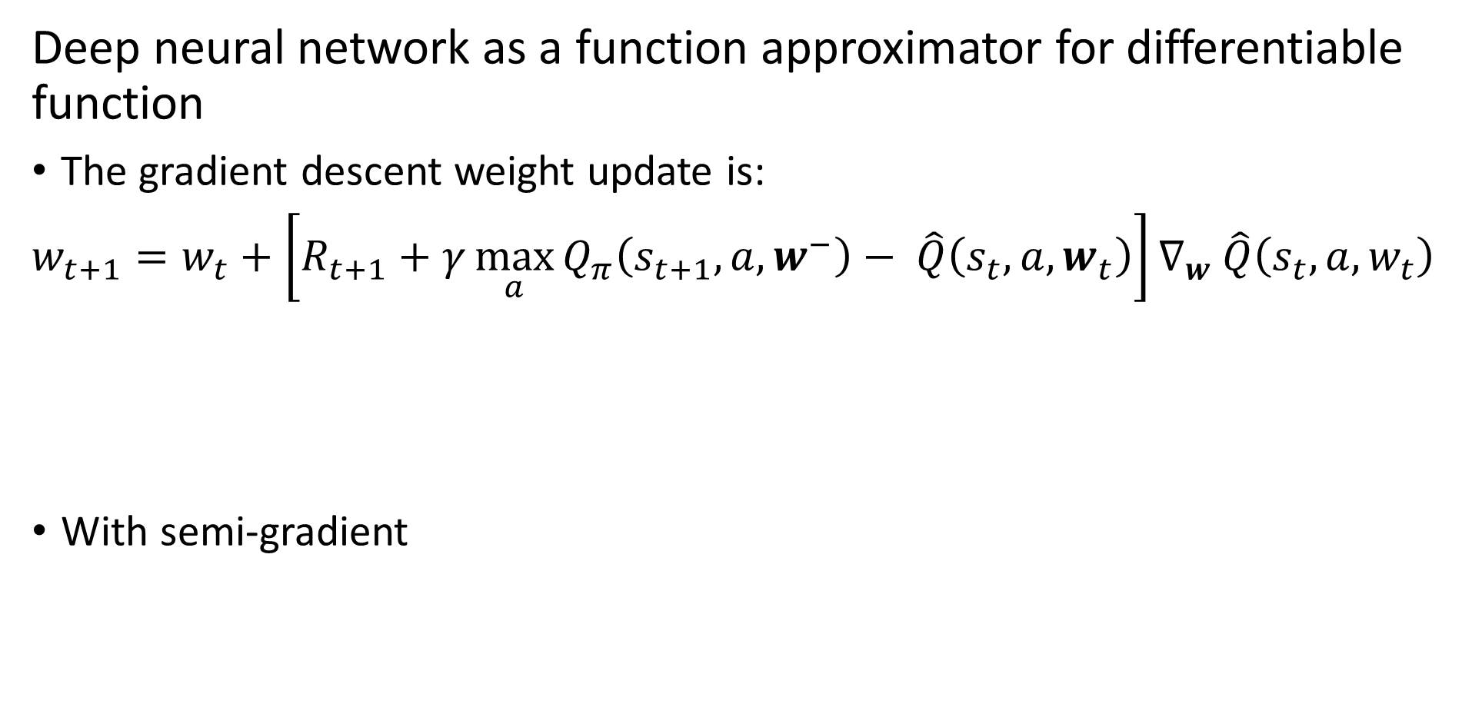
DQN Algorithm
Deep neural network as a function approximator for differentiable function
The gradient descent weight update is:
$w_{t+1}=w_{t}+\left[R_{t+1}+γ\max_{a}{Q_{π}\left(s_{t+1},a,w^{−}\right)}− \hat{Q}\left({s_{t},a,w}_{t}\right)\right]∇_{w}$ $\hat{Q}\left({s_{t},a,w}_{t}\right)$
With semi-gradient

Slide 6




DQN Algorithm
Deep neural network as a function approximator
The regression estimator learns w_{t} minimizing loss function
The gain is:
is computed with the target model with fixed weights,
Weights, , must be frozen so gain bootstrap estimate, , is stable
Every T epochs the target model weights are updated,

Slide 7
Data Replay
The Replay Buffer
Deep neural networks trained with stochastic gradient descent
Gradient descent requires mini-batch samples from data
How is this done?
Use replay buffer

Slide 8
Data Replay
The Replay Buffer
Sample 1
Sample 2
Sample 3
Sample 4
Sample 5
Sample 1
Sample 2
Sample 3
Sample 4
Sample 5
Sample 1
Sample 2
Sample 3
Sample 4
Sample 1
Sample 2
Sample 3
Sample 1
Sample 2
Sample 1

Slide 9



DQN Algorithm
Putting everything together
State_{t}
Query Environment Compute samples
Replay Buffer
Learn w with online model
Update target model
Every T-cycles

Slide 10
Double DQN Algorithm
How to deal with the bias in the DQN algorithm?
The Double DQN algorithm eliminates the bias
The DDQN algorithm uses two online models
Initially one model acts as the online model and the other as the target model
Samples are added to the same replay buffer
The online model is updated
The roles of the models are switched and return to step 1
Alternating models and sampling eliminates bias

Slide 11
Key Improvements in DQN
Considerable research is improving the sample efficiency of DQN algorithms
Three key improvements for DQN:
Prioritized Experience Relay, Schaul, et. al., 2016
Dueling Network Architectures for Deep Reinforcement Learning, Wang et. al., 2016
Noisy Networks for Exploration, Fortunato, et. al., 2018

Slide 12
Prioritized Replay
For DQN and DDQN is uniform probability of sampling (learning) from cases in replay buffer
Uniform sampling can lead to slow learning
Samples with little information sampled
Samples with high information may not be sampled
Prioritized replay buffer implements importance sampling
Samples with high information more likely to be sampled

Slide 13
Prioritized Replay
Importance sampling for prioritized replay
Unfortunately no direct way to measure importance or information
Use absolute value of TD error as proxy:
This importance measure is both deterministic and subject to noise

Slide 14
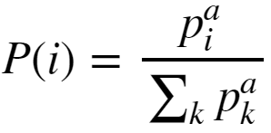
Prioritized Replay
Importance sampling for prioritized replay
Use absolute value of TD error as proxy:
Use probability, P(i):
Exponent, α, determines degree of prioritization
α = 0, sampling is uniform
α = 1, sampling sensitive to TD error and P(i) distribution is softmax

Slide 15
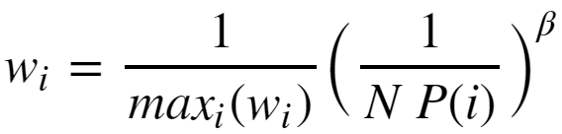
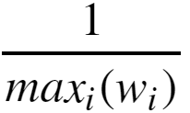

Prioritized Replay
Importance sampling for prioritized replay
Importance sampling introduces a biased estimate of the TD errors
Cases with larger error more likely to be sampled
Use normalized importance sample weighting:
With normalization,
The adjusted TD error is then,
If exponent β = 1, bias is fully adjusted

Slide 16
Summary of RL with Function Approximation
Deep function approximators
Q-learning and function approximation
Deep Q Network algorithm
Double DQN algorithm
Prioritize replay

