Slide 1


Machine Learning 410
Lesson 4
Optimization and Regularization for Deep Learning
Steve Elston
Copyright 2018, 2019, 2022 Stephen F Elston. All rights reserved.

Slide 2
Optimization and Regularization for Deep Neural Networks
With millions of weights, we need highly efficient and reliable algorithms for gradient descent
NN problems are inherently over-parameterized
Overview of this module
Convergence properties of optimizer
L2 regularization and eigenvalue methods
Batch gradient descent
Stochastic gradient descent
Adaptive stochastic gradient descent
L1 regularization
Neural net specific regularization

Slide 3
Optimization and Regularization for Deep Neural Networks
Training deep neural networks requires learning a large number parameters
Parameters are learned by gradient descent
Is an optimization method
Must be executed on a large scale
The optimization problem is ill-posed
Can have slow convergence
May not have unique solution
But, a good solution is often good enough
Over parameterized optimisation problems require regularization
Regularization prevents over-fitting

Slide 4
Optimization for Deep Neural Networks
Representation
Inference
Input = X
Output = Y
Learning

Slide 5

Optimization for Deep Neural Networks
Neural networks learn weights using the backpropagation algorithm
Weights are learned using the gradient descent method:
Where:

Slide 6
Convergence Properties of Optimizers

Slide 7
Local Convergence of Gradient Descent
Ideally, the loss function, J(W), is convex with respect to the weights
Contours of J(W)_{MLE}
Min_{W} (J(W)_{MLE})
Initial W
Convex loss function has one unique minimum
Convergence for convex loss function is guaranteed

Slide 8


Local Convergence of Gradient Descent
Expand loss function as a Taylor series to understand convergence properties of gradient descent:
Where:
This is formulation to quadratic optimization is known as Newton’s method

Slide 9
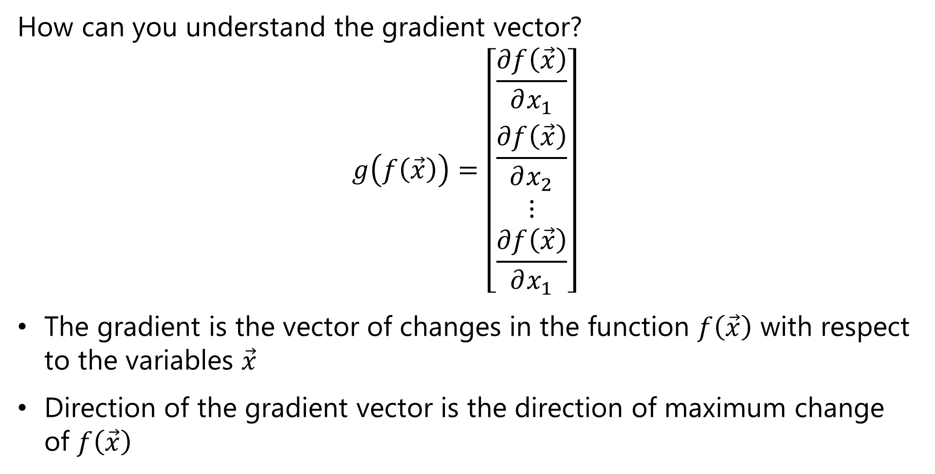
Local Convergence of Gradient Descent
How can you understand the gradient vector?
$$g\left(f\left(\vec{x}\right)\right)=\left[\begin{matrix}\frac{∂f\left(\vec{x}\right)}{∂x_{1}} \\ \begin{matrix}\frac{∂f\left(\vec{x}\right)}{∂x_{2}} \\ ⋮ \\ \frac{∂f\left(\vec{x}\right)}{∂x_{1}}\end{matrix}\end{matrix}\right]$$
The gradient is the vector of changes in the function $f\left(\vec{x}\right)$ with respect to the variables $\vec{x}$
Direction of the gradient vector is the direction of maximum change of $f\left(\vec{x}\right)$

Slide 10
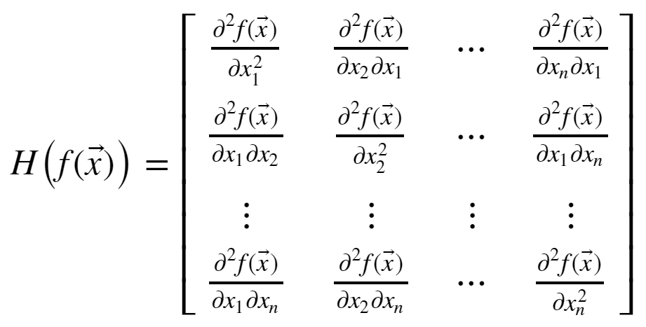
Local Convergence of Gradient Descent
How can you understand the Hessian matrix?
The Hessian is the matrix of all derivatives of the gradient
Properties of the Hessian determine convergence rate

Slide 11
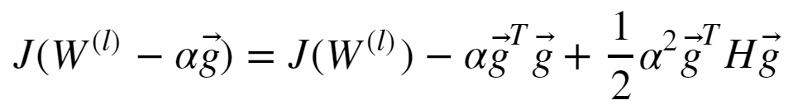

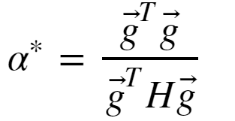
Local Convergence of Gradient Descent
Let’s look at a solution for the convex optimization problem:
Given a step size α we can rewrite the above quadradic equation:
The minimum occurs where the gradient is 0:
And, with optimal step size:

Slide 12
Local Convergence of Gradient Descent
Real-world loss functions are typically not convex
There can be multiple minimums and maximums; a multi-modal loss function
Finding the globally optimal solution is hard!
The minimum reached by an optimizer depends on the starting value of W
In practice, we are happy with a good local solution, if not, the globally optimal solution
First order optimization found to perform as well, or better, than second order

Slide 13
Bias, Variance and Model Capacity

Slide 14
The Bias-Variance Trade-Off
Machine learning algorithms learn a function approximation:
f(X, w) = y, where X is the feature vector, w is the parameter vector and y is the label
We say that a complex function has high capacity
High capacity model can approximate complex functions
High capacity model has large number of parameters or weights
But, may not generalize well
May learn the training data too well!

Slide 15
The Bias-Variance Trade-Off
High capacity models fit training data well
Overfit models exhibit high variance
Do not generalize well; exhibit brittle behavior
Error_{training} << Error_{test}
Low capacity models have high bias
Generalize well -> low variance
Do not fit data well
Regularization adds bias
Strong regularization adds significant bias
Weak regularization leads to high variance

Slide 16

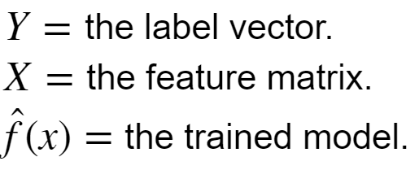
The Bias-Variance Trade-Off
How can we understand the bias-variance trade-off?
We start with the error:
Where:

Slide 17
The Bias-Variance Trade-Off
We can expand the error term
Increasing bias decreases variance
Increasing variance decreases bias
Notice that even if the bias and variance are 0 there is still irreducible error

Slide 18
The Bias-Variance Trade-Off
Variance
Bias
Test Error
Increasing bias
Increasing variance

Slide 19
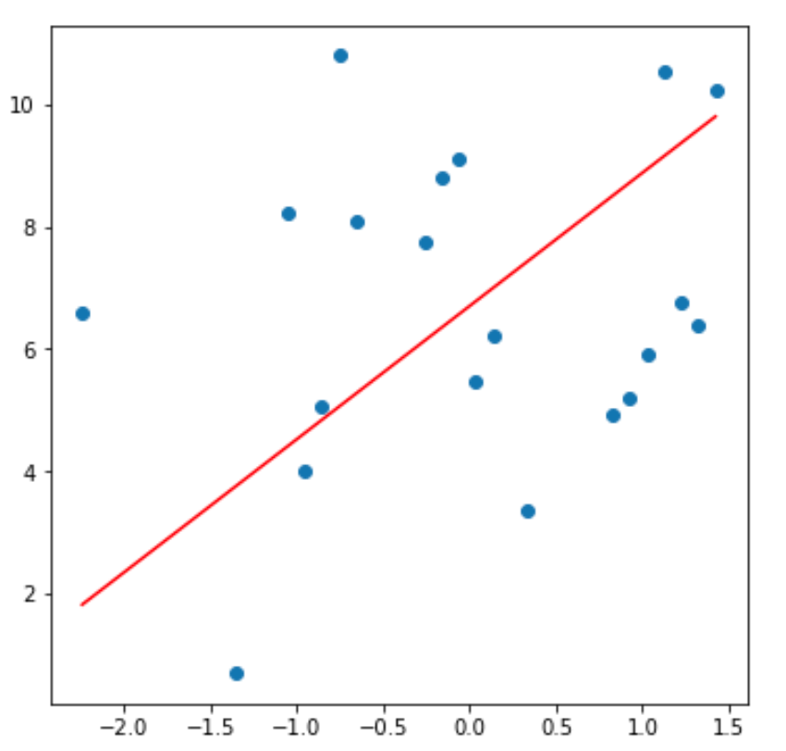
Model Capacity, Bias and Variance
Example: capacity, bias and variance for a polynomial model linear in coefficients
For a set of data values fit a strait line mode, with 2 parameters
This model has high bias, since does not fit the training data well
Variance is limited since low capacity model produces consistent predictions

Slide 20
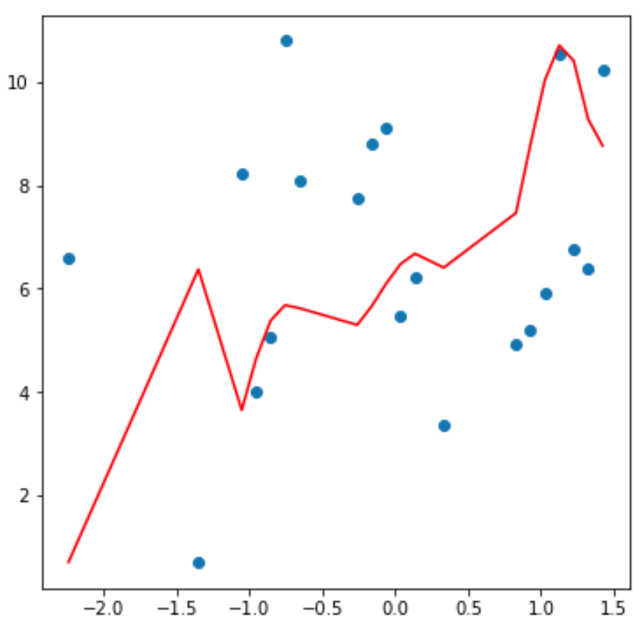
Model Capacity, Bias and Variance
Example: capacity, bias and variance for a polynomial model linear in coefficients
Fit same data with 12th order polynomial model with 13 parameters
The model has low bias, since it fits the training data fairly well
But the model will have high variance since predictions will be erratic
v

Slide 21
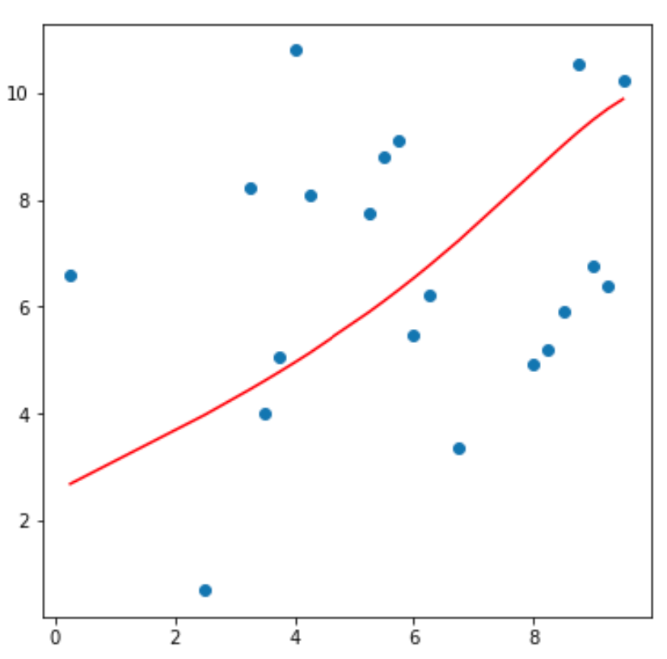
Model Capacity, Bias and Variance
Example: capacity, bias and variance for a polynomial model linear in coefficients
Models of many different capacities possible between the extremes
Need to find an optimal trade-off point between bias and variance

Slide 22
The L2 Regularization Method

Slide 23
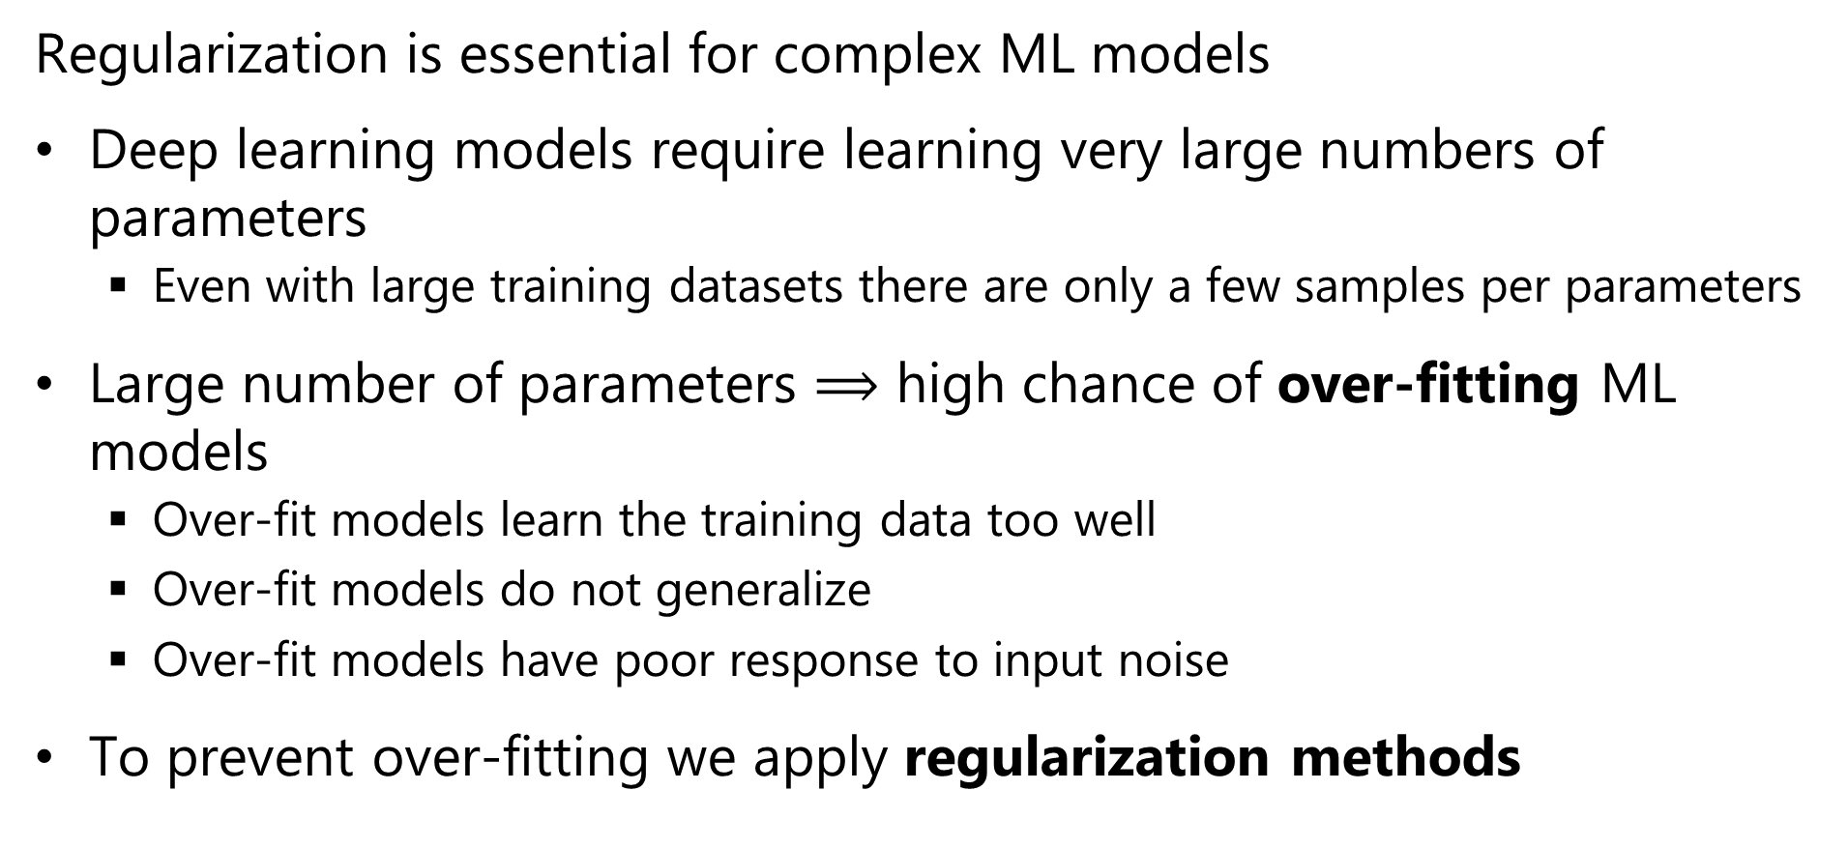
Regularization for Machine Learning
Regularization is essential for complex ML models
Deep learning models require learning very large numbers of parameters
Even with large training datasets there are only a few samples per parameters
Large number of parameters $⟹$ high chance of over-fitting ML models
Over-fit models learn the training data too well
Over-fit models do not generalize
Over-fit models have poor response to input noise
To prevent over-fitting we apply regularization methods

Slide 24
l2 Regularization
L2 or Euclidean norm regularization is a widely used method
Over-fit models tend to have parameters (weights) with extreme values
One way to regularize models is to limit the values of the parameters
Limit the L2 norm of the model parameter vector
We add a small bias term to (greatly) reduce the variance

Slide 25
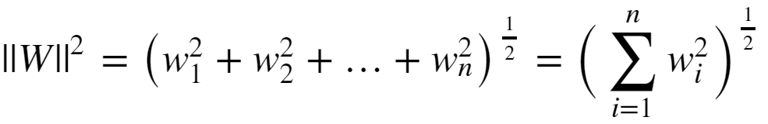

l2 Regularization
Limit the size of the model parameters is to constrain the l2 or Euclidian norm:
The regularized loss function is then:
Where λ is the regularization hyperparameter
Large λ increases bias but reduces variance
Small λ decreases bias and increases variance

Slide 26
l2 Regularization
How can you gain some intuition about l2 regularization?
X2
Β1 ~ 0
Β1 large
Β2 small
-Β1 = Β2
X1
Β2 ~ 0
Constant ||Β||²
l2 regularization is considered a soft constraint

Slide 27
L2 Regularization
How can you gain some intuition about l2 regularization?
Contours of J(W)_{MLE}
Min_{W} (J(W)_{MLE})
Constraint on model parameters binds
Initial W
Domain of Overfitting
Contours of ||W||²

Slide 28
l2 Regularization
l2 regularization goes by many names
Euclidian norm regularization
First published by Andrey Tikonov in late 1940s
Only published in English in 1977
Is known as Tikhonov regularization
In the statistics literature often called ridge regression
In the engineering literature is referred to as pre-whitening

Slide 29
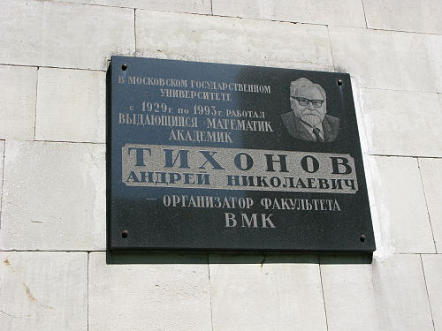
l2 Regularization
Plaque commemorating Andrey Tikhonov at Moscow Institute of Mathematics

Slide 30
Eigenvalues and Regularization

Slide 31



Eigenvalues and Regularization
l2 regularization with eigenvalue-eigenvector decomposition
A linear model with feature matrix, A, labels, x, and parameter vector b is written:
We want to find a solution:
The normal equations represent a computationally efficient approach:

Slide 32

Eigenvalues and Regularization
l2 regularization with eigenvalue-eigenvector decomposition
The n coefficients of the linear model are found with the normal equations:
The solution requires finding the inverse of a symmetric n x n covariance matrix
This matrix can be represented by its eigenvalue-eigenvector decomposition:

Slide 33

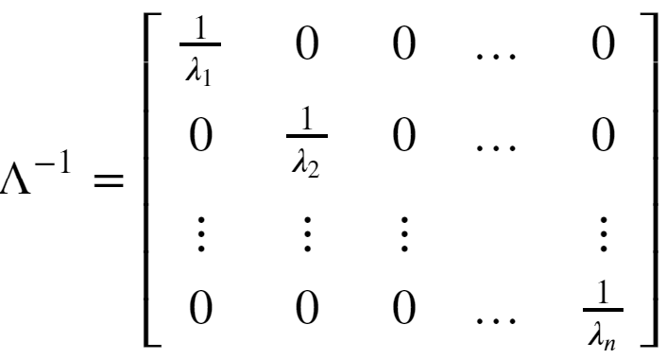
Eigenvalues and Regularization
l2 regularization with eigenvalue-eigenvector decomposition
We need the inverse of the symmetric matrix with decomposition:
Where

Slide 34
Eigenvalues and Regularization
l2 regularization with eigenvalue-eigenvector decomposition
Can compute the inverse of the symmetric covariance matrix with decomposition:
But, (A^{T}A)⁻¹ can be rank deficient!
In practice, many machine learning problems are rank deficient
A the columns of a rank deficient matrix are not linearly independent
A rank deficient matrix has some zero eigenvalues
A matrix with m nonzero eigenvalues is said to have rank m

Slide 35


Eigenvalues and Regularization
l2 regularization with eigenvalue-eigenvector decomposition
For l2 regularization we introduce a small bias term, α²
The least-squares, or l2 minimization problem, is then:
With solution

Slide 36

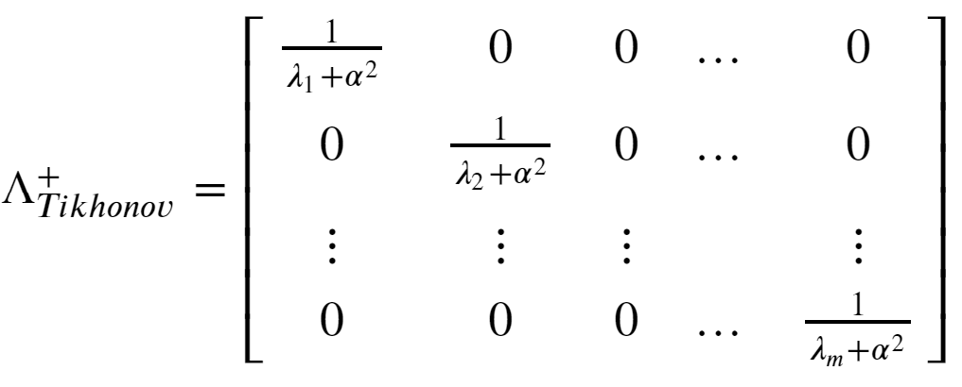
Eigenvalues and Regularization
l2 regularization with eigenvalue-eigenvector decomposition
For the inverse the eigenvalue matrix is:
Even for an eigenvalue, λ, of 0, the biased inverse becomes 1/ α²
Thus, the bias term, α², creates a ‘ridge’ of nonzero values on the diagonal ensuring the inverse exists and is stable.

Slide 37
Eigenvalues and Regularization
l2 regularization with eigenvalue-eigenvector decomposition
Consider the bias-variance trade off of the solution:
For α² = 0, there is no bias, but variance can be high
For a large value of α² , the inverse is stable and the variance is low, but the bias can be high

Slide 38
Nature of Gradients

Slide 39

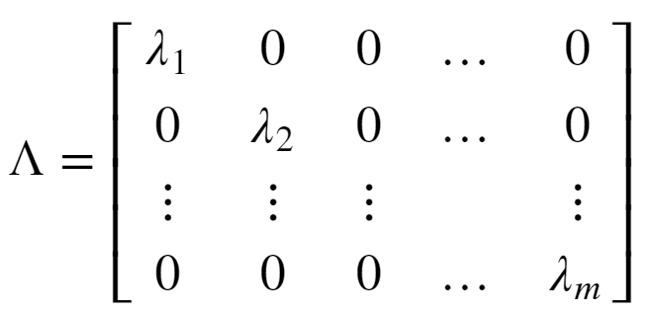
The Nature of Gradients
To understand the behavior of the Hessian we need to examine the eigenvalues
A square matrix can be decomposed into eigenvalues and eigenvectors:
Where Q is the matrix of unitary eigenvectors
The eigenvalues are a diagonal matrix

Slide 40
The Nature of Gradients
Gradients determine the nature of convergence of optimizers
At convergence, the gradient must be zero along all dimensions
The Hessian is the curvature of the quadradic surface
At a minimum the Hessian has positive curvature
At a maximum the Hessian has negative curvature

Slide 41
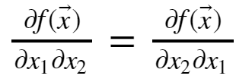
The Nature of Gradients
Some key properties of the Hessian matrix:
The Hessian is symmetric since
For a convex loss function the Hessian has all positive eigenvalues; it is positive definite
At a maximum point the Hessian has all negative eigenvalues; it is negative definite
The Hessian has some positive and some negative eigenvalues at a saddle point
Saddle points are problematic since direction of descent to the minimum is unclear
If Hessian has some very small eigenvalues, the gradient is low and convergence will be slow

Slide 42
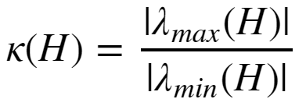
The Nature of Gradients
For quadratic optimization, the rate of convergence is determined by the condition number of the Hessian:
Where:
If the condition number is close to 1.0, the Hessian is well conditioned and convergence will be fast
If the condition number is large, the Hessian is ill-conditioned and convergence will be slow; gradient is flat in some dimensions

Slide 43
The Nature of Gradients
Example of well-conditioned and ill-conditioned gradients:
Min_{W} (J(W)_{MLE})
Min_{W} (J(W)_{MLE})
well-conditioned gradient
ill-conditioned gradient

Slide 44
Vanishing and Exploding Gradient Problems
There is no guarantee that the gradient of the loss function is well behaved
The gradient can vanish
Flat spots in the gradient
Imagine a loss function with a long narrow valley
Ill-conditioned Hessian
Slow convergence
The gradient can explode
Sudden changes in the gradient; falling off a cliff!
Ill-conditioned Hessian
Very large step; optimizer over-shoots the minimum point

Slide 45


Vanishing and Exploding Gradient Problems
What happens to the eigenvalues of the Hessian?
Consider an n layer NN with linear activation
The gradient is just the weight tensor, W, with eigen decomposition:
Multiplying the n weight tensors for the multi-layer NN:
If the eigenvalue << 1.0, the gradient vanishes
If the eigenvalue >> 1.0, the gradient explodes

Slide 46
Vanishing and Exploding Gradient Problems
What can be done about extreme gradient problems?
Dealing with vanishing gradient can be difficult
Normalization of input values
Regularization is essential!
Dealing with exploding gradients is easy
Gradient clipping prevents extreme values

Slide 47

Convex vs. Non-Convex Optimization
Gradient descent is well-behaved with convex loss function
Only 1 global minimum
From any starting point the gradient leads to global minimum
Hessian is always positive definite
Convex loss
Poorly conditioned

Slide 48
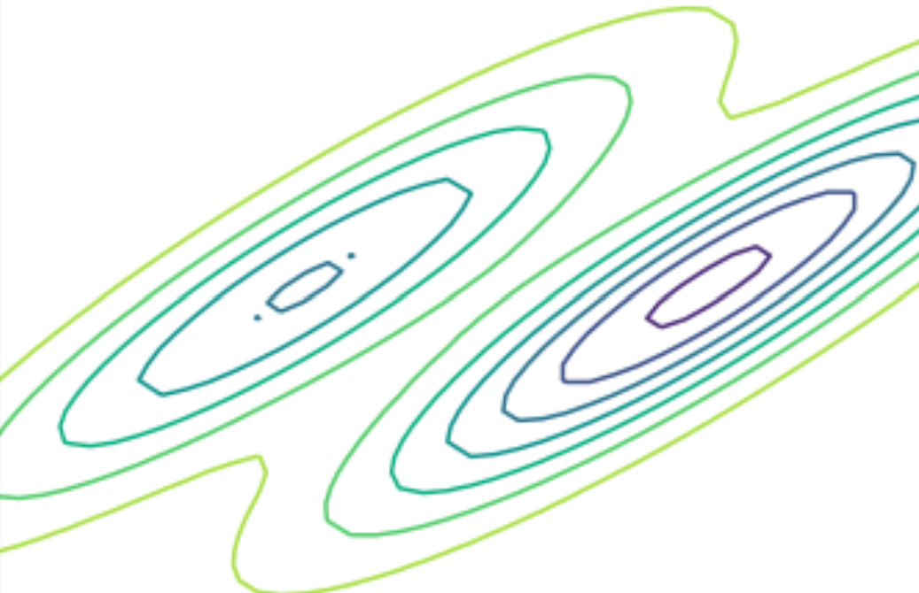
Convex vs. Non-Convex Optimization
Gradient descent can be problematic with nonconvex loss function
There is a global minimum
Possibly many local minimums
Minimum found with gradient descent depends on starting point
A good minimum may be good enough
Hessian positive definite at any minimum, but globally who knows??
Nonconvex loss

Slide 49
Convex vs. Non-Convex Optimization
Gradient descent can be problematic with nonconvex loss function
Can get stuck at saddle point!
Gradient is ambiguous at saddle point
Hessian is not positive definite
?
?
Nonconvex loss

Slide 50
Gradient Descent Alogorithms

Slide 51
Batch Gradient Descent
Recall the basic gradient descent equation:
Where:
The gradients of the multi-layer NN are computed using the chain rule

Slide 52
Batch Gradient Descent
Can we use the gradient descent equation directly?
Yes, we can
Iterate the weight tensor relation until a stopping criteria or error tolerance is reached:
||W^{t+1} – W^{t}|| < tolerance
But;
Must compute the gradient for all weights at one time as a batch at each step
Does not scale if there are a large number of weights

Slide 53
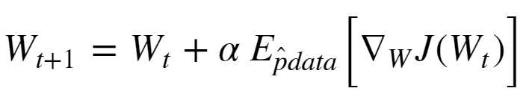


Stochastic Gradient Descent
We need a more scalable way to apply gradient descent
Stochastic gradient descent is just such a method
The weight tensor update for stochastic gradient descent follows this relationship:
Where:
is the Bernoulli sampled mini-batch
is the expected value of the gradient given the Bernoulli
sample

Slide 54
Stochastic Gradient Descent
Stochastic gradient descent is known to converge well in practice
Empirically, using mini-batch samples provide a better exploration of the loss function space
Can help solution escape from small local gradient problems
Sampling is dependent on mini-batch size

Slide 55
Stochastic Gradient Descent
Stochastic gradient descent algorithm
Random_sort(cases)
while(grad > stopping_criteria):
mini-batch = sample_next_n(cases)
grad = compute_expected_grad(mini_batch)
weights = update_weights(weights, grad)
Notice that the addition rounds repeat the samples
In practice this does not create much bias
For large samples this may not happen

Slide 56



Stochastic Gradient Descent with Momentum
The stochastic gradient descent algorithm can be slow to converge if flat spots in the gradient are encountered
What is a solution?
Add momentum to the gradient;
Analogy with Newtonian mechanics;
Where:

Slide 57
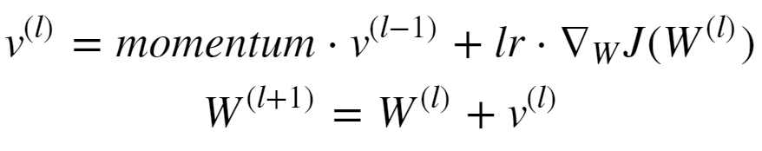


Stochastic Gradient Descent with Momentum
Letting the mass be 1.0, update of the weight tensor is:
Where:
Notice there are now two hyperparameters, momentum and learning rate

Slide 58
Adaptive Stochastic Gradient Descent
A single learning rate is not likely to be optimal
Far from the minimum, a large learning rate speeds convergence
Near the minimum a small learning rate presents over-shooting the minimum
What can improve the convergence
Use a manually created learning schedule
Introduces additional hyperparameters
Use an adaptive algorithm
Learning rate is adjusted based on the estimates of the gradient

Slide 59
Selecting Initial Weight Values
To prevent weights from becoming linearly dependent the initial values must be randomly selected
Otherwise, some weight values are never learned
Simple truncated Gaussian or Uniform distributed values work well in practice
This process is referred as adding fuzz to the initial values

Slide 60
L1 Regularization Methods

Slide 61
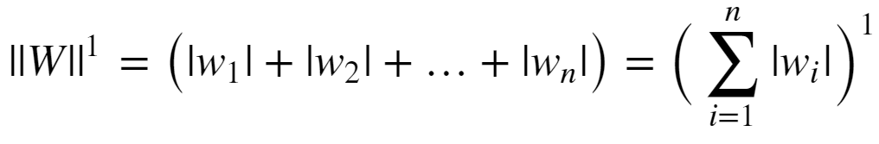
l1 Regularization
Regularization can be performed with other norms
The l1 (min-max) norm is another common choice
Conceptually, l1 norm limits the sum of the absolute values of the weights:
The l1 norm is also known as the Manhattan distance or taxi cab distance, since it is the distance traveled on a grid between two points.

Slide 62

l1 Regularization
Given the l1 norm of the weights, the loss function becomes:
Where α is the regularization hyperparameter
Large α increases bias but reduces variance
Small α decreases bias and increases variance
The l1 constraint drives some weights to exactly 0
This behavior leads to the term lasso regularization
L1 regularization provides a hard constraint on parameters
In contrast L2 provides soft constraints

Slide 63
l1 Regularization
A diagram helps develop some intuition on l1 regularization:
X2
Β1 = 0
X1
Β2 = 0
Constant ||Β||
L1 regularization is a hard constraint on the weights

Slide 64
L1 Regularization
A diagram helps develop some intuition on l1 regularization:
Contours of J(W)_{MLE}
Min_{W} (J(W)_{MLE})
Nonzero parameter
value
Initial W
Domain of Overfitting
Contours of ||W||¹

Slide 65
Early Stopping as Regularization

Slide 66
Early Stopping
Early stopping is an old and simple idea
Stop updating the model weights before the model becomes overfit
Early stopping is analogous to l2 regularization
We can formulate the regularized loss function as:
Where α is the regularization hyperparameter

Slide 67
Early Stopping
Early stopping has a simple geometric interpretation
Contours of J(W)_{MLE}
Min_{W} (J(W)_{MLE})
Early stopping point
Initial W
Domain of Overfitting
Contours of ||W||²

Slide 68
Dropout Regularization

Slide 69
Dropout regularization
Overfit deep network models tend to suffer from a problem of co-adaptation
With limited training data weight tensors become adapted to the training data
Such a model is unlikely to generalize
We need a way to break the co-adaptation of the weight tensor
Note: Recently, some researchers have questioned the co-adaptation theory, but there is no consensus for an alternative theory

Slide 70
Dropout regularization
Dropout regularization is a conceptually simple method unique to deep learning
At each step of the gradient decent some fraction, p, of the weights are dropped-out of each layer
The result is a series of models trained for each dropout sample
The final model is a geometric mean of the individual models
Weight values are clipped in a small range as a further regularization
Result is an ensemble model!
For full details see the readable paper by Srivastava et. al., 2014 http://www.cs.toronto.edu/~rsalakhu/papers/srivastava14a.pdf

Slide 71
Dropout regularization
Let’s look at a simple example of a network with one hidden layer:
O
h₁
h₂
h₃
h₄
i₁
i₂

Slide 72
Dropout regularization
There are six of the possible models with 2 hidden units in the sample:
O
O
O
h₃
h₄
h₂
h₄
h₂
h₃
i₁
i₂
i₁
i₂
i₁
i₂
O
O
O
h₁
h₄
h₁
h₃
h₁
h₂
i₁
i₂
i₁
i₂
i₁
i₂
Can also sample models with 1 or 3 hidden units:

Slide 73




Dropout regularization
How can the partial derivatives for backpropagation be computed with dropout regularization?
The probability of a weight being in a given model is:
The forward propagation equations then become:

Slide 74


Dropout regularization
How can the partial derivatives for backpropagation be computed with dropout regularization?
We need partial derivatives of
For the dropout layer σ is linear, and the derivatives with respect to the weights are:
, in which case the partial derivative = 1
, in which case the partial derivative = 0

Slide 75
Optimization and Regularization for Deep Neural Networks
With millions of weights, we need highly efficient and reliable algorithms for gradient descent
NN problems are inherently over-parameterized
Key points
Convergence properties of optimizers
L2 regularization and eigenvalue methods
Batch gradient descent
Stochastic gradient descent
Adaptive stochastic gradient descent
L1 regularization
Neural net specific regularization

Slide 76
Batch Regularization

Slide 77
Batch Normalization
In deep neural networks there is a high chance that units in a hidden layer have a large range of output values
Causes shifts in the covariance of the output values
Leads to difficulty computing the gradient
Slows convergence
A solution is to normalize the output of the hidden layers in the network as a batch
This simple idea can be really effective
For more details see Sergey and Szegedy, 2015: https://arxiv.org/pdf/1502.03167.pdf

Slide 78
Optimization and Regularization for Deep Neural Networks
With millions of weights, we need highly efficient and reliable algorithms for gradient descent
NN problems are inherently over-parameterized
Overview of this module
Convergence properties of optimizer
L2 regularization and eigenvalue methods
Batch gradient descent
Stochastic gradient descent
Adaptive stochastic gradient descent
L1 regularization
Neural net specific regularization

Slide 79
Appendix: Review of Eigenvectors and Eigenvalues

Slide 80
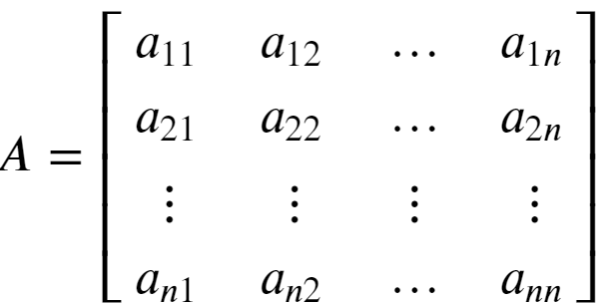
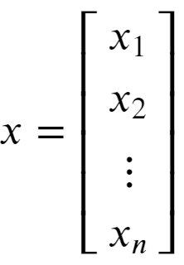

Review of Eigenvalues
Eigenvalues are characteristic roots or characteristic values of a linear system
Start with a square n x n matrix A, and vector x:
Then, an eigenvalue of A has the property:

Slide 81
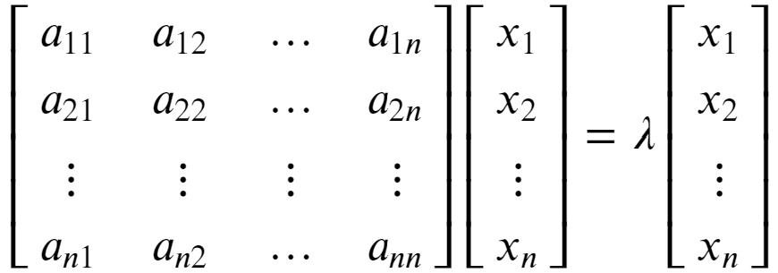


Review of Eigenvalues
Eigenvalues are characteristic roots or characteristic values of a linear system
Rewrite the eigenvalue relationship:
To see that λ is a root of A we can rearrange as follows:

Slide 82

Review of Eigenvalues
Eigenvalues are characteristic roots or characteristic values of a linear system
An n x n matrix A will have n eigenvalues
Find eigenvalues by solving
Find n roots of the determinant:
For more detail on determinants see: https://en.wikipedia.org/wiki/Determinant

Slide 83


Review of Eigenvalues and Eigenvectors
Each eigenvalue of a square matrix is associated with an eigenvector
There is a left and right eigenvector for each eigenvalue
The right eigenvector has the following relationship to the matrix A and eigenvalue λ:
Notice that the right eigenvector is to the right of the matrix

Slide 84



Review of Eigenvalues and Eigenvectors
Each eigenvalue of a square matrix is associated with an eigenvector
There is also a left eigenvector with the following relationship to the matrix A and eigenvalue λ:
Notice that the left eigenvector is to the left of the matrix

Slide 85


Review of Eigenvalues and Eigenvectors
Each eigenvalue of a square matrix is associated with an eigenvector
The l2 norm of any eigenvector is 1:
This property means that the matrix of n eigenvectors, Q, is unitary
For a full rank matrix, each eigenvector is orthogonal to every other eigenvector, and linearly independent
Thus, for diagonal matrix of n eigenvalues, Λ, an n x n matrix, A, can be factored:

Slide 86


Review of Eigenvalues and Eigenvectors
Each eigenvalue of a square matrix is associated with an eigenvector
Given the eigenvalue-eigenvector factorization of the matrix A:
The inverse of A can be found:
And, A to the Nth power can be computed:
You can find more on eigenvalue-eigenvector decomposition: https://en.wikipedia.org/wiki/Eigendecomposition_of_a_matrix

Slide 87
Review of Eigenvalues
Eigenvalues are characteristic roots or characteristic values of a linear system
Start with a square n x n matrix A, and vector x:
Then, an eigenvalue of A has the property:

Slide 88
Review of Eigenvalues
Eigenvalues are characteristic roots or characteristic values of a linear system
Rewrite the eigenvalue relationship:
To see that λ is a root of A we can rearrange as follows:

Slide 89
Review of Eigenvalues
Eigenvalues are characteristic roots or characteristic values of a linear system
An n x n matrix A will have n eigenvalues
Find eigenvalues by solving
Solve n equations involving the determinant:
For more detail on determinants see: https://en.wikipedia.org/wiki/Determinant
Copyright 2020, Stephen F Elston. All rights reserved.

Slide 90
Review of Eigenvalues and Eigenvectors
Each eigenvalue of a square matrix is associated with an eigenvector
There is a left and right eigenvector for each eigenvalue
The right eigenvector has the following relationship to the matrix A and eigenvalue λ:
Notice that the right eigenvector is to the right of the matrix

Slide 91
Review of Eigenvalues and Eigenvectors
Each eigenvalue of a square matrix is associated with an eigenvector
There is also a left eigenvector with the following relationship to the matrix A and eigenvalue λ:
Notice that the right eigenvector is to the right of the matrix

Slide 92
Review of Eigenvalues and Eigenvectors
Each eigenvalue of a square matrix is associated with an eigenvector
The l2 norm of any eigenvector is 1:
This property means that the matrix of n eigenvectors, Q, is unitary
For a full rank matrix, each eigenvector is orthogonal to every other eigenvector, and linearly independent
Thus, for diagonal matrix of n eigenvalues, Λ, an n x n matrix, A, can be factored:

Slide 93
Review of Eigenvalues and Eigenvectors
Warning! – Advanced concepts ahead
Each eigenvalue of a square matrix is associated with an eigenvector
Given the eigenvalue-eigenvector factorization of the matrix A:
The inverse of A can be found:
You can find more on eigenvalue-eigenvector decomposition: https://en.wikipedia.org/wiki/Eigendecomposition_of_a_matrix

