Slide 1


Machine Learning 530
Lesson 1
Building Blocks of Deep Learning
Steve Elston
Credit: https://www.wellesleyfreelibrary.org/
Copyright 2020, 2021, 2021, 2022 Stephen F Elston. All rights reserved.

Slide 2
Why this course?
Deep neural networks have revolutionized areas of machine learning for unstructured data
Object detection and classification
Image segmentation
Natural language processing
Generative models for images and natural language
…

Slide 3
Why this course?
Deep neural networks have revolutionized areas of machine learning for unstructured data
Many types of deep neural networks used in CV
Fully connected NNs – our focus this week
Convolutional NNs for building feature maps – next week
Recurrent NNs for series data – e.g. NLP
Many others …

Slide 4
Why this course?
Reinforcement learning is a rapidly evolving area of research and application
RL has had spectacular success playing certain games at superhuman level
Take these results with a gain of salt – RL fails spectacularly on other simple games
RL shows promise for certain complex robotic planning tasks
RL has advanced folding models for complex proteins
Expect to see more RL solutions in the future
Focus of massive research efforts

Slide 5
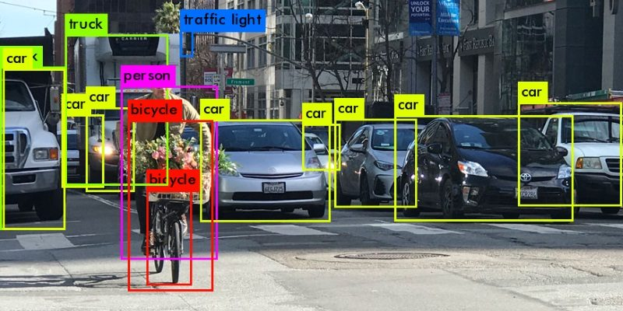
Autonomous vehicle Application of Deep Learning
Learning to track and identify moving objects in the environment
https://heartbeat.comet.ml/introduction-to-basic-object-detection-algorithms-b77295a95a63

Slide 6

About your Instructor: Steve Elston
Instructor for UW since 2017
Data science consultant with several decades of experience
Lead team that commercialized Bell Labs S, now open source R
Company co-founder and held executive positions in several industries
Creator of multiple edX courses, author of books and articles
Holder of several patents
BS, physics and math (minor), University of New Mexico
MS and PhD, geophysics, Princeton University – John von Neuman Supercomputing Fellow

Slide 7

About your Teaching Assistant: Lauren Jensen
Currently works for Accenture
Previously took UW Statistical Analysis with R Programming Certification and the Machine Learning Certification
Over 8 years of experience in retail data science and analytics
Worked in a variety of areas – marketing and membership, eCommerce, travel, supply chain, operations, employee engagement, and sustainability
Designed customer retention and acquisition models and campaign, as well as identified the best target audience, and calculated member lifetime value

Slide 8
Course Communications
Communicating with your instructors and other students is a significant aspect of participation in this course!
Ask questions about the course material, homework, etc.
Ask questions in the public forum so others can answer and gain from the discussion: if you have a question others do as well!
Answer other students’ questions
Comment on weekly graded discussion topics
Piazza is the primary communications method and you are required to sign up for the course Piazza forum - piazza.com/washington/spring2022/mlearn530 - Pass code: MLearn530

Slide 9
Course Communications
For private matters, you can directly communicate with the instructional team
Grades
Absences
Etc
Use private messages in Piazza or:
Steve Elston, Instructor, stephen.elston@gmail.com
Lauren Jensen, TA, l.jensen4@live.com
Communications by Canvas may be significantly delayed!

Slide 10
Grading Policy
Grades are determined by assignments and participation in discussion questions
Assignments and exercises: 80%
Hands-on assignments in Jupyter notebooks
Expect a few conceptual exercises for lessons with limited hands-on component
Graded weekly discussion: 20%

Slide 11
Grading Policy
By UW policy, you must attend at least 6 of 10 live class meetings to receive credit
Benefits of attending all class meetings:
You will find the course easier
You will gain a deeper understanding of the material by participating in the exercises
If you cannot attend, we will record the class meetings
Life happens sometimes!

Slide 12
Late Assignment Policy
Late assignment policy facilitates timely release of solutions for assignments once all students have submitted
Late assignments are penalized as follows:
More that 1 day late minus 20 percent
More that 1 week late no credit
For unusual and unavoidable circumstance contract your instructor in advance
Private message in Piazza
Or stephen.elston@gmail.com

Slide 13
Building Blocks of Deep Learning

Slide 14
Building Blocks of Deep Learning
Key points for this lesson
Preceptron and forward propagation
Depth, breath and model capacity
Nonlinearity and activation functions
Learning weights with backpropagation
Loss functions
Computing gradients and the chain rule
Efficient calculation with execution graphs

Slide 15
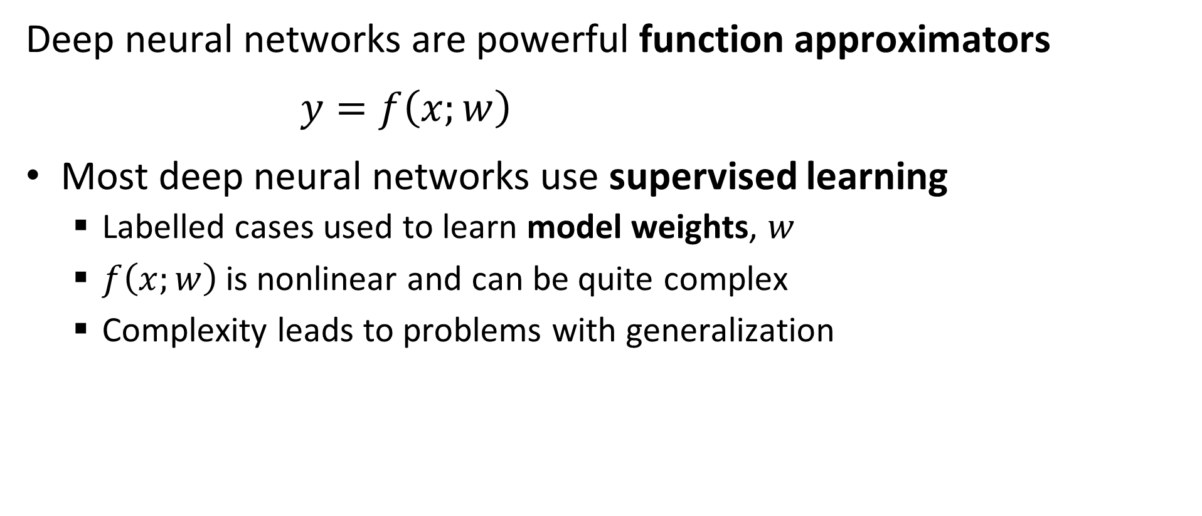
Function Approximation and Deep Neural Networks
Deep neural networks are powerful function approximators
$y=f\left(x;w\right)$
Most deep neural networks use supervised learning
Labelled cases used to learn model weights, $w$
$f\left(x;w\right)$is nonlinear and can be quite complex
Complexity leads to problems with generalization

Slide 16
Essential Elements of Deep Learning
Representation
Inference
Input = X
Output = Y
Learning

Slide 17
Perceptrons and Forward Propagation

Slide 18
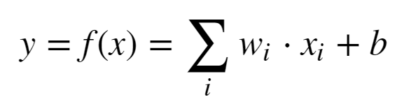
Representation: Linear Neural Network
Proposed by McCulloch and Pitts (1943)
X₁
w₁
w₂
X₂
Σ + b
Y
w₃
X₃

Slide 19

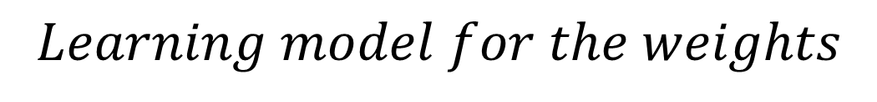


Representation: Linear Neural Network
Early learning model for a neural network - Heeb (1949)
X₁
$$Learning model for the weights$$
w₁
$$w_{ij}=x_{i}x_{j}$$
w₂
Σ + b
$$Δw_{ij}=ηx_{i}x_{j}$$
X₂
Y
w₃
$$Where, η is the learning rate$$
X₃
But, this is just linear regression!

Slide 20
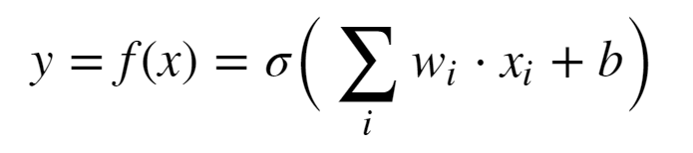
Representation: Perceptron
Use of nonlinear activation proposed by Rosenblatt (1962)
X₁
w₁
w₂
X₂
σ(Σ + b)
Y
w₃
X₃
Minsky and Papert (1969) showed the perceptron cannot represent an exclusive or (XOR)
This is just logistic regression!

Slide 21
We Need a Better Deep Representation
By mid-1980s need for architecture with hidden layers for greater model capacity was recognized
Input layer
Multiple hidden layers
Output layer
Multiple units in layers
Nonlinear activations in units
Fully connect between units in layers
Learn weights for complex function approximation
Can solve XOR problem and much more

Slide 22
We Need a Better Deep Representation
w¹₁₁
X₁
S₁ = σ_{h}(Σ )
w²₁
w¹₁₂
w¹₂₁
S₃ = Σ
X₂
w²₂
w¹₂₂
S₂ = σ_{h}(Σ )
_{Input Layer}
_{Hidden Layer}
_{Output Layer}

Slide 23
We Need a Better Deep Representation
What is the output of the simple network?
Process called forward propagation
Start with the output of the hidden layer:
S₁ = σ(Σ_{i} x_{i} * W¹_{1i})
S₂ = σ(Σ_{i} x_{i} * W¹_{2i})
Next, compute the output of the output layer
S₃ = Σ_{j} W²_{j} * σ(Σ_{i} x_{i} * W¹_{ji})

Slide 24
Model Depth, Width and Capacity

Slide 25
Model Capacity
The universal approximation theorem, Hornik (1991), tells us that an infinitely wide hidden layer can represent any function
Usefulness limited:
It’s nice to know we can represent complex functions
But, completely infeasible in practice
What can we do?
Trade depth for breath

Slide 26
Model Capacity
Model capacity is fundamentally related to the bias-variance trade-off of machine learning
Low capacity models have high bias but low variance
High capacity models have low bias but high variance
High capacity models have a tendency to be overfit
We have more to say about this problem in another lesson

Slide 27
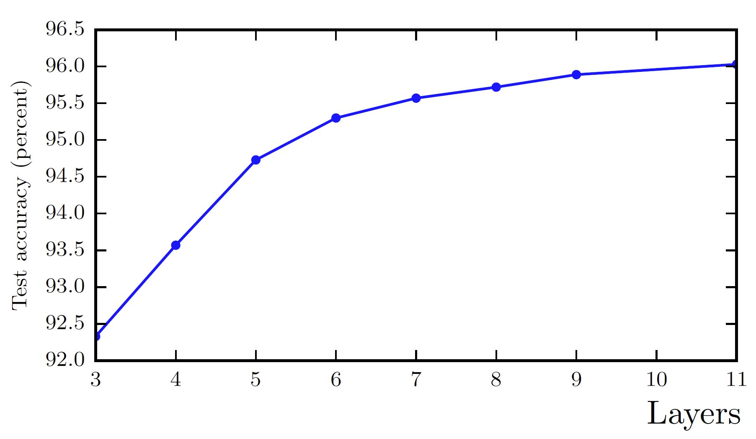
Model Capacity
Model capacity with increasing depth. From Goodfellow et. al. 2014.

Slide 28
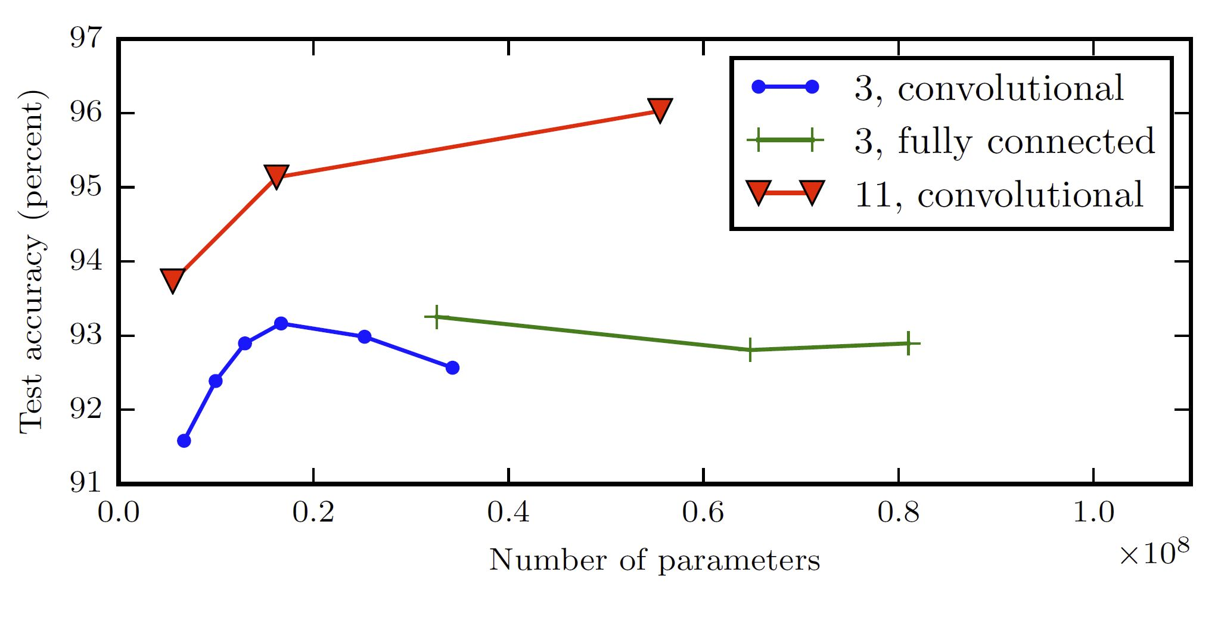
Model Capacity
Model capacity vs. number of parameters. From Goodfellow et. al. 2014.

Slide 29
Nonlinearity and Activation Functions

Slide 30
Activation functions
Nonlinear activation is key to achieving good function approximation.
Many activation functions have been tried, here are a few:
Function | How Used? | Comments
Sigmoid | Binary classifier output layer | Historically the most used
Softmax | Multi-class output layer | For categorical distribution
Linear | Numeric output layer | Regression models
Rectilinear | Hidden layers | Widely used to avoid vanishing gradient
Leak Rectilinear | Hidden layers | Widely used to avoid vanishing gradient
Tanh | Binary classifier output layers Other specialized applications | Better gradient properties than sigmoid

Slide 31
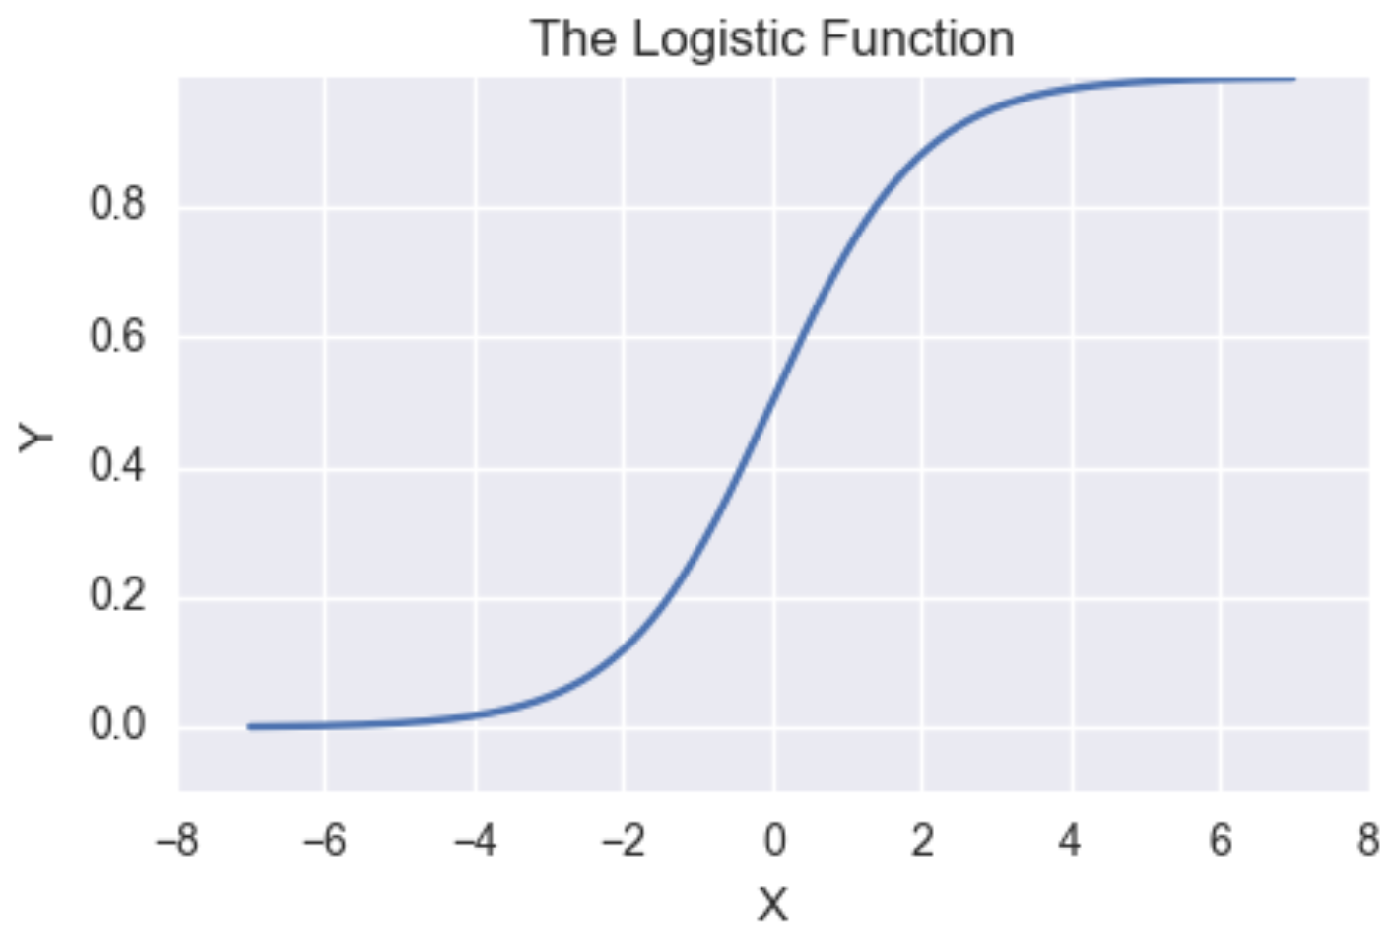
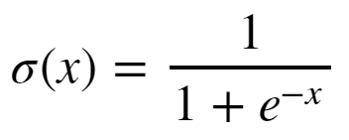
Activation functions
Sigmoid has vanishing gradients
Near-0 gradient
Near-0 gradient

Slide 32
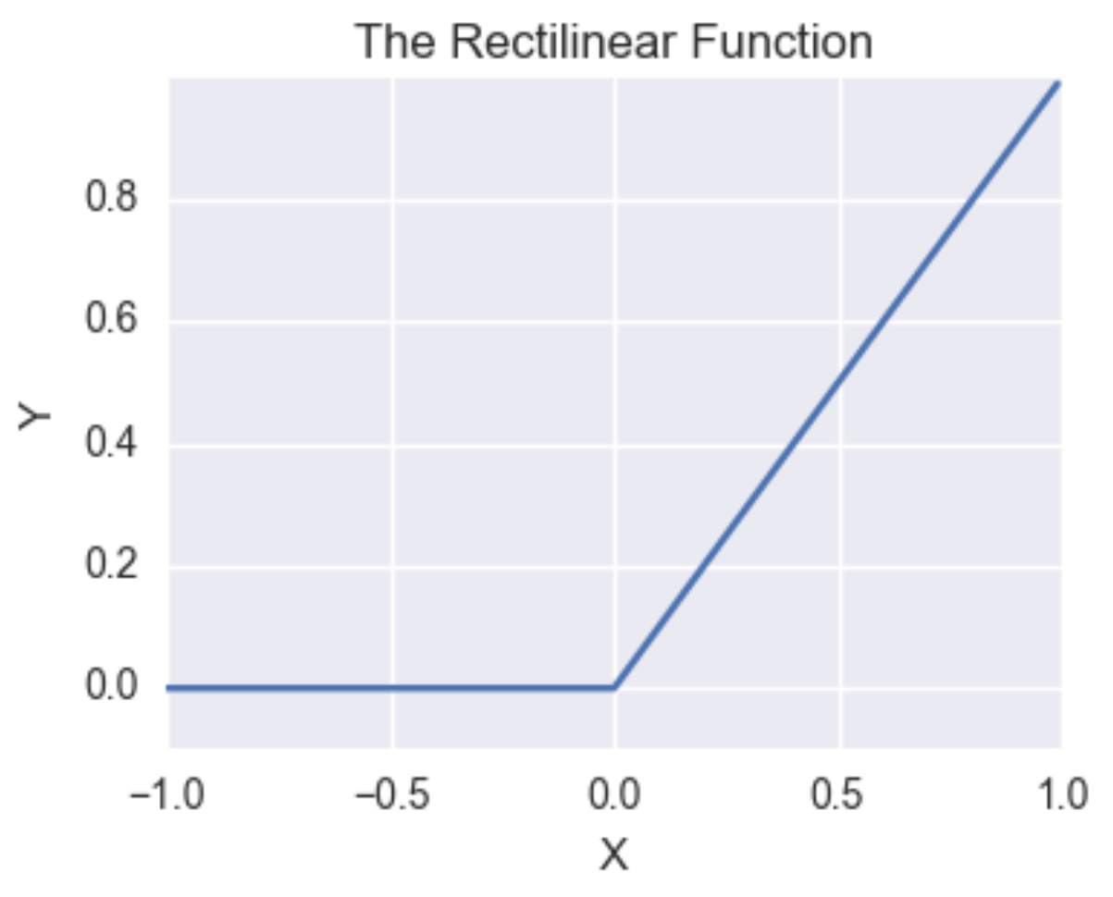

Activation functions
Rectilinear function has constant gradient for positive values
Constant gradient
Gradient of Leaky ReLU < 0

Slide 33
Learning Weights with Backpropagation

Slide 34
The Backpropagation Algorithm
To find function approximation, f(x), we need to learn model weights
The primary algorithm we use to learn model weights is known as backpropagation
Backpropagation was applied to learning (system identification) for control problems as early as 1960 by Henry Kelly and 1961 by Arthur Bryson for dynamic programming
First applied to neural networks by Paul Werbos in 1974
In 1986 by Rumelhart, Hinton and Williams showed that backpropagation was effective for learning the weights of hidden layers

Slide 35
The Backpropagation Algorithm
w¹₁₁
X₁
S₁ = σ_{h}(Σ )
w²₁
w¹₁₂
w¹₂₁
S₃ = Σ
J(W)
X₂
w²₂
w¹₂₂
S₂ = σ_{h}(Σ )
Y
_{Input Layer}
_{Hidden Layer}
_{Output Layer}
_{Loss Function}

Slide 36

The Backpropagation Algorithm
To learn model weight tensor we must minimize the loss function using the gradient:
Where:

Slide 37

The Back Propagation Algorithm
Backpropagation is a gradient decent algorithm
Weight updates are taken as small steps in the direction of the gradient of the loss function
Backpropagation converges when the gradient is approximately 0

Slide 38
Loss Functions

Slide 39

Entropy

Slide 40

Loss Functions for Training Neural Networks
What are some choices for a loss function, , given the weight tensor?
For regression problems use MSE
Which loss function should we use for classification problems?
Cross entropy is a good choice, but is a bit abstract

Slide 41
Information
Information from observing the occurrence of an event
= the number of bits needed to encode the probability of the event.
If an event has probability p, we need –log₂(p) bits
A coin flip from a fair coin encodes 1 bit of information.
p =1/2, and then –log₂(1/2) = 1 bit
For an event with probability 1, we don’t need any bits.
p =1, and then –log₂(1) = 0 bits

Slide 42
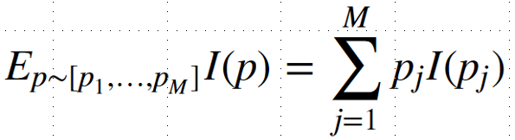
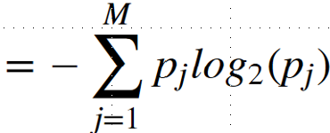

Information
If we had many events, with probabilities [p_{1,…,}p_{M}], what is their mean information?
If there are only 2 events (binary) with probabilities p and 1-p,
If the probabilities are ½ and ½:
Entropy!
If the probabilities are .99 and .01:

Slide 43
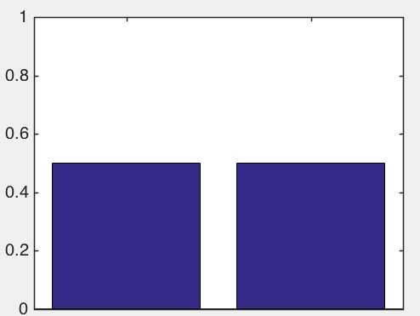
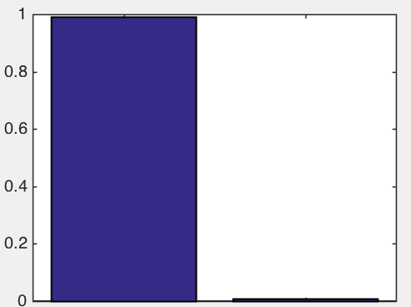
Information
If we had many events, with probabilities [p_{1,…,}p_{M}], what is their mean information?
If there are only 2 events (binary) with probabilities p and 1-p,
If the probabilities are ½ and ½:
If the probabilities are .99 and .01:

Slide 44
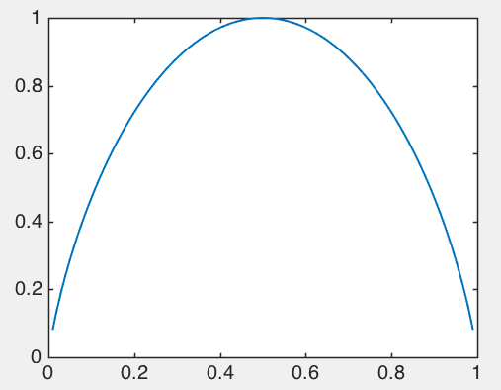
Information
Entropy changes with the probability of an event
Max entropy when max uncertainty, p = 0.5 – can’t predict next event
Min entropy when certainty, p = [0,1] – no uncertainty about next event
Entropy [p,1-p]
Probability p

Slide 45

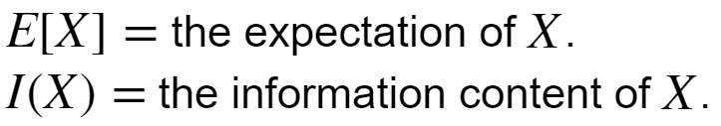
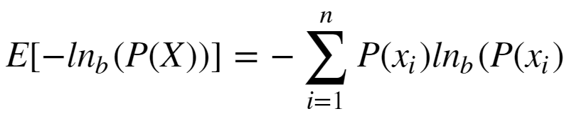
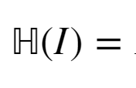
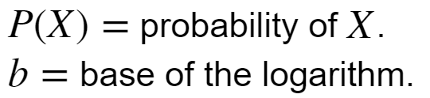
Loss Functions for Training Neural Networks
How can we apply Shannon Entropy?
Where:
We are working with probability distributions, so:
Where:

Slide 46
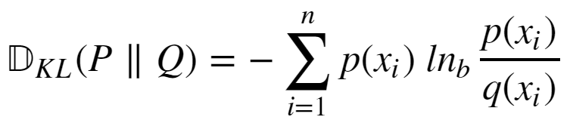
Loss Functions for Training Neural Networks
We need to measure the difference between the distribution of our function approximation and the distribution of the data
The Kullback-Leibler divergence between two distributions P(X) and Q(X) is such a measure:

Slide 47
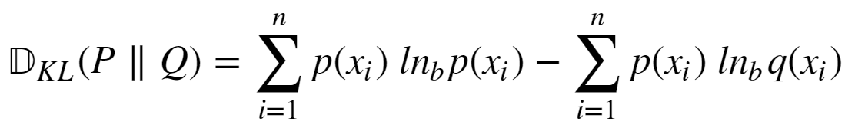
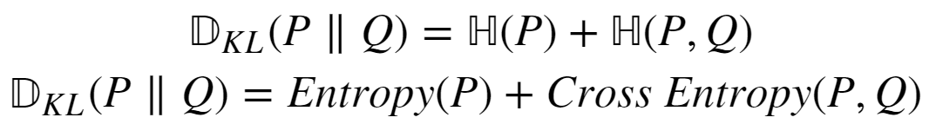
Loss Functions for Training Neural Networks
How do we compute KL divergence?
If we knew P(X) we would not need to compute KL divergence
We can expand KL divergence as:

Slide 48


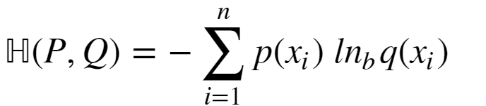
Loss Functions for Training Neural Networks
Given:
The term is constant
So, we only need the cross entropy term:

Slide 49
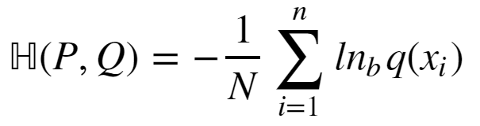
Loss Functions for Training Neural Networks
How can we compute cross entropy when we don’t know P(X):
Since we don’t know P(X), use the approximation:

Slide 50
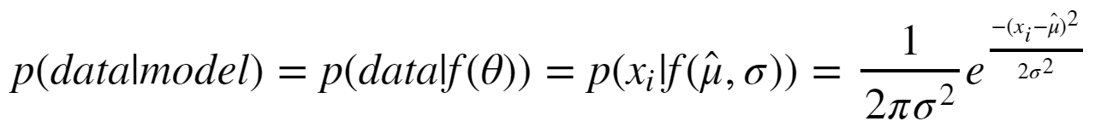
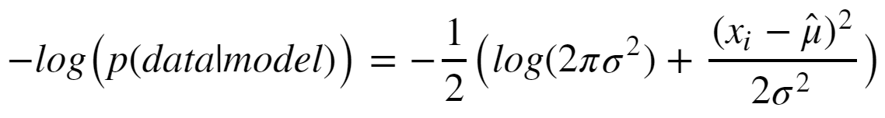
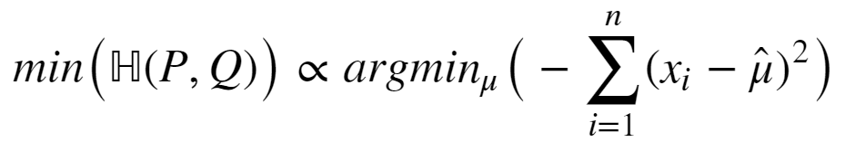
Loss Functions for Training Neural Networks
Consider the special case of Gaussian likelihood:
Taking the negative logarithm:
Ignoring the constant terms, the minimum of cross entropy is:

Slide 51

Performance Metrics for Deep NNs
How can we measure the performance of deep neural networks?
Use the same metrics used for other machine learning algorithms
RMSE, $R^{2}$, etc. for regression
Accuracy, precision, recall, etc. for classification

Slide 52
Computing gradients and the chain rule

Slide 53
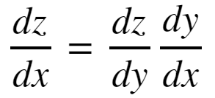
The Chain Rule of Calculus
In order to compute the gradients of the loss function though the layers of a deep neural network we need to apply the chain rule of calculus
To consider a function z = f(y), where y = g(x); then z = f(g(x)). Then the derivative of z with respect to x is:

Slide 54
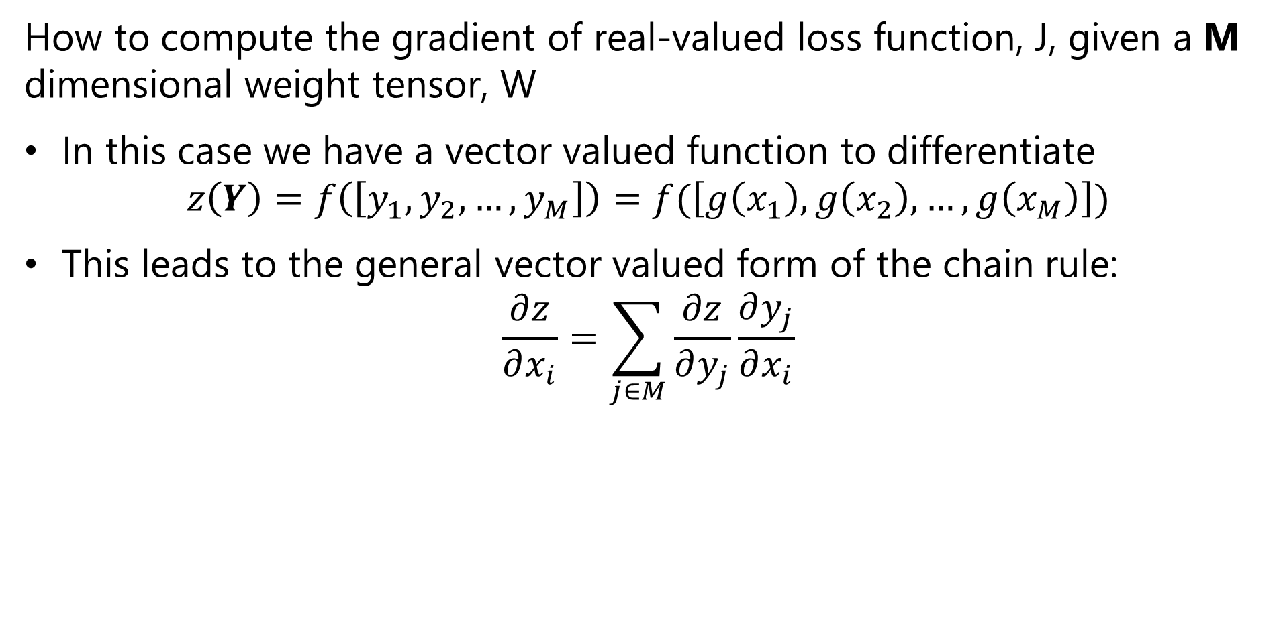
The Chain Rule of Calculus
How to compute the gradient of real-valued loss function, J, given a M dimensional weight tensor, W
In this case we have a vector valued function to differentiate
$$z\left(Y\right)=f\left(\left[y_{1},y_{2},…,y_{M}\right]\right)=f(\left[g\left(x_{1}\right),g\left(x_{2}\right),…,g\left(x_{M}\right)\right])$$
This leads to the general vector valued form of the chain rule:
$$\frac{∂z}{∂x_{i}}=\sum_{j∈M}{\frac{∂z}{∂y_{j}}\frac{∂y_{j}}{∂x_{i}}}$$

Slide 55
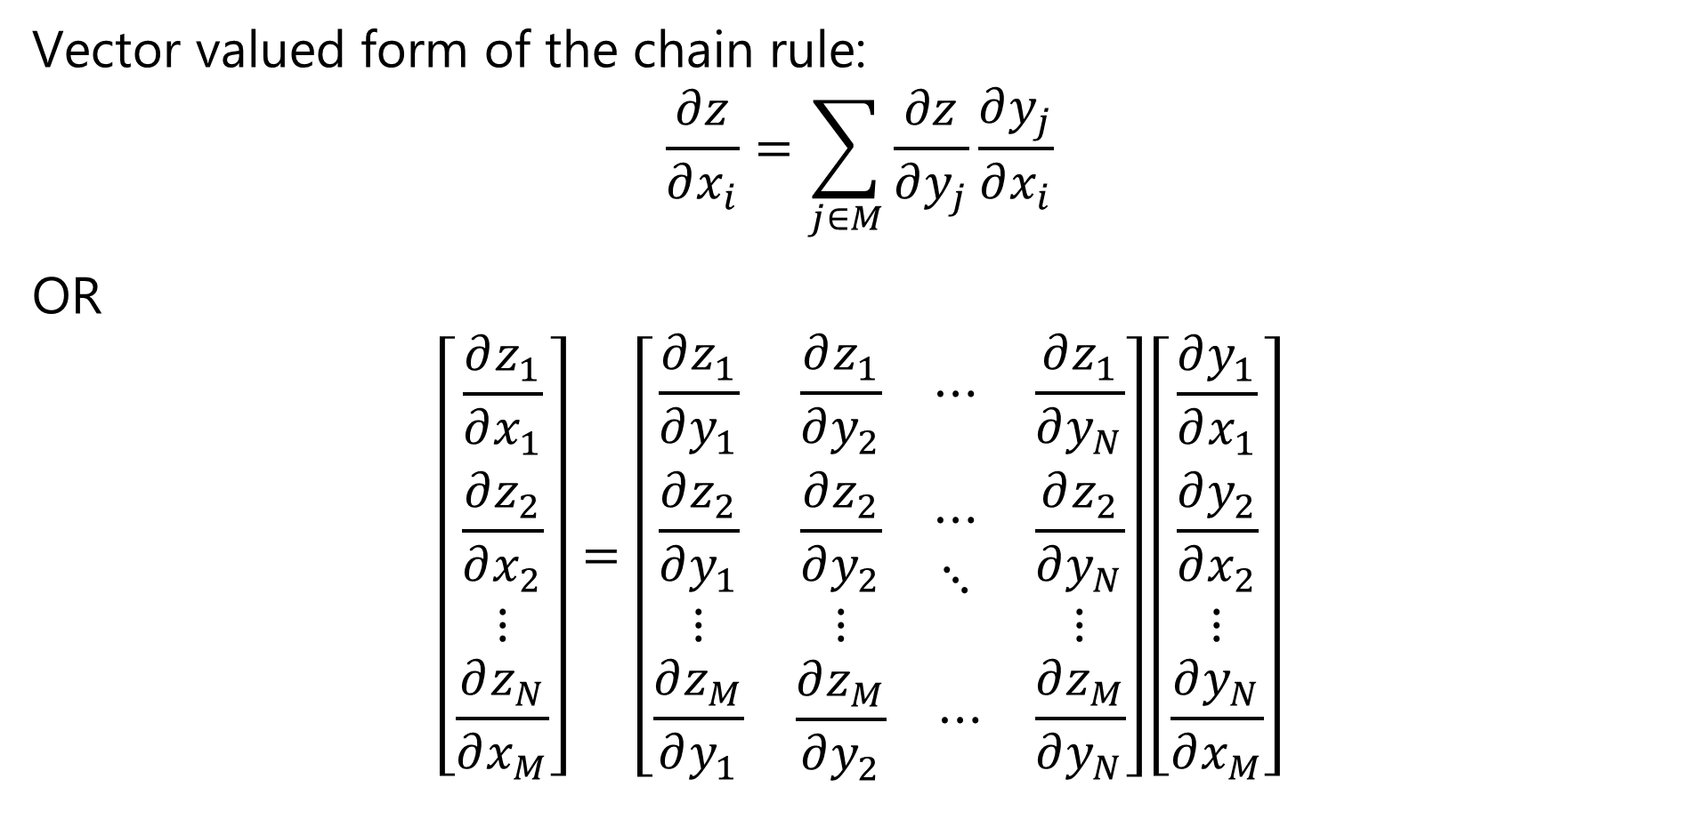
The Chain Rule of Calculus
Vector valued form of the chain rule:
$$\frac{∂z}{∂x_{i}}=\sum_{j∈M}{\frac{∂z}{∂y_{j}}\frac{∂y_{j}}{∂x_{i}}}$$
OR
$$\left[\begin{matrix}\frac{∂z_{1}}{∂x_{1}} \\ \frac{∂z_{2}}{∂x_{2}} \\ \begin{matrix}⋮ \\ \frac{∂z_{N}}{∂x_{M}}\end{matrix}\end{matrix}\right]=\left[\begin{matrix}\frac{∂z_{1}}{∂y_{1}} & \begin{matrix}\frac{∂z_{1}}{∂y_{2}} & ⋯\end{matrix} & \frac{∂z_{1}}{∂y_{N}} \\ \begin{matrix}\frac{∂z_{2}}{∂y_{1}} \\ ⋮\end{matrix} & \begin{matrix}\begin{matrix}\frac{∂z_{2}}{∂y_{2}} \\ ⋮\end{matrix} & \begin{matrix}⋯ \\ ⋱\end{matrix}\end{matrix} & \begin{matrix}\frac{∂z_{2}}{∂y_{N}} \\ ⋮\end{matrix} \\ \frac{∂z_{M}}{∂y_{1}} & \begin{matrix}\frac{∂z_{M}}{∂y_{2}} & ⋯\end{matrix} & \frac{∂z_{M}}{∂y_{N}}\end{matrix}\right]\left[\begin{matrix}\frac{∂y_{1}}{∂x_{1}} \\ \frac{∂y_{2}}{∂x_{2}} \\ \begin{matrix}⋮ \\ \frac{∂y_{N}}{∂x_{M}}\end{matrix}\end{matrix}\right]$$

Slide 56

The Chain Rule of Calculus
We define the $n×m$ Jacobian Matrix, $J$, as:
$$J^{T}=\left[\begin{matrix}\frac{∂z_{1}}{∂y_{1}} & \begin{matrix}\frac{∂z_{1}}{∂y_{2}} & ⋯\end{matrix} & \frac{∂z_{1}}{∂y_{N}} \\ \begin{matrix}\frac{∂z_{2}}{∂y_{1}} \\ ⋮\end{matrix} & \begin{matrix}\begin{matrix}\frac{∂z_{2}}{∂y_{2}} \\ ⋮\end{matrix} & \begin{matrix}⋯ \\ ⋱\end{matrix}\end{matrix} & \begin{matrix}\frac{∂z_{2}}{∂y_{N}} \\ ⋮\end{matrix} \\ \frac{∂z_{M}}{∂y_{1}} & \begin{matrix}\frac{∂z_{M}}{∂y_{2}} & ⋯\end{matrix} & \frac{∂z_{M}}{∂y_{N}}\end{matrix}\right]$$

Slide 57
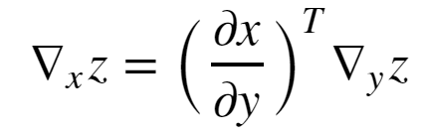


The Chain Rule of Calculus
In matrix notation the vector valued gradient then becomes:
Where, = is the nxm Jacobian matrix of partial derivatives
= the gradient of z with respect to y

Slide 58
Example: Computing a Gradient
w¹₁₁
X₁
S₁ = σ_{h}(Σ )
w²₁
w¹₁₂
w¹₂₁
S₃ = Σ
J(W)
X₂
w²₂
w¹₂₂
S₂ = σ_{h}(Σ )
Y
_{Input Layer}
_{Hidden Layer}
_{Output Layer}
_{Loss Function}

Slide 59
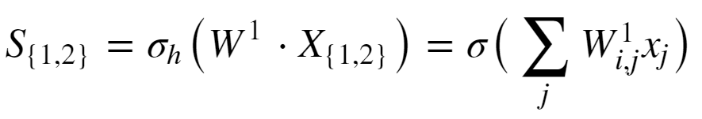
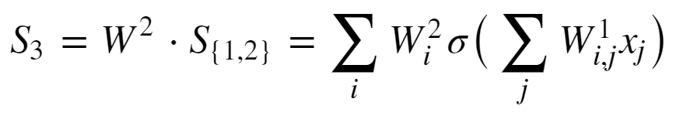
Example: Computing a Gradient
Start with forward propagation relationships
The output of the hidden units are computed as:
The output unit relation is:

Slide 60
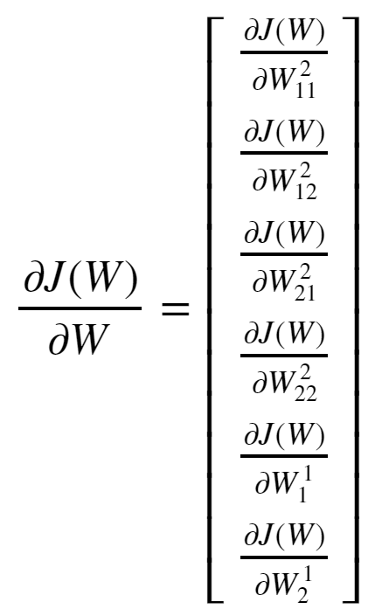
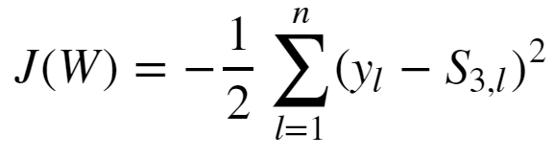
Example: Computing a Gradient
Goal is to compute the gradient:
The loss function is:

Slide 61
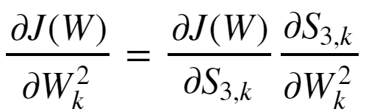
Example: Computing a Gradient
Start with the easier case of the gradient with respect to the output tensor.
Applying the chain rule yields:

Slide 62
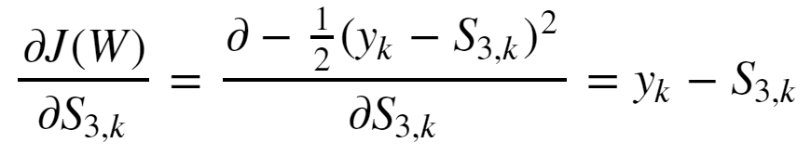
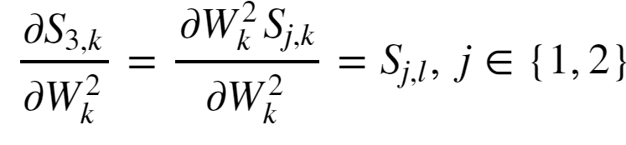
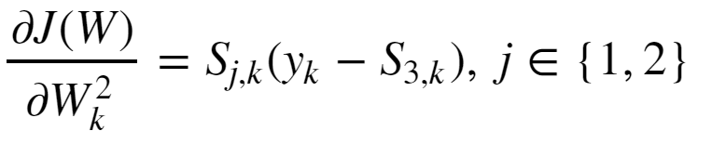
Example: Computing a Gradient
The first partial derivative is:
The second partial derivative is:
And the gradient with respect to the output tensor is then:

Slide 63
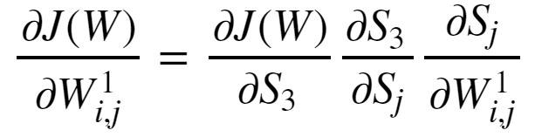
Example: Computing a Gradient
The gradient with respect to the input tensor is a bit more complicated
Apply the chain rule twice to get:

Slide 64
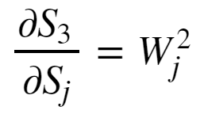
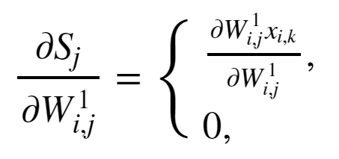
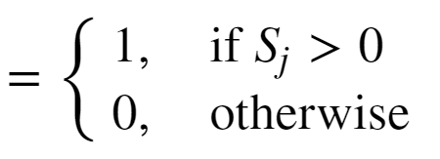
Example: Computing a Gradient
The output layer has linear activation so the left most partial derivative is just 1.
The middle partial derivative :
The right most partial derivative, given ReLU activation:

Slide 65
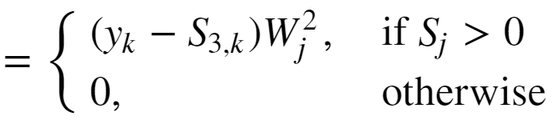
Example: Computing a Gradient
The gradient with respect to the input weights is then:

Slide 66
Automatic Differentiation
In practice, how do we perform the differentiation
Computing all the required derivatives by hand is impractical
Complexity grows with NN depth
Too many opportunities for error
Use automatic differentiation
Automatic differentiators handle the complexity of deep architectures
Automatic differentiators built into all deep learning platforms
See the review paper by Baydin et.al. (2015) or the TensorFlow automatic differentiation tutorial

Slide 67
Efficient Calculation with Evaluation Graphs

Slide 68
Workflow Architectures
How can we efficiently perform backpropagation?
Many machine learning algorithms are iterative
Solving linear equations algorithms
Optimization and dynamic programming
Backpropagation
…
Iterative algorithms have complex execution graphs
Must operate on saved values multiple times
Only want to compute required quantities
Reading and writing to disk is too slow!
Need a workflow platform to handle complex execution graphs

Slide 69
Workflow Architectures
Lazy evaluation
Lazy evaluation prevents evaluation of unneeded values
Is an old idea
Independently invented several researchers in mid 1970s
For example: Henderson, et.al. (1976) developed a lazy evaluator for the LISP language
The lazy evaluation model
Lazy evaluation eliminates unnecessary calculations
Execution is performed when needed only for values required to compute the out the output
Contrasts with eager evaluation which requires I/O between operations
For example: Numpy reads and writes between cache and main memory between each operation

Slide 70
Workflow Architectures
Execution graphs
All calculations along the graph are performed in cache/main memory
An execution graph is created for the specified workflow
Using look ahead on the graph, execution done only for values required for the output – lazy evaluation
Use graph to find values to keep in main memory for iterations
Limits disk I/O – can speed execution by orders of magnitude
Concept of lazy evaluation along an execution graph introduced in Spark in 2010 (Zaharia, et. al., 2011)
One of many tutorials on the Spark lazy execution model can be found here
You can find an overview of the TensorFlow graph evaluation model here

Slide 71
Example: Execution graph for forward propagation in fully connected NN with one hidden layer
b²
σ_{ο}
Y
W²
+
U⁵
b¹
U⁴
W¹
dot
σ_{h}
U³
+
U²
Mat
Mult
U¹
X

Slide 72
Example: Computing a Gradient
U⁹
U¹⁰
J
U⁷
sum
+
mult
+
U⁵
λ
sqr
U⁶
sum
U⁸
sqr
J_{MLE}
W¹
W²
Y_{est}
Cross-
entropy
dot
σ_{ο}
U⁴
σ_{h}
Mat
Mult
U¹
U³
Y
X

Slide 73
Platforms for Deep NN Models
Platforms for deep learning combine execution graphs, lazy evaluation and GPU support
Graphics Processing Units (GPU) greatly increase speed of linear algebra computations
First applied to machine learning by Stienkrau et.al. (2005)
The recognition that large scale ML models can be trained with clusters of low-cost hardware revolutionized deep learning
Seminal paper GPUs applied to deep learning is raina et.al. (2009)
Some currently widely used
TensorFlow and the wrapper package Keras
PyTorch built on Torch
Caffé
You can find a review of many currently used deep learning platforms here

Slide 74
Deployment of Deep NN Models
How can we deploy deep NN models to the edge?
Many applications use CV at the edge – a.k.a. Internet of Things (IoT)
Example: advanced smart phone photograpy
Example: security monitoring
Example: industrial inspection
…
Need to push CV processing to edge
Limited network bandwidth precludes central processing
Edge devices typically have limited computing and memory capacity
Can deploy solutions like TensorFlow Lite
Use fixed point or integer arithmetic
Give up a bit of accuracy massive reduction in computing and memory

Slide 75
Summary
Key points for this lesson
Preceptron and forward propagation
Depth, breath and model capacity
Nonlinearity and activation functions
Learning weights with backpropagation
Loss functions
Computing gradients and the chain rule
Efficient calculation with execution graphs

Slide 76
Appendix – Working with images and multi-class classification

Slide 77
Machine Learning with Image Data

Slide 78
Formulating a Computer Vision Machine Learning Model
How do we formulate the machine learning model for computer vision
$$Ax=b$$
Features, $b$, are the categories of the objects
These are the know labels used to train the model
$A$ is the feature matrix
Features values are in the columns
Are $p$ columns
$x$ is the vector of length $p$ model parameters or weights
These values are learned

Slide 79
Formulating a Computer Vision Machine Learning Model
How do we formulate the machine learning model for computer vision
$$Ax=b$$
$A$ is the feature matrix
Features values are in the columns
Are $p$ columns
What types of features can we use?
Gray-scale pixel values
Color channel pixel values
Lines
Corners and interest points
Texture
…

Slide 80
How Can We Work With Image Data?
How to prepare image pixel values for machine learning?
0,0
1,0
Must flatten the image into a feature vector
Example: start with a d-2 gray-scale image
Flatten to a 1-d feature vector
For color image concatenate channel feature vectors
.
.
.
0 ,0
0 ,1
. . .
0 ,M-1
1 ,0
1 ,1
. . .
1 ,M-1
N-2,0
2 ,0
2 ,1
. . .
2 ,M-1
N-1,0
Flatten
3 ,0
3 ,1
. . .
3 ,M-1
.
.
.
.
.
.
.
.
.
0,M-1
N-2 ,0
N-2 ,1
. . .
N-2 ,M-1
1,M-1
N-1,0
N-1,1
. . .
N-1,M-1
.
.
.
N-2,M-1
N-1,M-1

Slide 81
How Can We Work With Image Data?
Images yield high-dimensional feature space
A single 28x28 gray scale image -> 784 features
A single 1024x1024x3 color image -> 3 million features!
Large numbers of features cause convergence problems with machine learning models
Its hard to work with high-dimensional spaces
Details are beyond the scope of our course
There are more efficient ways to represent images, including:
Principle component compression
Extract higher level features; edges, corners, textures, etc.

Slide 82
How Can We Work With Image Data?
Images yield high-dimensional feature space
Deep neural networks are machine learning models
Deep neural networks learn features
Under right conditions improve performance over hand engineered features
Much more on this topic!

Slide 83
Review Binary Classification

Slide 84
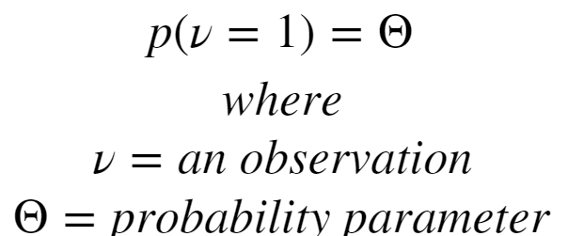
Review of Binary Classification
Binary classification selects most probable category from set {0,1}
Binary classification is based on the Bernoulli distribution
Binary Bernoulli distribution for probability of success or probability of observation: ν = 1:

Slide 85
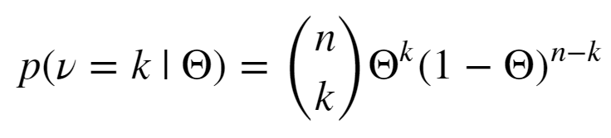

Review of Binary Classification
We extend the Bernoulli distribution for multiple trials with the Binomial distribution for k successes in n trials:
Were the Binomial coefficient, pronounced n choose k is:
The Binomial coefficient tells us the number of ways we can choose k values from n possibilities

Slide 86
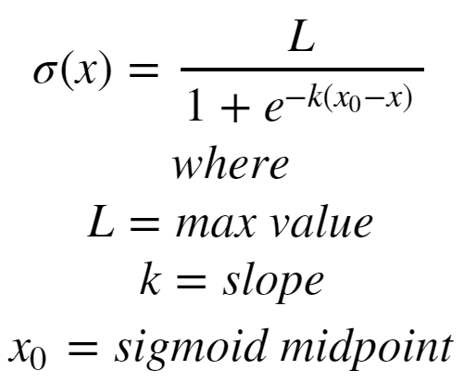
Review of Binary Classification
How do perform classification with the Bernoulli distribution?
Must transform a numeric value to the set {0,1}
Use the logistic or sigmoid function to squash the model output value

Slide 87
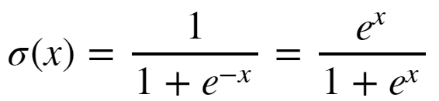

Review of Binary Classification
Simplify the logistic function if k = 1, L = 1 and x_{o} = 0:

Slide 88
Review of Binary Classification
Use logistic regression to transform linear model into binary classifier
Start with a linear model for the link function for the Binomial distribution
λ_{i} = ln$\left\{\frac{θ}{1−θ}\right\}$= $b•xi$
The probability of $ν=1$is given by the inverse link function
$P\left(νi=1 | xi\right)={ ^{ }\frac{1}{1+ e^{−b•xi}}}$
The inverse link function transforms linear response to the nonlinear response!

Slide 89

Review of Binary Classification
Example: Cut off for binary classification
Cut off applied to the cumulative distribution function for the positive and negative cases

Slide 90
Multi-Class Classification

Slide 91
Multi-Class Classifiers
Many applications of multi-class classifiers
Images can contain many types of objects
A binary classifier is not useful for object classification
We need a multi-class classifier

Slide 92
Multi-Class Classifiers
How can we create multi-class classifiers?
Approach
A hierarchy of binary classifiers
Use a multi-class distribution
Hierarchical binary classifiers
One vs. many
One vs. one

Slide 93
Multi-Class Classifiers
Classify using possible binary splits
Several possible approaches
One class vs. all others
Continue until all classes identified
Every class vs. every other class
Apply to all possible pairs

Slide 94



Classification with the Categorical Distribution
What is the distribution for multi-class problems?
Use the Categorical distribution for k categories with probability mass function:
Where probability mass for each category is :
And the normalization of the probability distribution :

Slide 95


Classification with the Categorical Distribution
How do we create a categorical classifier?
Use a softmax function for K classes:
The normalization, , ensures the probabilities sum to 1.0
Softmax squashes the response of the linear models to a probability
Softmax used for response layer in deep learning models

Slide 96
Classification with the Categorical Distribution
What is the output of softmax?
One value for each category, K
For example, if we have 10 categories, there are 10 softmax output values
Take the max as the most probable category
Label must be one-hot encoded
Binary value for each possible category
Only one 1, others 0

Slide 97
Coding Multi-Class Labels
How do you work with multi-class labels?
Must uniquely code each category using one-hot encoding
Example; code label with K = 3 levels, {e₁, e₂, e₃,}
$$\begin{matrix}\text{e}\text{1} & & \\ \text{e}\text{3} & & \\ \text{e}\text{2} & ⇒ & \end{matrix}\begin{matrix}1 & 0 & 0 \\ 0 & 0 & 1 \\ 0 & 1 & 0\end{matrix}$$
$$\begin{matrix}⋮ & & \\ \text{e}\text{3} & & \end{matrix}\begin{matrix}⋮ & ⋮ & ⋮ \\ 0 & 0 & 1\end{matrix}$$
Label One-hot encoding

Slide 98
Classification with the Categorical Distribution
Visualize the categorical distribution as a simplex
Example; encode 3 possible categories: {e₁, e₂, e₃,}
Each category falls at the vertex of the simplex with probability, $θ=\left[π_{1},π_{2},π_{3}\right]$ and $\sum_{i}{π_{i}=1}$
(0,0, e₃)
(0,e₂,0)
(e₁,0,0)

Slide 99
(0,0,4)
(1,0,3)
(0,3,1)
(1,1,2)
(2,0,2)
C
(0,2,2)
(2,1,1)
(1,2,1)
(3,0,1)
(0,3,1)
B
A
(4,0,0)
(0,4,0)
(3,1,0)
(2,2,0)
(1,3,0)

Slide 100
Multi-Class Logistic Regression
What could possibly go wrong?
Probability differences between classes can be small
Sometimes better to consider top few classes
Example; most probable 5 classes of 1,000 of objects in image
Assumption of well-separated classes
But class characteristics can overlap – be nonunique
Assumption of balance in class samples in training data
Imbalance common – some objects are rare
Model learning biased to more frequent cases

Slide 101
Multi-Class Logistic Regression
What could possibly go wrong?
Consider fruit processing with 8 categories
{A_large, A_medium,…, B_small, unmarketable, not_fruit}
Imbalance in classes
Example; perhaps A_large infrequent, B_medium most frequent
Classes not well defined
How different is A_small from B_small in computer vision sensor?
If each classifier is 95% accurate so overall accuracy is ${0.95}^{7}=0.7$!

