Slide 1


Machine Learning 530
Introduction to Markov Processes
Steve Elston
Copyright 2019, 2022, Stephen F Elston. All rights reserved.

Slide 2
Introduction to Markov Processes
What is a Markov process?
Markov reward processes
Utility and Gain
Markov decision processes

Slide 3
Markov Processes

Slide 4




Introduction to Markov Processes
A Markov process has states
A Markov process transitions between states at discrete time steps
The probability of transition from one state to another for a first order Markov process is determined only by the current state:
Where, the history of states is,
And, the current state is
A first order Markov process has no memory

Slide 5
Example of Markov Processes
0.00001
0.98999
Old Car
Accident
0.01
0.01
0.99
0.000001
Old Breakdown
New Breakdown
1.0
0.0001
0.99
New Car
0.01
0.998999

Slide 6
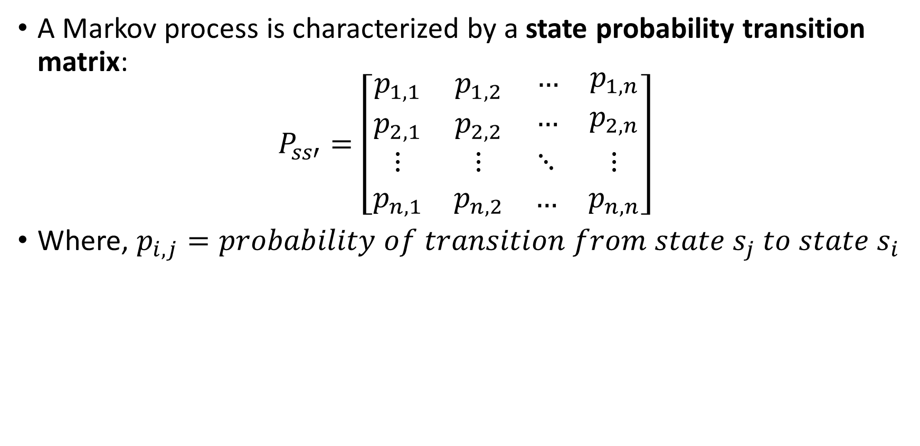
Introduction to Markov Processes
A Markov process is characterized by a state probability transition matrix:
$$P_{ss′}=\left[\begin{matrix}p_{1,1} & p_{1,2} & \begin{matrix}… & p_{1,n}\end{matrix} \\ p_{2,1} & p_{2,2} & \begin{matrix}… & p_{2,n}\end{matrix} \\ \begin{matrix}⋮ \\ p_{n,1}\end{matrix} & \begin{matrix}⋮ \\ p_{n,2}\end{matrix} & \begin{matrix}⋱ & ⋮ \\ … & p_{n,n}\end{matrix}\end{matrix}\right]$$
Where, $p_{i,j}=probability of transition from state s_{j} to state s_{i}$

Slide 7

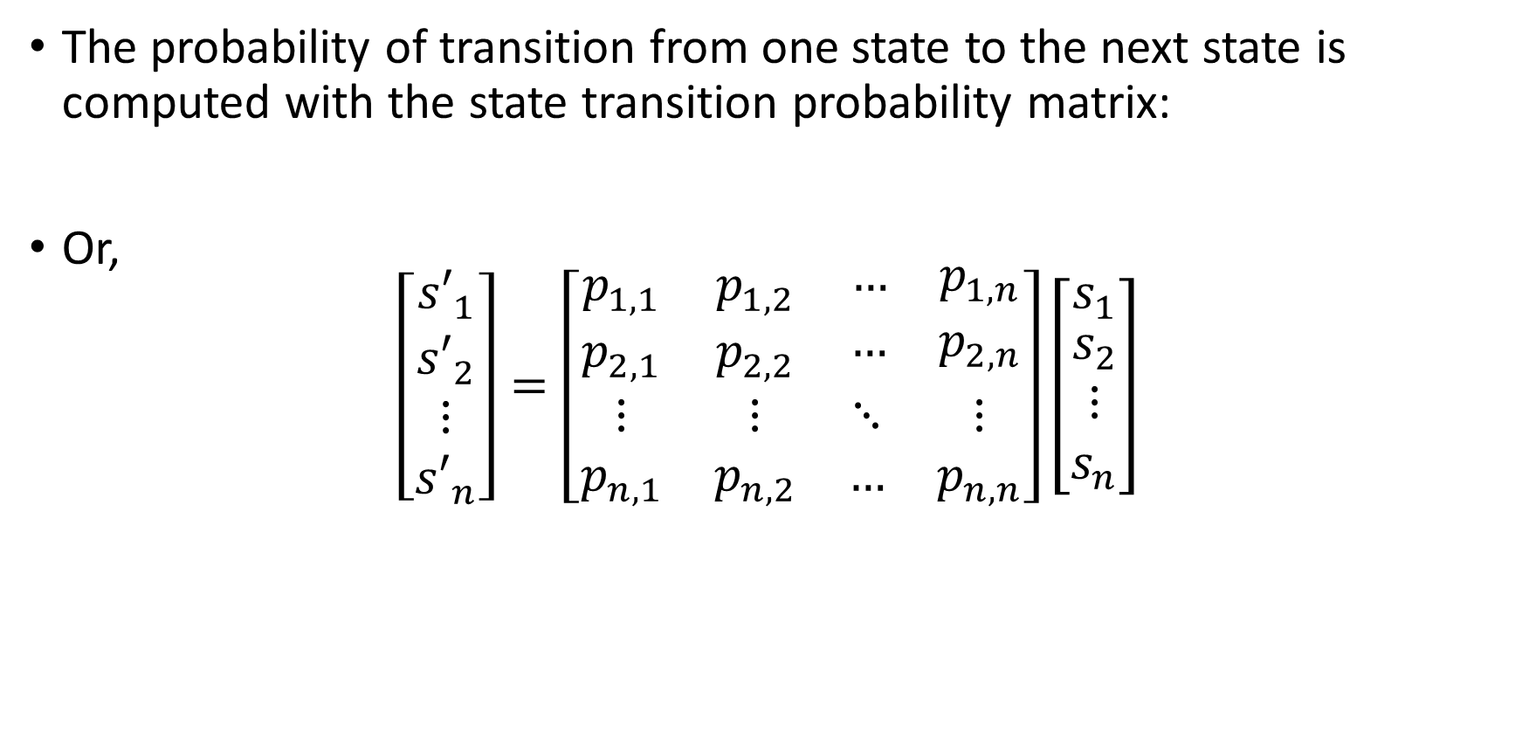
Introduction to Markov Processes
The probability of transition from one state to the next state is computed with the state transition probability matrix:
Or,
$$\left[\begin{matrix}{s′}_{1} \\ \begin{matrix}{s′}_{2} \\ ⋮ \\ {s′}_{n}\end{matrix}\end{matrix}\right]=\left[\begin{matrix}p_{1,1} & p_{1,2} & \begin{matrix}… & p_{1,n}\end{matrix} \\ p_{2,1} & p_{2,2} & \begin{matrix}… & p_{2,n}\end{matrix} \\ \begin{matrix}⋮ \\ p_{n,1}\end{matrix} & \begin{matrix}⋮ \\ p_{n,2}\end{matrix} & \begin{matrix}⋱ & ⋮ \\ … & p_{n,n}\end{matrix}\end{matrix}\right]\left[\begin{matrix}s_{1} \\ \begin{matrix}s_{2} \\ ⋮ \\ s_{n}\end{matrix}\end{matrix}\right]$$

Slide 8

Introduction to Markov Processes
A Markov chain is a sequence of Markov state transition processes
E.g. running a Markov process over several time steps creates a Markov chain
If the state transition probability matrix, , does not change with time, the Markov chain is stationary
Stationary Markov chains converge to a steady state
At steady state the state probabilities are unchanged

Slide 9
Markov Reward Processes

Slide 10
Example of Markov Reward Process
-100,000
-30
Old Car
Accident
-200
-3,000
-600
-50,000
Old Breakdown
New Breakdown
-30,000
-1,000
-100
New Car
-30,000
-50

Slide 11



Introduction to Markov Reward Processes
A Markov reward process generates a reward or change in utility for each state transition
Reward can be positive or negative
Reward may not follow simple monitary value
The inconvenience of a car breakdown may exceed the cost of repair
A piece of art has subjective aesthetic value
The reward function for a transition from state to state is defined:

Slide 12
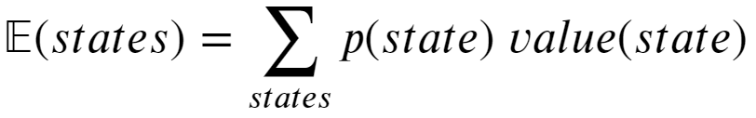
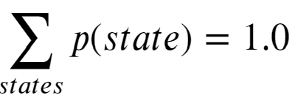
Introduction to Markov Reward
How can you compute expectation for a probabilistic process?
The expectation is the sum of the probability weighted values of a set of states
The normalization of the expectation is correct since:

Slide 13
Example of Markov Reward Process
Rª_{s} = -30 * 0.98999 = - 29.6997
Rª_{s} = -100,000 * 0.00001 = -1.0
Old Car
Accident
Rª_{s} = -200 * 0.01 = -2.0
Rª_{s} = -600 * 0.99 * 0.01 = -5.94
Old Breakdown
E[R(Old Car)] = - 29.6997 - 1.0 – 2.0 – 5.94 = -38.6397

Slide 14
Utility and Gain

Slide 15
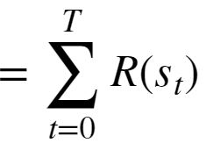


Utility and Gain
Utility is the sum of rewards in a Markov chain
Since the rewards are additive:
The above formulation works for an episodic process
An episodic process has a terminal state

Slide 16


Utility and Gain
What happens to the Utility for a continuous process
A continuous process has no termination state and the utility is unbounded
As
So, apply a discount factor at each time step:
Properties of discounted returns

Slide 17

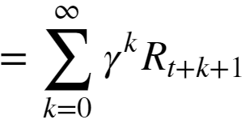

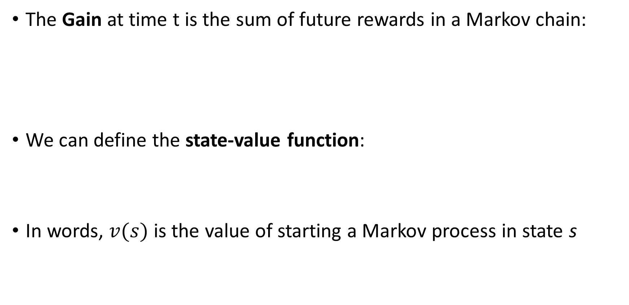
Utility and Gain
The Gain at time t is the sum of future rewards in a Markov chain:
We can define the state-value function:
In words, $v(s)$ is the value of starting a Markov process in state s

Slide 18
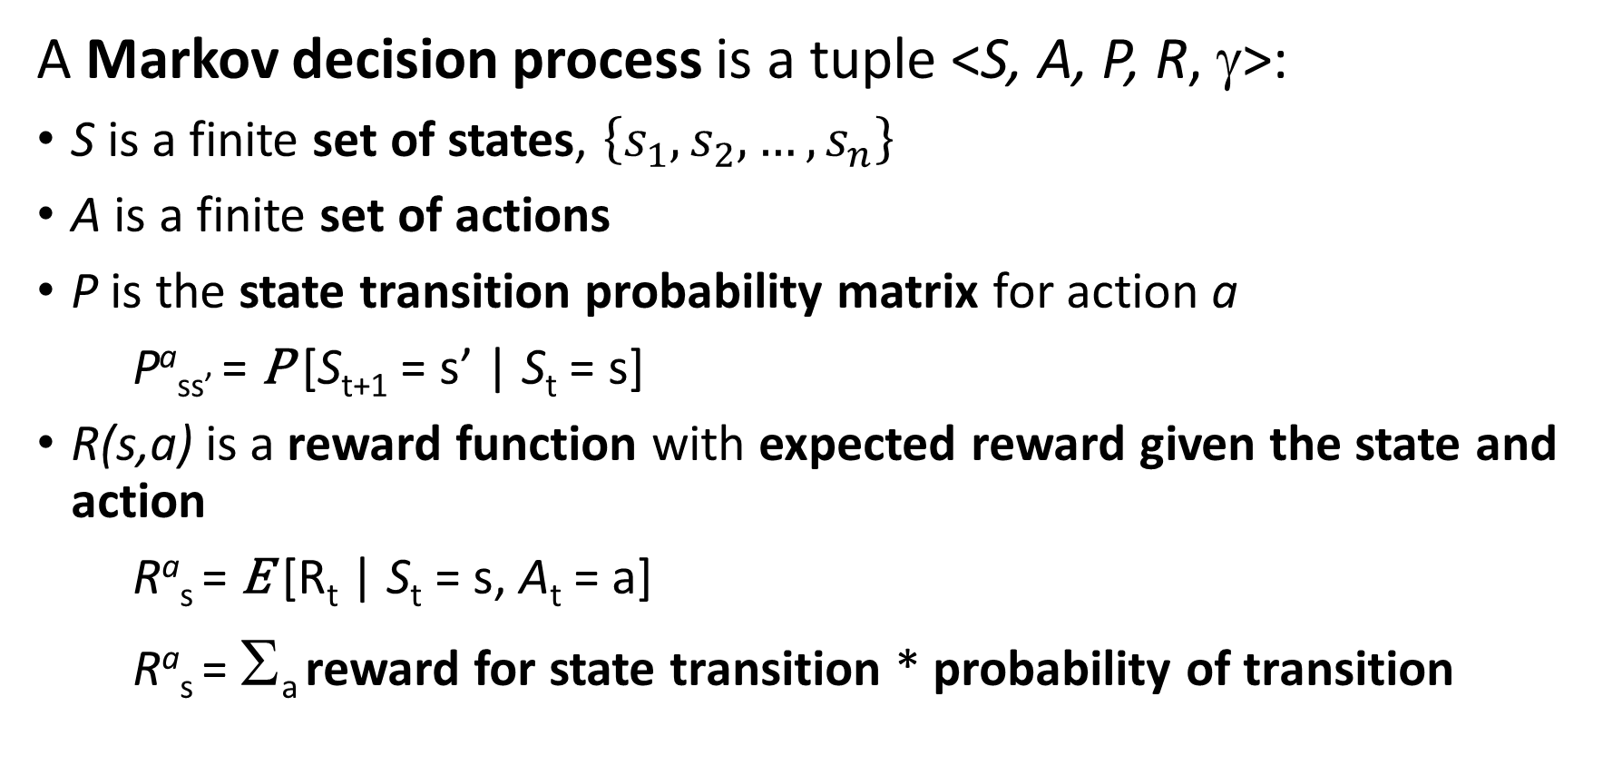
Introduction to Markov Decision Processes
A Markov decision process is a tuple <S, A, P, R, γ>:
S is a finite set of states, $\left\{s_{1},s_{2},…,s_{n}\right\}$
A is a finite set of actions
P is the state transition probability matrix for action a
Pª_{ss’} = P [S_{t+1} = s’ | S_{t} = s]
R(s,a) is a reward function with expected reward given the state and action
Rª_{s} = E [R_{t} | S_{t} = s, A_{t} = a]
Rª_{s} = Σ_{a} reward for state transition * probability of transition

Slide 19
Policy Improvement

Slide 20
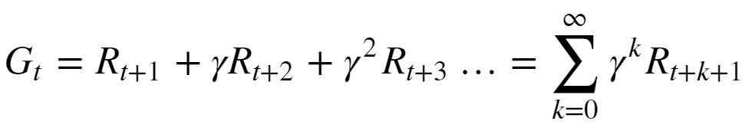


Policy Evaluation
Recall the definition of discounted return from the current time t
Where, R_{t+1} is the expected reward or change in utility over the possible state transitions from the current state, s, to all possible successor states, s’
And,
= the reward for the transition from state s to s’
= discount factor
In words, the gain is the sum of the expectation of rewards for all future possible state transitions

Slide 21
Introduction to Markov Decision Processes
A policy, π, is probability distribution over actions given states:
π(a|s) = P [A_{t} = a | S_{t} = s]
The policy fully defines agent behavior
The MDP depends only on current state, not history
A given policy is stationary; does not change in time

Slide 22

Optimal Policy for MDP
Actions of the agent are determined by a policy, π
The expectation of the policy determines the action-value
Goal is to learn an optimal policy
The optimal policy has an expected action-value greater than or equal to all possible policies:

Slide 23
Policy Improvement

Slide 24
Policy Evaluation
We want our intelligent agent to follow an optimal policy
Policy evaluation is needed to compare policies
Can evaluate policy by value:
State value: expected value of being in a state
Action value: expected value of taking an action in a given state

Slide 25

State Value Policy Evaluation
Bellman value equations are fundamental to computing expected state-values
Recall that a first order Markov process depends only on the current state, s
The probability of a state transition, and therefore the expected reward, is determined by the policy, π, and the transition probabilities of the Markov process
We can find the state-value of state s, given a policy π, as the expected value of the gain from the Bellman value equation:
Where

Slide 26



State Value Policy Evaluation
Expand the Bellman value equations to find a recursion
Since gain equals the reward plus the gain for the next step:
This recursion leads to one-step bootstrap approximation of gain using state-value for the next step:
The bootstrap approximation uses the current estimate of to update the estimate of

Slide 27

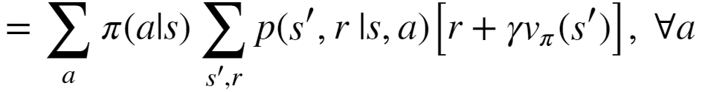
State Value Policy Evaluation
Compute the expected value for the Bellman value equations
Where

Slide 28

State Value Policy Evaluation
There is one Bellman value equation for each possible state, s, or n equations for a n-state system
In theory this system of equations can be solved directly
But requires O(n³) computations
Or, can use the recursion relationship using the last estimate of
Using the estimated state-value to compute a better estimate is called bootstrapping
Recursion continues until convergence criteria is achieved

Slide 29

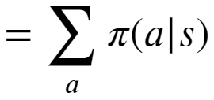
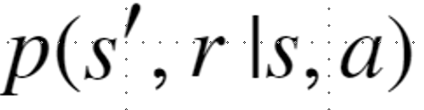
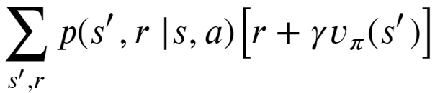
State Value Policy Evaluation
How to interpret the Bellman state-value equations
0
1
2
3
0
1
2
3
4
5
6
7
4
5
6
7
8
9
10
11
8
9
10
11
= {u:0.5,d:0.0,l:0.5,r:0.0}
V_{π}(10)
= {(6,r₁₀₋₆|10,u):1.0,
(9,r₁₀₋₉|10,l):1.0}

Slide 30
Action Value Policy Evaluation
Bellman action-value equations are fundamental to computing expected action-values
Recall the definition of state-value:
We can find the action-value, of taking action a in state s, given a policy π as:
Where:

Slide 31

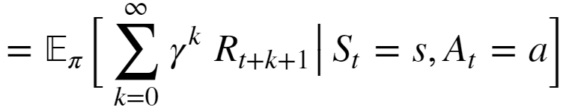

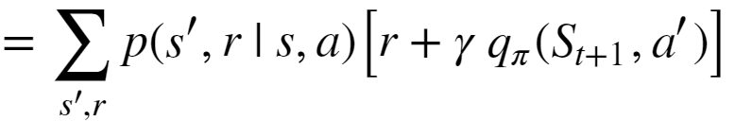
Action Value Policy Evaluation
Expand the Bellman action-value equations to find a recursion
Expanding the gain as the sum of rewards gives:
Then using the transition probability and the bootstrapped action-values gives:
Where,

