Slide 1


Machine Learning 530
Introduction to Function Approximation for Reinforcement Learning
Steve Elston
Copyright 2019, Stephen F Elston. All rights reserved.

Slide 2
RL with Function Approximation
Why use function approximation for RL?
Function approximators and basis functions
Linear approximators and coding
Linear functions and gradient descent
The mountain car problem
Solving the mountain car problem
Q-learning and function approximation

Slide 3
Why Use Function Approximation?
Up to now, only used tabular algorithms
Tabular algorithms have limits of scalability
Value function needs table entry for every state
Action-value function needs table entry for every action-value pair
Problems with large number of discrete states and actions
Backgammon: 10²⁰ states
Go: 10¹⁷⁰ states
Problems with continuous variables
Examples; temperature, pressure, acceleration, velocity, etc.
Have an infinite number of states

Slide 4
Function Approximators
How to scale beyond tabular algorithms?
Need a better representation
Use function approximation
Agent learns value function
v(s) ~ f(s,w) = function of state, s, and features w
Or, agent learns action-value function
q(s,a) ~ f(s,a,w) = function of state, s, action, a, features w
f(s,w), f(s,a,w) have sparse number of parameters compared to original space

Slide 5
Function Approximators
Which function approximators to use?
Linear function approximators
Grid coding
Coarse coding
Fourier and wavelet basis function
Radial basis function – e.g. Gaussian
Splines – Generalized Additive Models
Nonlinear function approximators
Nearest neighbors
Decision trees
Deep neural networks - More on these later

Slide 6
Tile Coding
Two continuous variables
Divided values on rectangular grid
Values coded on the grid
X
X
Dimension 2
O
O
Dimension 1
O coded in two tiles
Xs coded in one tile

Slide 7
Tile Coding
X
X
X
X
Dimension 2
Dimension 2
O
O
O
O
Dimension 1
Dimension 1
Os coded in two tiles
Xs coded in one tile
Os coded in one tile
Xs coded in one tile

Slide 8
Coarse Coding
Example, overlapping coarse coding
Dimension 2
X
Dimension 1
Point coded in 4 circles

Slide 9
Linear Function Coding
Grid coding is a linear function approximator
Each tile is a feature
Each linear feature has one parameter or model weight
Function approximator is linear in the parameters

Slide 10


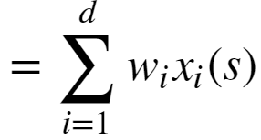

Linear Function Coding
The value function as a linear function of model weights
The approximate value function:
The weight vector, w
Coding is a binary function of state:
The coded approximate value function is then:

Slide 11




Linear Functions and Gradient Descent
How good is the approximation?
Like any approximator there is a difference between the estimated and actual values
Can use value function approximation, , of the true state-value given a policy π,
OR, an action-value function approximation, , of the true action-value value given a policy π,

Slide 12
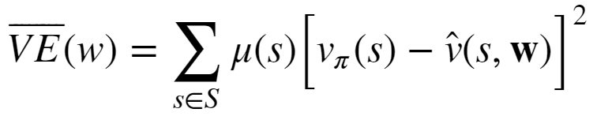

Linear Functions and Gradient Descent
How good is the approximation?
Compute the mean square value error between and as the metric or loss function:
Where, is the probability of being in state, s
For on-policy algorithms is known as the on-policy distribution

Slide 13
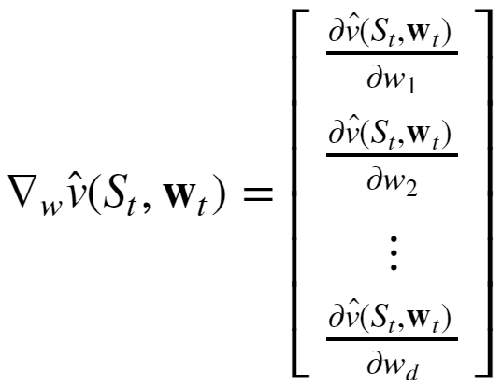
Linear Functions and Gradient Descent
Solve linear system of equations with gradient descent
Must compute a gradient with respect to the d-dimensional weight vector, w

Slide 14


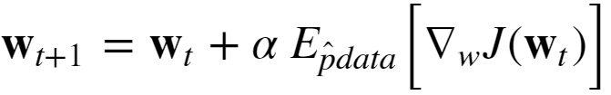



Linear Functions and Gradient Descent
Solution with stochastic gradient descent
For a random sample of the data, , and a loss function the stochastic gradient descent update is:
Using the estimated state-value function, , the stochastic gradient descent update becomes
Since is a bootstrap estimate of , is a semi-gradient

Slide 15
Mountain Car Problem
The mountain car problem is a canonical control problem used to test RL algorithms
An under-powered car must travel to the top of a hill
The car can accelerate forward, +1, backward, -1, and neutral, 0
The agent must learn a policy to get the car to the top
There are two state variables
Position
Velocity

Slide 16
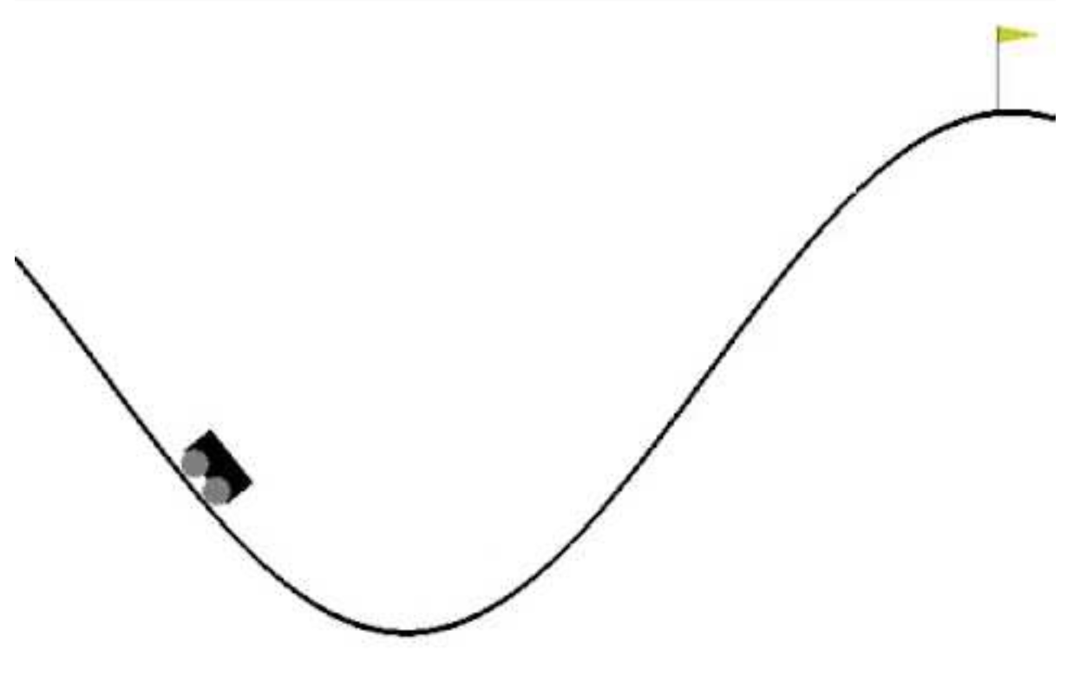
Mountain Car Problem
Under-powered car must gain momentum to get to the goal at the top of the mountain

Slide 17


Mountain Car Problem
The state equation for car position is:
The state equation for car velocity is:
Acceleration, is the action, determined by the agent from the set:

Slide 18
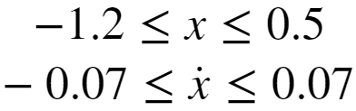
Mountain Car Problem
Car reward function:
Each time step, -1
At goal, 100
The position and velocity of the car are limited
Starting position of car is random

Slide 19
Solving Mountain Car Problem is Hard!
Why is the Mountain Car Problem Hard?
Several characteristics make this problem difficult for an agent to learn a good policy
Positive reward delayed to end of episode
State variables, position and velocity, are continuous
The relationship between the state variables is nonlinear

Slide 20



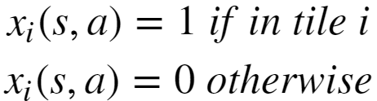

Solving the Mountain Car Problem
Use 3-dimensional tile coding
First dimension divides the position interval,
Section dimension divides the velocity interval,
Third dimension has three steps for the acceleration state - action,
Coding function has values:

Slide 21
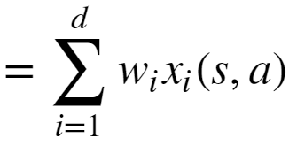



Solving the Mountain Car Problem
Use an approximate linear function for action-values
Where,
= the approximate state-value function
= state-action tile coding function, {0,1}
w_{i} = function weights, which must be learned
s = state variable tuple, position and velocity

Slide 22
Solving the Mountain Car Problem
n-step SARSA for control
The n-step bootstrapped gain with function approximation:
The weight update:
Where:

Slide 23





Solving the Mountain Car Problem
Need to find the semi-gradient of the linear function approximation
The action-value function, , is linear in w_{i}, so:
, if
else, 0

Slide 24
Q-Learning and Function Approximation
What happens if Q-learning is used in a tabular case?
Recall basic Q-learning update
The TD error is then,
For tabular case, convergence as δ_{t} approaches 0

Slide 25
Q-Learning and Function Approximation
Q-learning converges in the tabular case – discrete state-actions
Q(S,A
Optimal q(s,a)
Reduce TD error until convergence
q(s,a)
Initial q(s,a)
State variable 1

Slide 26
Q-Learning and Function Approximation
Q-learning converges in the tabular case – discrete state-actions
Optimal q(s,a)
Reduce TD error until convergence
q(s,a)
Initial q(s,a)
State variable 1

Slide 27





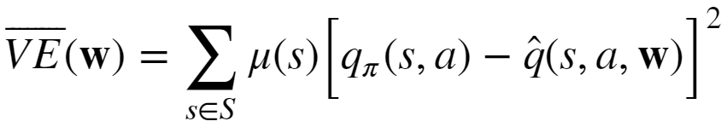
Q-Learning and Function Approximation
What happens if Q-learning is used with function approximation?
The TD error uses an approximation of action-value function,
The gain depends on the nonlinear operator
But, the action-value function approximator minimizes least squares error

Slide 28
Q-Learning and Function Approximation
What happens if Q-learning is used with function approximation?
Using TD error based on max operator with function approximation using least squares error leads to instability and poor convergence!
Problem arises if three conditions are met:
Function approximation;
Off-policy algorithm
Bootstrapping with an approximate action-value
The deadly triad!
Monte Carlo control algorithms do not bootstrap and always converge

Slide 29
Q-Learning and Function Approximation
Q-learning will not converge with function approximation
Q(S,A)
Decreasing TD Error
Linear function approximation
q(s,a)
Decreasing
TD Error,
Increasing least
square error!!
State variable 1

Slide 30
Q-Learning and Function Approximation
Convergence of control algorithms
Algorithm | Tabular | Linear
Monte Carlo Control | ✔ | ✔
SARSA | ✔ | ✔
Q-learning | ✔ | ✘
Algorithm
Monte Carlo Control
SARSA
Q-learning
Algorithm | Tabular
Monte Carlo Control | ✔
SARSA | ✔
Q-learning | ✔
Algorithm | Tabular | Linear | Nonlinear
Monte Carlo Control | ✔ | ✔ | ✔
SARSA | ✔ | ✔ | ✘
Q-learning | ✔ | ✘ | ✘

