Slide 1
Introduction to the Exercises
How to survive the exercise code.

Slide 2
Prerequisites
Rabbit MQ (RMQ)
You need RMQ installed as it is the middleware we use for these examples
We use RMQ because it does not require cloud accounts and is easy to install and work with
Docker
We provide a Docker Compose file with the exercises, that if you have Docker installed can be used to run RMQ
Navigate to one of the directories containing the docker-compose.yml file
Run docker-compose up –d
Run docker ps to confirm that RMQ is running
We use a Linux container (if you are running on Windows, adjust settings)
Native
Install from https://www.rabbitmq.com/download.html

Slide 3
Patterns
There are videos which introduce key patterns in messaging
There are many more patterns catalogued by Hohpe here
Many of these patterns also have associated exercises
They show you how one type of middleware, RabbitMQ, can be used to implement these patterns

Slide 4
Exercises
The exercises are in GitHub
They have supporting, short videos in Dropbox.
The videos explain key messaging patterns
The exercises let you write code to try some of these patterns yourself
Solutions and Exercises are different branches
The master branch is blank, the solutions and questions are branches
You have the solutions as a clue if you need it
One way to work is to locally use the exercise branch, have solutions open in your browser
That way, if you get stuck, you can look for a hint and switch back

Slide 5
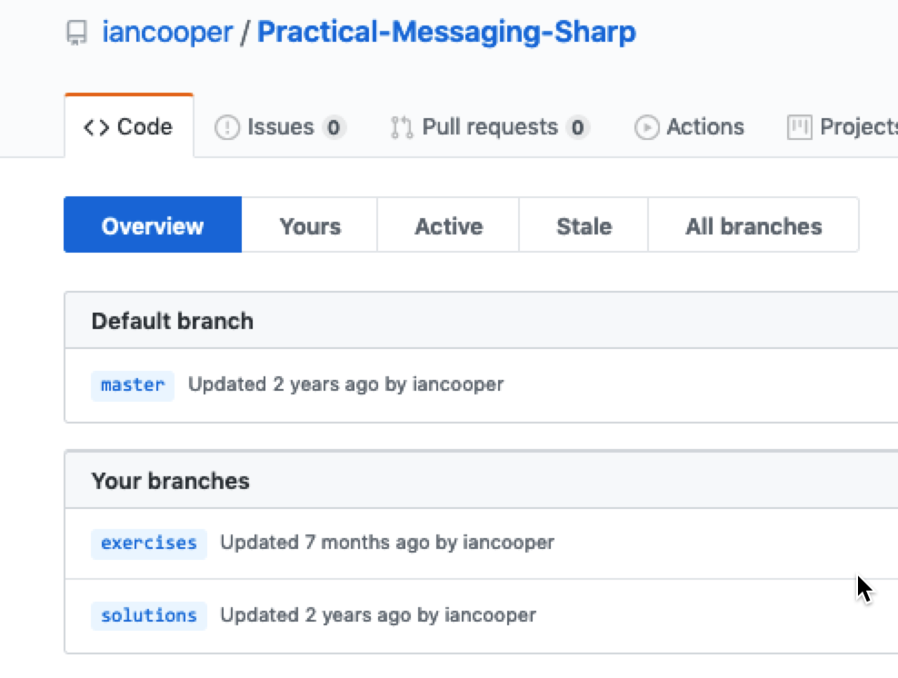

Slide 6
Steps
Watch a messaging patterns video
If there is an associated exercise
Do the exercise
Repeat
I am here to help, if you get stuck or have questions.

Slide 7
What Do You Do?
In each exercise there is code that is missing, replaced by comments
You need to provide the appropriate code, as indicated by the comments
Once you have the code building, you run the samples to see how it works
You may wish to have the RMQ management console open, to observe what is happening on the server

Slide 8
Making the Most of This
You could just type the code from Solutions into Exercises
You won’t learn as much though
It’s better to try and understand what you are being asked to do, consult the RMQ client documentation etc.
That way you will leave here with knowledge of how to write this code yourself, and find answers to your problems.

Slide 9
Code Structure
The Exercises come in five languages:
C#, Go, Java, JavaScript and Python
The Exercises are not production code
They are intended to provide just enough code for the exercise
They omit most of the error handling production code would need
They trade maintainability for focus on what an exercise teaches
They should help you understand production code
Working through these exercises and the workshop material will enable to understand production-grade OSS projects
You can see approaches to structure and error handling better there

Slide 10
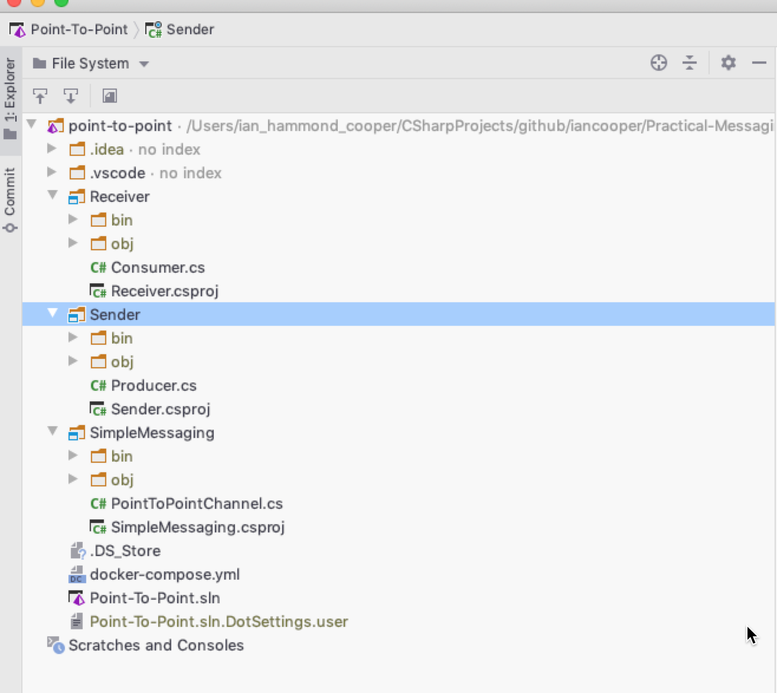
A simple console application for receiving a message
A simple console application for sending a message
We have a simple Messaging Gateway that mediates access to RMQ

Slide 11
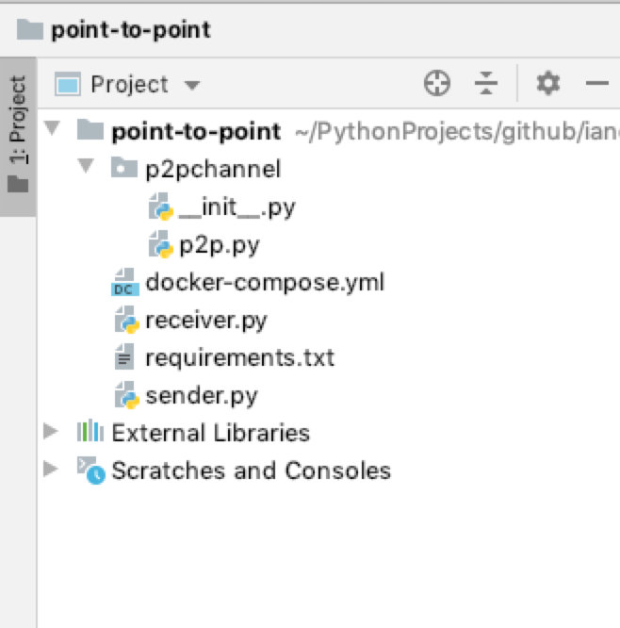
We have a simple Messaging Gateway that mediates access to RMQ
A simple console application for receiving a message
A simple console application for sending a message

Slide 12
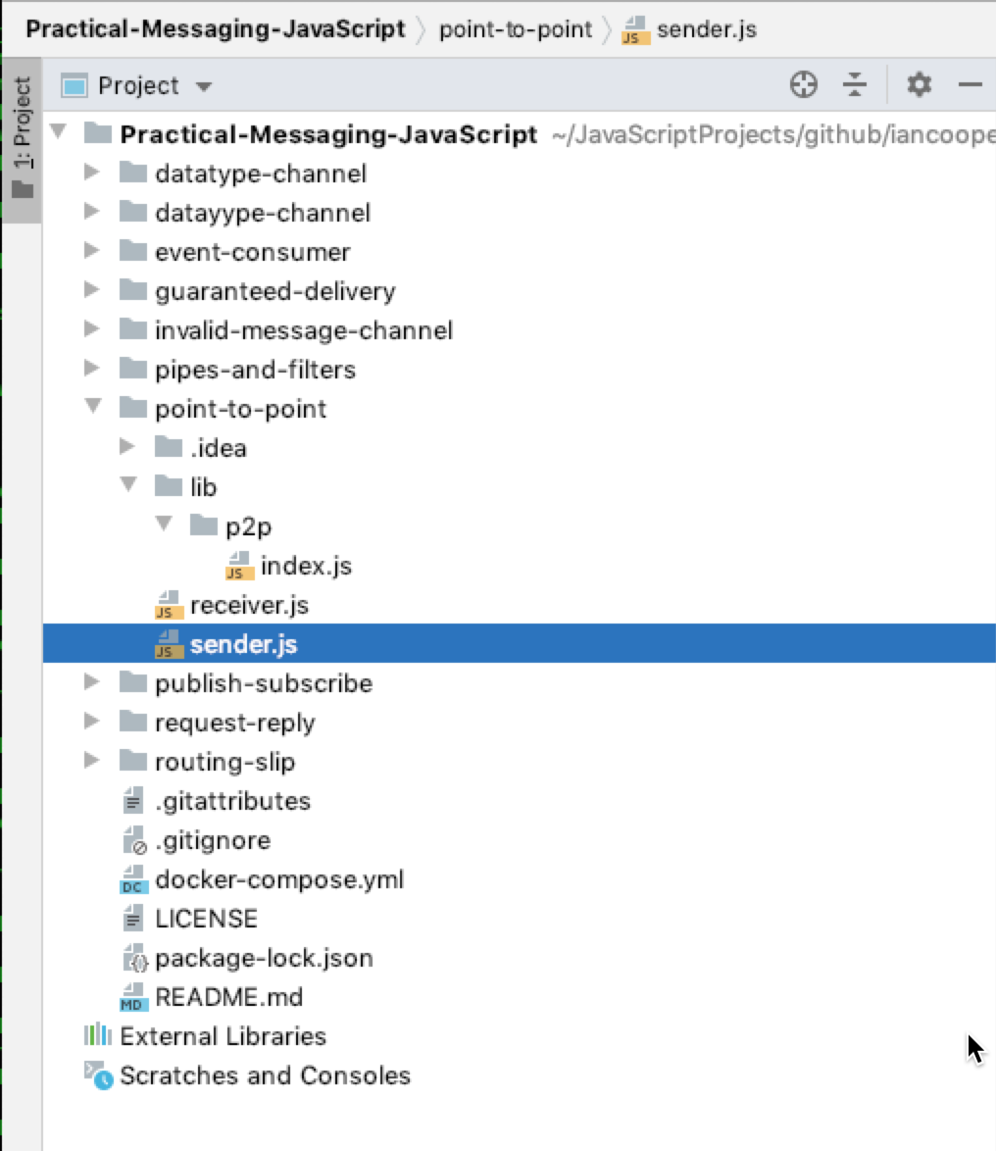
We have a simple Messaging Gateway that mediates access to RMQ
A simple console application for sending a message
A simple console application for receiving a message

Slide 13
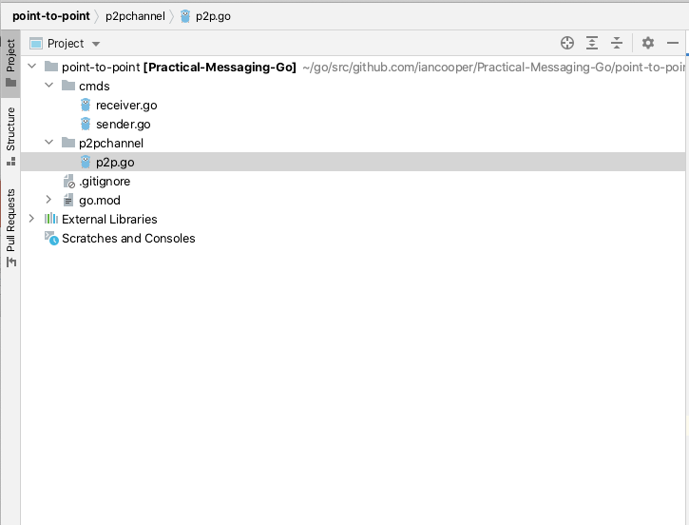
A simple console application for receiving a message
A simple console application for sending a message
We have a simple Messaging Gateway that mediates access to RMQ

Slide 14
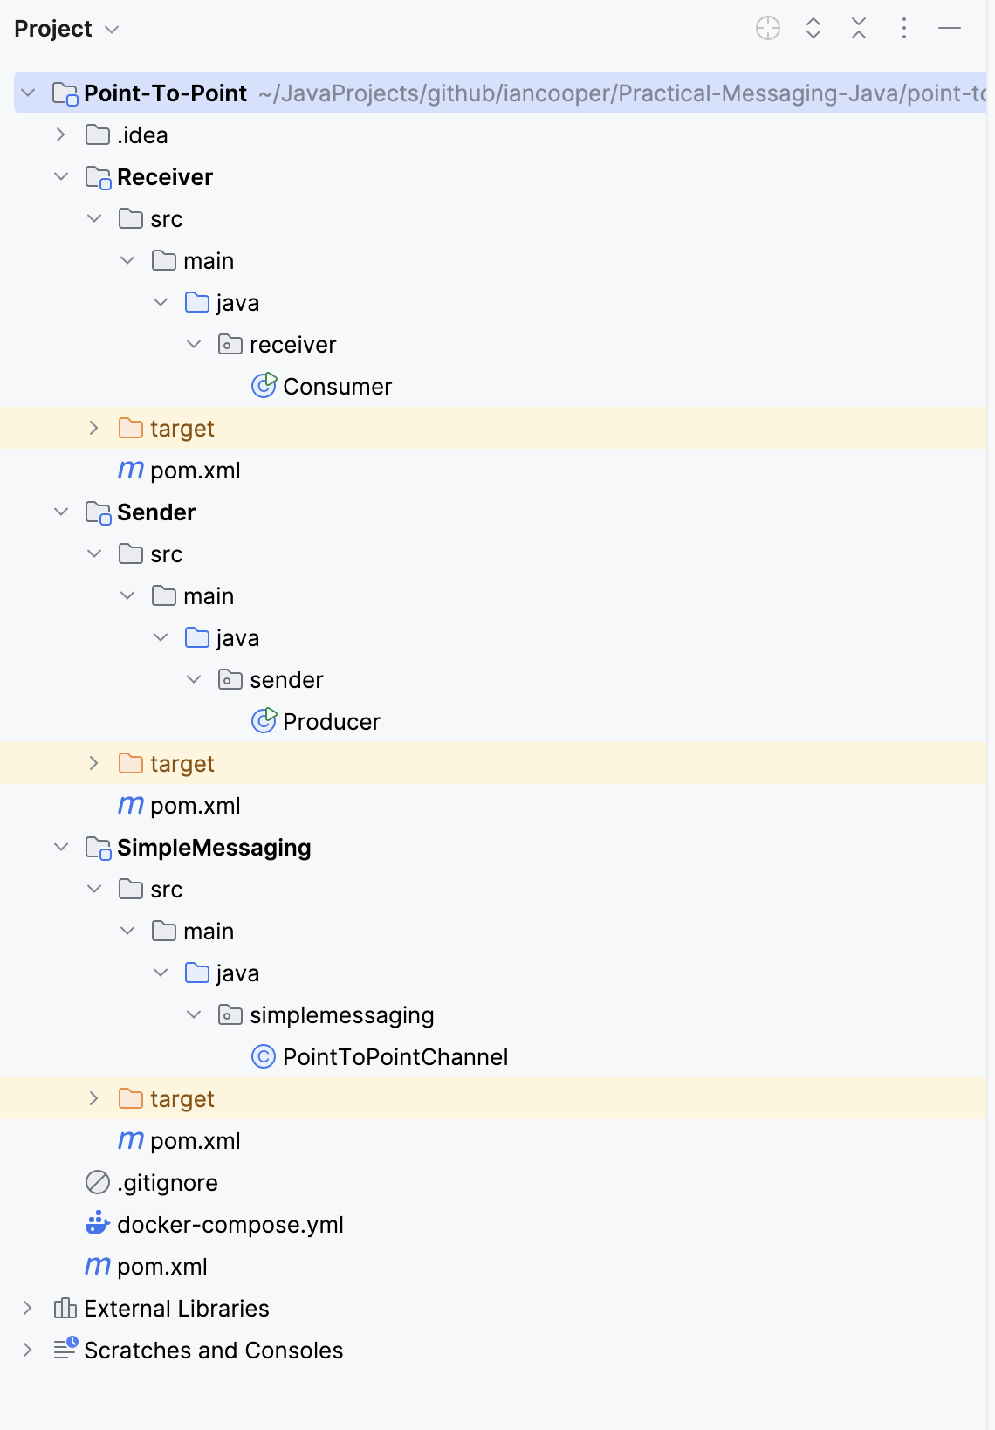
A simple console application for receiving a message
A simple console application for sending a message
We have a simple Messaging Gateway that mediates access to RMQ

