Slide 1
Consumers
Exercise Notes

Slide 2
Introduction
In this exercise you will create a Consumer
We use a Polling Consumer in C# and Python
This is less-efficient on the client than an event-based consumer
Though it is less burden on the server
Middleware like SNS/SQS on AWS does not offer an event consumer option, it’s all polling
We use an Event Consumer in JavaScript
This can be a more complex programming model
Applying ‘backpressure’ – slowing down the rate of arrival of messages to protect downstream resources – can be more complex or not possible depending on the middleware API
RMQ lets us use QoS to change this

Slide 3
Notes
Up to now we have sent and received messages on demand
A real world application tends to wait for messages to arrive
We want to separate user code – a handler – from the endpoint code
We create a Message Pump to read messages
This implementation has the relevant steps though is cruder than a real pump
As we only have one translator and handler, we can just use them without lookup
A handler and translator is usually what the application developer writes
The endpoint code is the pump and gateway over the middleware API

Slide 4
C#

Slide 5
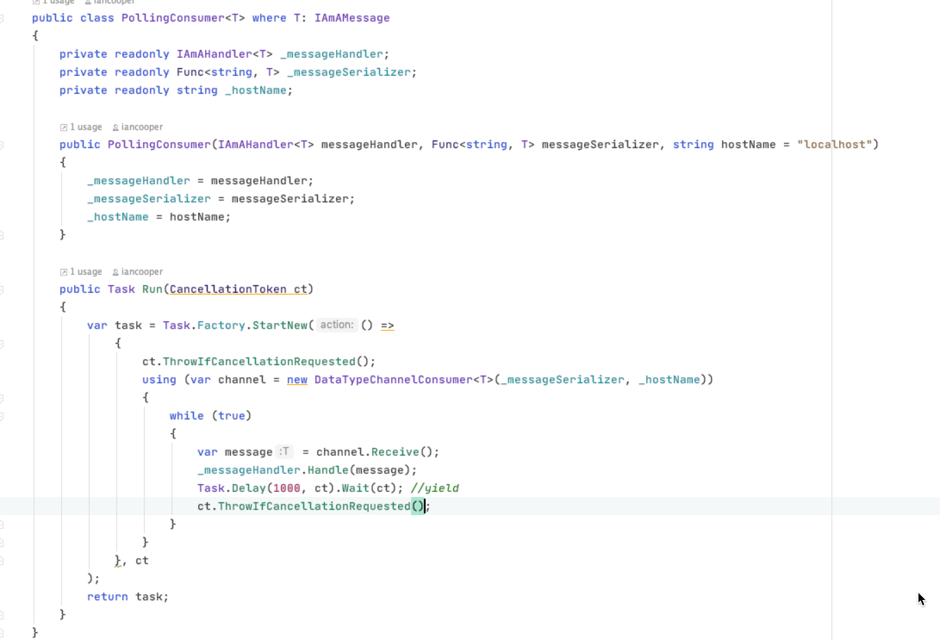
This is the message pump – it loops doing:
Get
Translate
Dispatch
Although in our case, Get and Translate are in the Receive call

Slide 6
Python

Slide 7
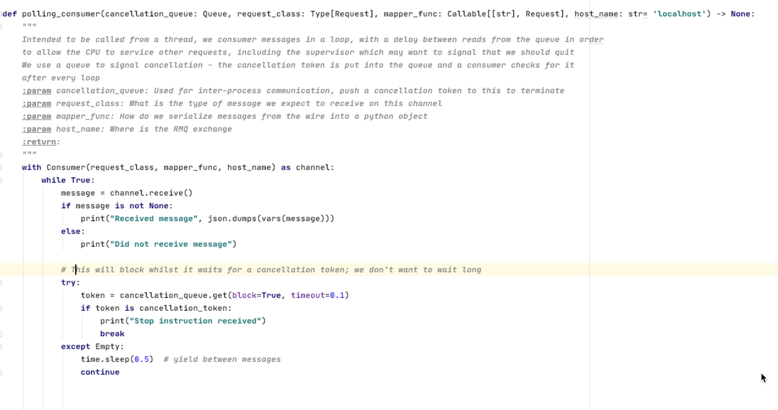
This is the message pump – it loops doing:
Get
Translate
Dispatch
Although in our case, Get and Translate are in the Receive call and our handler is inline

Slide 8
JavaScript

Slide 9
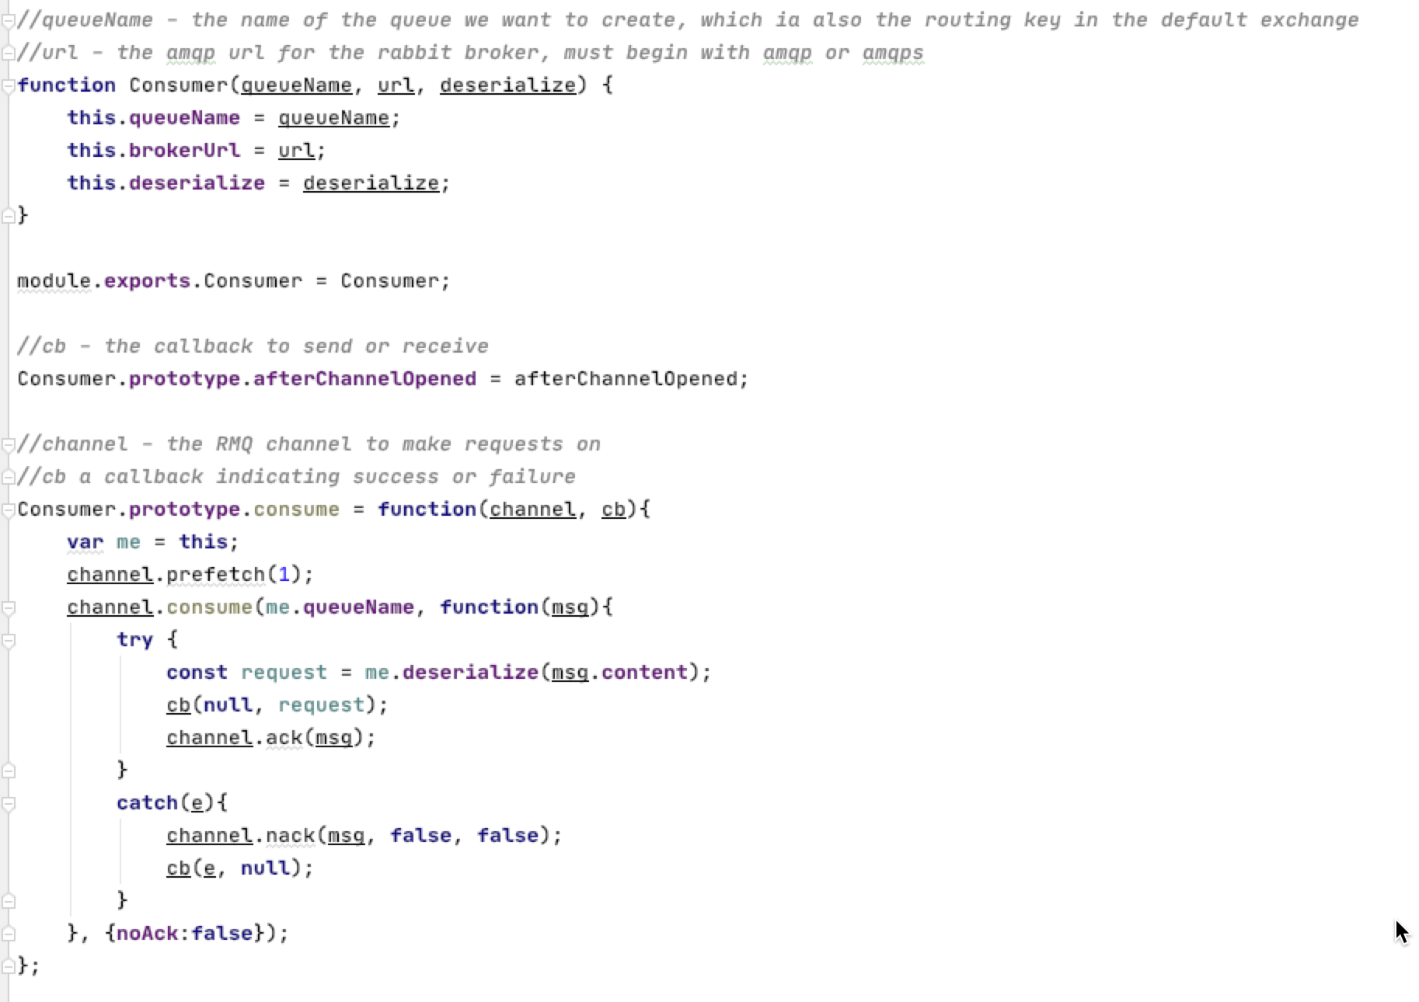
This is the message pump – it loops doing:
Get
Translate
Dispatch
Although in our case, Get awaits a notification of work

Slide 10
Go

Slide 11
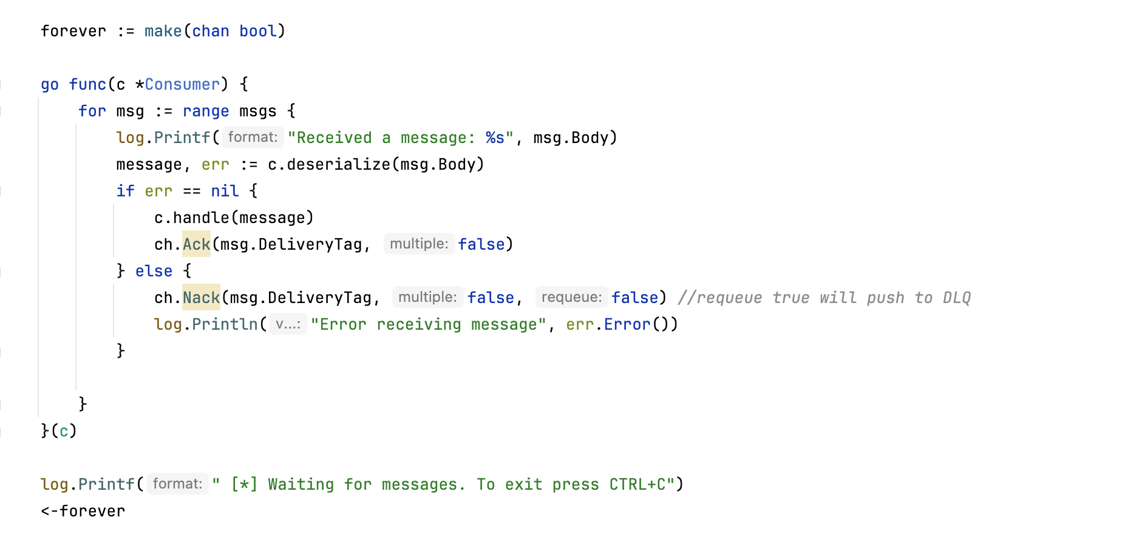
This is the message pump – it loops doing:
Get
Translate
Dispatch
Although in our case, Get awaits a notification of work

Slide 12
Java

Slide 13
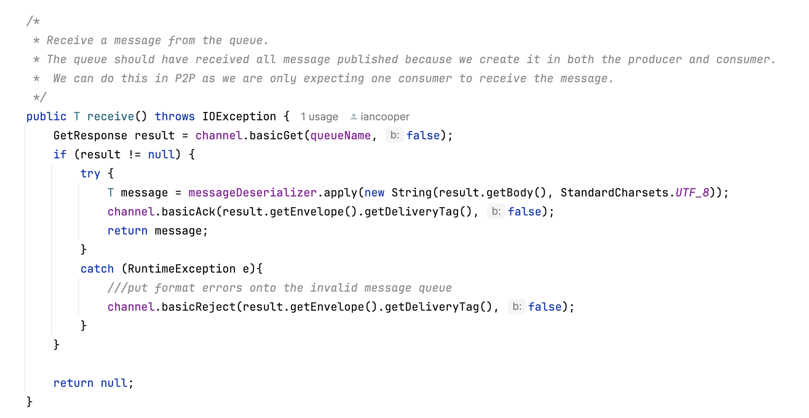
This is the message pump – it loops doing:
Get
Translate
Dispatch
Although in our case, Get awaits a notification of work

