Slide 1
Quick Start Kafka
A Hitchhikers Guide to Kafka

Slide 2
Protocol
Kafka uses its own Protocol
https://kafka.apache.org/protocol.html
Request-Response Pairs sent over TCP/IP. Connections relatively expensive, but single clients don’t need to pool
Only processes a single request at a time per client connection to guarantee ordering

Slide 3
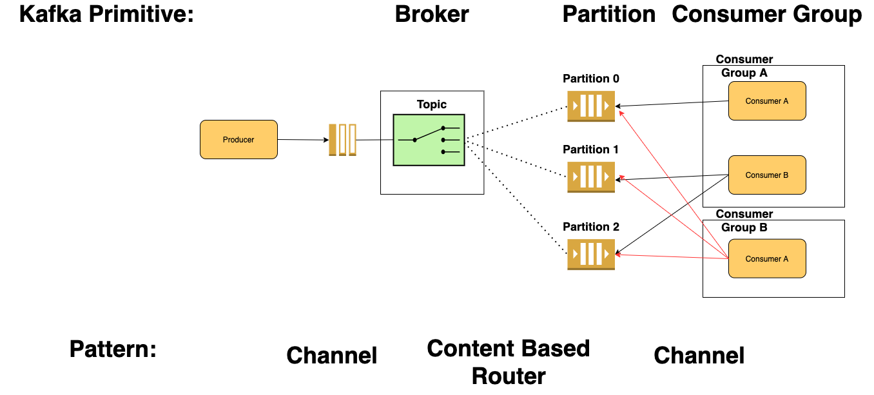

Slide 4
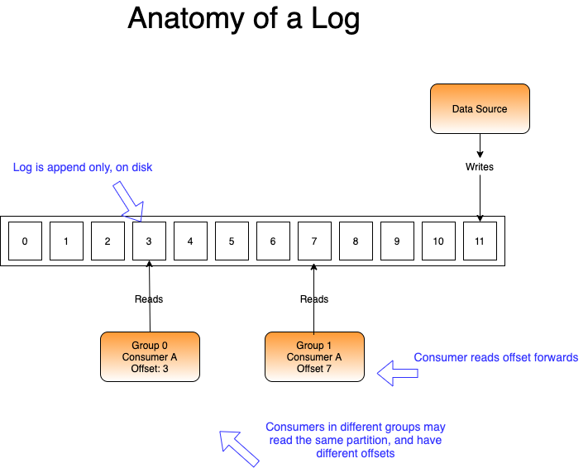

Slide 5
EnableAutoCommit = true
AutCommitIntervalMs = n milliseconds
Your consumer want to commit an offset to Kafka
EnableAutoCommit = true
AutCommitIntervalMs = n milliseconds
Yes
Yes
EnableAutoOffsetStore = false
Call StoreOffset to commit offset when processed
Do you want to commit at an time interval or in batches?
Yes
Are you alright to commit read offsets, that may not have been processed?
No
Do you want to commit at an time interval or in batches?
No
No
Monitor batch count in your code
Call Commit() when you want to commit offsets
Monitor batch count in your code
Call Commit() with specific offsets when you want to commit offsets

Slide 6
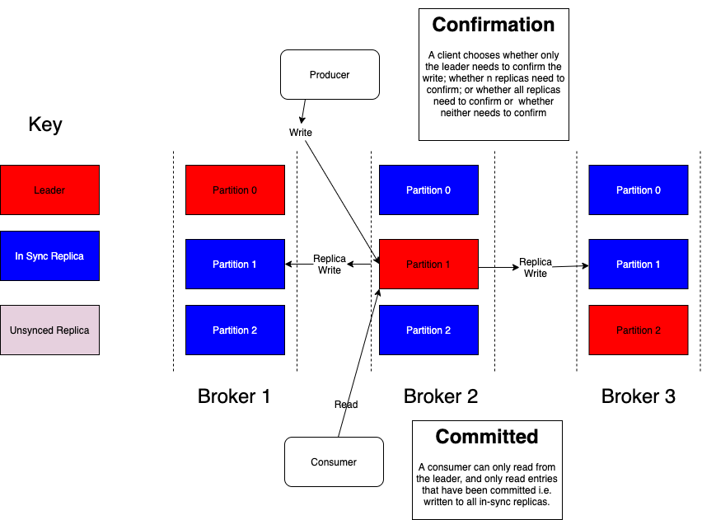

Slide 7
