Slide 1
Quick Start SNS & SQS
A Hitchhikers Guide to SNS & SQS

Slide 2
Protocol
SNS and SQS use HTTP
Most people interact using an SDK not directly
We don’t have implementation details for the server, only documented behavior though

Slide 3
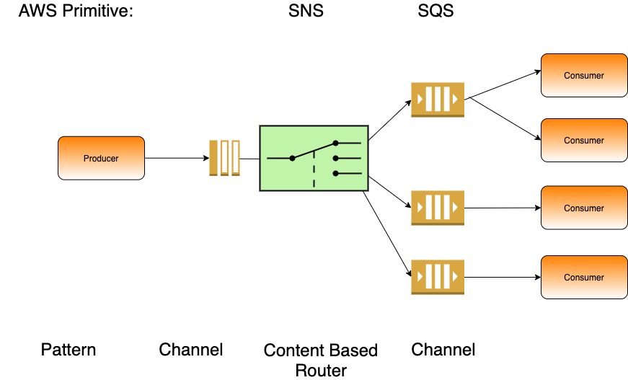

Slide 4
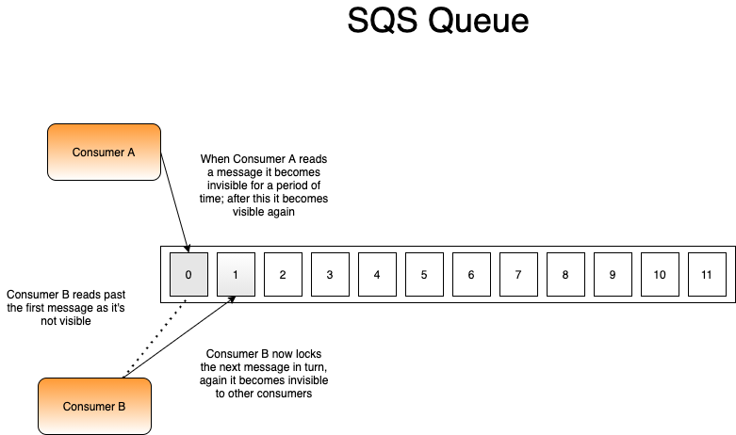

Slide 5
