Slide 1
Datatype Channel
Exercise Notes

Slide 2
Introduction
In this exercise you will create a Datatype channel
Previously we passed a string, but now we want to pass data
The message body is a data structure that we want to share
We now have distinguish Producer and Consumer
One serializes the other deserializes
We know what the schema is, because of the channel we received it on
In our case it is JSON, but it could be XML, Protobuf, Avro
The definition of the schema is communicated out-of-band
Via documentation such as AsyncAPI
Not show here

Slide 3
Notes
Is it a good idea to share a type when serializing code?
This is a form of coupling
Platform Coupling – both sides need so use the same language and framework
This may be fine if we ship both components as part of the same CI-boundary
For example, if we use the Task Queue pattern (covered in part 2) for background processing
Or, for example, if the two components are part of the same microservice boundary
Such as a web process receiving HTTP and a worker process receiving AMQP

Slide 4
C#

Slide 5
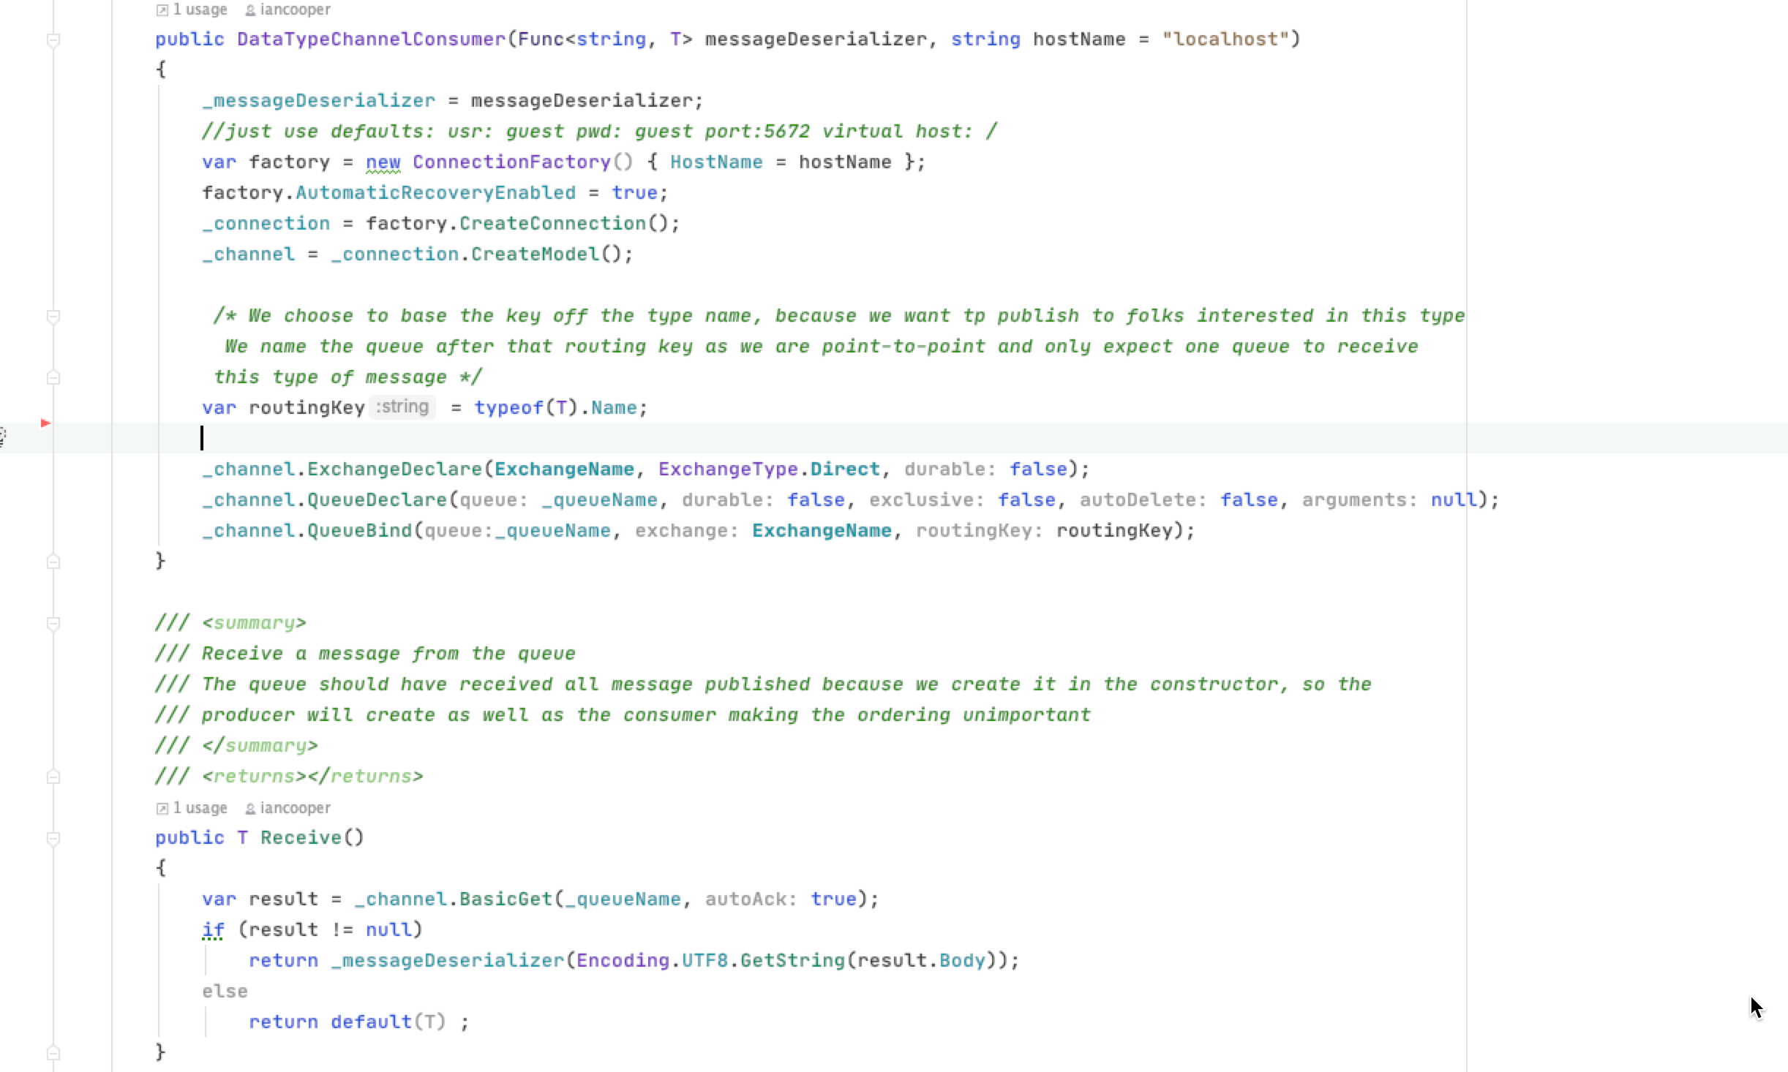
You’ll need to serialize as well
We pass in a deserialization function
We deserialize the message body

Slide 6
Python

Slide 7
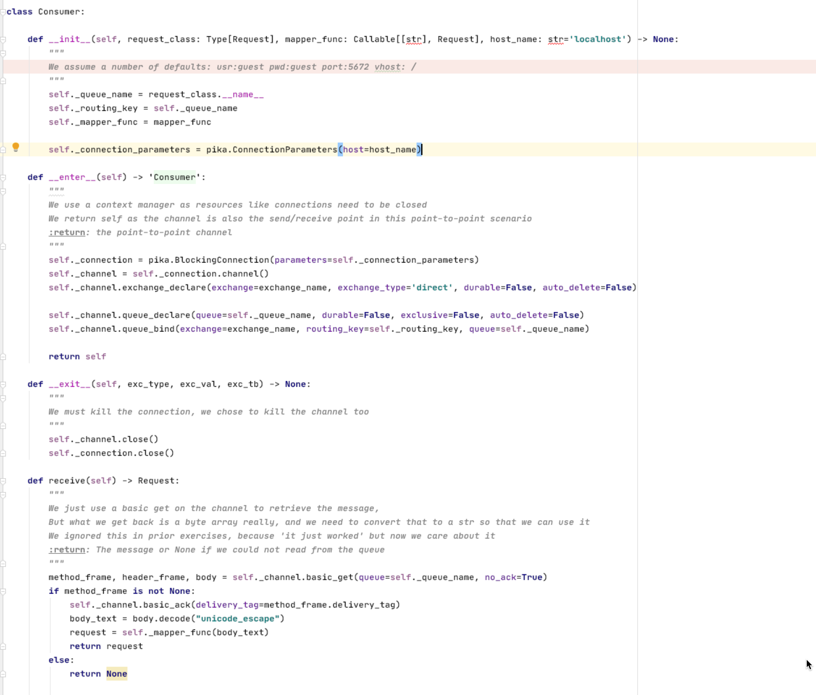
We pass in a deserialization function
You’ll need to serialize as well
We deserialize the message body

Slide 8
JavaScript

Slide 9
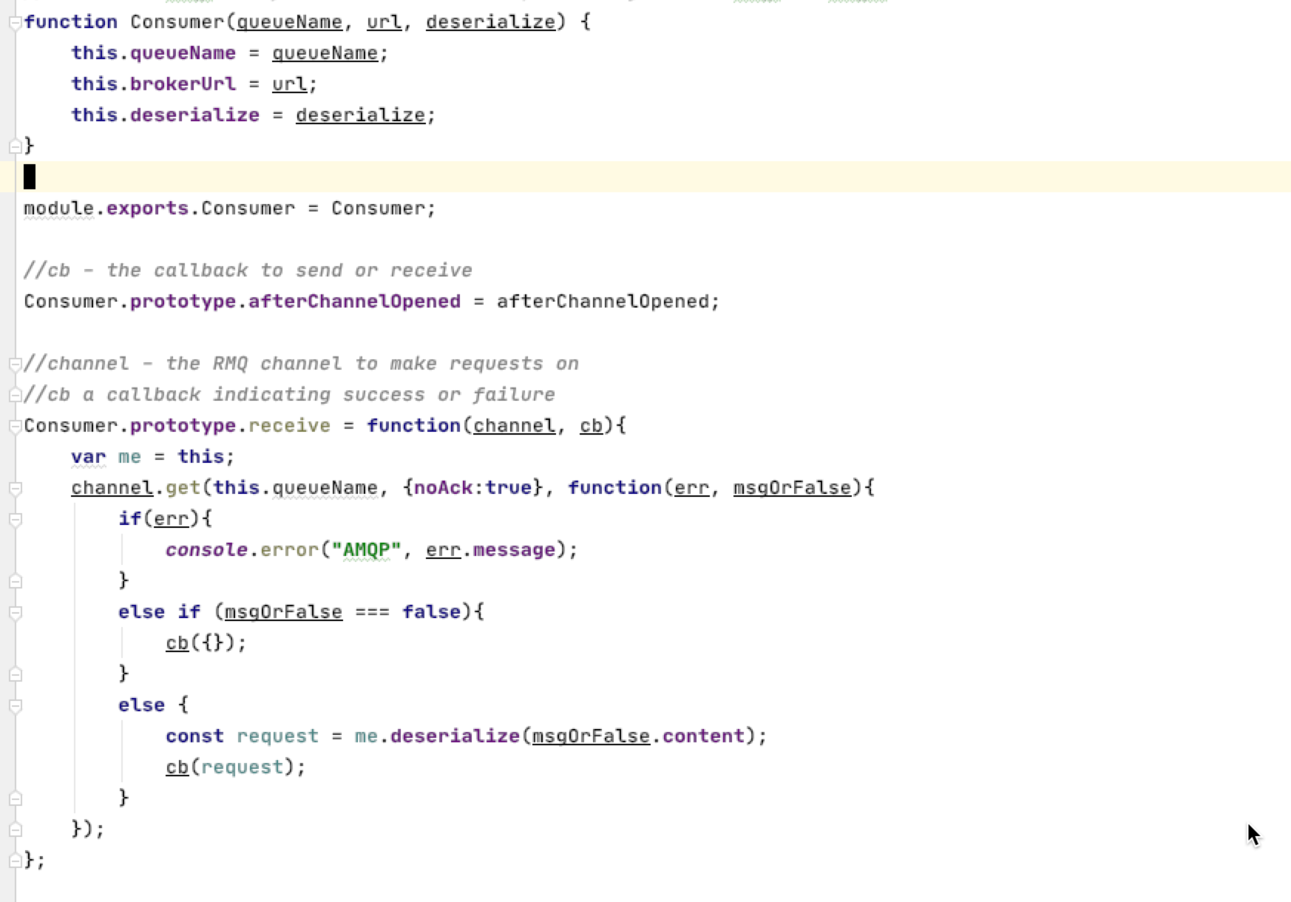
We pass in a deserialization function
You’ll need to serialize as well
We deserialize the message body

Slide 10
Java

Slide 11
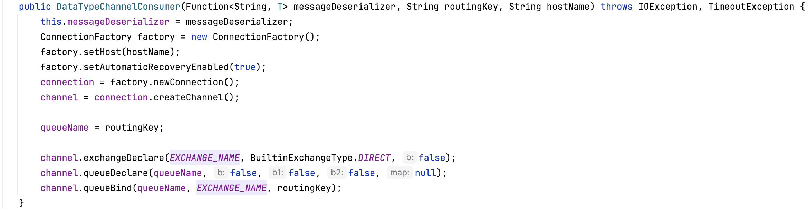
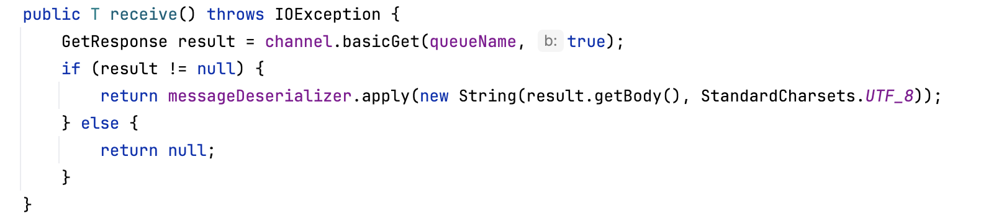
You’ll need to serialize as well
We pass in a deserialization function
We deserialize the message body

Slide 12
Go

Slide 13
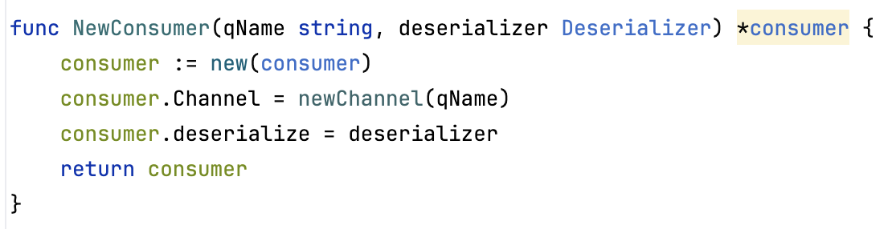
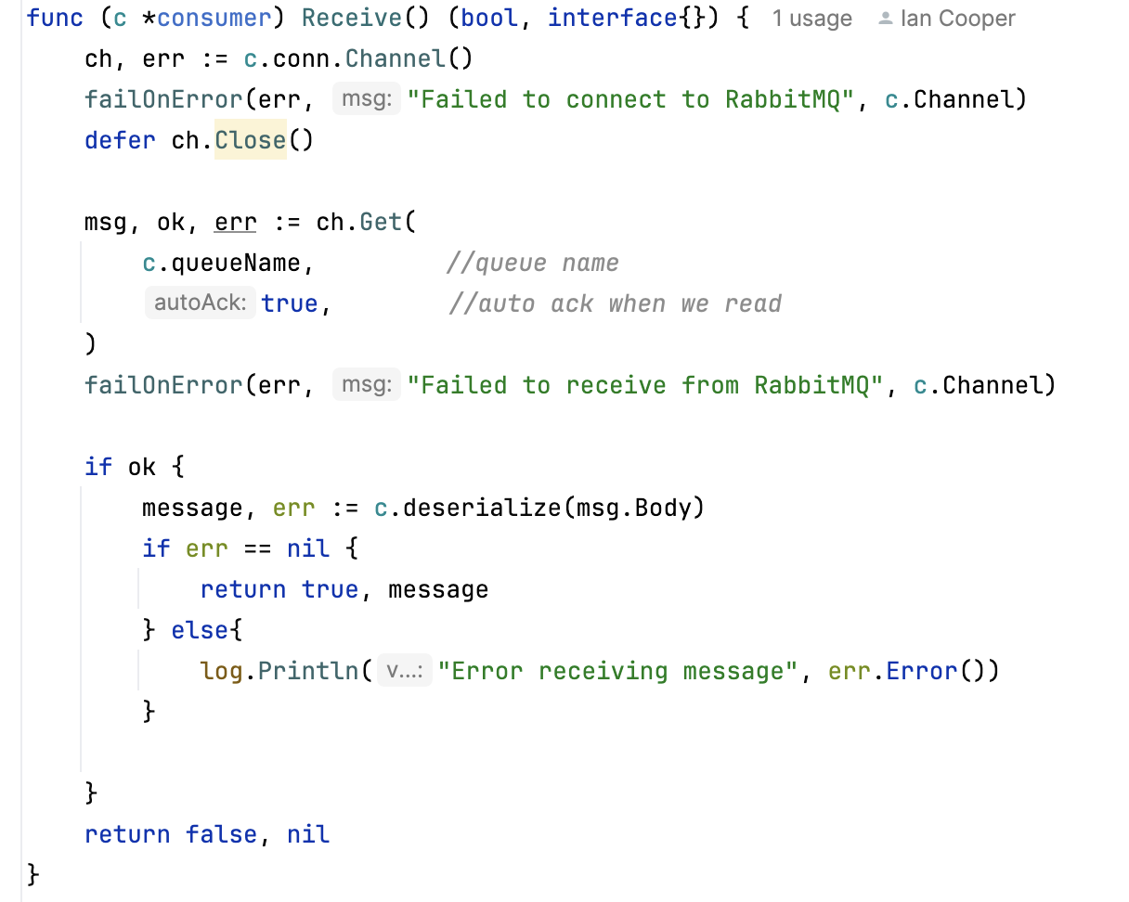
We pass in a deserialization function
You’ll need to serialize as well
We deserialize the message body

