Slide 1
Invalid Message Channel
Exercise Notes

Slide 2
Introduction
In this exercise you will create a Invalid Message Channel
RMQ calls this a Dead Letter Exchange
The problem with this moniker is that it is used for messages you have already received
This is an invalid message channel
And the reason to use it is that the type was not expected, or as-expected
RMQ handles failure to route via an Alternate Exchange
We don’t cover setting one of those up here as it is usually a policy action

Slide 3
Notes
As we are declaring everything in both consumer and producer we need to declare in both locations
We only show one in this deck as it is the same
You still need to implement both
We use the expedient of deliberately sending the wrong message
This is used to force an error you can see in the Dead Letter Queue
It is representative however of versioning errors which we discuss in part 2
You will need to use the Management Web Page to view the results
As we don’t have a client of the dead letter queue

Slide 4
C#

Slide 5
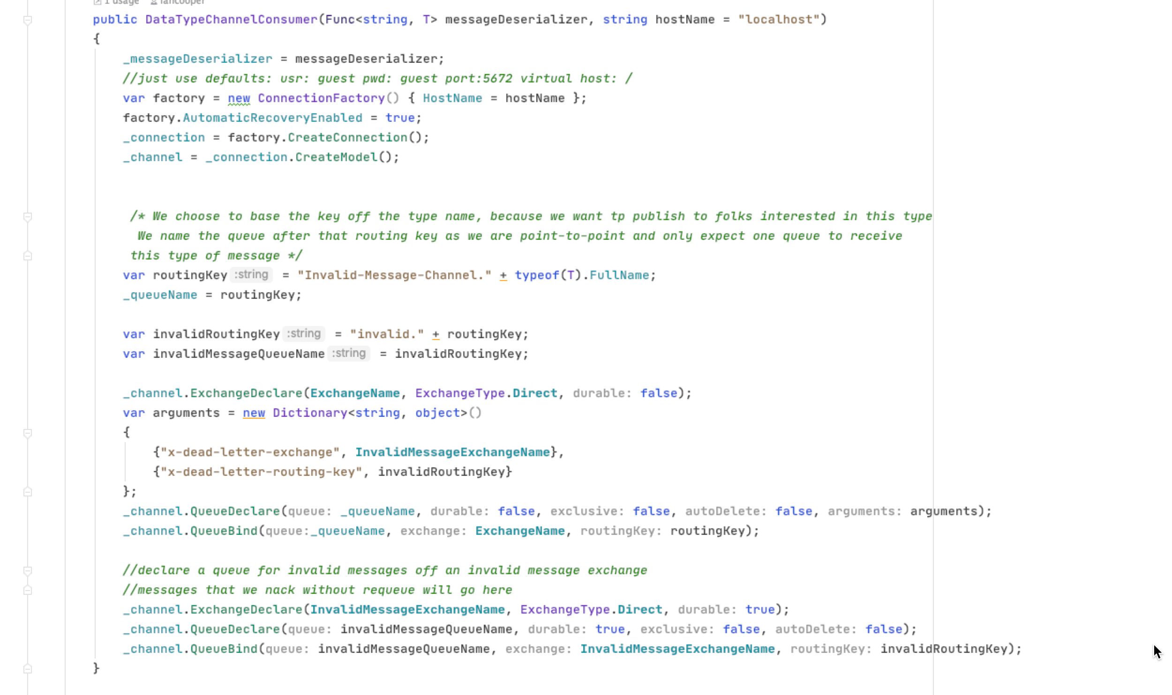
When we create our queue we pass it in the dead letter exchange name
To route to our DLQ we have to send in the routing key
We can create the dead letter exchange after we identify it when creating the queue
We bind the DLQ
We create the DLQ

Slide 6
Python

Slide 7
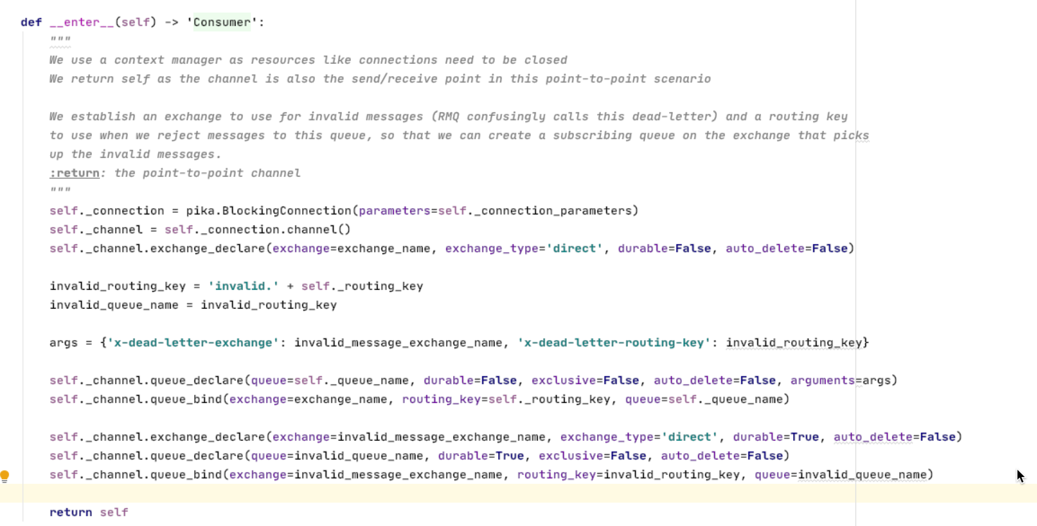
To route to our DLQ we have to send in the routing key
When we create our queue we pass it in the dead letter exchange name
We can create the dead letter exchange after we identify it when creating the queue
We create the DLQ
We bind the DLQ

Slide 8
JavaScript

Slide 9
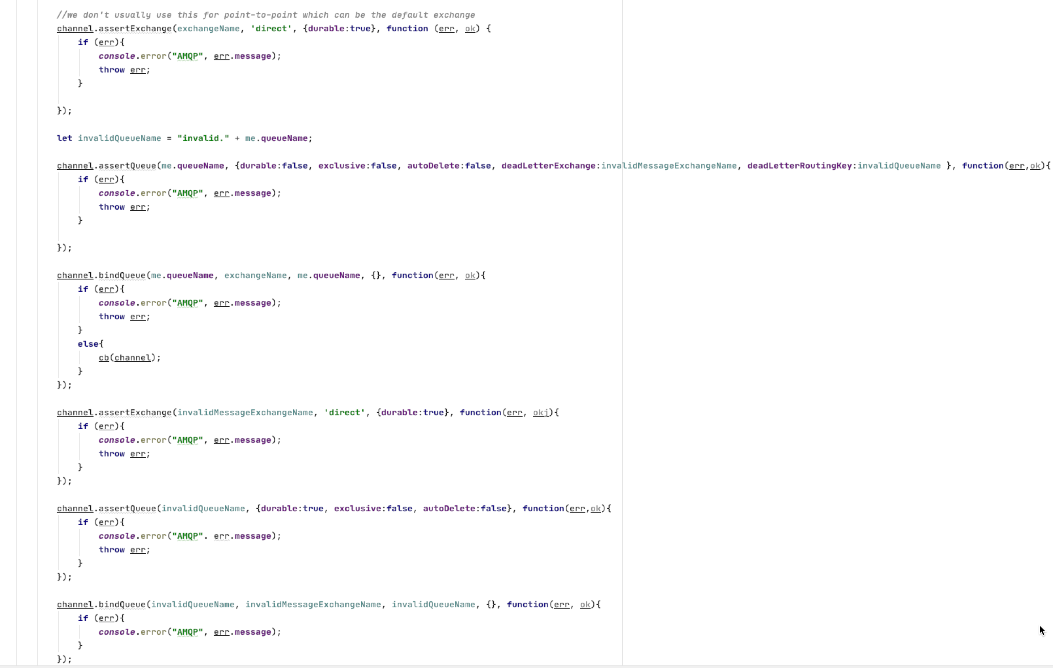
When we create our queue we pass it in the dead letter exchange name
To route to our DLQ we have to send in the routing key
We can create the dead letter exchange after we identify it when creating the queue
We create the DLQ
We bind the DLQ

Slide 10
Java

Slide 11
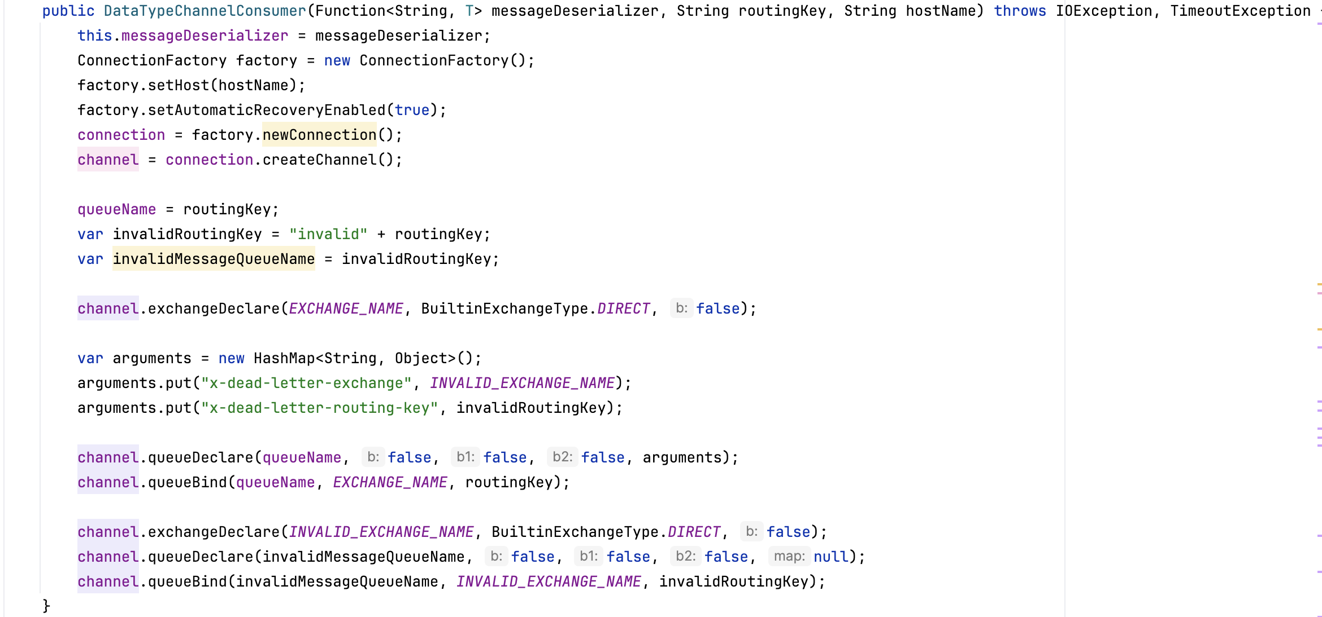
When we create our queue we pass it in the dead letter exchange name
To route to our DLQ we have to send in the routing key
We can create the dead letter exchange after we identify it when creating the queue
We bind the DLQ
We create the DLQ

Slide 12
Go

Slide 13
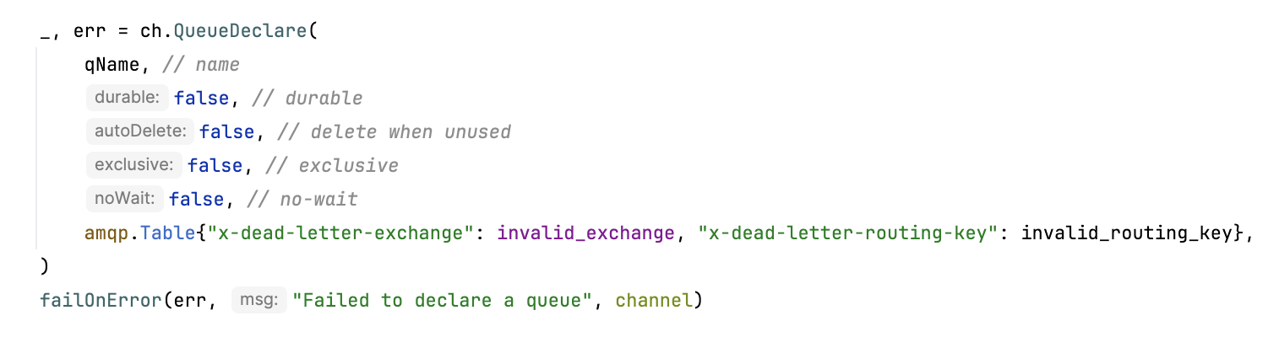
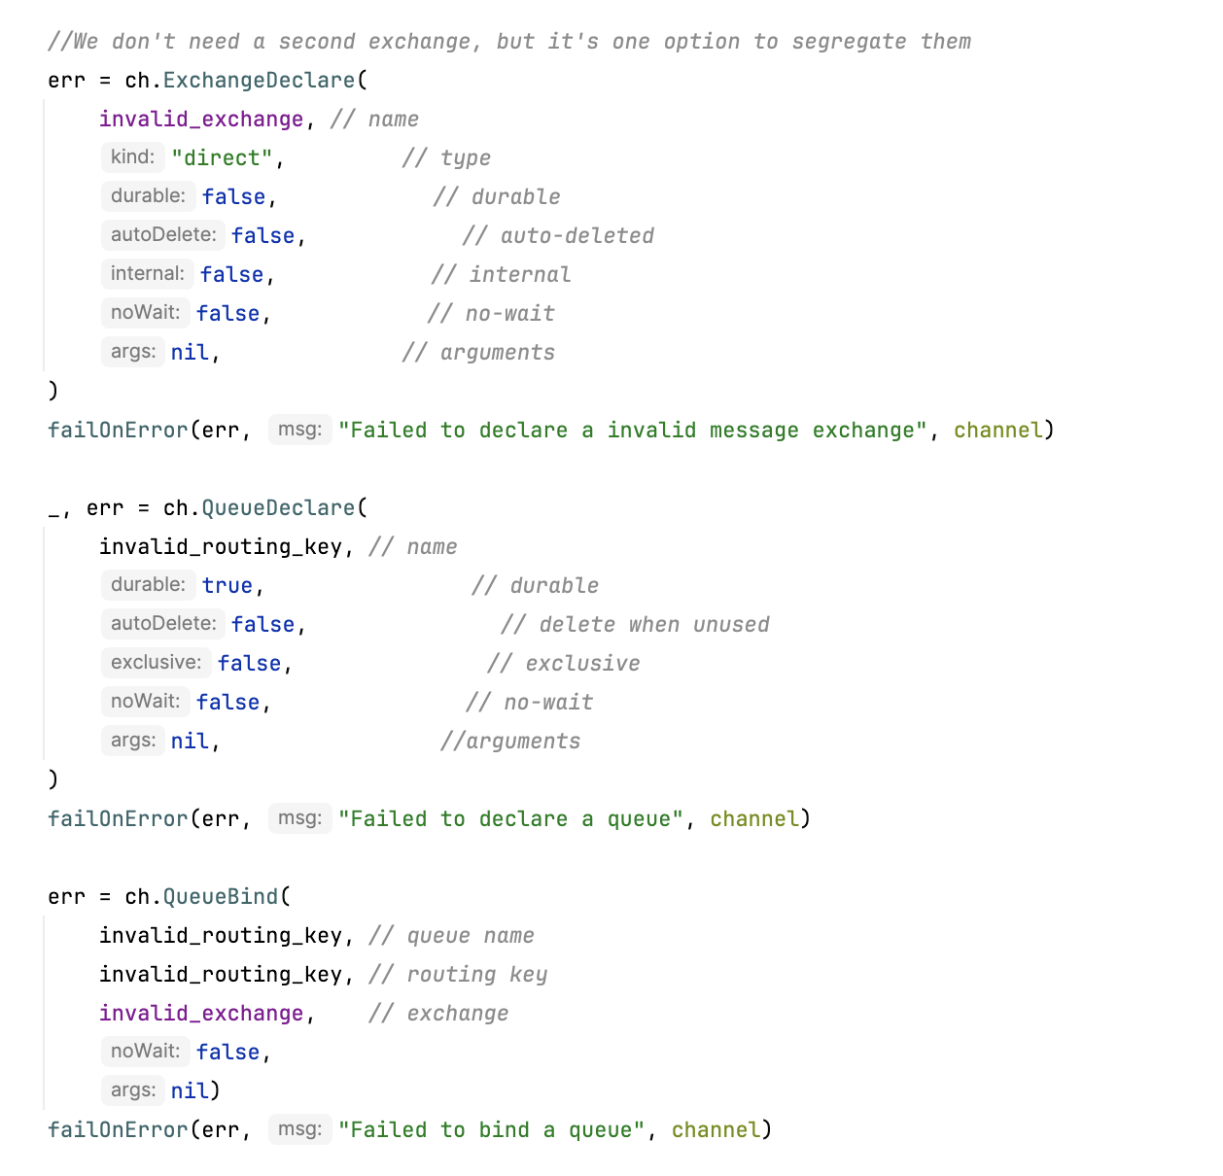
When we create our queue we pass it in the dead letter exchange name
To route to our DLQ we have to send in the routing key
We can create the dead letter exchange after we identify it when creating the queue
We bind the DLQ
We create the DLQ

