Slide 1
Pipes and Filters
Exercise Notes

Slide 2
Introduction
In this exercise you will create a Content Enricher
Previously we forwarded a message from a Producer to a Consumer
The message travelled by an Exchange
An RMQ Exchange is a Dynamic Router
Or perhaps a direct/default exchange is a Recipient List and a topic exchange is a dynamic router

Slide 3
Notes
We create an explicit Filter type, but that is actually unnecessary
A Handler can take a dependency on a Producer and send in response to actioning a message
Often understood as receive Command and raise Event/Document in response
Our use here is mainly to highlight the role being played, which is often elided when we think about a Hander raising an event in turn.
Ask Ian to tell you about Clarissa, when you reach this point
We’ll explain how it relates to messaging

Slide 4
C#

Slide 5
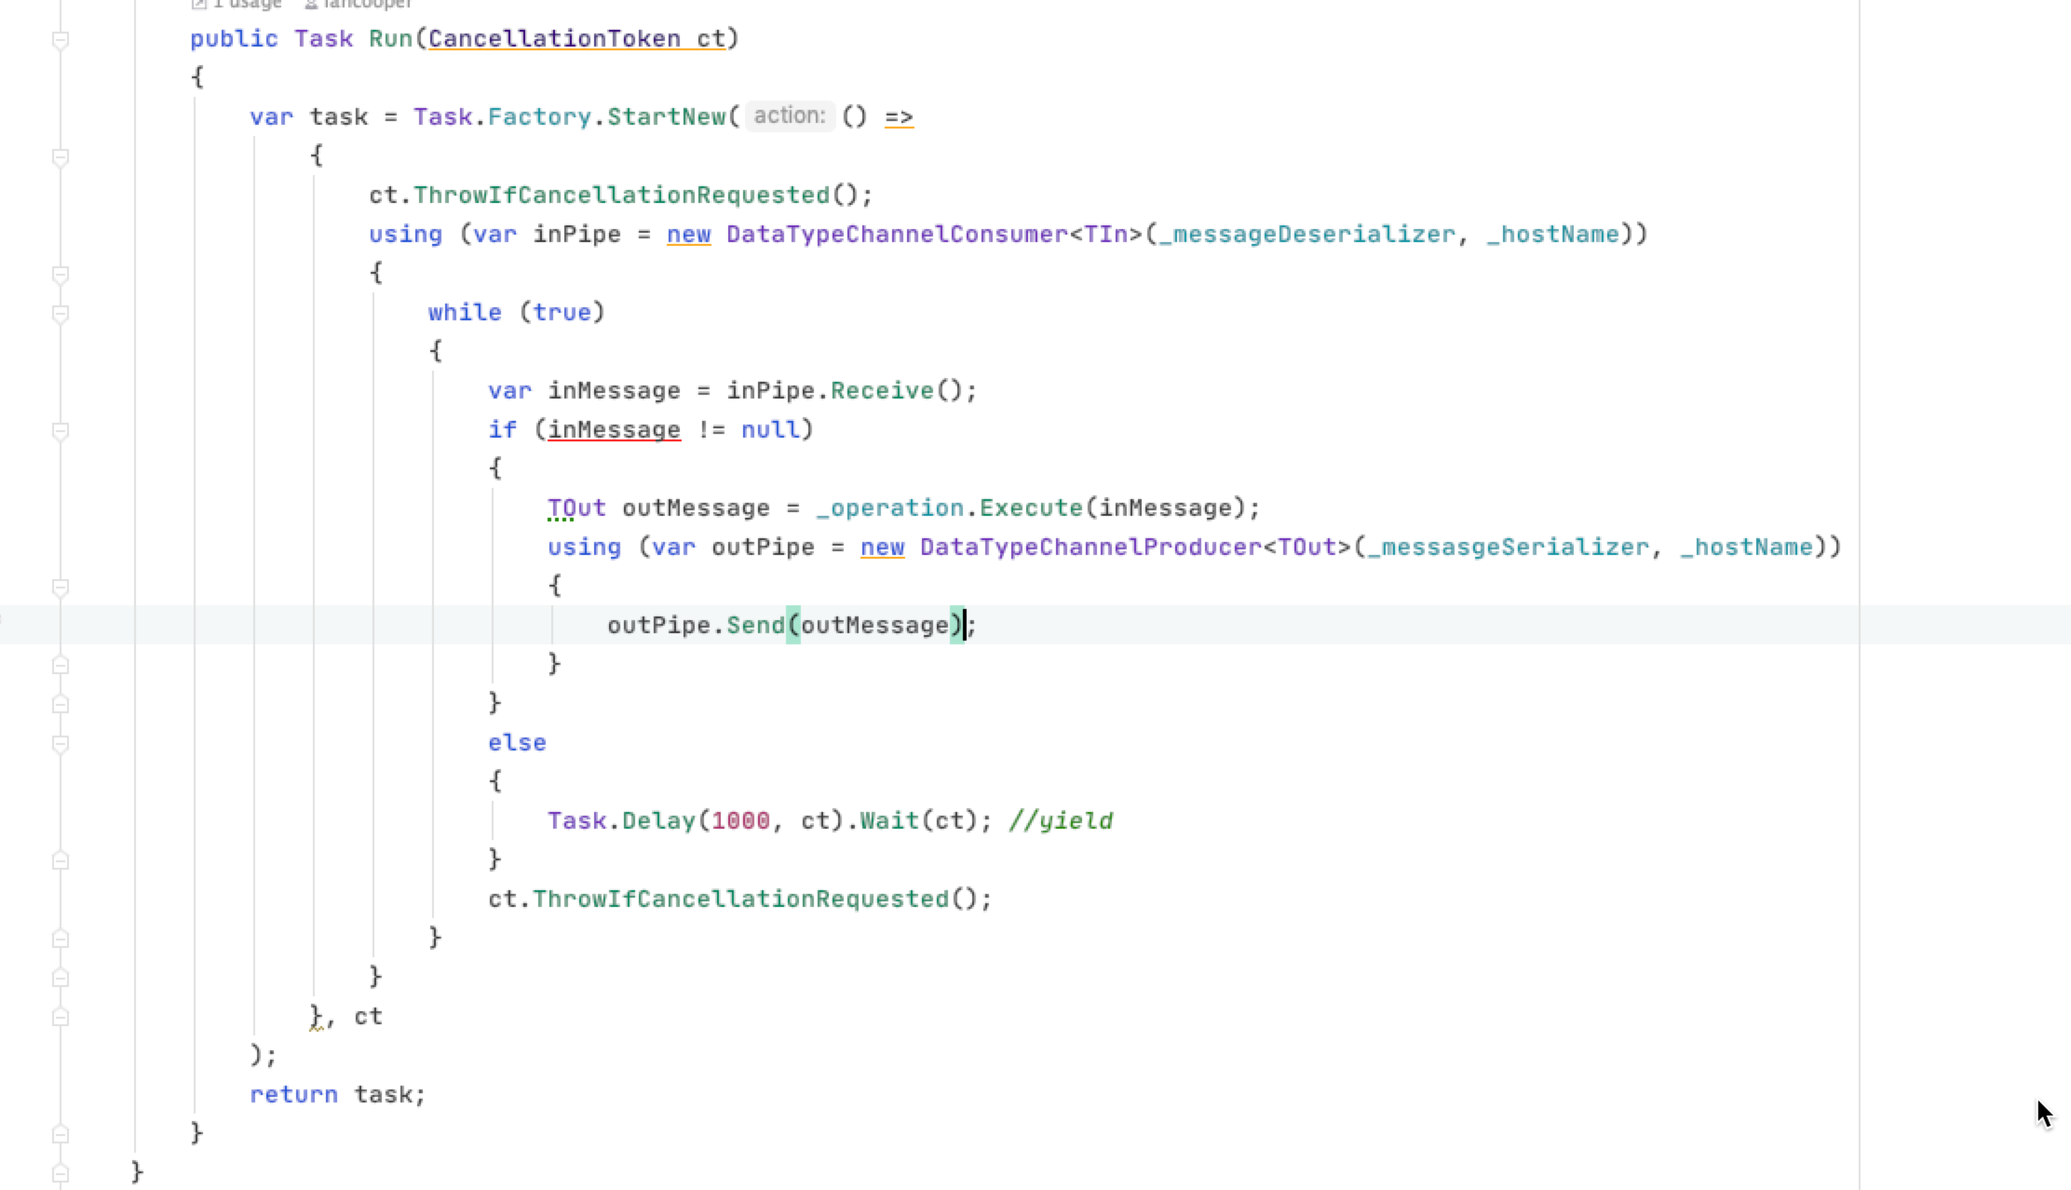
We are running a message pump
We receive on the in port
A handler transforms the code
We forward on the out port

Slide 6
Python

Slide 7
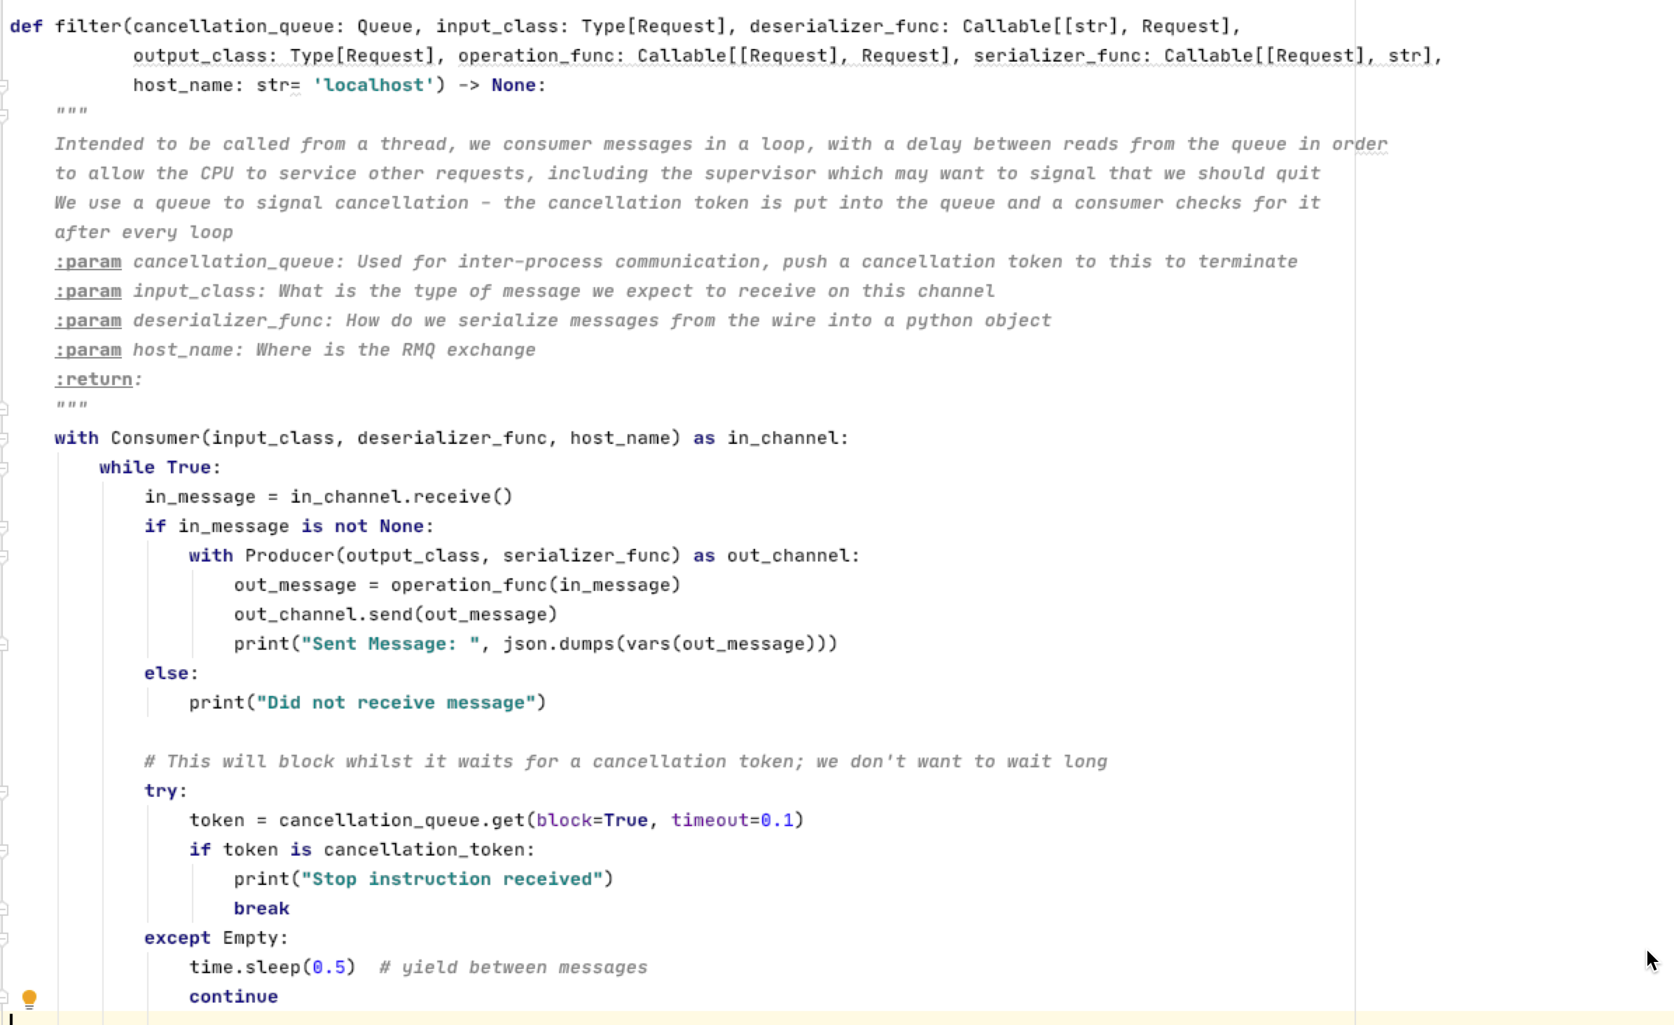
We are running a message pump
We receive on the in port
A handler transforms the code
We forward on the out port

Slide 8
JavaScript

Slide 9
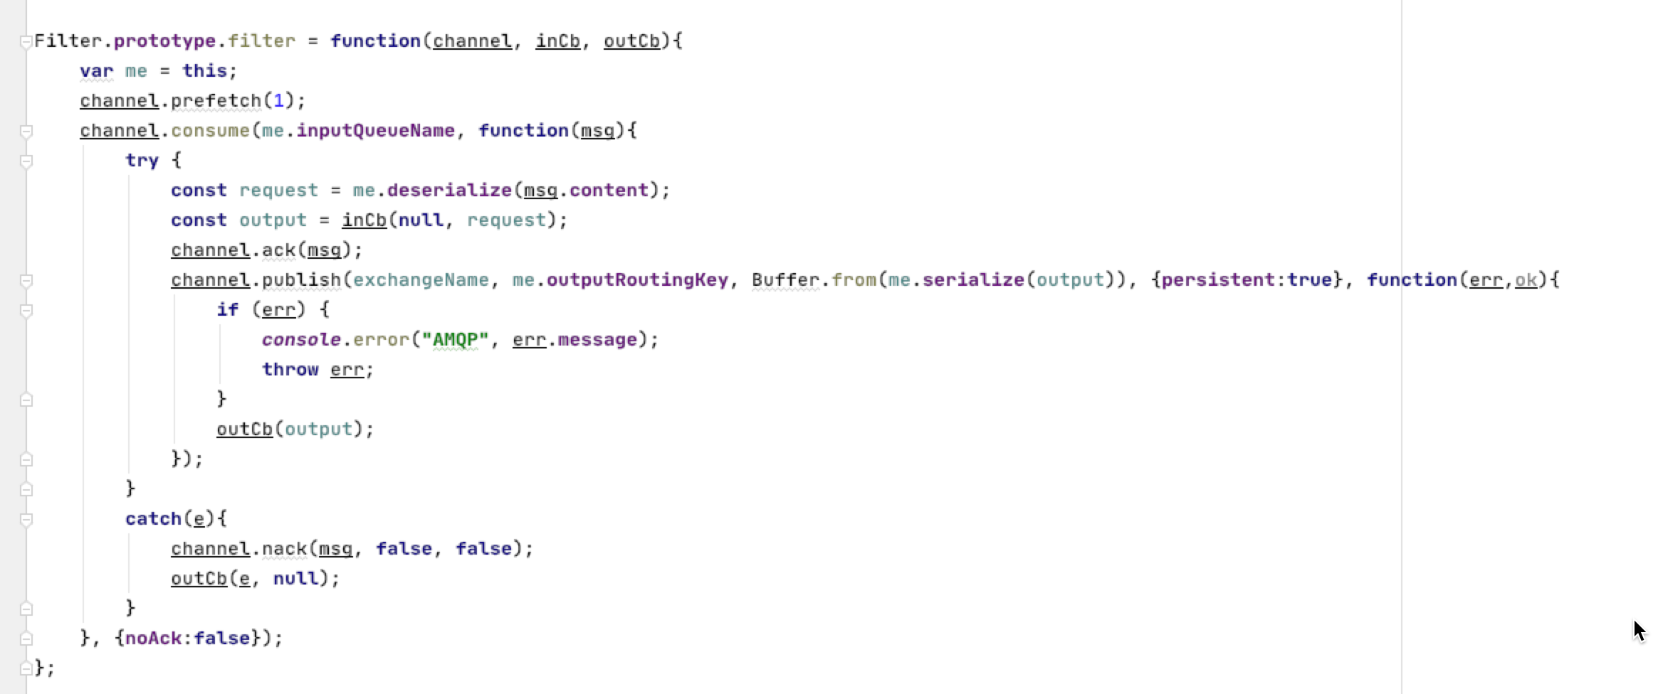
We receive on the in port
A handler transforms the code
We forward on the out port

Slide 10
Java

Slide 11
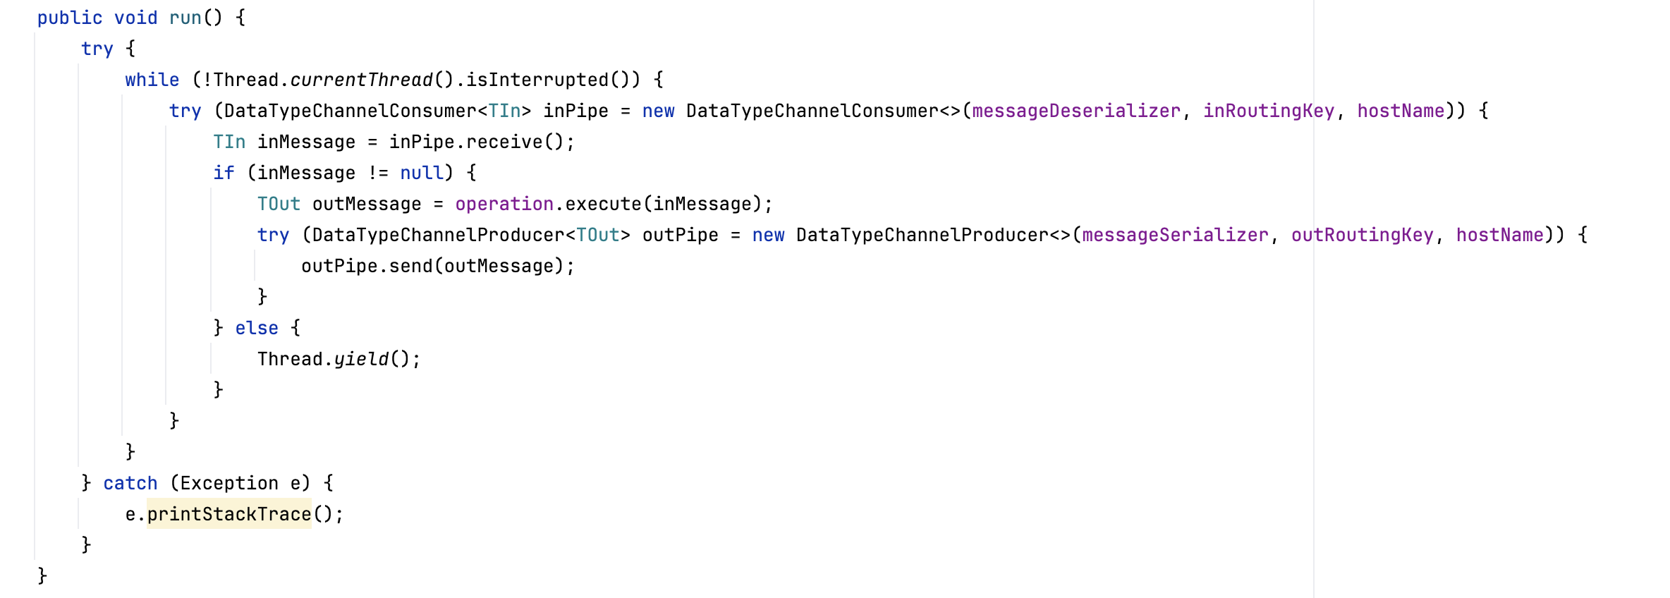
We are running a message pump
We receive on the in port
A handler transforms the code
We forward on the out port

Slide 12
Go

Slide 13
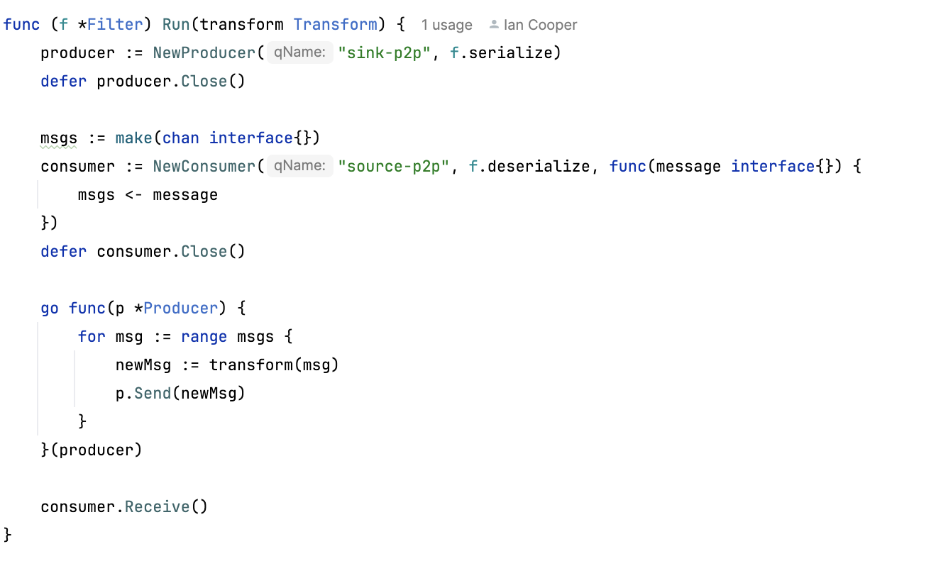
We receive on the in port
We are running a message pump
A handler transforms the code
We forward on the out port

