Slide 1
Point To Point Channel
Exercise Notes

Slide 2
Introduction
In this exercise you will create a Point To Point channel
RMQ does not have a Point To Point channel
RMQ mediates all producer consumer interaction through an exchange – a dynamic router. We will cover that pattern later.
However, we can emulate a Point To Point channel by ensuring that one queue subscribes to one routing key
We could also use the Default Exchange, which maps queue names to a routing key name – but we want to build on the Direct Exchange later, so we are using convention instead.

Slide 3
Notes
Much of this exercise is learning how to create AMQ model primitives
You will learn how to create an Exchange, a Queue and a binding between them
This forms the foundation for other exercises

Slide 4
C#

Slide 5
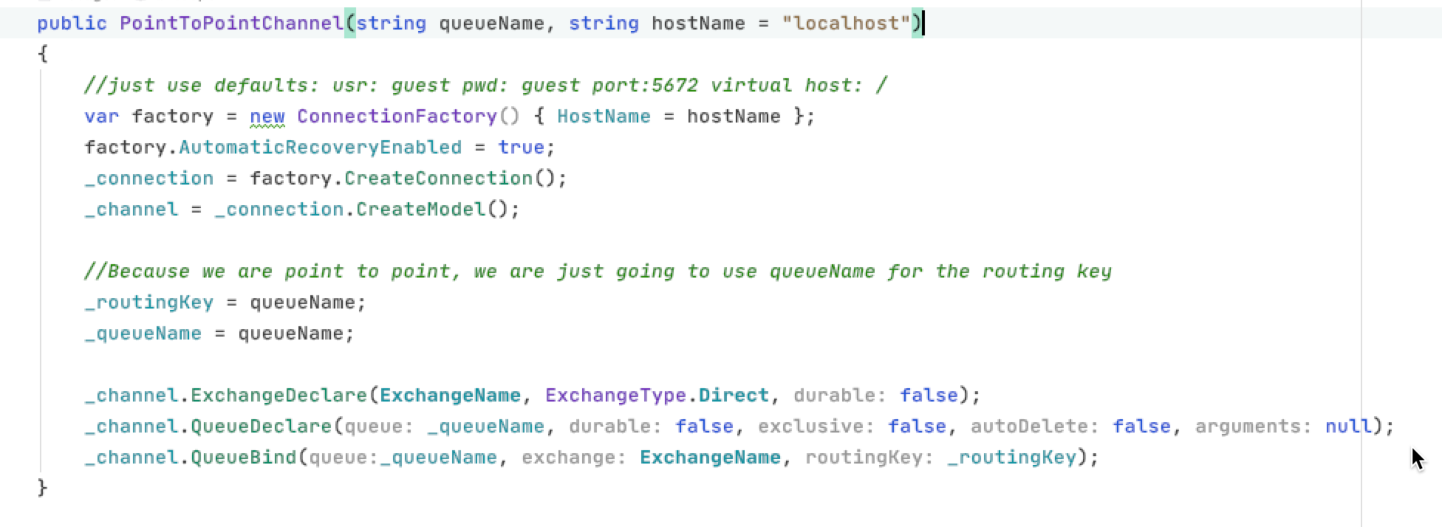
We need to create the Exchange
We need to create the Queue
We need to route messages to the Queue

Slide 6
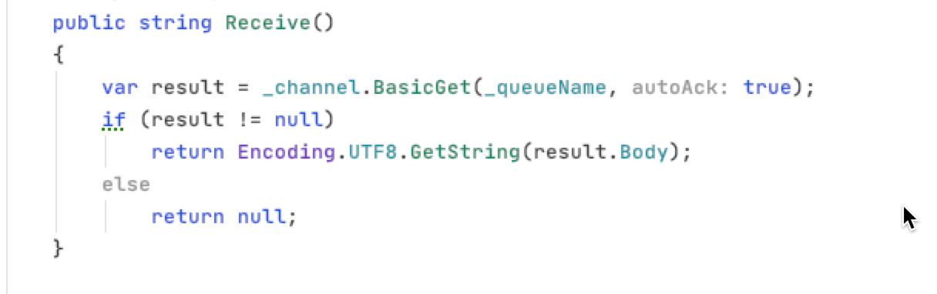
You’ll need to do send as well!!
This polls for messages on the queue.
We set autoAck to true so that a message will be acked as soon as read.
This is convenient, but carries the danger that if we crash, the work will be lost!

Slide 7
Python

Slide 8
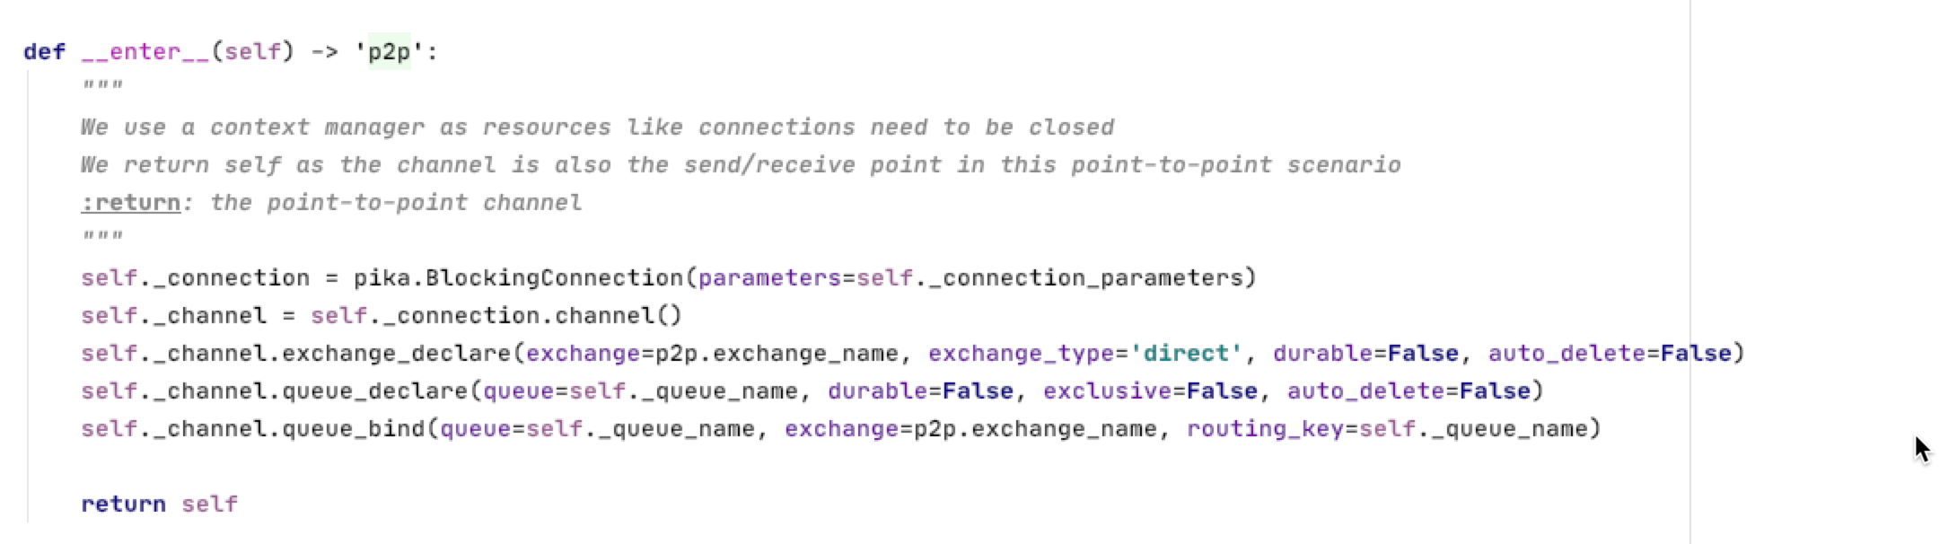
We need to create the Exchange
We need to create a Queue
We need to route messages to the Queue

Slide 9
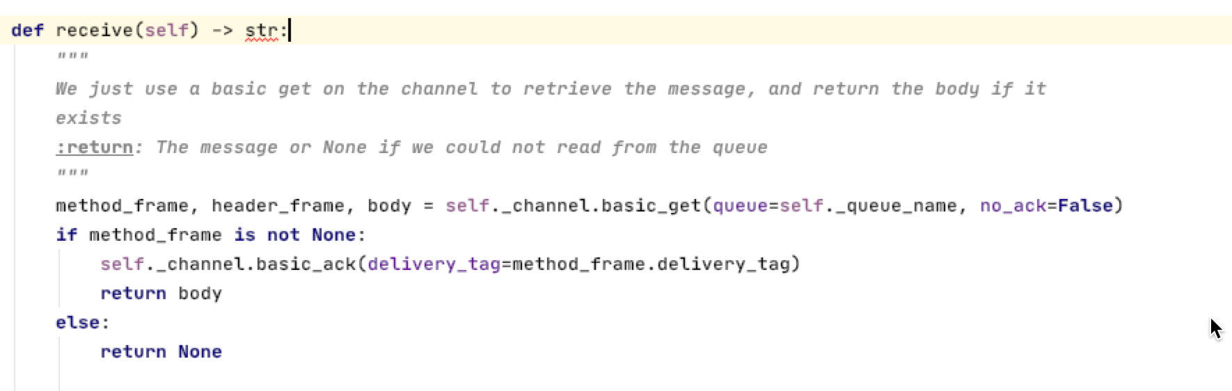
You’ll need to do send as well!!
This polls for messages on the queue.
We set autoAck to false so that we must explicity acknowledge the message when done.
We ack the message.

Slide 10
JavaScript

Slide 11
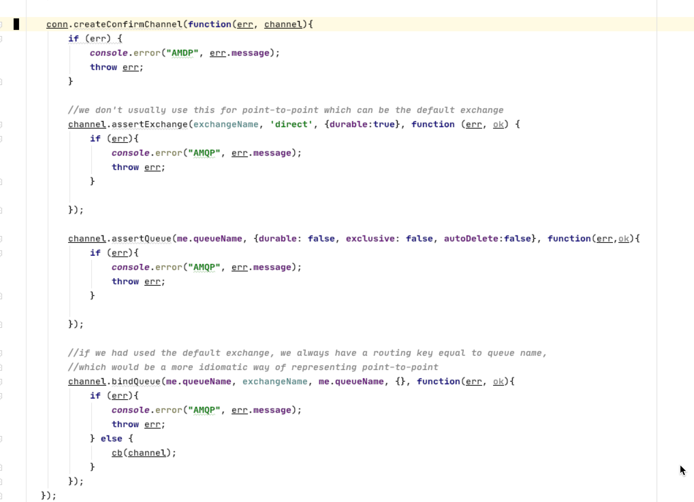
We need to create the Exchange
We need to create a Queue
We need to route messages to the Queue

Slide 12
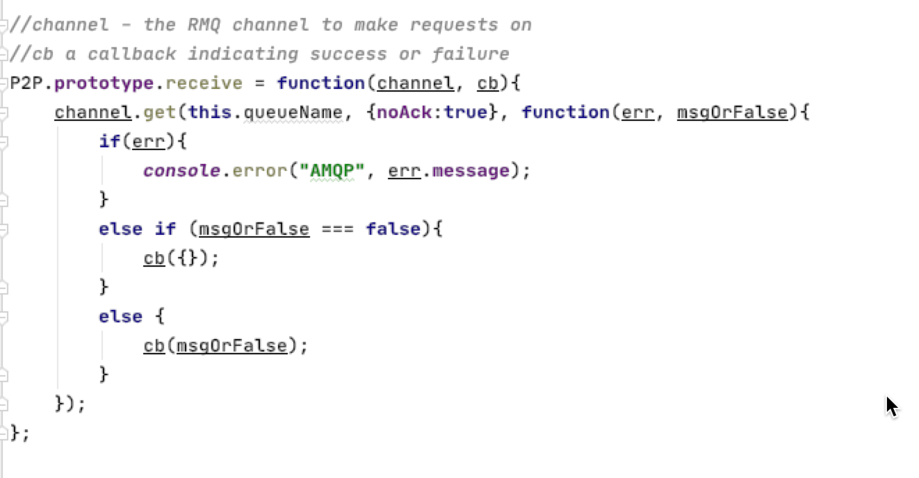
You’ll need to do send as well!!
This polls for messages on the queue.
We set autoAck to false so that we must explicity acknowledge the message when done.
We ack the message.

Slide 13
Java

Slide 14
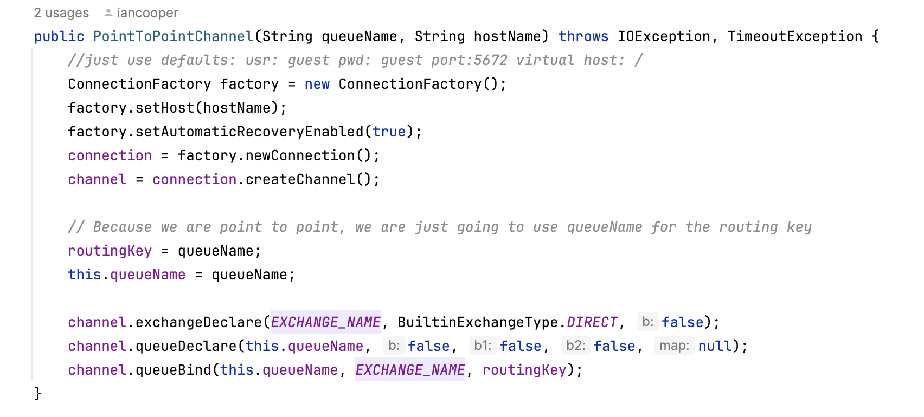
We need to create the Exchange
We need to create the Queue
We need to route messages to the Queue

Slide 15
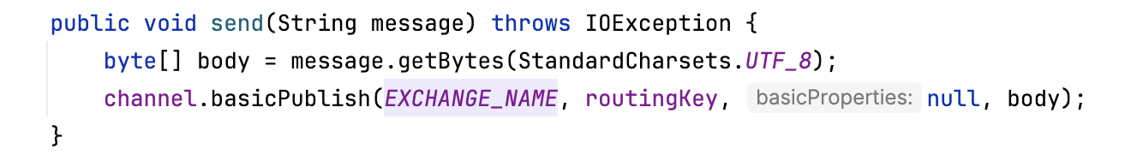
You’ll need to do send as well!!
This polls for messages on the queue.
We set autoAck to true so that a message will be acked as soon as read.
This is convenient, but carries the danger that if we crash, the work will be lost!

Slide 16
Go

Slide 17
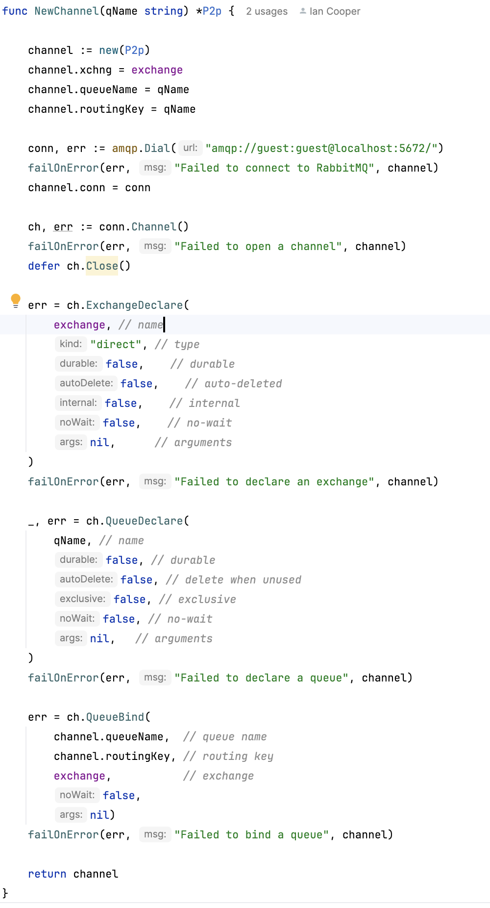
We need to create the Exchange
We need to create a Queue
We need to route messages to the Queue

