Slide 1

WIKI -> Sharepoint
Team: VAS & BILLING
Prepared By: Stephen Ghool

Slide 2
Introduction
What is Sharepoint?
Web-based collaborative platform
Organizations use it to share and manage content
Benefits of using sharepoint
Easily scalable
Enable secure cross collaboration
Ease of management

Slide 3
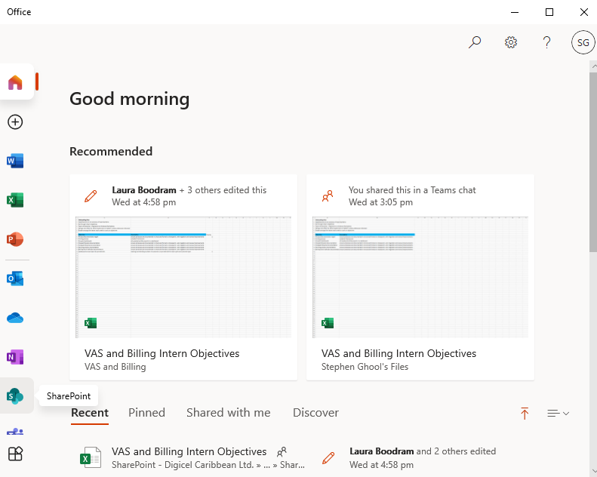
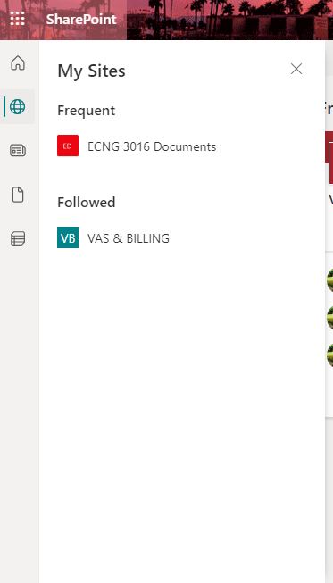
How to Access ?

Slide 4
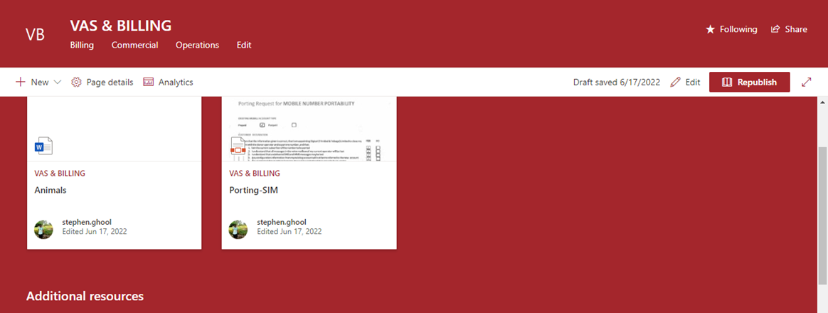
Welcome to Sharepoint Site

Slide 5
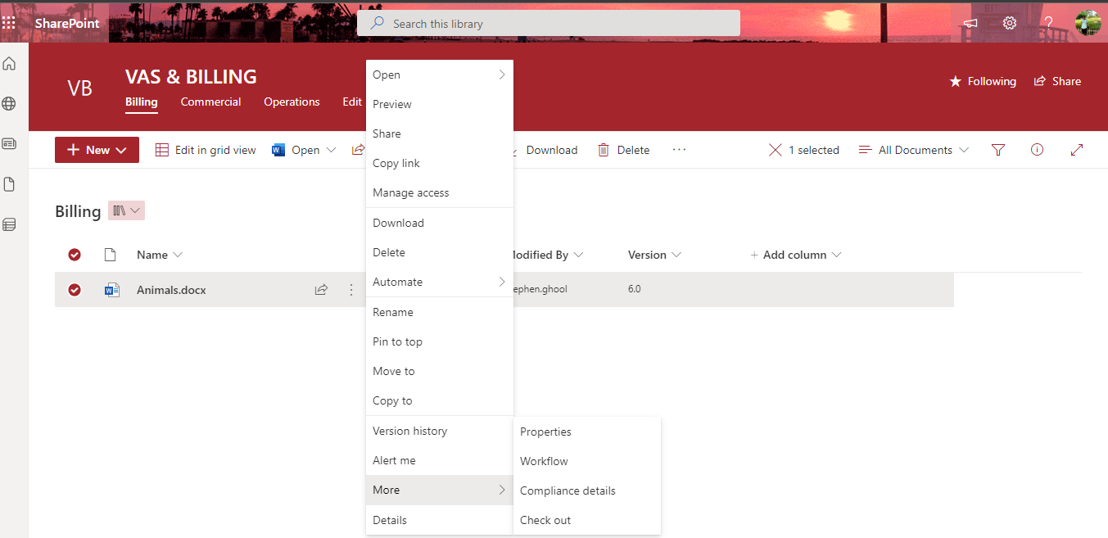
How to create tags ?
Select: More -> Properties

Slide 6
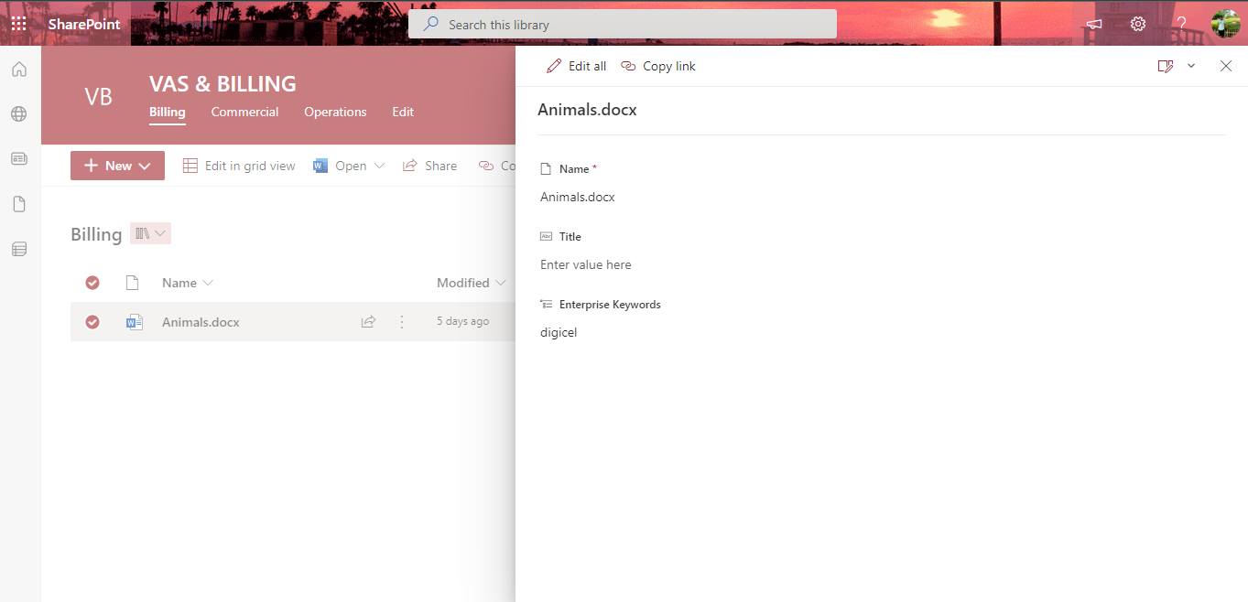
How to create tags ?
Enter tag/keyword, then press enter

Slide 7
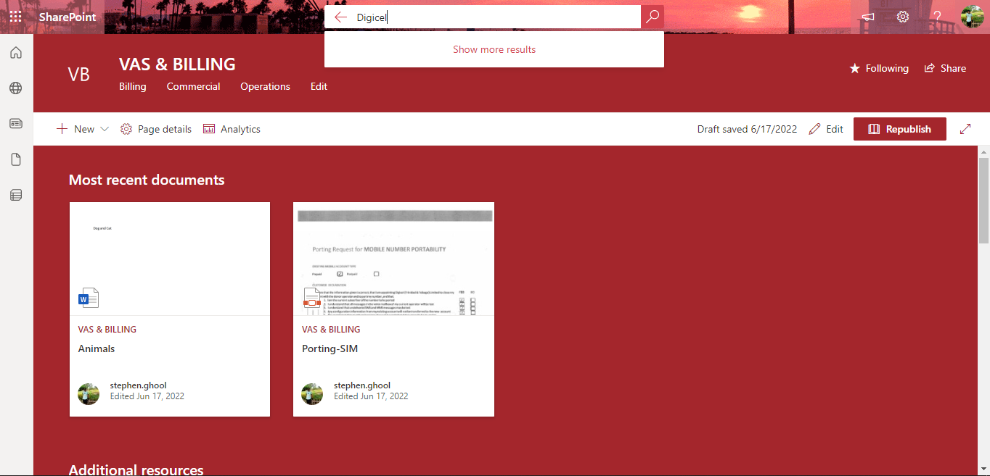
Search using tags
Enter tag/keyword, then press enter

Slide 8
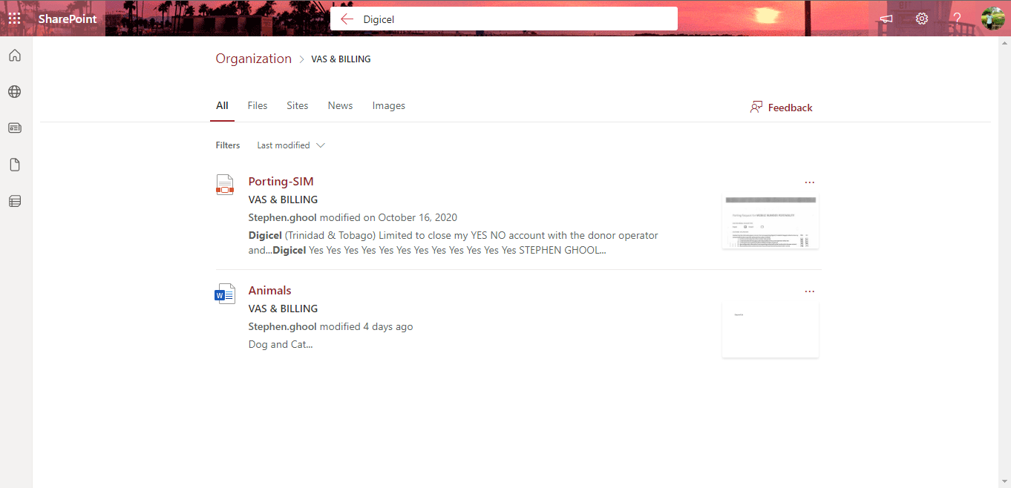
Search using tags
Returns documents with search parameter within the contents
as well as documents tagged with search parameter

Slide 9

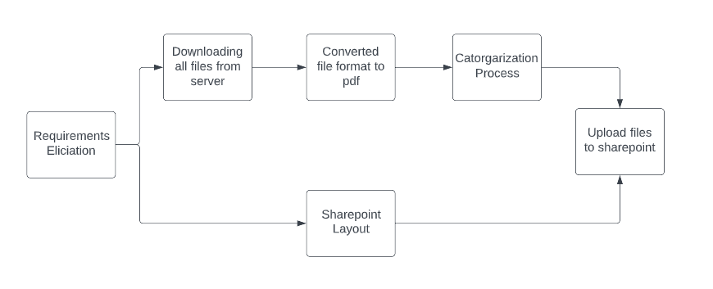

Solution Overview

Slide 10
Requirements
Search
Edit
Version Control
Tagging/ Categories

Slide 11
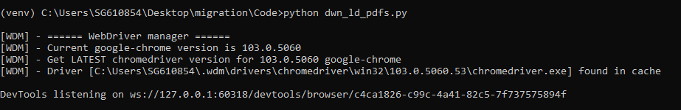
Downloading from server
Login to Website
Navigate to different files
Download pdf file

Slide 12
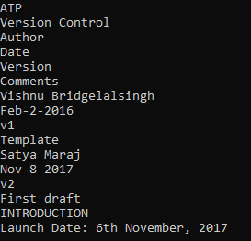
Converting to PDF
Extracted PDF
Uploading to online PDF converter

Slide 13
Migration Challenges
Downloading all Wiki Files
Converting to an editable format on sharepoint
Online services are not free of charge
Could retrieve all in xml format but this would not be ideal
Could retrieve individually as pdf
R&I is being done to create a script to convert pdf to words.
An example service is ShareGate

Slide 14
Migration Challenges
#1 – Accessing all Wiki Files
Could retrieve all in xml format but this would not be ideal
Could retrieve individually as pdf
#2 – Converting to an editable format on sharepoint
Efforts are being made to create a script to convert pdf to words. This would automate the process however, we still need all the pdfs
#3 – Online services are not free of charge
An example service is ShareGate

Slide 15
Online Services
ShareGate

Slide 16


Slide 17
Pages vs Docs

