Slide 1
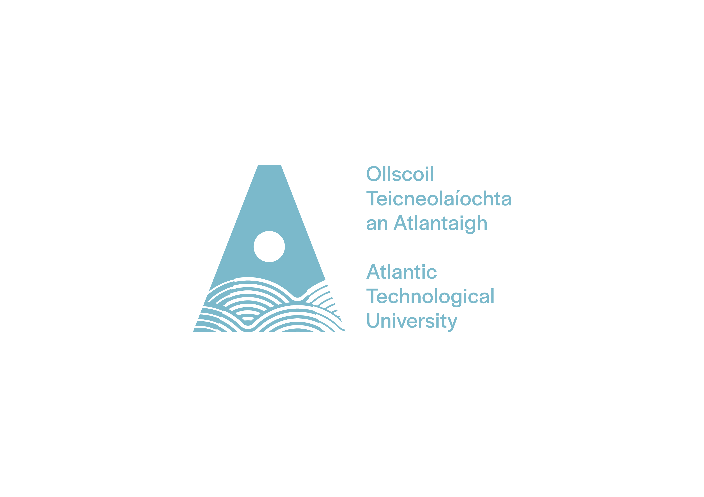

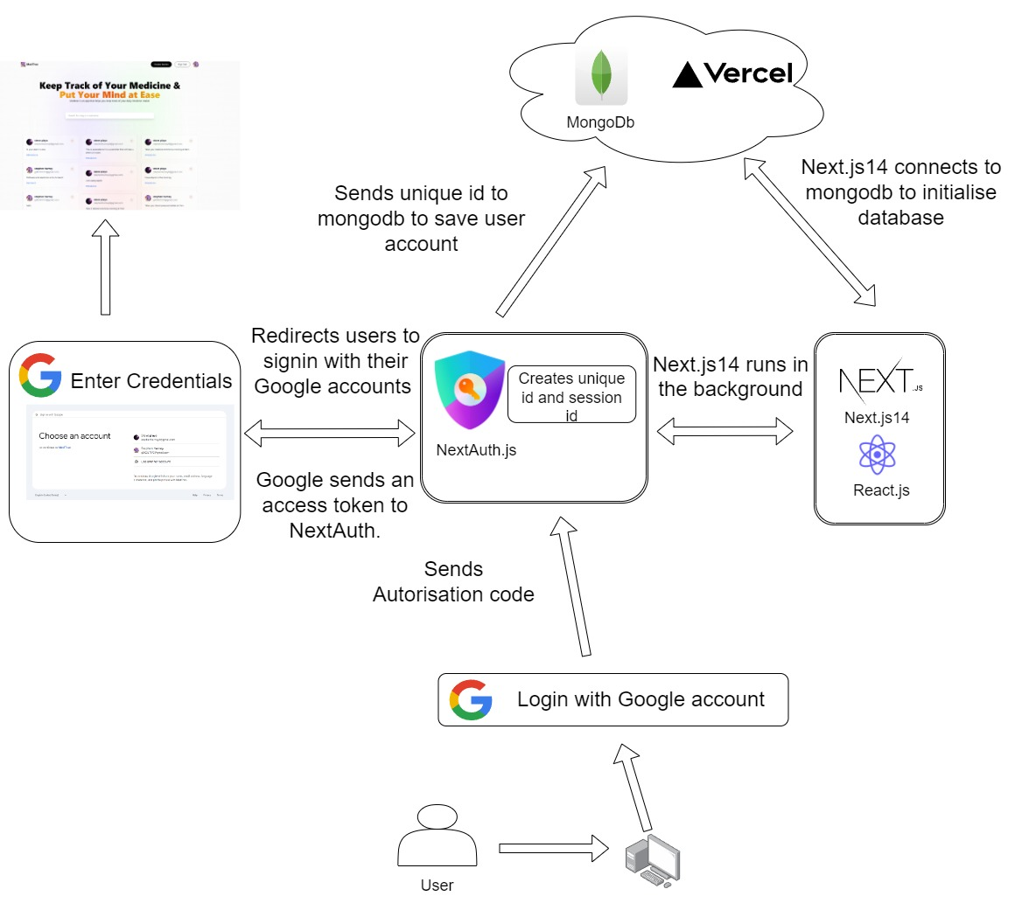

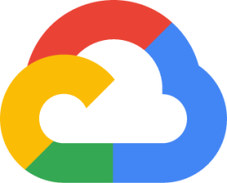

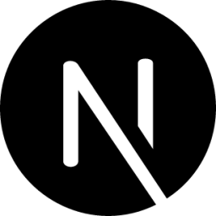
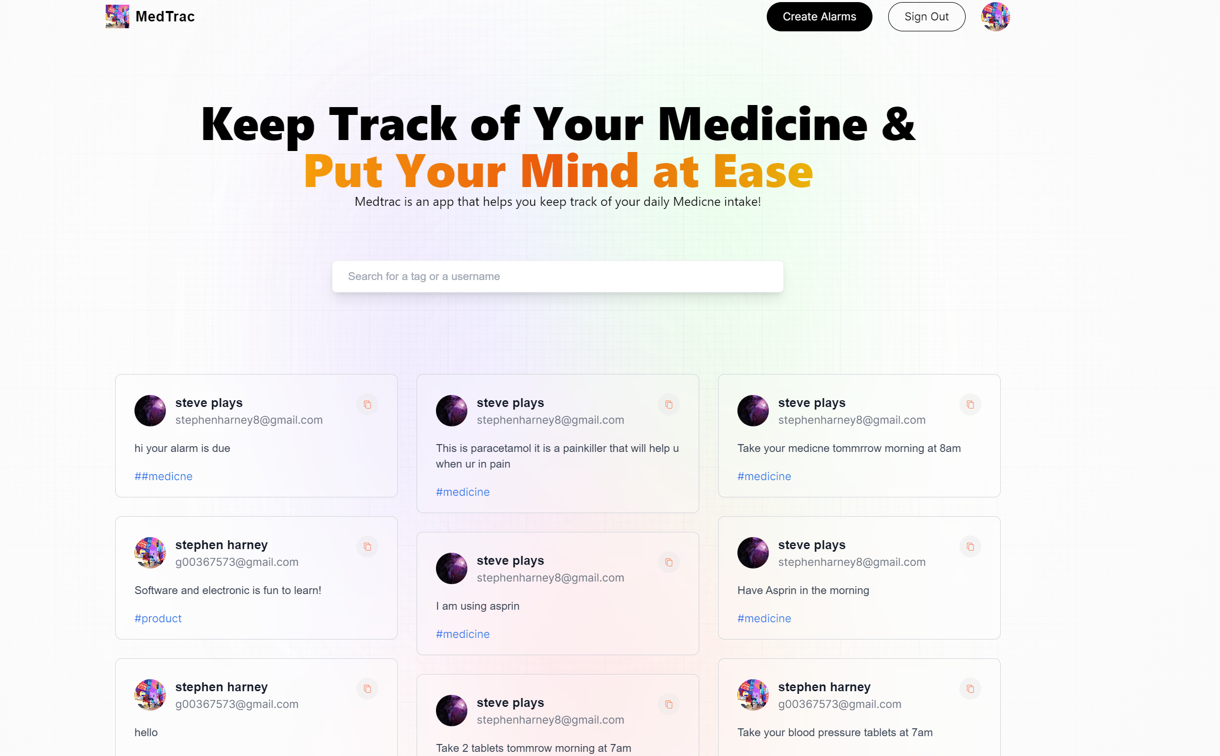
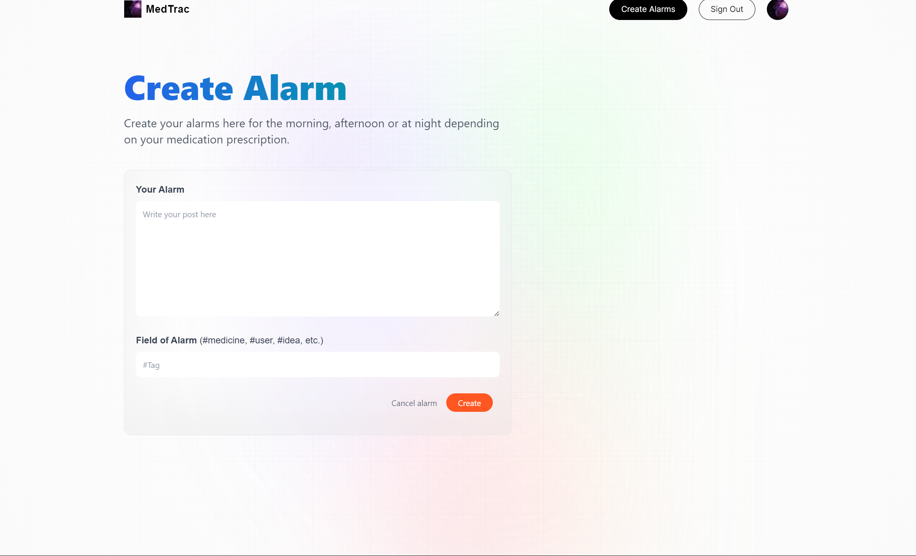
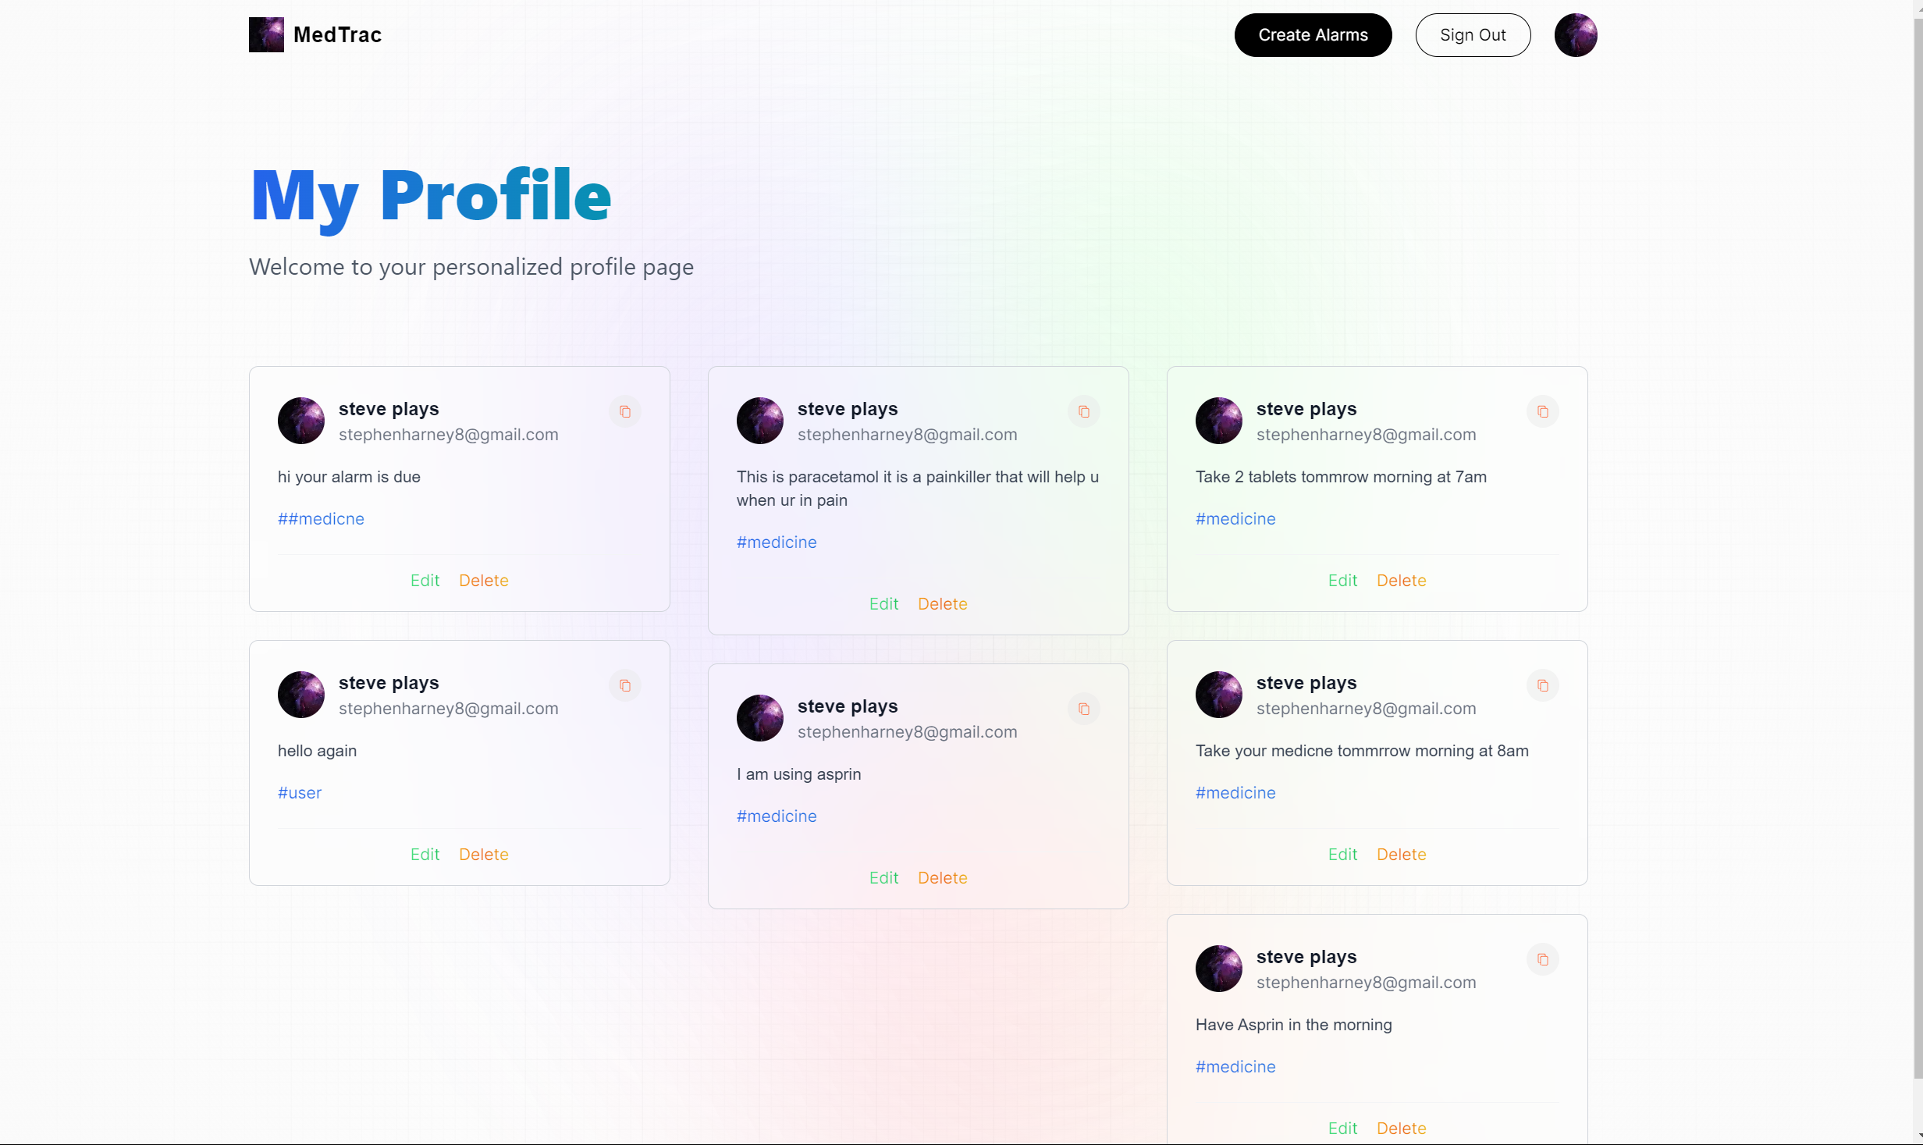
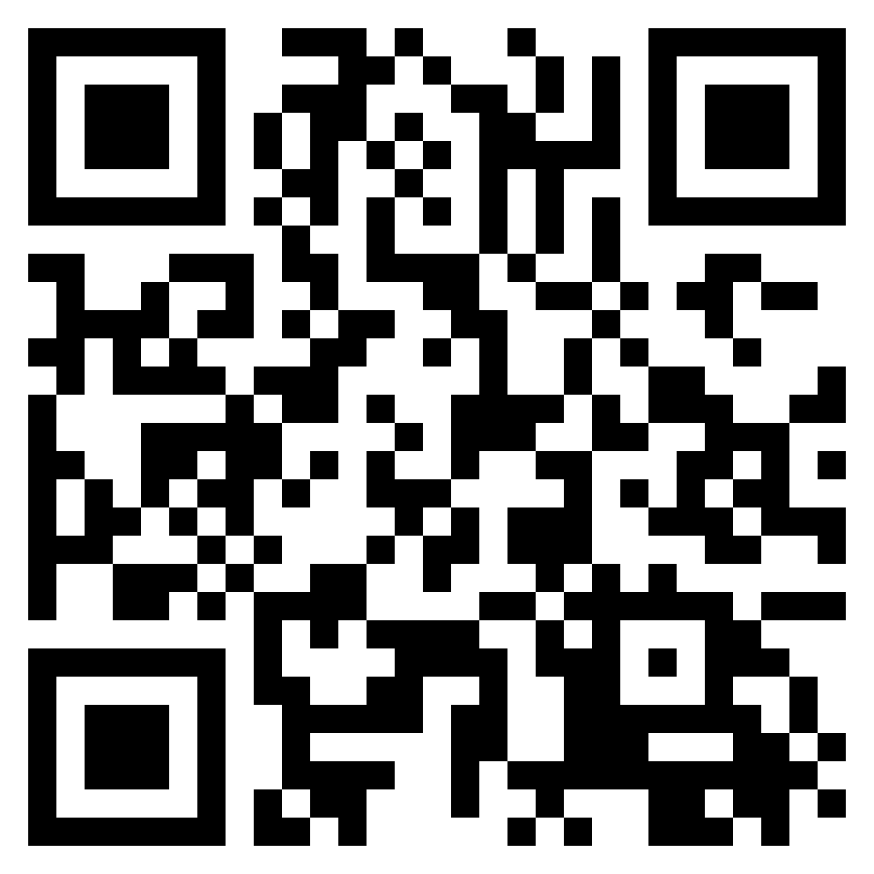
MedTrac
Introduction
Technologies
This is a web app that will track your medicine.
This is achieved by using Next.js14 Framework which is built on top of React.js.
NextAuth.js
GoogleCloud
Users will be able to sign in with their Google accounts using Google cloud and NextAuth.js for verifying the user authentication.
NextAuth will save the users unique id to MongoDB that will save the users account to MongoDB that will allow the user to be singed in.
MongoDB
Next.js14
Users would be able to create their alarms, delete and edit their alarms.
Results:
By Stephen Harney
BEng (Honours) Software and Electronic Engineering Level8
GitHub Source code:
Supervisor: Michelle Lynch

Slide 2
MedTrac
Introduction
Technologies
This is a web app that will track your medicine.
This is achieved by using Next.js14 Framework which is built on top of React.js.
NextAuth.js
GoogleCloud
Users will be able to sign in with their Google accounts using Google cloud and NextAuth.js for verifying the user authentication.
NextAuth will save the users unique id to MongoDB that will save the users account to MongoDB that will allow the user to be singed in.
MongoDB
Next.js14
Users would be able to create their alarms, delete and edit their alarms.
Results:
By Stephen Harney
BEng (Honours) Software and Electronic Engineering Level8
GitHub Source code:
Supervisor: Michelle Lynch

