Slide 1
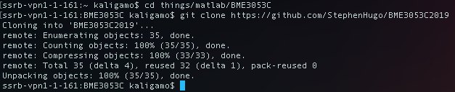
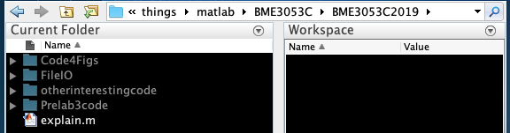
Getting code from a git repo
Using the terminal or command window, navigate to the folder where you want the repo using the cd command followed by the folder path.
Type: git init
Then: git clone https://github.com/StephenHugo/BME3053C2019
The code will be placed in that folder on your computer. Navigate there in MATLAB and make sure you add folders to the working path by right clicking and choosing ‘Add to Path’

Slide 2
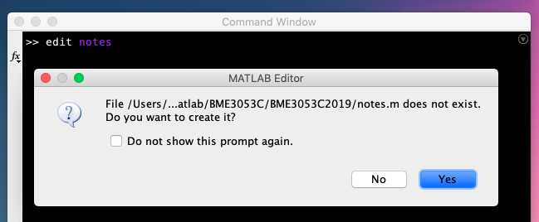
Creating a Script
There are several ways to work with MATLAB. I prefer using function and console commands, but you may prefer working with scripts. To create a script, type ‘edit’ and a name for your script file. Below I start a blank script named notes and MATLAB tells me it doesn’t exist, so go ahead and create it.

Slide 3
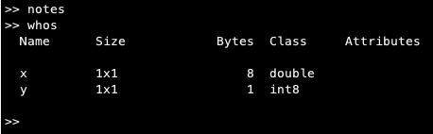
Running a Script
Once you type some code in your script, you can run the code using the button in the text editor window. I prefer running scripts from the command window (I love the command window).
The variables stored in memory appear in the workspace. This picture demonstrates how the notes script creates two variables: x and y.
The ‘whos’ command also displays variables in the workspace. X uses 8 bytes of memory and y uses only 1 byte, or 8 bits. The binary value for y = 1 is 0000 0001.
The binary value for x = 1 is 63 zeroes and a 1.

Slide 4
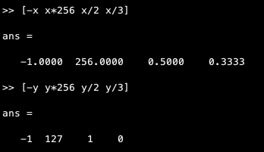
Variable types
The extra bits dedicated to x allow us to assign it large and small values, even fractions.
Since y only has 8 bits, it’s max value is 127 (2^7 -1 because you count from zero). The 8th bit is dedicated to the sign of the number, so while you can’t give y larger values or fractions, it can be negative.
Check out the notes.m file for more info about precision.
TLDR cast values to double precision to perform complex math operations.

Slide 5
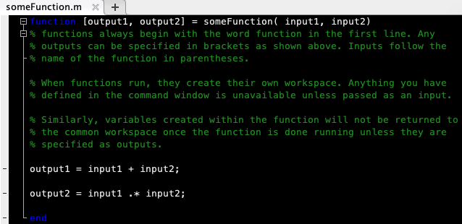
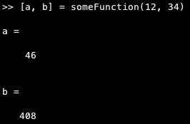
Functions
Functions are VERY useful. Here is an example:
You can call a function from the command window like this. The 12 and 34 become input1 and input2 when the function runs, and output1 and output2 within the function are returned as a and b once the function finishes running.
Other than handling inputs/outputs, code inside functions runs like a script.

Slide 6
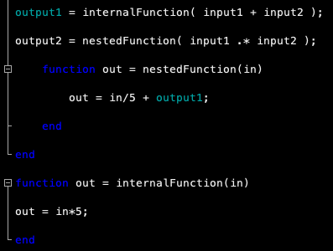
Functions
Functions can also contain other functions without explicitly saving separate m-files. Nested functions share the workspace they are written in. Here, output1 is used without passing it into the nested function as an input.
Internal functions outside of the scope of the first function create their own workspaces.
Neither nested nor internal functions will appear if you search using ‘help’, ‘edit’ or ‘doc’ commands in the main MATLAB command window.

Slide 7
Functions for figures
We have used several functions to format figures. In general, there are multiple ways to display images and plot data in MATLAB. The best way to understand how to use each function is to actually use each function and practice.
Get to the point where you can write your own code to do things you want. Do not copy and paste code from class unless you absolutely understand EACH LINE.
If you do not understand each line, you can explore what each line does one at a time in the command window.
The next slide goes through bjff.m, but you should plot a figure and run each line one by one to understand what the code is doing.
before bjff.m
after bjff.m

Slide 8
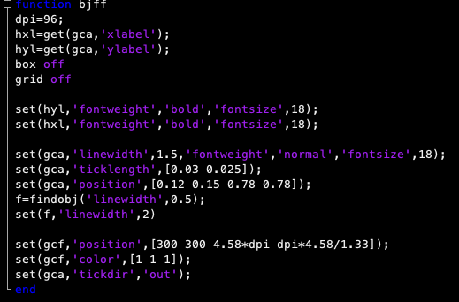
Looking at bjff.m
dpi sets a value for ‘dots per inch’ used in the function later for sizing the figure window.
hxl is a handle object for the xlabel on the plot
If there is no xlabel set, this creates an object with a blank ‘String’ property
Try box off/on and grid off/on on your own
The set function changes values for graphical objects on the figure/axes/plot
gcf points to the current figure object (figures are ‘parents’ for other graphics objects)
gca points to the current axes object (a child of the figure)
gco points to the currently SELECTED object (you must plot first, then select and object)
The ‘findobj’ function looks for graphics objects with the specified attribute at the given value. In bjff, the f variable is a vector of handles to objects with 0.5 LineWidth (default lines).

Slide 9
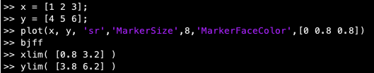

Plotting points not lines
Sometimes you don’t want to plot connected lines, and it’s tedious to always edit lines into points using get and set functions. The plot command and similar functions can take extra arguments as inputs to change how data is shown.
Use what you think is appropriate for the data you want to display. Individual measurements should be plotted as points, whereas simulated data or fitted lines can be plotted as lines.

