Slide 1
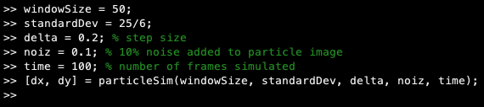
Using particleSim.m
Using the terminal or command window, navigate to the folder where you want the repo using the cd command followed by the folder path.
Type: git init
Then: git clone https://github.com/StephenHugo/BME3053C2019
Specifying the inputs to particleSim.m is not necessary, but the image below should be helpful to get you started.
The outputs represent the displacements of the particle BEFORE adding noise. Your job will be to denoise the images generated and extract the particle location in each frame. The trajectory you measure can be compared to the ideal trajectory.

Slide 2
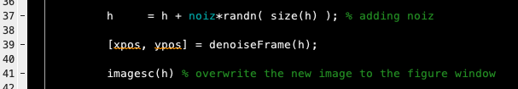
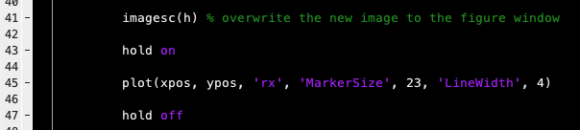
Building denoiseFrame.m
Place a function in the particleSim.m code here:
In this example, I’ve placed a function named denoiseFrame.m in the particleSim code right after adding noise to the particle image, and before the image displays. The two outputs might record the measured position of the particle in the noisy image as xpos and ypos. You can check the accuracy as the sim runs by plotting these values.

Slide 3
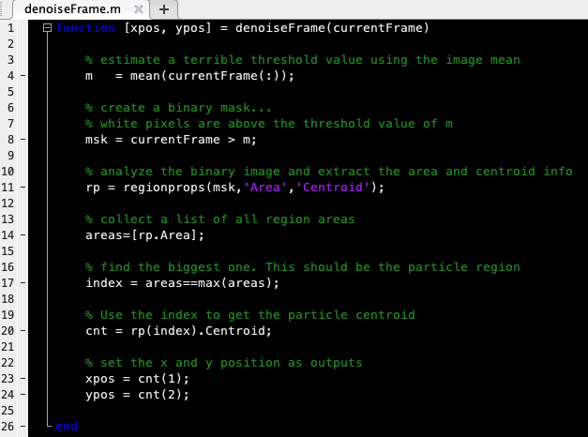
Modify denoiseFrame.m
Use what we learned in class to modify the code below to have it localize the particle better than the arbitrary threshold it currently uses.

Slide 4

Things to try
In class we used three methods to improve our chance of localizing a particle in a noisy image:
1) Convolution
2) Fourier Transforms
3) Expectation Maximization
These methods are packed in the bottom of the denoiseFrame.m template I have provided you. Figure out how to apply them for this assignment, and generate a lab report about which method worked best for you for 3 different cases that use the following noise levels: noiz = [0.05, 0.1, 0.3]

