Slide 1
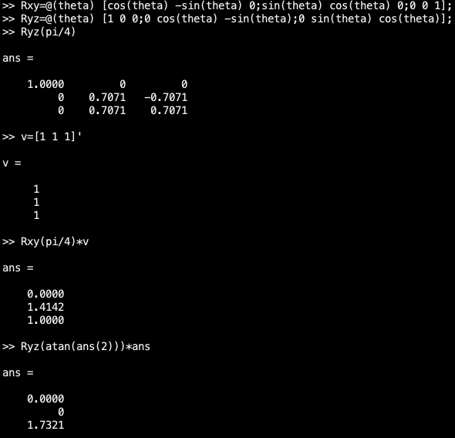
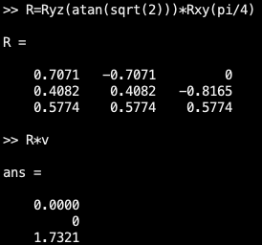
Rotation and Colors
After Wednesday, I played with rotating vectors in 3-d. The work to the left represents my search for the matrix that can rotate the vector v to point straight up the z-axis, i.e. ([0;0;1.7321]).
Eventually R emerged →
To go back, you’d type R’*vector.

Slide 2
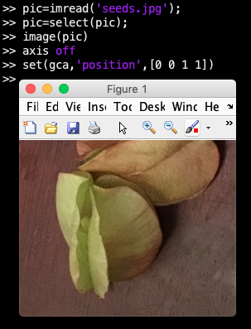
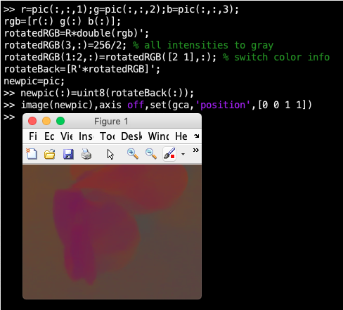
Rotation and Colors
Let’s load up an image, crop it to zoom in and make expand it to take up the whole figure (right). We can rotate the color info around in 3-d and mute intensities or switch around colors (below).

Slide 3
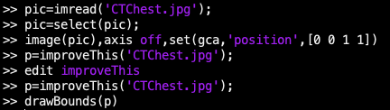
Real Images
Go here: https://www.researchgate.net/figure/High-resolution-CT-scan-of-the-chest-showing-the-lung-nodules_fig1_23687520
Try the following:
The ‘round things’ are nodules of concern.
Write code that improves improveThis.m and can measure the ‘roundness’ of the lung nodules and their size. Can you come up with a way to identify dangerous nodules using z-scores and some parameter from your measurements?
*Don’t get confused, this doesn’t require rotations.

