Slide 1





Quick and Dirty Guide to Mobile Apps:
Session 3

Slide 2
Overview
The Apple Dev Program
Preparing for Distribution
Recap: Compiling for iOS and Android
Archiving on Xcode and Distribution
iTunes Connect
Discussion: Fun, Difficulty and Accessibility

Slide 3
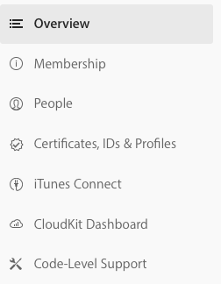
The Apple Dev Program
https://developer.apple.com/account/
Membership and people describe the dev team and their roles.
We will revisit iTune Connect The CloudKit and Support will not be discussed. For now, we will focus on Certificates, IDs & Profiles

Slide 4
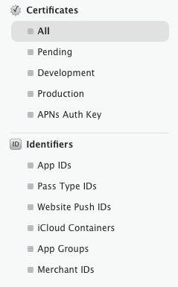
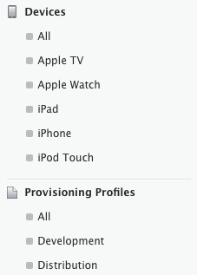
The Apple Dev Program
Within Certificates, IDs & Profiles:
Certificates (Identify you: distribution or development)
Identifiers (Identify Apps: com.company.app)
Devices (Identify Devices by UDID)
Provisioning Profiles (Used for signing your Apps: distribution or development)
*Xcode now automatically manages signing

Slide 5
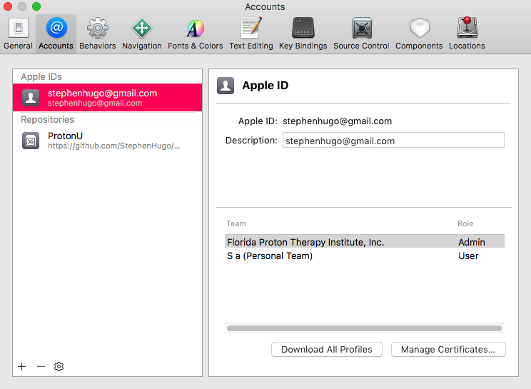
Preparing for Distribution
In Xcode:
Xcode -> Preferences -> Accounts (Manage your profiles)

Slide 6
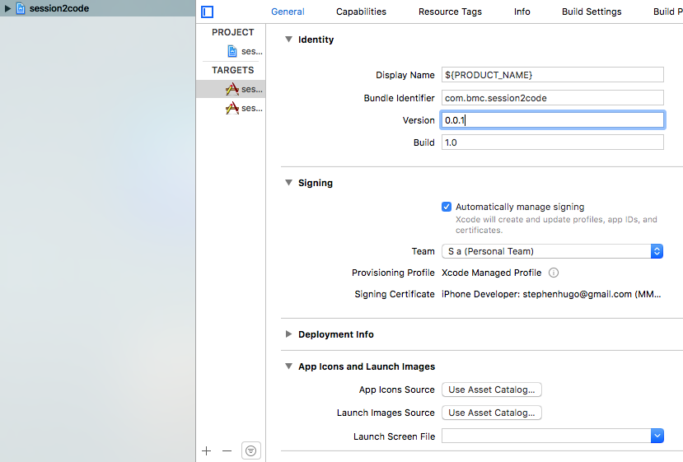
Preparing for Distribution
In Xcode:
Click the project: Targets -> mobile -> General
Set Identity (version and build), Signing (automatic), Icons and Launch Images
Angry Marmot: Generate Icons!

Slide 7
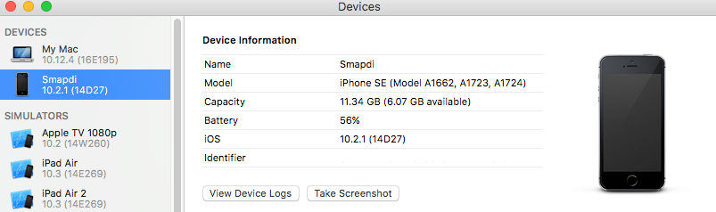
Compiling for iOS
1. Connect your device via USB
2. Window -> Devices – See devices available for installation
3. Product -> Scheme -> App-mobile
4. Product -> Destination -> Your Device
5. Hit “Play”
The App should install to your device. You may have to allow permission to run the app if you haven’t associated your device with your dev account.

Slide 8
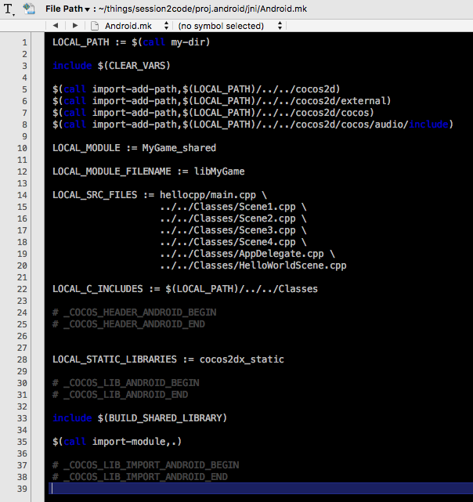

Compiling for Android
1. Connect your device via USB and open the terminal
2. user$ adb devices – check connected devices
3. open: AppDirectory/proj.android-studio/app/jni/Android.mk
4. Update the list of class files

Slide 9
Compiling for Android
5. user$ cocos compile -p android --ap android-XX --ndk-mode release
…if there is an error try the following:
Move:
Android-SDK/platforms/android-23/optional/org.apache.http.legacy.jar
To:
AppFolder/cocos2d/cocos/platform/android/java/libs/org.apache.http.legacy.jar
6. user$ adb install AppFolder/bin/debug/android/session2code-debug.apk
The App should now run on your android device

Slide 10
Archiving the App
In Xcode:
Xcode -> Product -> Archive
Xcode -> Window -> Organizer
Choose: ‘Upload to App Store’
Select correct provisioning files and cross your fingers…

Slide 11
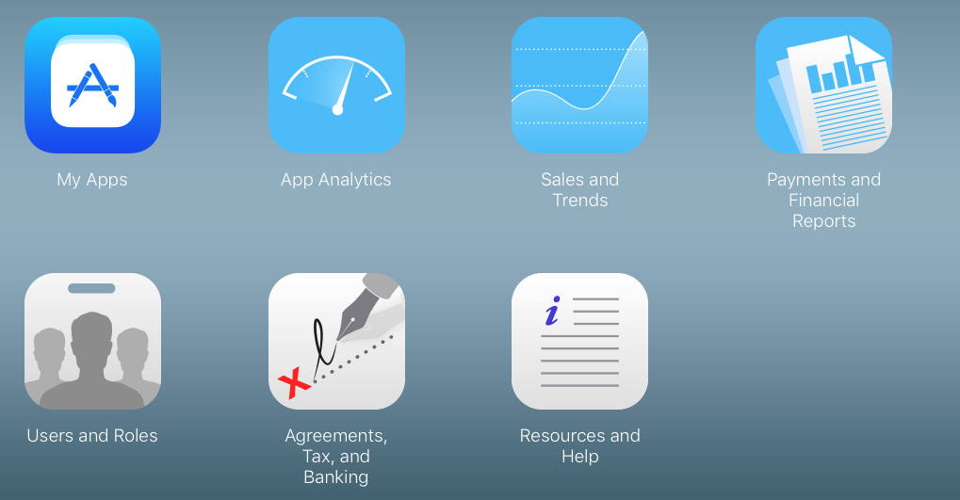
iTunes Connect

Slide 12
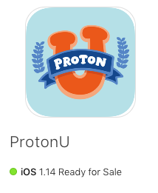
My Apps
Add Preview and Screenshots
Create Description
Select the build from uploaded archive
Choose pricing
Provide requested App info
Submit for review!

Slide 13
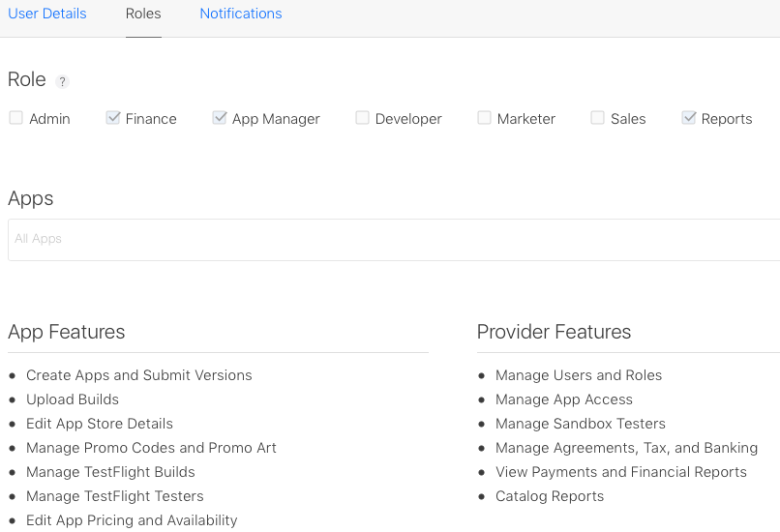
Users & Roles

Slide 14
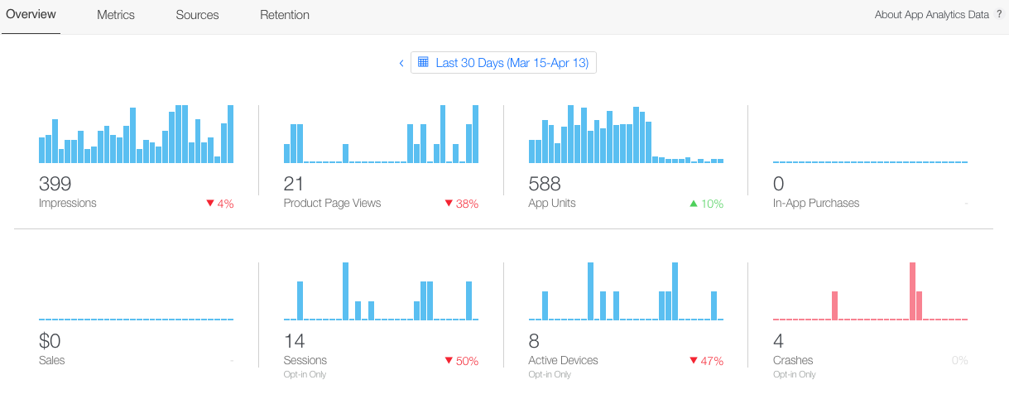
App Analytics

Slide 15
Fun, Difficulty and Accessibility

Slide 16
Resources
Here are some excellent resources:
Sonar Systems: Cocos Tutorial and Flappy Bird Tutorial
Nathaniel Weiss: Making Songbringer
ProtonU Source Code:
https://github.com/StephenHugo/ProtonU
https://github.com/StephenHugo/How2App
GameDev Community:
Tigsource - Game Developers Conference - Ludum Dare
Itch – Twitch - Stack Overflow (advanced)
Reddit: GameDev TrueGameDev

Slide 17

Thank You!
Questions?

