Slide 1



Quick and Dirty Guide to Mobile Apps:
Session 1

Slide 2






My Background
I currently teach Design and Instrumentation and manage the teaching labs in the BME department. Several student orgs use our space to meet and build. I recently finished up my first App, ProtonU, though I’ve been programing for years with roots in image processing in MATLAB.

Slide 3

Show and Tell
iOS vs Android
Apps vs Games
Free vs Paid
What do you use/play? How does everything work?

Slide 4
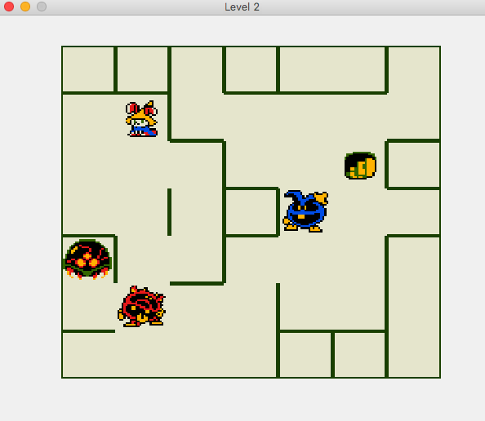
Before we begin, some advice
Start small and make something terrible. There are teams of experienced programmers behind Facebook, Yelp or Pokemon Go. You can get there, but begin with Flappy Bird, Pong or this:

Slide 5
A Basic Program
Psuedocode to explain how a computer follows directions:
1. Initialize
~Begin main loop (repeat the steps below)
2. Display the program state
3. Check for Input from a user
4. Handle inputs and update the program state
5. Close the program
~ http://grapefrukt.com/f/games/juicy-breakout/

Slide 6
What are my options?
- Pick a platform (phone, web, console, computer)
- Pick a language (c++, Java, Lua, HTML5, python, ruby, swift)
- Find a development environment (xcode, visual studio, eclipse, android studio, notepad)
- Use libraries to fill in the gaps (cocos2d-x, SFML, libGDX, libtcod, jquery)
Or use a game engine like Unity or Love (or Scratch or Puzzlescript)

Slide 7
Picking a Platform
There is a billion dollar market for mobile games.
The US market seems to prefer iOS while the global market uses Android devices.
Tough choice? The Apple Developer Program costs $$$ while distributing an App on Android is FREE. That usually helps people decide.
When making ProtonU, my costumer (the UF Proton Therapy Institute) wanted to distribute it on iTunes so I needed to get enrolled in the Dev Program.
~ Superdata

Slide 8
Programming Languages
Once you have a platform in mind (let’s assume phones), there are usually popular languages in use.
With zero coding experience, some languages might be more accessible, but you have to start SOMEWHERE. Having a small project in mind helps to narrow down what you need to know to get things working.
I chose c++ for my App after playing with cocos for a previous (terrible) game. Swift may have been an option, and the previous dev was using Xamarin, but I went with what I knew.

Slide 9
Development Environment
Code is just text. Tools like xcode or visual studio are really, really fancy text editors.
You must compile the code you write into directions for the computer so the program can run. C++ uses header files (.h) to help the computer compile the actual code files (.cpp) and xcode helps keep everything organized.
I used xcode for ProtonU because it seemed like a good idea to use an Apple product to make an Apple product.
Again, choose something you feel familiar with and start small.

Slide 10
What are libraries?
Without even knowing it, someone else has been helping you write an App.
Libraries are pieces of code that you can refer to when writing you own program. For example, there are libraries for creating visual effects, adding sound or connecting to the internet.
The cocos2d-x library is intended for games and includes some tools for graphics and audio that let me avoid coding those aspects of the App myself. It also let me deploy the same code to different platforms, leaving the option to provide ProtonU to Android users in the future.

Slide 11
How do I start small?
Here are some excellent resources:
Sonar Systems: Cocos Tutorial and Flappy Bird Tutorial
Nathaniel Weiss: Making Songbringer
ProtonU Source Code:
https://github.com/StephenHugo/ProtonU
GameDev Community:
Tigsource - Game Developers Conference - Ludum Dare
Itch – Twitch - Stack Overflow (advanced)
Reddit: GameDev TrueGameDev

Slide 12

Thank You!
Questions?

