Slide 1
Home Area
Event Area
A
B

Slide 2
A
Home Area
Event Area
B

Slide 3
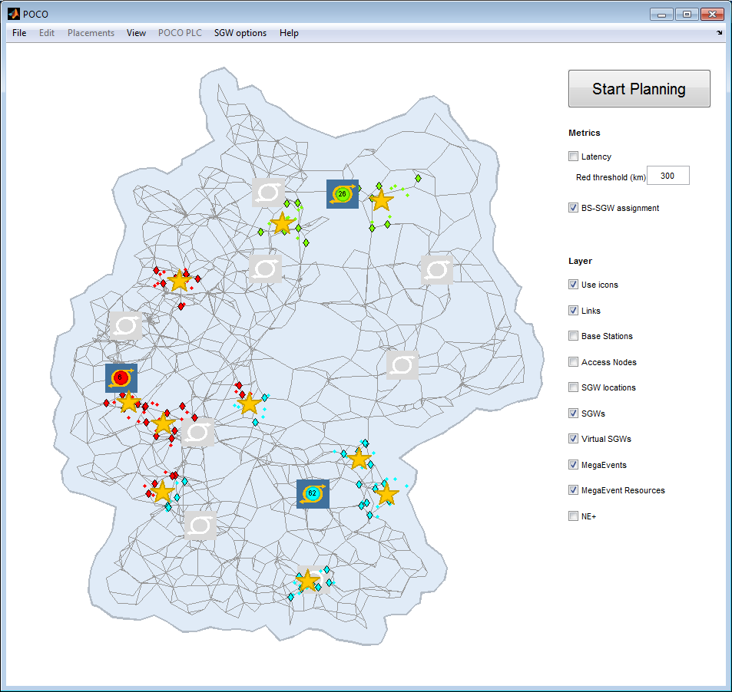
A
Event Area
Home Area
B

