Slide 1
ALL WASTE
EARTH

Slide 2
Team Members Joy Nkatha Cynthia Muiruri Faith Muiruri

Slide 3
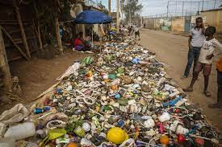

Slide 5
Wastestars
Wastestars is a team of 3 university students pursuing Informatics and Computer Science.
We possess different skills such as UI/UX design, mobile app development, web application development, database management, server management, cloud services(Azure) amongst others.

Slide 6
Project Description - Problem
One of the biggest issues facing cities today is the enhancement of the urban waste collection service as well as the general attainment of more effective waste management.

Slide 7
Why Dandora?
Dandora is not only the biggest dumpsite in Kenya but also the second largest in Africa.
Dandora landfill is located in Nairobi and is approximately 30 acres and is the destination of about 850 tonnes of solid waste.
Most garbage is disposed at Dandora which leads to air, soil, and water pollution. Waste from the dumpsite has tainted the water supply causing diseases such as cholera which have led to several deaths.

Slide 8
Why Dandora?
Burning the waste leads to air pollution where toxic substances are emitted to the atmosphere leading to diseases such as asthma.
The dumpsite also emits an unpleasant smell particularly from burnt plastic which makes it uncomfortable for residents and children in nearby schools.
Leachate overflows to surrounding areas polluting the soil.

Slide 9
Project Description - Problem
Poor waste management contributes to climate changes which directly affect many ecosystems and species. These wastes release methane and sulphate gases, very powerful greenhouse gases linked to climate change formed from non biodegradeable wastes that contaminate soil, water and air.

Slide 10
Project Description - Solution
Our project, All Waste, aims to design a smart waste web-based collection system that allows citizens to choose and post the various types of solid waste they want to dispose on the website, garbage collectors, and recyclists to view posted waste.

Slide 11
Project Description - Solution
There are two types of waste categories the citizen can dispose, recyclable and organic wastes.
For recyclable waste posted, recyclists can buy.
For organic waste posted, garbage collectors can collect.

Slide 12
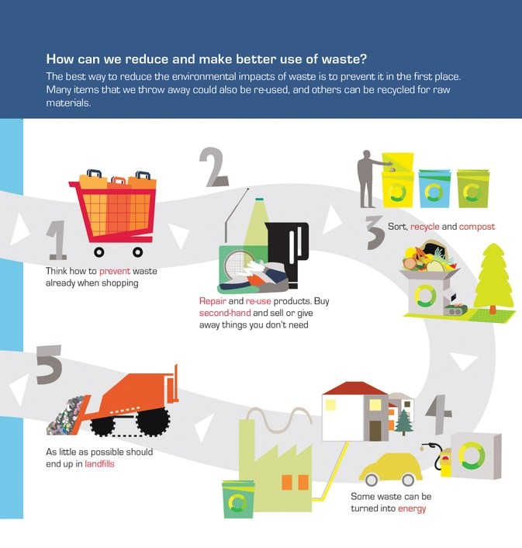

Slide 13
All Waste Interfaces
Make an admin interface where an admin can view all payments.
Make user interfaces where users can schedule waste pickup, make payments, post recyclable waste, and recyclists and garbage collectors can view posted recyclable items.

Slide 14
Target Audience
Our target audience is:
Citizens in Nairobi looking to dispose their waste.
Garbage collectors and recyclists looking for recyclable waste to collect and use.
Dandora residents who are affected by the effects of dumping waste at the landfill.

Slide 15
Platform Features
Our project uses Microsoft’s azure services such as:
Azure App Service to deploy and host the developed PHP application.
Azure SQL database to build the database for the application for backend functionality of the web application.

Slide 16
Marketing the Project
Patnering with Non-Governmental Organizations such as United Nations Environmental Programme
Patnering with National Environment Management Authority of Kenya and Nairobi County Government.
By advertising our project. For example, through:
Social Media sites such as Twitter, Instagram, Facebook
Blogs
Word of mouth
Media

Slide 17
Thank You!

