Slide 1
Project 1: ALU Arithmetic Logic Unit
by
Nnamani Stephen Obumnaeme
Daniel Maria Emanuel Dworski
Shanmugapriya Sathiyamoorthi

Slide 2
Exercise 1 Introduction to logisim

Slide 3
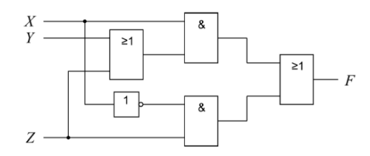
1: Exercise 1.5.a
Circuit Implementation and Simulation
Automatic Circuit Generation
Verification through Test Vectors
Minimization through K-Maps
Chronograms

Slide 4
Exercise 2 Adders

Slide 5
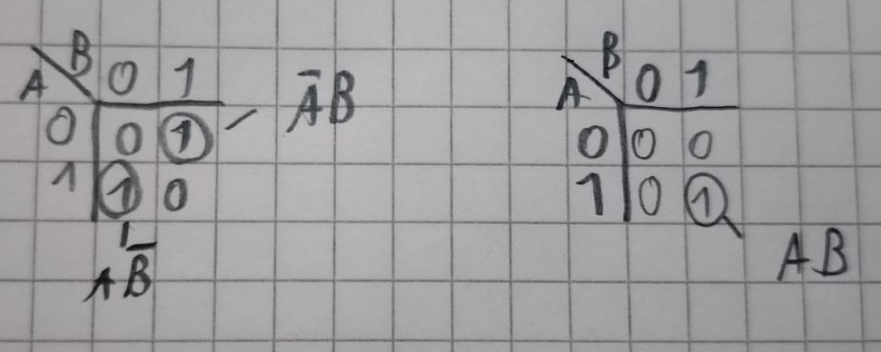
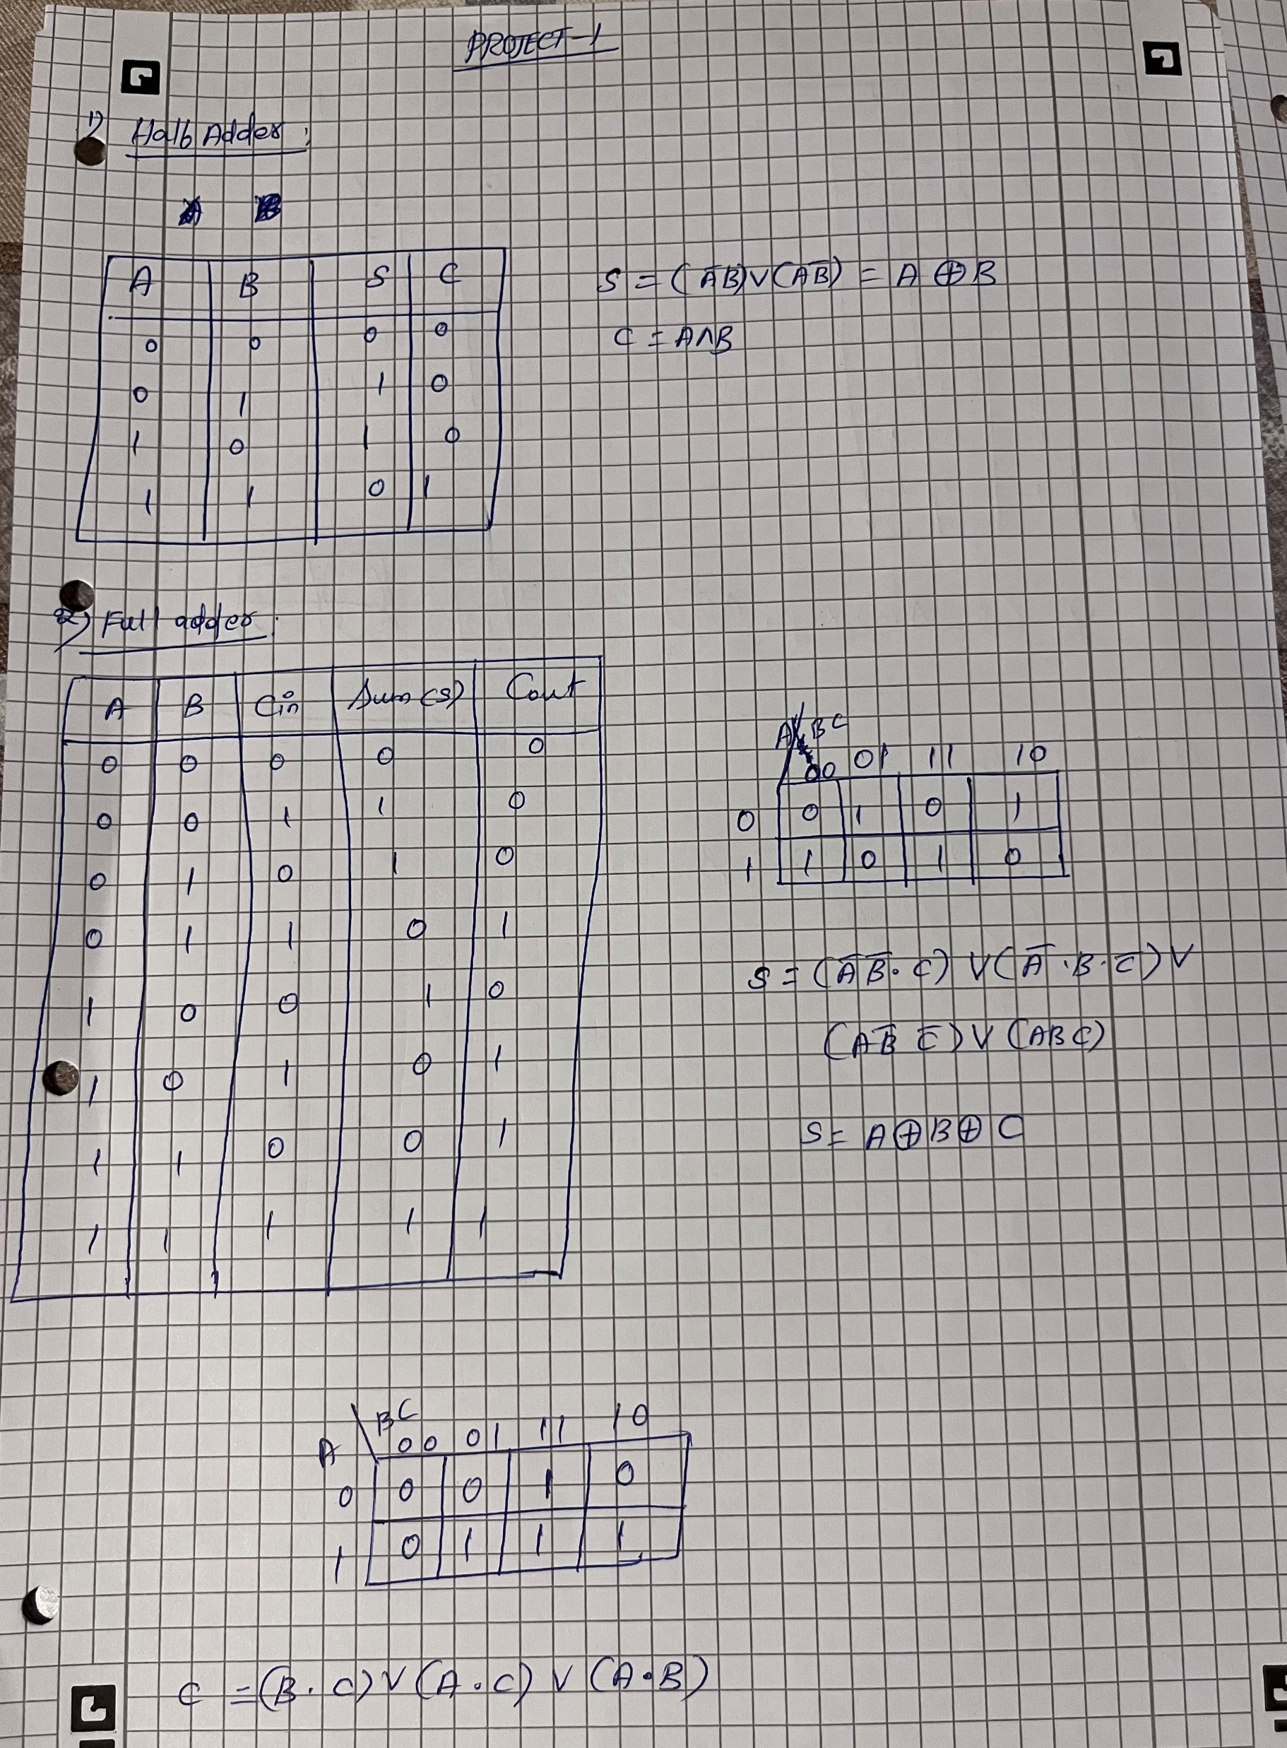
2.1: Half Adder

Slide 6
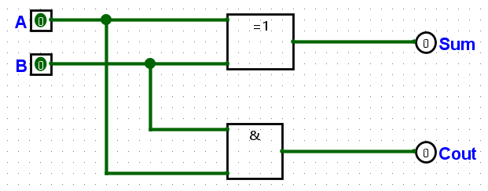
2.1: Half Adder

Slide 7

2.2: Full Adder

Slide 8
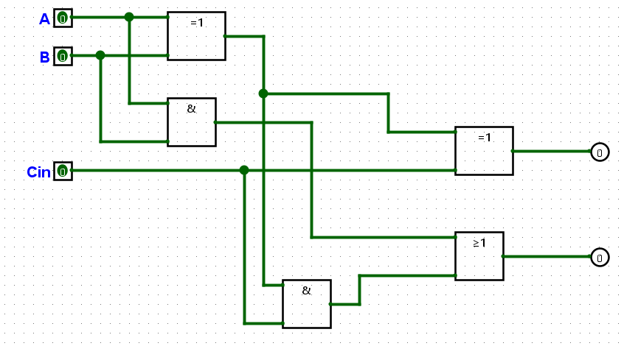
2.2: Full Adder

Slide 9
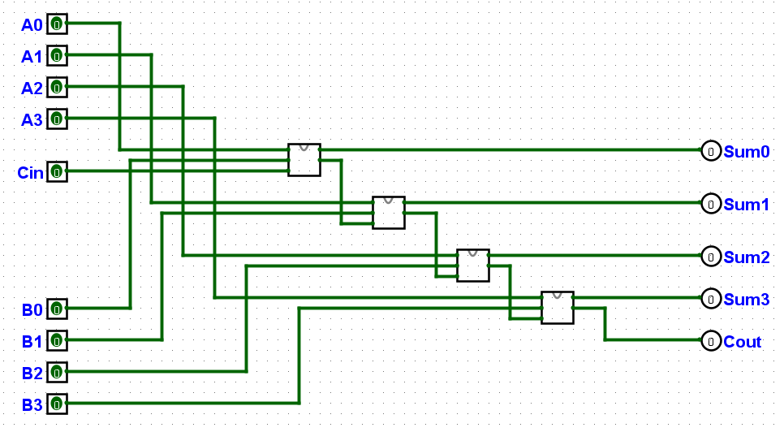
2.3: Carry-Ripple Adder

Slide 10
Exercise 3 Arithmetic Unit

Slide 11
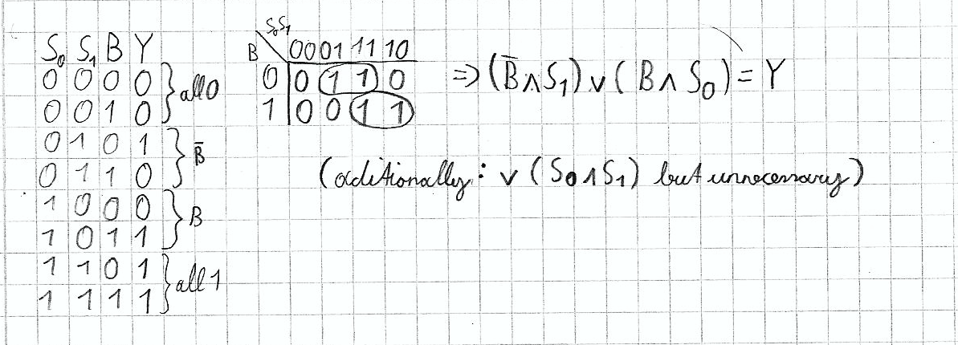
3.1: B-input-logic 1 bit version

Slide 12
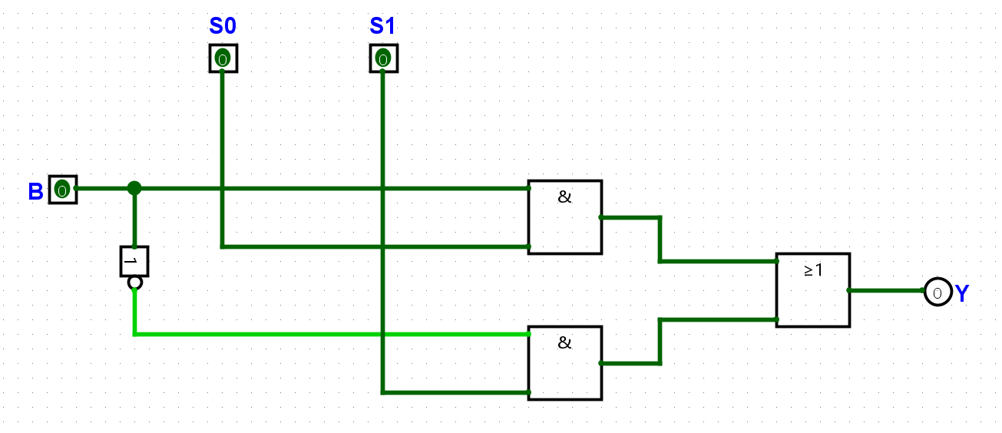
3.1: B-input-logic 1 bit

Slide 13
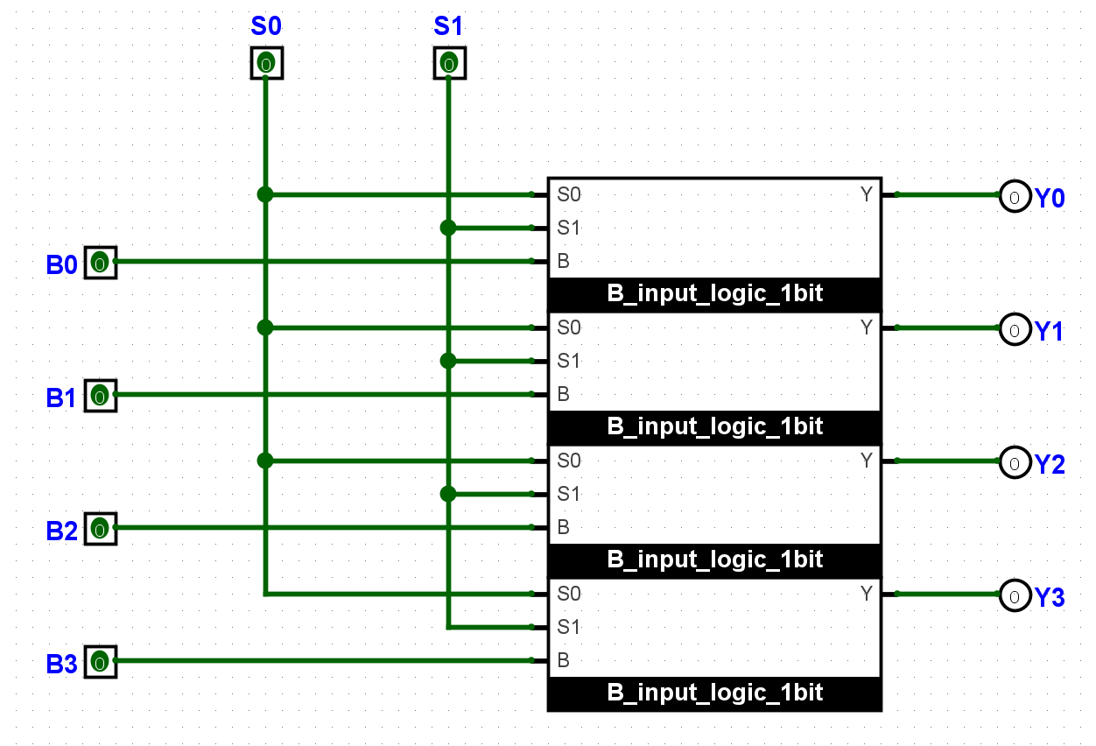
3.2: B-input-logic n bit

Slide 14
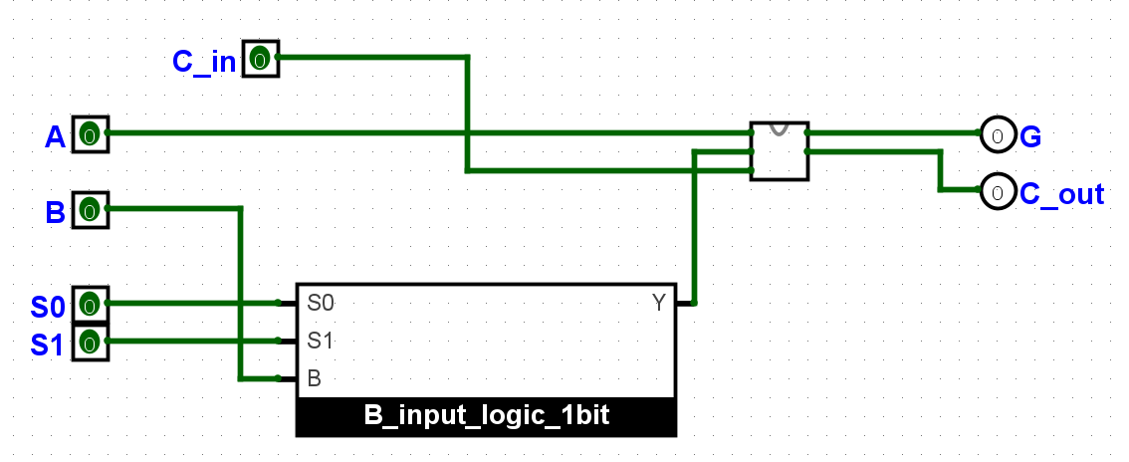
3.3: arithmetic unit 1 bit

Slide 15
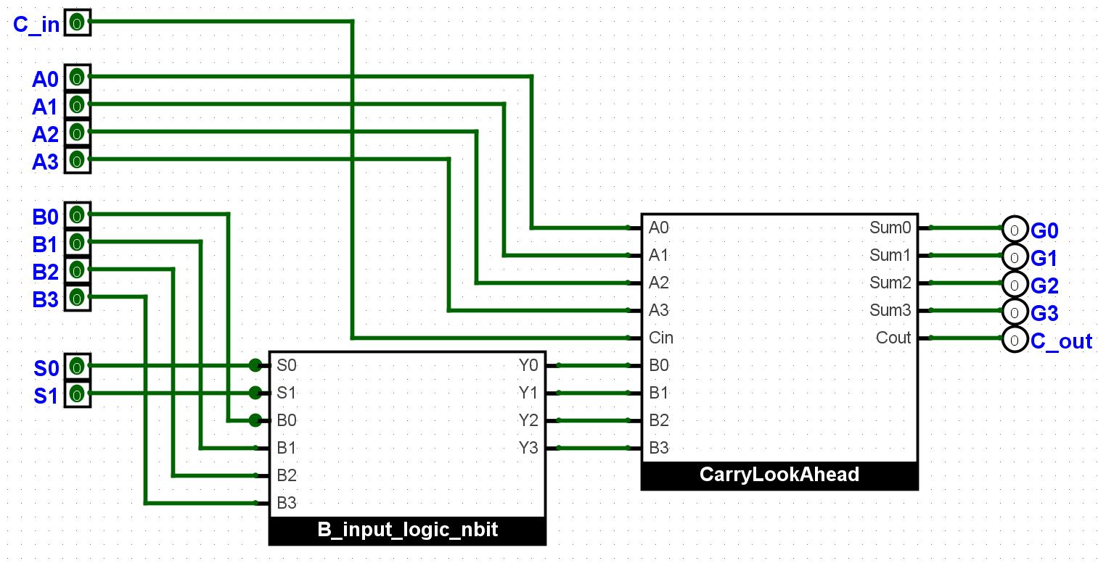
3.4: arithmetic unit n bit

Slide 16
Exercise 4 Logical unit

Slide 17
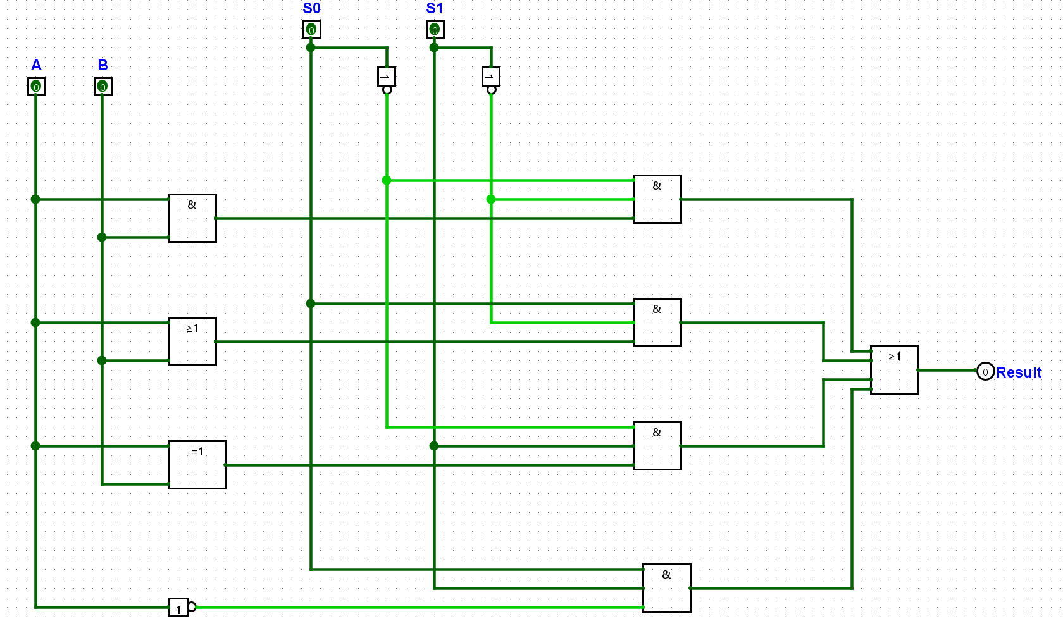
4.1: Logical Unit 1 bit version

Slide 18
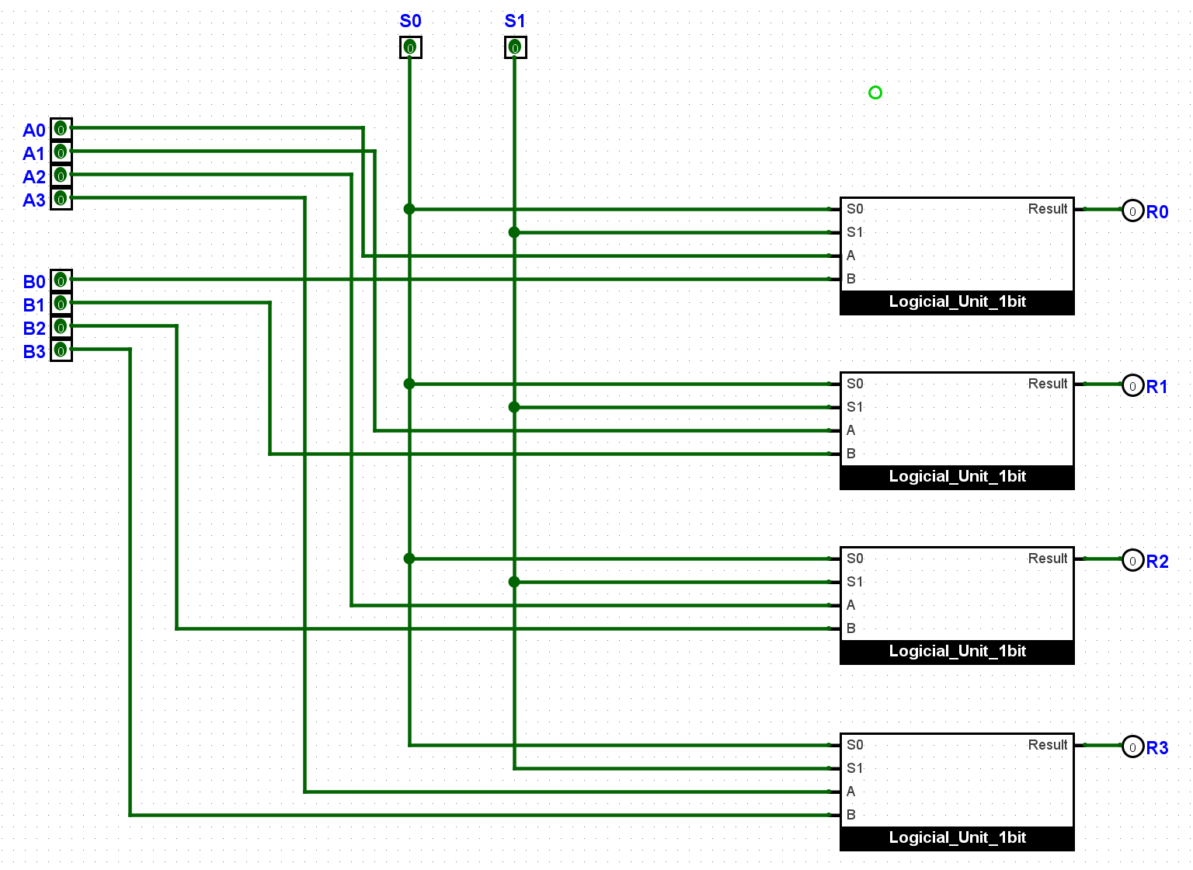
4.2: Logical Unit n bit version

Slide 19
Exercise 5 Multiplexer

Slide 20
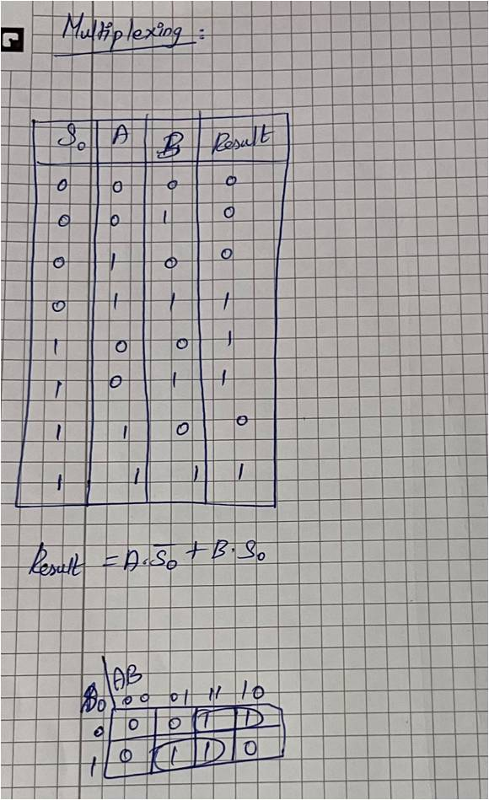
5: Multiplexer

Slide 21
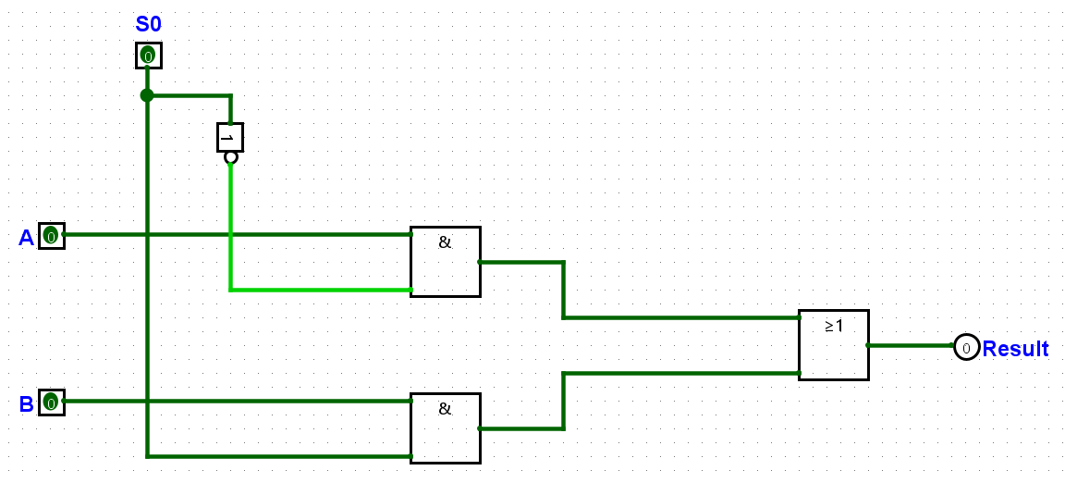
5: Multiplexer

Slide 22
Exercise 6 ALU

Slide 23
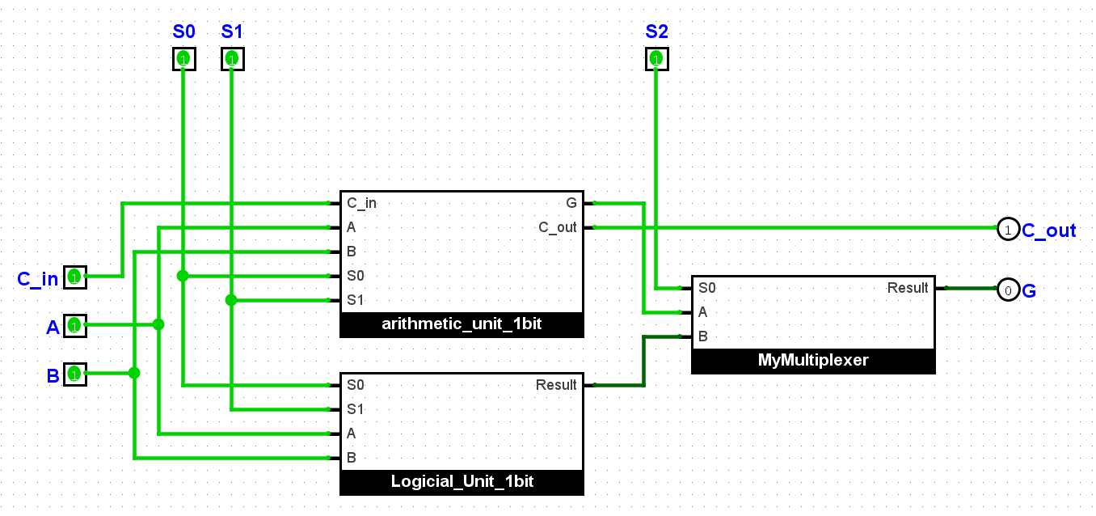
6.1: ALU 1 bit version

Slide 24
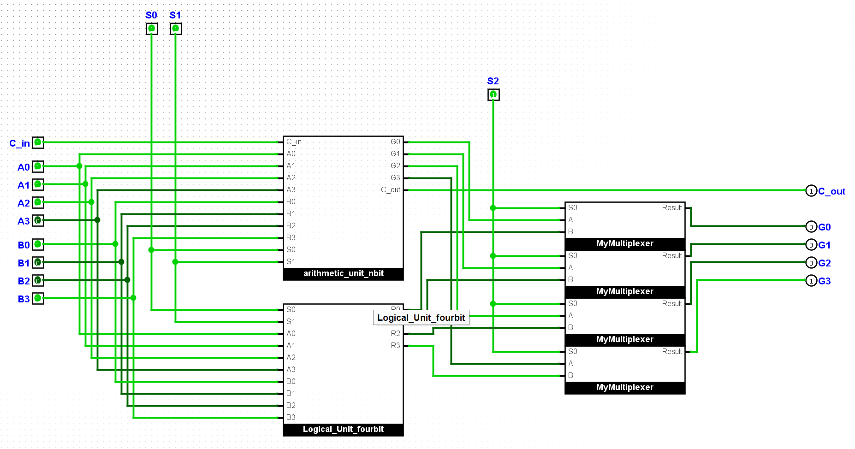
6.2: ALU n bit version

Slide 25
Thank you for your attention
by
Nnamani Stephen Obumnaeme
Daniel Maria Emanuel Dworski
Shanmugapriya Sathiyamoorthi

Slide 26
Other Data
by
Nnamani Stephen Obumnaeme
Daniel Maria Emanuel Dworski
Shanmugapriya Sathiyamoorthi

Slide 27
1: Exercise 1.5.a
Truth table:
X Y Z F
0 0 0 0
0 0 1 1
0 1 0 0
0 1 1 1
1 0 0 0
1 0 1 1
1 1 0 1
1 1 1 1
Difficulties:
- Getting truth table for Automatic Circuit Generation
Not having immediate Minimization through K-Maps
Creating useful Chronograms

Slide 28
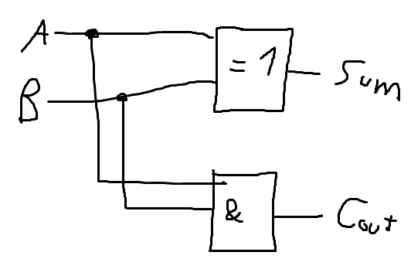
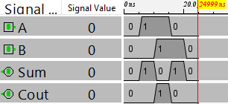
2.1: half adder
Block Diagram:
Test-Vectors:
A B Sum Cout
0 0 0 0
0 1 1 0
1 0 1 0
1 1 0 1
Difficulties:
- 2 K-maps instead of 1
Chronogram:

Slide 29
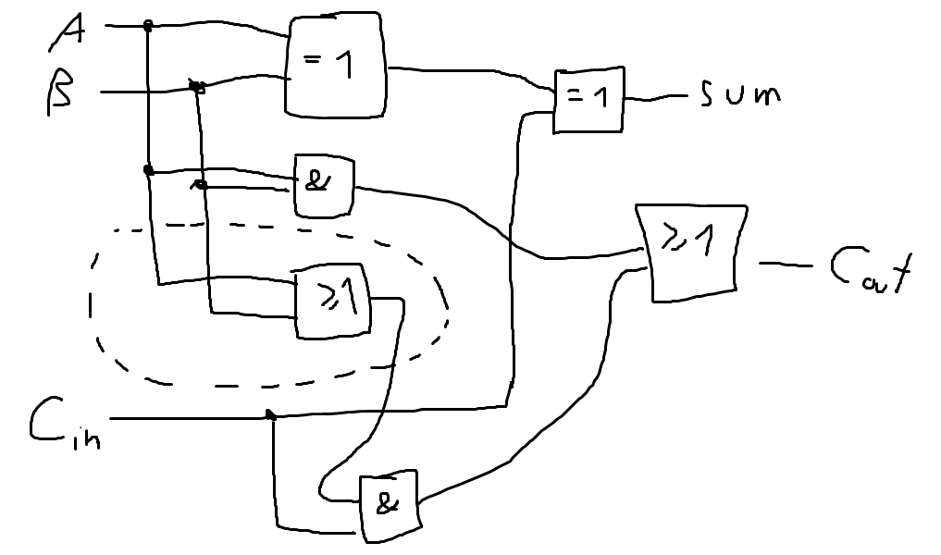
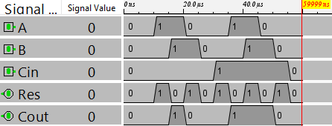
2.2: full adder
Test-Vectors:
A B Cin Res Cout
0 0 0 0 0
0 0 1 1 0
0 1 0 1 0
0 1 1 0 1
1 0 0 1 0
1 0 1 0 1
1 1 0 0 1
1 1 1 1 1
Block Diagram:
Chronogram:
Difficulties:
Using Subcircuits for the first time
Having 2 outputs

Slide 30
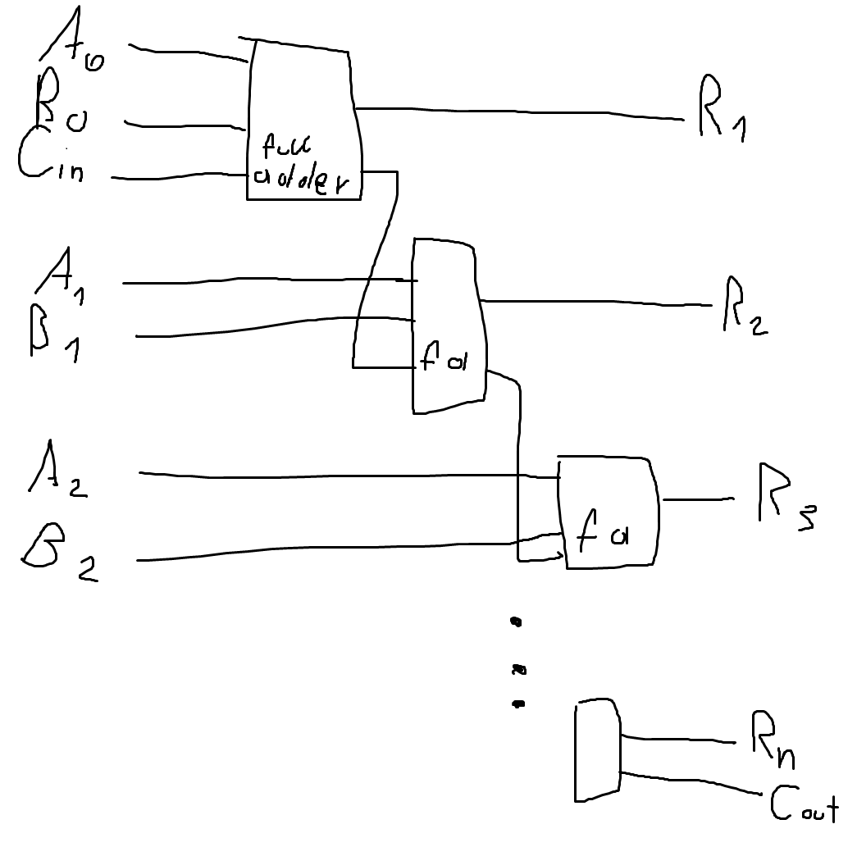
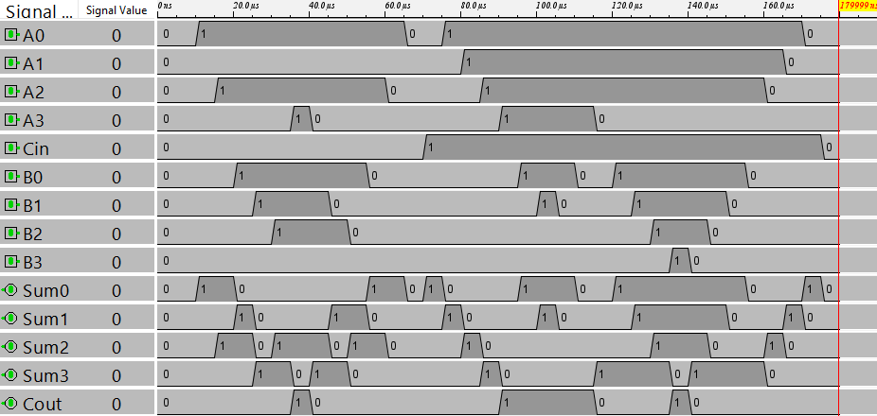
2.3: Carry-Ripple-Adder
Test-Vectors:
Cin A3 A2 A1 A0 B3 B2 B1 B0 Sum3 Sum2 Sum1 Sum0 Cout
0 0 0 0 1 0 0 0 1 0 0 1 0 0
1 0 0 0 1 0 0 0 1 0 0 1 1 0
0 0 0 0 1 0 0 1 0 0 0 1 1 0
1 0 0 0 1 0 0 1 0 0 1 0 0 0
0 1 1 1 1 0 0 0 1 0 0 0 0 1
0 1 1 1 1 1 1 1 1 1 1 1 0 1
1 1 1 1 1 1 1 1 1 1 1 1 1 1
0 1 1 0 0 1 0 1 0 0 1 1 0 1
1 1 0 0 0 0 1 1 1 0 0 0 0 1
Difficulties:
Creating „N“ bit circuit
(impossible => chose 4 bit)
Block Diagram:
Chronogram:

Slide 31
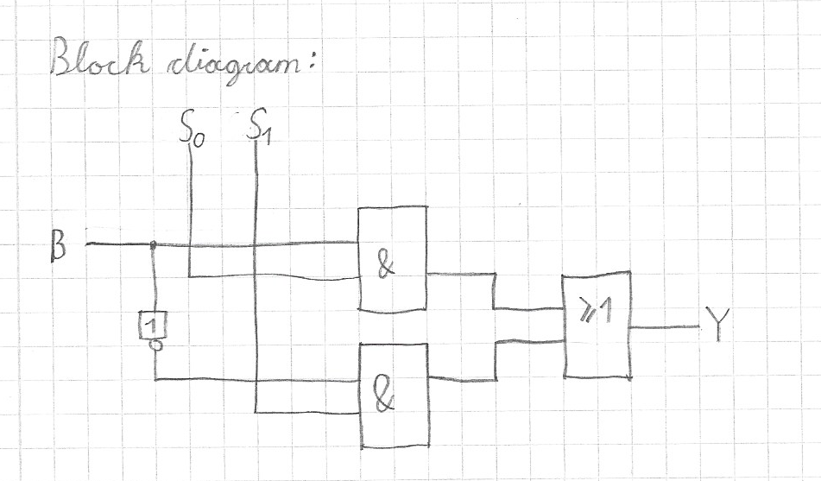
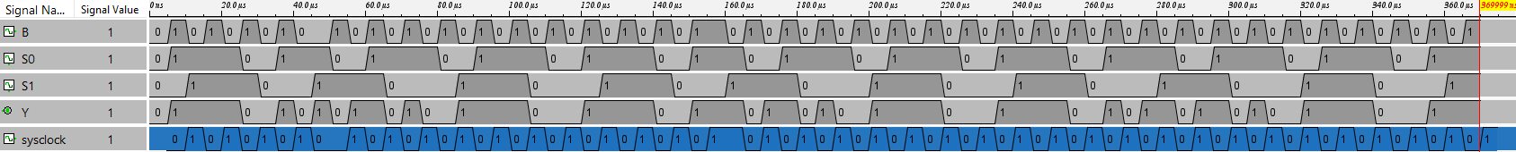
3.1: B-input-logic 1bit
Truth Table, K-map, boolean expression
Test-Vectors:
S0 S1 B Y
# all 0
0 0 0 0
0 0 1 0
# -B
0 1 0 1
0 1 1 0
# B
1 0 0 0
1 0 1 1
# all 1
1 1 0 1
1 1 1 1
Difficulties:
- Understanding b̄ is not negative number but logic „not“
Chronogram:

Slide 32
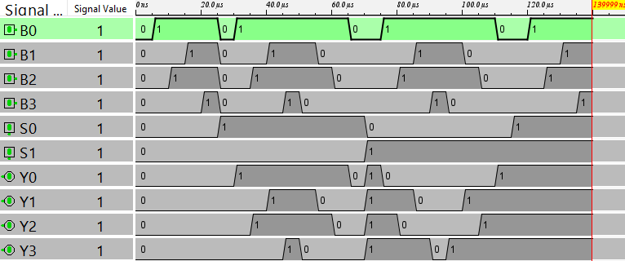
3.2: B-input-logic nbit
Test-Vectors:
S0 S1 B0 B1 B2 B3 Y0 Y1 Y2 Y3
# all 0
0 0 0 0 0 0 0 0 0 0
0 0 0 0 0 1 0 0 0 0
0 0 0 0 1 0 0 0 0 0
0 0 0 0 1 1 0 0 0 0
0 0 0 1 0 0 0 0 0 0
0 0 0 1 0 1 0 0 0 0
0 0 0 1 1 0 0 0 0 0
0 0 0 1 1 1 0 0 0 0
0 0 1 0 0 0 0 0 0 0
0 0 1 0 0 1 0 0 0 0
0 0 1 0 1 0 0 0 0 0
0 0 1 0 1 1 0 0 0 0
0 0 1 1 0 0 0 0 0 0
0 0 1 1 0 1 0 0 0 0
0 0 1 1 1 0 0 0 0 0
0 0 1 1 1 1 0 0 0 0
## B
1 0 0 0 0 0 0 0 0 0
1 0 0 0 0 1 0 0 0 1
1 0 0 0 1 0 0 0 1 0
1 0 0 0 1 1 0 0 1 1
1 0 0 1 0 0 0 1 0 0
1 0 0 1 0 1 0 1 0 1
1 0 0 1 1 0 0 1 1 0
1 0 0 1 1 1 0 1 1 1
1 0 1 0 0 0 1 0 0 0
1 0 1 0 0 1 1 0 0 1
1 0 1 0 1 0 1 0 1 0
1 0 1 0 1 1 1 0 1 1
1 0 1 1 0 0 1 1 0 0
1 0 1 1 0 1 1 1 0 1
1 0 1 1 1 0 1 1 1 0
1 0 1 1 1 1 1 1 1 1
# -B
0 1 0 0 0 0 1 1 1 1
0 1 0 0 0 1 1 1 1 0
0 1 0 0 1 0 1 1 0 1
0 1 0 0 1 1 1 1 0 0
0 1 0 1 0 0 1 0 1 1
0 1 0 1 0 1 1 0 1 0
0 1 0 1 1 0 1 0 0 1
0 1 0 1 1 1 1 0 0 0
0 1 1 0 0 0 0 1 1 1
0 1 1 0 0 1 0 1 1 0
0 1 1 0 1 0 0 1 0 1
0 1 1 0 1 1 0 1 0 0
0 1 1 1 0 0 0 0 1 1
0 1 1 1 0 1 0 0 1 0
0 1 1 1 1 0 0 0 0 1
0 1 1 1 1 1 0 0 0 0
## all 1
1 1 0 0 0 0 1 1 1 1
1 1 0 0 0 1 1 1 1 1
1 1 0 0 1 0 1 1 1 1
1 1 0 0 1 1 1 1 1 1
1 1 0 1 0 0 1 1 1 1
1 1 0 1 0 1 1 1 1 1
1 1 0 1 1 0 1 1 1 1
1 1 0 1 1 1 1 1 1 1
1 1 1 0 0 0 1 1 1 1
1 1 1 0 0 1 1 1 1 1
1 1 1 0 1 0 1 1 1 1
1 1 1 0 1 1 1 1 1 1
1 1 1 1 0 0 1 1 1 1
1 1 1 1 0 1 1 1 1 1
1 1 1 1 1 0 1 1 1 1
1 1 1 1 1 1 1 1 1 1
Difficulties:
- „N“ bit => chose 4 bit as n
Chronogram:

Slide 33
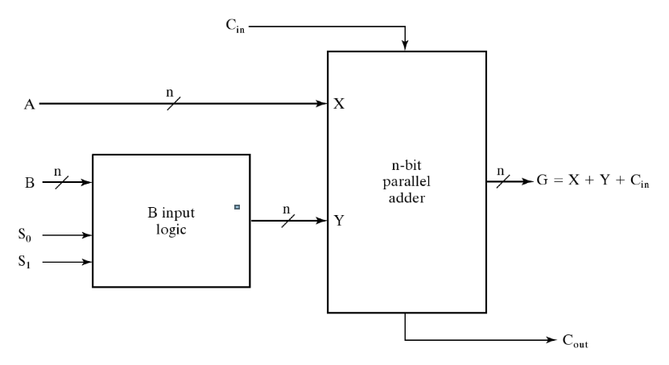
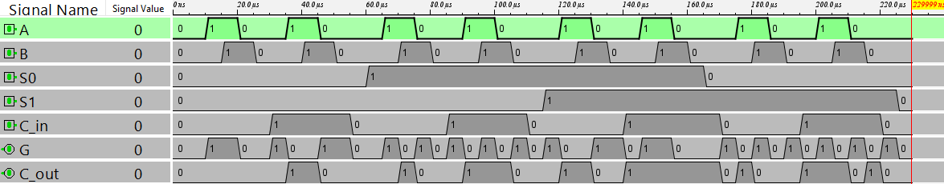
3.3: arithmetic unit 1bit
Test-Vectors:
S1 S0 C_in A B G C_out
#A transfer (1)
0 0 0 0 1 0 0
0 0 0 1 1 1 0
0 0 0 1 0 1 0
#A increment
0 0 1 0 0 1 0
0 0 1 1 0 0 1
0 0 1 0 1 1 0
#A+B
0 1 0 0 0 0 0
0 1 0 1 0 1 0
0 1 0 0 1 1 0
0 1 0 1 1 0 1
#A+B+1
0 1 1 0 0 1 0
0 1 1 1 0 0 1
0 1 1 0 1 0 1
0 1 1 1 1 1 1
#A+-B
1 0 0 0 0 1 0
1 0 0 1 0 0 1
1 0 0 0 1 0 0
1 0 0 1 1 1 0
#subtract (A+-B+1)
1 0 1 0 0 0 1
1 0 1 1 0 1 1
1 0 1 0 1 1 0
1 0 1 1 1 0 1
#decrement (A-1)
1 1 0 0 0 1 0
1 1 0 1 0 0 1
1 1 0 1 1 0 1
#A transfer (2)
# carry over: 1 => positive number
1 1 1 0 1 0 1
1 1 1 1 1 1 1
1 1 1 1 0 1 1
Difficulties:
Using 2 subcircuits
Creating negative numbers
Block Diagram (from task):
Chronogram:

Slide 34
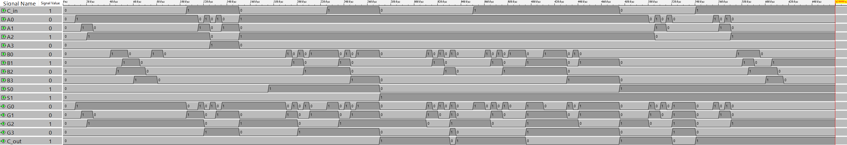
3.4: arithmetic unit nbit
Difficulties:
Testing proficiently
Test-Vectors:
S1 S0 C_in A3 A2 A1 A0 B3 B2 B1 B0 G3 G2 G1 G0 C_out
#-conf---- ----A------ -----B----- ----G------ -carry_over-
# A,B and G are right to left to easily see them as numbers
# A transfer (1)
0 0 0 1 0 1 0 0 0 0 0 1 0 1 0 0
0 0 0 1 1 1 1 0 0 0 0 1 1 1 1 0
0 0 0 0 0 1 1 0 0 0 0 0 0 1 1 0
0 0 0 1 1 1 1 1 1 1 1 1 1 1 1 0
#increment
0 0 1 1 0 1 0 0 0 0 0 1 0 1 1 0
0 0 1 1 1 1 1 0 0 0 0 0 0 0 0 1
0 0 1 0 0 1 1 0 0 0 0 0 1 0 0 0
0 0 1 1 1 1 1 1 1 1 1 0 0 0 0 1
#add
0 1 0 1 0 1 0 0 1 0 1 1 1 1 1 0 # 10 + 5 = 15
0 1 0 1 0 1 0 0 0 1 1 1 1 0 1 0 # 10 + 3 = 13
0 1 0 0 1 1 0 0 1 1 0 1 1 0 0 0 # 6 + 6 = 12
0 1 0 0 0 0 0 0 0 0 0 0 0 0 0 0 # 0...
0 1 0 1 1 1 1 1 1 1 1 1 1 1 0 1 # 15 + 15 = 14 + carry over
# add +1 (all tests from add)
0 1 1 1 0 1 0 0 1 0 1 0 0 0 0 1 # 10 + 5 +1 = 0 + carry over
0 1 1 1 0 1 0 0 0 1 1 1 1 1 0 0 # 10 + 3 +1 = 14
0 1 1 0 1 1 0 0 1 1 0 1 1 0 1 0 # 6 + 6 +1 = 13
0 1 1 0 0 0 0 0 0 0 0 0 0 0 1 0 # 0 +1 = 1
0 1 1 1 1 1 1 1 1 1 1 1 1 1 1 1 # 15 + 15 +1 = 15 + carry over
# subtract (A + -B + 1)
# (positive numbers: always carry over active)
# (negative numbers in 1-komplement layout without carry over)
1 0 1 1 0 1 0 0 1 0 1 0 1 0 1 1 # 10 - 5 = 5
1 0 1 1 0 1 0 0 0 1 1 0 1 1 1 1 # 10 - 3 = 7
1 0 1 0 1 1 0 0 1 1 0 0 0 0 0 1 # 6 - 6 = 0
1 0 1 1 1 1 1 1 1 1 1 0 0 0 0 1 # 15 - 15 = 0
1 0 1 0 0 0 0 0 0 0 1 1 1 1 1 0 # -1
1 0 1 0 1 0 1 1 0 1 0 1 0 1 1 0 # 5 - 10 = -5
1 0 1 0 1 1 1 1 1 1 1 1 0 0 0 0 # 7 - 15 = -8
# A + -B (subtraction -1 )
1 0 0 1 0 1 0 0 1 0 1 0 1 0 0 1 # 10 - 5 = 5-1 = 4
1 0 0 1 0 1 0 0 0 1 1 0 1 1 0 1 # 10 - 3 = 7-1 = 6
1 0 0 0 1 1 0 0 1 1 0 1 1 1 1 0 # 6 - 6 = 0-1 = -1
1 0 0 1 1 1 1 1 1 1 1 1 1 1 1 0 # 15 - 15 = 0-1 = -1
1 0 0 0 0 0 0 0 0 0 1 1 1 1 0 0 # -1-1 = -2
1 0 0 0 1 0 1 1 0 1 0 1 0 1 0 0 # 5 - 10 = -5-1 = -6
1 0 0 0 1 1 1 1 1 1 1 0 1 1 1 0 # 7 - 15 = -8-1 = -9
# decrement
# carry over: 1 => positive number; 0=> negative number
1 1 0 1 0 1 0 0 0 0 0 1 0 0 1 1
1 1 0 1 1 1 1 0 0 0 0 1 1 1 0 1
1 1 0 0 0 0 0 0 0 0 0 1 1 1 1 0
1 1 0 0 1 1 0 0 0 0 0 0 1 0 1 1
1 1 0 0 0 0 1 0 0 0 0 0 0 0 0 1
#transfer (2)
# carry over: 1 => positive number
1 1 1 1 0 1 0 0 0 0 0 1 0 1 0 1
1 1 1 1 1 1 1 0 0 0 0 1 1 1 1 1
1 1 1 0 0 1 1 0 0 0 0 0 0 1 1 1
1 1 1 1 1 1 1 1 1 1 1 1 1 1 1 1
Chronogram:

Slide 35
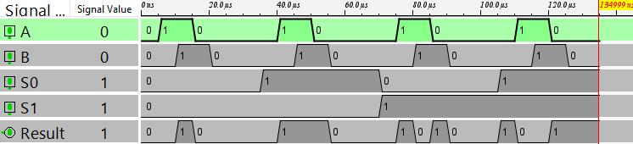
4.1: Logical Unit 1bit
Test-Vectors:
S1 S0 A B Result
# AND
0 0 0 0 0
0 0 0 1 0
0 0 1 0 0
0 0 1 1 1
# OR
0 1 0 0 0
0 1 0 1 1
0 1 1 0 1
0 1 1 1 1
Difficulties:
Not using Boolean expressions to get circuit idea
Using a 4:1 Multiplexer without having it implemented
# XOR
1 0 0 0 0
1 0 0 1 1
1 0 1 0 1
1 0 1 1 0
# NOT A
1 1 0 0 1
1 1 0 1 1
1 1 1 0 0
1 1 1 1 0
Chronogram:

Slide 36
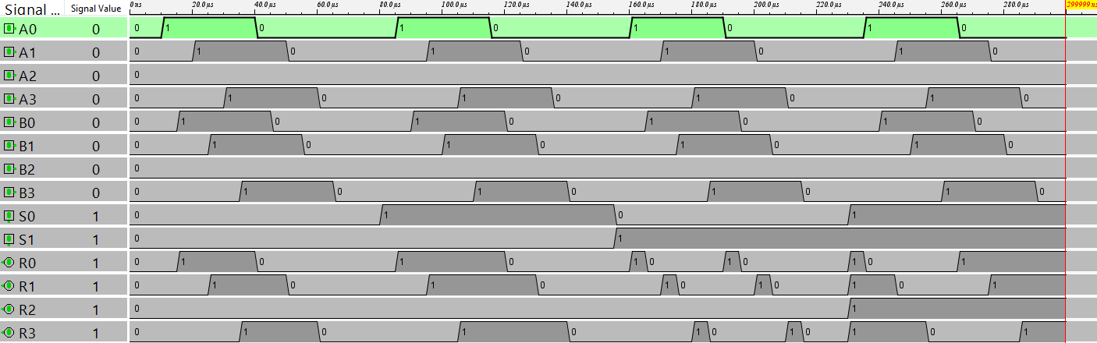
4.2: Logical Unit nbit
Test-Vectors:
S1 S0 A0 A1 A2 A3 B0 B1 B2 B3 R0 R1 R2 R3
# AND
0 0 1 0 1 0 1 1 0 0 1 0 0 0
0 0 0 1 1 1 1 1 1 1 0 1 1 1
0 0 0 1 0 0 1 1 0 0 0 1 0 0
0 0 0 1 0 0 0 0 0 0 0 0 0 0
0 0 0 0 1 1 0 1 0 1 0 0 0 1
0 0 0 0 0 0 0 1 1 0 0 0 0 0
0 0 1 1 0 1 0 1 0 0 0 1 0 0
# OR
0 1 1 0 1 1 0 0 0 1 1 0 1 1
0 1 0 1 0 1 1 0 0 1 1 1 0 1
0 1 1 1 1 0 1 0 0 0 1 1 1 0
0 1 1 1 0 0 1 1 0 1 1 1 0 1
# XOR
1 0 1 0 0 0 0 1 1 0 1 1 1 0
1 0 1 0 1 0 1 0 0 1 0 0 1 1
1 0 1 1 1 0 0 0 0 0 1 1 1 0
1 0 0 1 0 0 1 0 0 1 1 1 0 1
# NOT A
1 1 1 1 0 0 0 0 0 1 0 0 1 1
1 1 1 0 0 1 1 0 1 1 0 1 1 0
1 1 1 0 1 0 1 1 0 1 0 1 0 1
1 1 0 1 1 0 0 0 1 0 1 0 0 1
1 1 0 1 1 1 1 0 0 1 1 0 0 0
Difficulties:
N bit (chose 4)
Many wires
Chronogram:

Slide 37
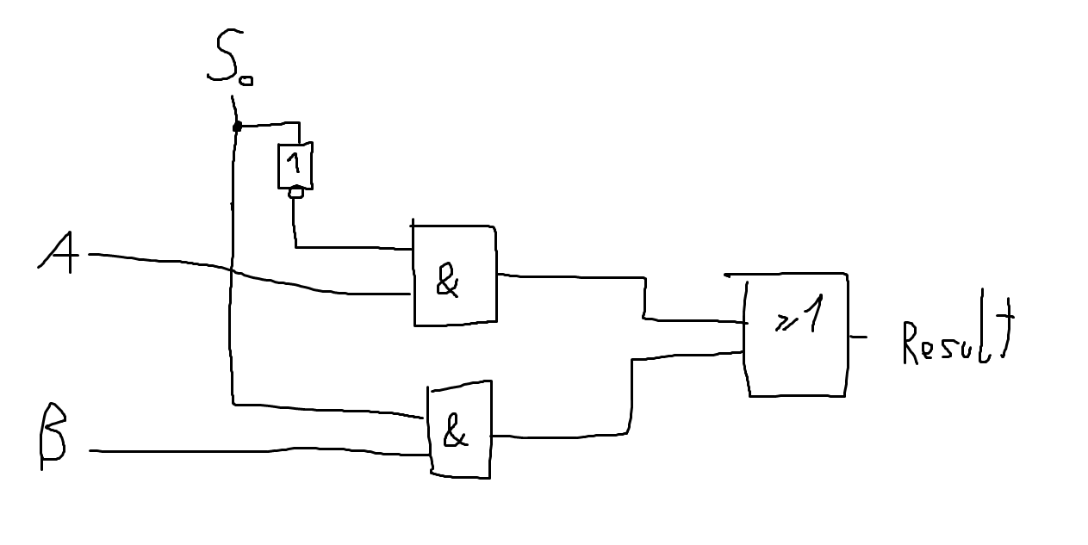
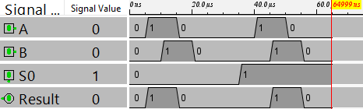
5: Multiplexer 2:1
Block Diagram:
Difficulties:
None, because VO shows circuit
Truth Table: K-Map +
Boolean expression
Test-Vectors:
S0 A B Result
0 0 0 0
0 0 1 0
0 1 0 1
0 1 1 1
1 0 0 0
1 0 1 1
1 1 0 0
1 1 1 1
Chronogram:

Slide 38
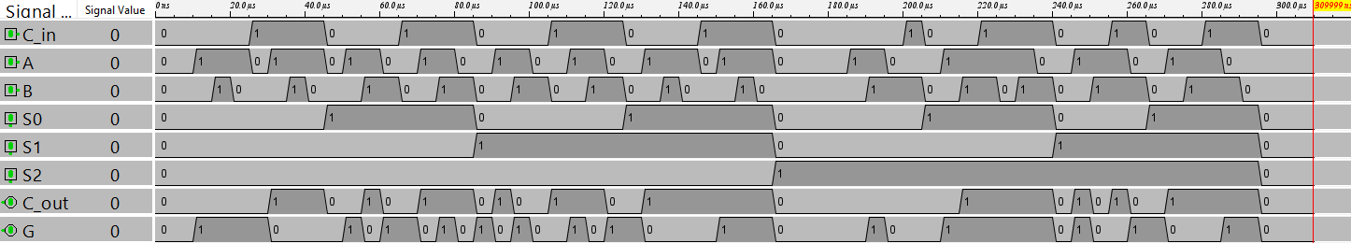
6.1: ALU 1bit
Test-Vectors:
S2 S1 S0 C_in A B G C_out
#Arithmetic:
#A transfer (1)
0 0 0 0 0 0 0 0
0 0 0 0 0 1 0 0
0 0 0 0 1 1 1 0
0 0 0 0 1 0 1 0
#A increment
0 0 0 1 0 0 1 0
0 0 0 1 1 0 0 1
0 0 0 1 0 1 1 0
0 0 0 1 1 1 0 1
#A+B
0 0 1 0 0 0 0 0
0 0 1 0 1 0 1 0
0 0 1 0 0 1 1 0
0 0 1 0 1 1 0 1
#A+B+1
0 0 1 1 0 0 1 0
0 0 1 1 1 0 0 1
0 0 1 1 0 1 0 1
0 0 1 1 1 1 1 1
#Logic:
#(x = don´t care)
# AND
1 0 0 0 0 0 0 x
1 0 0 0 0 1 0 x
1 0 0 0 1 0 0 x
1 0 0 0 1 1 1 x
# OR
1 0 1 0 0 0 0 x
1 0 1 0 0 1 1 x
1 0 1 0 1 0 1 x
1 0 1 0 1 1 1 x
# XOR
1 1 0 0 0 0 0 x
1 1 0 0 0 1 1 x
1 1 0 0 1 0 1 x
1 1 0 0 1 1 0 x
# NOT A
1 1 1 0 0 0 1 x
1 1 1 0 0 1 1 x
1 1 1 0 1 0 0 x
1 1 1 0 1 1 0 x
#A+-B
0 1 0 0 0 0 1 0
0 1 0 0 1 0 0 1
0 1 0 0 0 1 0 0
0 1 0 0 1 1 1 0
#subtract (A+-B+1)
0 1 0 1 0 0 0 1
0 1 0 1 1 0 1 1
0 1 0 1 0 1 1 0
0 1 0 1 1 1 0 1
#decrement (A-1)
0 1 1 0 0 0 1 0
0 1 1 0 1 0 0 1
0 1 1 0 0 1 1 0
0 1 1 0 1 1 0 1
#A transfer (2)
0 1 1 1 0 0 0 1
0 1 1 1 0 1 0 1
0 1 1 1 1 1 1 1
0 1 1 1 1 0 1 1
Difficulties:
Using all subcircuits
Testing everything
#same with C_in = 1:
# AND
1 0 0 1 0 0 0 x
1 0 0 1 0 1 0 x
1 0 0 1 1 0 0 x
1 0 0 1 1 1 1 x
# OR
1 0 1 1 0 0 0 x
1 0 1 1 0 1 1 x
1 0 1 1 1 0 1 x
1 0 1 1 1 1 1 x
# XOR
1 1 0 1 0 0 0 x
1 1 0 1 0 1 1 x
1 1 0 1 1 0 1 x
1 1 0 1 1 1 0 x
# NOT A
1 1 1 1 0 0 1 x
1 1 1 1 0 1 1 x
1 1 1 1 1 0 0 x
1 1 1 1 1 1 0 x
Chronogram:

Slide 39
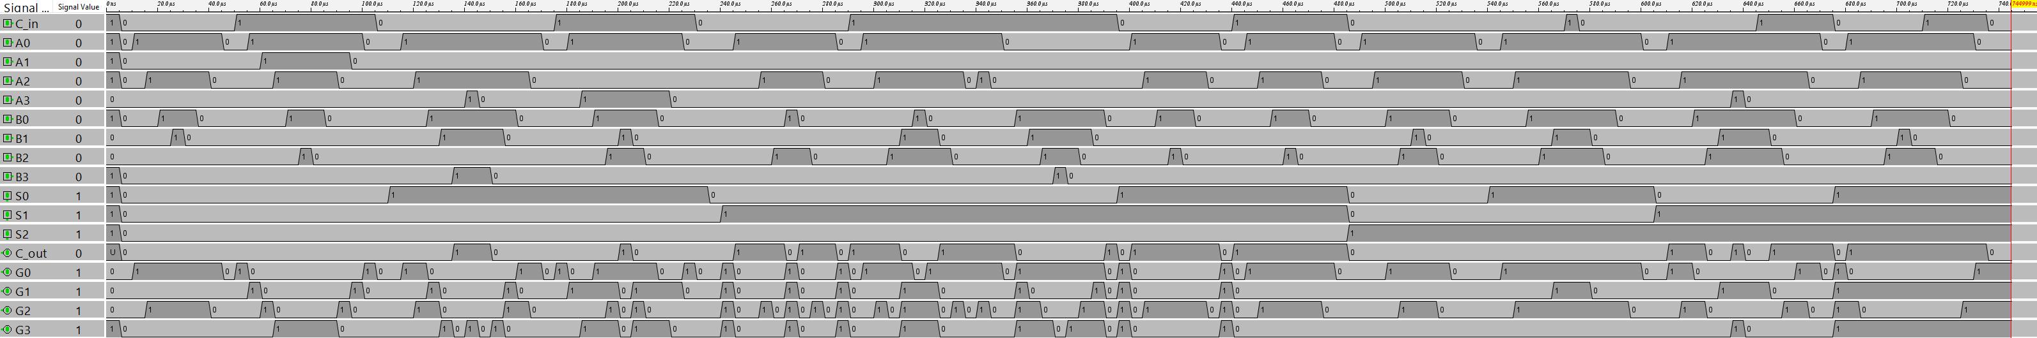
6.2: ALU nbit
Test-Vectors:
#basically tests of arithmetic and logic unit together
S2 S1 S0 C_in A3 A2 A1 A0 B3 B2 B1 B0 G3 G2 G1 G0 C_out
#arithmetic:
# A transfer (1)
0 0 0 0 1 0 1 0 0 0 0 0 1 0 1 0 0
0 0 0 0 1 1 1 1 0 0 0 0 1 1 1 1 0
0 0 0 0 0 0 1 1 0 0 0 0 0 0 1 1 0
0 0 0 0 1 1 1 1 1 1 1 1 1 1 1 1 0
#increment
0 0 0 1 1 0 1 0 0 0 0 0 1 0 1 1 0
0 0 0 1 1 1 1 1 0 0 0 0 0 0 0 0 1
0 0 0 1 0 0 1 1 0 0 0 0 0 1 0 0 0
0 0 0 1 1 1 1 1 1 1 1 1 0 0 0 0 1
#add
0 0 1 0 1 0 1 0 0 1 0 1 1 1 1 1 0 # 10 + 5 = 15
0 0 1 0 1 0 1 0 0 0 1 1 1 1 0 1 0 # 10 + 3 = 13
0 0 1 0 0 1 1 0 0 1 1 0 1 1 0 0 0 # 6 + 6 = 12
0 0 1 0 0 0 0 0 0 0 0 0 0 0 0 0 0 # 0...
0 0 1 0 1 1 1 1 1 1 1 1 1 1 1 0 1 # 15 + 15 = 14 + carry over
# add +1 (all tests from add)
0 0 1 1 1 0 1 0 0 1 0 1 0 0 0 0 1 # 10 + 5 +1 = 0 + carry over
0 0 1 1 1 0 1 0 0 0 1 1 1 1 1 0 0 # 10 + 3 +1 = 14
0 0 1 1 0 1 1 0 0 1 1 0 1 1 0 1 0 # 6 + 6 +1 = 13
0 0 1 1 0 0 0 0 0 0 0 0 0 0 0 1 0 # 0 +1 = 1
0 0 1 1 1 1 1 1 1 1 1 1 1 1 1 1 1 # 15 + 15 +1 = 15 + carry over
Difficulties:
Using all subcircuits
Testing everything
# subtract (A + -B + 1)
# (positive numbers: always carry over active)
# (negative numbers in 1-komplement layout without carry over)
0 1 0 1 1 0 1 0 0 1 0 1 0 1 0 1 1 # 10 - 5 = 5
0 1 0 1 1 0 1 0 0 0 1 1 0 1 1 1 1 # 10 - 3 = 7
0 1 0 1 0 1 1 0 0 1 1 0 0 0 0 0 1 # 6 - 6 = 0
0 1 0 1 1 1 1 1 1 1 1 1 0 0 0 0 1 # 15 - 15 = 0
0 1 0 1 0 0 0 0 0 0 0 1 1 1 1 1 0 # -1
0 1 0 1 0 1 0 1 1 0 1 0 1 0 1 1 0 # 5 - 10 = -5
0 1 0 1 0 1 1 1 1 1 1 1 1 0 0 0 0 # 7 - 15 = -8
# A + -B (subtraction -1 )
0 1 0 0 1 0 1 0 0 1 0 1 0 1 0 0 1 # 10 - 5 = 5-1 = 4
0 1 0 0 1 0 1 0 0 0 1 1 0 1 1 0 1 # 10 - 3 = 7-1 = 6
0 1 0 0 0 1 1 0 0 1 1 0 1 1 1 1 0 # 6 - 6 = 0-1 = -1
0 1 0 0 1 1 1 1 1 1 1 1 1 1 1 1 0 # 15 - 15 = 0-1 = -1
0 1 0 0 0 0 0 0 0 0 0 1 1 1 1 0 0 # -1-1 = -2
0 1 0 0 0 1 0 1 1 0 1 0 1 0 1 0 0 # 5 - 10 = -5-1 = -6
0 1 0 0 0 1 1 1 1 1 1 1 0 1 1 1 0 # 7 - 15 = -8-1 = -9
# decrement
# carry over: 1 => positive number; 0=> negative number
0 1 1 0 1 0 1 0 0 0 0 0 1 0 0 1 1
0 1 1 0 1 1 1 1 0 0 0 0 1 1 1 0 1
0 1 1 0 0 0 0 0 0 0 0 0 1 1 1 1 0
0 1 1 0 0 1 1 0 0 0 0 0 0 1 0 1 1
0 1 1 0 0 0 0 1 0 0 0 0 0 0 0 0 1
#transfer (2)
# carry over: 1 => positive number
0 1 1 1 1 0 1 0 0 0 0 0 1 0 1 0 1
0 1 1 1 1 1 1 1 0 0 0 0 1 1 1 1 1
0 1 1 1 0 0 1 1 0 0 0 0 0 0 1 1 1
0 1 1 1 1 1 1 1 1 1 1 1 1 1 1 1 1
#logic:
#(x = don´t care)
# AND
1 0 0 0 1 0 1 0 1 1 0 0 1 0 0 0 x
1 0 0 0 0 1 1 1 1 1 1 1 0 1 1 1 x
1 0 0 0 0 1 0 0 1 1 0 0 0 1 0 0 x
1 0 0 0 0 1 0 0 0 0 0 0 0 0 0 0 x
1 0 0 0 0 0 1 1 0 1 0 1 0 0 0 1 x
1 0 0 0 0 0 0 0 0 1 1 0 0 0 0 0 x
1 0 0 0 1 1 0 1 0 1 0 0 0 1 0 0 x
# OR
1 0 1 0 1 0 1 1 0 0 0 1 1 0 1 1 x
1 0 1 0 0 1 0 1 1 0 0 1 1 1 0 1 x
1 0 1 0 1 1 1 0 1 0 0 0 1 1 1 0 x
1 0 1 0 1 1 0 0 1 1 0 1 1 1 0 1 x
# XOR
1 1 0 0 1 0 0 0 0 1 1 0 1 1 1 0 x
1 1 0 0 1 0 1 0 1 0 0 1 0 0 1 1 x
1 1 0 0 1 1 1 0 0 0 0 0 1 1 1 0 x
1 1 0 0 0 1 0 0 1 0 0 1 1 1 0 1 x
# NOT A
1 1 1 0 1 1 0 0 0 0 0 1 0 0 1 1 x
1 1 1 0 1 0 0 1 1 0 1 1 0 1 1 0 x
1 1 1 0 1 0 1 0 1 1 0 1 0 1 0 1 x
1 1 1 0 0 1 1 0 0 0 1 0 1 0 0 1 x
1 1 1 0 0 1 1 1 1 0 0 1 1 0 0 0 x
#same with C_in = 1:
# AND
1 0 0 1 1 0 1 0 1 1 0 0 1 0 0 0 x
1 0 0 1 0 1 1 1 1 1 1 1 0 1 1 1 x
1 0 0 1 0 1 0 0 1 1 0 0 0 1 0 0 x
1 0 0 1 0 1 0 0 0 0 0 0 0 0 0 0 x
1 0 0 1 0 0 1 1 0 1 0 1 0 0 0 1 x
1 0 0 1 0 0 0 0 0 1 1 0 0 0 0 0 x
1 0 0 1 1 1 0 1 0 1 0 0 0 1 0 0 x
# OR
1 0 1 1 1 0 1 1 0 0 0 1 1 0 1 1 x
1 0 1 1 0 1 0 1 1 0 0 1 1 1 0 1 x
1 0 1 1 1 1 1 0 1 0 0 0 1 1 1 0 x
1 0 1 1 1 1 0 0 1 1 0 1 1 1 0 1 x
# XOR
1 1 0 1 1 0 0 0 0 1 1 0 1 1 1 0 x
1 1 0 1 1 0 1 0 1 0 0 1 0 0 1 1 x
1 1 0 1 1 1 1 0 0 0 0 0 1 1 1 0 x
1 1 0 1 0 1 0 0 1 0 0 1 1 1 0 1 x
# NOT A
1 1 1 1 1 1 0 0 0 0 0 1 0 0 1 1 x
1 1 1 1 1 0 0 1 1 0 1 1 0 1 1 0 x
1 1 1 1 1 0 1 0 1 1 0 1 0 1 0 1 x
1 1 1 1 0 1 1 0 0 0 1 0 1 0 0 1 x
1 1 1 1 0 1 1 1 1 0 0 1 1 0 0 0 x
Chronogram:

