Slide 1
Real Estate Predictioneering: Determining What Factors Best Predict Home Sale Prices
Author: Stephen Re

Slide 2
Introduction
According to Experian, there are 5 main factors that influence the sale price of homes:
Price of comparable properties
Neighborhood
Home Age and Condition
Home Size
Housing market conditions
We can’t predict market forces using a point-in-time dataset, but we can determine what home features contribute to its price.
To determine these features, we will build a predictive model. This will involve:
Using provided dataset of historical house sales, including prices and features.
Cleaning and organizing the data for analysis.
Exploring the data to determine how best to build the model.
Running experiments to see which features best predict sale prices.

Slide 3
The Data
The provided dataset is a historical list of house sales in Ames, Iowa. The set includes:
SalePrice which is the dependent variable we will be attempting to predict
79 other columns describing various characteristics of the house that was sold such as:
Neighborhood
Square feet of living space
Year the home was built
*Please add slides as required.

Slide 4
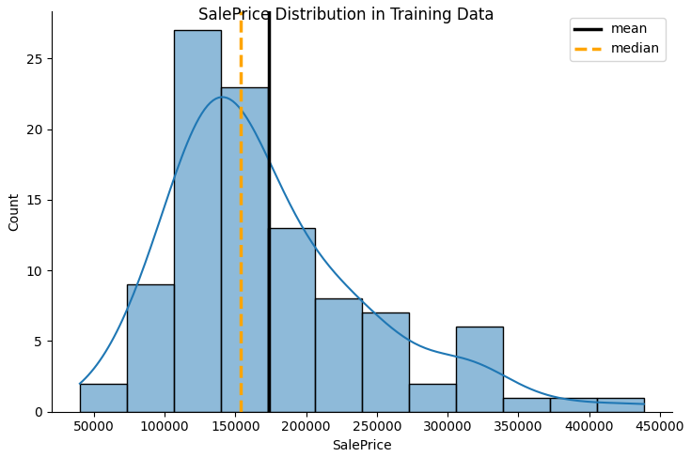
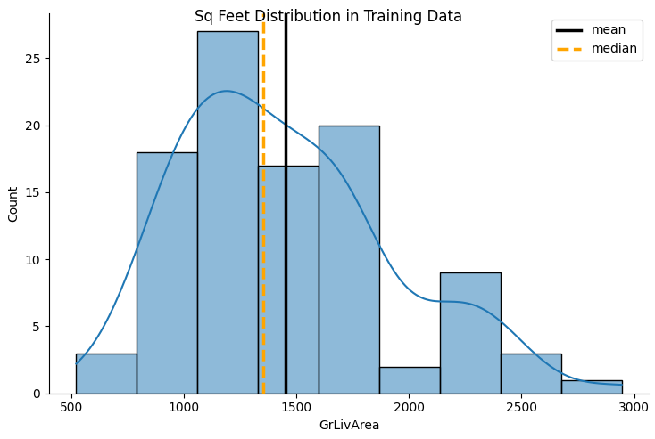
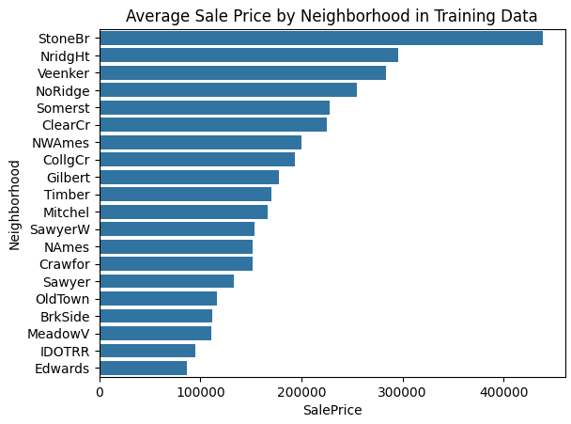
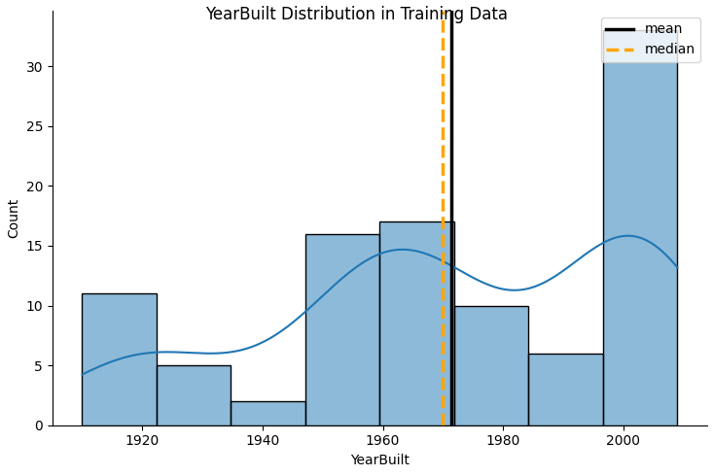
Data Exploration
There is a clear skew in the data toward newer, smaller, less expensive homes.
Average price by neighborhood shows a distinct house value gap with Stone Brook averaging 140k more than the next highest neighborhood.

Slide 5
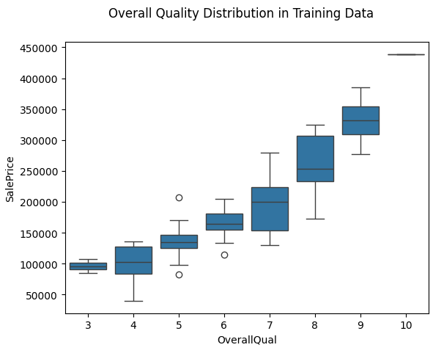
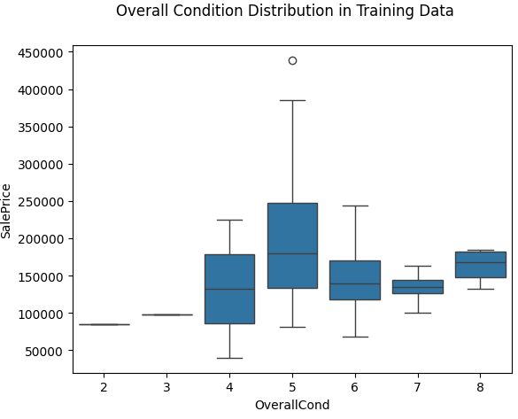
Data Exploration
OverallQual shows a strong relationship with price as would be expected.
OverallCond, however, does not show a strong relationship with price.
So even houses in moderate shape are selling for as much or more than houses in exelent condition.

Slide 6
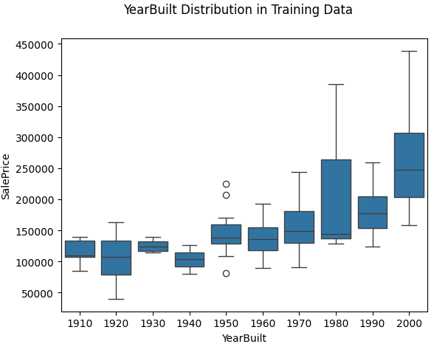
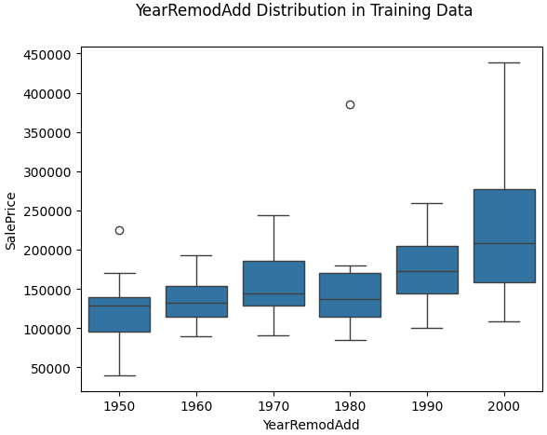
Data Exploration
There is a clear skew in the data toward newer, smaller, less expensive homes.
Average price by neighborhood shows a distinct house value gap with Stone Brook averaging 140k more than the next highest neighborhood.
Boxplot by YearBuilt was too crowded so I did it by decade built.
Shows, as expected, a rising relationship with price as the houses become newer.
Houses from the 80s and 2000s have the biggest outliers.
But, there is little movement on price between houses built in the 1910s and 1960s.
The age of remodel does not seem to be nearly as strongly related to SalePrice as YearBuilt

Slide 7
Data Preparation
To prep the data, I followed these steps:
Combined training and testing datasets into one for ease of preparation
Dropped several unusable.
Added several calculated columns such as:
Total Sqft = basement sqft + above grade
Total Bathrooms = full baths + half baths*0.5
Replaced blank values in categorical columns with default ‘NA’ value.
Used interpolation to fill in small gaps in numeric data where appropriate.
Encoded categorical columns to break them out into numeric columns for
Split the dataset back into training and testing sets now that they have gone through the same cleaning process.
*Please add slides as required.

Slide 8
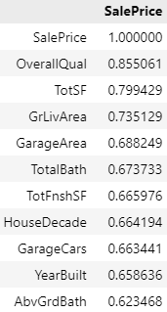
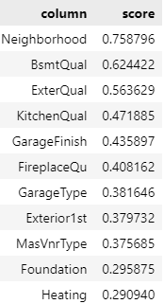
Correlation
To help direct my efforts in testing features, I ran a correlation between all the numeric columns and SalePrice. These showed a strong correlations with the features you might expect to affect prices, but there were a few surprises such as garage features. Here are the top scores:
To get a sense of what categorical variables to use, I decided to encode them into numeric columns and run a preliminary linear model on each one. The results were mixed with the only strong standouts being neighborhood and, strangely, basement quality. Here are the top scores:
Numeric Correlations
Categorical LR Predictions

Slide 9
Project Description
I improved on Dr Williams' analysis by:
Using more columns than he did
Using numeric columns most correlated to SalePrice.
Iterating through other numeric columns to find best performance.
Added categorical columns to the model and continued iterating until I got the best score I could.
Some of the features were calculated columns that added up similar columns like FullBath and HalfBath to get a TotalBath column. These proved very effective for the analysis.
The columns I used make sense in the context of buying or selling a home. They are the the things I look for:
Overall quality
Square feet of space,
Number of bathrooms
Number of bedrooms
Size of garage, etc.
*Please add slides as required.

Slide 10
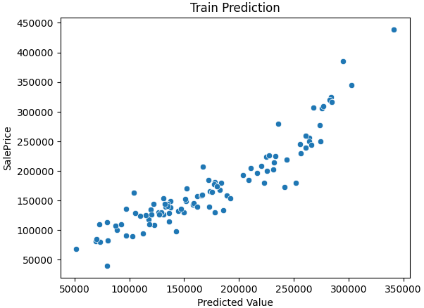
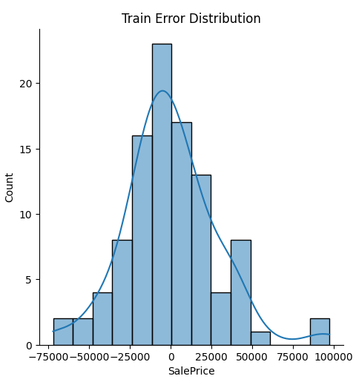
Analysis and Results
First attempt: top 9 correlated numerical columns from the correlation analysis.
'OverallQual’
'TotSF’
'GrLivArea’
'GarageArea’
'TotalBath’
'TotFnshSF’
'HouseDecade’
'GarageCars’
'YearBuilt'
R2 = 0.8511
Already much better than the professor's results. TotSF, TotalBath, TotFnshSF, HouseDecade are all my aggregated columns.
*Please add slides as required.

Slide 11
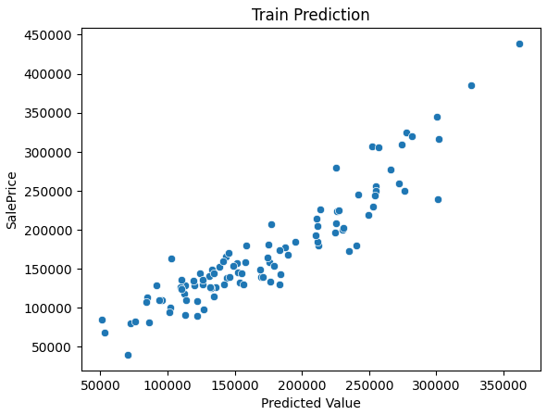
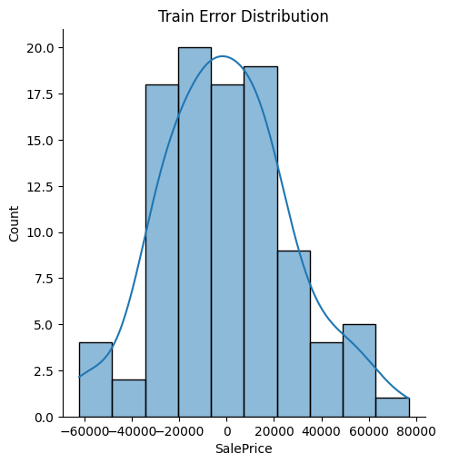
Analysis and Results
Last try for just numeric columns: all of the numeric columns I thought would be predictive.
'OverallQual’
'OverallCond’
'YearBuilt’
'GrLivArea’
'BedroomAbvGr’
'TotRmsAbvGrd’
'GarageCars’
'GarageArea’
'AbvGrdBath'
R2 = 0.856
Slight improvement and as much as i could get using just numeric columns.
*Please add slides as required.

Slide 12
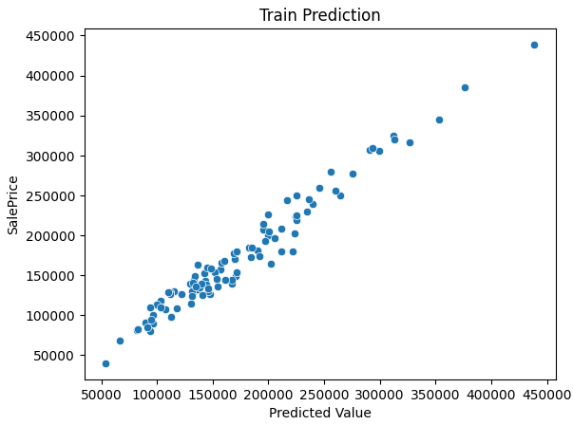
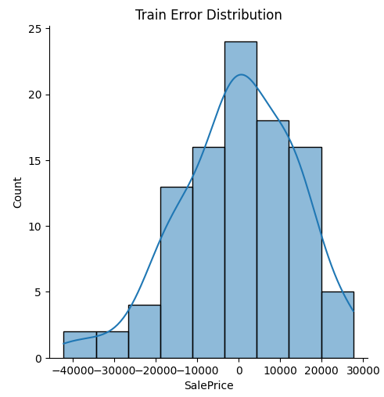
Analysis and Results
Last try before testing. This time with the same numeric variables and the top 10 categorical variables from my LM analysis.
'Neighborhood’
'BsmtQual’
'ExterQual’
'KitchenQual’
'GarageFinish’
'FireplaceQu’
'GarageType’
'Exterior1st’
'MasVnrType’
'Foundation'
R2 = 0.962 This greatly improved the results.
*Please add slides as required.

Slide 13
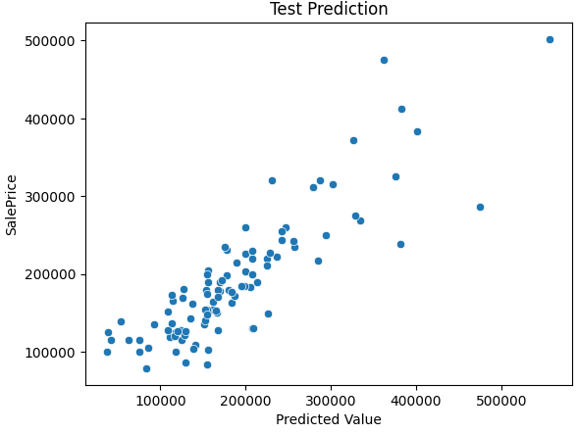
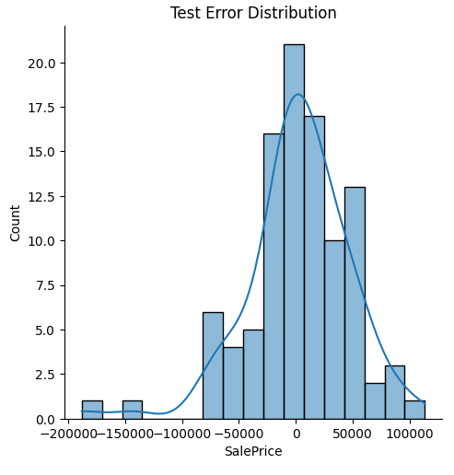
Verification
With the large set of numeric and categorical columns, I only scored R2 = 0.680. They were not in accordance with what I found earlier.
My theory is that I tried to use too many variables and fit the model too closely to the training data.

Slide 14
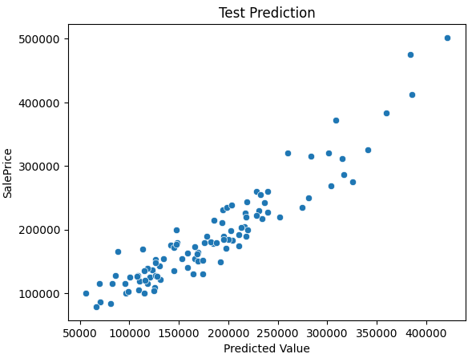
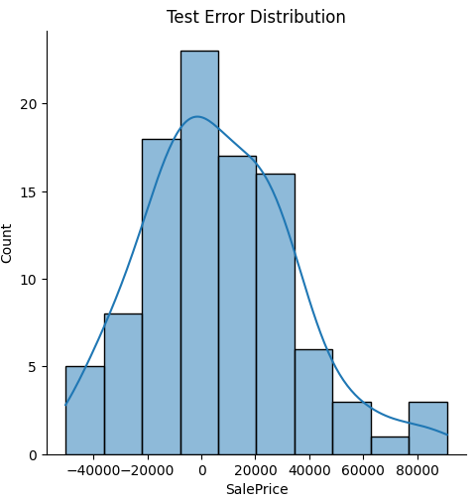
Verification
I tried several more times and settled on a small set of 4:
'BldgType’
'HouseStyle’
'BsmtQual’
'KitchenQual'
Looking at what they represent: type of home (house, condo, etc), home layout, basement quality, and kitchen quality, they all seem like useful stats that I would look for when buying a home, but they aren’t the most important things. I was banking on Neighborhood being a strong indicator, but it actually made the model worse.
In the end, i was able to score R2 = 0.92 value on the training set and R2 = 0.87 when ran against the test data.

Slide 15
Conclusion
In the end, I was able to beat the professor's score by using more columns, and incorporating categorical variables.
However, I think I overfit the training model by using too many columns and my test model suffered.
Through iterating through the variables, I was able to find a model that was significantly better in both train and test than the professors’.
Other approaches that helped were cleaning both test and train data at the same time. I ran into trouble when I tried to encode them seperately because some encoded columns were missing between the datasets. Cleaning them together eliminated that problem.
I also added calculated columns to the dataset to consolidate similar variables into aggregated ones. Several of those columns were in the top of the correlation analysis.
This was an interesting project. I learned a lot more about linear regression and correlation, as well as using python in a notebook and creating visuals
Thank you and I look forward to your comments.
*Please add slides as required.

Slide 16
References
Hayes, Marianne. “5 Factors That Affect a Home’s Value” Experian.com March 10, 2022 https://www.experian.com/blogs/ask-experian/factors-that-affect-home-value/
Asked by: pr338 Answered by: silviomoreto. “**How to do linear regression using Python and Scikit learn using one hot encoding?”. stackoverflow.com Dec 25, 2016** https://stackoverflow.com/questions/41325227/how-to-do-linear-regression-using-python-and-scikit-learn-using-one-hot-encoding
Anonymous Author. “One Hot Encoding in Machine Learning” geeksforgeeks.org 21 Mar, 2024. https://www.geeksforgeeks.org/ml-one-hot-encoding/
Asked by: Erin Shellman Answered by: sascha. “**Label axes on Seaborn Barplot”. stackoverflow.com Jul 26, 2015.** https://stackoverflow.com/questions/31632637/label-axes-on-seaborn-barplot
Anonymous Author. “Boxplot using Seaborn in Python” geeksforgeeks.org 10 Nov, 2020**.** https://www.geeksforgeeks.org/boxplot-using-seaborn-in-python/
BOBBITT, ZACH. “How to Add a Title to Seaborn Plots (With Examples)”, statology.org April 8, 2021. https://www.statology.org/seaborn-title/
Asked by: a11 Answered by: Trenton McKinney. “**How to add a mean and median line to a Seaborn displot”. stackoverflow.com Jul 26, 2015.** https://stackoverflow.com/questions/67613774/how-to-add-a-mean-and-median-line-to-a-seaborn-displot
Ngecha, Michael. “Exploratory Data Analysis (EDA)through Data Visualization.” medium.com/ Oct 9, 2023. https://medium.com/@ngechamike26/exploratory-data-analysis-eda-through-data-visualization-bc1bf1dce3b2
Unable to find Author. “STAT 501 | Regression Methods” online.stat.psu.edu. Penn State University. Accessed 7/3/2024. https://online.stat.psu.edu/stat501/lesson/1/1.2
*Please add slides as required.

