Slide 1
Terraform

Slide 2
Infrastructure
Information technology (IT) infrastructure are the components required to operate and manage enterprise IT environments. IT infrastructure can be deployed within a cloud computing system, or within an organization's own Data Centre facilities.
These components include hardware, software, networking components, an operating system (OS), and data storage, all of which are used to deliver IT services.
If an IT infrastructure is flexible, reliable and secure, it can help an enterprise meet its goals and provide a competitive edge in the market. Alternatively, if an IT infrastructure isn’t properly implemented, businesses can face connectivity, productivity and security issues—like system disruptions and breaches.

Slide 3
Types ….
A traditional IT infrastructure is made up of the usual hardware and software components: facilities, data centres, servers, networking hardware desktop computers and enterprise application software solutions. Typically, this infrastructure setup requires more power, physical space and money than other infrastructure types. A traditional infrastructure is typically installed on-premises for company-only, or private dc.
A cloud computing IT infrastructure is similar to traditional infrastructure. However, end users can access the infrastructure via the internet, with the ability to use computing resources without installing on-premises through virtualization. Virtualization connects physical servers maintained by a service provider at any or many geographical locations. Then, it divides and abstracts resources, like storage, to make them accessible to users almost anywhere an internet connection can be made. Because cloud infrastructure is often public, it’s usually referred to as a public cloud

Slide 4
Infrastructure As A Code
Infrastructure as code is the process of managing and provisioning computer data centres through machine-readable definition files, rather than physical hardware configuration or interactive configuration tools.
Infrastructure as code (IaaC) means to manage your IT infrastructure using configuration files.
In simple words provisioning / creating infrastructure with code

Slide 5
Why IAAC ??
Infrastructure as code (IaaC) tools allow you to manage infrastructure with configuration files rather than through a graphical user interface. IaaC allows you to build, change, and manage your infrastructure in a safe, consistent, and repeatable way by defining resource configurations that you can version, reuse, and share.

Slide 6
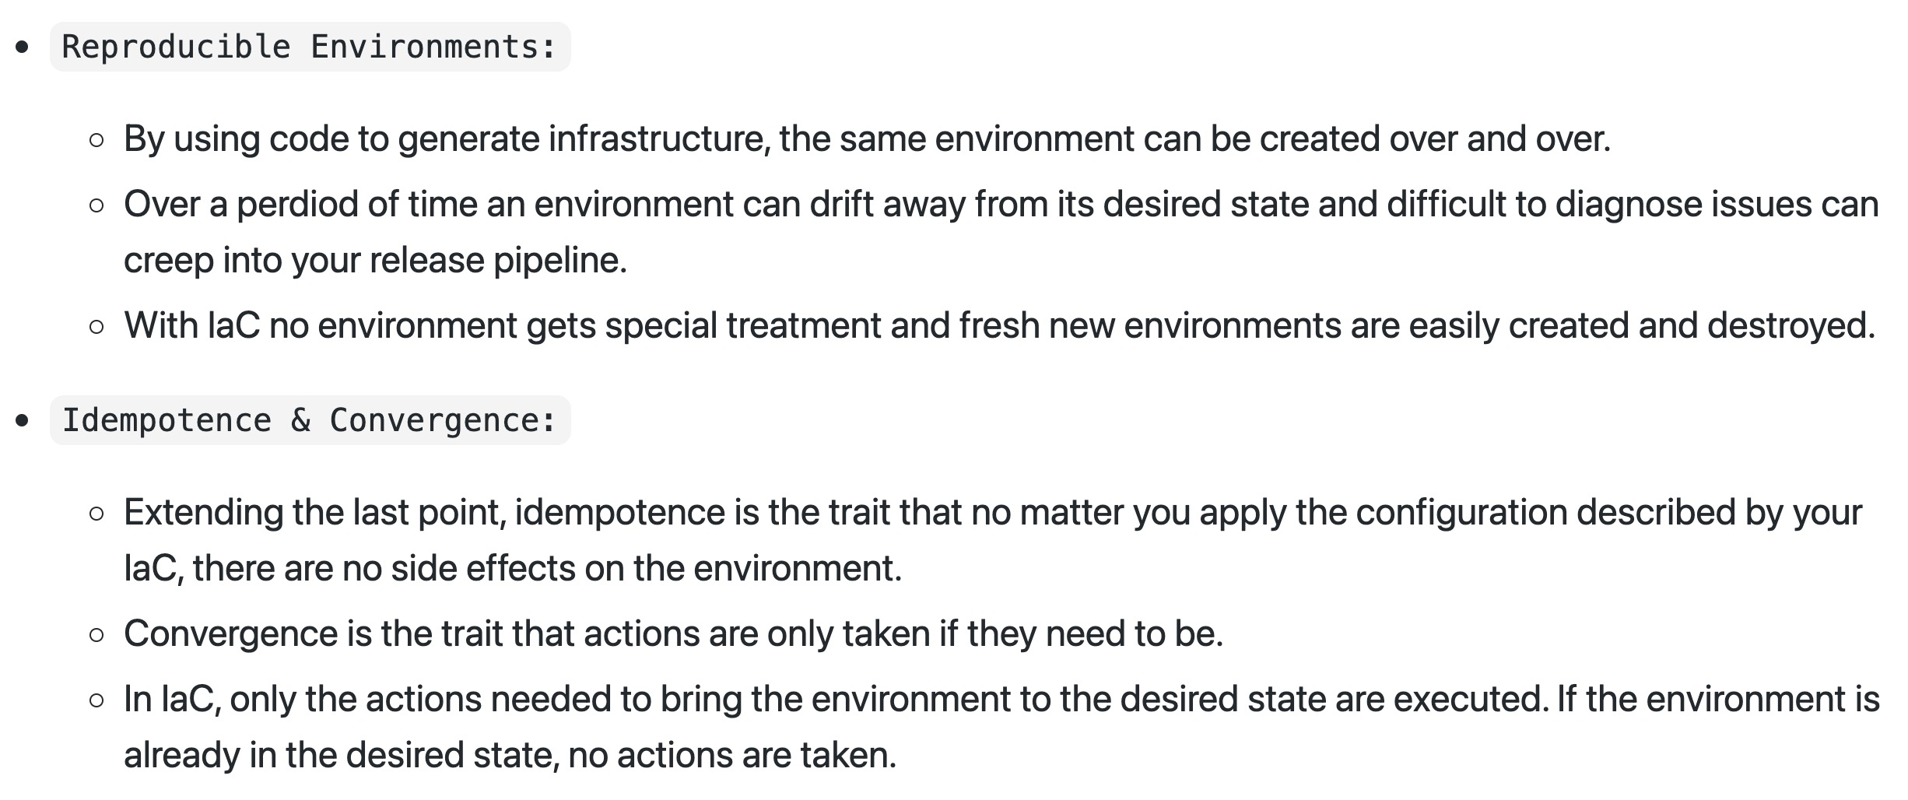

Slide 7
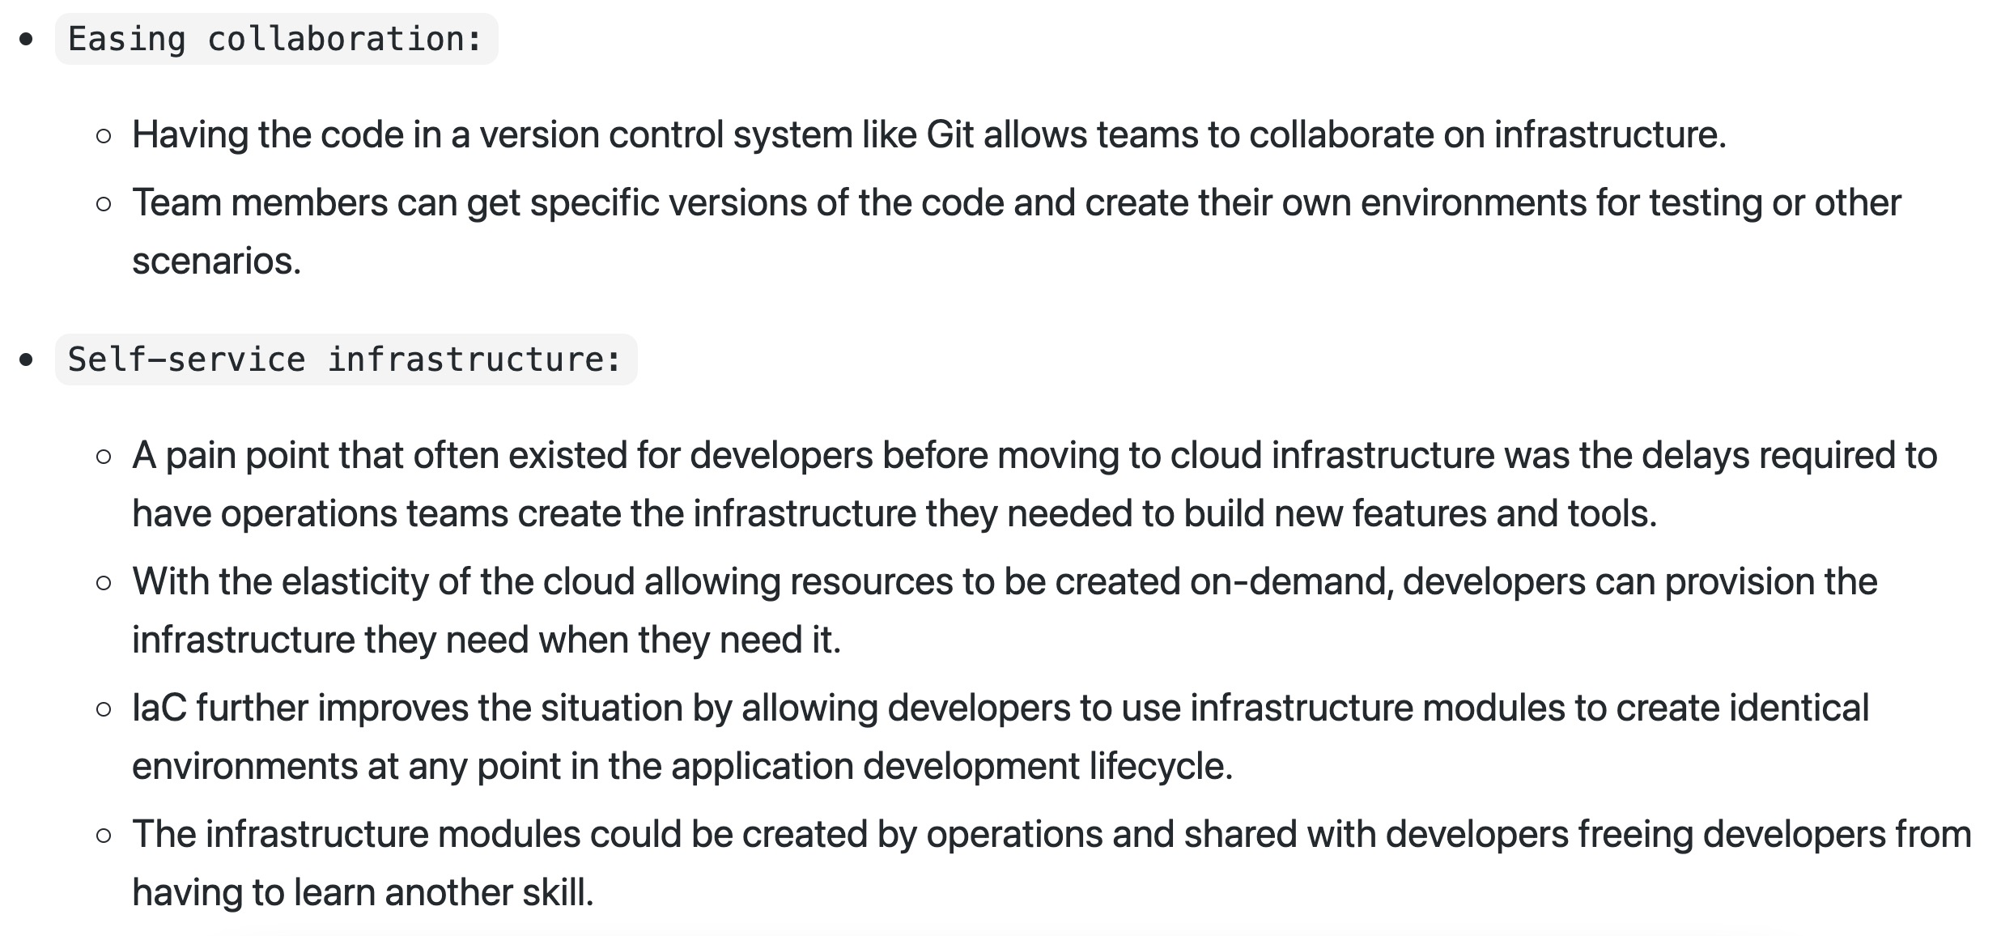

Slide 8
Advantages
Automation We can bring up the servers with one script and scale up and down based on our load with the same script
Reusability of the code We can reuse the same codec.
Versioning We can check it into version control, and we get versioning. Now we can see an incremental history of who changed what, how is our infrastructure actually defined at any given point of time, and we have this transparency of documentation
IaaC makes changes idempotent, consistent, repeatable, and predictable.
Makes it easy to provision and apply infrastructure configurations, saving time. It standardizes workflows across different infrastructure providers (e.g., VMware, AWS, Azure, GCP, etc.) by using a common syntax across all of them.

Slide 9
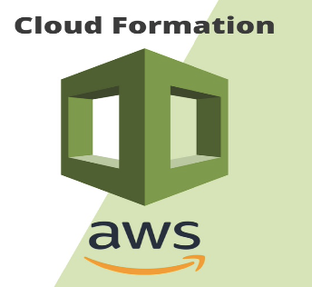
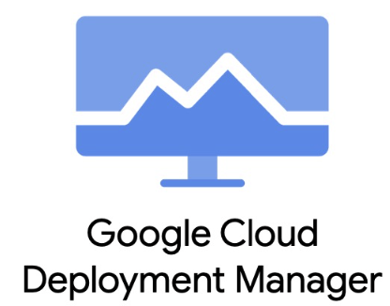

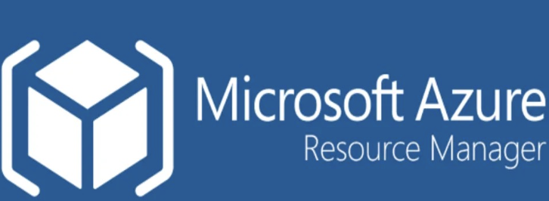

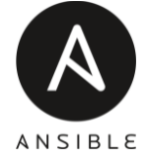








Slide 10


Provisioning vs CM
“Provisioning is not the same thing as configuration, but they are both steps in the deployment process. Once something has been provisioned, the next step is configuration”

Slide 11
Let’s Discuss
Complexity in simplicity
Creating an Ansible playbook to configure these nginx instances enables your engineers to do this. The process is straightforward: create a “playbook” that contains “plays” which does things like install nginx from yum or apt, copies configuration to the host and/or starts the nginx service.
But, what happens when you want to deploy onto multiple regions with different IDs and, potentially, different keys? What about when you need to perform modifications to the operating system after the machine is already created?
Maintaining state is important
you would like to have three database servers in your environment instead of two. (We will assume that this environment does not currently have auto-scaling built in.) Because configuration management tools, like Chef or Puppet, are designed to modify existing infrastructure, not to keep a history of past configurations, in order to add an additional database server, you would need to write code to calculate the state of your current environment before taking any action against it. Otherwise, your cookbook will deploy three more database servers instead of just the additional one that you needed.
Rollbacks ?
Configuration management tools do not keep state of their actions. Consequently, without writing additional code to account, performing rollback with code will be impossible
Use the right !
https://www.thoughtworks.com/insights/blog/choosing-right-tool-provision-aws-infrastructure

Slide 12



Slide 13
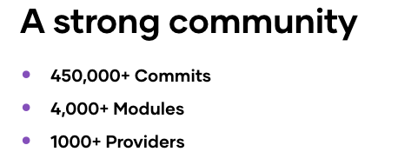
Why Terraform ?
Terraform is an open-source infrastructure as code software tool that provides a consistent CLI workflow to manage hundreds of cloud services. Terraform codifies cloud APIs into declarative configuration files.
Write infrastructure as code using declarative configuration files. HashiCorp Configuration Language (HCL) allows for concise descriptions of resources using blocks, arguments, and expressions.
Run terraform plan to check whether the execution plan for a configuration matches your expectations before provisioning or changing infrastructure.
Apply changes to hundreds of cloud providers with terraform apply to reach the desired state of the configuration.
Codify your application infrastructure
Manage infrastructure across clouds
Create reproducible infrastructure
Over 100 publicly available infrastructure integrations.

Slide 14
Offerings !
Terraform
OSS
CLOUD
ENTERPRISE
Free
Team
Team & Governance

Slide 15
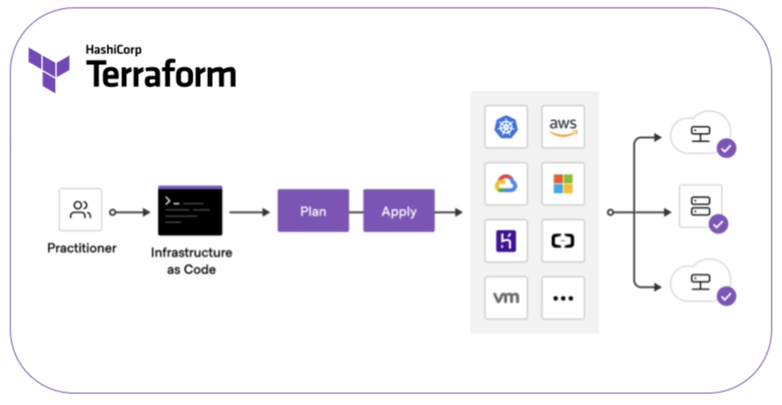
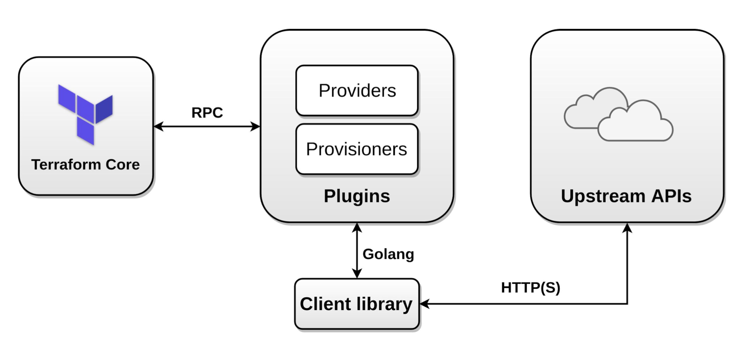
The FLOW

Slide 16


