Slide 1
Modules

Slide 2
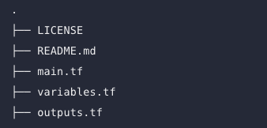
Module
A Terraform module is a set of Terraform configuration files in a single directory. Even a simple configuration consisting of a single directory with one or more .tf files is a module. When you run Terraform commands directly from such a directory, it is considered the root module. So in this sense, every Terraform configuration is part of a module.
You may have a simple set of Terraform configuration files such as:

Slide 3
Overview
As you manage your infrastructure with Terraform, you will create increasingly complex configurations. There is no intrinsic limit to the complexity of a single Terraform configuration file or directory, so it is possible to continue writing and updating your configuration files in a single directory. However, if you do, you may encounter one or more problems:
Understanding and navigating the configuration files will become increasingly difficult.
Updating the configuration will become more risky, as an update to one section may cause unintended consequences to other parts of your configuration.
There will be an increasing amount of duplication of similar blocks of configuration, for instance when configuring separate dev/staging/production environments, which will cause an increasing burden when updating those parts of your configuration.
You may wish to share parts of your configuration between projects and teams, and will quickly find that cutting and pasting blocks of configuration between projects is error prone and hard to maintain.

Slide 4
How Modules Help
Organize configuration - Modules make it easier to navigate, understand, and update your configuration by keeping related parts of your configuration together. Even moderately complex infrastructure can require hundreds or thousands of lines of configuration to implement. By using modules, you can organize your configuration into logical components.
Encapsulate configuration - Another benefit of using modules is to encapsulate configuration into distinct logical components. Encapsulation can help prevent unintended consequences, such as a change to one part of your configuration accidentally causing changes to other infrastructure, and reduce the chances of simple errors like using the same name for two different resources.
Re-use configuration - Writing all of your configuration from scratch can be time consuming and error prone. Using modules can save time and reduce costly errors by re-using configuration written either by yourself, other members of your team, or other Terraform practitioners who have published modules for you to use. You can also share modules that you have written with your team or the general public, giving them the benefit of your hard work.
Provide consistency and ensure best practices - Modules also help to provide consistency in your configurations. Not only does consistency make complex configurations easier to understand, it also helps to ensure that best practices are applied across all of your configuration. For instance, cloud providers give many options for configuring object storage services, such as Amazon S3 or Google Cloud Storage buckets. There have been many high-profile security incidents involving incorrectly secured object storage, and given the number of complex configuration options involved, it's easy to accidentally misconfigure these services.

Slide 5
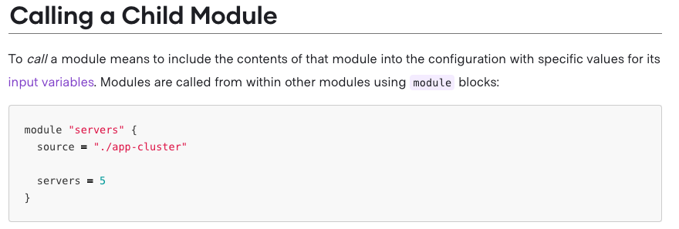
Calling
Terraform commands will only directly use the configuration files in one directory, which is usually the current working directory. However, your configuration can use module blocks to call modules in other directories. When Terraform encounters a module block, it loads and processes that module's configuration files.
A module that is called by another configuration is sometimes referred to as a "child module" of that configuration

Slide 6
Source
All modules require a source argument, which is a meta-argument defined by Terraform. Its value is either the path to a local directory containing the module's configuration files, or a remote module source that Terraform should download and use. This value must be a literal string with no template sequences; arbitrary expressions are not allowed.
The same source address can be specified in multiple module blocks to create multiple copies of the resources defined within, possibly with different variable values.
After adding, removing, or modifying module blocks, you must re-run terraform init to allow Terraform the opportunity to adjust the installed modules. By default this command will not upgrade an already-installed module; use the -upgrade option to instead upgrade to the newest available version.

Slide 7
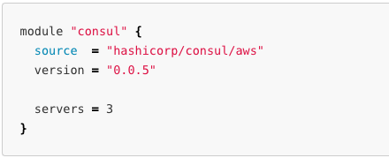
Version
When using modules installed from a module registry, we recommend explicitly constraining the acceptable version numbers to avoid unexpected or unwanted changes.
Use the version argument in the module block to specify versions
Version constraints are supported only for modules installed from a module registry, such as the public Terraform Registry or Terraform Cloud's private module registry.

Slide 8
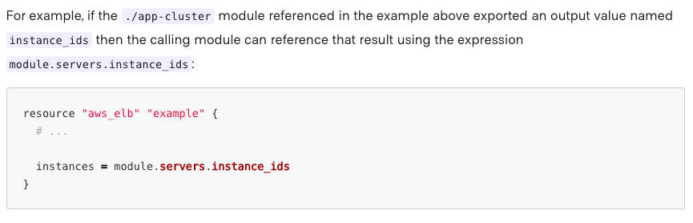
Module Output
The resources defined in a module are encapsulated, so the calling module cannot access their attributes directly. However, the child module can declare output values to selectively export certain values to be accessed by the calling module.

Slide 9

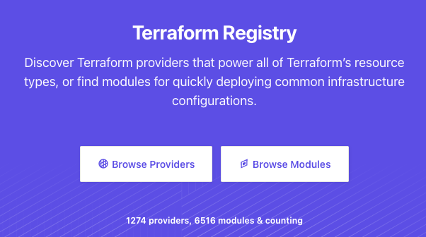
Registry
https://registry.terraform.io/

