Slide 1












Arrows
ZOOM LEVELS
Zoom
Save
IMAGE FILE
Print
Script
SAVE / COPY
ORDER
REVERSE
OFFSET
FILL
Fit
Home
RESET
AXES
Drag
R-clk PAN
L-clk STRETCH
Grids
ON / OFF
Options
MENU
Waterfall
FITTING
TAB
https://materialdesignicons.com/

Slide 2
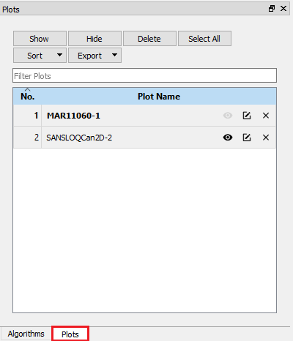





Plots
Show
Hide
Delete
Select All
FIND + ORGANISE
Sort
Export
Filter Plots
No. Plot Name
1 | MAR11060-1
2 | SANSLOQCan2D-2
SELECTED PLOTS APPEAR BOLD
HIDE/
SHOW
RENAME
DELETE
Algorithms
Plots
OPEN PLOTS TOOLBOX

Slide 3
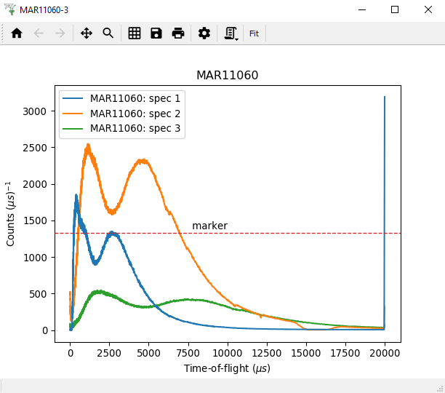
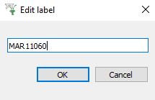

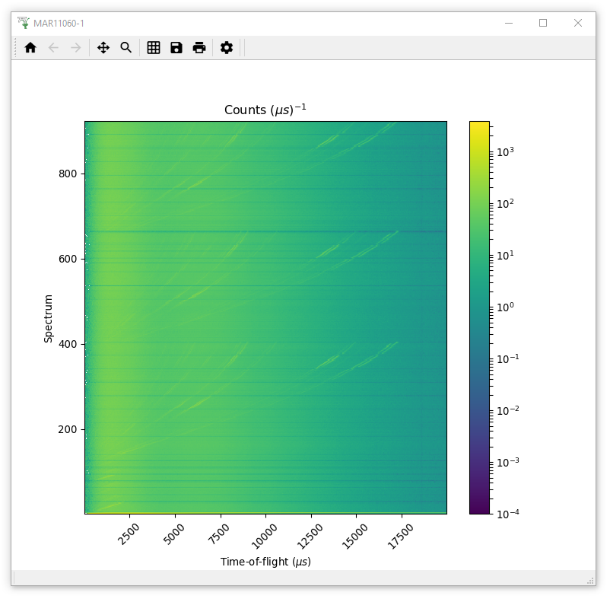
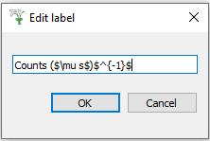

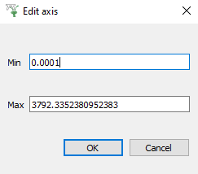
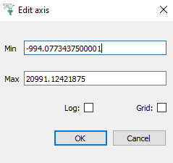
1D PLOT
COLORFILL
Axes
LINEAR / LOGARITHMIC
Normalization
NONE / by BIN WIDTH
Error Bars
SHOW / HIDE
Markers
HORZ / VERT LINE
Plot Type
1D / WATERFALL
Axes
Normalization
Color bar
LINEAR / LOGARITHMIC
Double-Click
Right-Click

Slide 4
ptions Menu

Slide 5
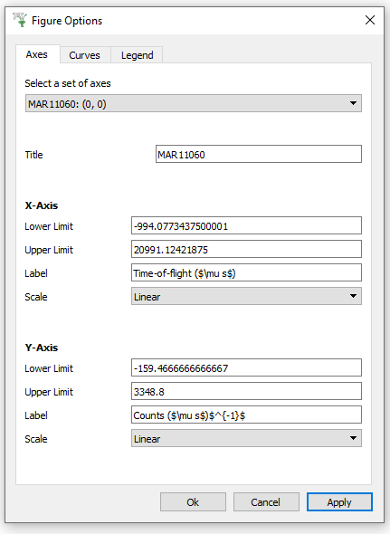
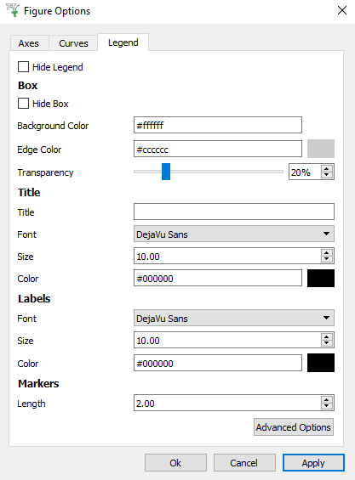
1D PLOT
IMPORTANT FOR
TILED PLOTS
LINEAR / LOG / SYMLOG / LOGIT
e.g.
Counts (μs)⁻¹
FORMATTING

Slide 6

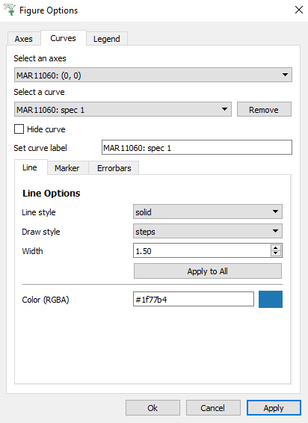
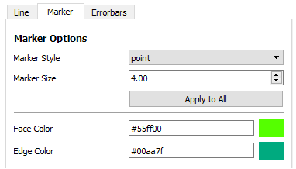
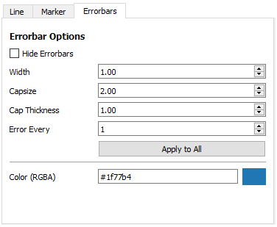
1D PLOT
SELECT A SPECTRUM
EDIT ALL SPECTRA
EDIT SELECTED SPECTRUM

Slide 7
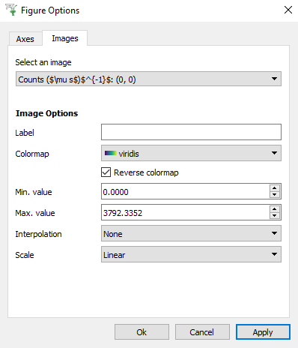
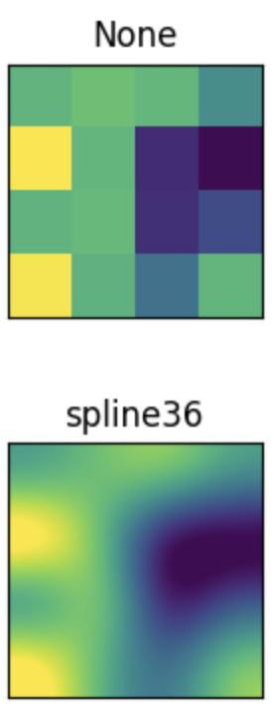
COLORFILL
LINEAR /
LOGARITHMIC

Slide 8
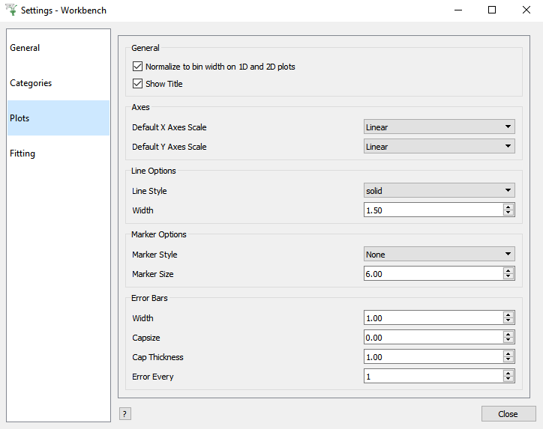
LINEAR / LOGARITHMIC

