Slide 1
Smart Image Identifier
Ambitious-Designs

Slide 2

Product backlog & Sprint backlogs

Slide 3
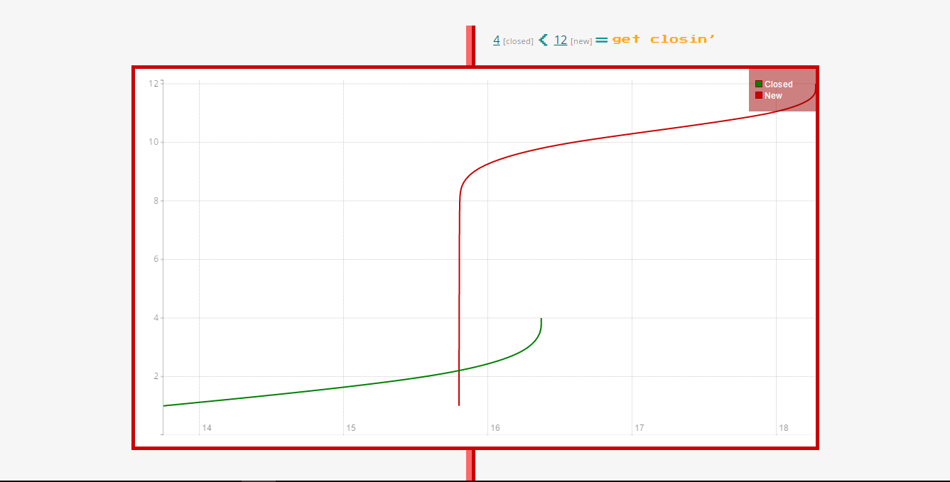
Burndown Chart (30 Days)

Slide 4
Software related
Challenges
Solution Attempts
Detecting humans in some images but not in others due to difference in size, depth within the image, colour etc.
Image processing
OpenCV provides methods in which the image may be manipulated in various ways: size, grey scaling, histogram equalization etc.

Slide 5
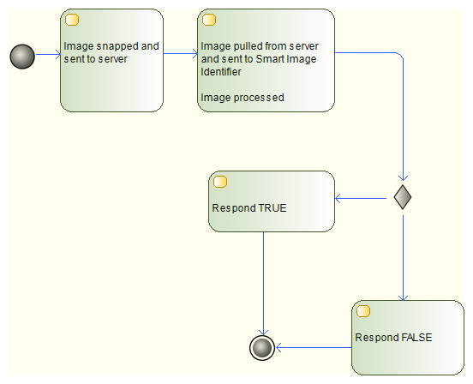
Activity Diagram

Slide 6
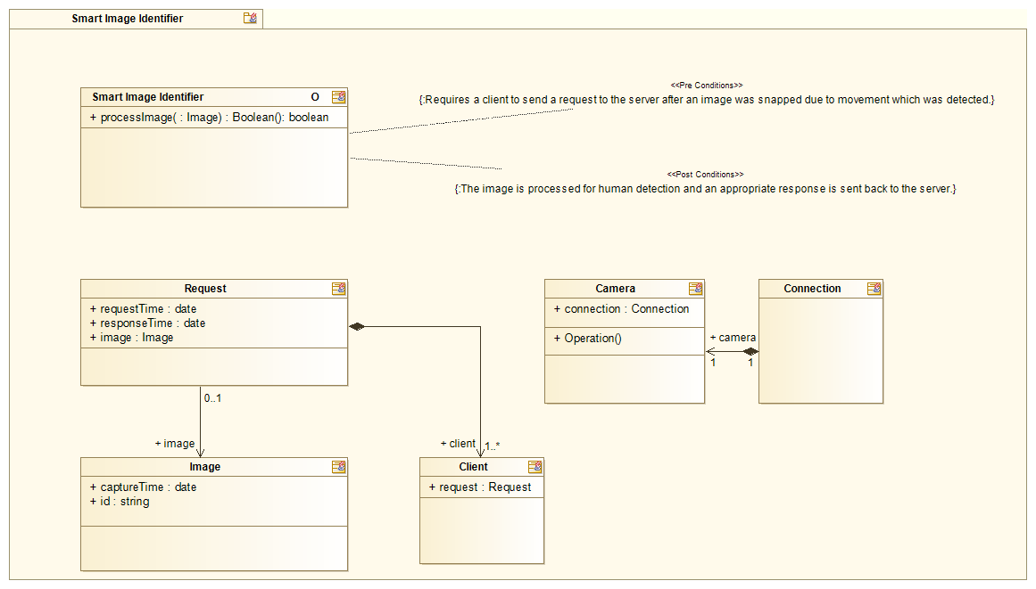
Services Contract

