Slide 1
EECS 448 Project 2 Java Calendar Remix
Originally Created by: Ryan Niday, Adam Van Hal, and Stuart Wreath
Edited by: Stephen Fulton, Rebekah Manweiler, and Shawn Parkes

Slide 2
Contents
Initial State and Problems
Division of Labor
UML Documents
Project Retrospect
Work Cited

Slide 3
Initial State of the project and problems

Slide 4
Division of labor
Stephen Fulton
Rebekah Manweiler
Shawn parkes
Handled file IO (database)
Worked on …
Handled UML and Presentation
Worked on …
Overall design
recognizing event conflicts
New write methods
Adding events in the AddView
Handled GUI
Worked on …

Slide 5
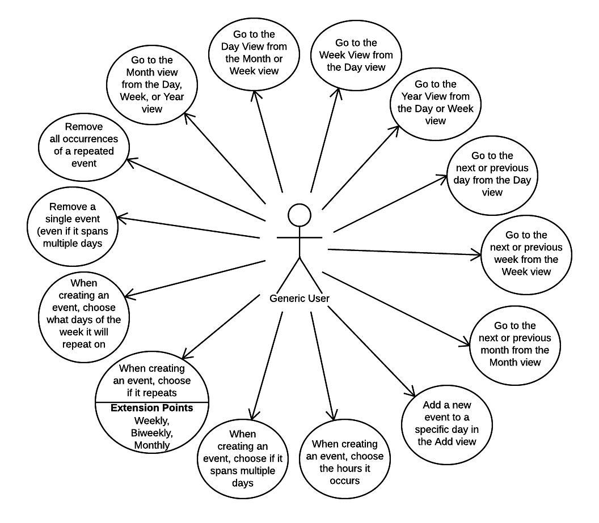
UML: Use Case Diagram (requirements)
Requirements: User must be able to…
Add a timeframe to an event
View events that overlap (view conflicts)
View events in the Day View in order by time
Create events that span multiple days
Create events that repeat weekly, biweekly, or monthly
If an event is weekly, or biweekly, also be able to select what days of the week it is repeated

Slide 6
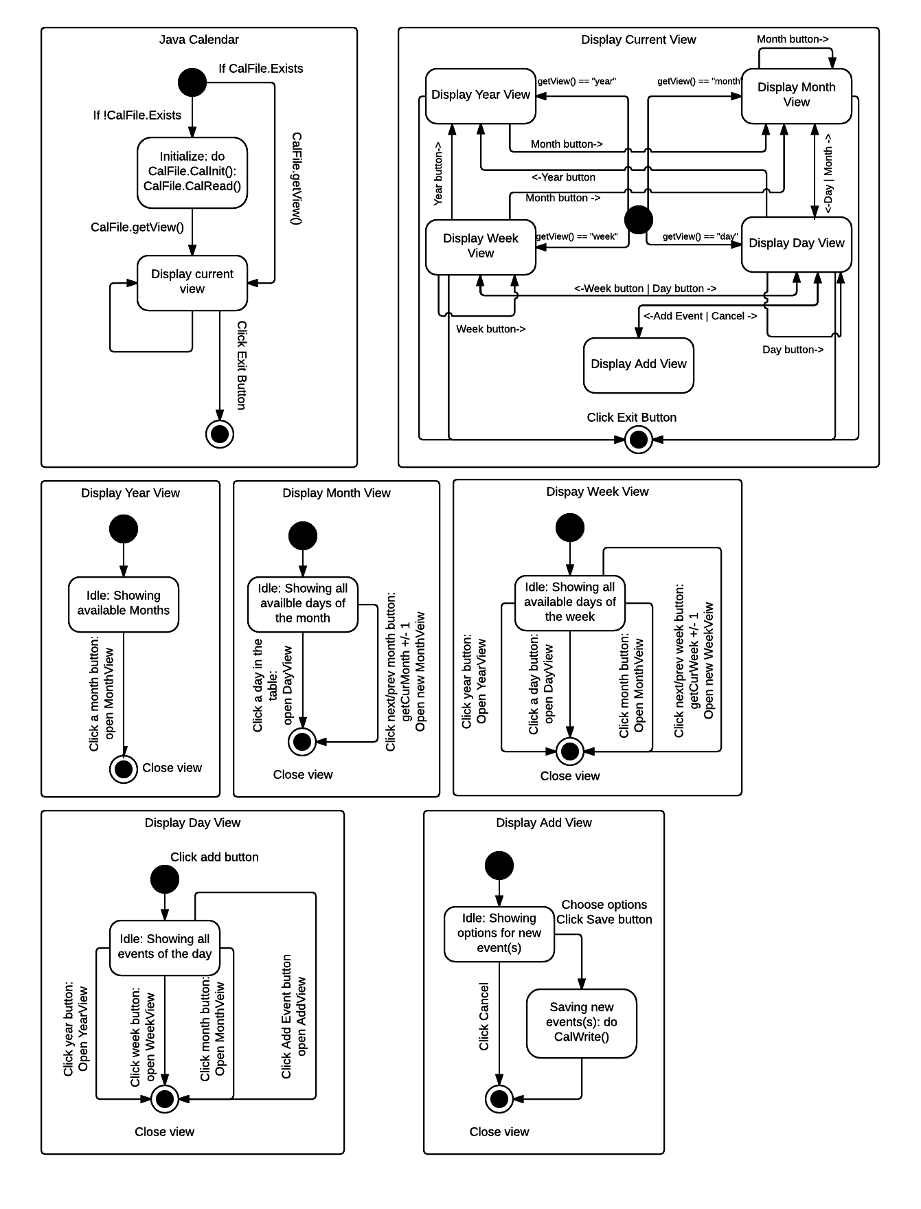
UML: State Diagram

Slide 7
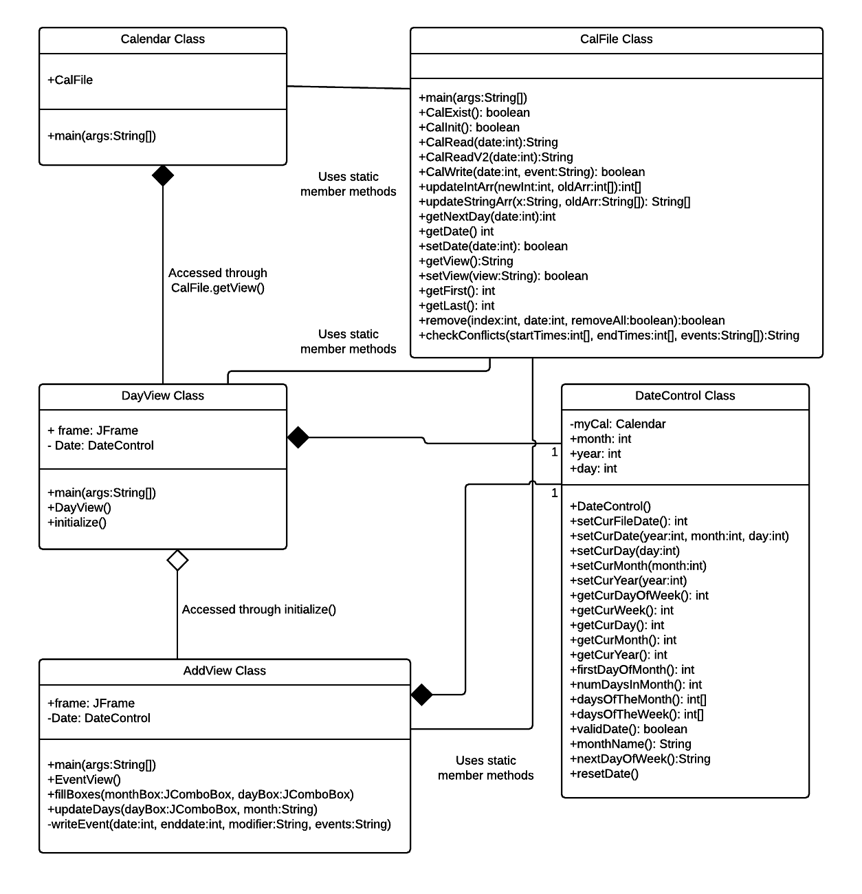
UML: Class diagram

Slide 8
Project retrospect

Slide 9
Work Cited

