Slide 1
EECS 448 Project 2 Java Calendar Remix
Originally Created by: Ryan Niday, Adam Van Hal, and Stuart Wreath
Edited by: Stephen Fulton, Rebekah Manweiler, and Shawn Parkes

Slide 2
Contents
Initial State of the Project
Division of Labor
UML Documents
Project Retrospect

Slide 3
Initial State of the project
No remove methods
The previous team allowed the user to remove events from they day view by allowing them to edit the text area storing all of the events.
They only needed a write method.
Everything is linked to the CalFile class.
If there is an error in the CalFile class, or something has not yet been implemented, it is difficult to test the other classes.
Few comments about why the program did not work cross OS (specifically on Windows).
The reason the program did not originally work when we inherited the project was because the end lines in CalInfo.txt were not compatible. We had to get in contact with the team to understand this issue.

Slide 4
Division of labor
Stephen Fulton
Rebekah Manweiler
Shawn parkes
Handled file IO (database)
Worked on …
New read method
Adding and removing events
Event repetition
Handled UML and Presentation
Worked on …
Overall design
recognizing event conflicts
New write methods
Adding events in the AddView
Handled GUI
Worked on …
AddView display
DayView display
Action listeners for user activity

Slide 5
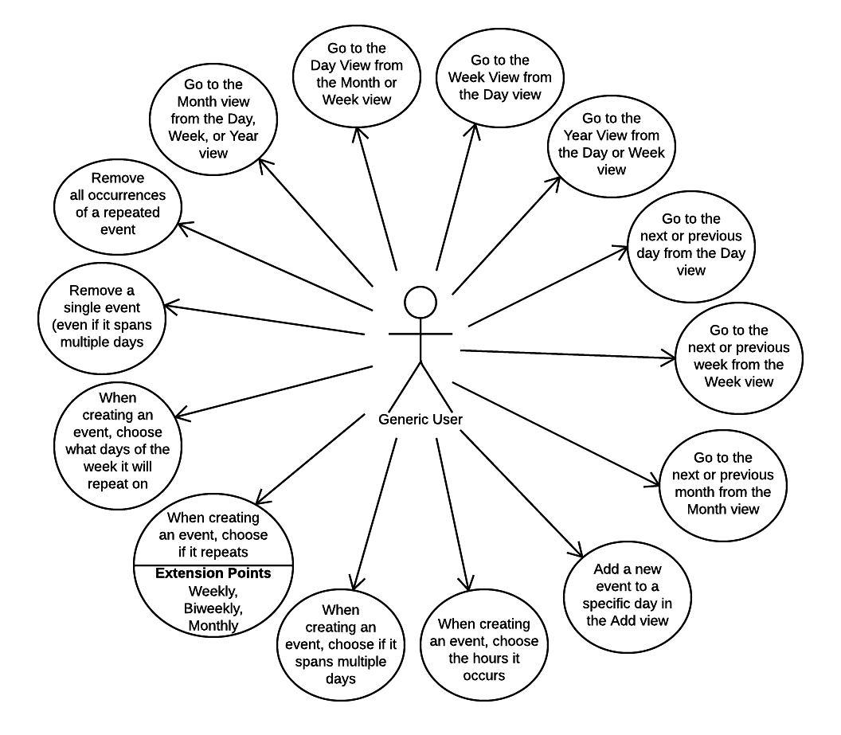
UML: Use Case Diagram (requirements)
Requirements: User must be able to…
Add a timeframe to an event
View events that overlap (view conflicts)
View events in the Day View in order by time
Create events that span multiple days
Create events that repeat weekly, biweekly, or monthly
If an event is weekly, or biweekly, also be able to select what days of the week it is repeated

Slide 6
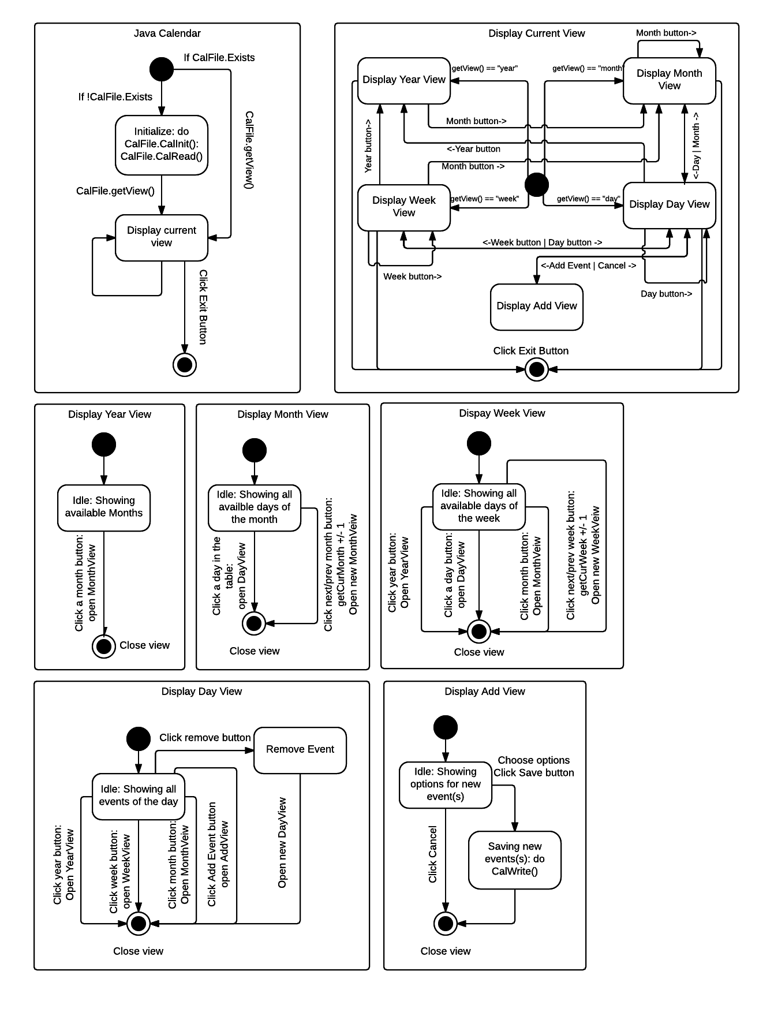
UML: State Diagram
The top level diagram appears in the top left-hand corner. On launch, the program initializes the calendar if needed and displays the current view.
The main loop of the program is closing the current view and displaying the new ‘current’ view, until the user clicks the exit button.
In each view, the user can push buttons in order to switch to a new view
From the year view, the user can access the month view by clicking a month button
From the month view, the user can access 1) the day view by clicking on a day in the month table, 2) a different month by clicking the next and previous month buttons
From the week view, the user can access 1) the year view by clicking the year button, 2) the month view by clicking the month button, 3) the day view by clicking on a day button, 4) a different week by clicking the next and previous week buttons
From the day view, the user can access 1) the year view by clicking the year buttons, 2) the month view by clicking the month button, 3) the week view by clicking the week button, 4) a different day by clicking the next and previous day buttons, 5) the add view by clicking on the add event button, 6) a new day view after clicking the remove button and removing an event
From the add view, the user can access the day view by clicking the cancel button, or the save button after choosing options to add a new event and adding the event

Slide 7
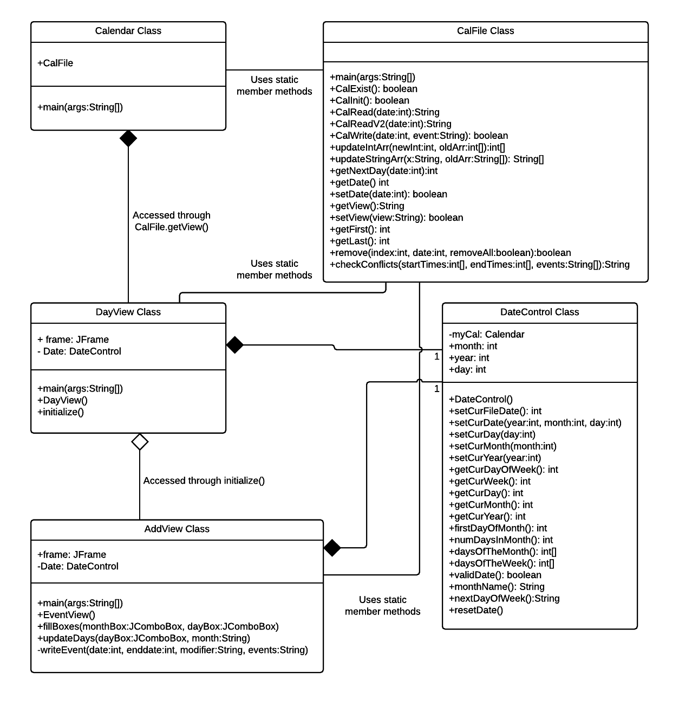
UML: Class diagram
Calendar Class
Inside the main, the CalFile static member method getView() is used to determine the initial view of the program (which is the DayView).
CalFile Class
Defines the File IO which controls the entire program. All methods are defined statically so they may be called from any point of the program.
DayView Class
The day view contains buttons connecting it with the other calendar views, including the AddView.
In charge of displaying the current events of the day and allowing the user to remove a specific event.
AddView Class
Accessed through the DayView class, and is in charge of displaying options for the user to create a new event and add it to the current day.
DateControl Class
Used by all the ‘view’ classes to control and keep track of the current date.

Slide 8
Project retrospect
Taking over another team’s code base proved to be more difficult than we anticipated, although we were luckier than some teams and managed to figure things out relatively quickly because between project 1 and project 2 we did not change platform, language, or database system.
From this experience, we have seen the ramifications of code that was not commented enough. The overall project comments were well organized and readable, but for individual, long methods we would have had an easier time adapting them if there had been more comments inside the method describing the functionality of all of the variables.
UML has proven to be a useful tool, and we wish we would have used it in the first project. During this project we did not need the UML to help us design the code base and instead just added features to it. UML would have been more useful in project 1 while designing the project, and then we would have been able to use the other team’s UML to better, and more quickly understand the code base for project 2.
We would have finished sooner and might have added more features if we had made contact with the other team sooner.

